Slide 1
UNIT-IV
Database Transactions and Query Processing

Slide 2
Basic concept of a Transaction
Collections of operations that form a single logical unit of work are called transactions.
A database system must ensure proper execution of transactions despite failures—either the entire transaction executes, or none of it does.
A transaction is a unit of program execution that accesses and possibly updates various data items.
E.g., transaction to transfer $50 from account A to account B:
1. read(A)
2. A := A – 50
3. write(A)
4. read(B)
5. B := B + 50
6. write(B)
Two main issues to deal with:
Failures of various kinds, such as hardware failures and system crashes
Concurrent execution of multiple transactions

Slide 3
A transaction is delimited by statements (or function calls) of the form begin transaction and end transaction.
The transaction consists of all operations executed between the begin transaction and end transaction.

Slide 4
Required Properties of a Transaction
The values of accounts A and B are $1000 and $2000, respectively.
Transaction to transfer $50 from account A to account B:
1. read(A)
2. A := A – 50
3. write(A)
4. read(B)
5. B := B + 50
6. write(B)
Atomicity requirement
If the transaction fails after step 3 and before step 6, money will be “lost” leading to an inconsistent database state
Failure could be due to software or hardware
The system should ensure that updates of a partially executed transaction are not reflected in the database.
All actions of the transaction are reflected in the database, or none are.
This “all-or-none” property is referred to as atomicity.
database system keeps track (on disk) of the old values of any data in file called the log.
Ensuring atomicity is the responsibility of component called Recovery System.

Slide 5
Required Properties of a Transaction(cont..)
Durability requirement —
Once the user has been notified that the transaction has completed (i.e., the transfer of the $50 has taken place), the updates to the database by the transaction must persist even if there are software or hardware failures.

Slide 6
Required Properties of a Transaction (Cont.)
Consistency requirement in above example:
The sum of A and B is unchanged by the execution of the transaction
In general, consistency requirements include
Explicitly specified integrity constraints such as primary keys and foreign keys
Implicit integrity constraints
e.g., sum of balances of all accounts, minus sum of loan amounts must equal value of cash-in-hand
A transaction, when starting to execute, must see a consistent database.
During transaction execution the database may be temporarily inconsistent.
When the transaction completes successfully the database must be consistent
Erroneous transaction logic can lead to inconsistency

Slide 7
Required Properties of a Transaction (Cont.)
Isolation requirement — if between steps 3 and 6 (of the fund transfer transaction) , another transaction T2 is allowed to access the partially updated database, it will see an inconsistent database (the sum A + B will be less than it should be).
T1 T2
1. read(A)
2. A := A – 50
3. write(A) read(A), read(B), print(A+B)
4. read(B)
5. B := B + 50
6. write(B
Isolation can be ensured trivially by running transactions serially
That is, one after the other.
However, executing multiple transactions concurrently has significant benefits, as we will see later.

Slide 8
Properties of Transactions ACID properties
Atomicity. Either all operations of the transaction are properly reflected in the database or none are.
Consistency. Execution of a transaction in isolation preserves the consistency of the database.
Isolation. Although multiple transactions may execute concurrently, each transaction must be unaware of other concurrently executing transactions. Intermediate transaction results must be hidden from other concurrently executed transactions.
That is, for every pair of transactions T_{i} and T_{j}, it appears to T_{i} that either T_{j}, finished execution before T_{i} started, or T_{j} started execution after T_{i} finished.
Durability. After a transaction completes successfully, the changes it has made to the database persist, even if there are system failures.

Slide 9
Transaction State
Active – the initial state; the transaction stays in this state while it is executing
Partially committed – after the final statement has been executed.
Failed -- after the discovery that normal execution can no longer proceed.
Aborted – after the transaction has been rolled back and the database restored to its state prior to the start of the transaction. Two options after it has been aborted:
Restart the transaction
can be done only if no internal logical error
Kill the transaction
Committed – after successful completion.

Slide 10
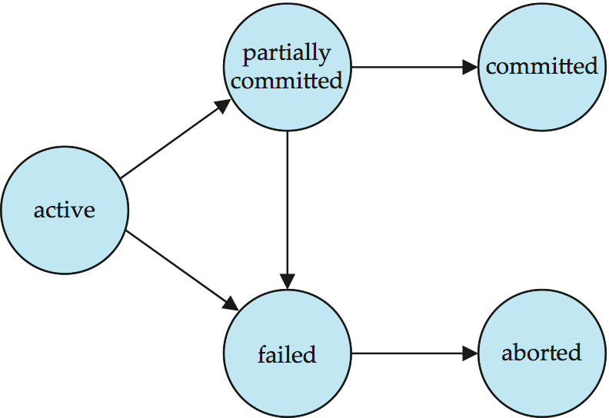
Transaction State (Cont.)

Slide 11
Concurrent Executions
Concurrency:
Managing simultaneous operations
Prevent Inference
Multiple transactions are allowed to run concurrently in the system but update data concurrently causes several complications with consistency.
Advantages of Concurrency are:
Increased processor and disk utilization,
leading to better transaction throughput i.e. “number of transactions executed in a given amount of time”
E.g. one transaction can be using the CPU while another is reading from or writing to the disk
Reduced average response time for transactions: short transactions need not wait behind long ones.
Concurrency control schemes – mechanisms to achieve isolation
That is, to control the interaction among the concurrent transactions in order to prevent them from destroying the consistency of the database

Slide 12
Schedules
Schedule – a sequences of instructions that specify the chronological order in which instructions of concurrent transactions are executed
A schedule for a set of transactions must consist of all instructions of those transactions
Must preserve the order in which the instructions appear in each individual transaction.
A transaction that successfully completes its execution will have a commit instructions as the last statement
By default transaction assumed to execute commit instruction as its last step
A transaction that fails to successfully complete its execution will have an abort instruction as the last statement

Slide 13
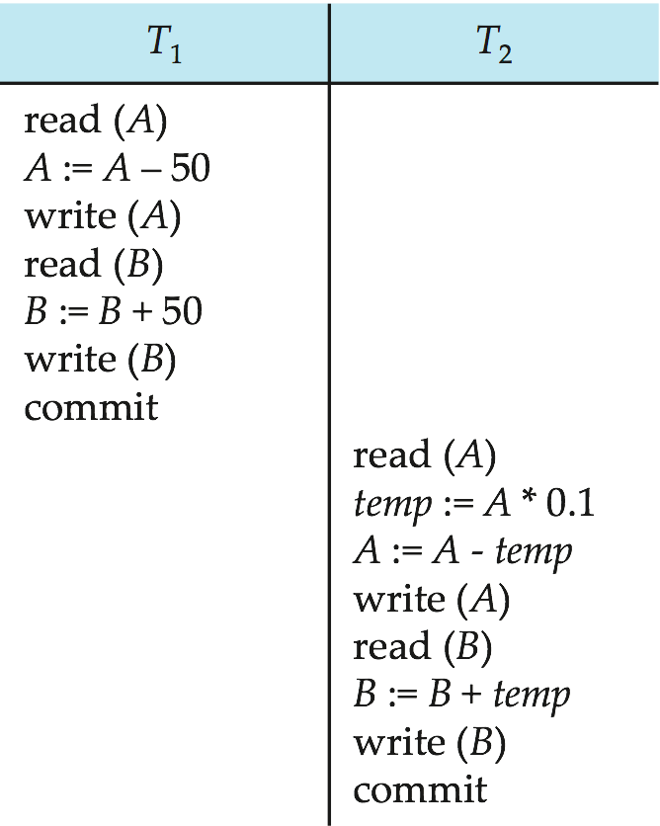
Schedule 1
Let T₁ transfer $50 from A to B, and T₂ transfer 10% of the balance from A to B.
An example of a serial schedule in which T₁ is followed by T₂ :

Slide 14
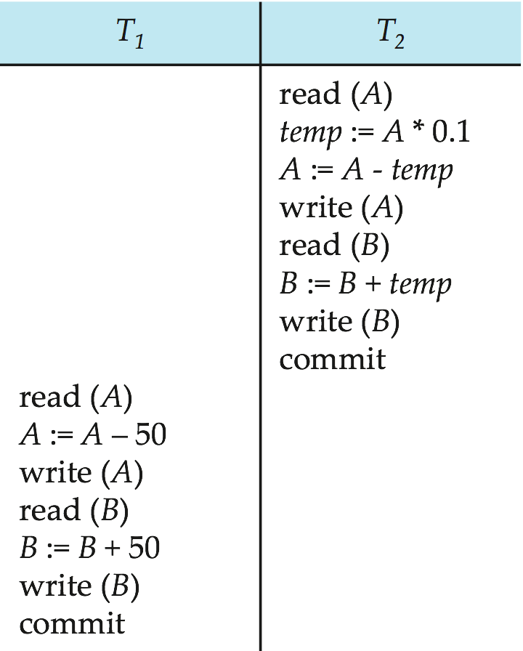
Schedule 2
A serial schedule in which T₂ is followed by T₁ :

Slide 15
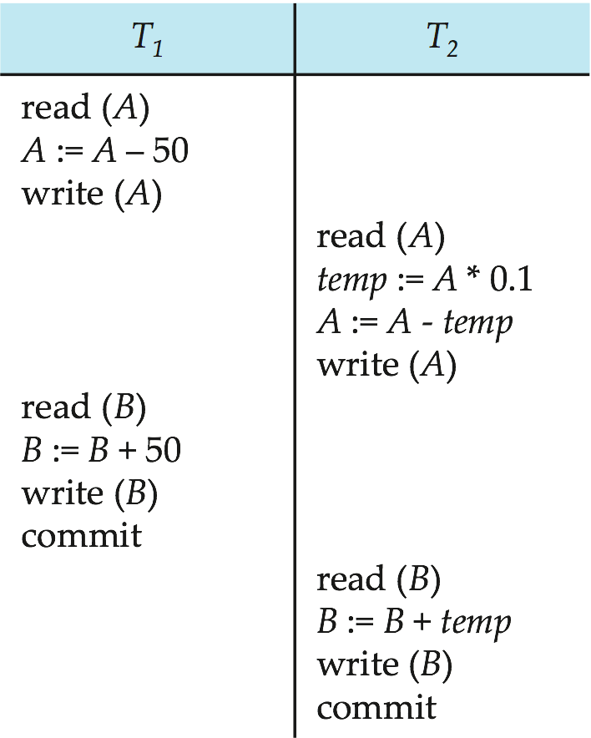
Schedule 3
Let T₁ and T₂ be the transactions defined previously. The following schedule is not a serial schedule, but it is equivalent to Schedule 1.
Note -- In schedules 1, 2 and 3, the sum “A + B” is preserved.

Slide 16
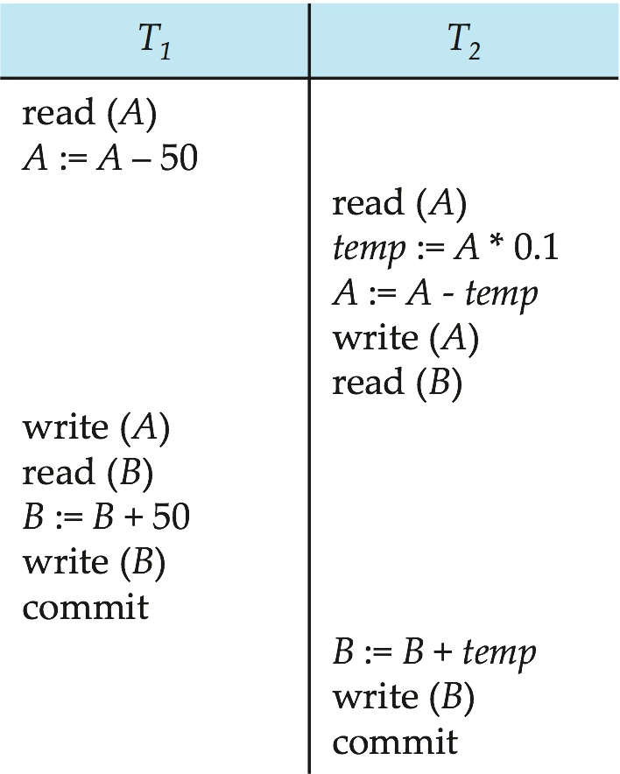
Schedule 4
The following concurrent schedule does not preserve the sum of “A + B”

Slide 17
Serializability
We can ensure consistency of the database under concurrent execution by making sure that any schedule that is executed has the same effect as a schedule that could have occurred without any concurrent execution.
That is, the schedule should, in some sense, be equivalent to a serial schedule. Such schedules are called serializable schedules.
Basic Assumption – Each transaction preserves database consistency.
Thus, serial execution of a set of transactions preserves database consistency.
Different forms of schedule equivalence give rise to the notions of:
1. conflict serializability
2. view serializability

Slide 18
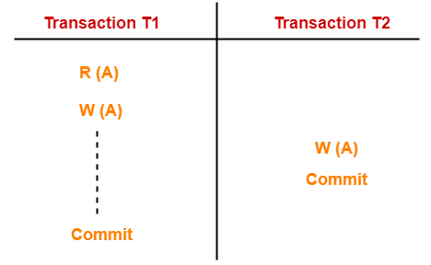
Lost Update Problem
Need of Concurrency
This problem occurs when multiple transactions execute concurrently and updates from one or more transactions get lost.

Slide 19
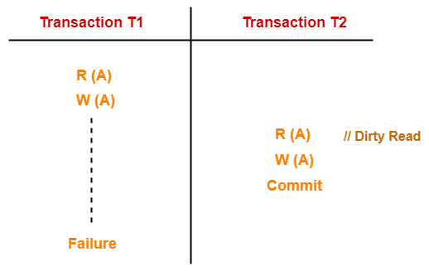
Dirty Read Problem
Reading the data written by an uncommitted transaction is called as dirty read.
There is always a chance that the uncommitted transaction might roll back later.
Thus, uncommitted transaction might make other transactions read a value that does not even exist.
This leads to inconsistency of the database.

Slide 20
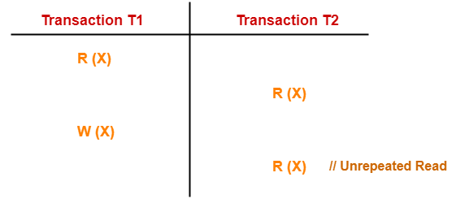
Unrepeatable Read Problem
This problem occurs when a transaction gets to read unrepeated i.e. different values of the same variable in its different read operations even when it has not updated its value.

Slide 21
Simplified view of transactions
We ignore operations other than read and write instructions
We assume that transactions may perform arbitrary computations on data in local buffers in between reads and writes.
Our simplified schedules consist of only read and write instructions.

Slide 22
Conflicting Instructions
Let l_{i} and l_{j} be two Instructions of transactions T_{i} and T_{j} respectively. Instructions l_{i} and l_{j} conflict if and only if there exists same item Q accessed by both l_{i} and l_{j}, and at least one of these instructions wrote Q.
1. l_{i} = read(Q), l_{j} = read(Q). l_{i} and l_{j} don’t conflict. 2. l_{i} = read(Q), l_{j} = write(Q). They conflict. 3. l_{i} = write(Q), l_{j} = read(Q). They conflict 4. l_{i} = write(Q), l_{j} = write(Q). They conflict
Intuitively, a conflict between l_{i} and l_{j} forces a (logical) temporal order between them.
If l_{i} and l_{j} are consecutive in a schedule and they do not conflict, their results would remain the same even if they had been interchanged in the schedule.

Slide 23
Conflict Serializability
Let us consider a schedule S in which there are two consecutive instructions, I and J , of transactions Ti and Tj , respectively (i ≠j). If I and J refer to different data items, then we can swap I and J without affecting the results of any instruction in the schedule.
However, if I and J refer to the same data item Q, then the order of the two steps may matter. Since we are dealing with only read and write instructions, there are four cases that we need to consider:
I = read(Q), J = read(Q). The order of I and J does not matter, since the same value of Q is read by Ti and Tj , regardless of the order.
I = read(Q), J = write(Q). If I comes before J , then Ti does not read the value of Q that is written by Tj in instruction J . If J comes before I, then Ti reads the value of Q that is written by Tj. Thus, the order of I and J matters.

Slide 24
Conflict Serializability (Cont.)
I = write(Q), J = read(Q). The order of I and J matters for reasons similar to those of the previous case.
I = write(Q), J = write(Q). Since both instructions are write operations, the order of these instructions does not affect either Ti or Tj . However, the value obtained by the next read(Q) instruction of S is affected, since the result of only the latter of the two write instructions is preserved in the database. If there is no other write(Q) instruction after I and J in S, then the order of I and J directly affects the final value of Q in the database state that results from schedule S.
We say that I and J conflict if they are operations by different transactions on the same data item, and at least one of these instructions is a write operation.

Slide 25
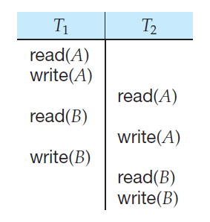
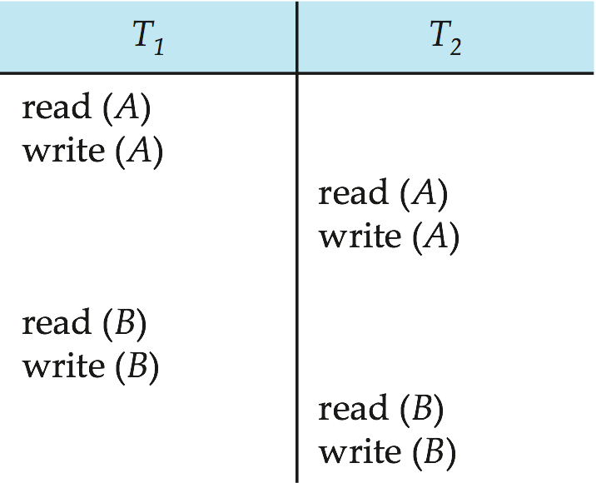
Conflict Serializability (Cont.)
Schedule 3 can be transformed into Schedule 6 -- a serial schedule where T₂ follows T₁, by a series of swaps of non-conflicting instructions. Therefore, Schedule 3 is conflict serializable.
Schedule 3
Schedule 5

Slide 26
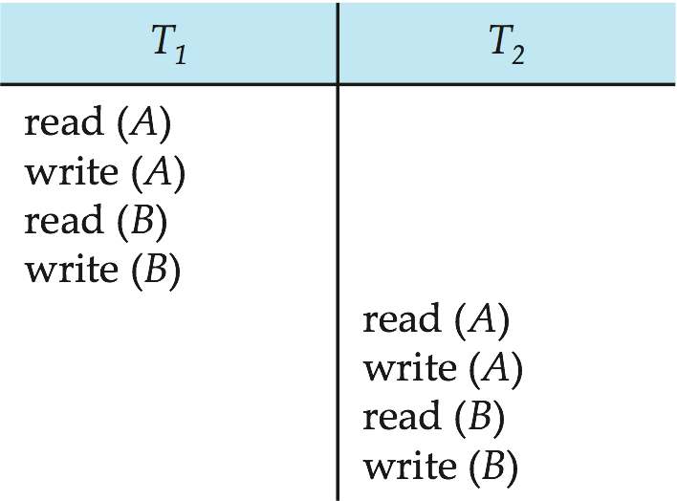
Conflict Serializability (Cont.)
Schedule 6
If a schedule S can be transformed into a schedule S´ by a series of swaps of non-conflicting instructions, we say that S and S´ are conflict equivalent.
We say that a schedule S is conflict serializable if it is conflict equivalent to a serial schedule.

Slide 27
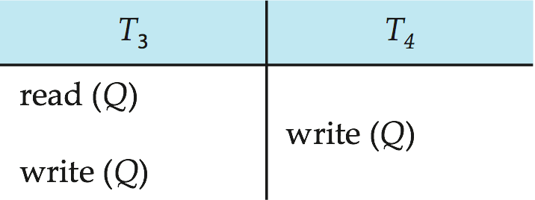
Conflict Serializability (Cont.)
Example of a schedule that is not conflict serializable:
We are unable to swap instructions in the above schedule to obtain either the serial schedule < T₃, T₄ >, or the serial schedule < T₄, T₃ >.

Slide 28
View Serializability
Let S and S´ be two schedules with the same set of transactions. S and S´ are view equivalent if the following three conditions are met, for each data item Q,
If in schedule S, transaction T_{i} reads the initial value of Q, then in schedule S’ also transaction T_{i} must read the initial value of Q.
If in schedule S transaction T_{i} executes read(Q), and that value was produced by transaction T_{j} (if any), then in schedule S’ also transaction T_{i} must read the value of Q that was produced by the same write(Q) operation of transaction T_{j} .
The transaction (if any) that performs the final write(Q) operation in schedule S must also perform the final write(Q) operation in schedule S’.
As can be seen, view equivalence is also based purely on reads and writes alone.

Slide 29
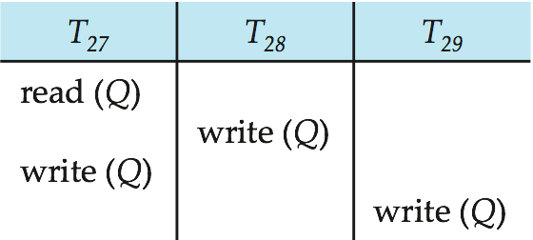
View Serializability (Cont.)
A schedule S is view serializable if it is view equivalent to a serial schedule.
Every conflict serializable schedule is also view serializable.
Below is a schedule which is view-serializable but not conflict serializable.
What serial schedule is above equivalent to?
Every view serializable schedule that is not conflict serializable has blind writes.

Slide 30
Testing for Conflict Serializability
Method for determining conflict serializability of a schedule.
Consider a schedule S. We construct a directed graph, called a precedence graph, from S.
This graph consists of a pair G = (V, E), where V is a set of vertices and E is a set of edges.
The set of vertices consists of all the transactions participating in the schedule. The set of edges consists of all edges Ti →Tj for which one of three conditions holds:
1. Ti executes write(Q) before Tj executes read(Q).
2. Ti executes read(Q) before Tj executes write(Q).
3. Ti executes write(Q) before Tj executes write(Q).
If an edge Ti → Tj exists in the precedence graph, then, in any serial schedule S equivalent to S', Ti must appear before Tj .

Slide 31
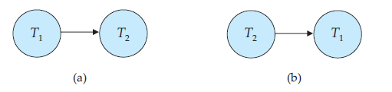
Schedule 1
Schedule 2

Slide 32
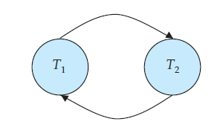
Schedule 4

Slide 33
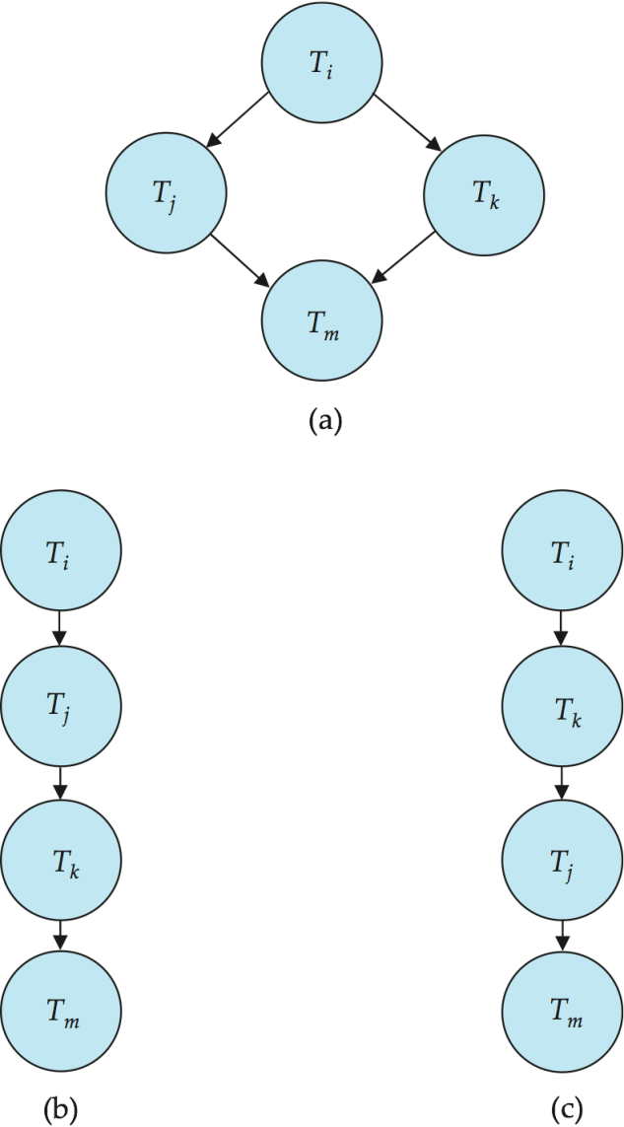
Testing for Conflict Serializability
A schedule is conflict serializable if and only if its precedence graph is acyclic.
Cycle-detection algorithms exist which take order n² time, where n is the number of vertices in the graph.
(Better algorithms take order n + e where e is the number of edges.)
If precedence graph is acyclic, the serializability order can be obtained by a topological sorting of the graph.
That is, a linear order consistent with the partial order of the graph.
For example, a serializability order for the schedule (a) would be one of either (b) or (c)

Slide 34
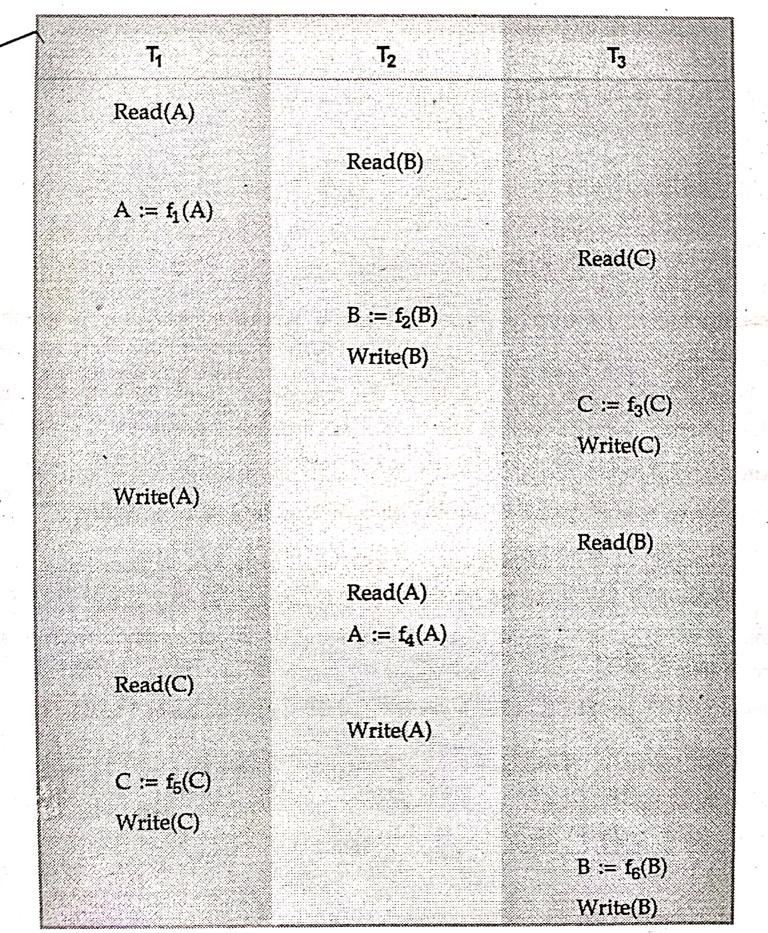
Consider following Schedule. Is the given schedule conflict serializable?

Slide 35
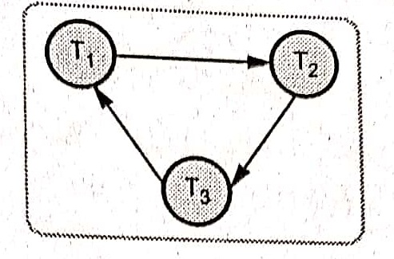
Precedence Graph for given schedule is.
The graph has cycle, therefore given schedule is not conflict serializable

Slide 36
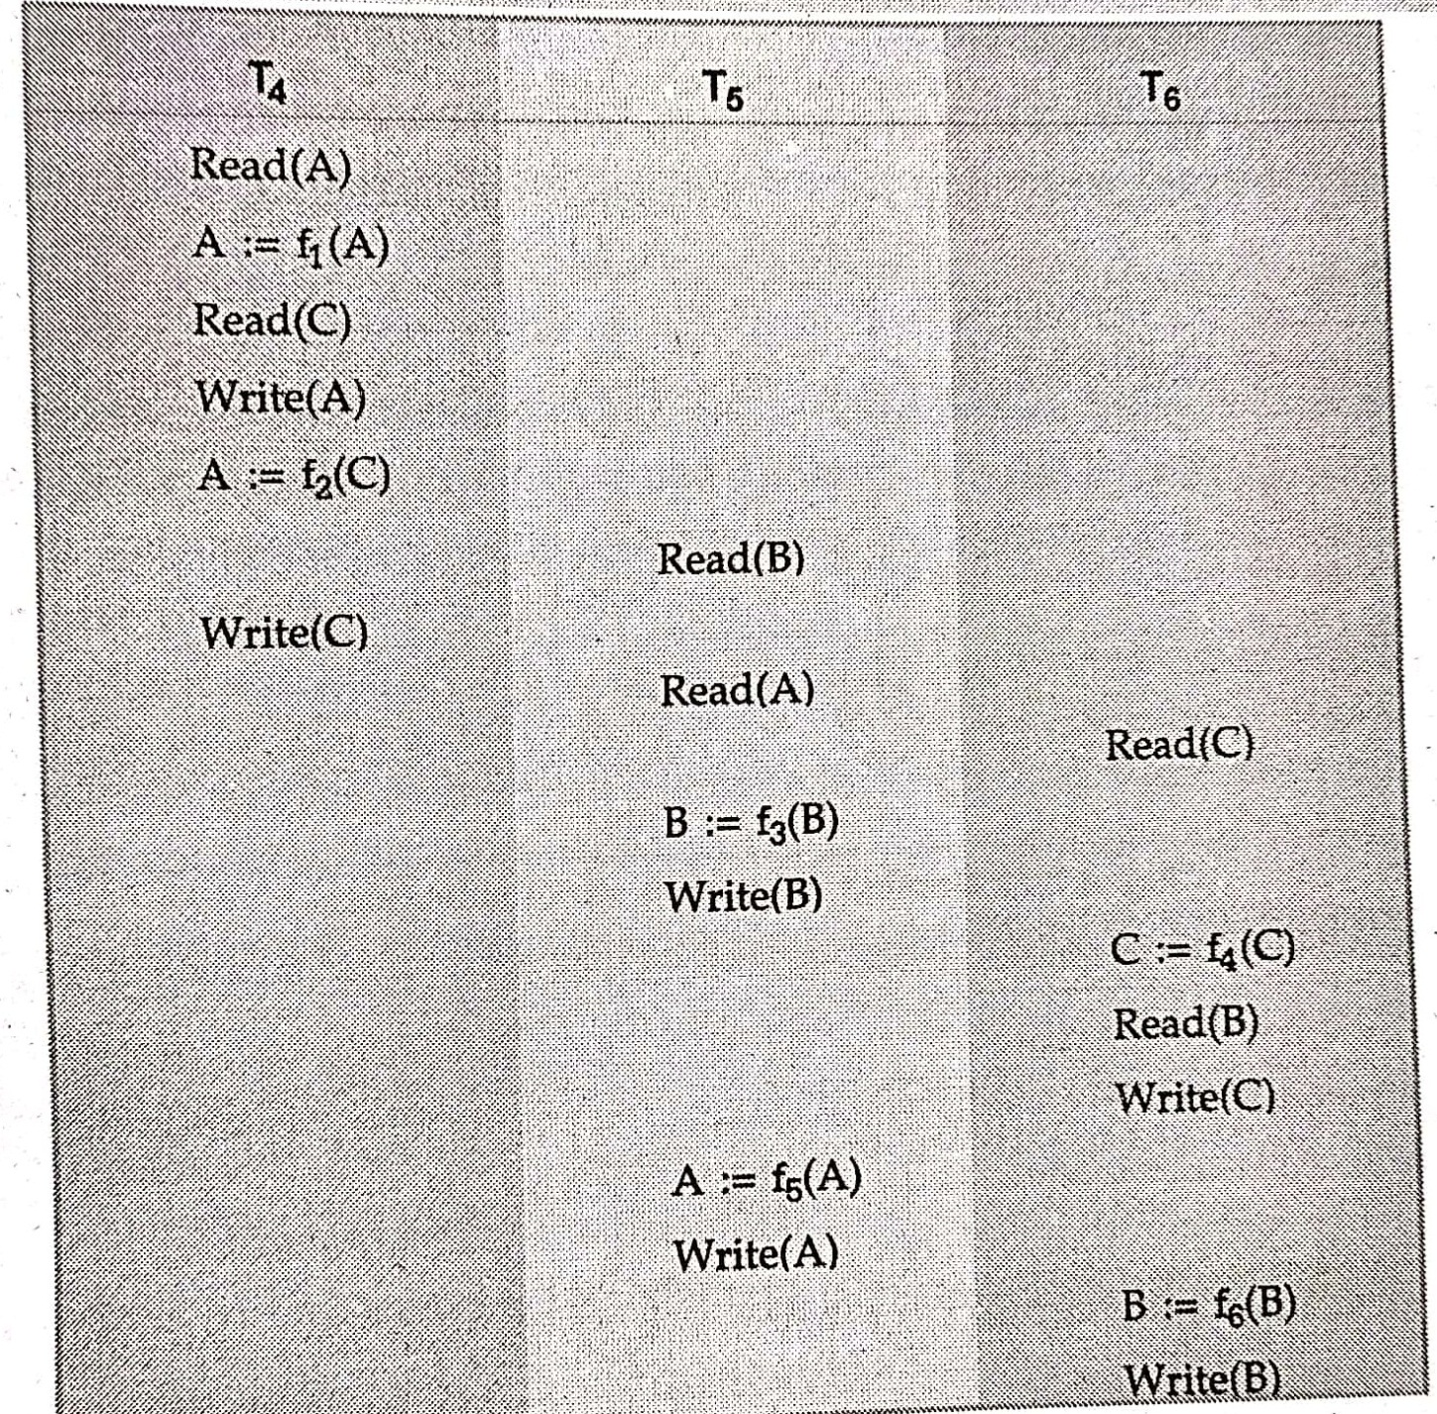
Consider following Schedule. Is the given schedule conflict serializable?

Slide 37
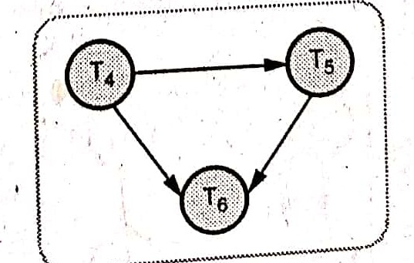
Precedence Graph for given schedule is given bellow.
The graph has no cycle, therefore given schedule is conflict serializable

Slide 38
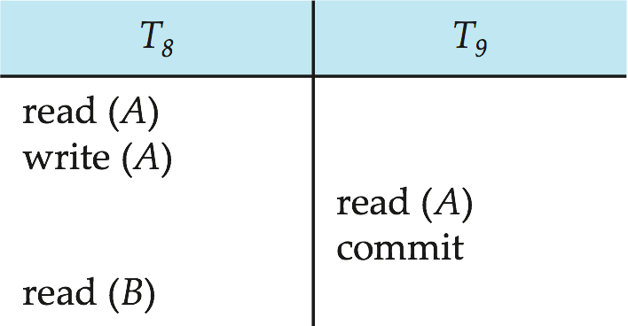
Recoverable and Non Recoverable Schedules
Recoverable schedule — if a transaction T_{j} reads a data item previously written by a transaction T_{i} , then the commit operation of T_{i} must appear before the commit operation of T_{j}.
The given schedule is not recoverable if T₉ commits immediately after the read(A) operation. Suppose that T₈ fails before it commits, then T₈ should abort.
But T₉ would have read (and possibly shown to the user) an inconsistent database state. So we must abort T₉ to ensure transaction atomicity. But it is impossible.
Hence, database must ensure that schedules are recoverable.

Slide 39
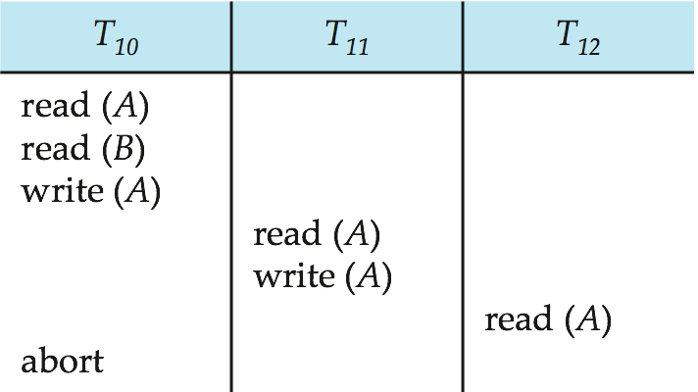
Cascading Rollbacks
Cascading rollback – a single transaction failure leads to a series of transaction rollbacks. Consider the following schedule where none of the transactions has yet committed (so the schedule is recoverable)
If T₁₀ fails, T₁₁ and T₁₂ must also be rolled back.
Can lead to the undoing of a significant amount of work

Slide 40
Cascadeless Schedules
Cascadeless schedules — for each pair of transactions T_{i} and T_{j} such that T_{j} reads a data item previously written by T_{i}, the commit operation of T_{i} appears before the read operation of T_{j}.
Every cascadeless schedule is also recoverable.
It is desirable to restrict the schedules to those that are cascadeless.
Example of a schedule that is NOT cascadeless

Slide 41
Concurrency Control
When several transactions execute concurrently in the database, however, the isolation property may no longer be preserved.
To ensure that, the system must control the interaction among the concurrent transactions; this control is achieved through one of a variety of mechanisms called concurrency control schemes.
Schemes used to control the concurrency:
Lock Based Protocols
Timestamp Based Protocols

Slide 42
Lock-Based Protocols
To ensure isolation, data items be accessed in a mutually exclusive manner that is, while one transaction is accessing a data item, no other transaction can modify that data item.
The most common method used to implement this requirement is to allow a transaction to access a data item only if it is currently holding a lock on that item.
A lock is a mechanism to control concurrent access to a data item
Data items can be locked in two modes :
exclusive(X) mode. If a transaction Ti has obtained an exclusive- mode lock (denoted by X) on item Q, then Ti can both read and
write Q.
shared(S) mode. If a transaction Ti has obtained a shared-mode lock (denoted by S) on item Q, then Ti can read, but cannot write, Q.
Lock requests are made to the concurrency-control manager by the programmer. Transaction can proceed only after request is granted.

Slide 43
Lock-Based Protocols (Cont.)
Lock-compatibility matrix
A transaction may be granted a lock on an item if the requested lock is compatible with locks already held on the item by other transactions
Any number of transactions can hold shared locks on an item,
But if any transaction holds an exclusive mode lock on the item no other transaction may hold any lock on the item.
If a lock cannot be granted, the requesting transaction is made to wait till all incompatible locks held by other transactions have been released. The lock is then granted.

Slide 44
Lock-Based Protocols (Cont.)
Example of a transaction performing locking:
Transaction T1 transfers $50 from account B to account A
T1: lock-X(B);
read(B);
B := B − 50;
write(B);
unlock(B);
lock-X(A);
read(A);
A := A + 50;
write(A);
unlock(A).

Slide 45
Lock-Based Protocols (Cont.)
Example of a transaction performing locking:
Transaction T2 displays the total amount of money in accounts A and B—that is, the sum A + B
T₂: lock-S(A);
read (A);
unlock(A);
lock-S(B);
read (B);
unlock(B);
display(A+B)
Locking as above is not sufficient to guarantee serializability — if A and B get updated in-between the read of A and B, the displayed sum would be wrong.
A locking protocol is a set of rules followed by all transactions while requesting and releasing locks. Locking protocols restrict the set of possible schedules.

Slide 46
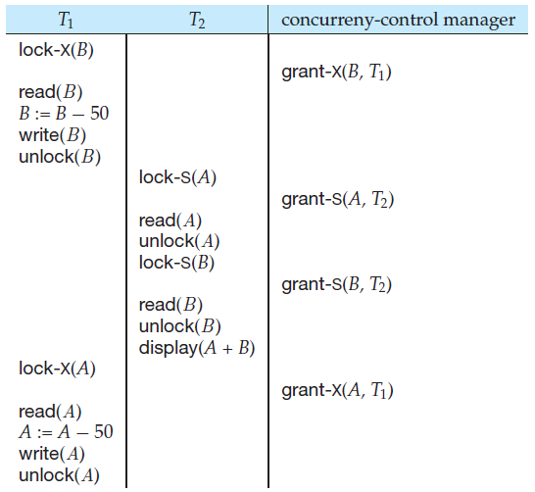
Lock-Based Protocols (Cont.)

Slide 47
Lock-Based Protocols (Cont.)
The transaction T1 unlocked data item B too early, as a result of which T2 saw an inconsistent state.
Unlocking is delayed to the end of the transaction.
Unfortunately, locking can lead to an undesirable situation.

Slide 48
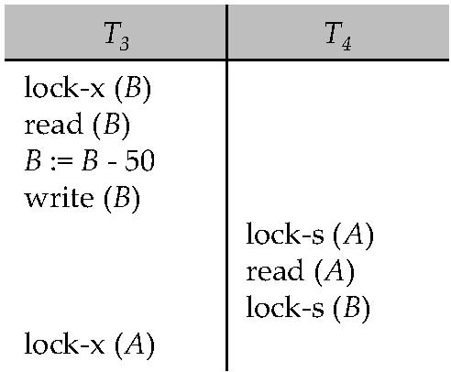
Deadlocks
Consider the partial schedule
Neither T₃ nor T₄ can make progress — executing lock-S(B) causes T₄ to wait for T₃ to release its lock on B, while executing lock-X(A) causes T₃ to wait for T₄ to release its lock on A.
Such a situation is called a deadlock.
To handle a deadlock one of T₃ or T₄ must be rolled back and its locks released.

Slide 49
Deadlocks (Cont.)
Two-phase locking does not ensure freedom from deadlocks.
In addition to deadlocks, there is a possibility of starvation.
Starvation occurs if the concurrency control manager is badly designed. For example:
A transaction may be waiting for an X-lock on an item, while a sequence of other transactions request and are granted an S-lock on the same item.
The same transaction is repeatedly rolled back due to deadlocks.
Concurrency control manager can be designed to prevent starvation.

Slide 50
locking protocol
We shall require that each transaction in the system follow a set of rules, called a locking protocol.
We shall present several locking protocols that allow only conflict-serializable schedules.

Slide 51
The Two-Phase Locking Protocol
This protocol ensures conflict-serializable schedules.
Phase 1: Growing Phase
Transaction may obtain locks
Transaction may not release locks
Phase 2: Shrinking Phase
Transaction may release locks
Transaction may not obtain locks
Transactions T1 and T2 are not two phase, T3 and T4 are two phase.
The point in the schedule where the transaction has obtained its final lock (the end of its growing phase) is called the lock point of the transaction.
The protocol assures serializability. It can be proved that the transactions can be serialized in the order of their lock points (i.e., the point where a transaction acquired its final lock).

Slide 52
The unlock instructions do not need to appear at the end of the transaction.
Two-phase locking does not ensure freedom from deadlock.

Slide 53
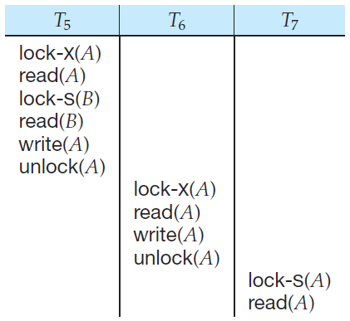
Cascading rollback may occur under two-phase locking.
But the failure of T5 after the read(A) step of T7 leads to cascading rollback of T6 and T7.

Slide 54
Strict Two-phase Locking Protocol
Cascading rollbacks can be avoided by a modification of two-phase locking called the strict two-phase locking protocol.
This protocol requires not only that locking be two phase, but also that all exclusive-mode locks taken by a transaction be held until that transaction commits.
So any data written by an uncommitted transaction are locked in exclusive mode until the transaction commits, preventing any other transaction from reading the data.

Slide 55
Rigorous Two-phase Locking Protocol
Another variant of two-phase locking is the rigorous two-phase locking protocol, which requires that all locks be held until the transaction commits.

Slide 56
Timestamp-Based Protocols
With each transaction T_{i} in the system, we associate a unique fixed timestamp, denoted by TS(T_{i} ). This timestamp is assigned by the database system before the transaction T_{i} starts execution.
If a transaction T_{i} has been assigned timestamp TS(T_{i} ), and a new transaction T_{j} enters the system, then TS(T_{i} ) < TS(T_{j} ). There are two simple methods for implementing this scheme:
Use the value of the system clock
Use a logical counter

Slide 57
Timestamp-Based Protocols (Cont.)
The timestamps of the transactions determine the serializability order. Thus, if TS(Ti ) < TS(Tj ), then the system must ensure that the produced schedule is equivalent to a serial schedule in which transaction Ti appears before transaction Tj .
To implement this scheme,we associate with each data item Q two timestamp values:
• W-timestamp(Q) denotes the largest timestamp of any transaction that executed write(Q) successfully.
• R-timestamp(Q) denotes the largest timestamp of any transaction that executed read(Q) successfully.

Slide 58
Timestamp-Based Protocols
The timestamp ordering protocol ensures that any conflicting read and write operations are executed in timestamp order.
Suppose a transaction T_{i} issues a read(Q)
If TS(T_{i}) ≤ W-timestamp(Q), then T_{i} needs to read a value of Q that was already overwritten.
Hence, the read operation is rejected, and T_{i} is rolled back.
If TS(T_{i}) ≥ W-timestamp(Q), then the read operation is executed, and R-timestamp(Q) is set to max(R-timestamp(Q), TS(T_{i})).

Slide 59
Timestamp-Based Protocols (Cont.)
Suppose that transaction T_{i} issues write(Q).
If TS(T_{i}) < R-timestamp(Q), then the value of Q that T_{i} is producing was needed previously, and the system assumed that that value would never be produced.
Hence, the write operation is rejected, and T_{i} is rolled back.
If TS(T_{i}) < W-timestamp(Q), then T_{i} is attempting to write an obsolete value of Q.
Hence, this write operation is rejected, and T_{i} is rolled back.
Otherwise, the write operation is executed, and W-timestamp(Q) is set to TS(T_{i}).

Slide 60
Deadlock Handling
System is deadlocked if there is a set of transactions such that every transaction in the set is waiting for another transaction in the set.
There exists a set of waiting transactions {T0, T1, . . . , Tn} such that T0 is waiting for a data item that T1 holds, and T1 is waiting for a data item that T2 holds, and . . . , and Tn−1 is waiting for a data item that Tn holds, and Tn is waiting for a data item that T0 holds. None of the transactions can make progress in such a situation.
Two principal methods for dealing with the deadlock problem.
Deadlock Prevention: protocol to ensure that the system will never enter a deadlock state.
Deadlock Detection and Deadlock Recovery: we can allow the system to enter a deadlock state, and then try to recover.

Slide 61
Deadlock prevention
Deadlock prevention protocols ensure that the system will never enter into a deadlock state. Some prevention strategies :
Require that each transaction locks all its data items before it begins execution (predeclaration).
Impose partial ordering of all data items and require that a transaction can lock data items only in the order specified by the partial order.
There are two main disadvantages to this protocol:
It is often hard to predict, before the transaction begins, what data items need to be locked;
Data-item utilization may be very low, since many of the data
items may be locked but unused for a long time.

Slide 62
Deadlock prevention (Cont.)
The second approach for preventing deadlocks is to use preemption and transaction rollbacks.
In preemption, when a transaction Tj requests a lock that transaction Ti holds, the lock granted to Ti may be preempted by rolling back of Ti , and granting of the lock to Tj .
To control the preemption, we assign a unique timestamp, based on a counter or on the system clock, to each transaction when it begins. The system uses these timestamps only to decide whether a transaction should wait or roll back.

Slide 63
Deadlock prevention (Cont.)
Following schemes use transaction timestamps for the sake of deadlock prevention alone.
wait-die scheme — non-preemptive
older transaction may wait for younger one to release data item. (older means smaller timestamp) Younger transactions never wait for older ones; they are rolled back instead.
a transaction may die several times before acquiring needed data item
wound-wait scheme — preemptive
older transaction wounds (forces rollback) of younger transaction instead of waiting for it. Younger transactions may wait for older ones.
may be fewer rollbacks than wait-die scheme.

Slide 64
Deadlock prevention (Cont.)
Both in wait-die and in wound-wait schemes, a rolled back transactions is restarted with its original timestamp. Older transactions thus have precedence over newer ones, and starvation is hence avoided.
Timeout-Based Schemes:
a transaction waits for a lock only for a specified amount of time. If the lock has not been granted within that time, the transaction is rolled back and restarted,
Thus, deadlocks are not possible
simple to implement; but starvation is possible. Also difficult to determine good value of the timeout interval.

Slide 65
Recovery System
A part of database system is a recovery scheme that can restore the database to the consistent state that existed before the failure.
The recovery scheme must also provide high availability; that is, it must minimize the time for which the database is not usable after a failure.

Slide 66
Failure Classification
Transaction failure :
Logical errors: transaction cannot complete due to some internal error condition such as bad input data not found, overflow, or resource limit exceeded.
System errors: The system has entered an undesirable state (for example, deadlock), as a result of which a transaction cannot continue with its normal execution. The transaction, however, can be re-executed at a later time.
System crash: There is a hardware malfunction, or a bug in the database software or the operating system, that causes the loss of the content of volatile storage, and brings transaction processing to a halt. The content of nonvolatile storage remains intact, and is not corrupted.
Fail-stop assumption: non-volatile storage contents are assumed to not be corrupted as result of a system crash
Database systems have numerous integrity checks to prevent corruption of disk data

Slide 67
Disk failure: A disk block loses its content as a result of either a head crash or failure during a data-transfer operation. Copies of the data on other disks, or archival backups on tertiary media, such as DVD or tapes, are used to recover from the failure.

Slide 68
Storage Structure
Volatile storage:
does not survive system crashes
examples: main memory, cache memory
Nonvolatile storage:
survives system crashes
examples: disk, tape, flash memory, non-volatile (battery backed up) RAM
but may still fail, losing data
Stable storage:
a mythical form of storage that survives all failures
approximated by maintaining multiple copies on distinct nonvolatile media

Slide 69
Recovery and Atomicity
To ensure atomicity despite failures, we first output information describing the modifications to stable storage without modifying the database itself.
Log-based recovery mechanisms
Shadow-paging

Slide 70
Log-Based Recovery
The most widely used structure for recording database modifications is the log.
The log is a sequence of log records, recording all the update activities in the database.
There are several types of log records. An update log record describes a single database write. It has these fields:
• Transaction identifier, which is the unique identifier of the transaction that performed the write operation.
• Data-item identifier, which is the unique identifier of the data item written.
Typically, it is the location on disk of the data item, consisting of the block
identifier of the block on which the data item resides, and an offset within
the block.
• Old value, which is the value of the data item prior to the write.
• New value, which is the value that the data item will have after the write.

Slide 71
Log-Based Recovery Cont..
We represent an update log record as<T_{i} , X_{j} , V1, V2>, indicating that transaction T_{i} has performed a write on data item X_{j} . X_{j} had value V1 before the write, and has value V2 after the write.
• <Ti start>. Transaction Ti has started.
• <Ti commit>. Transaction Ti has committed.
• <Ti abort>. Transaction Ti has aborted.
Whenever a transaction performs a write, the log record for that write be created and added to the log, before the database is modified.
Once a log record exists, we can output the modification to the database if that is desirable.
Also, we have the ability to undo a modification that has already been output to the database. We undo it by using the old-value field in log records.
Two approaches using logs
Immediate database modification
Deferred database modification

Slide 72
Database Modification
If database modifications occur while the transaction is still active, the transaction is said to use the immediate-modification technique.
The immediate-modification scheme allows updates of an uncommitted transaction to be made to the buffer, or the disk itself, before the transaction commits
Consider our simplified banking system. Let T0 be a transaction that transfers $50 from account A to account B:
<T₀ start>
<T₀ , A, 1000, 950>
<T₀ , B, 2000, 2050>
<T₀ commit>
<T₁ start>
<T₁ , C, 700, 600>
<T₁ commit>

Slide 73
Immediate Database Modification Example
Log Write Output
<T₀ start>
<T₀, A, 1000, 950>
<T_{o}, B, 2000, 2050>
A = 950
B = 2050
<T₀ commit>
<T₁ start>
<T₁, C, 700, 600>
C = 600
B_{B} , B_{C}
<T₁ commit>
B_{A}
Note: B_{X} denotes block containing X.
B_{C} output before T₁ commits
B_{A} output after T₀ commits

Slide 74
Using the log, the system can handle any failure that does not result in the
loss of information in nonvolatile storage. The recovery scheme uses two recovery
procedures.
undo(Ti): restores the value of all data items updated by transaction Ti to the old values.
redo(Ti): sets the value of all data items updated by transaction Ti to the new values.
After a system crash has occurred, the system consults the log to determine which transactions need to be redone, and which need to be undone so as to ensure atomicity.
Transaction Ti needs to be undone if the log contains the record <Ti start>,
but does not contain either the record <Ti commit>or the record <Ti abort>.
• Transaction Ti needs to be redone if the log contains the record
<Ti start>and either the record <Ti commit> or the record <Ti abort>. It may seem strange to redo Ti if the record <Ti abort> is in the log.

Slide 75
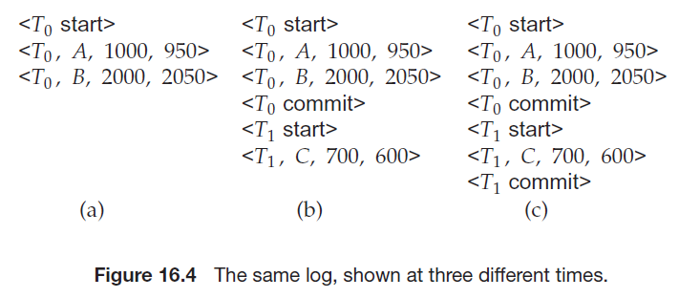
Banking example, with transaction T0 and T1 executed one after the other in the order T0 followed by T1. Suppose that the system crashes before the completion of the transactions.

Slide 76
First, let us assume that the crash occurs just after the log record for the step:
write(B)
of transaction T0 has been written to stable storage. When the system comes back up, it finds the record <T0 start> in the log, but no corresponding <T0 commit> or <T0 abort> record. Thus, transaction T0 must be undone, so an undo(T0) is performed. As a result, the values in accounts A and B (on the disk) are restored to $1000 and $2000, respectively.
Second, let us assume that the crash comes just after the log record for the step:
write(C)
of transaction T1 has been written to stable storage (Figure 16.4b). When the system comes back up, two recovery actions need to be taken. The operation undo(T1) must be performed, since the record <T1 start> appears in the log, but there is no record <T1 commit> or <T1 abort>. The operation redo(T0) must be performed, since the log contains both the record <T0 start> and the record <T0 commit>. At the end of the entire recovery procedure, the values of accounts A, B, and C are $950, $2050, and $700, respectively.

Slide 77
Finally, let us assume that the crash occurs just after the log record:
<T1 commit>
has been written to stable storage (Figure 16.4c). When the system comes back up, both T0 and T1 need to be redone, since the records <T0 start> and <T0 commit> appear in the log, as do the records<T1 start>and<T1 commit>.After the system performs the recovery procedures redo(T0) and redo(T1), the values in accounts A, B, and C are $950, $2050, and $600, respectively.

Slide 78
Deferred Database Modification
If a transaction does not modify the database until it has committed, it is said to use the deferred-modification technique.
Consider our simplified banking system. Let T0 be a transaction that transfers $50 from account A to account B:
T0: read(A);
A := A − 50;
write(A);
read(B);
B := B + 50;
write(B).
Let T1 be a transaction that withdraws $100 from account C:
T1: read(C);
C := C − 100;
write(C).

Slide 79
Deferred Database Modification
<T₀ start>
<T₀ , A, 950>
<T₀ , B, 2050>
<T₀ commit>
<T₁ start>
<T₁ , C, 600>
<T₁ commit>
Log Write
<T₀ start>
<T₀, A, 950>
<T_{o}, B, 2050>
<T₀ commit>
A = 950
B = 2050
<T₁ start>
<T₁, C, 600>
<T₁ commit>
C = 600

