Slide 1
UNIT-V
Parallel and Distributed Databases
By: R.S. Gaikwad
Reference: Silberschatz, Korth, Sudarshan, "Database System Concepts"

Slide 2
Introduction to Database Architectures
Client–server database systems: some tasks to be executed on a server system and some tasks to be executed on client systems.
Parallel database systems: allows database system activities to be speeded up.
Distributed database systems: Keeping multiple copies of the database across different sites also allows large organizations to continue their database operations even when one site is affected by a natural disaster, such as flood, fire, or earthquake.

Slide 3
Centralized Systems
Run on a single computer system and do not interact with other computer systems. Such systems are single-user database systems running on personal computers to high-performance database systems running on high-end server systems.
Each processor may have several independent cores, each of which can execute a separate instruction stream.
General-purpose computer system: one to a few CPUs and a number of device controllers that are connected through a common bus that provides access to shared memory.
Single-user system (e.g., personal computer or workstation): desk-top unit, single user, usually has only one CPU and one or two hard disks; the OS may support only one user.
Multi-user system: more disks, more memory, multiple CPUs, and a multi-user OS. Serve a large number of users who are connected to the system vie terminals. Often called server systems.

Slide 4
Coarse-granularity parallelism
Few processors, all sharing the main memory. Databases on such machines do not partition a single query among the processors; instead, they run each query on a single processor, allowing multiple queries to run concurrently in time shared manner.
Fine-granularity parallelism
Have a large number of processors, and database systems running on such machines attempt to parallelize single tasks.

Slide 5
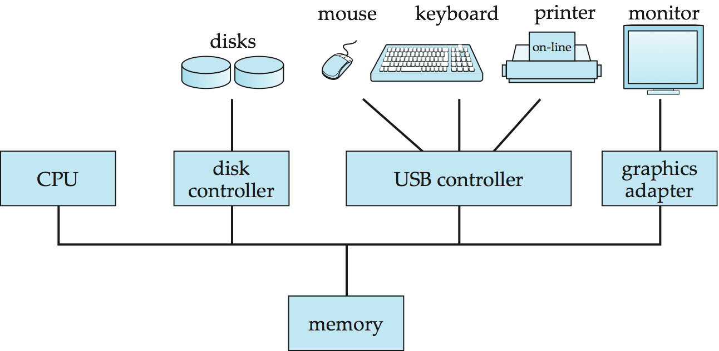
A Centralized Computer System

Slide 6
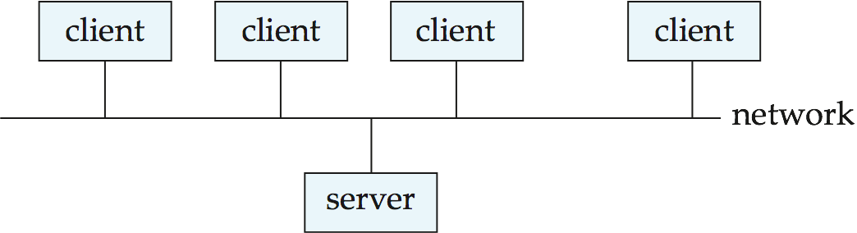
Client-Server Systems
Server systems satisfy requests generated at m client systems, whose general structure is shown below:

Slide 7
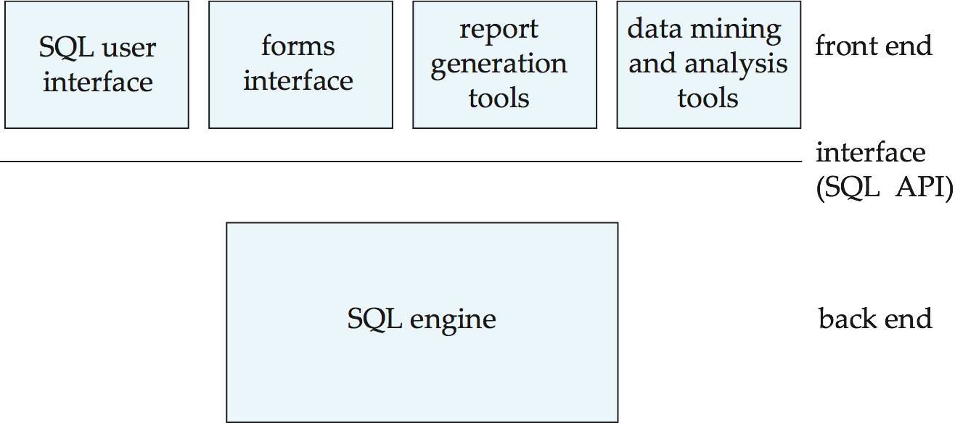
Client-Server Systems (Cont.)
Database functionality can be divided into two parts:
Back-end: manages access structures, query evaluation and optimization, concurrency control and recovery.
Front-end: consists of tools such as SQL user interface forms, report-writers, and graphical user interface facilities.
The interface between the front-end and the back-end is through SQL or through an application program interface.

Slide 8
Client-Server Systems (Cont.)
Standards such as ODBC and JDBC were developed to interface clients with servers.
application programs, such as spreadsheets and statistical-analysis packages, use the client–server interface directly to access data from a back-end server.
Transactional Remote Procedure Call interface to connect clients with a server.
Types of Client-Server Architecture:
Two tier Architecture
Three tier Architecture

Slide 9
Client-Server Systems (Cont.)
Two-tier architecture:
The application is on client machine and it invokes functionality of database system at the server machine with the help of query language statements.
Interface between client and server is provided by application program like JDBC or ODBC standards.
Three-tier architecture:
The client machine only acts as a front end and does not having any direct database calls.
So the client can communicate with the application server through forms interface. Hence to access data application server communicates with database System.
Business logic of the application which tells about action to be carried out under what condition is implanted in application server. It is not distributed across clients.
Three-tier architecture is suitable for large applications and applications running on Worlds-Wide-Web.

Slide 10
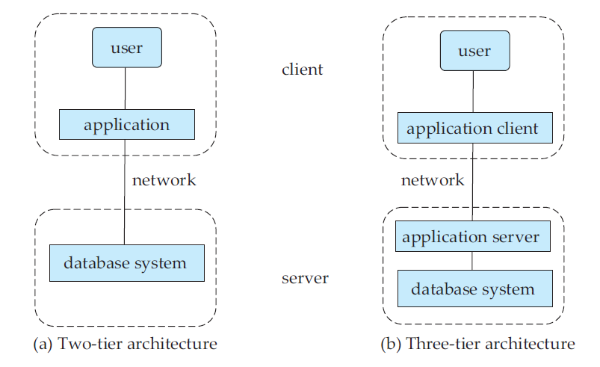
Client-Server Systems (Cont.)

Slide 11
Client-Server Systems (Cont.)
Advantages of replacing mainframes with networks of workstations or personal computers connected to back-end server machines:
better functionality for the cost
flexibility in locating resources and expanding facilities
better user interfaces
easier maintenance

Slide 12
Parallel Databases
Parallel systems improve processing and I/O speeds by using multiple processors and disks in parallel.
The demands of applications that have to query extremely large databases or that have to process an extremely large number of transactions per second
Many operations are performed simultaneously, as opposed to serial processing
A coarse-grain parallel machine consists of a small number of powerful processors
A massively parallel or fine grain parallel machine utilizes thousands of smaller processors.
Two main performance measures performance of a database system:
Throughput --- the number of tasks that can be completed in a given time interval
Response time --- the amount of time it takes to complete a single task from the time it is submitted

Slide 13
Speed-Up and Scale-Up
Performing a given task in less time by increasing the degree of parallelism is called speedup.
We increase the size of the system by increasing the number of processors, disks, and other components of the system.
Suppose that the execution time of a task on the larger machine is T_{L} , and that the execution time of the same task on the smaller machine is T_{S}. The speedup due to parallelism is defined as T_{S} / T_{L}.
The parallel system is said to demonstrate linear speedup if the speedup is N when the larger system has N times the resources (processors, disk, and so on) of the smaller system.
If the speedup is less than N, the system is said to demonstrate sublinear speedup. Figure 17.5 illustrates linear and sublinear speedup.

Slide 14
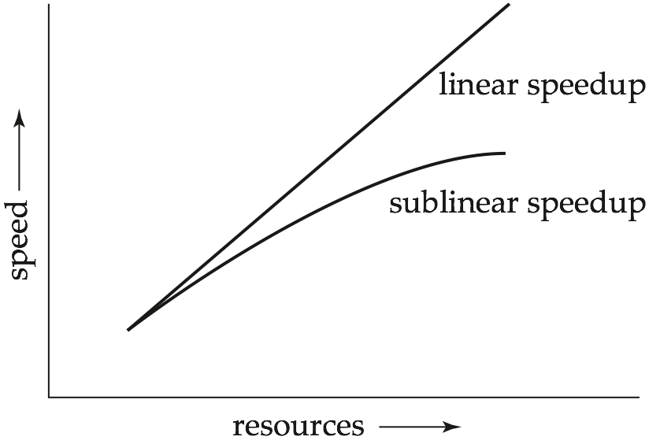
Speedup

Slide 15
Scaleup
Scaleup relates to the ability to process larger tasks in the same amount of time by providing more resources.
Let Q be a task, and let Q_{N} be a task that is N times bigger than Q. Suppose that the execution time of task Q on a given machine M_{S} is T_{S}, and the execution time of task Q_{N} on a parallel machine M_{L}, which is N times larger than M_{S}, is T_{L} The scaleup is then defined as
T_{S}/T_{L}
The parallel system ML is said to demonstrate linear scaleup on task Q if TL = TS.
If TL > TS, the system is said to demonstrate sublinear scaleup. Figure illustrates linear and sublinear scaleups (where the resources increase in proportion to problem size).
Scaleup is usually the more important metric for measuring efficiency of parallel database systems. The database system can continue to perform at an acceptable speed, even as the size of the database and the number of transactions increases.

Slide 16
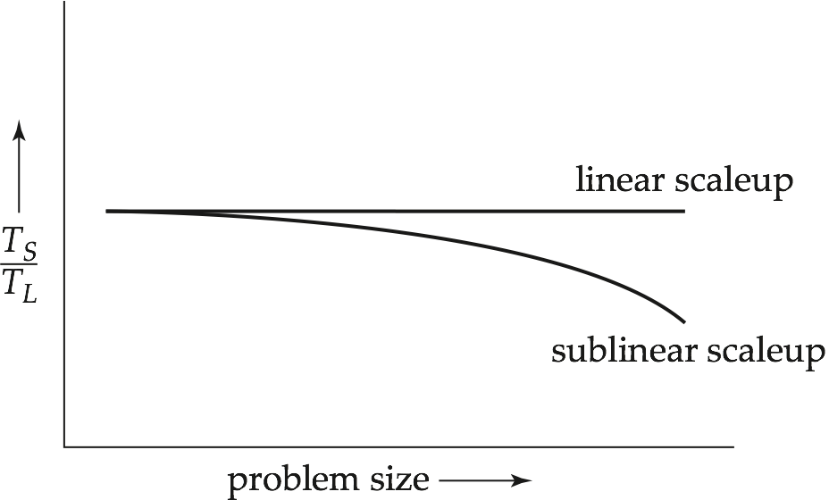
Scaleup
The goal of parallelism is the database system can continue to perform at an acceptable speed, even as the size of the database and the number of transactions increases.

Slide 17
A number of factors work against efficient parallel operation and can diminish both speedup and scaleup.
• Start-up costs. There is a start-up cost associated with initiating a single process. In a parallel operation consisting of thousands of processes, the start-up time may overshadow the actual processing time, affecting speedup adversely.
• Interference. Since processes executing in a parallel system often access shared resources, a slowdown may result from the interference of each new process as it competes with existing processes for commonly held resources, such as a system bus, or shared disks, or even locks. Both speedup and scaleup are affected by this phenomenon.
• Skew. By breaking down a single task into a number of parallel steps, we reduce the size of the average step. Nonetheless, the service time for the single slowest step will determine the service time for the task as a whole. It is often difficult to divide a task into exactly equal-sized parts, and the way that the sizes are distributed is therefore skewed. For example, if a task of size 100 is divided into 10 parts, and the division is skewed, there may be some tasks of size less than 10 and some tasks of size more than 10; if even one task happens to be of size 20, the speedup obtained by running the tasks in parallel is only five, instead of ten as we would have hoped.

Slide 18
Interconnection Network Architectures
Parallel systems consist of a set of components (processors, memory, and disks) that can communicate with each other via an interconnection network.
Bus. System components send data on and receive data from a single communication bus;
The bus could be an Ethernet or a parallel interconnect.
Work well for small numbers of processors
Does not scale well with increasing parallelism.
Mesh. Components are arranged as nodes in a grid, and each component is connected to all adjacent components
two-dimensional mesh each node connects to four adjacent nodes,while in a three-dimensionalmesh each node connects to six adjacent nodes.
Nodes that are not directly connected can communicate with one another by routing messages via a sequence of intermediate nodes
Communication links grow with growing number of components, and so scales better.

Slide 19
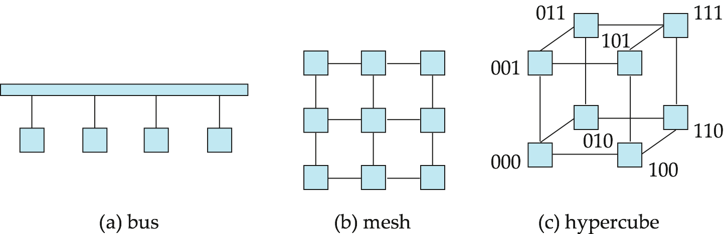
Interconnection Architectures
Hypercube. Components are numbered in binary; components are connected to one another if their binary representations differ in exactly one bit.
Each of the n components are connected to log(n) other components and can reach each other via at most log(n) links; reduces communication delays.

Slide 20
Parallel Database Architectures
Shared memory -- processors share a common memory
Shared disk -- processors share a common disk
Shared nothing -- processors share neither a common memory nor common disk
Hierarchical -- hybrid of the above architectures

Slide 21
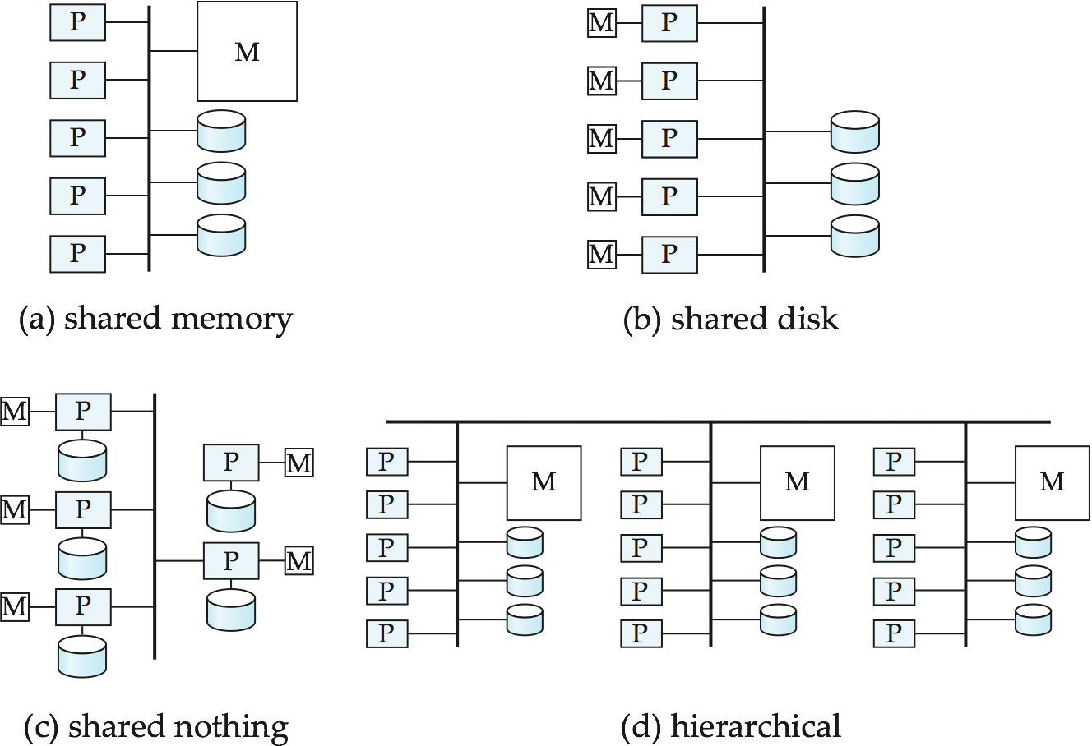
Parallel Database Architectures

Slide 22
Shared Memory
Processors and disks have access to a common memory, typically via a bus or through an interconnection network.
Extremely efficient communication between processors — data in shared memory can be accessed by any processor without having to move it using software.
A processor can send messages to other processors much faster by using memory writes than through a communication mechanism.
Downside – architecture is not scalable beyond 32 or 64 processors since the bus or the interconnection network becomes a bottleneck as processors spend most of their time waiting for their turn on the bus to access memory.
Widely used for lower degrees of parallelism (4 to 8).
have large memory caches at each processor, so that referencing of the shared memory is avoided.
the caches need to be kept coherent and becomes increasing overhead with no of processros.

Slide 23
Shared Disk
All processors can directly access all disks via an interconnection network, but the processors have private memories.
The memory bus is not a bottleneck
Architecture provides a degree of fault-tolerance — if a processor fails, the other processors can take over its tasks since the database is resident on disks that are accessible from all processors.
Examples: IBM Sysplex and DEC clusters (now part of Compaq) running Rdb (now Oracle Rdb) were early commercial users
Downside: bottleneck now occurs at interconnection to the disk subsystem.
Shared-disk systems can scale to a somewhat larger number of processors, but communication between processors is slower.

Slide 24
Shared Nothing
Node consists of a processor, memory, and one or more disks. Processors at one node communicate with another processor at another node using an interconnection network. A node functions as the server for the data on the disk or disks the node owns.
Examples: Teradata, Tandem, Oracle-n CUBE
Data accessed from local disks (and local memory accesses) do not pass through interconnection network, thereby minimizing the interference of resource sharing. only queries, accesses to nonlocal disks, and result relations pass through the network.
Shared-nothing multiprocessors can be scaled up to thousands of processors without interference.
Main drawback: cost of communication and non-local disk access; sending data involves software interaction at both ends.

Slide 25
Hierarchical
Combines characteristics of shared-memory, shared-disk, and shared-nothing architectures.
Top level is a shared-nothing architecture – nodes connected by an interconnection network, and do not share disks or memory with each other.
Each node of the system could be a shared-memory system with a few processors.
Alternatively, each node could be a shared-disk system, and each of the systems sharing a set of disks could be a shared-memory system.
Reduce the complexity of programming such systems by distributed virtual-memory architectures
Also called non-uniform memory architecture (NUMA)

Slide 26
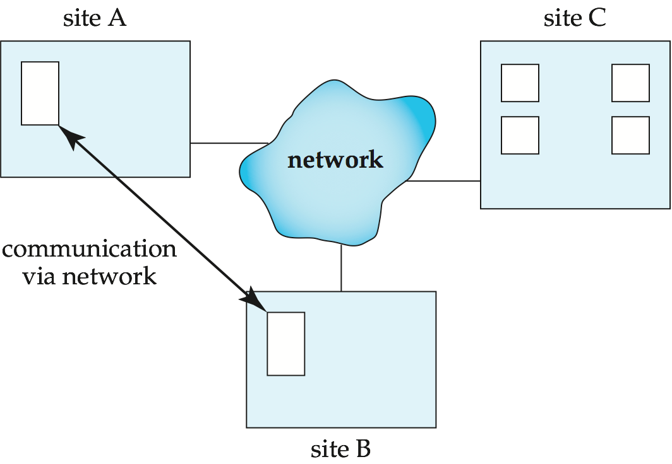
Distributed Systems
Data spread over multiple Computers (also referred to as sites or nodes).
Various communication Media for communication through high speed network or telephone lines.
Data shared by users on multiple machines.
They do not share main memory or disk
Ex. Banking System.

Slide 27
Homogeneous Distributed Databases
In a Homogeneous Distributed Database
All sites have identical software
Are aware of each other and agree to cooperate in processing user requests.
Each site surrenders part of its autonomy in terms of right to change schemas or software
Appears to user as a single system
In a Heterogeneous Distributed Database
Different sites may use different schemas and software
Difference in schema is a major problem for query processing
Difference in software is a major problem for transaction processing
Sites may not be aware of each other and may provide only limited facilities for cooperation in transaction processing

Slide 28
Distributed Databases
Differentiate between local and global transactions
A local transaction accesses data in the single site at which the transaction was initiated.
A global transaction either accesses data in a site different from the one at which the transaction was initiated or accesses data in several different sites.

Slide 29
Distributed Data Storage
Assume relational data model
Replication
System maintains multiple copies of data, stored in different sites, for faster retrieval and fault tolerance.
Fragmentation
Relation is partitioned into several fragments stored in distinct sites
Replication and fragmentation can be combined
Relation is partitioned into several fragments: system maintains several identical replicas of each such fragment.

Slide 30
Data Replication
A relation or fragment of a relation is replicated if it is stored redundantly in two or more sites.
Full replication of a relation is the case where the relation is stored at all sites.
Fully redundant databases are those in which every site contains a copy of the entire database.

Slide 31
Data Replication (Cont.)
Advantages of Replication
Availability: failure of site containing relation r does not result in unavailability of r is replicas exist.
Parallelism: queries on r may be processed by several nodes in parallel.
Reduced data transfer: relation r is available locally at each site containing a replica of r.
Disadvantages of Replication
Increased cost of updates: each replica of relation r must be updated.
Increased complexity of concurrency control: concurrent updates to distinct replicas may lead to inconsistent data unless special concurrency control mechanisms are implemented.
One solution: choose one copy as primary copy and apply concurrency control operations on primary copy

Slide 32
Data Fragmentation
Division of relation r into fragments r₁, r₂, …, r_{n} which contain sufficient information to reconstruct relation r.
Horizontal fragmentation: each tuple of r is assigned to one or more fragments
Vertical fragmentation: the schema for relation r is split into several smaller schemas
All schemas must contain a common candidate key (or superkey) to ensure lossless join property.
A special attribute, the tuple-id attribute may be added to each schema to serve as a candidate key.

Slide 33
Horizontal Fragmentation of account Relation
branch_name
account_number
balance
Hillside
Hillside
Hillside
A-305
A-226
A-155
500
336
62
account₁ = σ_{branch_name=“Hillside”} (account )
branch_name
account_number
balance
Valleyview
Valleyview
Valleyview
Valleyview
A-177
A-402
A-408
A-639
205
10000
1123
750
account₂ = σ_{branch_name=“Valleyview”} (account )

Slide 34
Vertical Fragmentation of employee_info Relation
branch_name
customer_name
tuple_id
Hillside
Hillside
Valleyview
Valleyview
Hillside
Valleyview
Valleyview
Lowman
Camp
Camp
Kahn
Kahn
Kahn
Green
1
2
3
4
5
6
7
deposit₁ = Πbranch_name, customer_name, tuple_id (employee_info )
account_number
balance
tuple_id
A-305
A-226
A-177
A-402
A-155
A-408
A-639
500
336
205
10000
62
1123
750
1
2
3
4
5
6
7
deposit₂ = Πaccount_number, balance, tuple_id (employee_info )

Slide 35
Advantages of Fragmentation
Horizontal:
allows parallel processing on fragments of a relation
allows a relation to be split so that tuples are located where they are most frequently accessed
Vertical:
allows tuples to be split so that each part of the tuple is stored where it is most frequently accessed
tuple-id attribute allows efficient joining of vertical fragments
allows parallel processing on a relation
Vertical and horizontal fragmentation can be mixed.
Fragments may be successively fragmented to an arbitrary depth.

Slide 36
Distributed Transactions
Transaction may access data at several sites.
Each site has a local transaction manager responsible for:
Ensure the ACID properties of those transactions that execute at that site.
Maintaining a log for recovery purposes
Participating in coordinating the concurrent execution of the transactions executing at that site.
Each site has a transaction coordinator, which is responsible for:
Starting the execution of transactions that originate at the site.
Breaking the transaction into subtransactions and distributing at appropriate sites for execution.
Coordinating the termination of each transaction that originates at the site, which may result in the transaction being committed at all sites or aborted at all sites.

Slide 37
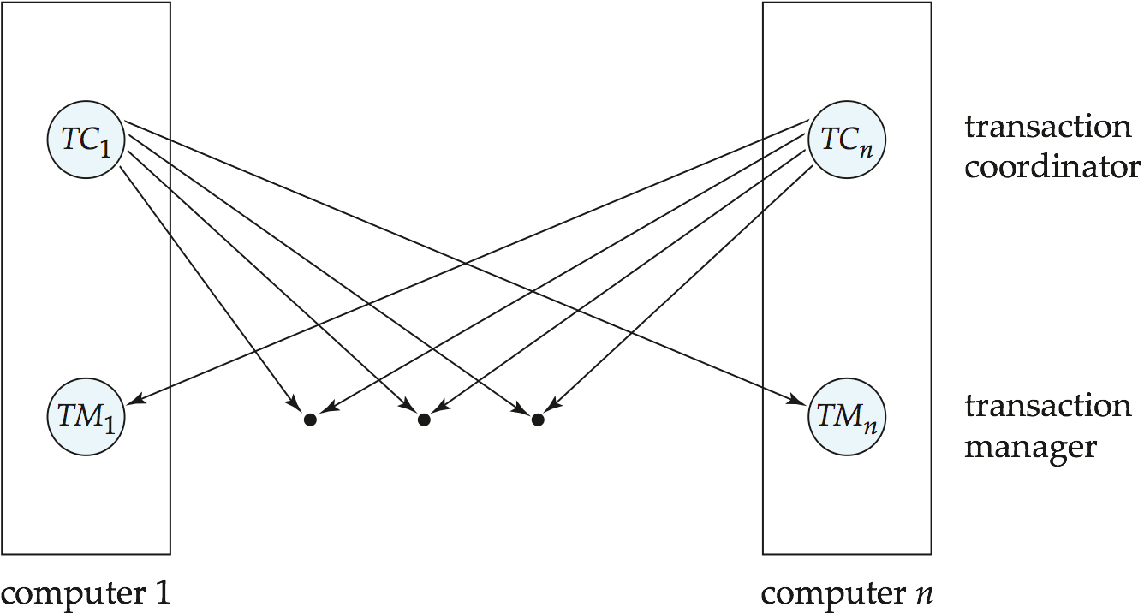
Transaction System Architecture

Slide 38
System Failure Modes
Failures unique to distributed systems:
Failure of a site.
Loss of massages
Handled by network transmission control protocols such as TCP-IP
Failure of a communication link
Handled by network protocols, by routing messages via alternative links
Network partition
A network is said to be partitioned when it has been split into two or more subsystems that lack any connection between them
Note: a subsystem may consist of a single node
Network partitioning and site failures are generally indistinguishable.

Slide 39
Commit Protocols
Commit protocols are used to ensure atomicity across sites
a transaction which executes at multiple sites must either be committed at all the sites, or aborted at all the sites.
not acceptable to have a transaction committed at one site and aborted at another
The two-phase commit (2PC) protocol is widely used
The three-phase commit (3PC) protocol is more complicated and more expensive, but avoids some drawbacks of two-phase commit protocol. This protocol is not used in practice.

Slide 40
Two Phase Commit Protocol (2PC)
Assumes fail-stop model – failed sites simply stop working, and do not cause any other harm, such as sending incorrect messages to other sites.
Execution of the protocol is initiated by the coordinator after the last step of the transaction has been reached.
The protocol involves all the local sites at which the transaction executed
Let T be a transaction initiated at site S_{i}, and let the transaction coordinator at S_{i} be C_{i}
When T completes its execution—that is, when all the sites at which T has executed inform C_{i} that T has completed—C_{i} starts the 2PC protocol.

Slide 41
Phase 1: Obtaining a Decision
Coordinator asks all participants to prepare to commit transaction T_{i}.
C_{i} adds the records <prepare T> to the log and forces log to stable storage
sends prepare T messages to all sites at which T executed
Upon receiving message, transaction manager at site determines if it can commit the transaction T
if not, add a record <no T> to the log and send abort T message to C_{i}
if the transaction can be committed, then:
add the record <ready T> to the log
force all records for T to stable storage
send ready T message to C_{i}

Slide 42
Phase 2: Recording the Decision
When C_{i} receives responses to the prepare T message from all the sites, or when a prespecified interval of time has elapsed since the prepare T message was sent out, C_{i} can determine whether the transaction T can be committed or aborted.
T can be committed of C_{i} received a ready T message from all the participating sites: otherwise T must be aborted.
Coordinator adds a decision record, <commit T> or <abort T>, to the log and forces record onto stable storage. Once the record stable storage it is irrevocable (even if failures occur)
Coordinator sends a message to each participant informing it of the decision (commit or abort)
When a site receives that message, it records the message in the log.

Slide 43
Two Phase Commit Protocol (2PC) cont..
A site at which T executed can unconditionally abort T at any time before
it sends the message ready T to the coordinator. Once the message is sent, the transaction is said to be in the ready state at the site. The ready T message is, in effect, a promise by a site to follow the coordinator’s order to commit T or to abort T.
In some implementations of the 2PC protocol, a site sends an acknowledge T message to the coordinator at the end of the second phase of the protocol. When the coordinator receives the acknowledge T message from all the sites, it adds the record <complete T> to the log.

Slide 44
Handling of Failures - Site Failure
When site S_{i} recovers, it examines its log to determine the fate of
transactions active at the time of the failure.
Log contain <commit T> record: txn had completed, nothing to be done
Log contains <abort T> record: txn had completed, nothing to be done
Log contains <ready T> record: site must consult C_{i} to determine the fate of T.
If T committed, redo (T); write <commit T> record
If T aborted, undo (T)
The log contains no log records concerning T:
Implies that S_{k} failed before responding to the prepare T message from C_{i}
since the failure of S_{k} precludes the sending of such a response, coordinator C₁ must abort T
S_{k} must execute undo (T)

Slide 45
Handling of Failures- Coordinator Failure
If coordinator fails while the commit protocol for T is executing then participating sites must decide on T’s fate:
If an active site contains a <commit T> record in its log, then T must be committed.
If an active site contains an <abort T> record in its log, then T must be aborted.
If some active participating site does not contain a <ready T> record in its log, then the failed coordinator C_{i} cannot have decided to commit T.
Can therefore abort T; however, such a site must reject any subsequent <prepare T> message from C_{i}
If none of the above cases holds, then all active sites must have a <ready T> record in their logs, but no additional control records (such as <abort T> of <commit T>).
In this case active sites must wait for C_{i} to recover, to find decision.
Blocking problem: active sites may have to wait for failed coordinator to recover.

Slide 46
Handling of Failures - Network Partition
If the coordinator and all its participants remain in one partition, the failure has no effect on the commit protocol.
If the coordinator and its participants belong to several partitions:
Sites that are not in the partition containing the coordinator think the coordinator has failed, and execute the protocol to deal with failure of the coordinator.
No harm results, but sites may still have to wait for decision from coordinator.
The coordinator and the sites are in the same partition as the coordinator think that the sites in the other partition have failed, and follow the usual commit protocol.
Again, no harm results

Slide 47
Recovery and Concurrency Control
In-doubt transactions have a <ready T>, but neither a <commit T>, nor an <abort T> log record.
The recovering site must determine the commit-abort status of such transactions by contacting other sites; this can slow and potentially block recovery.
Recovery algorithms can note lock information in the log.
Instead of <ready T>, write out <ready T, L> L = list of locks held by T when the log is written (read locks can be omitted).
For every in-doubt transaction T, all the locks noted in the <ready T, L> log record are reacquired.
After lock reacquisition, transaction processing can resume; the commit or rollback of in-doubt transactions is performed concurrently with the execution of new transactions.

Slide 48
Three Phase Commit (3PC)
Assumptions:
No network partitioning
At any point, at least one site must be up.
At most K sites (participants as well as coordinator) can fail
Phase 1: Obtaining Preliminary Decision: Identical to 2PC Phase 1.
Every site is ready to commit if instructed to do so
Phase 2 of 2PC is split into 2 phases, Phase 2 and Phase 3 of 3PC
In phase 2 coordinator makes a decision as in 2PC (called the
pre-commit decision) and records it in multiple (at least K) sites
In phase 3, coordinator sends commit/abort message to all participating sites,
Under 3PC, knowledge of pre-commit decision can be used to commit despite coordinator failure
Avoids blocking problem as long as < K sites fail
Drawbacks:
higher overheads
assumptions may not be satisfied in practice
Notes:
48

Slide 49
Alternative Models of Transaction Processing
Notion of a single transaction spanning multiple sites is inappropriate for many applications
E.g. transaction crossing an organizational boundary
No organization would like to permit an externally initiated transaction to block local transactions for an indeterminate period
Alternative models carry out transactions by sending messages
Code to handle messages must be carefully designed to ensure atomicity and durability properties for updates
Isolation cannot be guaranteed, in that intermediate stages are visible, but code must ensure no inconsistent states result due to concurrency
Persistent messaging systems are systems that provide transactional properties to messages
Messages are guaranteed to be delivered exactly once
Will discuss implementation techniques later

Slide 50
Persistent Messaging and Workflows
Workflows provide a general model of transactional processing involving multiple sites and possibly human processing of certain steps
E.g. when a bank receives a loan application, it may need to
Contact external credit-checking agencies
Get approvals of one or more managers
and then respond to the loan application
We study workflows in Chapter 25
Persistent messaging forms the underlying infrastructure for workflows in a distributed environment

Slide 51
Implementation of Persistent Messaging
Sending site protocol.
When a transaction wishes to send a persistent message, it writes a record containing the message in a special relation messages_to_send; the message is given a unique message identifier.
A message delivery process monitors the relation, and when a new message is found, it sends the message to its destination.
The message delivery process deletes a message from the relation only after it receives an acknowledgment from the destination site.
If it receives no acknowledgement from the destination site, after some time it sends the message again. It repeats this until an acknowledgment is received.
If after some period of time, that the message is undeliverable, exception handling code provided by the application is invoked to deal with the failure.
Writing the message to a relation and processing it only after the transaction commits ensures that the message will be delivered if and only if the transaction commits.

Slide 52
Implementation of Persistent Messaging (Cont.)
Receiving site protocol.
When a site receives a persistent message, it runs a transaction that adds the message to a received_messages relation
provided message identifier is not already present in the relation
After the transaction commits, or if the message was already present in the relation, the receiving site sends an acknowledgment back to the sending site.
Note that sending the acknowledgment before the transaction commits is not safe, since a system failure may then result in loss of the message.
In many messaging systems, it is possible for messages to get delayed arbitrarily, although such delays are very unlikely.
Each message is given a timestamp, and if the timestamp of a received message is older than some cutoff, the message is discarded.
All messages recorded in the received messages relation that are older than the cutoff can be deleted.

Slide 53
Concurrency Control in Distributed Database
Modify concurrency control schemes for use in distributed environment.
We assume that each site participates in the execution of a commit protocol to ensure global transaction atomicity.
We assume all replicas of any item are updated
Will see how to relax this in case of site failures later

Slide 54
Single-Lock-Manager Approach
System maintains a single lock manager that resides in a single chosen site, say S_{i}
When a transaction needs to lock a data item, it sends a lock request to S_{i} and lock manager determines whether the lock can be granted immediately
If yes, lock manager sends a message to the site which initiated the request
If no, request is delayed until it can be granted, at which time a message is sent to the initiating site

Slide 55
Single-Lock-Manager Approach (Cont.)
The transaction can read the data item from any one of the sites at which a replica of the data item resides.
Writes must be performed on all replicas of a data item
Advantages of scheme:
Simple implementation
This scheme requires two messages for handling lock requests and one message for handling unlock requests.
Simple deadlock handling
Since all lock and unlock requests are made at one site
Disadvantages of scheme are:
Bottleneck: lock manager site becomes a bottleneck
Vulnerability: If the site Si fails, the concurrency controller is lost.

Slide 56
Distributed Lock Manager
In this approach, functionality of locking is implemented by lock managers at each site
Each site maintains a local lock manager whose function is to administer the lock and unlock requests for those data items that are stored in that site.
When a transaction wishes to lock a data item Q that is not replicated and resides at site Si , a message is sent to the lock manager at site Si requestinga lock.
If data item Q is locked in an incompatible mode, then the request is delayed until it can be granted. Once it has determined that the lock request can be granted, the lock manager sends a message back to the initiator indicating that it has granted the lock request.
But special protocols may be used for replicas

Slide 57
Distributed Lock Manager
Advantage:
work is distributed and can be made robust to failures
It has a reasonably low overhead, requiring two message transfers for handling lock requests, and one message transfer for handling unlock requests.
Disadvantage: deadlock detection is more complicated
Lock managers cooperate for deadlock detection
More on this later
Several variants of this approach
Primary copy
Majority protocol
Biased protocol
Quorum consensus

Slide 58
Primary Copy
Choose one replica of data item to be the primary copy.
Site containing the replica is called the primary site for that data item
Different data items can have different primary sites
When a transaction needs to lock a data item Q, it requests a lock at the primary site of Q.
Implicitly gets lock on all replicas of the data item
Benefit
Concurrency control for replicated data handled similarly to unreplicated data - simple implementation.
Drawback
If the primary site of Q fails, Q is inaccessible even though other sites containing a replica may be accessible.

Slide 59
Majority Protocol
Local lock manager at each site administers lock and unlock requests for data items stored at that site.
When a transaction wishes to lock an unreplicated data item Q residing at site S_{i}, a message is sent to S_{i} ‘s lock manager.
If Q is locked in an incompatible mode, then the request is delayed until it can be granted.
When the lock request can be granted, the lock manager sends a message back to the initiator indicating that the lock request has been granted.

Slide 60
Majority Protocol (Cont.)
In case of replicated data
If Q is replicated at n sites, then a lock request message must be sent to more than half of the n sites in which Q is stored.
The transaction does not operate on Q until it has obtained a lock on a majority of the replicas of Q.
When writing the data item, transaction performs writes on all replicas.
Benefit
Can be used even when some sites are unavailable
details on how handle writes in the presence of site failure later
Drawback
Requires 2(n/2 + 1) messages for handling lock requests, and (n/2 + 1) messages for handling unlock requests.
Potential for deadlock even with single item - e.g., each of 3 transactions may have locks on 1/3rd of the replicas of a data.

Slide 61
Biased Protocol
Local lock manager at each site as in majority protocol, however, requests for shared locks are handled differently than requests for exclusive locks.
Shared locks. When a transaction needs to lock data item Q, it simply requests a lock on Q from the lock manager at one site containing a replica of Q.
Exclusive locks. When transaction needs to lock data item Q, it requests a lock on Q from the lock manager at all sites containing a replica of Q.
Advantage - imposes less overhead on read operations.
Disadvantage - additional overhead on writes

Slide 62
Quorum Consensus Protocol
A generalization of both majority and biased protocols
Each site is assigned a weight.
Let S be the total of all site weights
Choose two values read quorum Q_{r} and write quorum Q_{w}
Such that Q_{r} + Q_{w} > S and 2 * Q_{w} > S
Quorums can be chosen (and S computed) separately for each item
Each read must lock enough replicas that the sum of the site weights is >= Q_{r}
Each write must lock enough replicas that the sum of the site weights is >= Q_{w}
For now we assume all replicas are written
Extensions to allow some sites to be unavailable described later

Slide 63
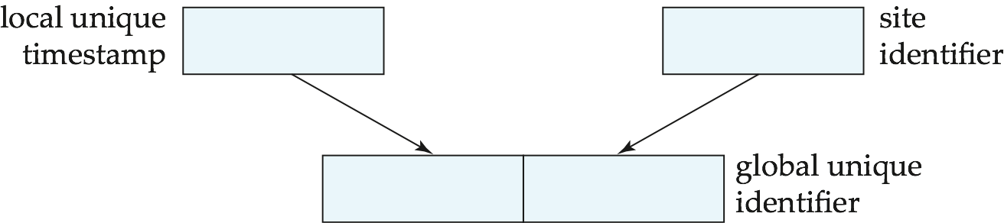
Timestamping
Timestamp based concurrency-control protocols can be used in distributed systems
Each transaction must be given a unique timestamp
Main problem: how to generate a timestamp in a distributed fashion
Each site generates a unique local timestamp using either a logical counter or the local clock.
Global unique timestamp is obtained by concatenating the unique local timestamp with the unique identifier.

Slide 64
Timestamping (Cont.)
A site with a slow clock will assign smaller timestamps
Still logically correct: serializability not affected
But: “disadvantages” transactions
To fix this problem
Define within each site S_{i} a logical clock (LC_{i}), which generates the unique local timestamp
Require that S_{i} advance its logical clock whenever a request is received from a transaction Ti with timestamp < x,y> and x is greater that the current value of LC_{i}.
In this case, site S_{i} advances its logical clock to the value x + 1.

