Slide 1
Unit 2: SQL AND PL/SQL

Slide 2
Outline
SQL: Characteristics and advantages,
SQL Data Types and Literals,
DDL, DML, DCL, TCL,
SQL Operators,
Tables: Creating, Modifying, Deleting,
Views: Creating, Dropping, Updating using Views,
Indexes,
SQL DML Queries: SELECT Query and clauses,
Set Operations, Predicates and Joins, Set membership,
Tuple Variables, Set comparison,
Ordering of Tuples,
Aggregate Functions,
Nested Queries,
Database Modification using SQL Insert, Update and Delete Queries.
PL/SQL: concept of Stored Procedures & Functions, Cursors, Triggers, Assertions, roles and privileges , Embedded SQL, Dynamic SQL.

Slide 3
What is SQL?
SQL stands for Structured Query Language
SQL is a computer language aimed to store, manipulate and retrieve data stored in relational databases.
SQL is the standard language for Relation Database System. All relational database management systems like “MySQL, MS Access, Oracle, Sybase, Informix, postgres and SQL Server” use SQL as standard database language.
SQL is a keyword based language and each statement begins with unique keyword.
SQL syntax is not case sensitive.

Slide 4
What Can SQL do?
SQL can execute queries against a database
SQL can retrieve data from a database
SQL can insert records in a database
SQL can update records in a database
SQL can delete records from a database
SQL can create new databases
SQL can create new tables in a database
SQL can create stored procedures in a database
SQL can create views in a database
SQL can set permissions on tables, procedures, and views

Slide 5
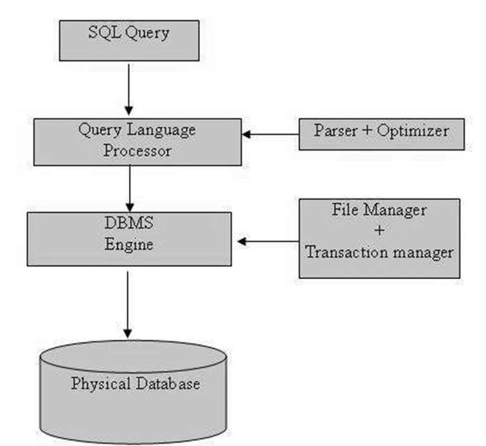
Fig1. SQL Architecture

Slide 6
MySQL Data Types
mysql-data-types.pdf

Slide 7
SQL Commands
DDL - Data Definition Language
DML - Data Manipulation Language
DCL - Data Control Language
DQL - Data Query Language
TCL – Transaction Control Language

Slide 8
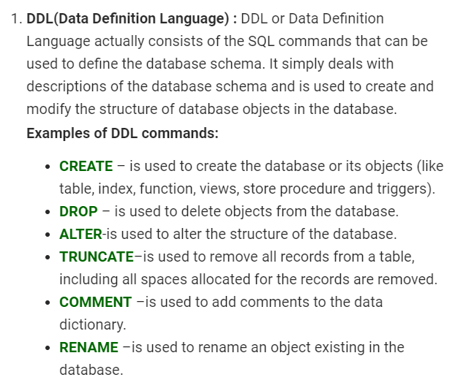

Slide 9
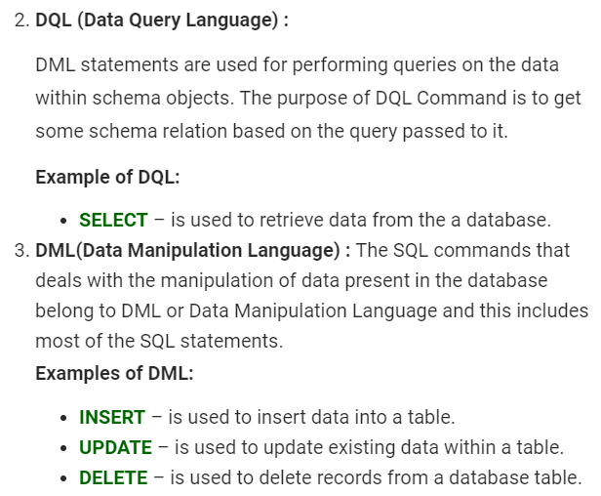

Slide 10
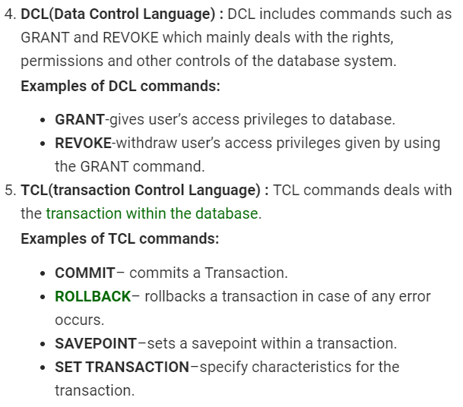

Slide 11
Data Integrity Constraints
Constraints make sure that only authorized user will make modifications to database and change should not lead to loss of data consistency and correctness.
Types of Data integrity Constraints
Domain Relational Constraints
Entity Relational Constraints
Referential Relational Constraints

Slide 12
Domain Relational Constraints
Domain Relational Constraints allows us to test whether the values inserted into the database are correct or not.
The CREATE TABLE Command may also include domain constraints which can check integrity of database.
Types of Constraints
Null Constraint/ Requires data Constraint
Check Constraint/ User defined Constraint
Default Constraint

Slide 13
1. Null Constraint/ Requires data Constraint
Database may have some attributes mandatory like, user registration must have email address.
These attributes(column) in a database are not allowed to contain NULL values or blanks.
CREATE TABLE Student(Name char(25) NOT NULL);
2. Check Constraint
The check constraint is used to ensure that attribute value satisfies specific condition as specified by data requirements.
Suppose in student table, gender of student can be male or female only.
CREATE TABLE customer(name char(25) NOT NULL, Gender char(1), Check(Gender IN(‘M’, ‘F’));

Slide 14
3. Default Constraint
Default Constraint is used to add a default specified value, if no attribute value is provided by user.
It avoid addition of NULL value by inserting default value as specified.
Create table customer(Name char(25) DEFAULT ‘UNKNOWN’);

Slide 15
Entity Relational Constraints
Entity Relational Constraints allows us to test whether the tuple (entity) inserted into database are correct or not.
Unique Constraint
In case of unique constraints, no two tuples can have equal value for same attributes.
Create table customer(Name char(20), id char(5), Email char(20) UNIQUE);
2. Primary Key Constraint
A table in a relational database has one column or combination of some column whose value uniquely identifies a single row in the table. The column or combination of columns is called the primary key of the table.
Create table customer(Name char(20), id char(5) PRIMARY KEY);

Slide 16
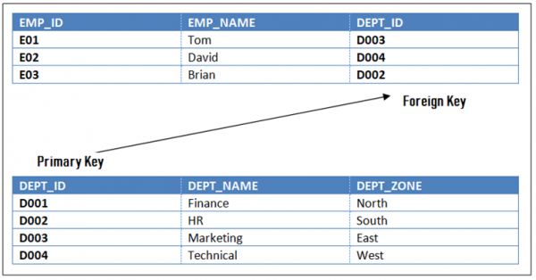
Referential Relational Constraints
A value appearing in one relation(table) for a given set of attributes also appear for another set of attributes in another relation(table). This is called referential integrity.
CREATE TABLE Department (dept_id INT NOT NULL, dept_name VARCHAR(256), PRIMARY KEY (dept_id));
CREATE TABLE Employee (emp_id INT NOT NULL, emp_name VARCHAR(256), dept_id INT, FOREIGN KEY (dept_id) REFERENCES Department(dept_id)

Slide 17
Views
The view is a virtual table. It does not physically exist. Rather, it is created by a query joining one or more tables.
A view contains rows and columns, just like a real table
The fields in a view are fields from one or more real tables in the database.
Types if Views
Simple View- The view which are based on only one table called as Simple View.
Complex View- The view which are based on more than one table called as Complex View.

Slide 18
Creating Views
The basic CREATE VIEW syntax is as follows:
CREATE VIEW view_name AS SELECT column1, column2..... FROM table_name WHERE [condition];
CREATE VIEW CUSTOMERS_VIEW AS SELECT NAME, AGE FROM CUSTOMER;
Updating a View
UPDATE CUSTOMERS_VIEW SET AGE = 35 WHERE name='Ramesh';
Deleting Row from the View
DELETE FROM CUSTOMERS_VIEW WHERE age = 22;
Dropping Views
DROP VIEW CUSTOMERS_VIEW;

Slide 19
Advantages of Views
Security
Hides Complexity
Dynamic Nature
Does not allows direct access to the tables of data dictionary
Data integrity
Disadvantages of Views
Performance
View Management
Update restrictions

Slide 20
SQL Indexes
An index can be created in a table to access data in database more quickly and efficiently.
Indexes are special lookup tables that the database search engine can use to speed up data retrieval. Simply put, an index is a pointer to data in a table. An index in a database is very similar to an index in the back of a book.
The basic syntax of a CREATE INDEX is as follows.
CREATE INDEX index_name ON table_name(Column_Name);
CREATE INDEX Customer_Index ON Customer(Cust_Name);
Removing the index
DROP INDEX index_name;

Slide 21
SQL DML Queries
Select Statement-
Select * from table_name;
Select name,id from Customer;
Order by Clause
SELECT column_name
FROM table_name
ORDER BY column_name ASC|DESC;

Slide 22
WHERE Clause
SELECT * FROM table_name [WHERE condition]
Arithmetic and Comparison Operators
1. | +
2. | -
3. | *
4. | /
5. | %
6. | =
7. | <
8. | <=
9. | >
10. | >=
11. | <>

