Slide 1
American Sign Language Recognition
SWE1011 - Project Presentation
Shantanu Gupta – 16MIS1109
Artham Abhinay – 16MIS1027

Slide 2
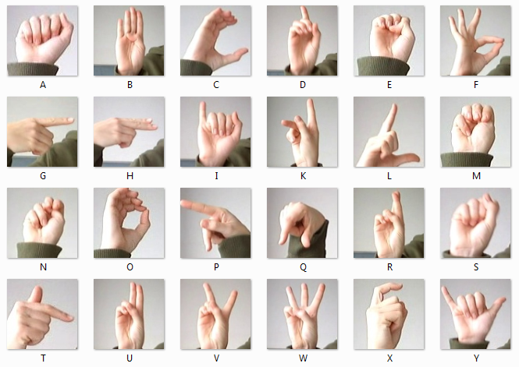
American Sign Language
History
ASL uses one hand to represent alphabets.
ASL alphabets derived from French Sign Language alphabets and various other village sign languages.

Slide 3
American Sign Language
Challenges
No sufficient data for American Sign Language
Thresholding plays a major role in real time application
Lighting is an important factor to consider when using this system
Variance in sign language with locality and usage of different symbols for the same alphabet by the same person.

Slide 4
Dataset Collection
1:- The American Sign Language letter database of hand gestures represent a multi-class problem with 24 classes of letters (excluding J and Z which require motion).
2:- Each training and test case represents a label (0-25) as a one-to-one map for each alphabetic letter A-Z
3:- The training data (27,455 cases) is approximately half the size of the standard MNIST but otherwise similar with a header row of label, pixel1,pixel2....pixel784 which represent a single 28x28 pixel image with grayscale values between 0-255.

Slide 5
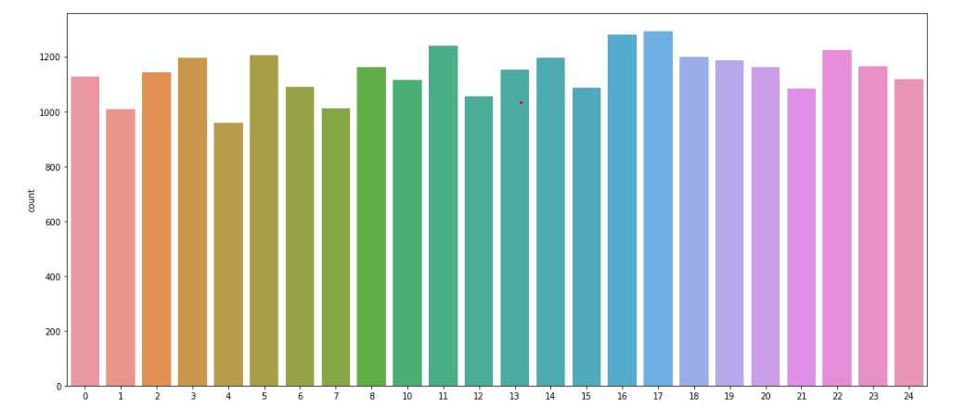
Data distribution
The dataset is almost equally distributed, to avoid any biased network

Slide 6
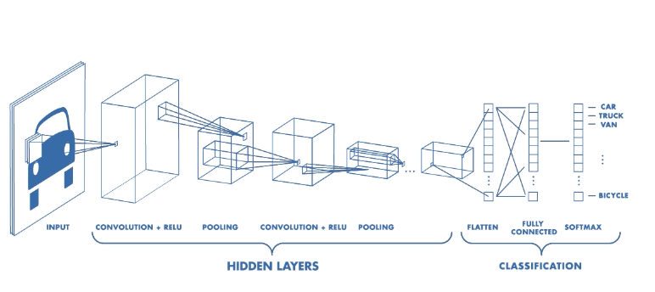
Convolution Neural Network

Slide 7
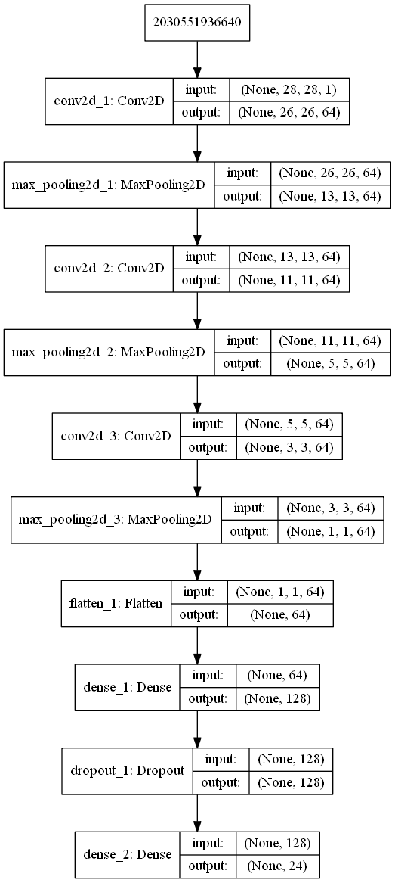
Our CNN architecture

Slide 8
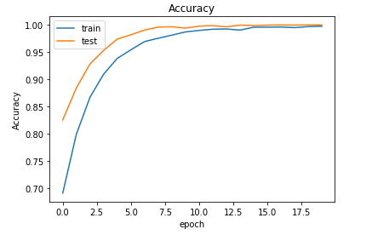
Training the CNN
We used a five layer CNN, three Conv2D layers and two dense layers
The training process was done in a batch size of 128 and number of epochs are 20
We secured a training accuracy of 99.74%

Slide 9

Results
We secured an accuracy of 89.7% while testing our model with test dataset we split earlier…

Slide 10
Future Work
1: This project can further be improved by adding more signs, and also forming sentences instead of single characters.
2: The next step would be real time implementation for video processing and converting it to text.

Slide 11

eferences
[ 1 ] https://pythonprogramming.net/introduction-deep-learning-pythontensorflow-keras/
[2] http://cs231n.github.io/convolutional-networks/
[3] https://github.com/loicmarie/sign-language-alphabet-recognizer

