Slide 1
Optimizing Revenue for restaurant with Linear Programming and Simplex Method
Gautham Gali

Slide 2
Problem Formulation
Let the dishes be represented as 𝑥1,𝑥2,𝑥3(Birayni, Butter chicken , Veg Pulao), where each 𝑥𝑖 signifies the quantity of each dish prepared daily.
The restaurant's operations are constrained by the availability of key ingredients and the capacity of kitchen operation hours. Specifically, the constraints include the availability of Ingredient X(tomatoes) and Ingredient Y(onions), along with the limited hours the kitchen can operate each day.
This constraint formulation ensures that the model focuses on the optimal allocation of these resources to maximize revenue.
The restaurant has a total of 100 kgs of Ingredient X and 72 kgs of Ingredient Y available each day.
The kitchen operation is limited to 80 hours per day due to staffing and operational constraints.
Assumptions, they have cloud kitchen setup and multiple people are working under the same restaurant.

Slide 3
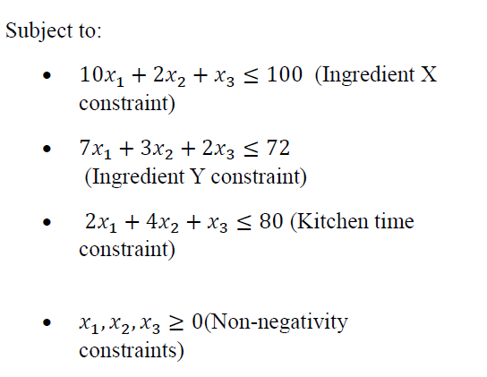
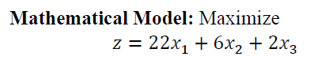
Problem Formulation

Slide 4
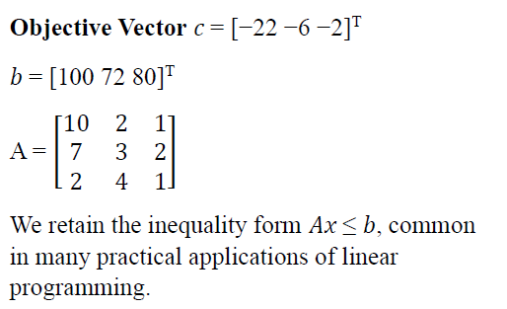
Standard Form

Slide 5
Slack Form

Slide 6
Exploring The Solution
Biryani: 9.75 kg
Butter Chicken: 1.25 kg
Veg Pulao: 0

Slide 7
Simplex solution Iteration I

Slide 8
Simplex solution Iteration I

Slide 9
Simplex solution Iteration II

Slide 10
Simplex solution Iteration II

Slide 11
Simplex solution Iteration III

Slide 12
the visualization of the feasible region with x1 fixed at 0,

Slide 13
the visualization of the feasible region with x2 fixed at 0,

Slide 14
the visualization of the feasible region with x3 fixed at 0,

Slide 15
Varying Constraints

Slide 16
Varying Constraints

Slide 17
Varying Constraints

Slide 18
Thank you
I pledge that this test/assignment has been completed in compliance with the Graduate Honor Code and that I have neither given nor received any unauthorized aid on this test/assignment. Name (Print): Gautham Gali Signed: Gautham Gali

