Slide 1

Optimizing USA Touring Routes with Dynamic Programming: A Comparative Analysis
Gautham Gali

Slide 2
Introduction
Efficiently touring all 49 states of the USA and returning to the starting point poses a classic optimization problem akin to the Traveling Salesman dilemma.
In this study, we explore the application of dynamic programming (DP) techniques to find an optimal solution. We investigate both top-down and bottom-up DP approaches, contrasting their performance with a naive recursive approach commonly used for such combinatorial problems.
Our analysis focuses on the time complexity of each method, aiming to provide insights into the practical applicability of DP for large-scale touring scenarios. By characterizing the performance analytically and empirically, we offer a comprehensive comparison of the three approaches.

Slide 3
Problem statement
the Traveling Salesman Problem (TSP). Leveraging the rich dataset compiled by the US Geological Survey (USGS), we propose an ambitious undertaking: the 115,475-city challenge spanning nearly all cities, towns, and villages across the contiguous 48 states
The aim is to find the shortest possible route that visits each location exactly once and returns to the starting point. Navigating through such a vast array of destinations poses significant computational challenges.
We define the travel cost between two points as the Euclidean distance rounded to the nearest integer value, reflecting an ideal scenario where our salesman travels by helicopter.

Slide 4
Input
Name: ”usa115475”
Type: TSP (Traveling Salesman Problem)
Comment: Indicates that the dataset consists of 115,474 towns and cities in the United States.
The dataset is then represented in the ”NODE COORD SECTION” section, where each line corresponds to the coordinates of a single city. Each line consists of three values:
The city index or identifier.
The x-coordinate (longitude) of the city.
The y-coordinate (latitude) of the city.
For example, the first city has the index 1 and coordinates (33613.158800, 86118.306100), indicating its position on a
two-dimensional plane.

Slide 5
Output
Best optimized route is of length 6204999, given by Xavier Clarist
Need to find the shortest route travelling all the cities.

Slide 6
Approach discussed
Naive Approach
Top-Down Dynamic Programming Approach
Bottom-Up Dynamic Programming Approach:

Slide 7
Why I choose dynamic programming?
Optimal Substructure: The problem exhibits optimal substructure, allowing the optimal solution to be constructed from optimal solutions to its subproblems. DP efficiently handles such problems by breaking them down into smaller, overlapping subproblems.
Overlapping Subproblems: DP efficiently solves problems with overlapping subproblems by storing solutions and reusing them when needed. This is advantageous for optimizing touring routes, where recurring subproblems, like finding the optimal route between two cities, may arise.
Efficiency: DP algorithms typically have polynomial time complexity, making them efficient for large input sizes. Given the dataset size and complexity of the task, an efficient solution approach like DP is essential to ensure reasonable computation times.
Proven Effectiveness: DP has been successfully applied to various optimization problems in different domains. Its effectiveness and reliability make it a preferred choice for tackling complex optimization tasks like touring route optimization.

Slide 8
Algorithm Description - Naive Approach
Start with an empty route.
Generate all possible permutations of cities.
Calculate the total distance for each permutation by summing the distances between consecutive cities.
Select the permutation with the shortest total distance.
Output the optimal route and its total distance.

Slide 9
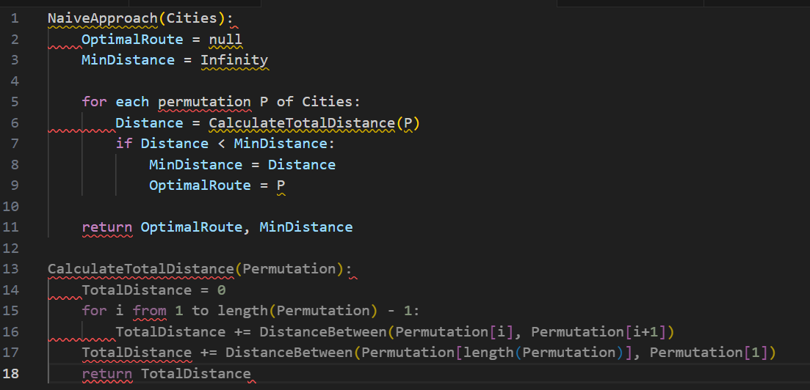

Slide 10
Time Complexity of Naive TSP Solution:
The time complexity of generating all permutations of cities is O(n!).
For each permutation, computing the total distance requires visiting each city once, resulting in an additional O(n) operations.
Therefore, the overall time complexity of the naive TSP solution is O(n!×n).
Big O Notation (O): O(n! × n)
Omega Notation (Ω): Ω(n! × n)
Theta Notation (Θ): Θ(n! × n)

Slide 11

Algorithm Description - Top-Down Approach
Define Subproblems: Define the subproblems as follows: For each city i (excluding the starting city), find the shortest path starting from the starting city (0), visiting all cities in the set S, and ending at city i.
Recurrence Relation: Recursively define the optimal solution for each subproblem. Let TSP(i,S) represent the shortest path starting from city 0, visiting all cities in set S, and ending at city i.The recurrence relation is as follows:
where S is the set of remaining unvisited cities, and j represents the previous city visited before city i.
Base Case: When S contains only one city, return the distance from that city to city 0.
Use memoization to store the results of already computed subproblems to avoid redundant computations.
Compute Optimal Solution: Compute the optimal solution for the entire problem by finding the minimum among all possible destinations for the last city to visit.
Return Result: Return the optimal solution, which represents the shortest tour that visits each city exactly once and returns to the starting city.

Slide 12
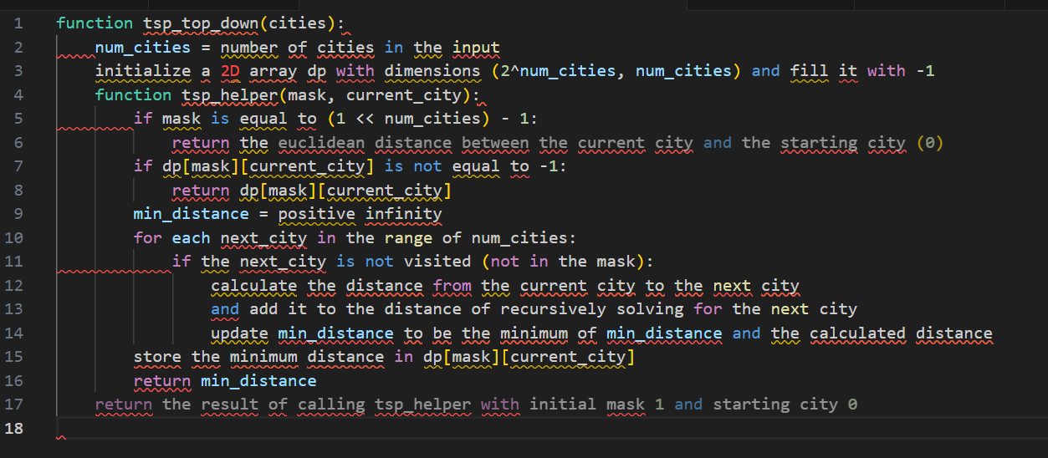
Psuedo Code

Slide 13
Time Complexity Analysis:
The time complexity arises from the following factors: 2n possible subsets of cities to consider.
For each subset, we need to consider n possible choices for the last city to visit.
Computing the cost for each choice involves visiting each city in the subset once, resulting in O(n) operations.
Big O Notation (O): O(2^n × N^2)
Omega Notation (Ω): Ω(2^n × N^2)
Theta Notation (Θ): Θ(2^n × N^2)

Slide 14
Algorithm Description - Bottom-Up Approach
Initialization: Initialize a 2D array dp of size 2n×n, where n is the number of cities. Initialize all entries of dp with infinity values, except for the base case where we set the distance from city 0 to city 0 as 0.
Base Case: Set dp[1 ≪ 0][0] = 0, where 1 ≪ 0 represents the binary representation of the set containing only city 0.
Subproblem Iteration: Iterate over all possible subset sizes s from 2 to n and over all subsets S of size s containing city 0. For each subset S and each destination city d in S: Compute the minimum cost of reaching city d from any city k in the subset S such that k != d. Update dp[S][d] with the minimum cost found.
Optimal Solution: After processing all subsets, the optimal solution is the minimum cost of reaching city 0 from any city d in the set of all cities excluding city 0. Iterate over all destination cities d and find the minimum value of dp[(1 ≪ n) − 1][d] + distance[d][0], where (1 ≪ n) − 1 represents the binary representation of the set containing all cities excluding city 0.
Return the minimum cost found in step 4, which represents the shortest tour that visits each city exactly once and returns to the starting city.

Slide 15
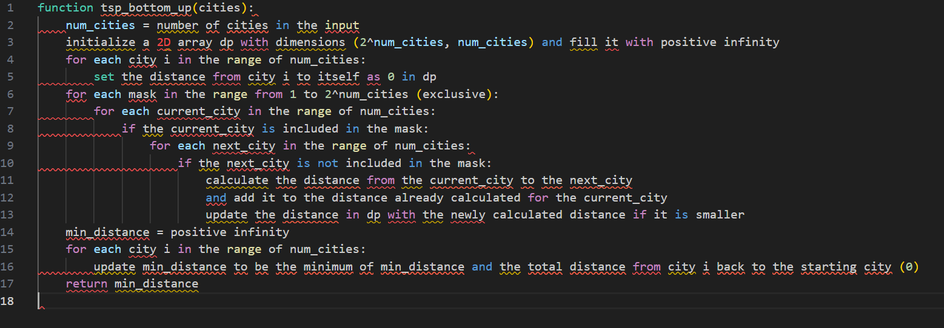
Psuedo Code

Slide 16
Time Complexity Analysis:
The time complexity arises from the following factors: 2n possible subsets of cities to consider.
For each subset, we need to consider n possible choices for the last city to visit.
Computing the cost for each choice involves visiting each city in the subset once, resulting in O(n) operations.
Big O Notation (O): O(2^n × N^2)
Omega Notation (Ω): Ω(2^n × N^2)
Theta Notation (Θ): Θ(2^n × N^2)

Slide 17
Results
The following table summarizes several exact algorithms to solve TSP:

Slide 18
Sensitivity Analysis
In the sensitivity analysis, execution times for Naive, Top-
Down DP, and Bottom-Up DP TSP algorithms are compared
across varying input sizes (10, 20, 50, 100). Results show the
scalability and performance trade-offs of each approach with
increasing city counts.

Slide 20
Algorithm | Time Complexity | Space Complexity | Performance
Naive Approach | O(n!) | O(n) | Poor, exponential growth
Top-Down Dynamic Programming | O(n^2 * 2^n) | O(n * 2^n) | Moderate, exponential growth
Bottom-Up Dynamic Programming | O(n^2 * 2^n) | O(n * 2^n) | Moderate, exponential growth

Slide 21
Conclusion
In general, all three algorithms have exponential time complexities, but the dynamic programming approaches (Top-Down and Bottom-Up) offer better performance compared to the Naive Approach. However, they require more memory space due to the need to store solutions to subproblems. Among the dynamic programming approaches, Bottom-Up DP is preferred over Top-Down DP due to its better efficiency and scalability.

