Slide 1
Breaking the Echo Chamber: A Hybrid Approach to Analyzing Bias in News Media
Gautam Gali
Yash Rathi
Seshadri Kakani

Slide 2
Agenda
Introduction
Methodology
Evaluation Metrics
Limitations
Related Work
End

Slide 3
Introduction

Slide 4
Why?
Neutrality
Nothing wrong with bias itself
Malicious intent

Slide 5
Types of bias
Linguistic bias
Text-level Context Bias’
Reporting-Level Context Bias
Cognitive Bias
Hate Speech
Racial Bias
Fake News
Gender Bias
Political Bias

Slide 6
Political Bias
text’s political leaning or ideology, potentially influencing the reader’s political opinion and, ultimately, their voting behavior (Huddy et al., 2023)[1] left leaning | center | right leaning left | | right
Granularity level
single sentence [2] [3]
article level [4] [5]

Slide 7
Methodology
Dataset building, LLM training

Slide 8
Dataset Creation
Independent organizations who rate media organizations on their bias
allsides.com
mediabiasfactcheck.com (MBFC)
Ad Fontes (paywalled)
We scrape the ratings of various media organizations and some articles for exemplifying the bias rating.
Selenium
Beautiful soup
MongoDB

Slide 9
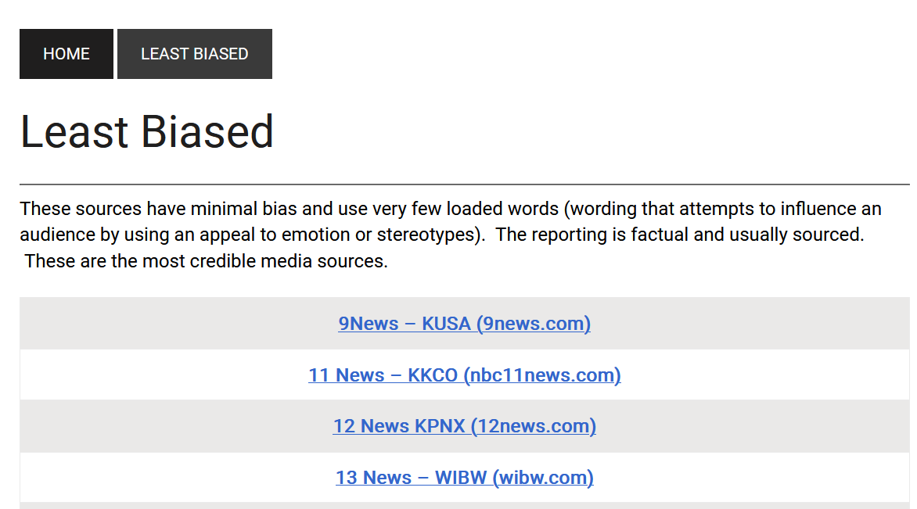
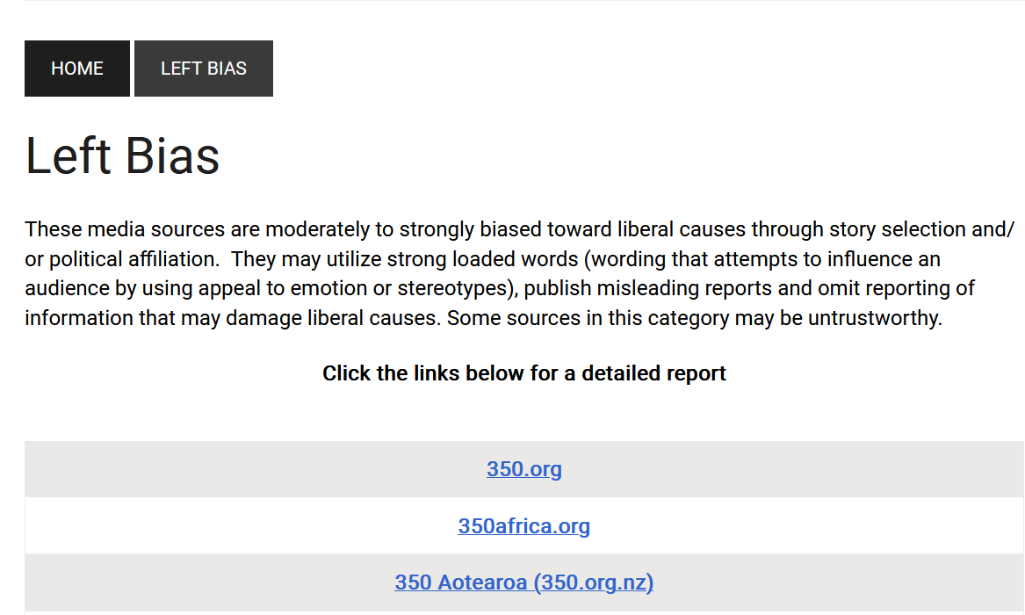
Dataset Creation

Slide 10
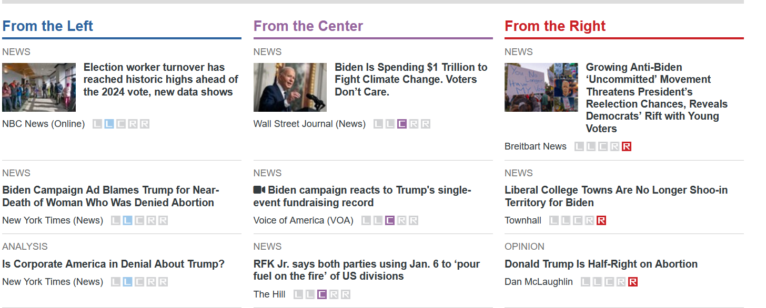
Dataset Creation
Manually curate the dataset for balanced representation of all bias labels.
Topic wise curation. For instance, topic of “elections 2024” will have total 50 articles (10 articles for each bias type)
Around 10 topics (~500 articles) custom dataset for fine-tuning LLM (more on this later).

Slide 11
LLMs for Political Bias detection
Generative abilities and generalization capabilities [6]
Excellent at classification tasks [6]
Can be fine-tuned for a specific task [7]
Emergent abilities with scale [8]
We leverage the abilities of LLMs to assist the humans by reducing the dependency on experts who are usually required for news bias labeling
Design prompt for generating bias label
Conduct a verification to get confidence score from LLM for generated label.

Slide 12
Finetuning LLMs for Political Bias detection
We make use of QLoRA, a efficient approach that allows finetuning in limited GPU memory [9]
Mistral 7b, Gemma 7b
Experiment with effect of quantization on finetune and inference and get most optimized model for faster bias detection. LLMs are resource intensive.
Mistral instruction format
"<s>[INST]
Identify the bias of the provided article – does it gives a balanced view of the topic or if it tends to favor one particular perspective. <actual article here. [/INST]“
“Left-leaning</s>”

Slide 13

Evaluation Metrics
We plan to use Media Bias Identification Benchmark Task and Dataset Collection (MBIB) by Wessel et al., 2023 [10] for a comprehensive benchmark to evaluate our system’s capabilities.
According to MBIB, for evaluating political bias indication capabilities of a technique following tasks and datasets are recommended –

Slide 14
Evaluation Metrics
F-1 score is primary performance metric.
The micro average 𝐹1-score: One 𝐹1-score is calculated on the predictions of a model on the entire test set.
The macro average 𝐹1-score: Multiple 𝐹1-scores are calculated on the predictions of a model on the test set. One 𝐹1-score is calculated individually for every dataset
Reasoning behind the “why” and “how” of metrics can be explored in more detail in MBIB paper.

Slide 15
Related Work

Slide 16
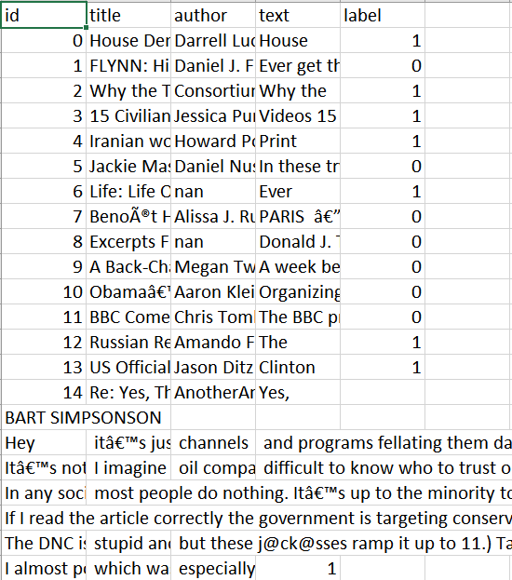
Data
⧫ Dataset source - Kaggle
⧫ ID, Title, Author, Text, Label
⧫ Label 1 - Unreliable
⧫ Label 0 - Reliable

Slide 17
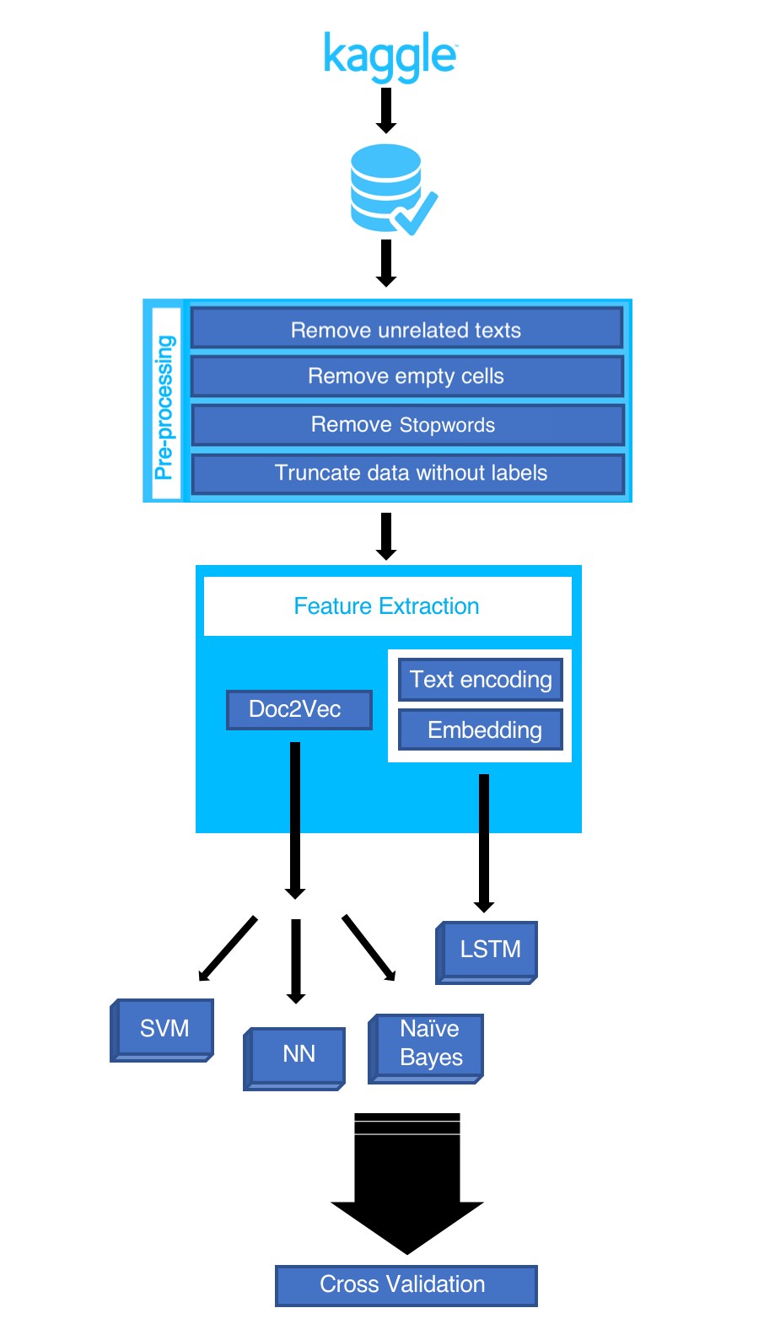
Workflow

Slide 18
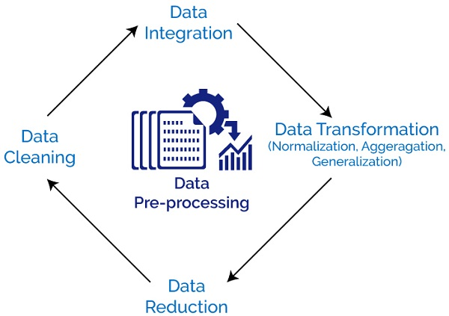
Data Preprocessing
Perform various text cleaning steps (remove all non-alphanumeric characters, delete stopwords, delete missing rows, etc.)
For Doc2Vec, convert to LabeledSentences(), comma separated word format

Slide 19
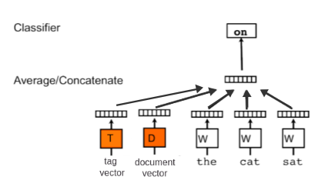
Doc2Vec Model
⧫ Based on Word2Vec model
⧫ Preserves word order information
⧫ Extracts Word2Vec features and adds an additional “document vector” with information about the entire document

Slide 20
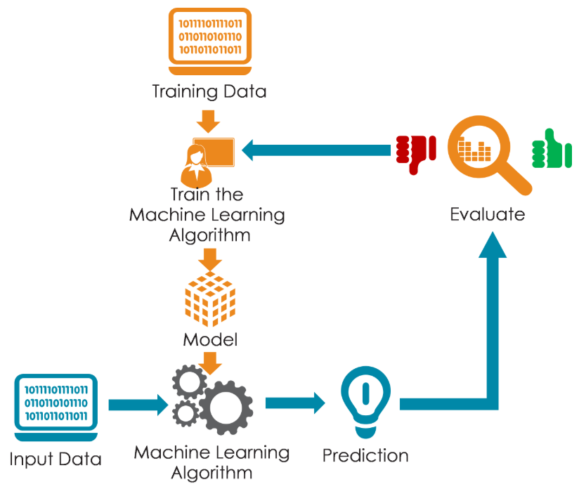
Training a Model
⧫ Models used-
Naive Bayes
Support Vector Machine (SVM)
Neural Network
Long Short-Term Memory (LSTM)

Slide 21
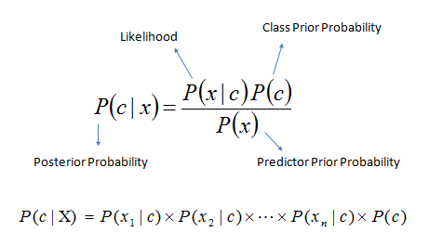
Naive Bayes
⧫ Classification technique based on Bayes’ theorem with an assumption of independence among predictors
1. Convert data set into a frequency table
2. Create likelihood table by finding probabilities
3. Use Naive Bayesian equation to calculate posterior probability for each class

Slide 22
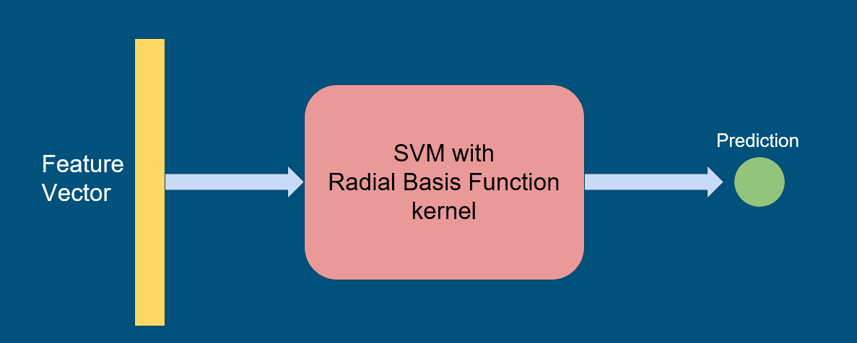
Support Vector Machine (SVM)

Slide 23
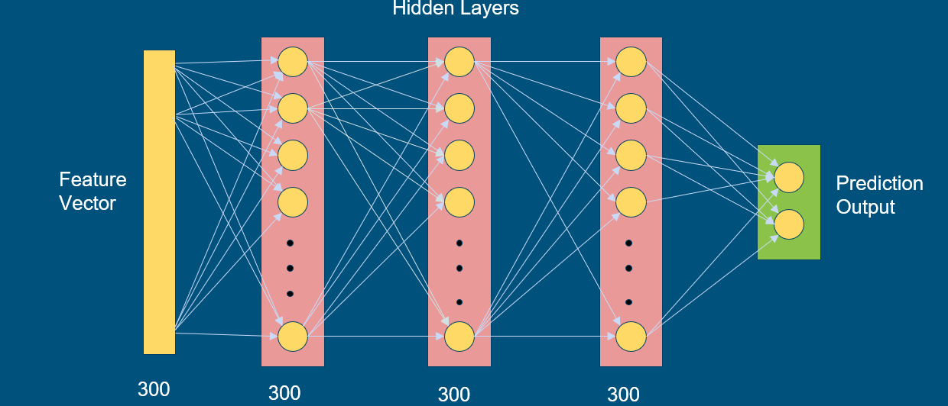
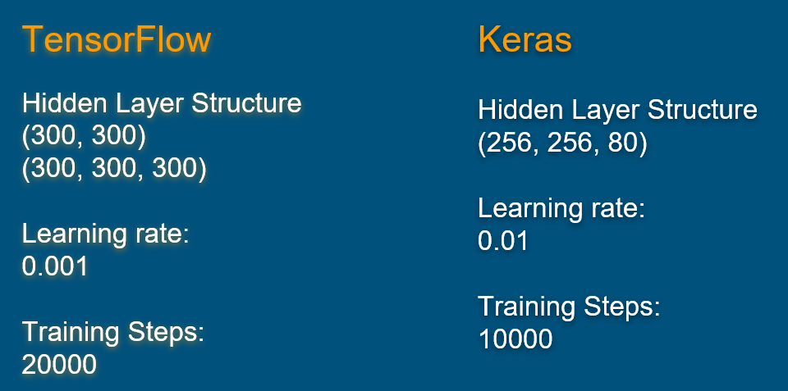
Neural Network

Slide 24
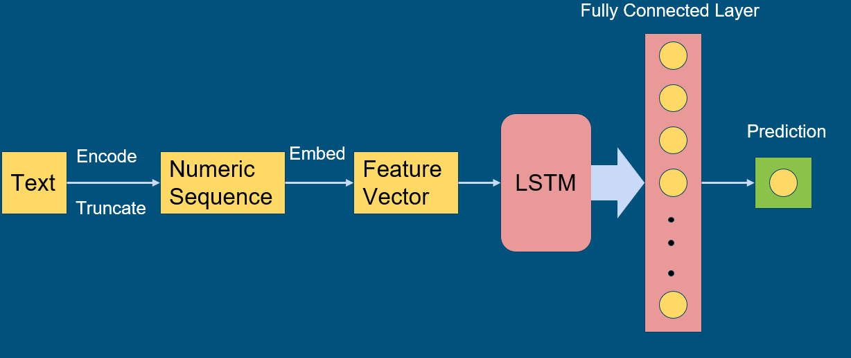
LSTM

Slide 25
Comparison of Models
Model | Accuracy
Naive Bayes | 83.84%
SVM | 94.07%
Neural Network using TensorFlow | 92.7%
Neural Network using Keras | 88.71%%
LSTM | 93.57%

Slide 26
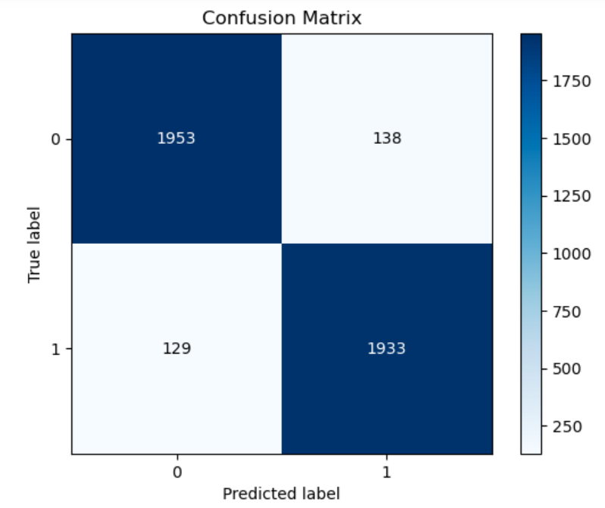
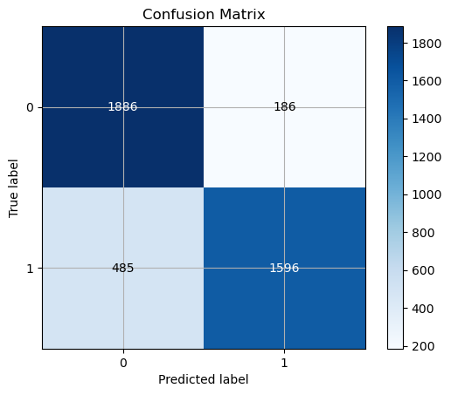
Confusion Matrices
Naïve Bayes
LSTM

Slide 27
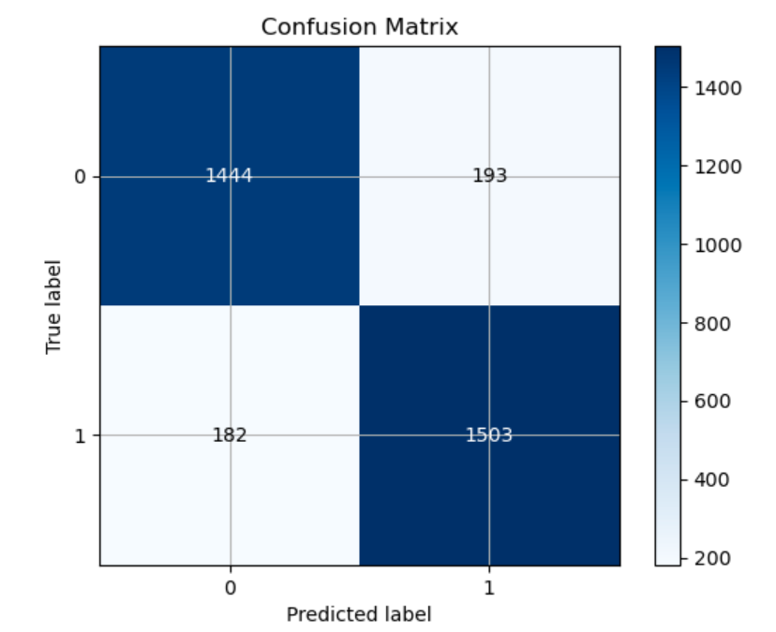
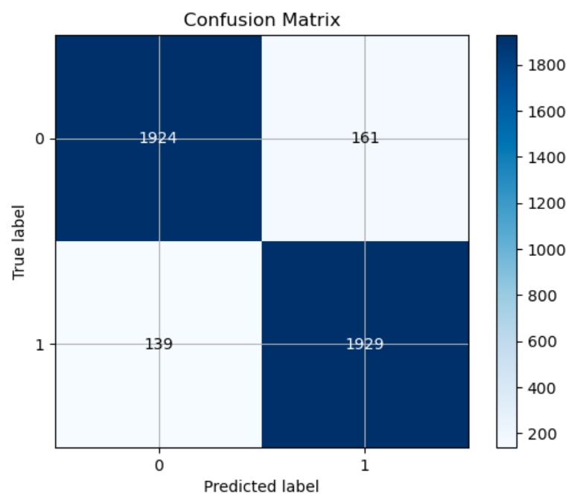
Confusion Matrices
Neural Network using Tensorflow
Neural Network using Keras

Slide 28
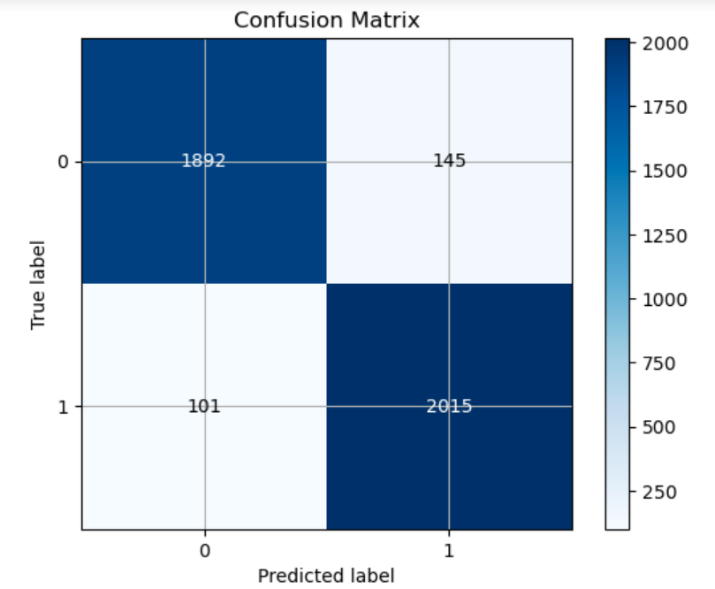
Confusion Matrices
SVM

Slide 29
Thank you

Slide 30
References

