Slide 1
An intelligent chronic disease management system to identify high risk CVD patients and provide suggestions
Powered by RWD/RWE and AI

Slide 2
Project roadmap and scope of each phase
MVP/PoC
Phase-I
Phase-II
start
EHR: demographics, diagnosis, clinical notes
EHR: prescriptions, laboratory tests
Domain DB: Biomarker, ICD-10, MeSH
EHR:medical imaging, pathologic reports
NLP: NER, Tagging, embedding, relationships
Data Labeling actions
Omics: genomics, proteomics, metabolomics
CVD patient prediction
BERT: BlueBERT, SciBERT,
Biometric data: wearable devices, life-style
Publications
LR, RF, SVM, AdaBoost
Drugbank
Data
2020-10
|
2021-06
Find significant risk factors
Doctor
NLP: pre-trained models for CVD
Measuring Patient Similarities
Researcher
Prediction: ensemble ML-models
Treatment recommendations
Patients
2021-06
|
2022-08
Physicians
Knowledge Graph
Nurses
Precision medicine
New biomarkers suggestion
Hospital
Model
Combination drugs suggestion
Pharma
2022-08
|
2023-10
Biotech
Health care provider
Drug Development: new indications
clinical trial recruitment
CFDA
More Chronic Diseases
Function
Customer

Slide 3
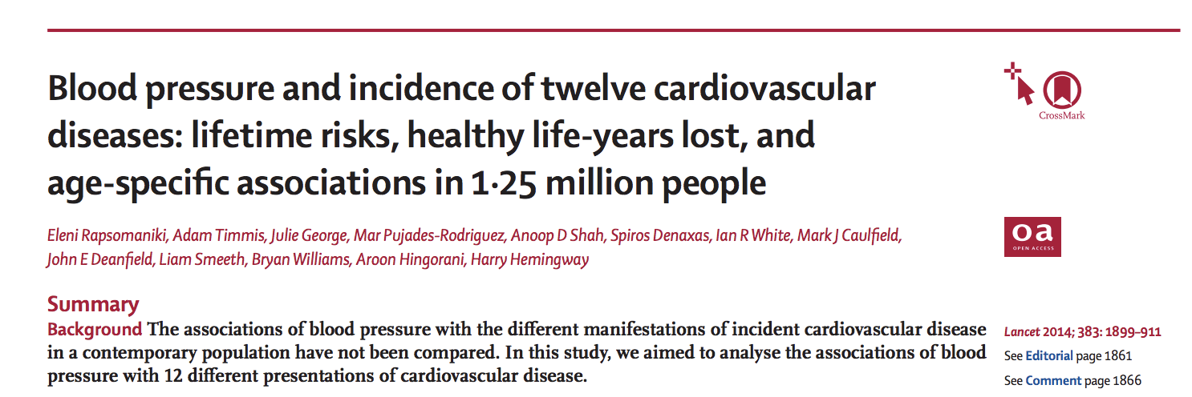
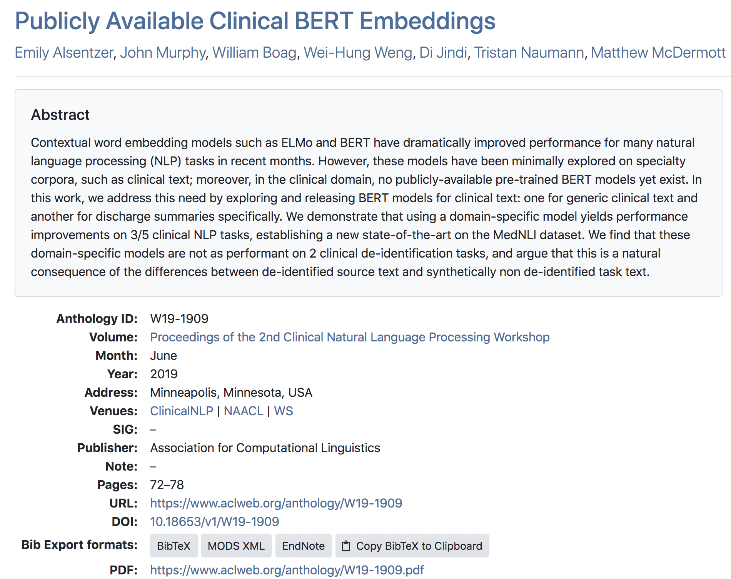
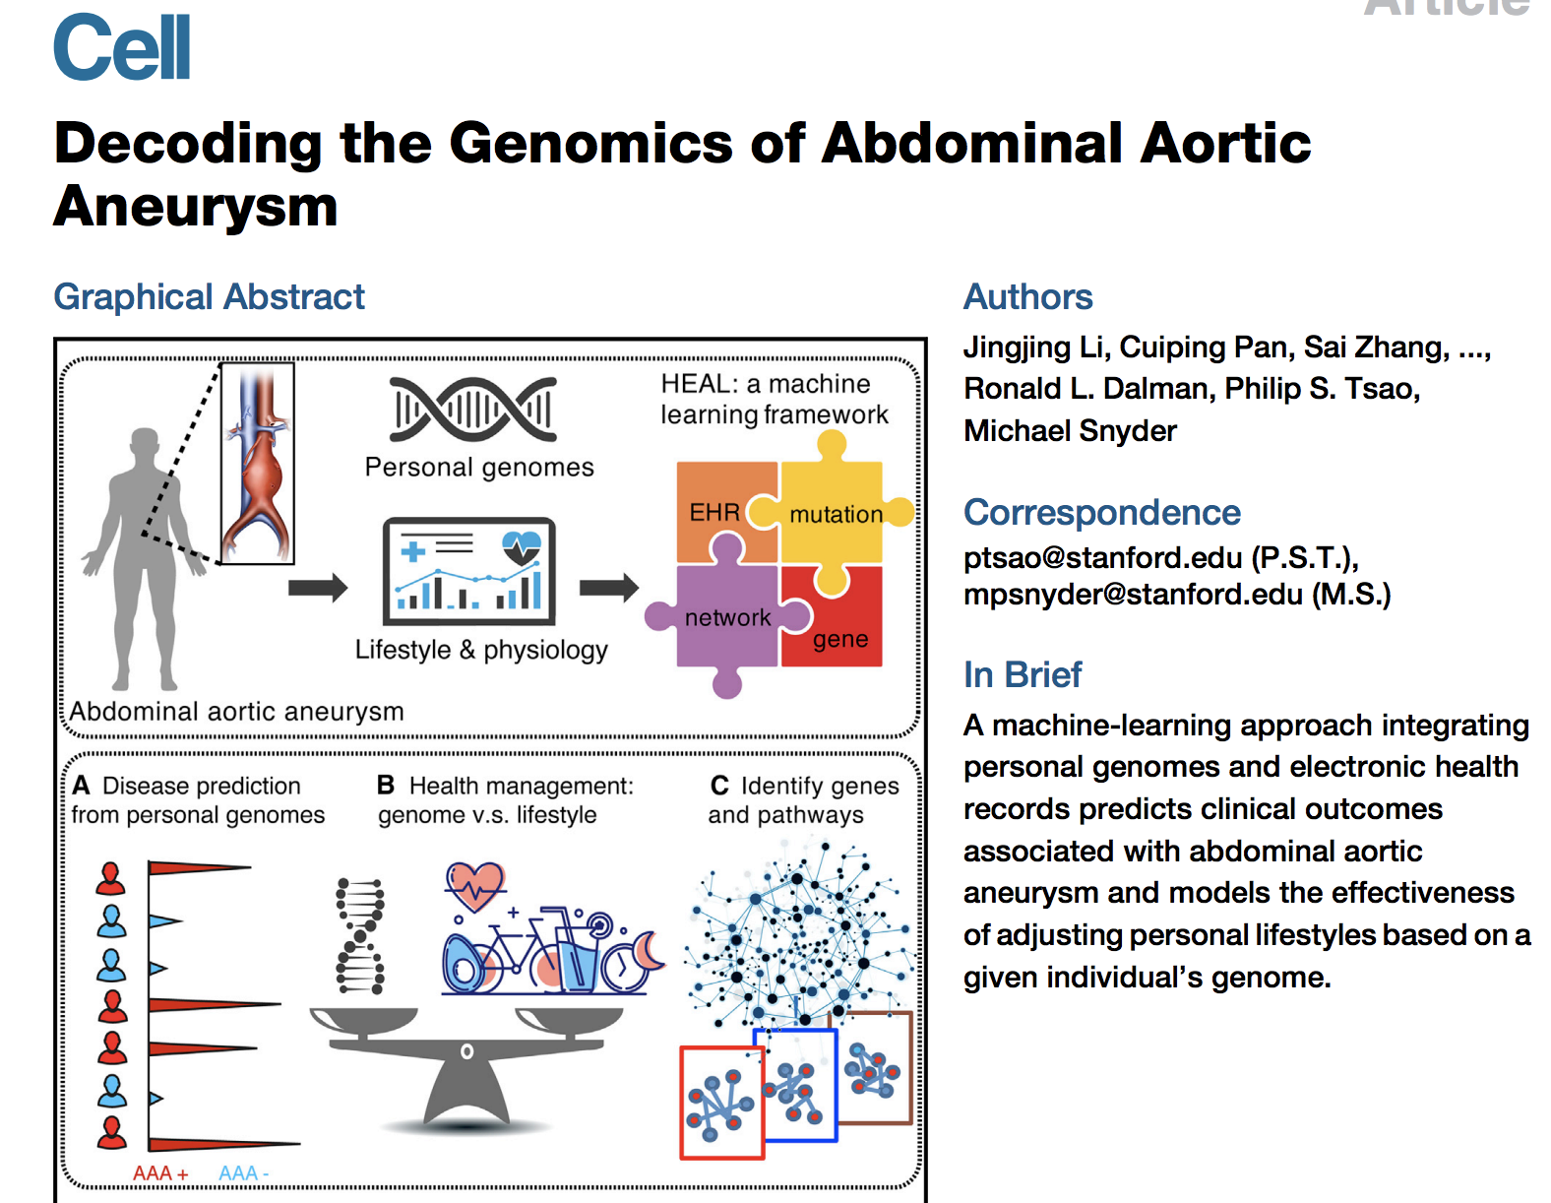
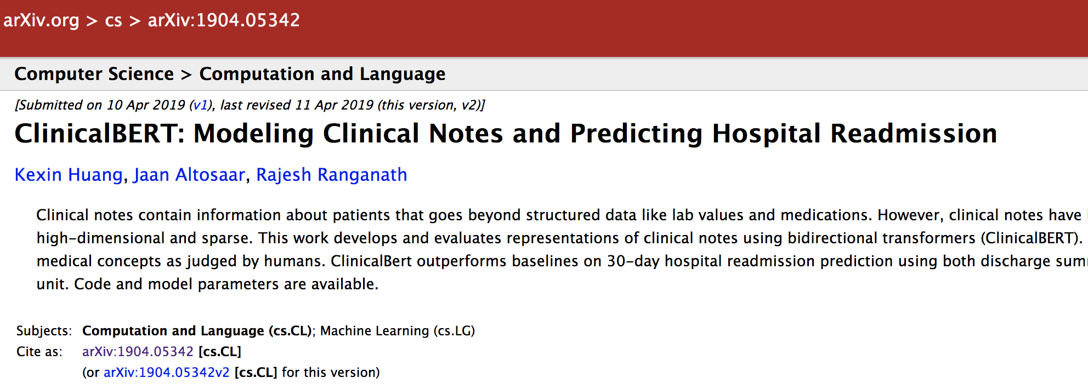
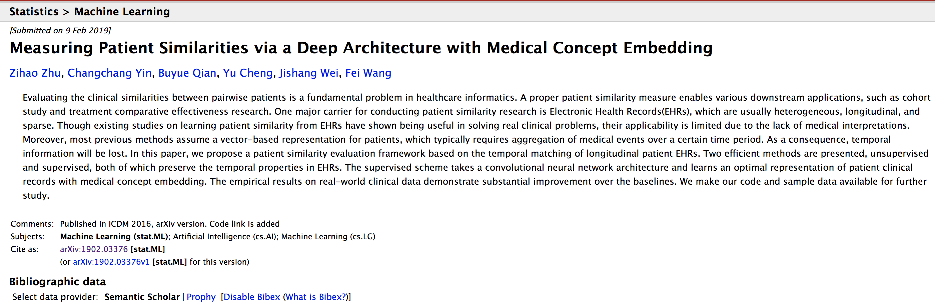
Background and some Reference
EHR Data
risk factors based large-scale statistics
BERT-based contextual word embedding models for EHR
genomics + EHR
patient similarities by EHR embedding

Slide 4
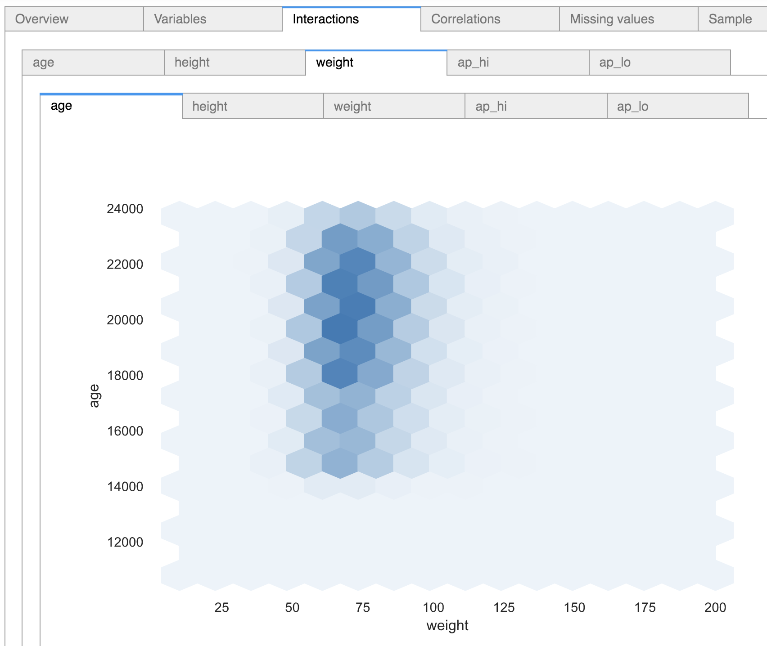
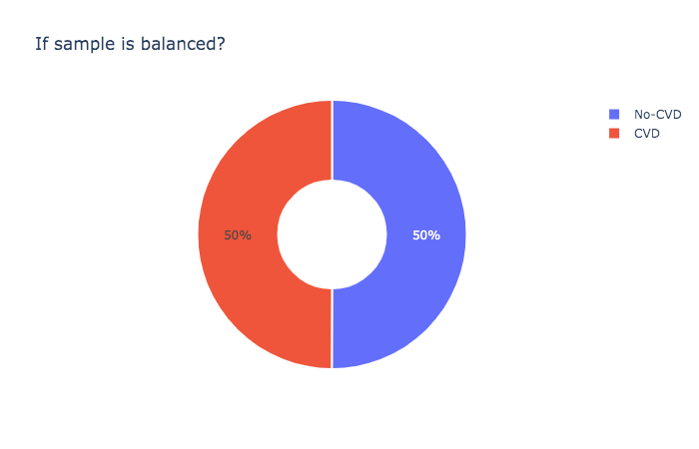
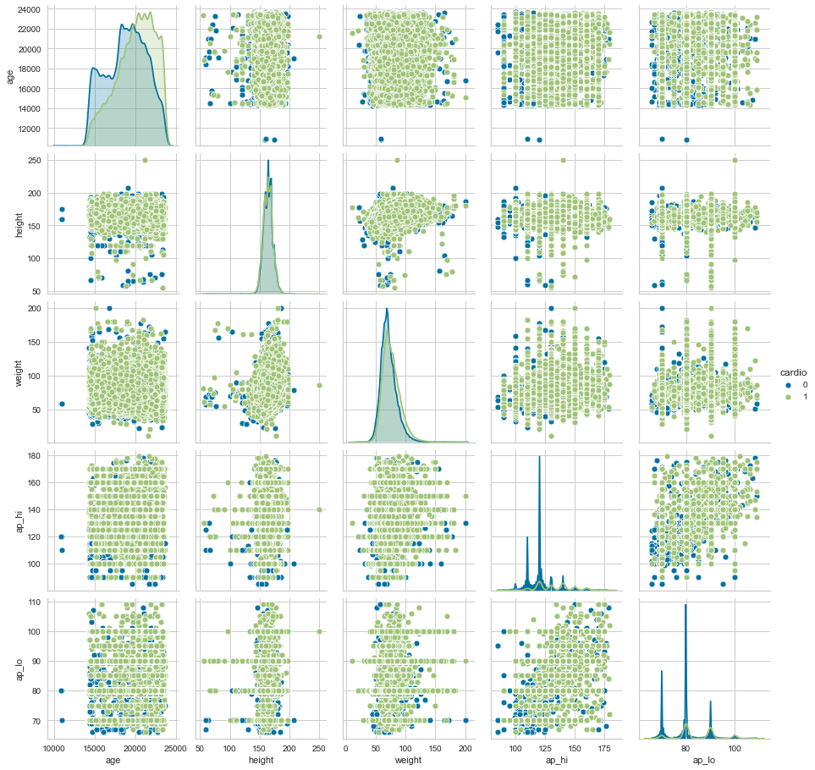
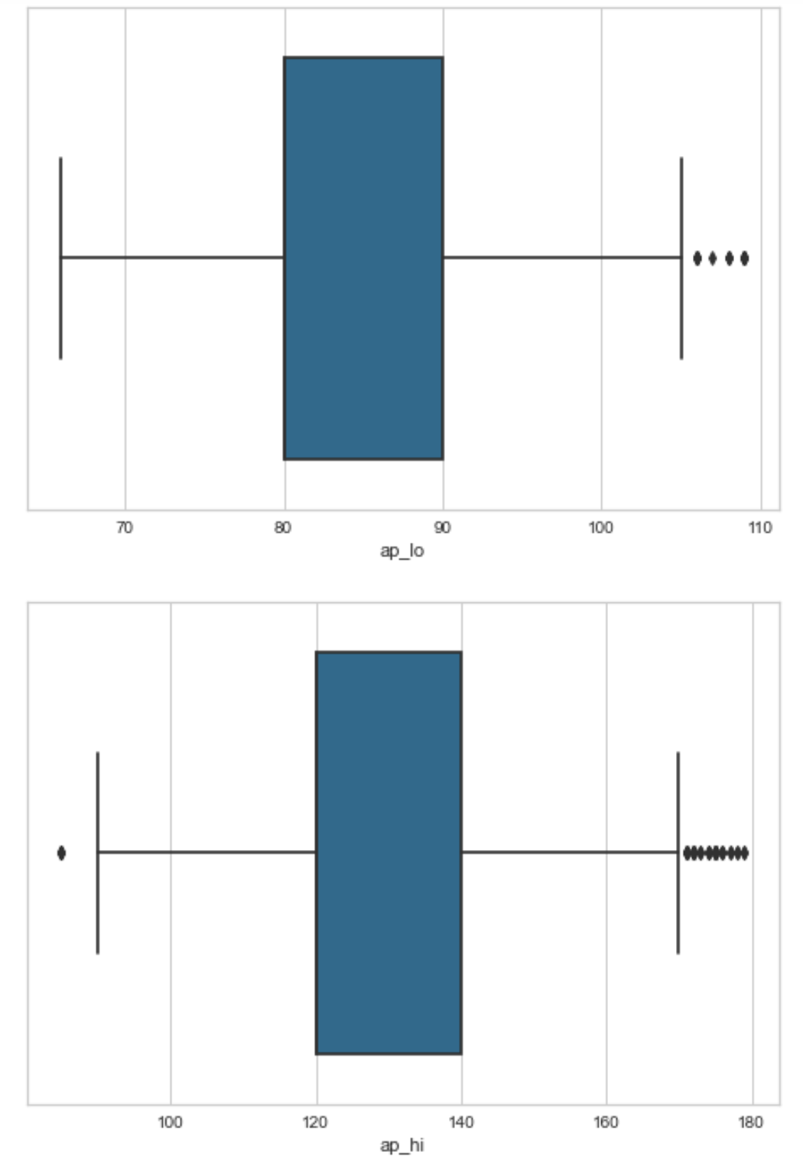
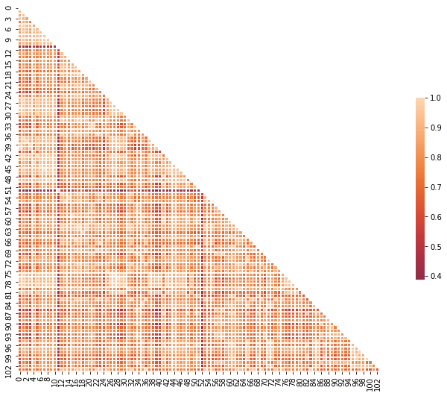

RWD processing workflow
More details and analysis can be found from the Notebook which used some EHR demo data to show the overall ideas.
structured data
Data Labeling
EDA
Feature Engineering
Model training/evaluation
EHR data
Domain Knowledge Base
Text data
Pre-trained Model
(BioBERT, BlueBERT, Scispacy, Transformer-XL)
NER
Structured Data
(Entity, Tag, word-vector, etc.)
Fine Tunning
Sentence Embedding
Patient ID
Patients Similarity

Slide 5
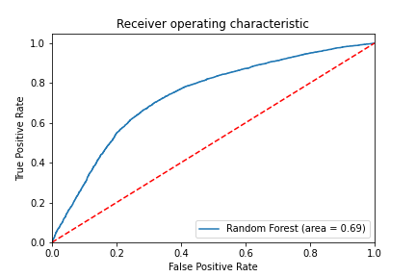
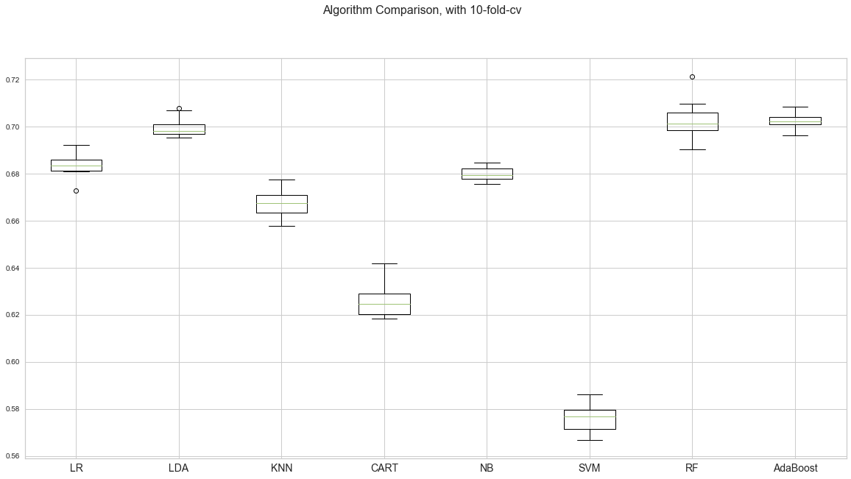
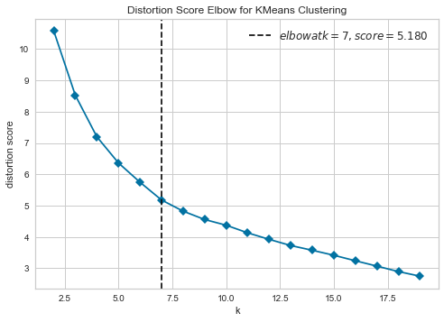
Model Performance Demo
Mode evaluation
Algorithms Selection
Clustering k Selection

Slide 6
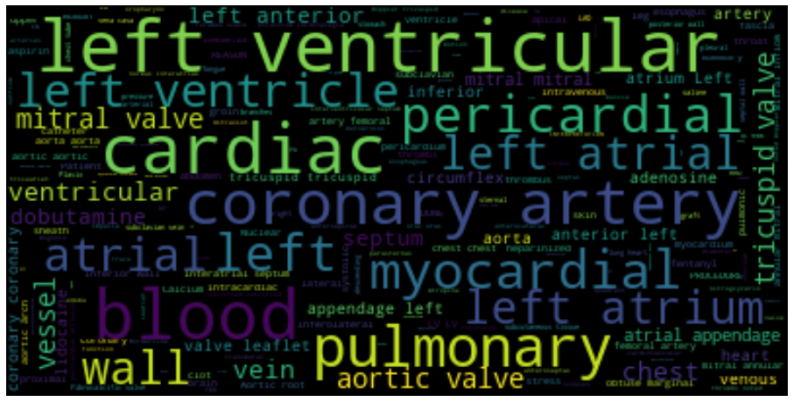
Word-cloud for potential factors by NLP

Slide 7
Predicting Service Demo
To be finish...
Thank you for your time

