Slide 1
FEM with DNN

Slide 2
13.10.2026

Slide 3
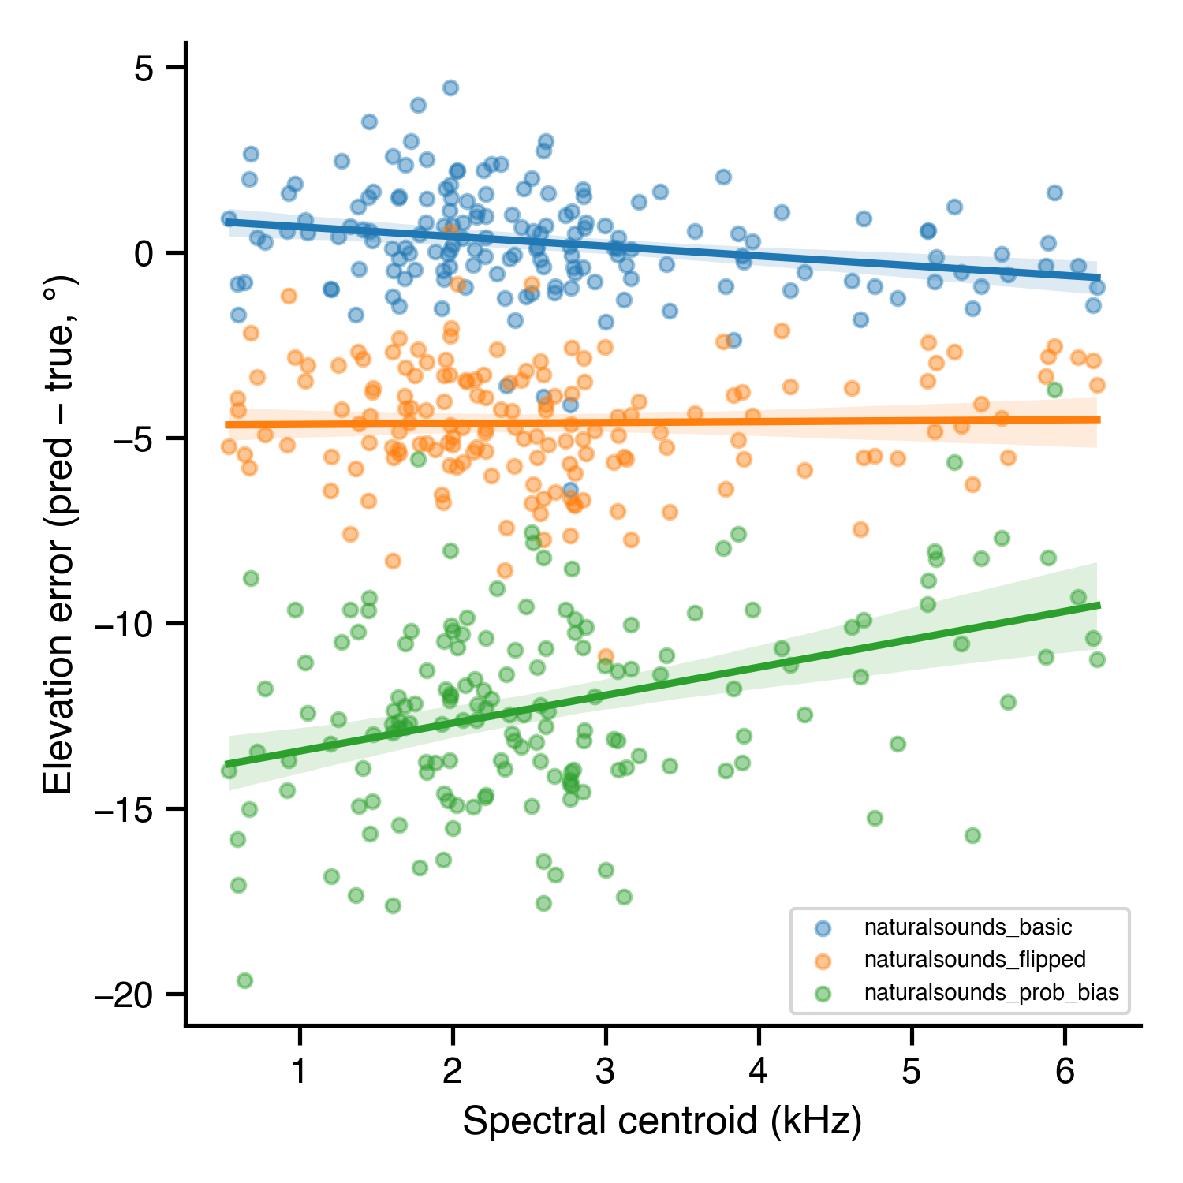
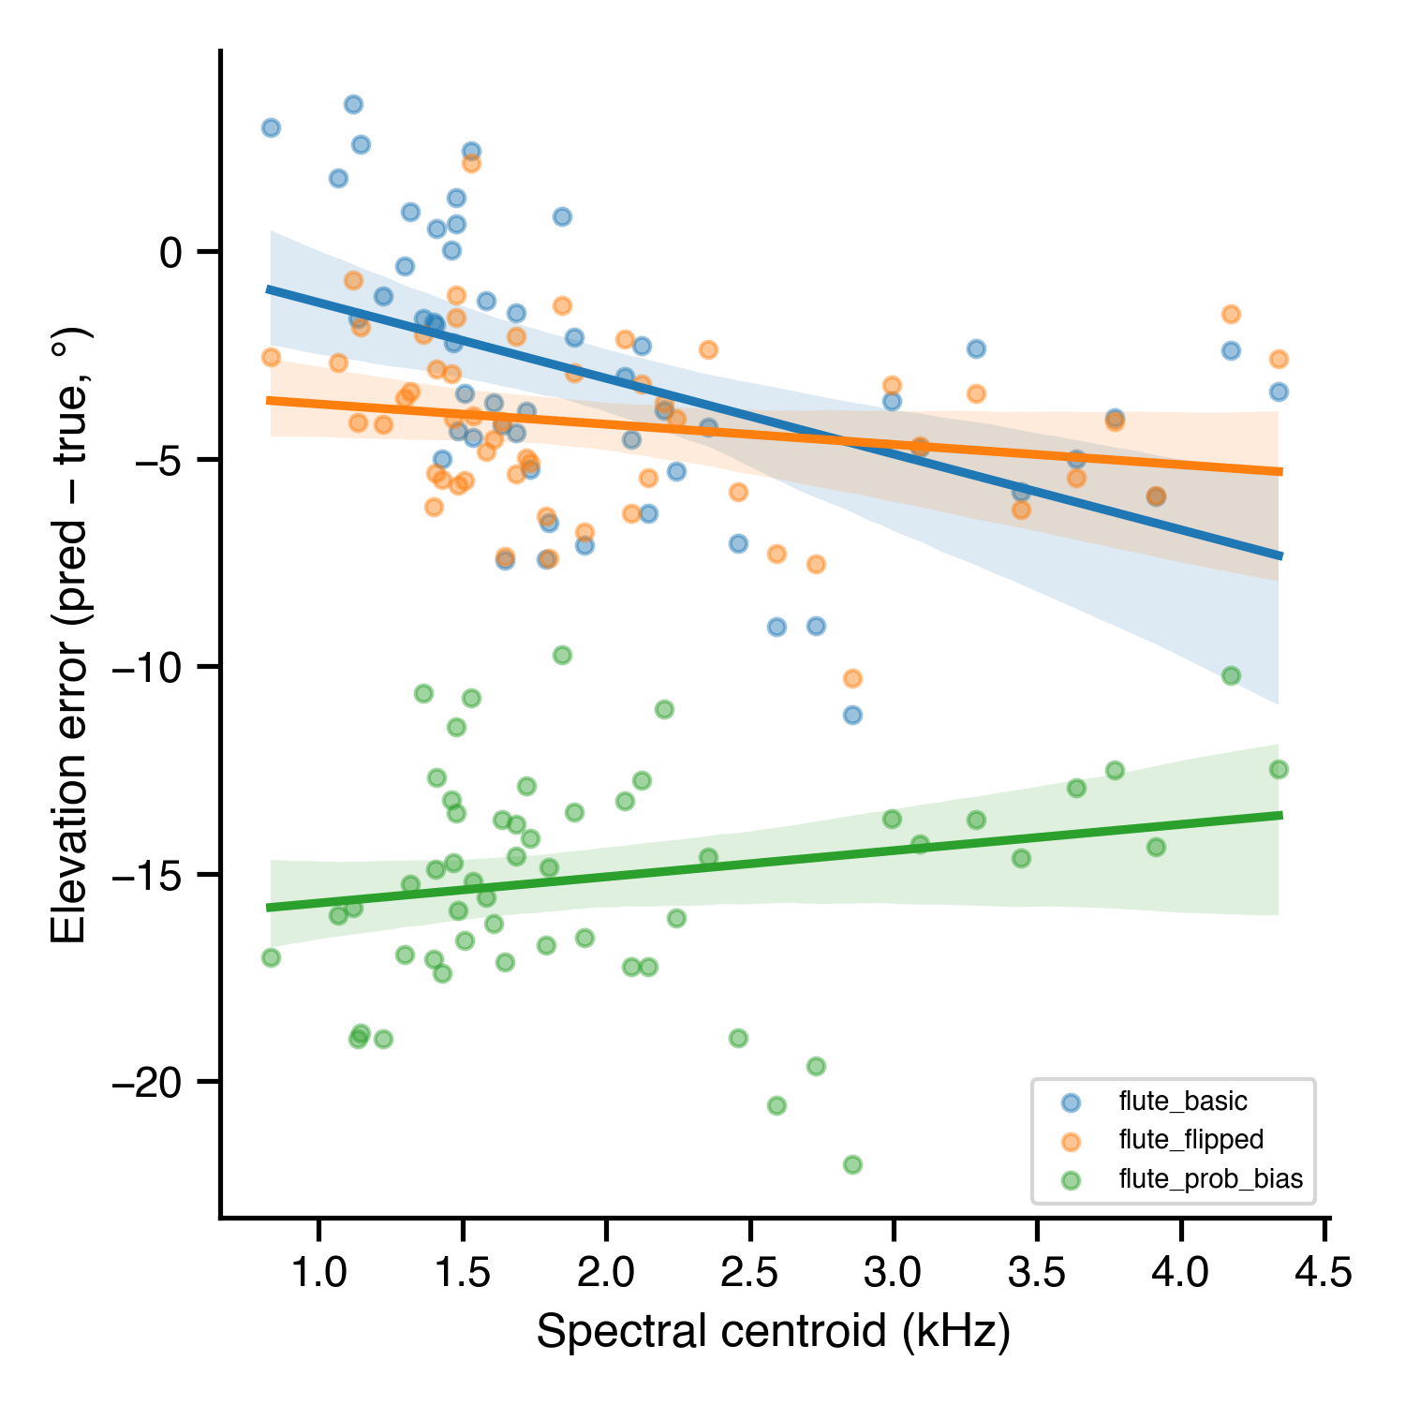
natural sounds
flute
Correlation between centroid and elevation difference:
naturalsounds_basic: r = -0.235, p = 0.00233
naturalsounds_flipped: r = 0.020, p = 0.796
naturalsounds_prob_bias: r = 0.380, p = 4.96e-07
Correlation between centroid and elevation difference:
flute_basic: r = -0.479, p = 0.000245
flute_flipped: r = -0.194, p = 0.161
flute_prob_bias: r = 0.202, p = 0.143

Slide 4
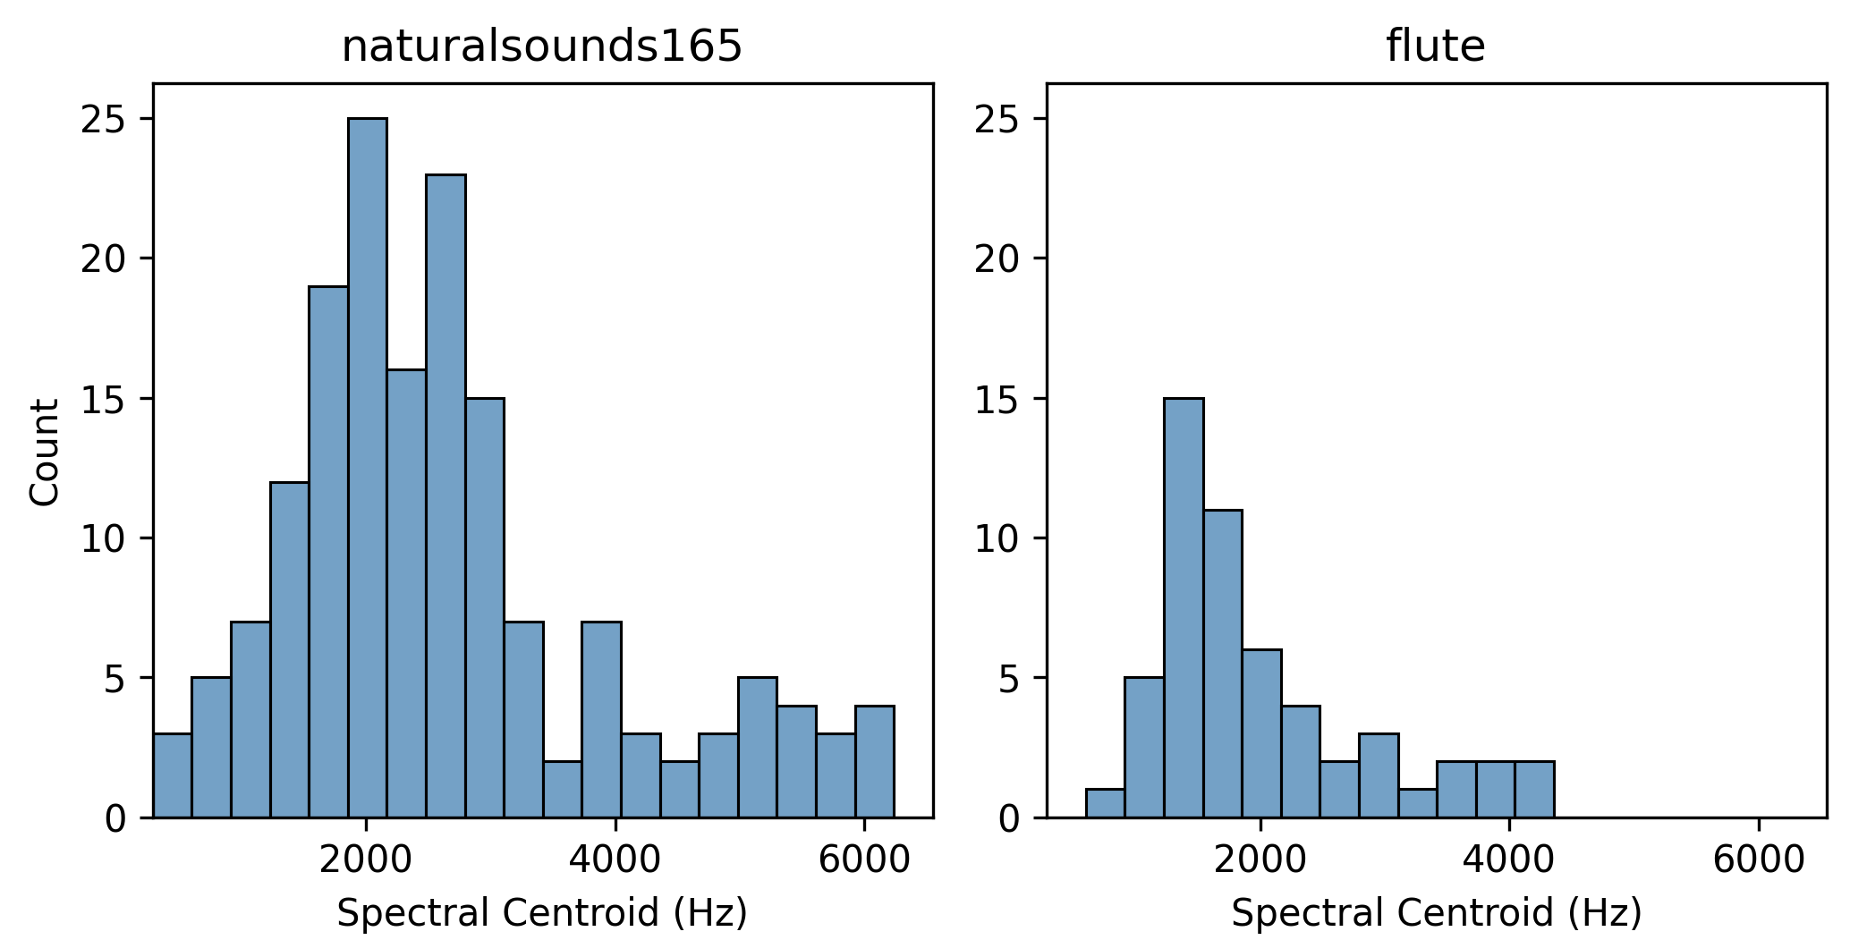

Slide 5
