Slide 1
Python OOP
Manoj Joshi

Slide 2
Python is a multi-paradigm programming language. It supports different programming approaches.
One of the popular approaches to solve a programming problem is by creating objects. This is known as Object-Oriented Programming (OOP).
An object has two characteristics:
attributes
behavior

Slide 3
A parrot is an object, as it has the following properties:
name, age, color as attributes
singing, dancing as behavior
The concept of OOP in Python focuses on creating reusable code. This concept is also known as DRY (Don't Repeat Yourself).

Slide 4
Dunder or magic methods in Python
Dunder or magic methods in Python are the methods having two prefix and suffix underscores in the method name.
Dunder here means “Double Under (Underscores)”.
These are commonly used for operator overloading. Few examples for magic methods are: __init__, __len__, __repr__ etc.
A __repr__ method is used to represent an object, __init__ method runs when object is created, __len__ method return length of object.

Slide 5
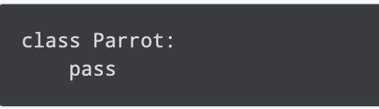
Class
A class is a blueprint for the object.
We can think of class as a sketch of a parrot with labels. It contains all the details about the name, colors, size etc. Based on these descriptions, we can study about the parrot. Here, a parrot is an object.
we use the class keyword to define an empty class Parrot. From class, we construct instances. An instance is a specific object created from a particular class.

Slide 6
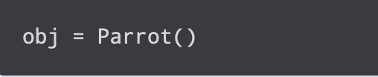
Object
An object (instance) is an instantiation of a class. When class is defined, only the description for the object is defined. Therefore, no memory or storage is allocated.
Here, obj is an object of class Parrot
Suppose we have details of parrots. Now, we are going to show how to build the class and objects of parrots.

Slide 7
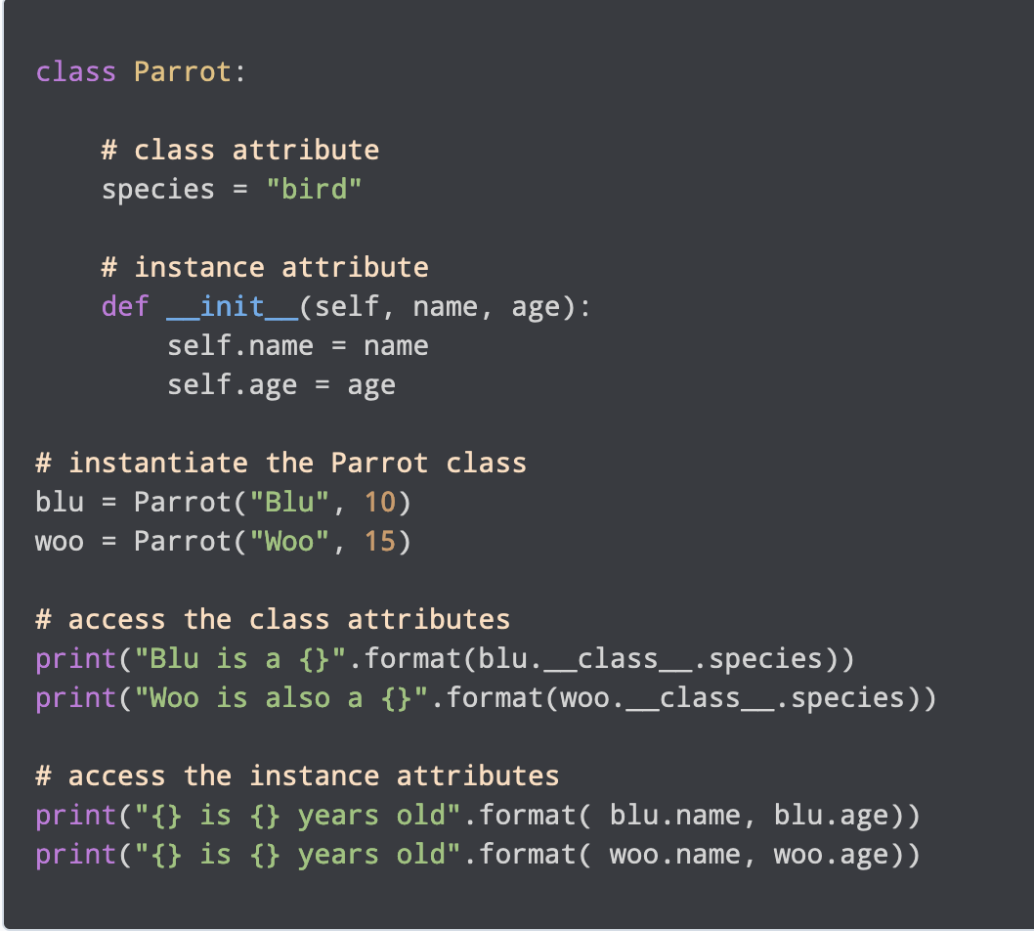
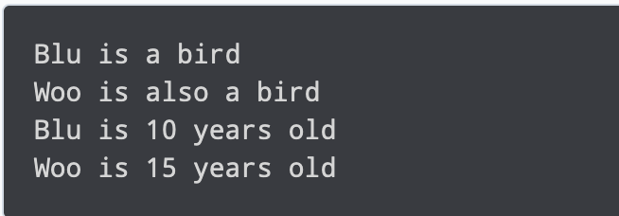
Creating Class and Object in Python
Output:

Slide 8
Attributes are defined inside the __init__ method of the class. It is the initializer method that is first run as soon as the object is created.
Then, we create instances of the Parrot class. Here, blu and woo are references (value) to our new objects.
We can access the class attribute using __class__.species. Class attributes are the same for all instances of a class.
we access the instance attributes using blu.name and blu.age
instance attributes are different for every instance of a class.

Slide 9
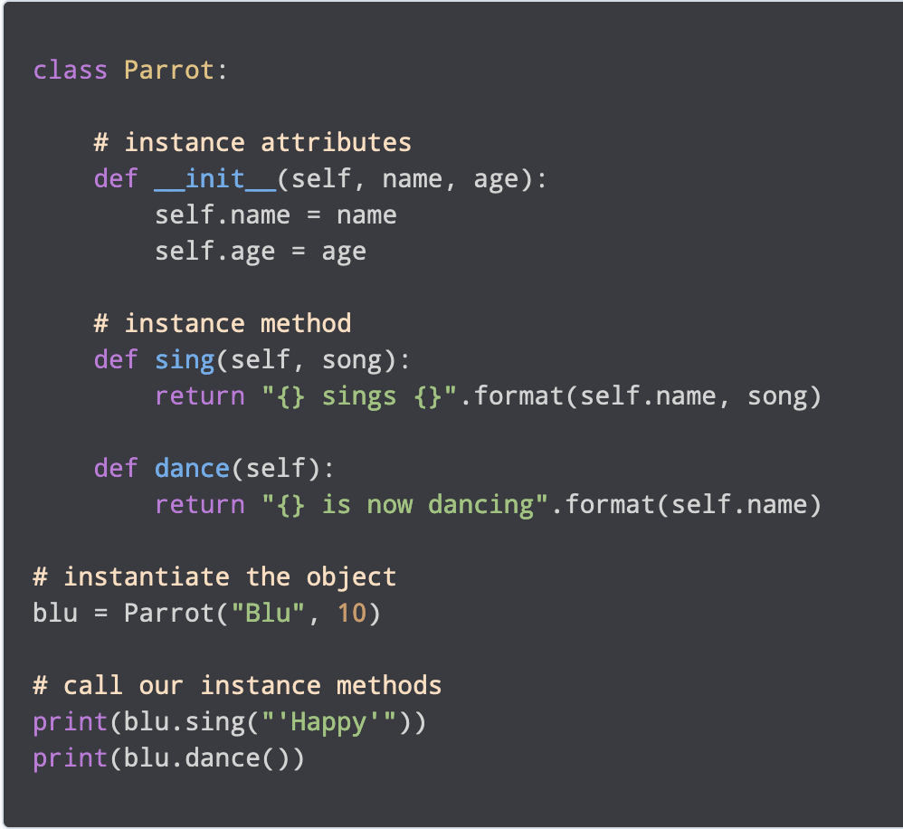

Methods
Methods are functions defined inside the body of a class. They are used to define the behaviors of an object.
Output:
We define two methods i.e sing() and dance(). These are called instance methods because they are called on an instance object i.e blu.

Slide 10
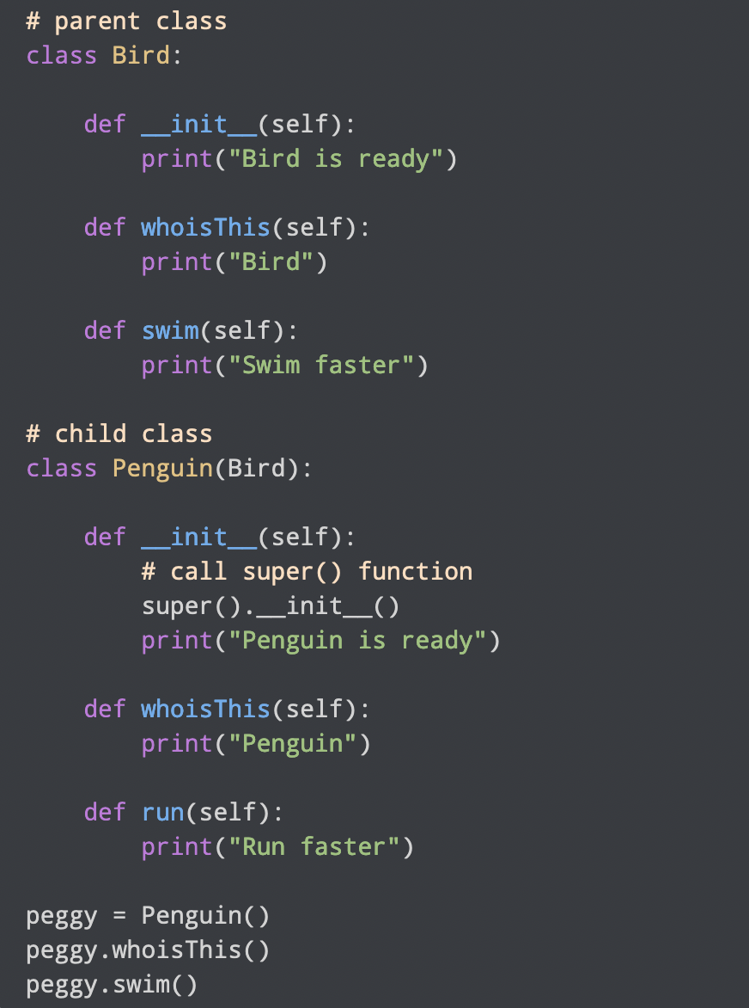
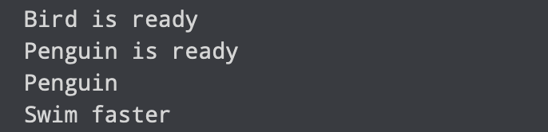
Inheritance
Inheritance is a way of creating a new class for using details of an existing class without modifying it.
The newly formed class is a derived class (or child class).
The existing class is a base class (or parent class).
OUTPUT:

Slide 11
We created two classes i.e. Bird (parent class) and Penguin (child class).
The child class inherits the functions of parent class. We can see this from the swim() method.
Again, the child class modified the behavior of the parent class. We can see this from the whoisThis() method
we use the super() function inside the __init__() method. This allows us to run the __init__() method of the parent class inside the child class.

Slide 12
Encapsulation
Using OOP in Python, we can restrict access to methods and variables.
This prevents data from direct modification which is called encapsulation.
In Python, we denote private attributes using underscore as the prefix i.e single _ or double __.

Slide 13
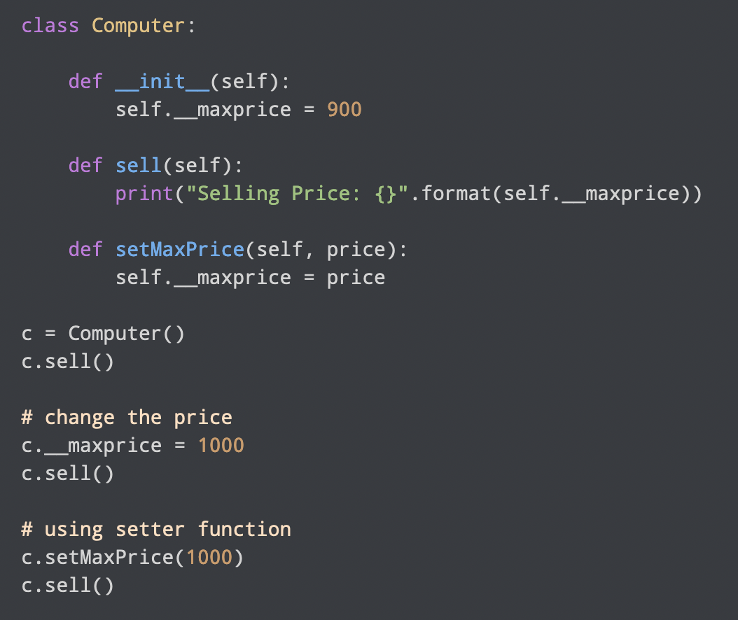
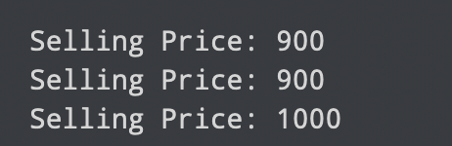
we defined a Computer class.
We used __init__() method to store the maximum selling price of Computer.
NOTICE: c.__maxprice = 1000
Here, we have tried to modify the value of __maxprice outside of the class. However, since __maxprice is a private variable, this modification is not seen on the output.
To change the value, we have to use a setter function i.e setMaxPrice() which takes price as a parameter.
OUTPUT:

Slide 14
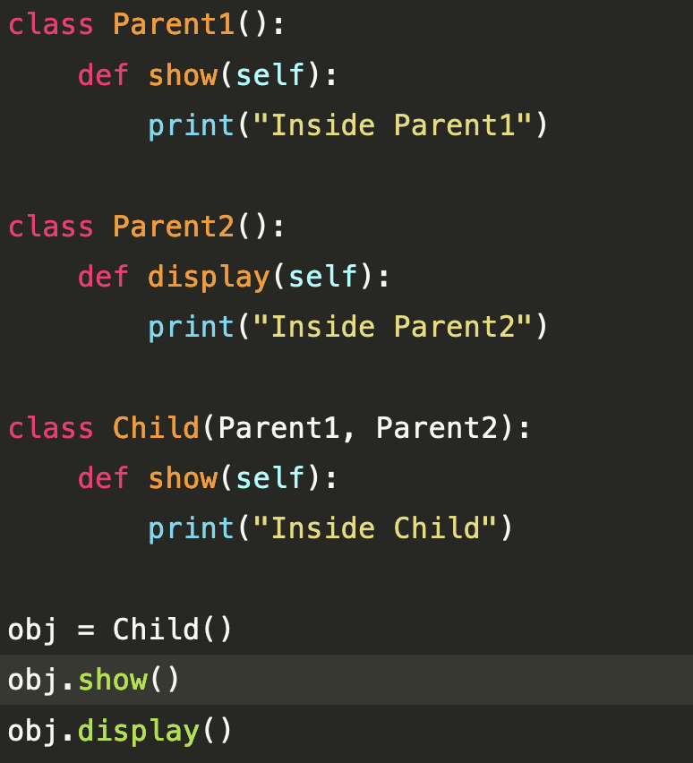
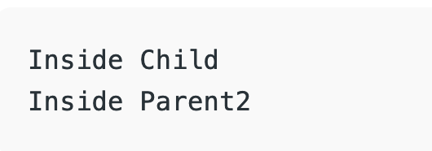
Method overriding with multiple and multilevel inheritance Multiple Inheritance:
When a class is derived from more than one base class it is called multiple Inheritance.

Slide 15
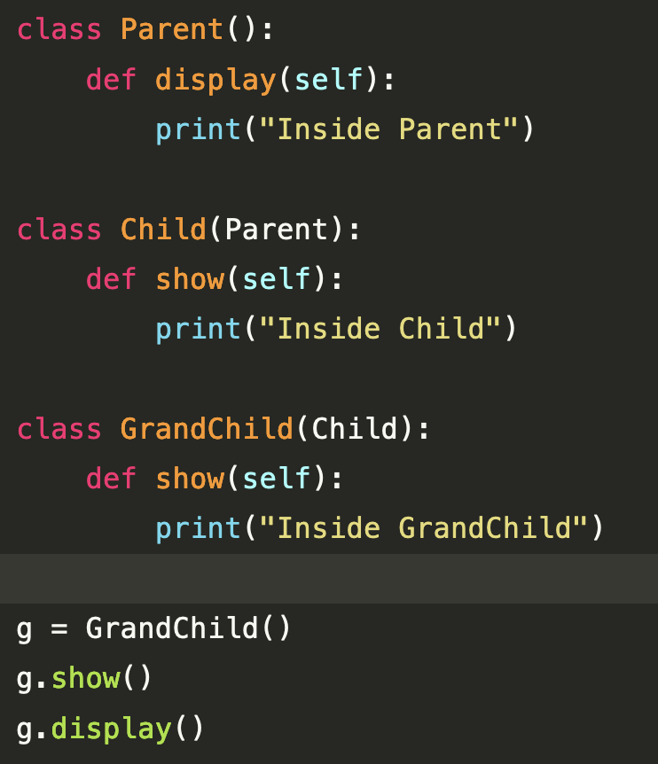
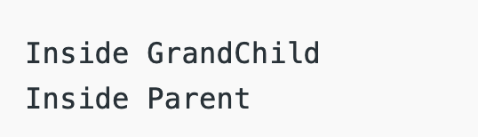
Multilevel Inheritance:
When we have a child and grandchild relationship.

Slide 16
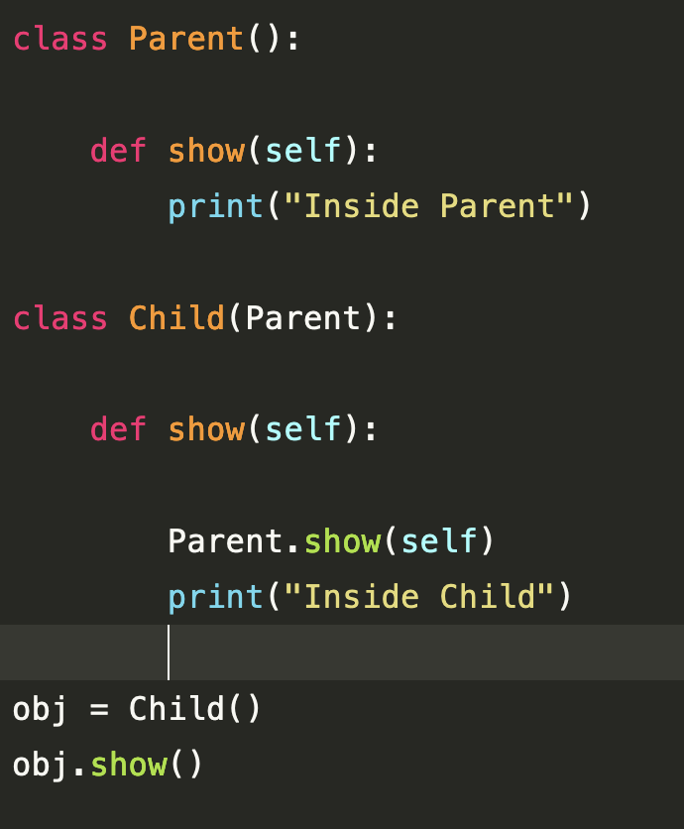
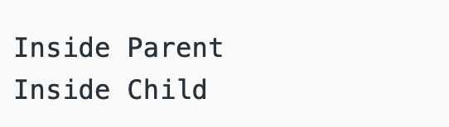
Calling the Parent’s method within the overridden method
Using Classname: Parent’s class methods can be called by using the Parent classname.method inside the overridden method.

Slide 17
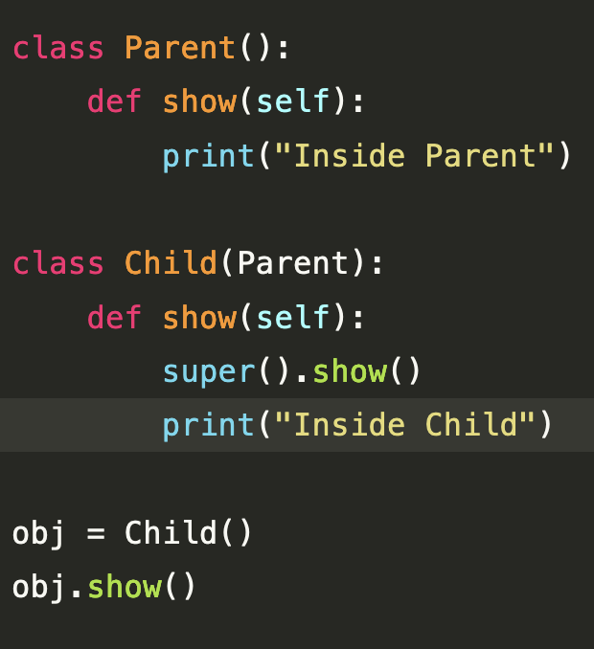
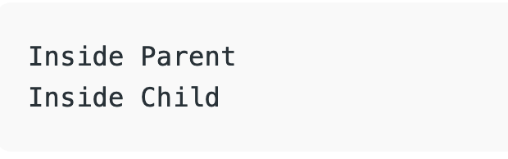
Using Super(): Python super() function provides us the facility to refer to the parent class explicitly. It is basically useful where we have to call superclass functions. It returns the proxy object that allows us to refer parent class by ‘super’.

Slide 18
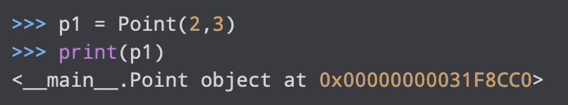
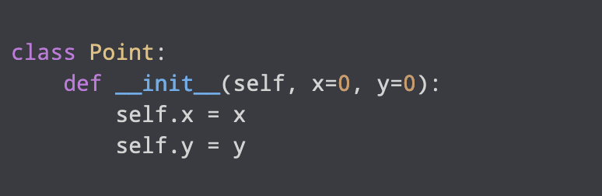
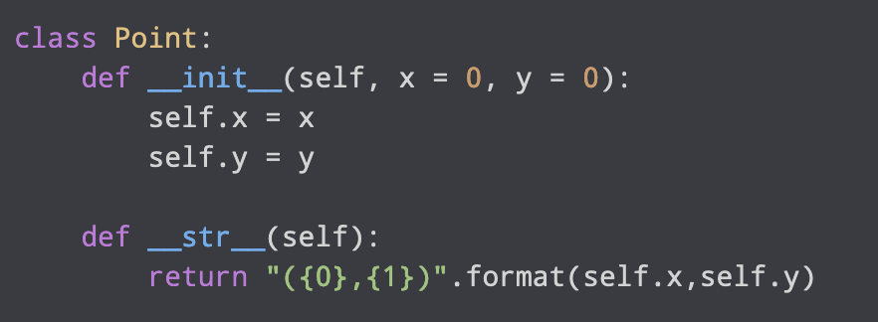
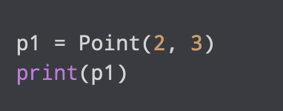
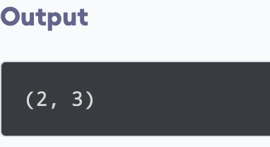
Python Special Functions
Suppose we want the print() function to print the
coordinates of the Point object instead of what we got.

Slide 19
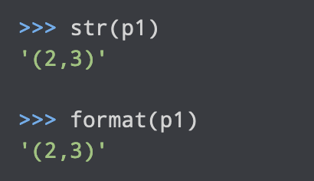
This same method is invoked when we use the built-in function str() or format()
So, when you use str(p1) or format(p1), Python internally calls the p1.__str__() method. Hence the name, special functions.

