Slide 1
CSS/Bootstrap/HTML
Manoj Joshi

Slide 2
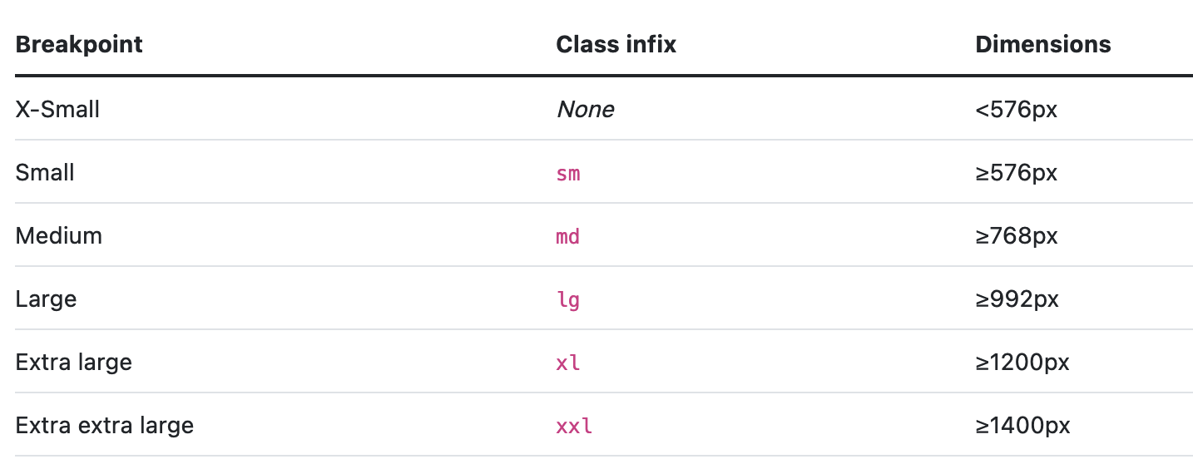
Breakpoints
Breakpoints are customizable widths that determine how your responsive layout behaves across device or viewport sizes in Bootstrap.

Slide 3
Media queries
Bootstrap is developed to be mobile first, we use a handful of media queries to create sensible breakpoints for our layouts and interfaces.
These breakpoints are mostly based on minimum viewport widths and allow us to scale up elements as the viewport changes.

Slide 4
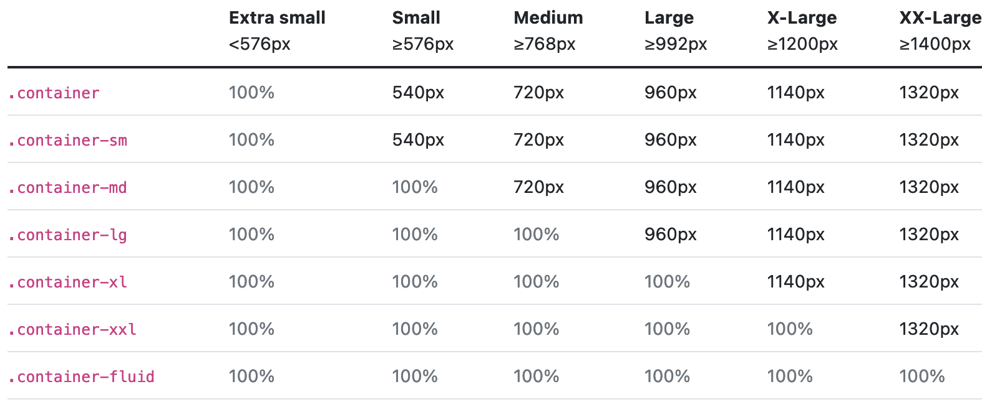
Containers
Containers are a fundamental building block of Bootstrap that contain, pad, and align your content within a given device or viewport.

Slide 5
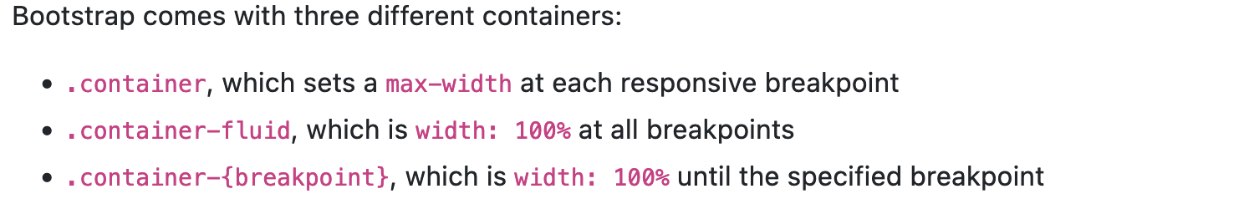
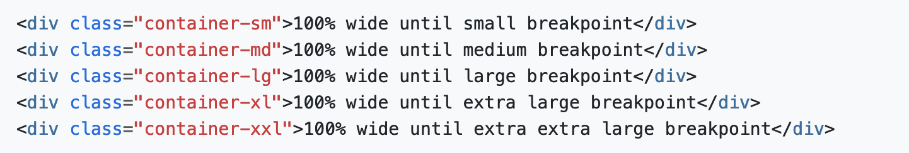

Slide 6
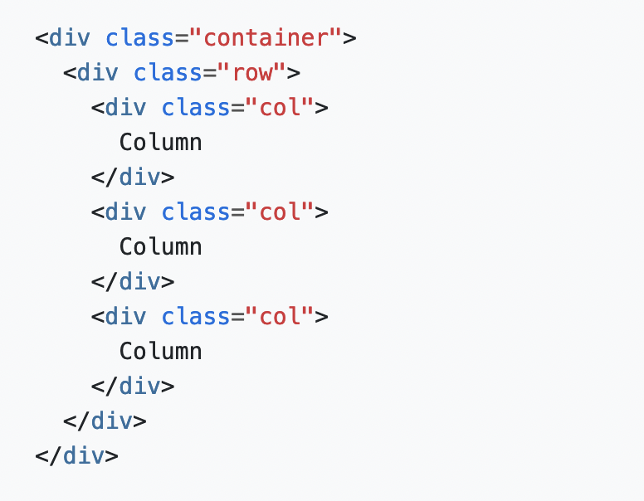
Grid system
Bootstrap’s grid system uses a series of containers, rows, and columns to layout and align content.
It’s built with flexbox and is fully responsive.
The above example creates three
equal-width columns across all devices
and viewports using our predefined
grid classes. Those columns are
centered in the page with the parent .container.

Slide 7
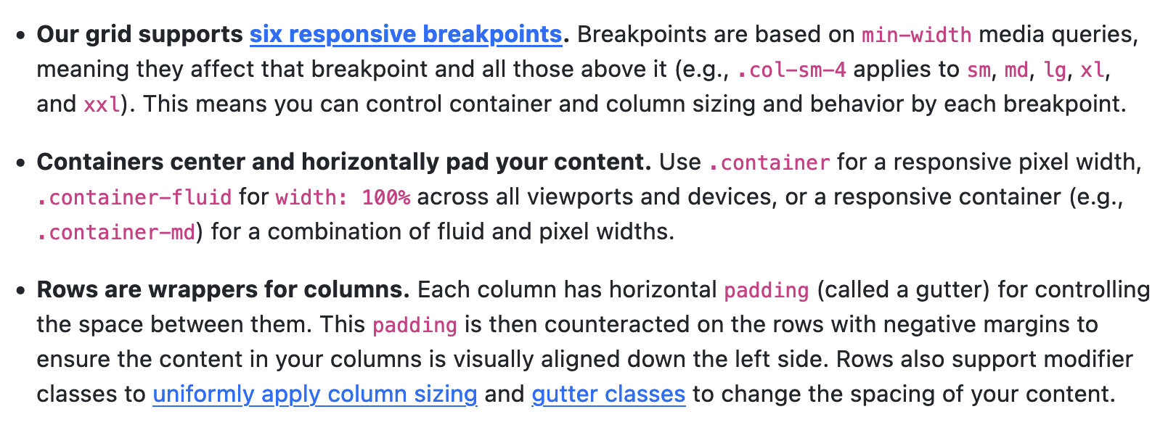

Slide 8
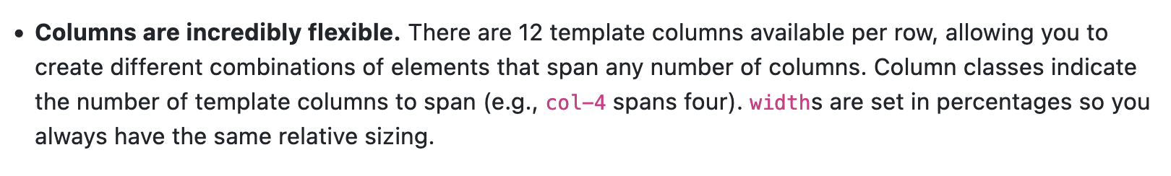

Slide 9
