Slide 1
Back to Basics
An Introduction to Diameter

Slide 2
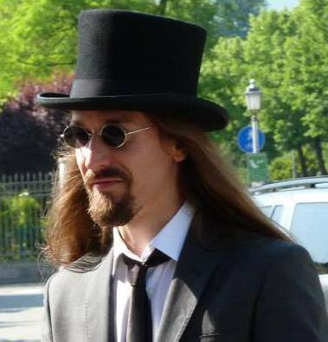

Who am I?
Software engineer @ Athonet S.r.l.
NOT a professional Erlang/Elixir developer (yet!) :(
Mainly developed in Python, C, C++
Full-est stack developer
Started exploring the Beam with Elixir

Slide 3
AAA – Protocol wanted!
What is Diameter?
Authentication, Authorization and Accounting network protocol: framework for applications such as network access or IP mobility
Application layer protocol
Evolution of RADIUS (Joke intended) [seriously]
Designed to be an AAA framework for next generation applications
RFC3588RFC 6733 (Diameter Base Protocol, 20032012) and many others
Widely used in 3GPP Control Plane protocols (authentication, billing, location services…)

Slide 4
Diameter == 2 * RADIUS
RADIUS | DIAMETER
UDP Transport | TCP or SCTP transport
Client – Server, mono directional communication | Peer-to-peer, bidirectional communication (Server generated messages)
Manual configuration of nodes and secret (some RFC7585 for dynamic discovery through NAI) | Dynamic peer discovery using DNS and NAPTR, SRVLOC
8 bit identifiers | 32 bit identifiers
Stateless | Both stateful (session, transaction) and stateless
No congestion control | Capacity, congestion control, overload (RFC 7660, 7068, ...)
Intermediate nodes (generically referred as Proxy, no specifications) | Intermediate nodes (Agents: Relay, Proxy, Redirect, Translation)
 | Capabilities exchange, applications

Slide 5
Diameter = 2 * RADIUS (pt. 2)
RADIUS | DIAMETER
Silent failures: invalid messages are discarded | Informational Application Errors (or even success!) or Protocol Errors (“E” header bit set): agents may try to correct them
Extension at attribute level | Extension at AVP, procedure or application level. Even Base Protocol can be extended. (new AVP codes assigned by IANA. New commands by IETF consensus)
Can support IPSec (not mandatory) | Clients must support at least one between IPSec or TLS. Diameter CMS Security Application is also available.
Unstructured messages | Mandatory flags, positional requirements
 | Loop detection (Route-Record), transaction path recording
 | ...not fully backwards compatible!

Slide 6
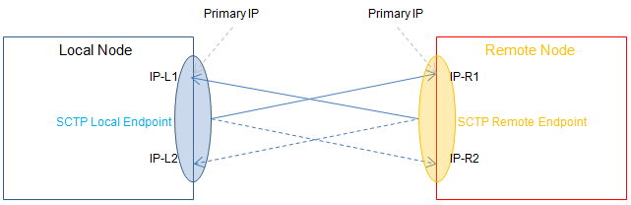
SCTP
Message oriented (like UDP)
In-sequence transport, congestion control (like TCP)
Multi-homing (also asymmetric): redundancy, transparent fail-over.
Concurrent transition of different streams of data
Can map to TCP API
Supported by Linux Kernel >= 2.4
Used by:
SSH
WebRTC
...Diameter!
Not used, why?
TCP was already in (wide) use!
TCP mostly works

Slide 7
Architecture (1)
Entities in the Diameter Architecture:
Node: host implementing Diameter protocol
Peer: Diameter node directly connected with another Diameter node
Client: device at the edge of the newtork that performs access control (MME – Mobility Management Entity -, PCEF – Policy and Charging Enforcement Function - in EPS architecture)
Server: node that handles AAA functions for a particular realm (HSS – Home Subscriber Server -, PCRF – Policy and Charging Rules Function – in EPS architecture)

Slide 8
Architecture (2)
Agent: node providing “networking” functions
  Relay Agent: agent that accept requests and route messages to other Diameter nodes based on message information (e.g. Destination-Realm). No application level processing. Relay Agents modify Diameter messages by inserting and removing routing information, and nothing more. Relays should not maintain session state but must maintain transaction state
  Proxy Agent: route Diameter messages using the Diameter Routing Table (like Relay Agents). Can modify messages to implement policy enforcement. Proxies may maintain session state and must maintain transaction state. Since enforcing policies requires an understanding of the service being provided, Proxies must only advertise the Diameter applications they support. Example: Diameter Routing Agent (DRA)
  Redirect Agent: do not relay messages, only return an answer with the information necessary for direct communication with destination. Do not modify messages. Do not receive answer messages, so do not maintain session state. Since they never relay requests, they are not required to maintain transaction state. Do not perform any application level processing, they provide relaying services for all Diameter applications, therefore must advertise the Relay Application Identifier. Example: Subscription Locator Function (SLF) in IMS
  Translation Agent : translates between two protocols (e.g. RADIUS to Diameter, MAP to Diameter) allowing server conversions to Diameter, for example, while permitting client NASes to be converted at a slower pace

Slide 9
Applications
Diameter offers the concept of Application: not a software, but an extension over the base protocol
Examples:
  Diameter Credit Control Application (DCCA): real time credit control for end-user services (rfc4006)
  Cx/Dx interface: AAA for VoLTE/IMS systems
  Sh interface: data handling procedure for the Ip Multimedia Subsystem
  Diameter-WebAuth: draft for identity based for Web Application AAA
Each applications offers commands (Request/Answer) to achieve its purpose.

Slide 10
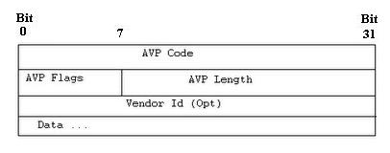
AVP
Like RADIUS, the protocol is based on AVP (Attribute-Value Pairs)
Attribute | Size | Description
AVP Code | 4 bytes | Combined with Vendor ID, identifies the attribute uniquely. 1-255 reserved for RADIUS backwards compatibility
AVP Flags | 1 byte | M – Mandatory bit: if set Client, Server, Proxy and Translation agents must support AVP handling V – Vendor bit: if set, the Vendor-Id AVP shall be present in the message P – Protected bit: if set, the AVP content is encrypted for end-to-end security
AVP Length | 3 bytes | Data + Vendor-Id + AVP Code + AVP Length + AVP Flags
Vendor Id | 4 bytes | IANA Assigned identifier, for Vendor-specific extensibility

Slide 11
AVP (2)
Basic AVP Types (unsurprisingly)
OctetString
Integer32/64
Unsigned32/64
Float32/64
Grouped
Derived AVP Types
Time
Address
UTF8String
DiameterIdentity
DiameterURI
Enumerated
IPFilterRule

Slide 12
eDiameter
https://github.com/erlang/otp/tree/master/lib/diameter
“Basic usage consists of creating a representation of a locally implemented Diameter node and its capabilities with start_service/2, adding transport capability using add_transport/2 and sending Diameter requests and receiving Diameter answers with call/4. Incoming Diameter requests are communicated as callbacks to a diameter_app(3) callback modules as specified in the service configuration.”

Slide 13
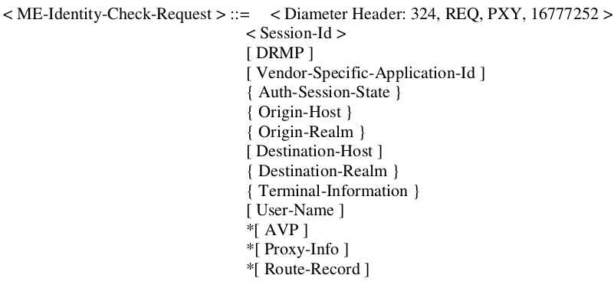
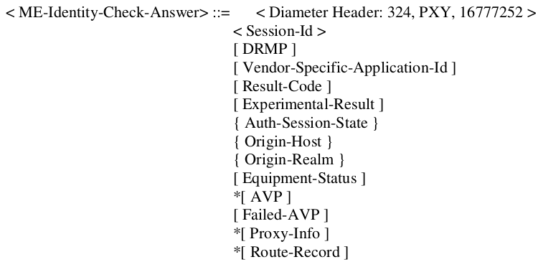
From Specification...

Slide 14
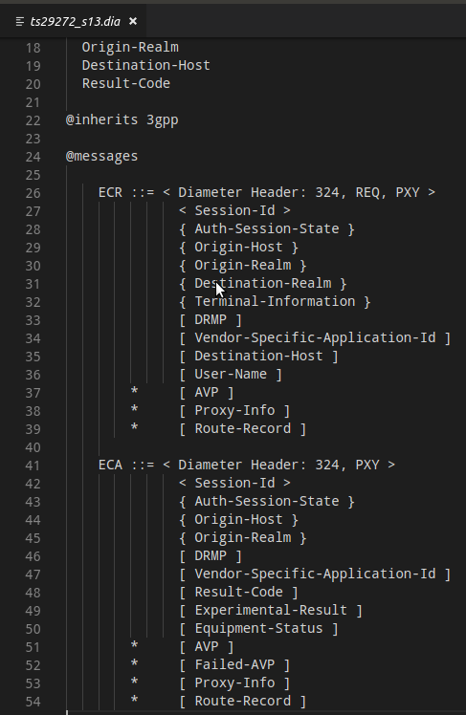
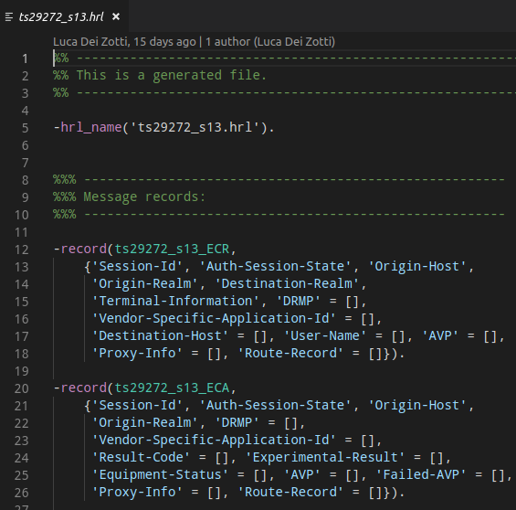
...to implementation!
rebar3

Slide 15
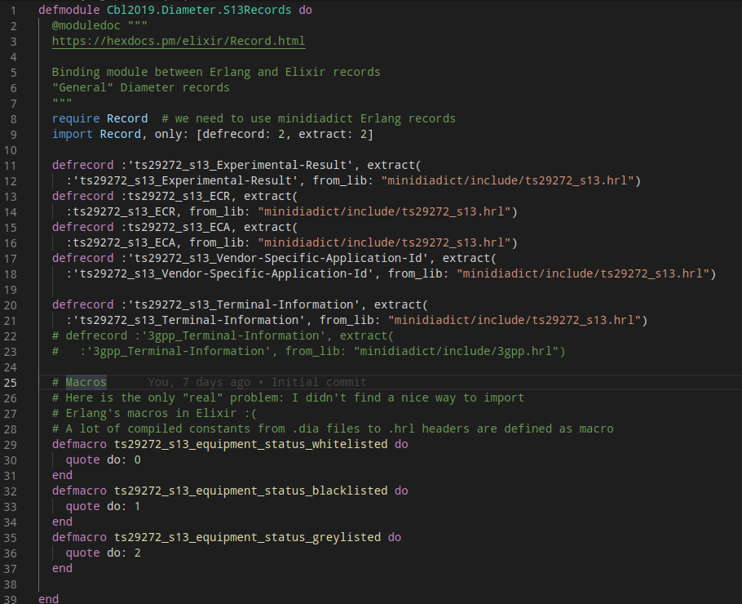
Crucible of Worlds

Slide 16
References
https://en.wikipedia.org/wiki/Diameter_(protocol) (of course)
http://erlang.org/doc/man/diameter.html (of super-course)
https://github.com/erlang/otp/tree/master/lib/diameter (when I grow up I'll be this good)
https://www.ibm.com/developerworks/library/wi-diameter/index.html
Comparison between RADIUS and Diameter – Anna Hosia, Helsinki University of Technology – 2003
Holger Winkelmann and Ulf Wiger -The Erlang/OTP DIAMETER Stack (https://vimeo.com/26034259)
https://diameter-protocol.blogspot.com

Slide 17

Thank you!
Questions?
Comments?
All code available on github.com/zoten

