Slide 1
Back to Basics
An Introduction to Diameter

Slide 2
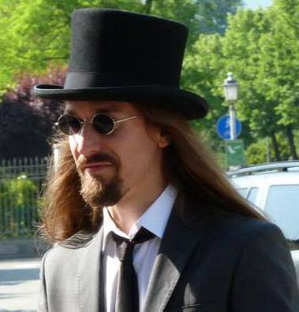


Who am I?
Software engineer @ Athonet S.r.l.
NOT a professional Erlang/Elixir developer (yet!) :(
Mainly developed in Python, C, C++
Full-est stack developer
Started exploring the Beam with Elixir
(not very good at slides)
[and those were originally at 4:3, sorry!]

Slide 3
Why this talk?
Because I was working on this :)
To re-discover the basics of the framework we're using
To see something unusual
(because you may say “I want to do this!”, and we are always searching for talents :) )

Slide 4
AAA – Protocol wanted!
What is Diameter?
Authentication, Authorization and Accounting network protocol: framework for applications such as network access or IP mobility
Application layer protocol
Evolution of RADIUS (Joke intended) [seriously]
Designed to be an AAA framework for next generation applications
RFC3588RFC 6733 (Diameter Base Protocol, 20032012) and many others
Widely used in 3GPP Control Plane protocols (authentication, billing, location services…)

Slide 5
Diameter == 2 * RADIUS
RADIUS | DIAMETER
UDP Transport | TCP or SCTP transport
Client – Server, mono directional communication | Peer-to-peer, bidirectional communication (Server generated messages)
Manual configuration of nodes and secret (some RFC7585 for dynamic discovery through NAI) | Dynamic peer discovery using DNS and NAPTR, SRVLOC
8 bit identifiers | 32 bit identifiers
Stateless | Both stateful (session, transaction) and stateless
No congestion control | Capacity, congestion control, overload (RFC 7660, 7068, ...)
Intermediate nodes (generically referred as Proxy, no specifications) | Intermediate nodes (Agents: Relay, Proxy, Redirect, Translation)
 | Capabilities exchange, applications

Slide 6
Diameter = 2 * RADIUS (pt. 2)
RADIUS | DIAMETER
Silent failures: invalid messages are discarded | Informational Application Errors (or even success!) or Protocol Errors (“E” header bit set): agents may try to correct them
Extension at attribute level | Extension at AVP, procedure or application level. Even Base Protocol can be extended. (new AVP codes assigned by IANA. New commands by IETF consensus)
Can support IPSec (not mandatory) | Clients must support at least one between IPSec or TLS. Diameter CMS Security Application is also available.
Unstructured messages | Mandatory flags, positional requirements
 | Loop detection (Route-Record), transaction path recording
 | ...not fully backwards compatible!

Slide 7
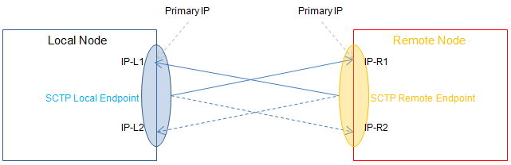
SCTP
Message oriented (like UDP)
In-sequence transport, congestion control (like TCP)
Multi-homing (also asymmetric): redundancy, transparent fail-over.
Concurrent transition of different streams of data
Can map to TCP API
Supported by Linux Kernel >= 2.4
Used by:
SSH
WebRTC
...Diameter!
Not used, why?
TCP was already in (wide) use!
TCP mostly works

Slide 8
Architecture (1)
Entities in the Diameter Architecture:
Node: host implementing Diameter protocol
Peer: Diameter node directly connected with another Diameter node
Client: device at the edge of the newtork that performs access control (MME – Mobility Management Entity -, PCEF – Policy and Charging Enforcement Function - in EPS architecture)
Server: node that handles AAA functions for a particular realm (HSS – Home Subscriber Server -, PCRF – Policy and Charging Rules Function – in EPS architecture)

Slide 9
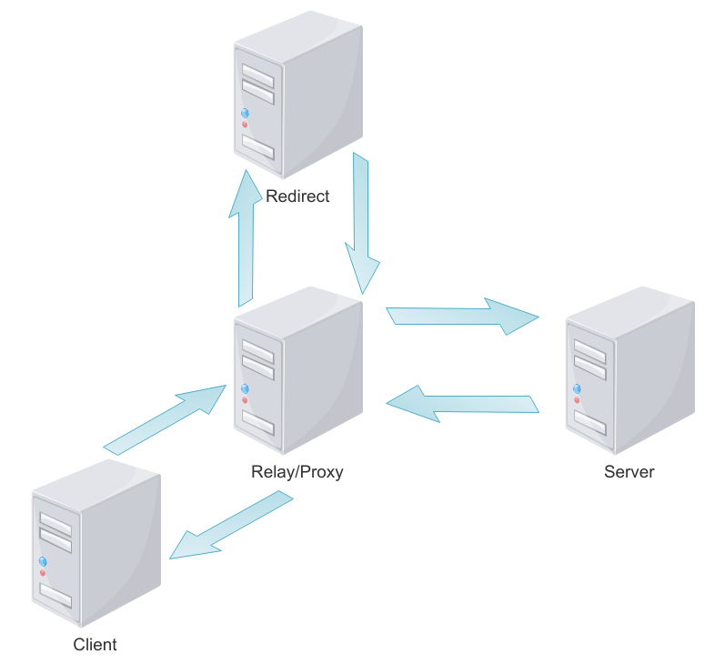
Architecture (2)
Agent: node providing “networking” functions
  Relay Agent: agent that accept requests and route messages to other Diameter nodes based on message information (e.g. Destination-Realm). No application level processing. Relay Agents modify Diameter messages by inserting and removing routing information, and nothing more. Relays should not maintain session state but must maintain transaction state
  Proxy Agent: route Diameter messages using the Diameter Routing Table (like Relay Agents). Can modify messages to implement policy enforcement. Proxies may maintain session state and must maintain transaction state. Since enforcing policies requires an understanding of the service being provided, Proxies must only advertise the Diameter applications they support. Example: Diameter Routing Agent (DRA)
  Redirect Agent: do not relay messages, only return an answer with the information necessary for direct communication with destination. Do not modify messages. Do not receive answer messages, so do not maintain session state. Since they never relay requests, they are not required to maintain transaction state. Do not perform any application level processing, they provide relaying services for all Diameter applications, therefore must advertise the Relay Application Identifier. Example: Subscription Locator Function (SLF) in IMS
  Translation Agent : translates between two protocols (e.g. RADIUS to Diameter, MAP to Diameter) allowing server conversions to Diameter, for example, while permitting client NASes to be converted at a slower pace

Slide 10
Applications
Diameter offers the concept of Application: not a software, but an extension over the base protocol
Examples:
  Diameter Credit Control Application (DCCA): real time credit control for end-user services (rfc4006)
  Cx/Dx interface: AAA for VoLTE/IMS systems
  Sh interface: data handling procedure for the Ip Multimedia Subsystem
  Diameter-WebAuth: draft for identity based for Web Application AAA
Each applications offers commands (Request/Answer) to achieve its purpose.

Slide 11
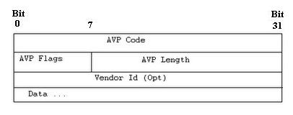
AVP
Like RADIUS, the protocol is based on AVP (Attribute-Value Pairs)
Field | Size | Description
AVP Code | 4 bytes | Combined with Vendor ID, identifies the attribute uniquely. 1-255 reserved for RADIUS backwards compatibility
AVP Flags | 1 byte | M – Mandatory bit: if set Client, Server, Proxy and Translation agents must support AVP handling V – Vendor bit: if set, the Vendor-Id AVP shall be present in the message P – Protected bit: if set, the AVP content is encrypted for end-to-end security
AVP Length | 3 bytes | Data + Vendor-Id + AVP Code + AVP Length + AVP Flags
Vendor Id | 4 bytes | IANA Assigned identifier, for Vendor-specific extensibility

Slide 12
AVP (2)
Basic AVP Types (unsurprisingly)
OctetString
Integer32/64
Unsigned32/64
Float32/64
Grouped
Derived AVP Types
Time
Address
UTF8String
DiameterIdentity
DiameterURI
Enumerated
IPFilterRule

Slide 13
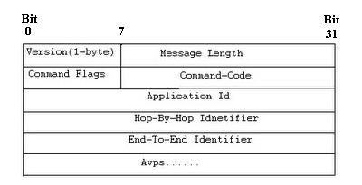
Packet
Field | Size | Description
Version | 1 byte | Protocol version (well, at the moment: 1)
Length | 3 byte | Let's guess :) (header + padded AVPs)
Command Flags | 1 byte | R (Request) bit: the message is a request (if set) or an answer P (Proxiable) bit: the message may be proxied, relayed or redirected (if set) or must be locally processed E (Error) bit: message contains a protocol error (if set) T (Potentially re-transmitted) bit: set when resending requests not yet acknowledged as an indication of a possible duplicate
Command Code | 3 bytes | 0-255 RADIUS backwards compatibility 256-16777213 Standard commands (allocated by IANA) 16777214-16777215 Experimental (testing)

Slide 14
Packet (2)
Field | Size | Description
Application Id | 4 bytes | Identifier of the application (standard or vendor-specific). Same values are repeated in each Application-Id AVP.
Hop-By-Hop Identifier | 4 bytes | Identifier to match requests and responses and keep transactions states
End-To-End Identifier | 4 bytes | Identifier to avoid duplicate requests (combined with origin-Host AVP)
AVPs | ... | Command-specific content

Slide 15
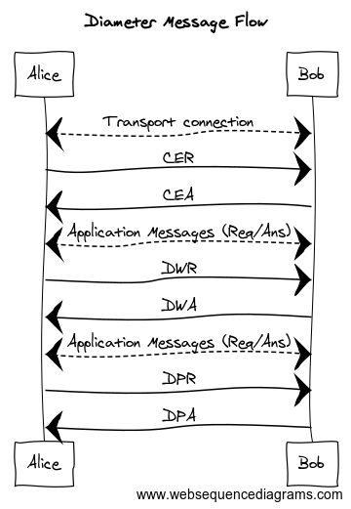

Slide 16
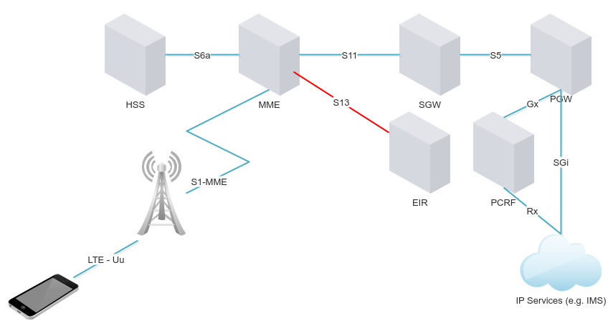
What will we build?
Equipment Identity Register (EIR)
Single message:
MME: “Do you know this user (IMSI) using this equipment (IMEI)?”
EIR: “No/Yes, and it's good/bad/whatever”

Slide 17
Why eDiameter?
Written initially by Ulf Wiger
Need for a DIAMETER client for a Session Border Gateway Controller (client)
3rd party stacks expensive/incomplete/not customizable
Re-written by Andres Svensson => OTP
How to test a client? Let's add a server!
Caveats:
RFC collapses 3 state machines into one (single-threaded event loop)
Solution:
Transport FSM, Handshake FSM, Service FSM, Request handler (one per request)
(More on the referenced slides and videos :) )

Slide 18
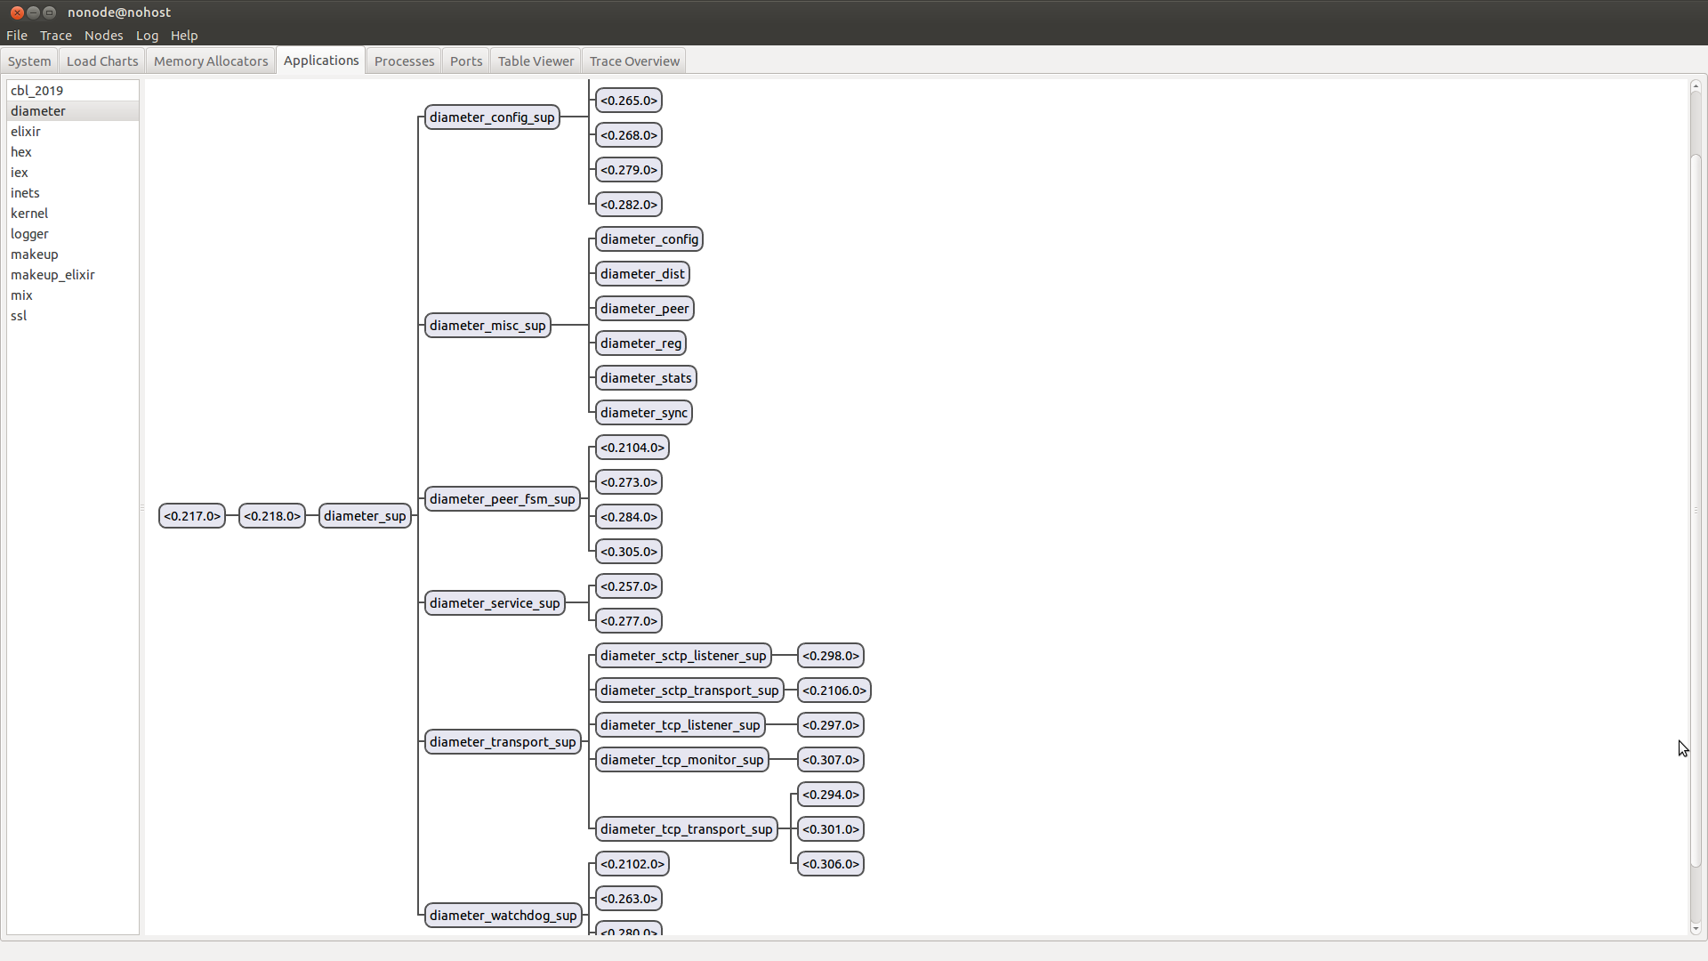

Slide 19
eDiameter
http://erlang.org/doc/man/diameter.html
https://github.com/erlang/otp/tree/master/lib/diameter
“Basic usage consists of creating a representation of a locally implemented Diameter node and its capabilities with start_service/2, adding transport capability using add_transport/2 and sending Diameter requests and receiving Diameter answers with call/4. Incoming Diameter requests are communicated as callbacks to a diameter_app(3) callback modules as specified in the service configuration.”

Slide 20
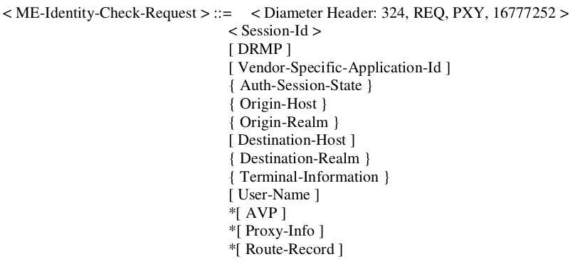
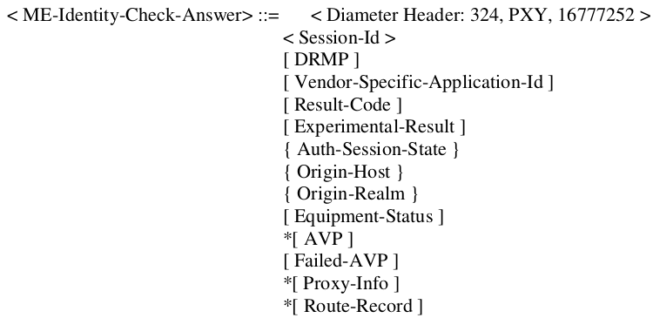
From Specification...

Slide 21
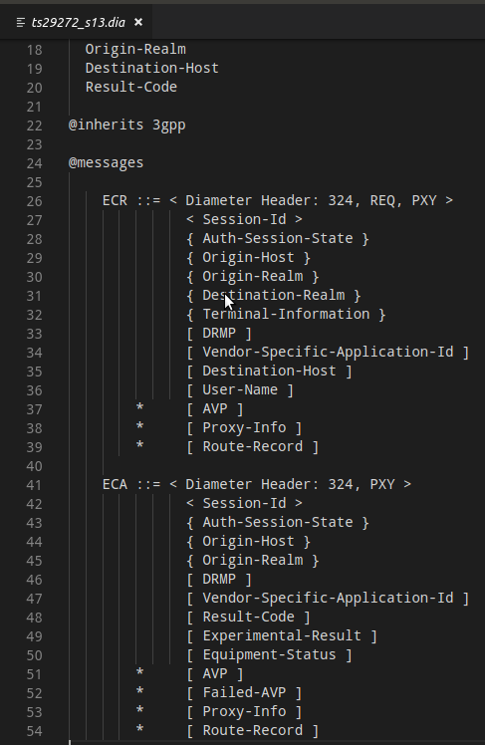
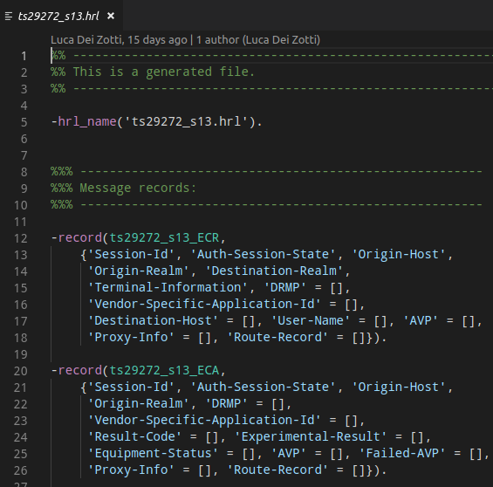
...to implementation!
rebar3

Slide 22
diameter_dict
http://erlang.org/doc/man/diameter_dict.html
“A diameter service, as configured with diameter:start_service/2, specifies one or more supported Diameter applications. Each Diameter application specifies a dictionary module that knows how to encode and decode its messages and AVPs. The dictionary module is in turn generated from a file that defines these messages and AVPs. The format of such a file is defined in FILE FORMAT below. Users add support for their specific applications by creating dictionary files, compiling them to Erlang modules using either diameterc(1) or diameter_make(3) and configuring the resulting dictionaries modules on a service.
Dictionary module generation also results in a hrl file that defines records for the messages and Grouped AVPs defined by the dictionary, these records being what a user of the diameter application sends and receives”

Slide 23
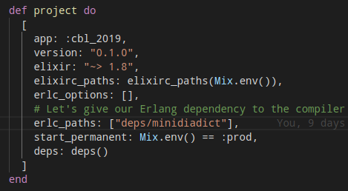
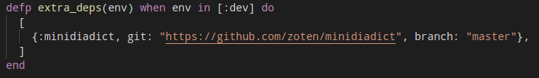
Introducing Erlang to Elixir

Slide 24
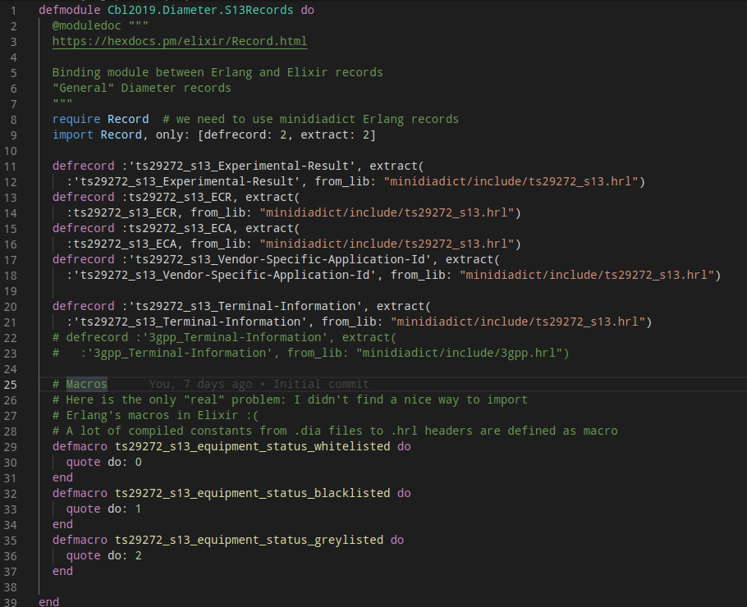
Crucible of Worlds

Slide 25
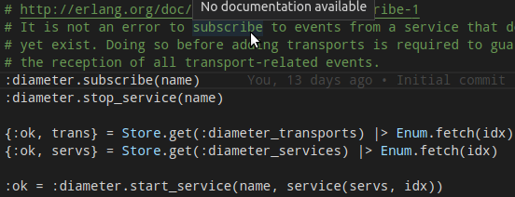
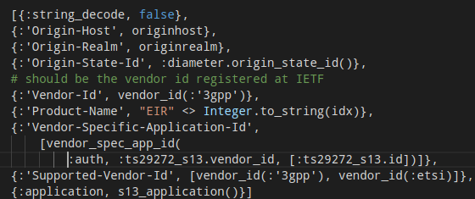
Callbacks
start_service/2
stop_service/1
subscribe/1
Callbacks to start or stop a service, specifying the capabilities to be advertised during capabilities exchange or triggering DPR requests.
Subscribing to a service (name) means receiving all service events from it.
A service defines basic properties of the diameter node we are implementing.

Slide 26
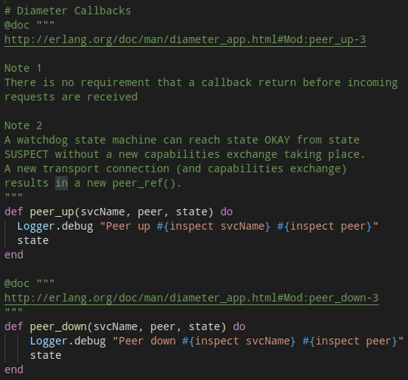
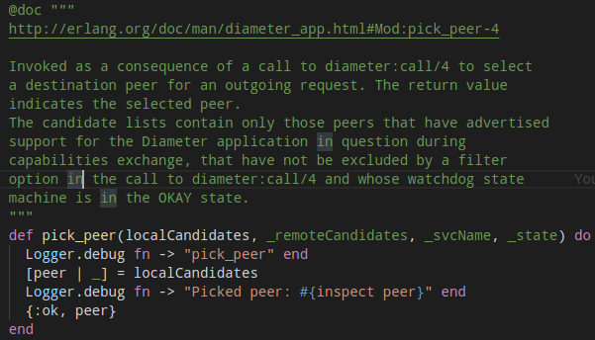
Callbacks (2)
peer_up/3
peer_down/3
pick_peer/4
Control actions to perform when a peer comes up or down, or to pick the
destination peer for a diameter_call request.
The stack automatically performs selection
on supported advertised applications from
known peers.

Slide 27
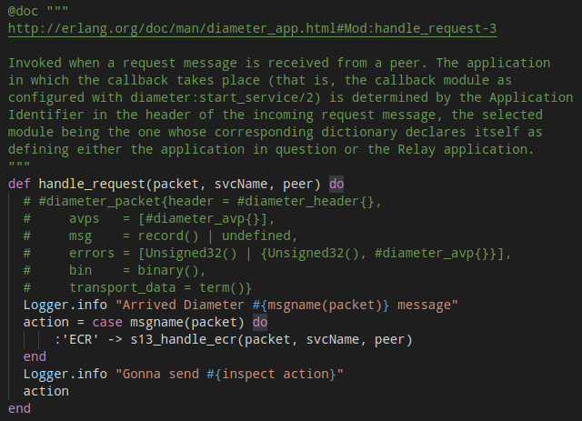
Callbacks (3)

Slide 28
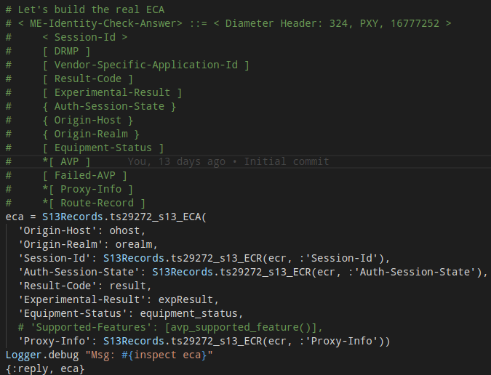
Callbacks (4)

Slide 29
...and on, and on
Other hooks:
prepare_request/3: invoked to return a request for encoding and transport. Allows the sender to use the selected peer's capabilities to modify the outgoing request (see the client file mme.ex)
prepare_retransmit/3: like prepare_request/3 but for lost peer connection and alternate peer selected
handle_answer/4 - handle_error/4: handlers for answer messages from peers, or to manage errors before answer
...and helpers
:diameter_codec.encode/2 - :diameter_codec.decode/2, session_id/1, origin_state_id/0, service_info/2 …
Not a lot of handy debugging information (“why my message/AVP is not sent/encoded?”): you have often to dig for solutions!

Slide 30
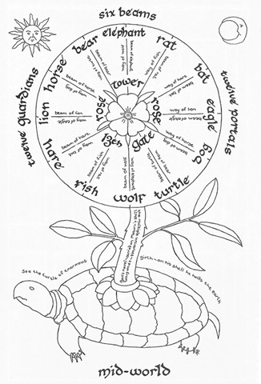
...let's follow the
Beam!
Courtesy of https://stephenking.fandom.com/wiki/File:Turtle-2-.jpg

Slide 31
References
https://en.wikipedia.org/wiki/Diameter_(protocol) (of course)
http://erlang.org/doc/man/diameter.html (of super-course)
https://github.com/erlang/otp/tree/master/lib/diameter (when I grow up I'll be this good)
https://www.ibm.com/developerworks/library/wi-diameter/index.html
Comparison between RADIUS and Diameter – Anna Hosia, Helsinki University of Technology – 2003
Holger Winkelmann and Ulf Wiger -The Erlang/OTP DIAMETER Stack (https://vimeo.com/26034259)
https://diameter-protocol.blogspot.com

Slide 32

Thank you!
Questions?
Comments?
All code available on github.com/zoten

