Slide 1

Design of Pipeline ADC based on Ring Amplifier
MTP Phase-II Presentation
Department of Electrical Engineering
Indian Institute of Technology, Bombay
Presented by Sagar Zoting
Roll no. 203070064
aiCAS Lab
Under guidance of
Prof. Rajesh Zele

Slide 2
Outline
Introduction and Motivation
Pipeline ADC Architecture
Conventional Ring Amplifier
Self-Biased Ring Amplifier
Comparator
Complete Pipeline ADC
Simulations and Results
Conclusion
Future Work
References

Slide 3
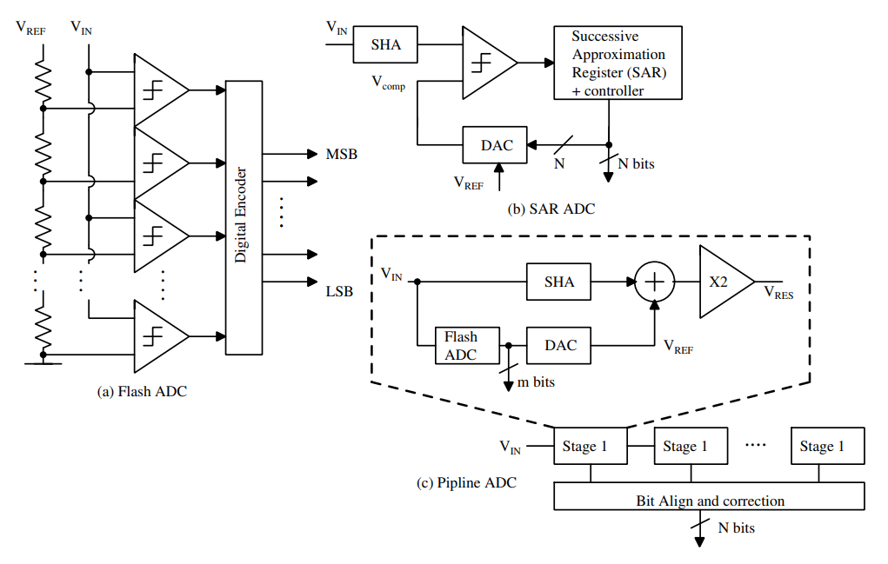
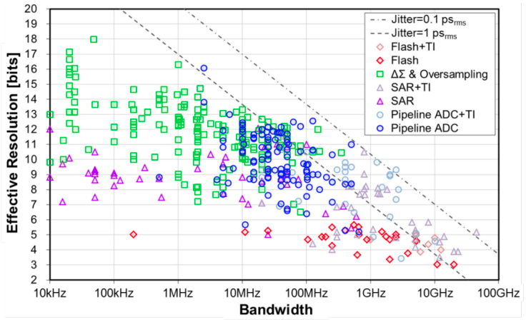
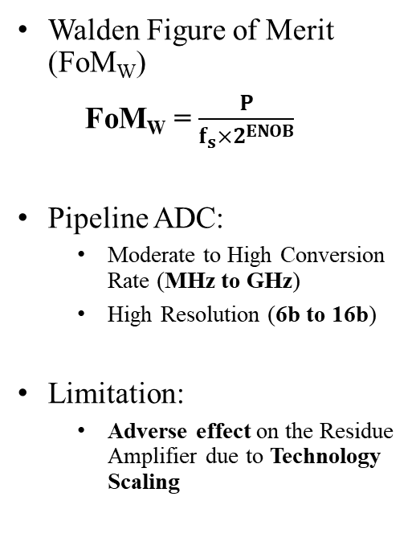
Motivation
Walden Figure of Merit (FoM_{W})
FoM_{W} = $\frac{P}{f_{s}×2^{ENOB}}$
Pipeline ADC:
Moderate to High Conversion Rate (MHz to GHz)
High Resolution (6b to 16b)
Limitation:
Adverse effect on the Residue Amplifier due to Technology Scaling
Ref: R. H. Walden, "Analog-to-digital converter survey and analysis," in IEEE Journal on Selected Areas in Communications, vol. 17, no. 4, pp. 539-550, April 1999, doi: 10.1109/49.761034.
B. Murmann, "The Race for the Extra Decibel: A Brief Review of Current ADC Performance Trajectories," in IEEE Solid-State Circuits Magazine, vol. 7, no. 3, pp. 58-66, Summer 2015, doi: 10.1109/MSSC.2015.2442393.

Slide 4
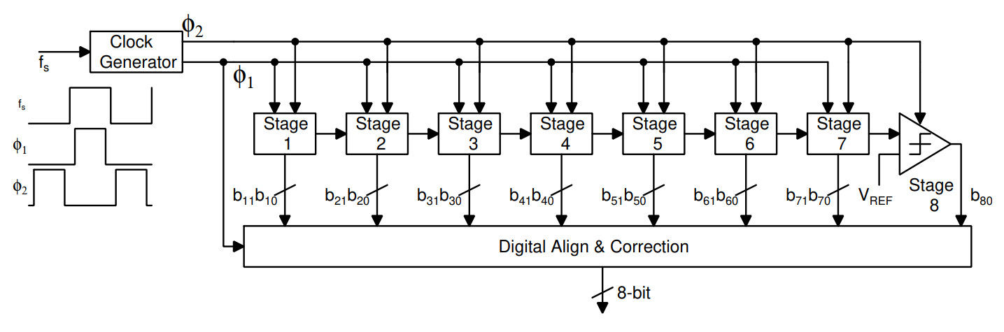
Pipeline ADC Architecture
Clock Phases: Non-Overlapping
Pipeline Stage Consist of Residue Amplifier, Sub-ADC and DAC
Bits are stored and synchronized
Corrected using Adders

Slide 5
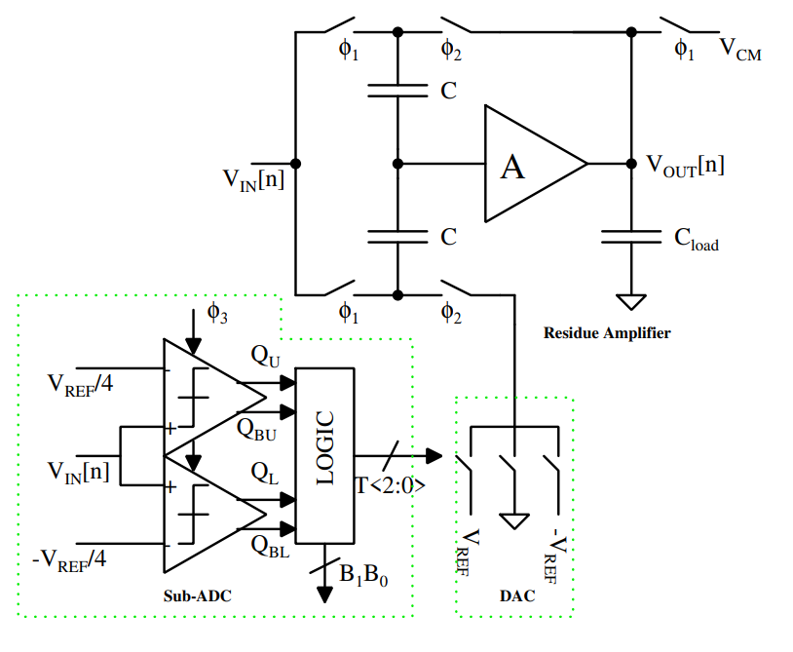

Pipeline ADC Architecture
Single Stage of Pipeline ADC
$ϕ_{3}$ is High, during Non-overlapping period
$C_{Load}=C_{L}+C_{sampling,i+1}$

Slide 6
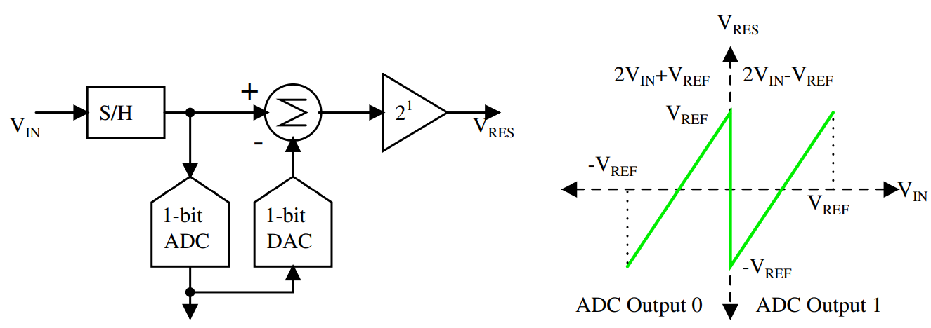
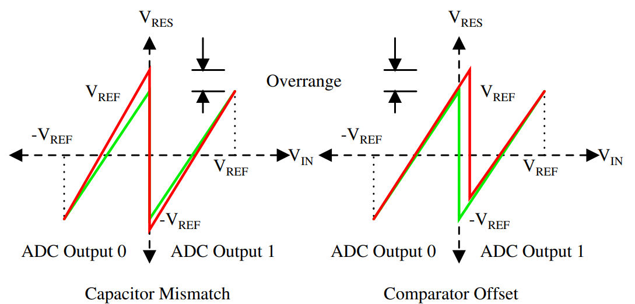
Pipeline ADC Architecture
Necessity of the Redundant Bit

Slide 7
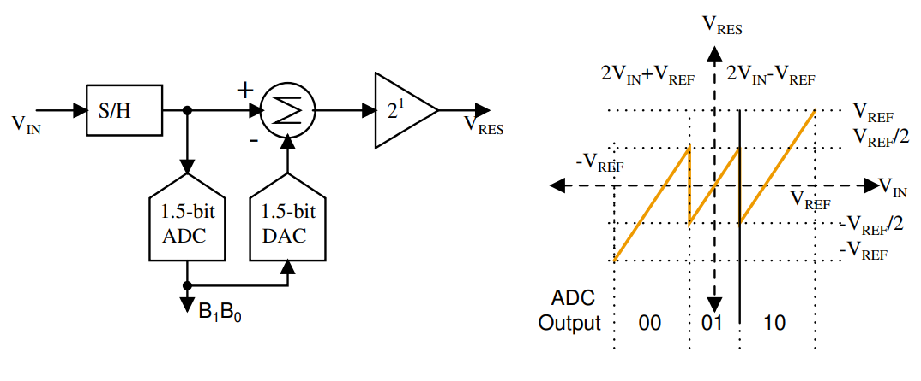
Pipeline ADC Architecture
1.5 bits/stage block diagram and Transfer Function

Slide 8
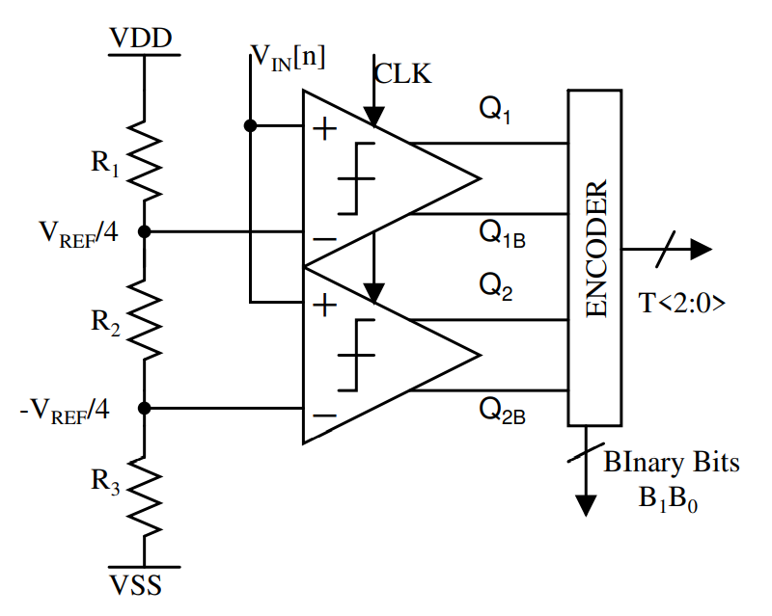
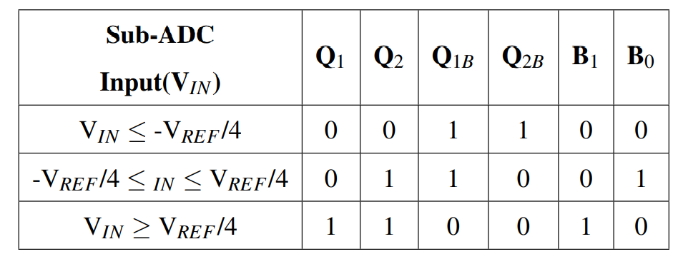
Pipeline ADC Architecture
1.5 bit Sub-ADC

Slide 9
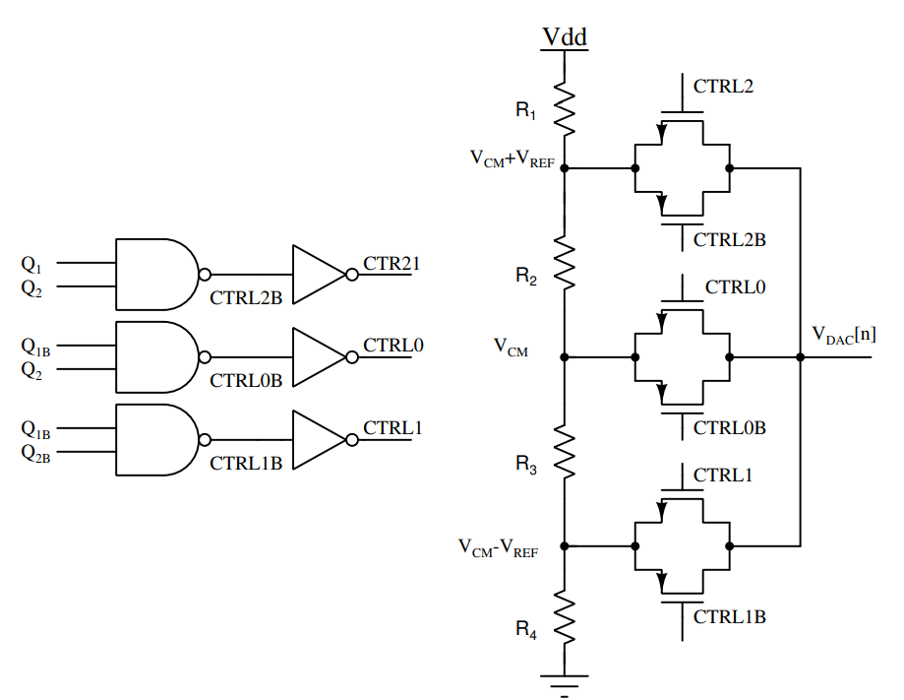
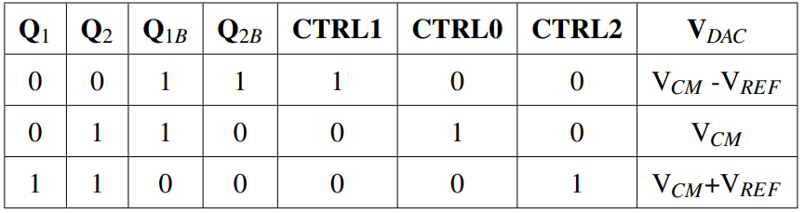
Pipeline ADC Architecture
1.5-bit DAC

Slide 10
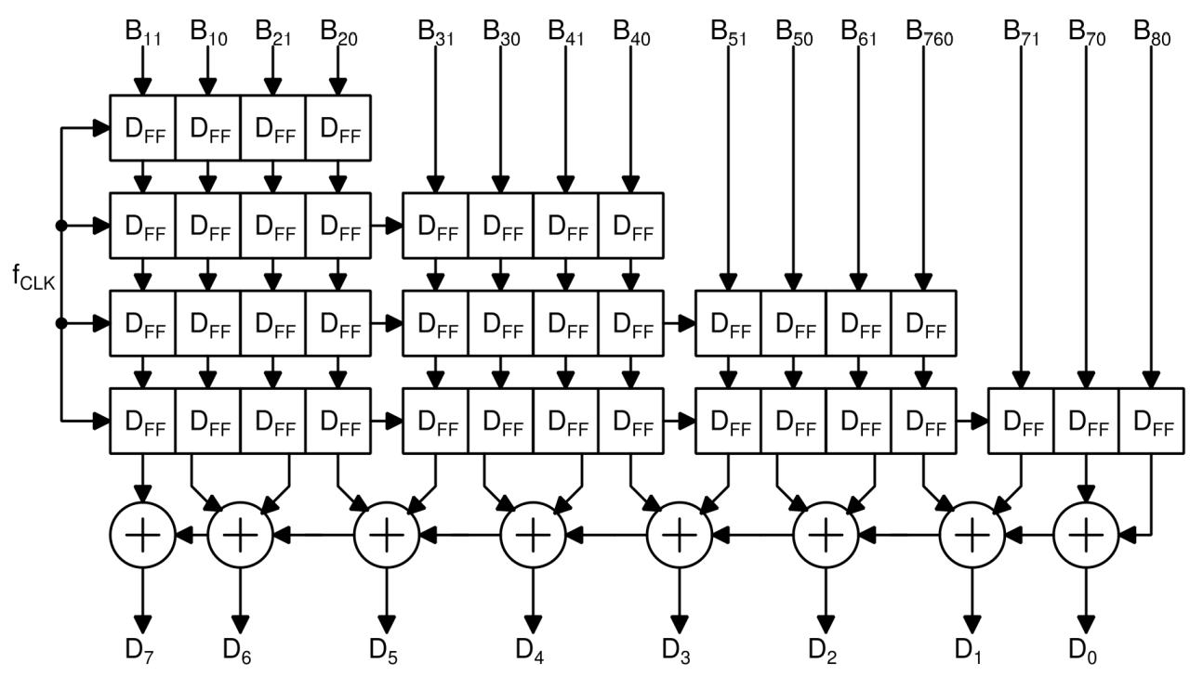
Pipeline ADC Architecture
Digital Bit Alignment and Correction

Slide 11
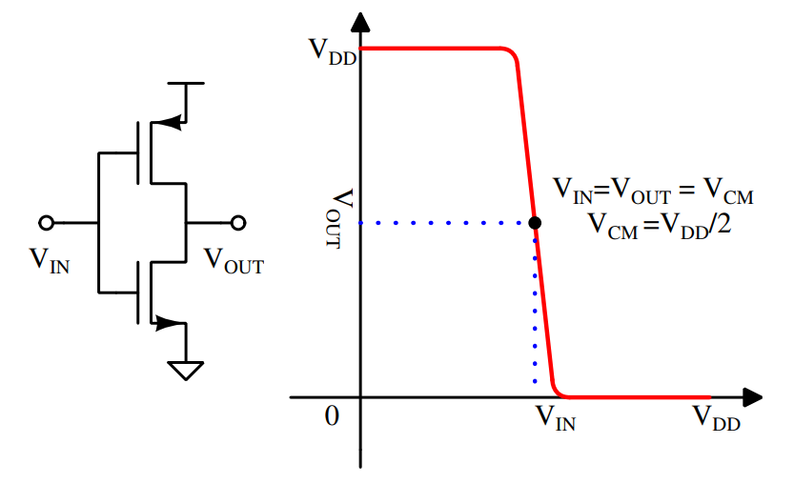

Conventional Ring Amplifier
Inverter Characteristics
High gain, High Bandwidth
Balanced at the trip point
($V_{IN}=V_{OUT}=V_{CM}$)

Slide 12
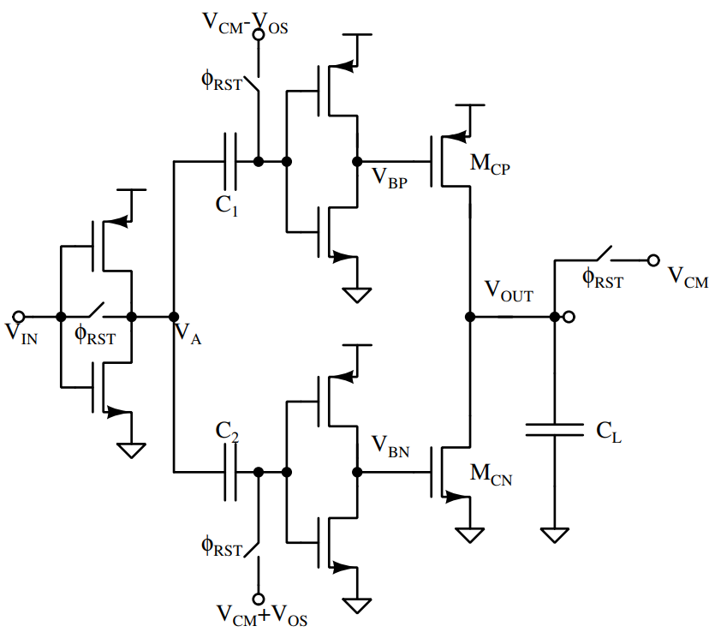
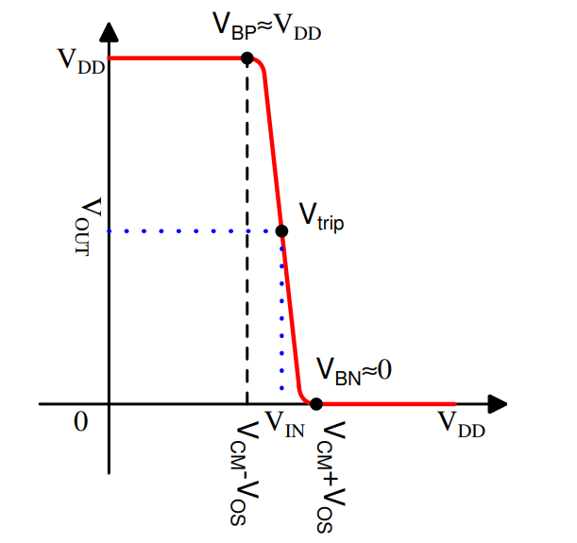

Conventional Ring Amplifier
Operation of the Ring Amplifier
$φ_{rst}$ is High: Ring Amplifier is off
$$∴V_{IN}=V_{A}=V_{CM}$$
$V_{BP}>V_{DD}−\left|V_{thp}\right|, V_{BN}<V_{thn}$
B. Hershberg, S. Weaver, K. Sobue, S. Takeuchi, K. Hamashita and U. Moon, "Ring Amplifiers for Switched Capacitor Circuits," in IEEE Journal of Solid-State Circuits, vol. 47, no. 12, pp. 2928-2942, Dec. 2012, doi: 10.1109/JSSC.2012.2217865.

Slide 13
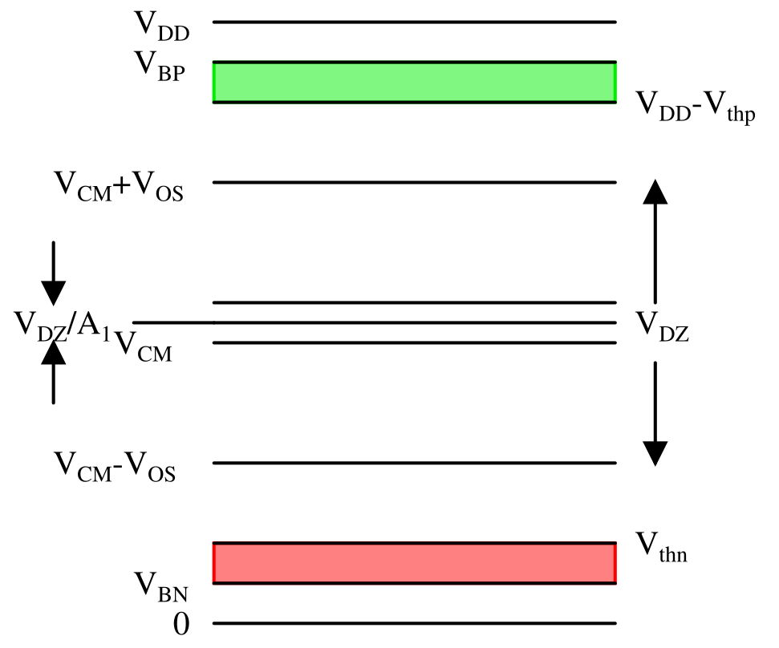
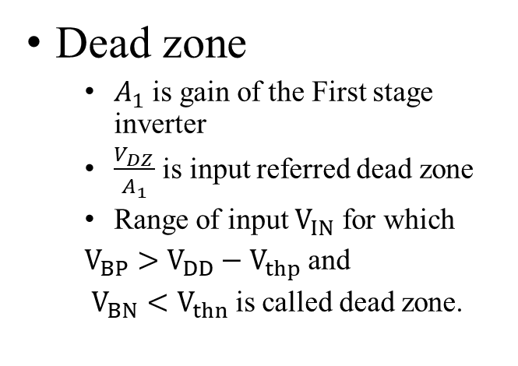
Conventional Ring Amplifier
Dead zone
$A_{1}$ is gain of the First stage inverter
$\frac{V_{DZ}}{A_{1}}$ is input referred dead zone
Range of input $V_{IN}$ for which
$V_{BP}>V_{DD}−V_{thp}$ and
$V_{BN}<V_{thn}$ is called dead zone.

Slide 14
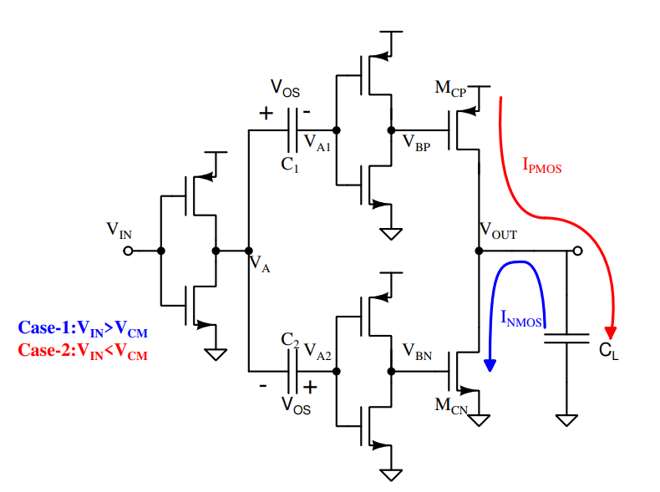
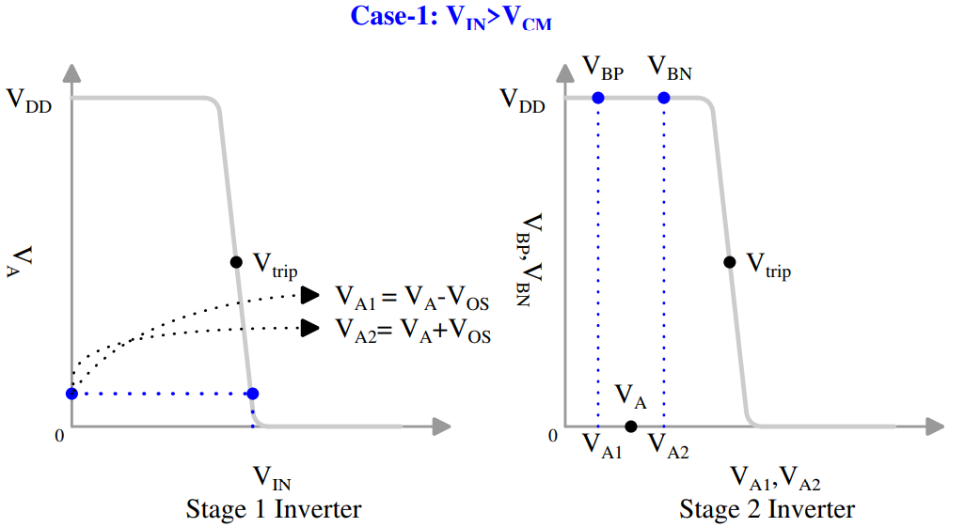

Conventional Ring Amplifier
Case -1: $V_{IN}>V_{CM}$
$V_{BP}>V_{DD} −\left|V_{thp}\right|$
Minimum $V_{OUT}=0$

Slide 15
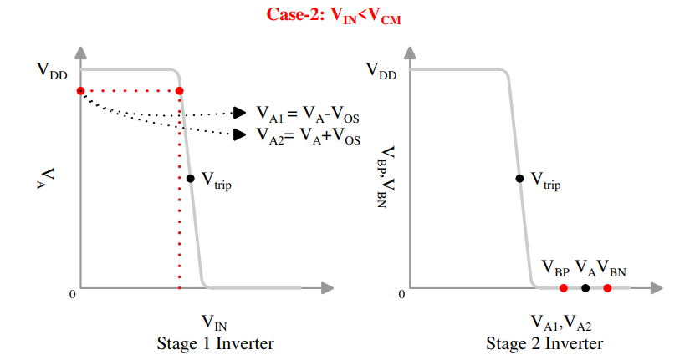

Conventional Ring Amplifier
Case -2: $V_{IN}<V_{CM}$
$V_{BN}<V_{thn}$
Maximum $V_{OUT}=VDD$

Slide 16
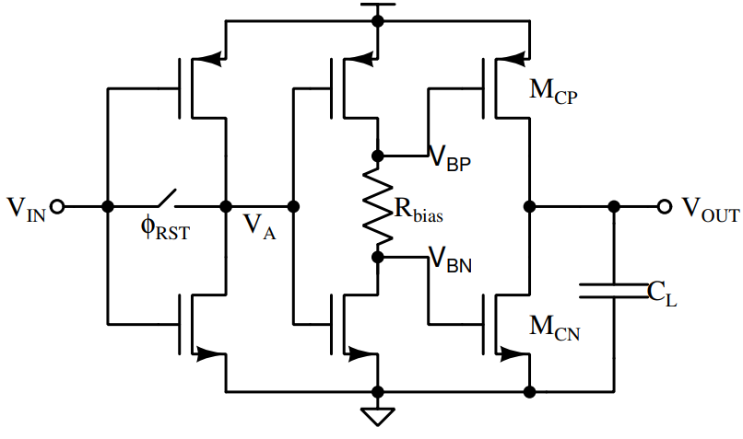

Self-Biased Ring Amplifier
Limitations of the Conventional Ring Amplifier
Floating Capacitors
Sensitive to PVT Variation
Dead zone independent of $V_{DD}$
Y. Lim and M. P. Flynn, "A 100 MS/s, 10.5 Bit, 2.46 mW Comparator-Less Pipeline ADC Using Self-Biased Ring Amplifiers," in IEEE Journal of Solid-State Circuits, vol. 50, no. 10, pp. 2331-2341, Oct. 2015, doi: 10.1109/JSSC.2015.2453332.

Slide 17
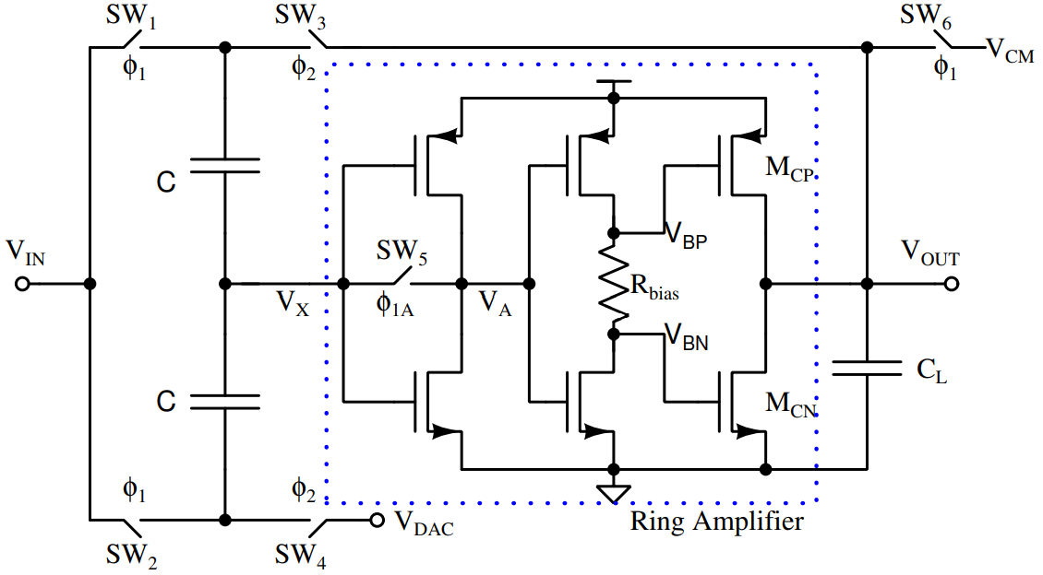


Self-Biased Ring Amplifier
MDAC using Self-Biased Ring Amplifier
$ϕ_{1}$ : Sampling phase
$ϕ_{2}$ : Amplification Phase
$V_{X}$ moves from $V_{CM}$ to $V_{CM}−V_{in}+\frac{V_{dac}}{2}+\frac{V_{out}}{2}$
Amplification Phase starts
$C_{Load}$ charges until $V_{OUT}=2V_{in}−V_{dac}$

Slide 18
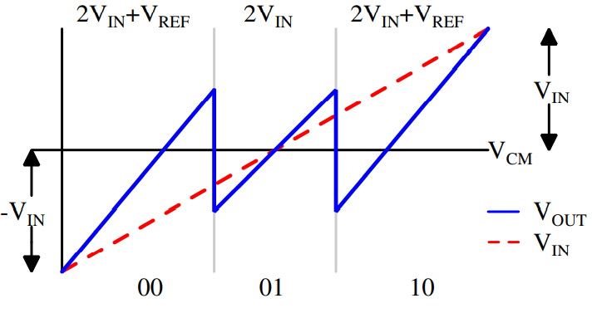
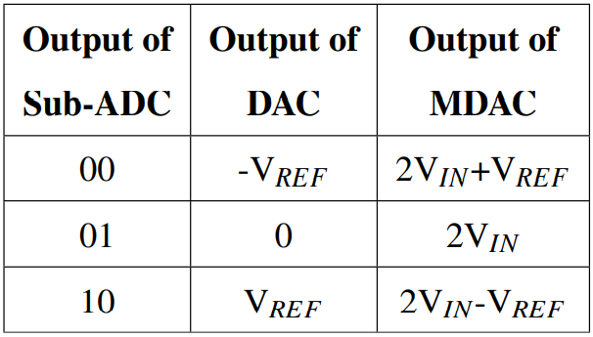
Self-Biased Ring Amplifier
MDAC Output

Slide 19
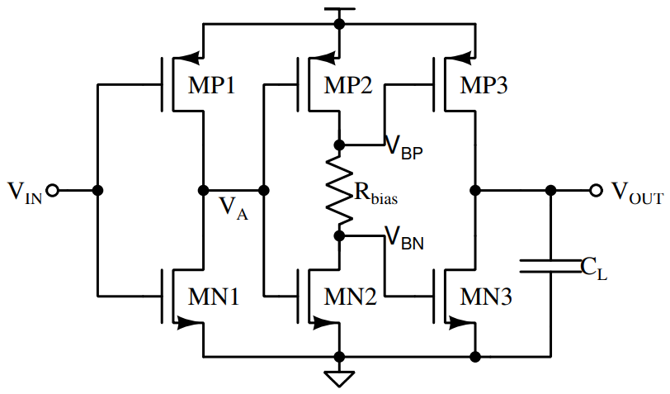
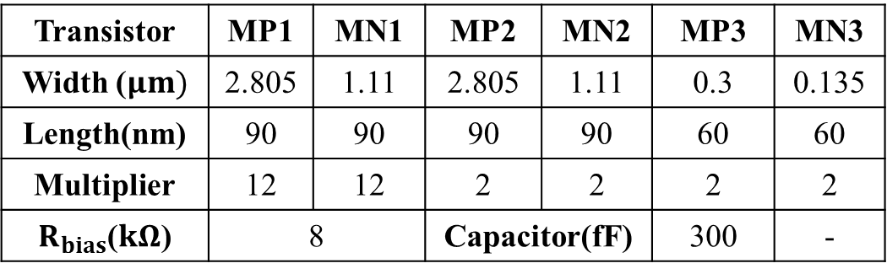
Self-Biased Ring Amplifier
Design
Transistor | MP1 | MN1 | MP2 | MN2 | MP3 | MN3
Width ($μm)$ | 2.805 | 1.11 | 2.805 | 1.11 | 0.3 | 0.135
Length(nm) | 90 | 90 | 90 | 90 | 60 | 60
Multiplier | 12 | 12 | 2 | 2 | 2 | 2
$R_{bias}$($kΩ$) | 8 |  | Capacitor(fF) |  | 300 | -

Slide 20
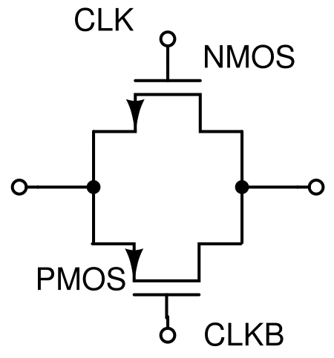
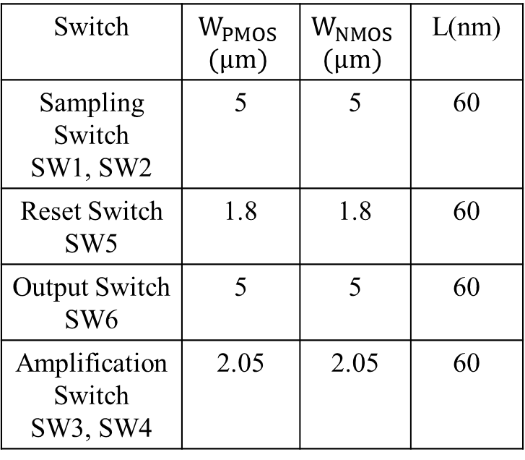
Self-Biased Ring Amplifier
Switch Design
Switch | $$W_{PMOS}$$ $$(μm)$$ | $$W_{NMOS}$$ $$(μm)$$ | L(nm)
Sampling Switch SW1, SW2 | 5 | 5 | 60
Reset Switch SW5 | 1.8 | 1.8 | 60
Output Switch SW6 | 5 | 5 | 60
Amplification Switch SW3, SW4 | 2.05 | 2.05 | 60

Slide 21
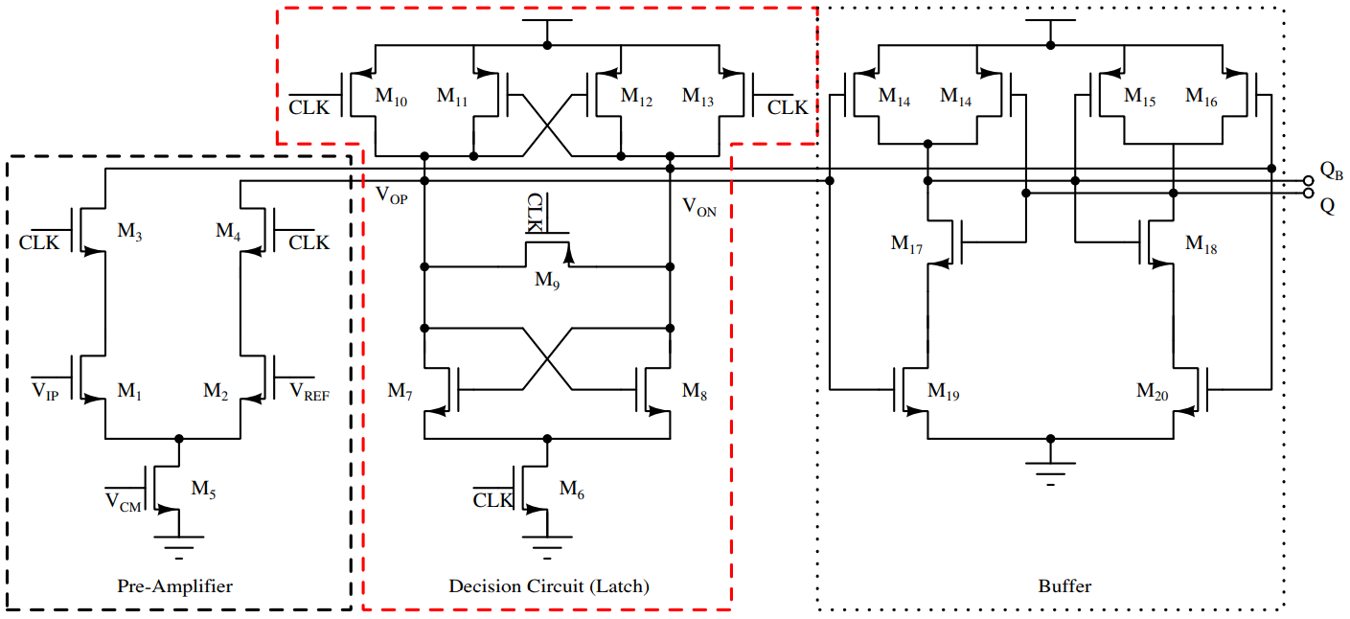
Comparator
Preamplifier Based Dynamic Comparator
Jipeng Li and Un-Ku Moon, "A 1.8-V 67mW 10-bit 100MSPS pipelined ADC using time-shifted CDS technique," Proceedings of the IEEE 2003 Custom Integrated Circuits Conference, 2003., 2003, pp. 413-416, doi: 10.1109/CICC.2003.1249430.

Slide 22
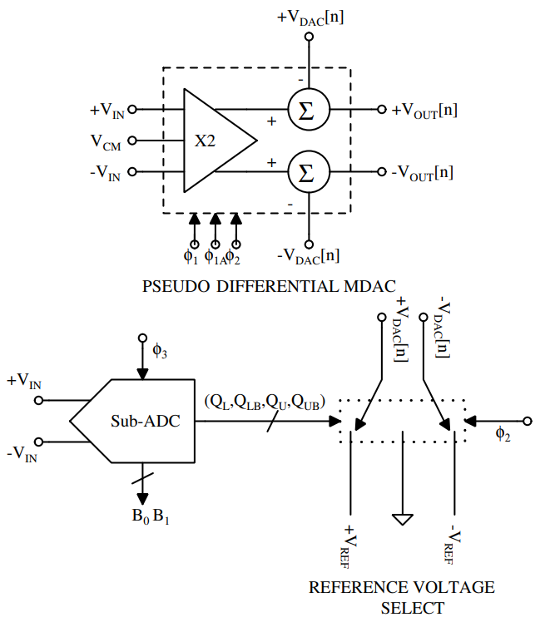
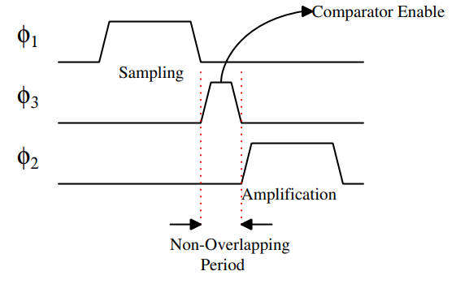
Complete Pipeline ADC
Single Stage of Pipeline ADC

Slide 23
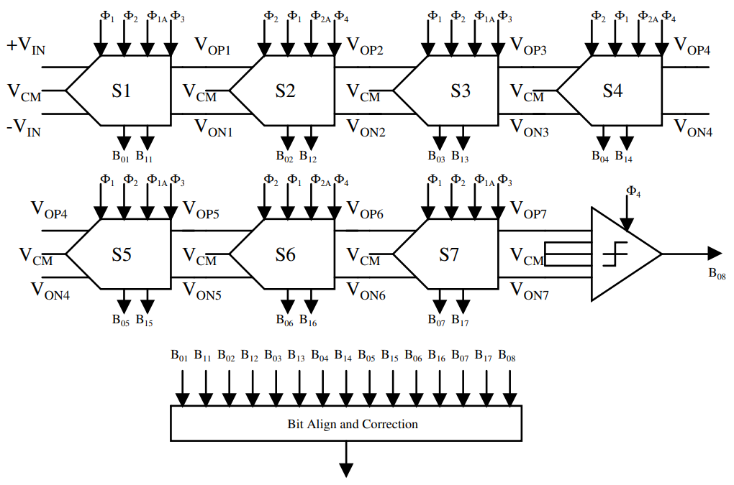
Complete Pipeline ADC
Block Diagram of the Pipeline ADC

Slide 24
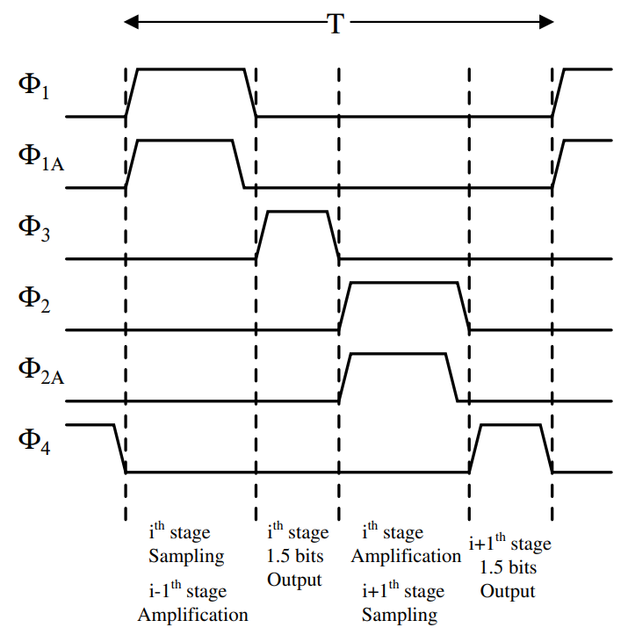
Complete Pipeline ADC
Clock Scheme Used in the Pipeline ADC

Slide 25
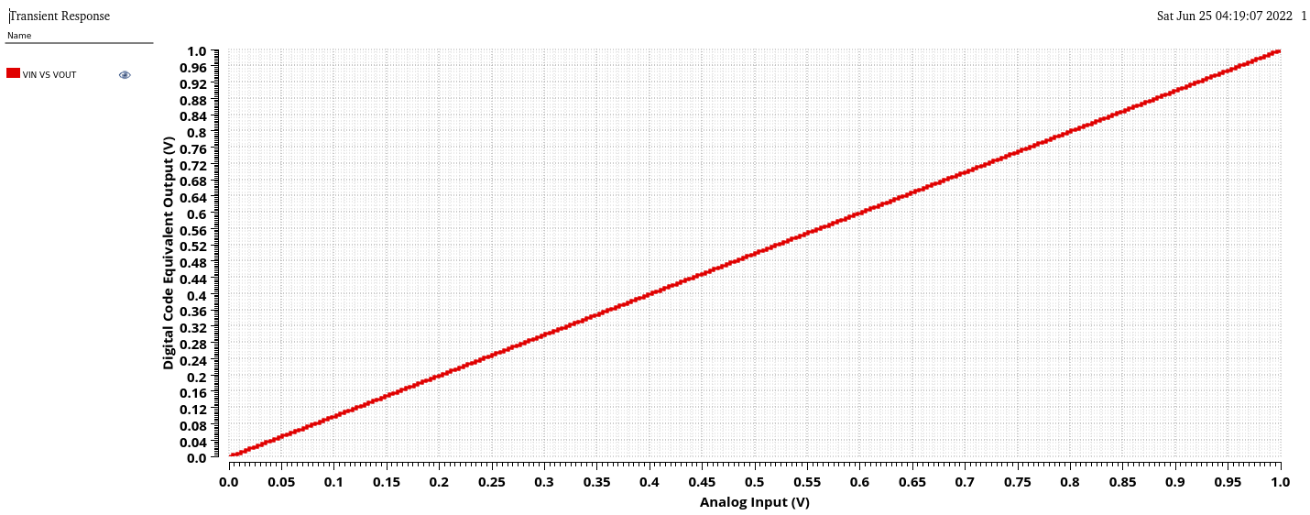

Simulations and Results
Transient Simulation of the ADC
$V_{OUT}=\frac{D_{7}}{2}+\frac{D_{6}}{4}+\frac{D_{5}}{8}+\frac{D_{4}}{16}+\frac{D_{3}}{32}+\frac{D_{2}}{64}+\frac{D_{1}}{128}+\frac{D_{0}}{256}$

Slide 26
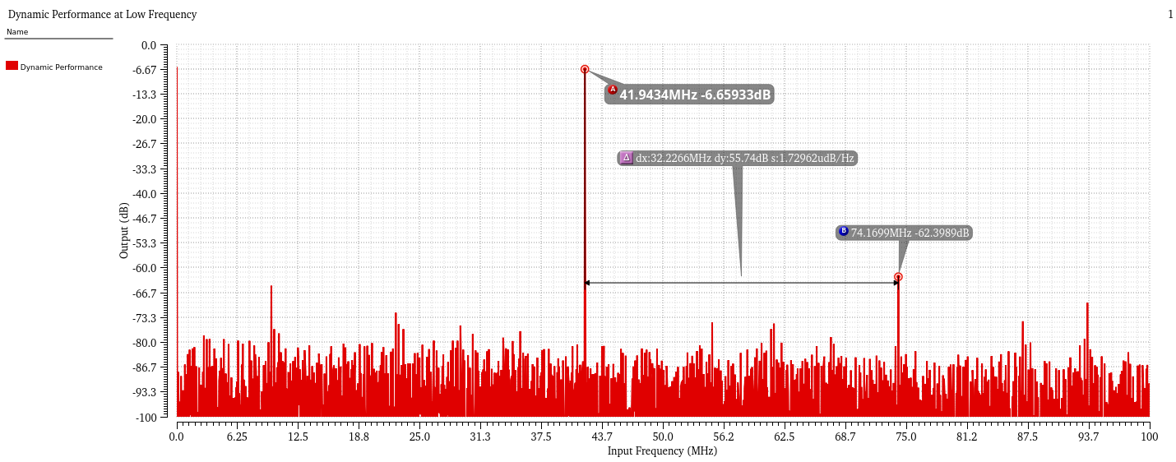

Simulations and Results
Dynamic Performance of the ADC
N = 4096 for FFT plot, $f_{sample}=200MHz$
For Low frequency, M = 859 → $f_{in}≈42MHz$
ENOB = 7.73b, SNDR = 48.3dB, SFDR = 55.73 dBc

Slide 27
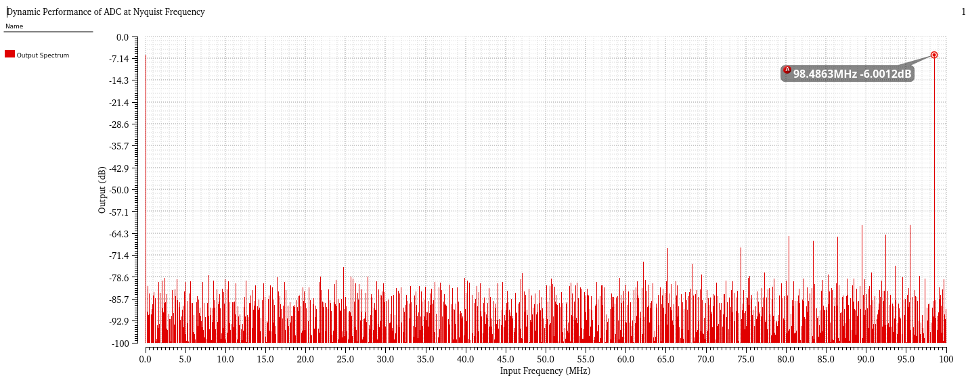

Simulations and Results
Dynamic Performance of the ADC
N = 4096 for FFT plot, $f_{sample}=200MHz$
For Nyquist frequency, M = 2017 → $f_{in}≈98MHz$
ENOB = 7.62b, SNDR = 47.68dB, SFDR = 54.3 dBc

Slide 28
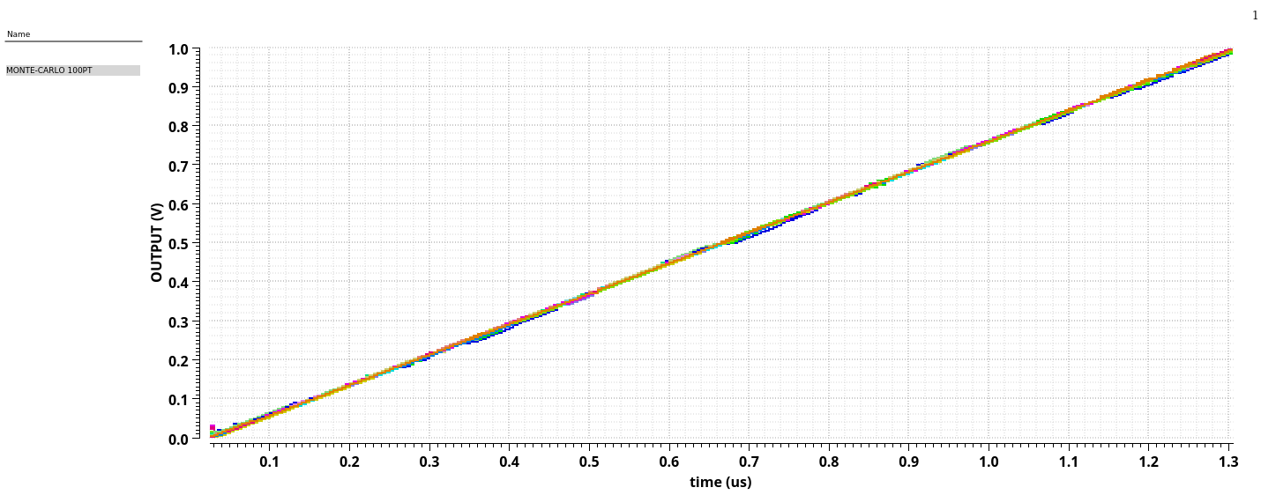
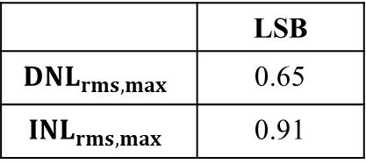

Simulations and Results
Static Performance of ADC
100 point Monte-Carlo simulation performed: Ideal LSB =3.90625mV
 | LSB
$$DNL_{rms,max}$$ | 0.65
$$INL_{rms,max}$$ | 0.91
 | mV
$$Mean(μ)$$ | 3.92
$$S.D.(σ)$$ | 0.012

Slide 29

Simulations and Results
Static Performance of ADC

Slide 30

Simulations and Results
Static Performance of ADC

Slide 31
Simulations and Results
Dynamic Performance [ENOB] in Different Corners
Corner :[Transistor Resistor Capacitor] ex. SSS = [Slow Slow Slow]
Low Frequency (M = 859)
 | Temperature
Corner | -40 | 27 | 100
SSS | 5.04 | 6.9 | 7.29
SSF | 5.65 | 7.22 | 6.97
SFS | 6.42 | 7.6 | 6.94
SFF | 5.77 | 7.27 | 7.77
FSS | 7.62 | 7.76 | 7.71
FSF | 7.84 | 7.87 | 7.92
FFS | 8.0 | 7.71 | 7.33
FFF | 7.95 | 7.65 | 7.0
TTT | 6.97 | 7.73 | 6.54
High Frequency (M = 2017)
 | Temperature
Corner | -40 | 27 | 100
SSS | 3.86 | 6.63 | 6.5
SSF | 4.96 | 7.09 | 6.59
SFS | 5.97 | 6.76 | 7.14
SFF | 5.18 | 6.38 | 7.08
FSS | 7.53 | 7.66 | 7.7
FSF | 7.6 | 7.57 | 7.79
FFS | 7.89 | 7.58 | 6.69
FFF | 7.83 | 6.93 | 6.84
TTT | 6.38 | 7.44 | 6.25

Slide 32

Simulations and Results
Dynamic Performance in Different Corners

Slide 33

Simulations and Results
Dynamic Performance in Different Corners

Slide 34

Conclusion
Ring Amplifier designed for interstage residue amplification.
8 bit Pipeline ADC is constructed using Sub-ADC(1.5 bit) and MDAC.
Operating frequency is 200Msps. Total latency of the pipeline ADC is 5 clock cycle:
4 Clock cycles for bit alignment
1 clock cycle for bit correction
For proposed pipeline ADC, ENOB, SNDR and SFDR are 7.44, 47.68 and 54.3 achieved for the $f_{in}≈$ 98MHz(Nyquist frequency)
$DNL_{rms,max}$ and $INL_{rms,max}$ are less than LSB

Slide 35
Future Work
Ring Amplifier structure can be explored more low power consumption and to improve the performance in the corners
Comparators needs to be optimized for minimum power consumption and accuracy
Clock generator circuit using logic gates
Transistor level implementation of the digital components like D flip-flop and adders
Layout of the complete pipeline ADC

Slide 36
References
B. Murmann, "The Race for the Extra Decibel: A Brief Review of Current ADC Performance Trajectories," in IEEE Solid-State Circuits Magazine, vol. 7, no. 3, pp. 58-66, Summer 2015, doi: 10.1109/MSSC.2015.2442393.
R. H. Walden, "Analog-to-digital converter survey and analysis," in IEEE Journal on Selected Areas in Communications, vol. 17, no. 4, pp. 539-550, April 1999, doi: 10.1109/49.761034.
Jipeng Li and Un-Ku Moon, "A 1.8-V 67mW 10-bit 100MSPS pipelined ADC using time-shifted CDS technique," Proceedings of the IEEE 2003 Custom Integrated Circuits Conference, 2003., 2003, pp. 413-416, doi: 10.1109/CICC.2003.1249430.
B. Hershberg, S. Weaver, K. Sobue, S. Takeuchi, K. Hamashita and U. Moon, "Ring Amplifiers for Switched Capacitor Circuits," in IEEE Journal of Solid-State Circuits, vol. 47, no. 12, pp. 2928-2942, Dec. 2012, doi: 10.1109/JSSC.2012.2217865.
Y. Lim and M. P. Flynn, "A 100 MS/s, 10.5 Bit, 2.46 mW Comparator-Less Pipeline ADC Using Self-Biased Ring Amplifiers," in IEEE Journal of Solid-State Circuits, vol. 50, no. 10, pp. 2331-2341, Oct. 2015, doi: 10.1109/JSSC.2015.2453332.
K. M. Megawer, F. A. Hussien, M. M. Aboudina and A. N. Mohieldin, "A Systematic Design Methodology for Class-AB-Style Ring Amplifiers," in IEEE Transactions on Circuits and Systems II: Express Briefs, vol. 65, no. 9, pp. 1169-1173, Sept. 2018, doi: 10.1109/TCSII.2018.2815705.
C. J. B. Fayomi and G. W. Roberts, "Design and characterization of low-voltage analog switch without the need for clock boosting," The 2004 47th Midwest Symposium on Circuits and Systems, 2004. MWSCAS '04., 2004, pp. iii-315, doi: 10.1109/MWSCAS.2004.1354358.
B. Razavi, "The Design of a Comparator [The Analog Mind]," in IEEE Solid-State Circuits Magazine, vol. 12, no. 4, pp. 8-14, Fall 2020, doi: 10.1109/MSSC.2020.3021865.
B. Razavi, "The Bootstrapped Switch [A Circuit for All Seasons]," in IEEE Solid-State Circuits Magazine, vol. 7, no. 3, pp. 12-15, Summer 2015, doi: 10.1109/MSSC.2015.2449714.

Slide 37
References
C. Y. Lee, P. K. Venkatachala, A. ElShater, B. Xiao, H. Hu and U. -K. Moon, "Cascoded Ring Amplifiers for High Speed and High Accuracy Settling," 2019 IEEE International Symposium on Circuits and Systems (ISCAS), 2019, pp. 1-5, doi: 10.1109/ISCAS.2019.8702710.
K. M. Megawer, F. A. Hussien, M. M. Aboudina and A. N. Mohieldin, "An adaptive slew rate and dead zone ring amplifier," 2016 IEEE International Symposium on Circuits and Systems (ISCAS), 2016, pp. 305-308, doi: 10.1109/ISCAS.2016.7527231.
C. Bae et al., "An 11-bit Ring Amplifier Pipeline ADC with Settling-Time Improvement Scheme," 2020 International Conference on Electronics, Information, and Communication (ICEIC), 2020, pp. 1-4, doi: 10.1109/ICEIC49074.2020.9051188.
W. -T. Chen, Y. -T. Shyu, C. -P. Huang and S. -J. Chang, "A pipeline ADC with latched-based ring amplifiers," 2016 IEEE International Symposium on Circuits and Systems (ISCAS), 2016, pp. 85-88, doi: 10.1109/ISCAS.2016.7527176.

Slide 38
THANK YOU

Slide 39

Pipeline ADC Architecture
Pipeline ADC Operations

Slide 40

Comparison
Comparison of Proposed ADC with Published Work
 | JSSC 2012[4] | JSSC 2015[5] | ICEIC 2020[12] | ISCAS 2015[13] | This Work
$$f_{sample}(MHz)$$ | 30 | 100 | 100 | 70 | 200
Resolution(bits) | 10.5 | 10.5 | 11 | 10 | 8
ENOB(bits) | 9.9 | 9.33 | 10.8 | 8.36 | 7.44
SNDR(dB) | 61.9 | 57.9 | 66.8 | 52 | 47.68
SFDR(dBc) | 74.2 | 71.9 | 76.03 | - | 54.3
Power(mW) | 2.6 | 2.46 | 18.6 | 3.64 | 22
FoM(fJ/C-step) | 90 | 38.4 | 104 | 159.2 | 460
Technology | 180 | 65 | 65 | 90 | 65

Slide 41


Simulation and Results
On Resistance of the Switch
$R_{on}≪\frac{1}{C.N.f_{sample}2\ln{2}}$; C = 300f $∴R≪4.5kΩ$

Slide 42

Simulation and Results
Open Loop Gain of the Ring Amplifier

Slide 43


Simulation and Results
Variation in Dead Zone due to $R_{bias}$ in the Ring Amplifier
$R_{bias}=5k,8k,11k,14k$
$V_{DZ}=V_{BP}−V_{BN}=I×R_{bias}$

Slide 44


Simulations and Results
Variation in Transient Behavior due to Slew Current
$SR=\frac{I_{I3}}{C_{L}}=\frac{μC_{ox}W_{3}{\left(V_{GS}−V_{th}\right)}^{2}}{2C_{L}L_{3}}$
Variation in Width of output inverter: W, 2W, 3W, 4W, 5W
For W = 80$μA$

Slide 45


Simulations and Results
Variation in Transient Behavior due to $R_{bias}$
$V_{overshoot}=I_{I3}.\frac{T_{delay}}{C_{load}}$
Variation in $R_{bias}:$ 5k, 8k, 11k, 14k

