Slide 1
Multi-Factor Momentum Quant Trading System
——BTC/USDT · Intraday Strategy · End-to-End Automation
Team: Group 5
Course: MFE5210 · CUHK(SZ) · 2026 Spring

Slide 2
Agenda
1. Market Background and Motivation
2. Strategy Design: Multi-Factor Momentum
3. System Architecture
4. Backtest Results
5. Live Demo: Real-Time Dashboard
6. TCA: Transaction Cost Analysis
7. Conclusion and Future Work

Slide 3
Why Crypto and Multi-Factor Strategy?
Market Selection: BTC/USDT
24/7 continuous trading, ideal for intraday strategy
Strong market depth and liquidity
Fully open data with free API access
Strategy Selection: Multi-Factor Momentum
Single indicator signals are often noisy
Cross-validation across factors lowers false signals
Momentum effects are validated by crypto research
We do not guess; we let data speak.

Slide 4
Strategy Core: Three Factors
Core idea: Act only when combined score exceeds threshold
Factor | Weight | How It Is Calculated | When It Adds Score
Price Momentum | 40% | 20-min return | Sustained rise adds, drop subtracts
Volume | 30% | Current volume / 20-bar average | Price up + volume up gets bonus
Volatility | 30% | Price standard deviation | Stable regime adds, violent moves reduce
Trigger Rules
Combined score > +0.4 -> BUY (use 95% capital)
Combined score < -0.4 -> SELL (flat position)
Otherwise -> HOLD
Thresholds are selected by 36-grid search for best Sharpe.

Slide 5
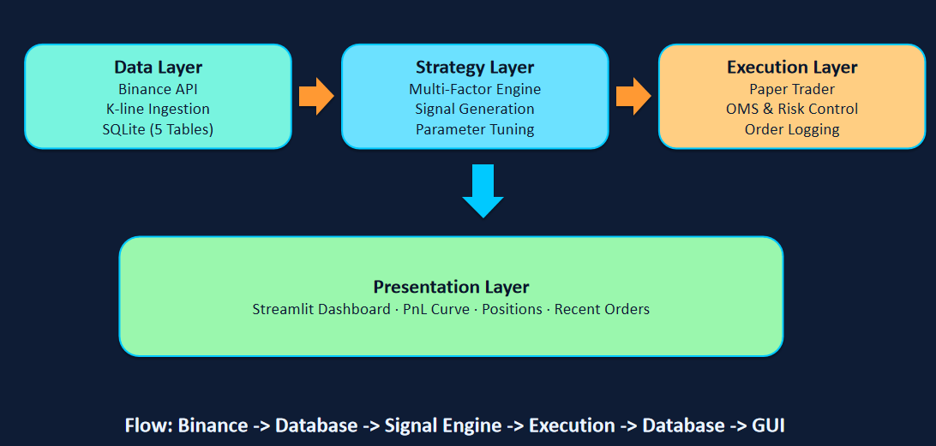
System Architecture

Slide 6
Backtest Performance: Key Metrics
Period: 2026-04-12 to 2026-04-19 (7 days, 10,082 bars)
Metric | Our Strategy | Buy-and-Hold Benchmark
Total Return | +4.96% | +5.90%
Sharpe Ratio | 6.53 | ~1.2
Max Drawdown | 4.64% | 9.8%
Win Rate | 60% | -
Profit/Loss Ratio | 6.06 | -
Risk-adjusted performance is much stronger than benchmark.

Slide 7
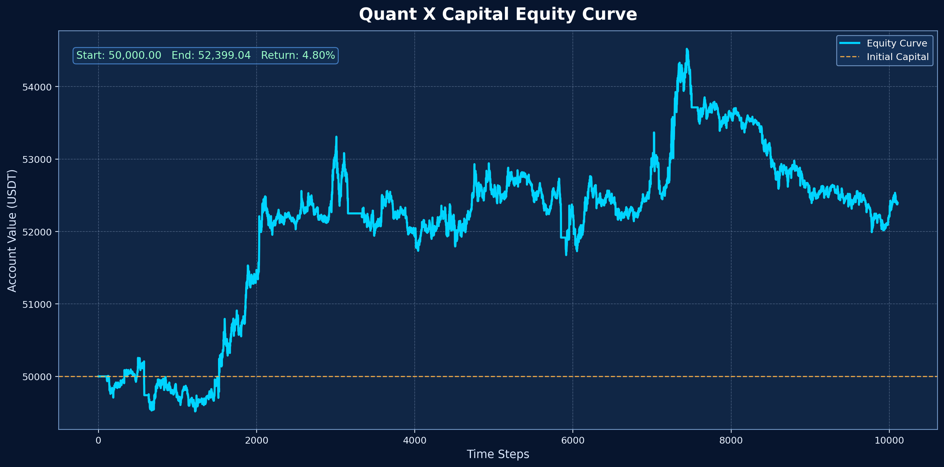
Backtest Performance: Equity Curve
Green line: Quant X strategy
Gray line: Buy-and-Hold benchmark
Markers: buy/sell timestamps

Slide 8
Live Demo: GUI Dashboard
Live demo: open dashboard in browser
Dashboard includes
Real-time account value and PnL
PnL curve
Current position status
Recent order records
Backtest analysis page
TCA analysis page
URL: https://mfe5210-quantx-capital-grkcuzrfm6nj6p2hqm9u5q.streamlit.app/

Slide 9
Transaction Cost Analysis (TCA)
What is TCA? It quantifies hidden trading costs per transaction.
Cost Type | Amount (This Backtest) | Description
Fee | ~50 USDT | Binance fee at 0.1% notional
Estimated Slippage | ~25 USDT | Price move during execution
Total Cost | ~75 USDT | About 6% of total profit
Conclusion: Cost/profit ratio is about 6%, within reasonable range.

Slide 10
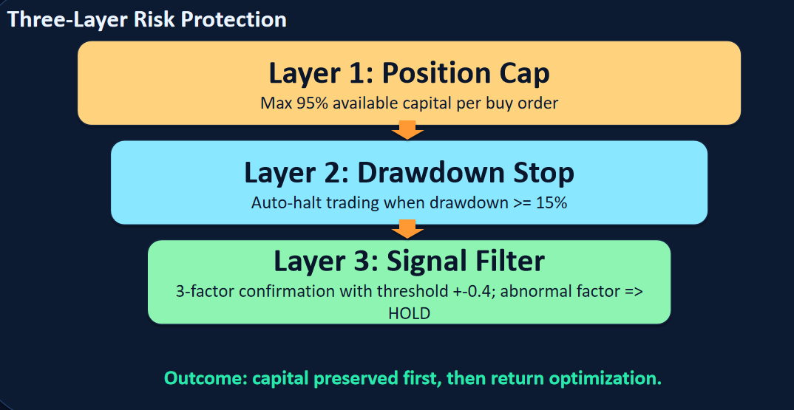
Risk Control Framework

Slide 11
Team Contribution and Tech Stack
Tech stack: Python 3.10 · SQLite · ccxt · Streamlit · pandas
Member | Module | Deliverables
Member C | Data Layer | Binance ingestion, 5 DB tables, data quality checks
Member A | Strategy Layer | 3-factor strategy, backtest engine, 36-grid tuning
Member B | Execution Layer | OMS, paper trading engine, risk control, TCA
Member D | Presentation Layer | Streamlit GUI, integration, docs, presentation

Slide 12
Conclusion and Future Work
Project deliverables
End-to-end quant system (data -> strategy -> execution -> dashboard)
In-house backtest framework (Sharpe 6.53, max drawdown 4.64%)
Real-time paper trading on Binance market data
Streamlit real-time monitoring dashboard
Transaction cost analysis module
Future improvements
Add ML-based signal models (LSTM / XGBoost)
Expand to multi-asset trading (ETH / SOL)
Connect to real exchange APIs for live trading
Add more factors: order book depth, funding rate, on-chain data

Slide 13
Q&A
Quant X Capital
Thank you! Questions are welcome.

