Slide 1

Instruction Pipelining and Hazards
An Zou
anzou@wustl.edu
The Preston M. Green Department of Electrical and Systems Engineering
Notes:
Dear students, today we will talk about the Instruction pipelining and the hazards in this pipelined executions.
在组合逻辑电路中，不同路径的输入信号变化传输到同一点门级电路时，在时间上有先有后，这种先后所形成的时间差称为竞争（Competition）
由于竞争的存在，输出信号需要经过一段时间才能达到期望状态，过渡时间内可能产生瞬间的错误输出，例如尖峰脉冲。这种现象被称为冒险（Hazard）

Slide 2

Single Instruction Execution
Instruction execution from C to assembly code
C code for a = b+c:
int a = b + c;
Machine code or ­­Assembly code for a = b+c:
lw Rb, b
lw Rc, c
add Ra, Rb, Rc
sw Ra, a
Load b to register Rb
Load c to register Rc
Add the value in register Rb and Rc to register Ra
write register Ra to memory a
Notes:
Let us first look at a example. We can write a simple C code to calculate the integer type addition. Here it is variable b plus variable c and result is assigned to variable a. To execution this instruction, the compiler first compiles it into machine code or assembly code. In the machine code or assembly code, four instructions are needed to finish this. First Load the variable b to register Rb, Load variable c to register Rc, Add the value in register Rb and Rc to register Ra, and finally write register Ra to memory a。

Slide 3
Single Instruction Execution
Assembly execution on the digital circuit
add Ra, Rb, Rc
Reg access / decode
Data access
Instruction fetch
ALU operation
Reg
write-
back
Notes:
Then, the machine code needs these steps to execute on hardware digital circuit. Let us the machine code add he value in register Rb and Rc to register Ra as example. First, the digital circuit need to fetch this instruction for cache or memory. Then the digital circuit needs to decode the instruction to know what operation it is and also access the registers used in this instruction. Next, it needs to do the calculation operation here it is addition. In other instructions such as memory read and write, the calculation operation calculate the target address. After this, it will access cache or memory if needed. Final, the value is written to the target register. In this example, it is register Ra.

Slide 4
Single Instruction Execution
Problems
Wasted resource and low instruction execution speed
Reg access / decode
Data access
Instruction fetch
ALU operation
Reg
write-
back
Notes:
With this example, we can notice the inefficiency in this instruction execution. When the instruction are in the instruction fetch status, only this part of digital circuits are used. Similarly, when the instruction comes to the decode and register access stage, other digital circuits are in idle. This execution manner has a low resource utilization rate. Meanwhile, when the digital circuits are in idle, they are still consuming power.

Slide 5
Single Instruction Execution
Multiple Instruction Execution Order
Cycle 1
Cycle 2
Cycle 3
Cycle 4
Cycle 5
Cycle 6
Cycle 7
Cycle 8
Cycle 9
lw Rb, b
Ifetch
Reg
ALU
DMem
Reg
lw Rc, c
Ifetch
Reg
ALU
DMem
Reg
Notes:
When multiple instructions are execution in this manner, the next instruction can start only after the previous instruction finish. Therefore, each instruction has a long latency and the system has a slow instruction execution speed, which means a low performance.

Slide 6

Pipelined Instruction Execution
The idea of pipelining (laundry example)
Step 1
Step 2
Step 3
Step 4
Step 5
Step 6
Step 7
Step 8
Step 9
Notes:
To increase the instruction execution speed, pipelined execution are introduced. Let us use a simple example to show how the pipeline works. We assume that we are doing laundry at home. It has three steps. First washing with wash machine. Second is drying with dryer. The third step is folding the clothes. After we wash the first basket of clothes, we do not need to wait all these three steps to finish and then start the second basket. We can start the second basket when the washer is free and comes to the dryer. Similarly, the second basket can start when the second basket finish the first step. So on and So forth.

Slide 7
Pipelined Instruction Execution
Pipelined Execution
Cycle 1
Cycle 2
Cycle 3
Cycle 4
Cycle 5
Cycle 6
Cycle 7
lw Rb, b
Ifetch
Reg
ALU
DMem
Reg
lw Rc, c
Ifetch
Reg
ALU
DMem
Reg
add Ra, Rb, Rc
Ifetch
Reg
ALU
DMem
Reg
sw Ra, a
Ifetch
Reg
ALU
DMem
Reg
Notes:
Then we come back to our instruction execution problem. The second instruction can execute when the first instruction finishes its first stage which is instruction fetch. The third instruction can execute when the second instruction finishes its first stage which is instruction fetch. So on and so forth. When there are N instructions, it will take N+4 cycles to finish all the instructions. When the number of instruction is large enough, the average instruction execution rate is 1 instruction per cycle.

Slide 8
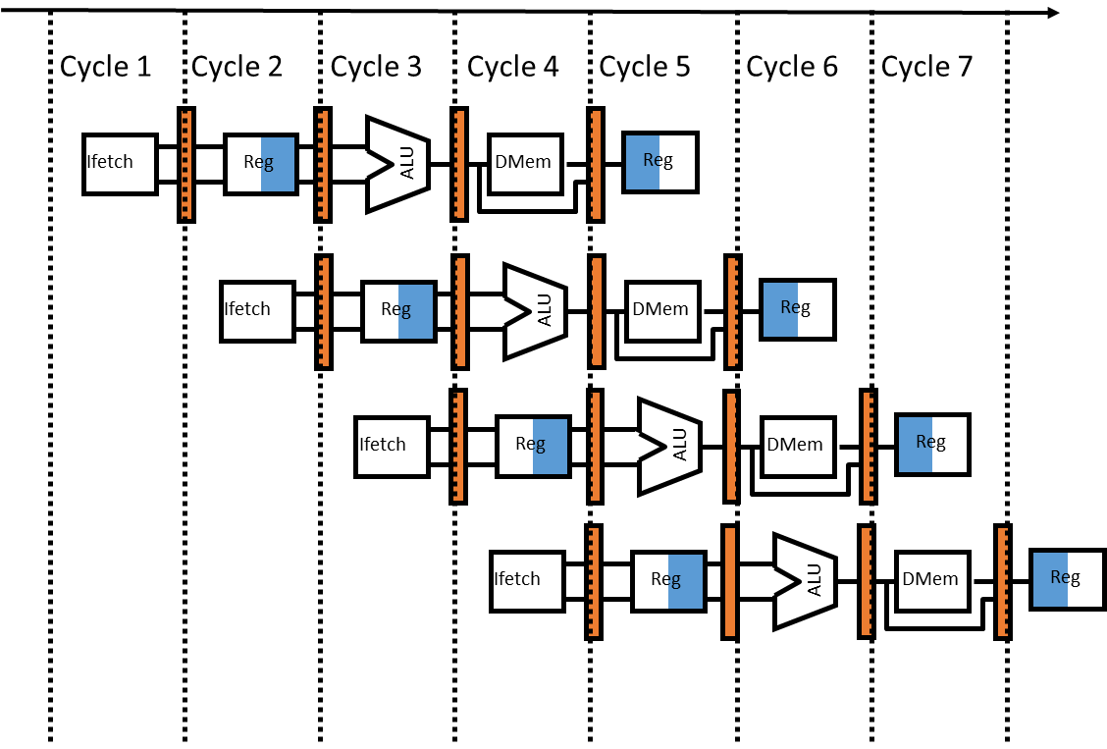
Pipelined Instruction Execution
Pipelined Execution
The good news
Multiple instructions are being processed
at same time
Best case speedup of N (N is stage number.)
The bad news
Instructions interfere with each other - hazards
Example: different instructions may need the same piece of hardware (e.g., memory) in same clock cycle
Example: instruction may require a result produced by an earlier instruction that is not yet complete
Example: instructions are not in order because of branches
Notes:
Now, let us have a brief summary of the pipeline instruction execution. For the advantages of pipelined execution, multiple instructions are being processed at same time. The pipeline can work because the stages are isolated by registers. The most significant one is the that it can speedup the instruction execution speed by N times. N is the number of stages. Every coin has two sides. Pipeline also brings extra problems. The instructions can interfere with each other which is call hazards. For example, XXX.

Slide 9
Pipeline Hazards
Hazards
Structural hazards:
Two different instructions use same hardware in same cycle
Data hazards:
Instruction depends on result of prior instruction still in the pipeline
Read after write (RAW): a true dependency.
Write after read (WAR): an anti-dependency (no hazards).
Write after write (WAW): an output dependency (no problem in atom execution and problems in concurrency).
Control hazards:
Pipelining of branches & other instructions that change the PC
Notes:
结构冒险（Structural Hazard）、
数据冒险（Data Hazard）
以及控制冒险（Control Hazard）

Slide 10
Pipeline Hazards
Hazards
Structural hazards:
Two different instructions use same hardware in same cycle
Data hazards:
Instruction depends on result of prior instruction still in the pipeline
Read after write (RAW): a true dependency.
Write after read (WAR): an anti-dependency (no hazards).
Write after write (WAW): an output dependency (no problem in atom execution and problems in concurrency).
Control hazards:
Pipelining of branches & other instructions that change the PC
Notes:
结构冒险（Structural Hazard）、
数据冒险（Data Hazard）
以及控制冒险（Control Hazard）

Slide 11
Pipeline Hazards
Structural Hazards：
Two different instructions use same hardware in same cycle
Cycle 1
Cycle 2
Cycle 3
Cycle 4
Cycle 5
Cycle 6
Cycle 7
If there is one memory (cache) for both data and instruction
Ifetch
Reg
ALU
DMem
Reg
C
Memory
Ifetch
Reg
ALU
DMem
Reg
C
Ifetch
Reg
ALU
DMem
Reg
Ifetch
Reg
ALU
DMem
Reg
Notes:
在第 1 条指令执行到访存（MEM）阶段的时候，流水线里的第 4 条指令，在执行取指令（Fetch）的操作。访存和取指令，都要进行内存数据的读取。我们的内存，只有一个地址译码器的作为地址输入，那就只能在一个时钟周期里面读取一条数据，没办法同时执行第 1 条指令的读取内存数据和第 4 条指令的读取指令代码。
类似的资源冲突，其实你在日常使用计算机的时候也会遇到。最常见的就是薄膜键盘的“锁键”问题。常用的最廉价的薄膜键盘，并不是每一个按键的背后都有一根独立的线路，而是多个键共用一个线路。如果我们在同一时间，按下两个共用一个线路的按键，这两个按键的信号就没办法都传输出去。

Slide 12
Pipeline Hazards
Structural Hazard Solution：
Add more resources (e.g. data memory and instruction memory)
Cycle 1
Cycle 2
Cycle 3
Cycle 4
Cycle 5
Cycle 6
Cycle 7
Reg
Data Mem
Ifetch
Reg
ALU
DMem
Ifetch
Reg
ALU
DMem
Reg
Ifetch
Reg
ALU
DMem
Reg
Inst Mem
Ifetch
Reg
ALU
DMem
Reg
Notes:
解决这种问题的本质方法就是增加资源。例如，对于访问内存数据和取指令的冲突，一个直观的解决方案就是把我们的内存分成两部分，让它们各有各的地址译码器。这两部分分别是存放指令的程序内存和存放数据的数据内存。
样把内存拆成两部分的解决方案，在计算机体系结构里叫作哈佛架构（Harvard Architecture）。对应的，我们之前说数据和指令都存在同一块内存中结构就是冯·诺依曼体系结构，又叫作普林斯顿架构（Princeton Architecture）。
我们今天使用的 CPU，仍然是冯·诺依曼体系结构的，并没有把内存拆成程序内存和数据内存这两部分。因为如果那样拆的话，对程序指令和数据需要的内存空间，我们就没有办法根据实际的应用去动态分配了。虽然解决了资源冲突的问题，但是也失去了灵活性。
现代的 CPU 虽然没有在内存层面进行对应的拆分，却在 CPU 内部的高速缓存部分进行了区分，把高速缓存分成了指令缓存（Instruction Cache）和数据缓存（Data Cache）两部分。

Slide 13
Pipeline Hazards
Hazards
Structural hazards:
Two different instructions use same hardware in same cycle.
Data hazards:
Instruction depends on result of prior instruction still in the pipeline
Read after write (RAW): a true dependency.
Write after read (WAR): an anti-dependency (no hazards).
Write after write (WAW): an output dependency (no problem in atom execution and problems in concurrency).
Control hazards:
Pipelining of branches & other instructions that change the PC.

Slide 14
Pipeline Hazards
Data Hazards：Read after Write
Instruction depends on result of prior instruction still in the pipeline
Cycle 1
Cycle 2
Cycle 3
Cycle 4
Cycle 5
Cycle 6
Cycle 7
add Ra, Rb, Rc
Ifetch
Reg
ALU
DMem
Reg
C
add Re, Ra, Rd
Ifetch
Reg
ALU
DMem
Reg
C
Ifetch
Reg
ALU
DMem
Reg
Ra is ready after Cycle 5 but we use it at Cycle 3
Ifetch
Reg
ALU
DMem
Reg
Notes:
Then let us look at the read after write (RAW) hazard which has a true dependency. The first instruction will write to register Ra at the cycle 5. The second instruction will read register Ra at the cycle 3. Then here comes the problem, Ra is ready after Cycle 5 but we use it at Cycle 3. This is the wrong execution called read after write (RAW) hazard.
这个先写后读的依赖关系，我们一般被称之为数据依赖，也就是 Data Dependency

Slide 15
Pipeline Hazards
Data Hazards：Write after Read
Instruction depends on result of prior instruction still in the pipeline
Cycle 1
Cycle 2
Cycle 3
Cycle 4
Cycle 5
Cycle 6
Cycle 7
add Rb, Ra, Rc
Ifetch
Reg
ALU
DMem
Reg
C
add Ra, Rc, Rd
Ifetch
Reg
ALU
DMem
Reg
C
Ifetch
Reg
ALU
DMem
Reg
Ra is read at Cycle 2 and we update it at Cycle 6: Correct
Ifetch
Reg
ALU
DMem
Reg
Notes:
The second data hazard is the write after read. The first instruction reads Ra at cycle 2 and the second instruction write the result to the register at cycle 6. This is totally correct. The writing does not affect the previous read.

Slide 16
Pipeline Hazards
Data Hazards：Write after Write
Instruction depends on result of prior instruction still in the pipeline
Cycle 1
Cycle 2
Cycle 3
Cycle 4
Cycle 5
Cycle 6
Cycle 7
add Ra, Rb, Rc
Ifetch
Reg
ALU
DMem
Reg
C
add Ra, Rc, Rd
Ifetch
Reg
ALU
DMem
Reg
C
Ifetch
Reg
ALU
DMem
Reg
No problem for atom execution and will cause problem in concurrency (multiple instruction are executed simultaneously)
Ifetch
Reg
ALU
DMem
Reg
Notes:
The third data hazard is called write after write. The first instruction writes register Ra at cycle 5 and the second instruction write the result to the same register Ra at cycle 6. The second writing will overwrite the first writing. This is totally correct. No problem for atom execution and will cause problem in concurrency (for example, two types of multiple instruction are executed by two sets of hardware simultaneously)
这个写后再写的依赖，一般被叫作输出依赖，也就是 Output Dependency。

Slide 17
Pipeline Hazards
Data Hazard Solutions:
Adding pipeline stall (also called pipeline bubbling)
Cycle 1
Cycle 2
Cycle 3
Cycle 4
Cycle 5
Cycle 6
Cycle 7
add Ra, Rb, Rc
Ifetch
Reg
ALU
DMem
Reg
add Re, Ra, Rd
Ifetch
Reg
ALU
DMem
Ifetch
Reg
ALU
Notes:
所以，我们需要有解决这些数据冒险的办法。其中最简单的一个办法，不过也是最笨的一个办法，就是流水线停顿（Pipeline Stall），或者叫流水线冒泡（Pipeline Bubbling）。流水线停顿的办法很容易理解。如果我们发现了后面执行的指令，会对前面执行的指令有数据层面的依赖关系，那最简单的办法就是“再等等”。我们在进行指令译码的时候，会拿到对应指令所需要访问的寄存器和内存地址。所以，在这个时候，我们能够判断出来，这个指令是否会触发数据冒险。如果会触发数据冒险，我们就可以决定，让整个流水线停顿一个或者多个周期。

Slide 18
Pipeline Hazards
Data Hazards Solutions:
Bypass (or forward) data directly to the consuming pipeline stage
Cycle 1
Cycle 2
Cycle 3
Cycle 4
Cycle 5
Cycle 6
Cycle 7
add Ra, Rb, Rc
Ifetch
Reg
ALU
DMem
Reg
add Re, Ra, Rd
Ifetch
Reg
ALU
DMem
Reg
Ifetch
Reg
ALU
DMem
Reg
Ifetch
Reg
ALU
DMem
Reg
Notes:
在解决数据冒险问题之前不需要等待指令的执行结束。对于上述的代码序列， 一旦ALU生成了加法运算的结果，就可以将它用作减法运算的一个输入项。从内部资源中直接提前得到缺少的运算项。例如在这个问题中，ALU data generated at end of EX; consumed at beginning of EX。那么就可以在两个指令的EX阶段之间加个旁路：

Slide 19
Pipeline Hazards
Hazards
Structural hazards:
Two different instructions use same hardware in same cycle
Data hazards:
Instruction depends on result of prior instruction still in the pipeline
Read after write (RAW): a true dependency.
Write after read (WAR): an anti-dependency (no hazards).
Write after write (WAW): an output dependency (no problem in atom execution and problems in concurrency).
Control hazards:
Pipelining of branches & other instructions that change the PC
Notes:
结构冒险（Structural Hazard）、
数据冒险（Data Hazard）
以及控制冒险（Control Hazard）

Slide 20
Pipeline Hazards
Control Hazards：
Pipelining of branches & other instructions that change the PC
Cycle 1
Cycle 2
Cycle 3
Cycle 4
Cycle 5
Cycle 6
Cycle 7
beq Ra, Rb, there
Ifetch
Reg
ALU
DMem
Reg
C
Branch to flag “there” if Ra is equal to Rb
Ifetch
Reg
ALU
DMem
Reg
Ifetch
Reg
ALU
DMem
Reg
there: add Ra, Rb, Rc
Ifetch
Reg
ALU
DMem
Reg
Notes:
The third type of hazard is control hazard. For example, let us take a look at a branch instruction. This instruction means Branch to flag “there” if Ra is equal to Rb. In this case, next instruction will be the fourth instruction. So that previously executed instructions are wrong. The system has to recover and start the fourth instruction.

Slide 21
Pipeline Hazards
Control Hazard Solution：
Fetch and cancel When Taken
Cycle 1
Cycle 2
Cycle 3
Cycle 4
Cycle 5
Cycle 6
Cycle 7
beq Ra, Rb, there
Ifetch
Reg
ALU
DMem
Reg
Ifetch
Reg
ALU
DMem
Reg
Ifetch
Reg
ALU
DMem
Reg
there: add Ra, Rb, Rc
Ifetch
Reg
ALU
DMem
Reg
Notes:
意思就是假设分支不发生，让流水线按顺序往下fetch。如果后来发现真的要branch了，就清空流水线（cancel instructions），相当于插入了bubble。如果没branch就按原计划执行，无bubble

Slide 22
Summary
Pipelined Execution
The good news
Multiple instructions are being processed
at same time
Best case speedup of N (N is stage number.)
The bad news
Instructions interfere with each other - hazards
Example: different instructions may need the same piece of hardware (e.g., memory) in same clock cycle
Example: instruction may require a result produced by an earlier instruction that is not yet complete
Example: instructions are not in order because of branches
Notes:
Now, let us have a brief summary of the pipeline instruction execution. For the advantages of pipelined execution, multiple instructions are being processed at same time. The pipeline can work because the stages are isolated by registers. The most significant one is the that it can speedup the instruction execution speed by N times. N is the number of stages. Every coin has two sides. Pipeline also brings extra problems. The instructions can interfere with each other which is call hazards. For example, XXX.

Slide 23
Summary
Hazards
Structural hazards:
Two different instructions use same hardware in same cycle.
S: Increase available resources, such as having multiple ports into main memory and multiple ALU (Arithmetic Logic Unit) units.
Data hazards:
Instruction depends on result of prior instruction still in the pipeline.
Read after write (RAW): a true dependency.
Write after read (WAR): an anti-dependency (no hazards).
Write after write (WAW): an output dependency (no problem in atom execution and problems in concurrency).
S: Insert a pipeline bubble whenever a read after write (RAW) dependency is encountered; bypassing and so on.
Control hazards:
Pipelining of branches & other instructions that change the PC.
Branch prediction: guess the outcome of a conditional operation and execute the most likely result.
Notes:
结构冒险（Structural Hazard）、
数据冒险（Data Hazard）
以及控制冒险（Control Hazard）

