Slide 1
Faster&Mask-RCNN
ZouBoHao

Slide 2
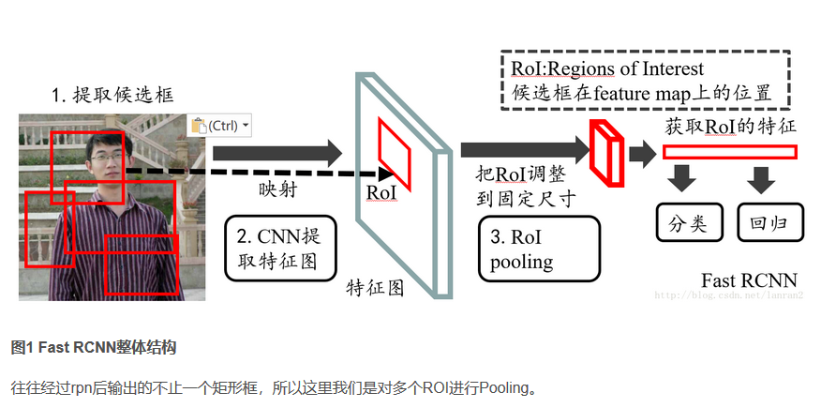
Fast-RCNN
Extracts features using RoIPool from each candidate box and performs classification and bounding-box regression.

Slide 3
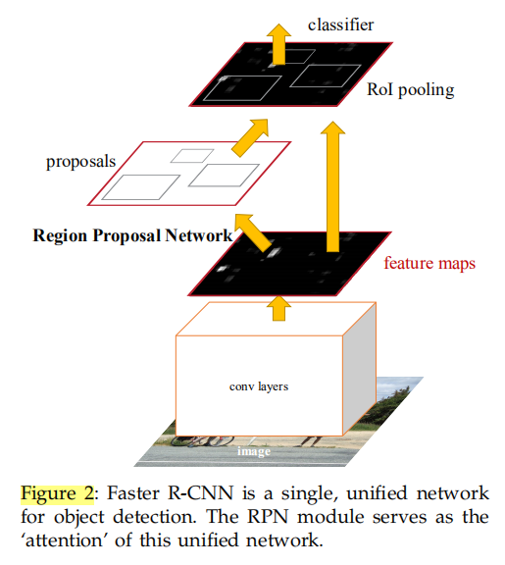
The structure of Faster-RCNN
The first module is a deep fully convolutional network that proposes regions(give or generate the proposed regions.)
The second is Fast R-CNN detector that uses the proposed regions.
The entire system is a single, unified network for object detection.

Slide 4
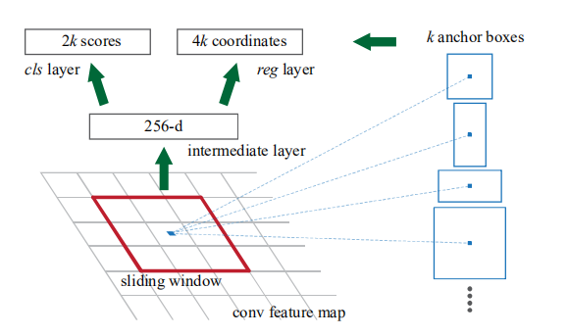
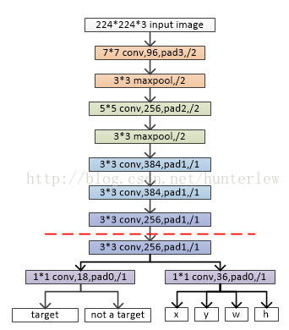
RPN(Region Proposal Networks)
An image (of any size) as input,outputs a set of rectangular object proposals, each with an objectness score.
To generate region proposals, we slide a small network over the convolutional feature map output by the last shared convolutional layer.This small network takes as input an n × n spatial window.
This feature is fed into two sibling fully connected layers—a box-regression layer (reg) and a box-classification layer (cls).
This architecture is naturally implemented with an n×n convolutional layer followed by two sibling 1 × 1 convolutional layers (for reg and cls, respectively)

Slide 5
Anchors
At each sliding-window location, we simultaneously predict multiple region proposals, where the number of maximum possible proposals for each location is denoted as k.So the reg layer has 4k outputs encoding the coordinates of k boxes, and the cls layer outputs 2k scores that estimate probability of object or not object for each proposal.
The k proposals are parameterized relative to k reference boxes, which we call anchors.
An anchor is centered at the sliding window , and is associated with a scale and aspect ratio. By default we use 3 scales and3 aspect ratios, yielding k = 9 anchors at each sliding position. For a convolutional feature map of a size W × H (typically ∼2,400), there are W *H*k anchors in total.
For anchors, we use 3 scales with box areas of 128*128,256*256, and 512*512 pixels, and 3 aspect ratios of 1:1, 1:2,and 2:1.
When sliding the window to the feature map(such as 60*40 piexs),the anchors need to remap to the original image (such as 1000*600).The proportion of mapping is around 16 times.
Translation-Invariant Anchors.

Slide 6
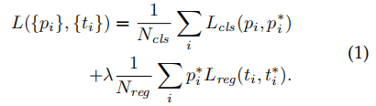

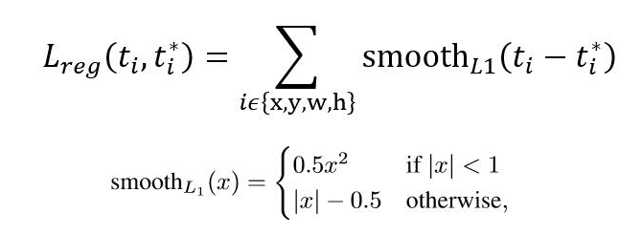
Loss Function
i is the index of an anchor in a mini-batch and
pi is the predicted probability of anchor i being an object.
The ground-truth label p∗i is 1 if the anchor is positive, and is 0 if the anchor is negative.
ti is a vector representing the 4 parameterized coordinates of the predicted bounding box,
t∗i is that of the ground-truth box associated with a positive anchor
We assign a positive label to two kinds of anchors:
(i) the anchor/anchors with the highest Intersection-over Union (IoU) overlap with a ground-truth box, or (ii) an anchor that has an IoU overlap higher than 0.7 with any ground-truth box .
We assign a negative label to a non-positive anchor if its IoU ratio is lower than 0.3 for all ground-truth boxes.
Anchors that are neither positive nor negative do not contribute to the training objective
The classification loss Lcls is log loss over two classes(object vs. not object).
For the regression loss, we use Lreg (ti, t∗i) = R(ti − t∗i) where R is the robust lossfunction (smooth L1)

Slide 7
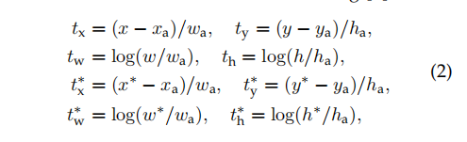
Loss Function
where x, y, w, and h denote the box's center coordinates and its width and height.
Variables x, xa, and x∗are for the predicted box, anchor box, and ground truth box respectively (likewise for y, w, h).

Slide 8
Training RPNs
The RPN can be trained end-to-end by back propagation and stochastic gradient descent (SGD)
It is possible to optimize for the loss functions of all anchors, but this will bias towards negative samples as they are dominate.
Instead, we randomly sample 256 anchors in an image to compute the loss function of a mini-batch, where the sampled positive and negative anchors have a ratio of up to 1:1. If there are fewer than 128 positive samples in an image, we pad the mini-batch with negative ones.
We randomly initialize all new layers by drawing weights from a zero-mean Gaussian distribution with standard deviation 0.01.
All other layers (i.e., the shared convolutional layers) are initialized by pretraining a model for ImageNet classification

Slide 9
Sharing Features for RPN and Fast R-CNN(two ways to train network)
Alternating training. In this solution, we first train RPN, and use the proposals to train Fast R-CNN.The network tuned by Fast R-CNN is then used to initialize RPN, and this process is iterated. This is the solution that is used in all experiments in this paper.
Approximate joint training. In this solution, the RPN and Fast R-CNN networks are merged into one network during training.the shared layers the backward propagated signals from both the RPN loss and the Fast R-CNN loss are combined.(reduces the training time by about 25-50% comparing with alternating training.but the result is not precise because the forward pass generates region proposals which are treated just like fixed)

Slide 10
4-Step Alternating Training
In the first step,we train the RPN. This network is initialized with an ImageNet-pre-trained model and fine-tuned end-to-end for the region proposal task.
In the second step, we train a separate detection network by Fast R-CNN using the proposals generated by the step-1 RPN.This detection network is also initialized by the ImageNet-pre-trained model.
At this point the two networks do not share convolutional layers.
In the third step, we use the detector network to initialize RPN training,fix the shared convolutional layers and only fine-tune the layers unique to RPN.
Finally, keeping the shared convolutional layers fixed, we fine-tune the unique layers of Fast R-CNN.

Slide 11
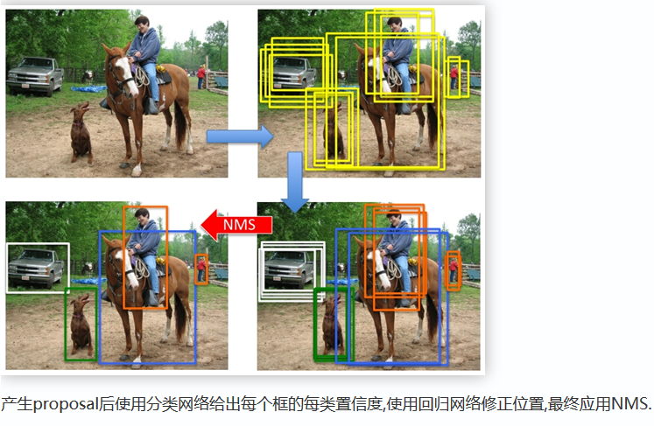
Some details in 4-Step Alternating Training（NMS）
Some RPN proposals highly overlap with each other. To reduce redundancy, we adopt non-maximum suppression (NMS) on the proposal regions based on their cls scores.
We fix the IoU threshold for NMS at 0.7, which leaves us about 2000 proposal regions per image.
After NMS, we use the top-N ranked proposal regions for detection.
In the following, we train Fast R-CNN using 2000 RPN proposals,

Slide 12
Some details in 4-Step Alternating Training（ignore cross-boundary achors）
The anchor boxes that cross image boundaries need to be handled with care.
During training, we ignore all cross-boundary anchors , so they do not contribute to the loss. For a typical 1000 × 600 image, there will be roughly 20000 (≈ 60 × 40 × 9) anchors in total. With the cross-boundary anchors ignored, there are about 6000 anchors per image for training.
If the boundary-crossing outliers are not ignored in training, they introduce large, difficult to correct error terms in the objective, and training does not converge。

Slide 13
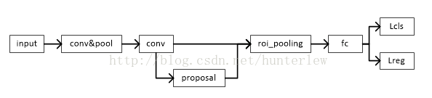
Test-Flow

Slide 14
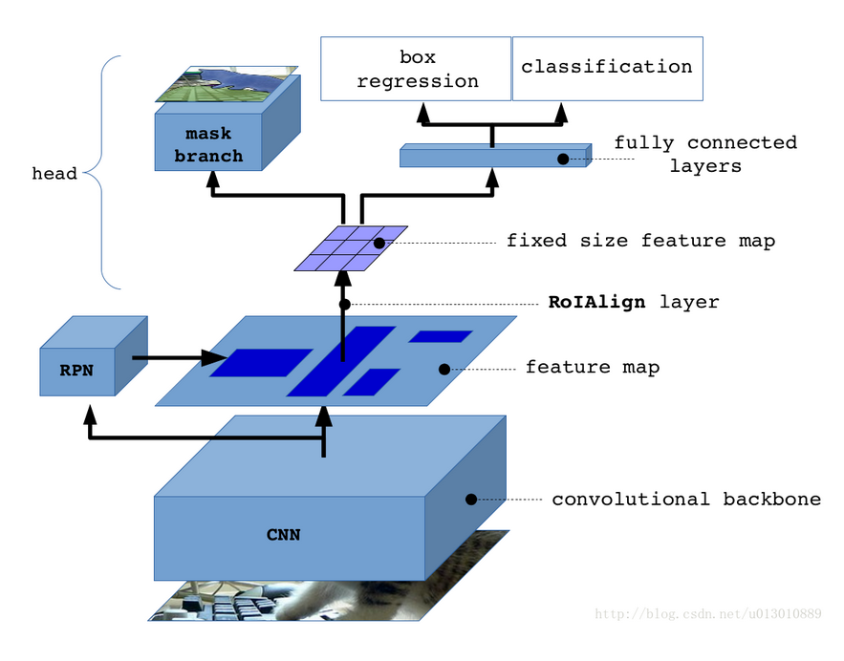
Mask-RCNN(The most different two points)
Mask R-CNN adopts the same two-stage procedure, with an identical first stage (which is RPN).In the second stage, in parallel to predicting the class and box offset, Mask R-CNN also outputs a binary mask for each RoI.
RoIAlign

Slide 15


Binary Mask(Loss function,training and represent)
We define a multi-task loss on each sampled RoI as L = Lcls + Lbox + Lmask.The classification loss Lcls and bounding-box loss Lbox are identical as those defined in Fast-RCNN.
The mask branch has a K*m*m-dimensional output for each RoI, which encodes K binary masks of resolution m * m, one for each of the K classes.
To this we apply a per-pixel sigmoid, and define Lmask as the average binary cross-entropy loss.
For an RoI associated with ground-truth class k, Lmask is only defined on the k-th mask (other mask outputs do not contribute to the loss).
With a per-pixel sigmoid and a binary loss can avoid competition in classes.
Mask Representation:
A mask encodes an input object's patial layout.
Extracting the spatial structure of masks can be addressed naturally by the pixel-to-pixel correspondence provided by convolutions.
Specifically, we predict an m × m mask from each RoI using an FCN (fully convolutional net).
This allows each layer in the mask branch to maintain the explicit m × m object spatial layout without collapsing it into a vector representation that lacks spatial dimensions.
Our fully convolutional representation requires fewer parameters, and is more accurate

Slide 16
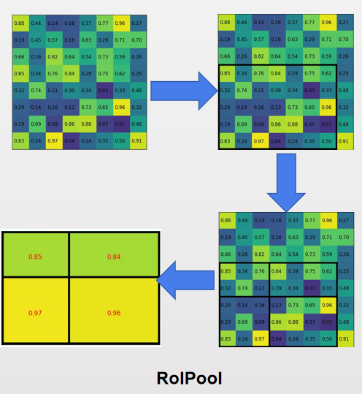
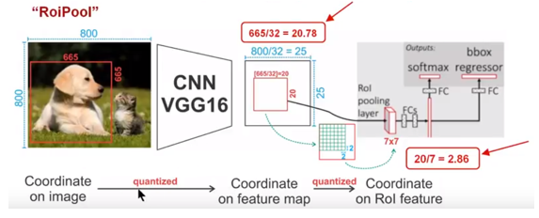
RoIPool
Quantization is performed, on a continuous coordinate x by computing [x/16], where 16 is a feature map stride
likewise, quantization is performed when dividing into bins (e.g., 7×7).These quantizations introduce misalignments between the RoI and the extracted features.
While this may not impact classification, which is robust to small translations, it has a large negative effect on predicting pixel-accurate masks.

Slide 17
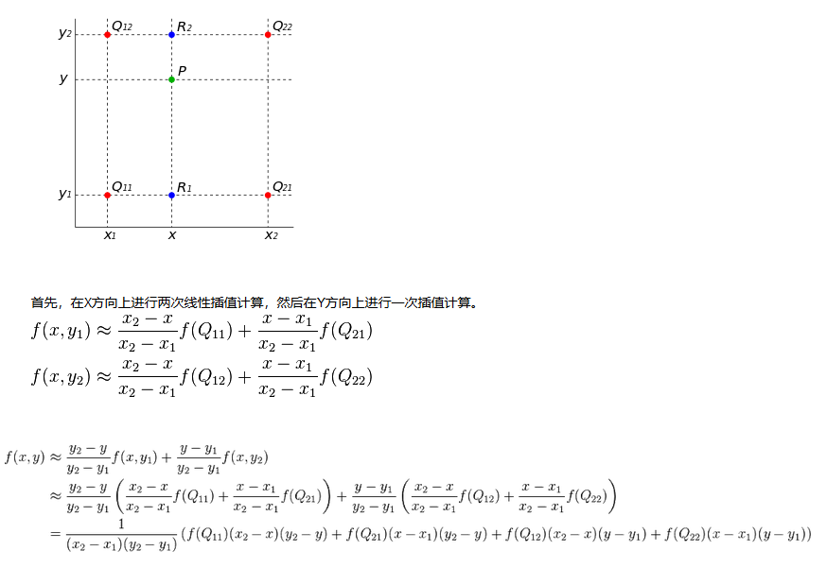
Bilinear interpolation

Slide 18
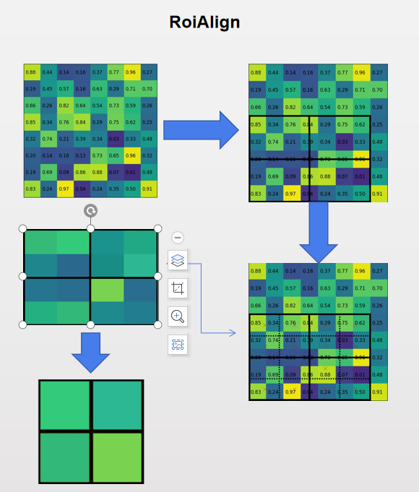
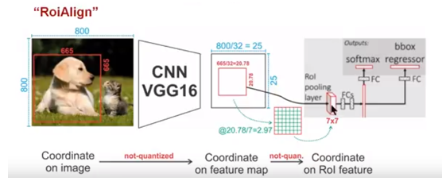
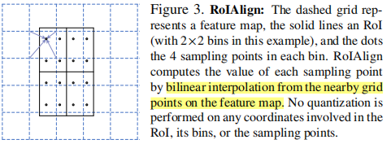
RoIAlign
To address this, we propose an RoIAlign layer that removes the harsh quantization of RoIPool, properly aligning the extracted features with the input.
We use bilinear interpolation to compute the exact values of the input features at four regularly sampled locations in each RoI bin,and aggregate the result (using max or average).

Slide 19
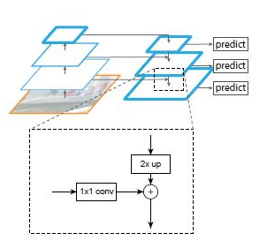
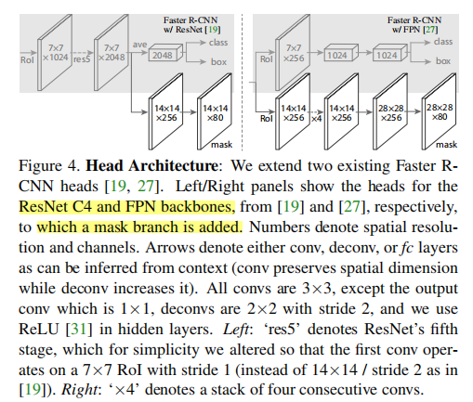
Network Architecture
FPN
We instantiate Mask R-CNN with multiple architectures. For clarity, we differentiate between: (i) the convolutional backbone architecture used for feature extraction over an entire image, and (ii) the network head for bounding-box recognition (classification and regression) and mask prediction that is applied separately to each RoI.
Using a ResNet-FPN backbone for feature extraction with Mask RCNN gives excellent gains in both accuracy and speed.
For the network head we closely follow architectures presented in previous work to which we add a fully convolutional mask prediction branch.

Slide 20
理解：
网络的两大块，RPN和classification模块是分开的，两个网络并不互相传递损失梯度。
他们之间的连接就是RoiPooling层，将backbone提取的特征归一化后分类回归而已。
RPN和backbone的损失梯度由有无背景目标和第一次粗略回归而来。这样在提取的特征里就包含了目标和它位置信息的特征。
classification的损失由最后的精确回归和分类得来。
所以，可以先训练RPN，再训练classification网络。也可以同时训练。

