Slide 1
Attention,Transformer And BERT
Bohao.Zou

Slide 2
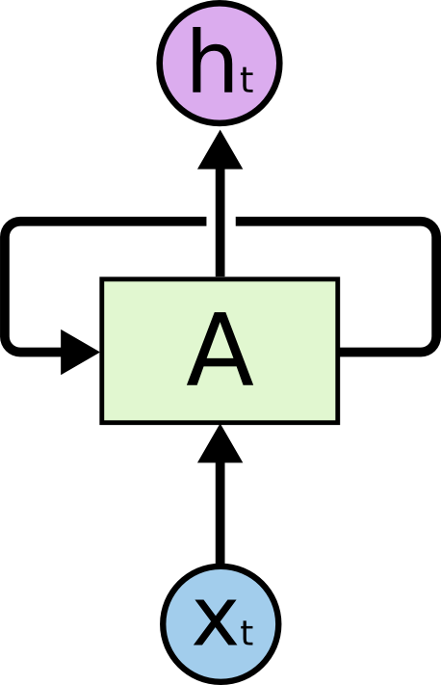

RNN （Sequence Model）

Slide 3






Encoder-Decoder Model
ENCODER MODEL:
In the Encoder–Decoder framework, an encoder reads the input sentence, a sequence of vectors , into a vector c .
The most common approach is to use an RNN such that and
Where is a hidden state at time t, and c is a vector generated from the sequence of the hidden states . f() and q() are some nonlinear functions.f() and q() function are LSTM Model as usual .
DECODER MODEL :
The decoder is often trained to predict the next word given the context vector c and all the previously predicted words .
In other words, the decoder defines a probability over the translation y by decomposing the joint probability into the ordered conditionals :
With an RNN, each conditional probability is modeled as
where g() is a nonlinear, potentially multi-layered, function that outputs the probability of and St is the hidden state of the RNN.

Slide 4
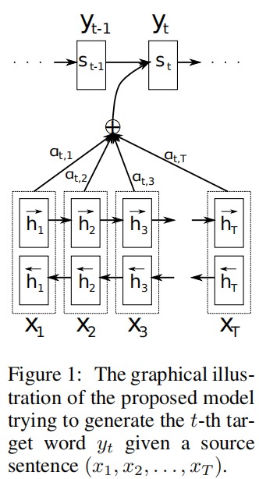




Attention Mechanism
In a new model architecture, we define each conditional probability in :
Where Si is an RNN hidden state for time i, computed by:
The context vector Ci depends on a sequence of annotations (h1, · · · , hTx) to which an encoder maps the input sentence. Each annotation hi contains information about the whole input sequence with a strong focus on the parts surrounding the i-th word of the input sequence.
The context vector Ci is, then, computed as a weighted sum of these annotations hi:
The weight αij of each annotation hj is computed by:
is an alignment model which scores how well the inputs around position j and the output at position i match.
We parametrize the alignment model a() as a feedforward neural network which is jointly trained with all the other components of the proposed system.

Slide 5
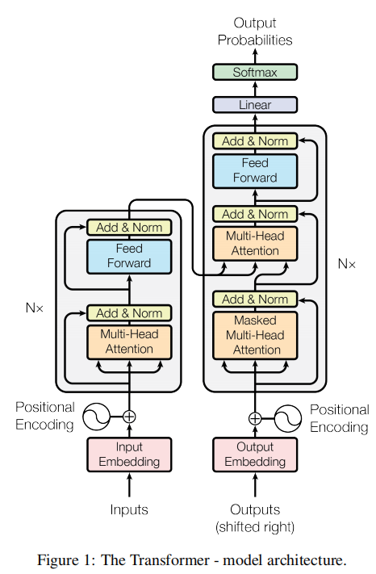
Transformer Model (Self-Attention model)
Most competitive neural sequence transduction models have an encoder-decoder structure .
Here, the encoder maps an input sequence of symbol representations (x1, ..., xn) to a sequence of continuous representations z = (z1, ..., zn).
Given z, the decoder then generates an output sequence (y1, ..., ym) of symbols one element at a time.
At each step the model is auto-regressive consuming the previously generated symbols as additional input when generating the next.

Slide 6
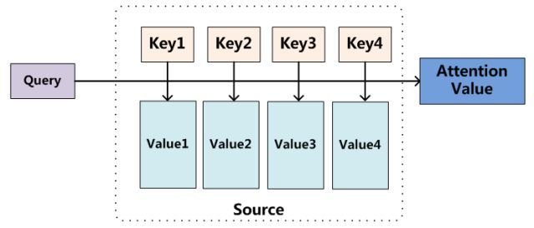
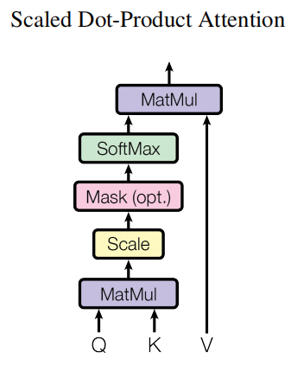

Transformer Model
Attention:
An attention function can be described as mapping a query and a set of key-value pairs to an output , where the query, keys, values, and output are all vectors. The output is computed as a weighted sum of the values, where the weight assigned to each value is computed by a compatibility function of the query with the corresponding key.
We call our particular attention "Scaled Dot-Product Attention". The input consists of queries and keys of dimension dk, and values of dimension dv. We compute the dot products of the query with all keys, divide each by √dk, and apply a softmax function to obtain the weights on the values.
In practice, we compute the attention function on a set of queries simultaneously, packed together into a matrix Q. The keys and values are also packed together into matrices K and V . We compute the matrix of outputs as:

Slide 7
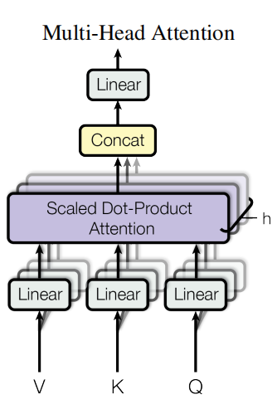
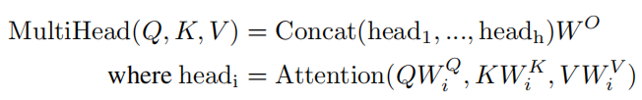
Transformer Model
Multi-Head Attention
Instead of performing a single attention function , we found it beneficial to linearly project the queries, keys and values h times with different, learned linear projections to dk, dk and dv dimensions, respectively.
On each of these queries, keys and values we can perform the attention function in parallel, yielding dv-dimensional output values.
These are concatenated and once again do linearly trans, resulting in the final values.
In this work we employ h = 8 parallel attention layers, or heads. For each of these we use dk = dv = 64.

Slide 8
Transformer Model
The Transformer uses multi-head attention in three different ways:
In "encoder-decoder attention" layers, the queries come from the previous decoder layer, and the memory keys and values come from the output of the encoder. This allows every position in the decoder to attend over all positions in the input sequence.
The encoder contains self-attention layers. In a self-attention layer all of the keys, values and queries come from the same place, in this case,the queries , keys and values are the output of previous layer . Each position in the encoder can attend to all positions in the previous layer of the encoder.
Similarly, self-attention layers in the decoder allow each position in the decoder to attend to all positions in the decoder up to and including that position. We need to prevent rightward information flow in the decoder to preserve the auto-regressive property. We implement this inside of scaled dot-product attention by masking out (setting to −∞) all values in the input of the softmax which correspond to illegal connections.

Slide 9
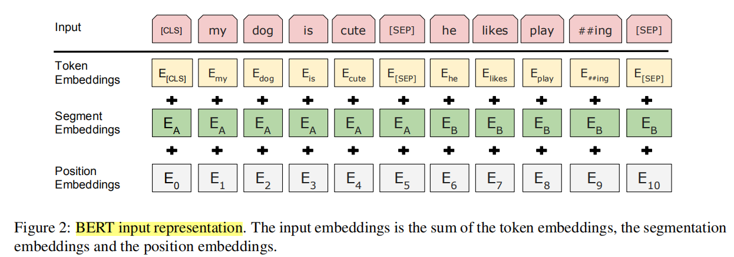
BERT Model (pre-training model)
BERT's model architecture is a multi-layer bidirectional Transformer encoder.
Input Representation :

Slide 10
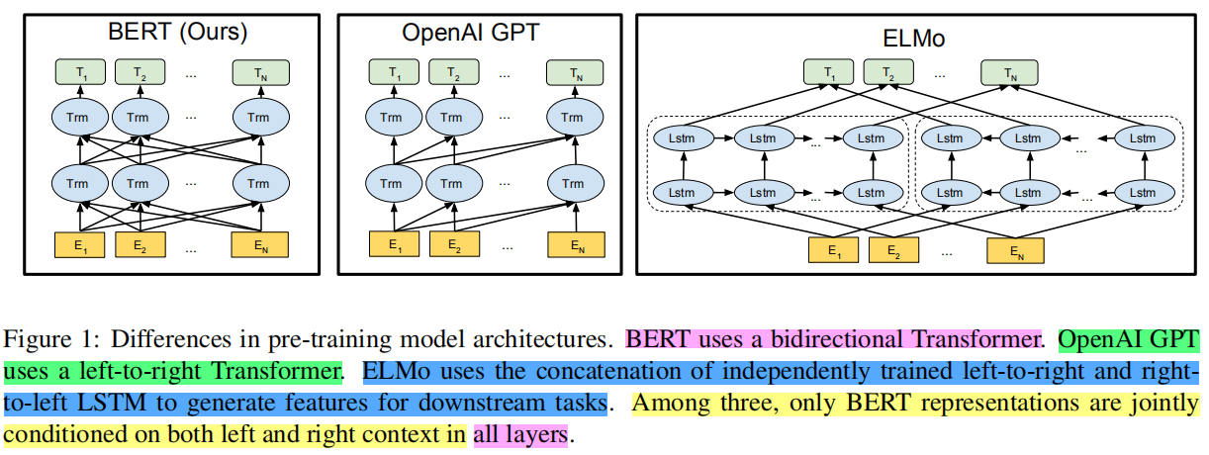
BERT Model

Slide 11
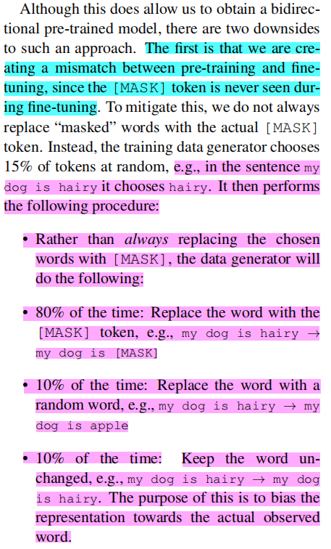
BERT Model
Task #1: Masked LM :
Intuitively, it is reasonable to believe that a deep bidirectional model is strictly more powerful than either a left-to-right model or the shallow concatenation of a left-to-right and right-to left model. Unfortunately, standard conditional language models can only be trained left-to-right or right-to-left, since bidirectional conditioning would allow each word to indirectly “see itself” in a multi-layered context.
In order to train a deep bidirectional representation, we take a straightforward approach of masking some percentage of the input tokens at random,and then predicting only those masked tokens.
In this case, the final hidden vectors corresponding to the mask tokens are fed into an output softmax over the vocabulary, as in a standard LM.
In all of our experiments, we mask 15% of all WordPiece tokens in each sequence at random.

Slide 12
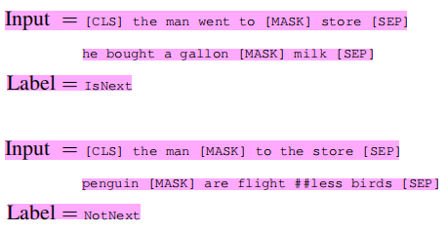
BERT Model
Task #2: Next Sentence Prediction
In order to train a model that understands sentence relationships, we pre-train a binarized next sentence prediction task that can be generated from any monolingual corpus.
Specifically, when choosing the sentences A and B for each pre-training example, 50% of the time B is the actual next sentence that follows A, and 50% of the time it is a random sentence from the corpus. For example:
We choose the NotNext sentences completely at random , and let BERT to predict the label of the input .

Slide 13
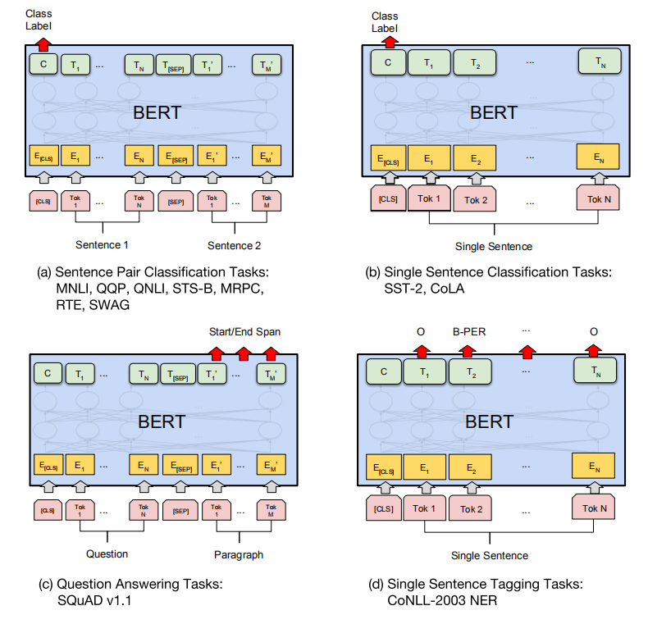
BERT Workflow for different task

Slide 14
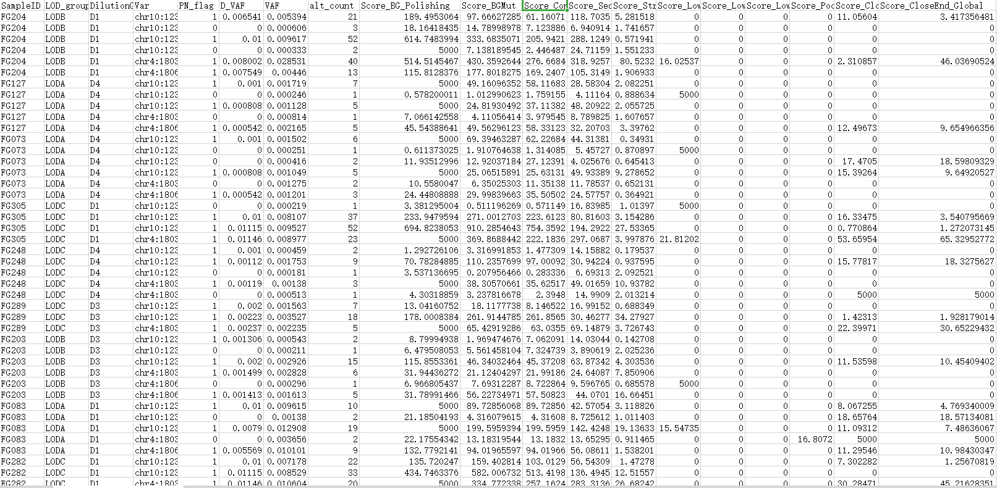
Actual Example (Recently)
Predict the PN_flag of every samples and extract the essential features of each sample .

Slide 15
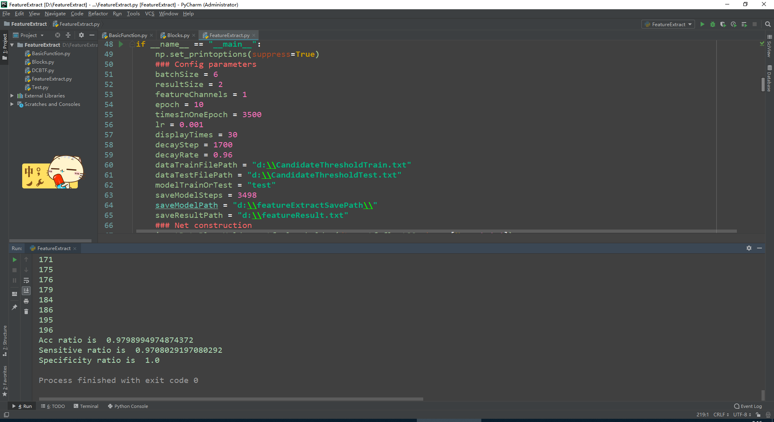
Actual Example (Recently)
Traning data : 940 samples of total 1140 samples .
Positive samples : 600
Negtive samples : 340
Test data : 200 samples of total 1140 samples .
Positive samples : 138
Negtive samples : 62
Result :
Acuurate ratio : 0.9798
Sensitive ratio : 0.9708
Specificity ratio : 1.0

