Slide 1
Business Listing Page
(seem after tapping ‘Listings’)
Shortcut to sorts
Menu to get all sorts
Carrier Info
C0
C1
C2
C3
…
Indicates business is part of AllSortz network
Personalized Score
Image
Hoagie Haven
Indicates it offers a way to earn credits
Sort Icons
1000 cr.
Entry 1
Link to business detail page
Swipe to right to get control panel for search (See Figure 2)
Entry 2
Credits available
Entry 3
Map
Listing
Account
Earn
Figure 1

Slide 2
Sorting Control Menu
(from Figure 1)
Clear all parameters (uncheck boxes and set sliders to not important
Save this as your own search
Carrier Info
Save
Reset
Done
Will show the current location (i.e. name of town you are in). Tapping will allow users to edit this location to be their current location or somewhere in particular
[Text Search Area]
Base Location of Sort
Proximity
Parameters to Adjust search by
Not Important
Bang for your Buck
Important
Score
Sort Icons
Price
Check boxes
Coffee
Italian
Lunch
Fast
Keep scrolling for more
Figure 2

Slide 3
Custom Sort Menu
(From tapping ‘…’)
Maybe a way to sort by “most recent” and “most used” for organization purposes.
Carrier Info
C0
C1
C2
C3
…
Tap to return to the main page.
Switch between pages of sorts by tapping the tab
Popular
Friend’s
Yours
Your own sorts (ones saved from the custom search bar
S
S
S
S
Popular Sorts and those created by AllSortz
S
S
S
S
Sorts popular with your friends.
Tap and hold to change the default sorts to one of the ones seen here. (works just like apps)
S
S
S
S
Sort icon with description
Below. Tap to leave this menu and perform the sort
Map
Listing
Account
Earn
Figure 3
Custom sort menu

Slide 4

Map View
(From tapping Map)
Carrier Info
Same behavior as figure 1
C0
C1
C2
C3
…
Go to my Location.
##
Swipe to right to get control panel
##
AllSortz Icon + Info (Display highest importance metric)
##
Map
Listing
Account
Earn
Figure 4

Slide 5
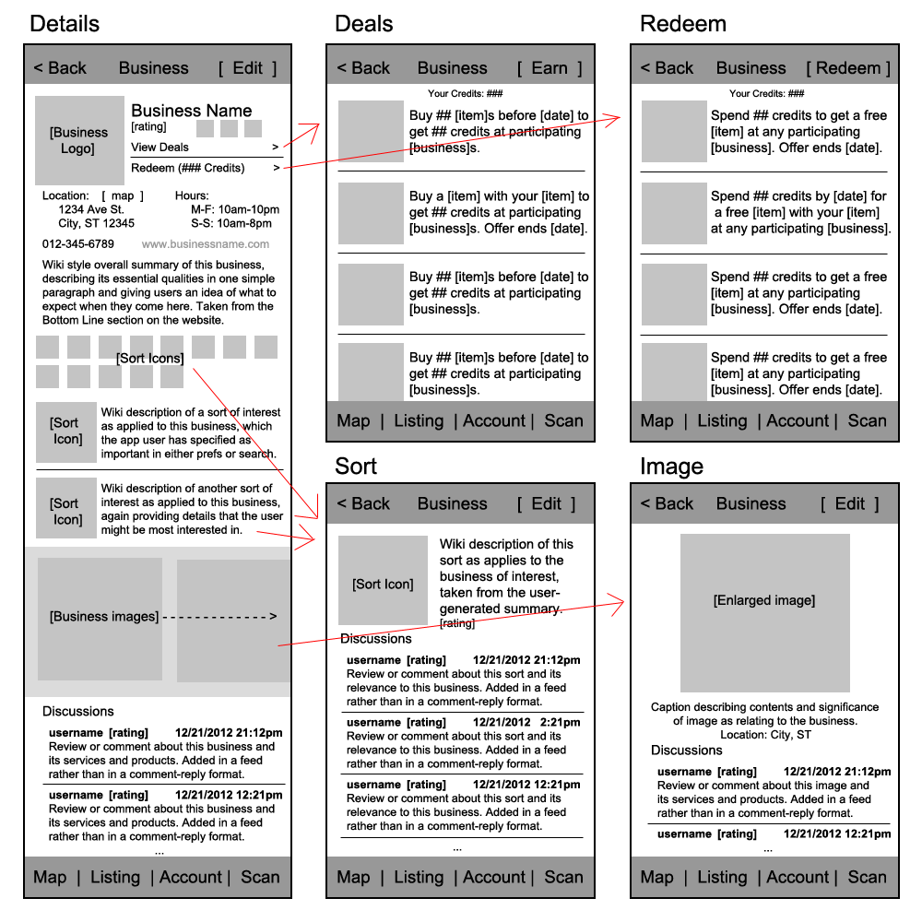
Tap to open photo gallery
Icon will indicate the sort’s rating as well
Removed 7/24
Add:
Rating Functionality
Discussions should include rating system and be threaded
Add:
Rating

Slide 6
[Title]
(access point(s))
Carrier Info
Figure N

Slide 10
Business Listing Page
(seem after tapping ‘Listings’)
Shortcut to sorts
Menu to get all sorts
Carrier Info
C0
C1
C2
C3
…
Indicates business is part of AllSortz network
Personalized Score
Image
Hoagie Haven
Princeton, NJ
1000 cr.
Indicates it offers a way to earn credits
Sort Icons
Your Score
Entry 1
Link to business detail page
Swipe to right to get control panel for search (See Figure 2)
Entry 2
Credits available
[ Keep Scrolling ]
Map
Listing
Account
Earn
Figure 1

