Slide 1
The Problem
“What do I do when I’m bored?”
Giving recommendations for things to do
Input data will be all user-provided
Provide useful recommendations for a user with only a few ratings
Tell users why they will like a business

Slide 2
NMF
We will give ratings by NMF
NMF discovers latent factors that affect ratings
If user x likes “burgers” and restaurant y is a “burgers” restaurant user x will like restaurant y

Slide 3
Businesses
…
Users
 | Pizza Palace | Sushi Store | Wrap Hut | Beer Bar
Bob | -- | -- | 5 | --
Jane | 2 | 5 | -- | 3
…
…
…
…
…
…
…
+ K latent factors
…
 | F1 (italian) | F2 (japanese)
Bob | .8 | .2
Jane | .1 | .5
…
…
…
…
…
 | Piz. | Sush. | Wrap | Beer
F1 | .9 | .2 | .3 | .5
F2 | .1 | .9 | .2 | .4
…
…
…
…
…
…
…
…

Slide 4
 | Piz. | Sush. | Wrap | Beer
F1 | .9 | .2 | .3 | .5
F2 | .1 | .9 | .2 | .4
…
 | F1 (italian) | F2 (japanese)
Bob | .8 | .2
Jane | .1 | .5
…
…
…
…
…
…
…
…
…
…
…
…
Dot Product!
Predicted Ratings
Businesses
…
 | Pizza Palace | Sushi Store | Wrap Hut | Beer Bar
Bob | -- 5 | -- 4 | 5 4 | -- 2
Jane | 2 1 | 5 4 | -- 5 | 3 2
…
…
…
…
…
…
…

Slide 5
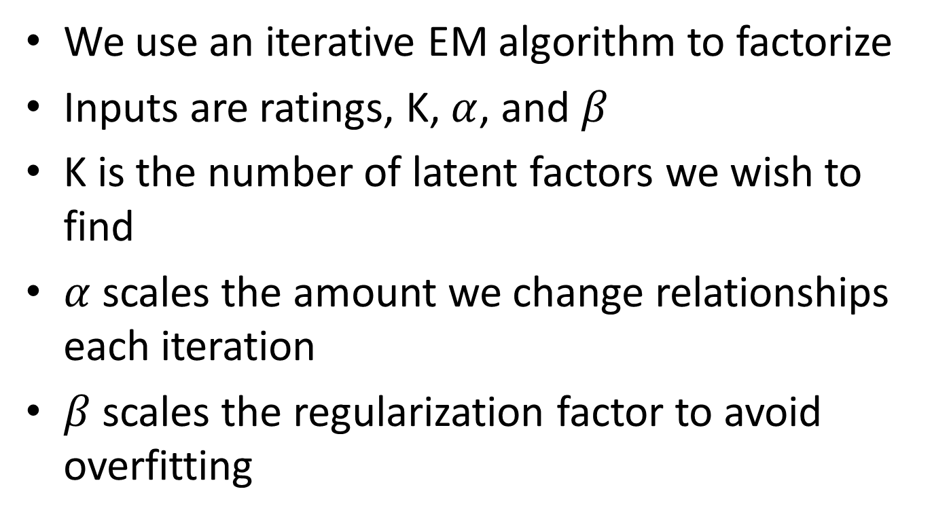
Algorithm
We use an iterative EM algorithm to factorize
Inputs are ratings, K, $α$, and $β$
K is the number of latent factors we wish to find
$α$ scales the amount we change relationships each iteration
$β$ scales the regularization factor to avoid overfitting

Slide 6
Dataset
Yelp academic datasets
<INSERT COUNTS HERE>
Some users and business have only single ratings
We got 2 datasets
Michigan dataset: For testing and building our model
Princeton dataset: Unused for now, we will test the quality of our model on this when it is complete

Slide 7
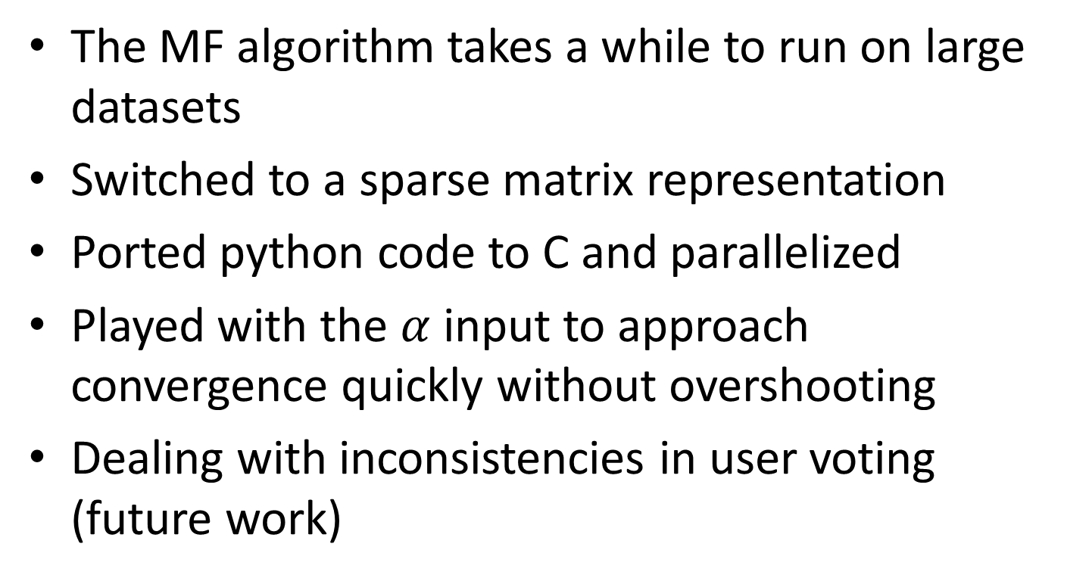
Challenges
The MF algorithm takes a while to run on large datasets
Switched to a sparse matrix representation
Ported python code to C and parallelized
Played with the $α$ input to approach convergence quickly without overshooting
Dealing with inconsistencies in user voting (future work)

