Slide 1
Nightout
Matt Zoufaly, Stephen Beard, Deep Ghosh, Joey Dodds

Slide 2
The Problem
“What do I do when I’m bored?”
We want to recommend things to do from previous user ratings
We will provide useful recommendations for a user with only a few ratings
Tell users why they will like a business
“We recommend Hoagie Haven because you liked George’s”

Slide 3
NMF
We will give ratings by Nonnegative Matrix Factorization (NMF)
NMF discovers latent factors that affect ratings
It relates both users and businesses to these factors
If user x likes “burgers” and restaurant y is a “burgers” restaurant user x will like restaurant y

Slide 4
Businesses
…
Users
 | Pizza Palace | Sushi Store | Wrap Hut | Beer Bar
Bob | -- | -- | 5 | --
Jane | 2 | 5 | -- | 3
…
…
…
…
…
…
…
+ K (number of latent factors)
Input
Output
Latent Factors
Businesses
…
Latent Factors
…
 | F1 (italian) | F2 (japanese)
Bob | .8 | .2
Jane | .1 | .5
 | Piz. | Sush. | Wrap | Beer
F1 | .9 | .2 | .3 | .5
F2 | .1 | .9 | .2 | .4
Users
…
…
…
…
…
…
…
…
…
…
…
…

Slide 5
 | Piz. | Sush. | Wrap | Beer
F1 | .9 | .2 | .3 | .5
F2 | .1 | .9 | .2 | .4
…
 | F1 (italian) | F2 (japanese)
Bob | .8 | .2
Jane | .1 | .5
…
…
…
…
…
…
…
…
…
…
…
…
Dot Product!
Predicted Ratings
Businesses
…
 | Pizza Palace |  | Sushi Store |  | Wrap Hut |  | Beer Bar
 | Actual | Predicted | Act. | Pred. | Act. | Pred. | Act. | Pred.
Bob | -- | 5 | -- | 4 | 5 | 4 | -- | 2
Jane | 2 | 1 | 5 | 4 | -- | 5 | 3 | 2
…
…
…
…
…
…
…

Slide 6
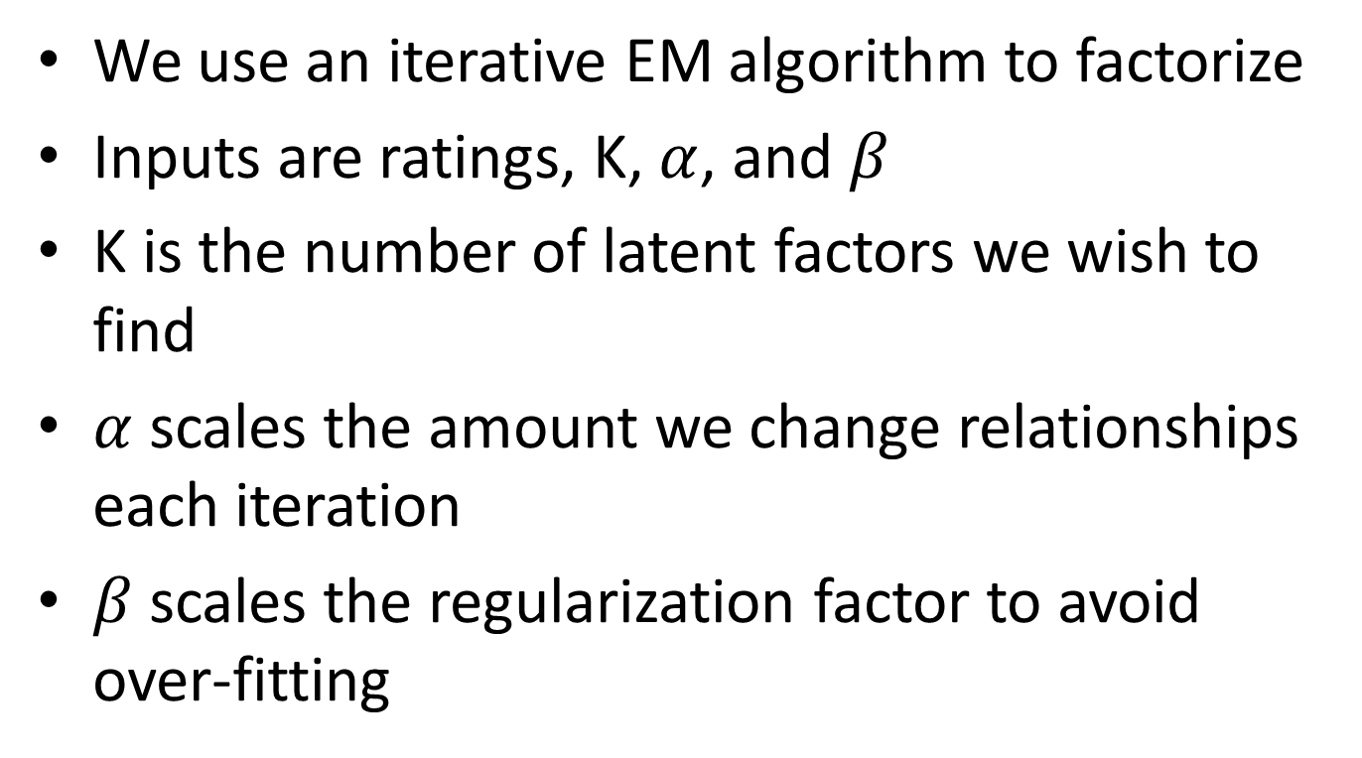
Algorithm
We use an iterative EM algorithm to factorize
Inputs are ratings, K, $α$, and $β$
K is the number of latent factors we wish to find
$α$ scales the amount we change relationships each iteration
$β$ scales the regularization factor to avoid over-fitting

Slide 7
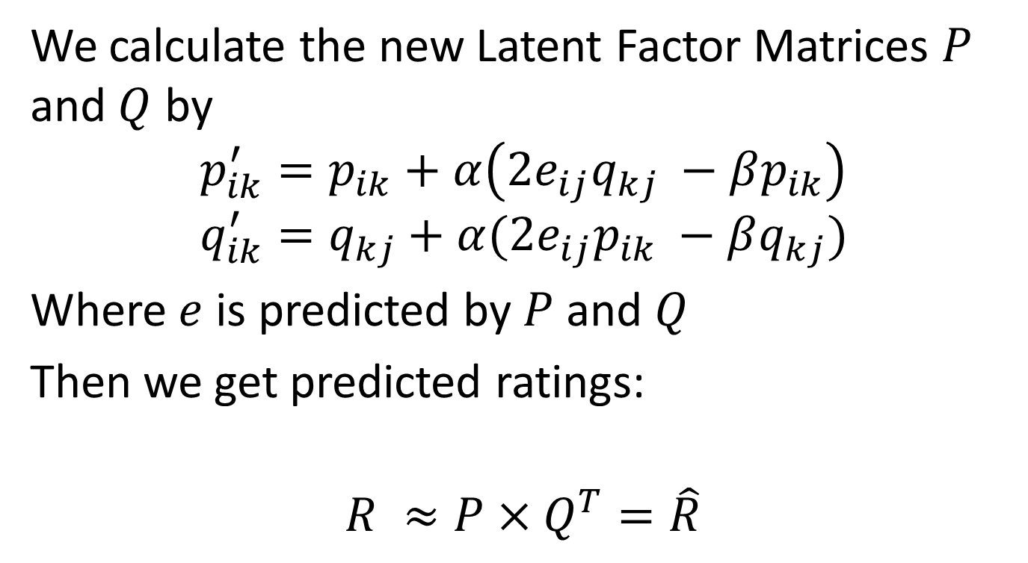
The Algorithm
We calculate the new Latent Factor Matrices $P$ and $Q$ by
$$p_{ik}^{′}=p_{ik}+α\left(2e_{ij}q_{kj} −βp_{ik}\right)$$
$$q_{ik}^{′}=q_{kj}+α(2e_{ij}p_{ik} −βq_{kj})$$
Where $e$ is predicted by $P$ and $Q$
Then we get predicted ratings:
$$R ≈P×Q^{T}=\hat{R}$$

Slide 8
Dataset
Yelp academic datasets
30k Users with 25 ratings or more each
1400 Businesses with 25 ratings or more each
Many other users and business have fewer ratings
We are using 2 datasets
Michigan dataset: For testing and building our model
Princeton dataset: Unused for now, we will test the quality of our model on this when it is complete

Slide 9
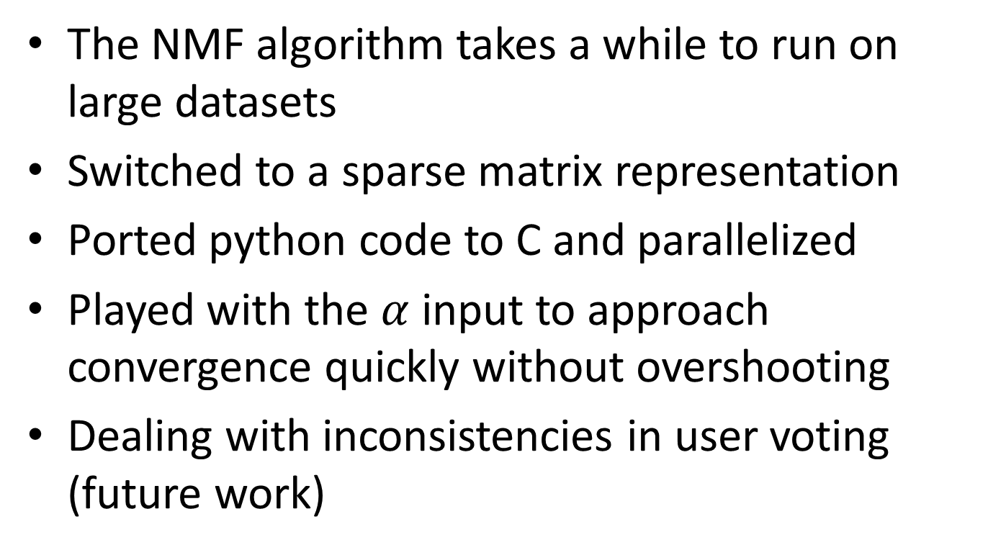
Challenges
The NMF algorithm takes a while to run on large datasets
Switched to a sparse matrix representation
Ported python code to C and parallelized
Played with the $α$ input to approach convergence quickly without overshooting
Dealing with inconsistencies in user voting (future work)

Slide 10
Distance Vs. K
Graphs “Mean RSS Vs. K” and “Distance Vs. K” show results of cross-validation on the Michigan data
Around 30 seems like the best value for K
We hope to find a relationship so we can discover an approximate good K from the data
We would expect a good value of K to be related to the number of “Tags” that are often applied to businesses
We might want to modify tags to include things like pricing and quality of service

Slide 11
Mean RSS
k
Notes:
for both slides 1 and 2, numUsers = 30133, numBusinesses = 1431, User Threshold = 25 ratings per user, Business Threshold = 25 ratings per business, numRatings = 80073, Steps = 1000, alpha = 0.0004

Slide 12
Mean Distance
k
Notes:
for both slides 1 and 2, numUsers = 30133, numBusinesses = 1431, User Threshold = 25 ratings per user, Business Threshold = 25 ratings per business, numRatings = 80073, Steps = 1000, alpha = 0.0004

Slide 13
Distance Per Rating
We are interested in building a recommendation engine
This means that we wish to predict high ratings correctly, and are less concerned about low
We compare distance from each rating from 1 to 5
These results will be especially interesting when we attempt to normalize global effects (correct for rater inconsistency)

Slide 14
Mean Distance and RSS for each Rating
Actual Rating | # Records | Mean Distance | Mean RSS
1 | 3870 | 2.319897 | 6.403101
2 | 8322 | 1.370704 | 2.714852
3 | 18756 | 0.576989 | 0.801663
4 | 29944 | 0.339701 | 0.411234
5 | 19182 | 0.823115 | 1.371546
k = 30 (best detected in terms of average RSS)
Thresholds = 25
# steps = 1000

Slide 15
Percentage of Businesses with Correct Predicted Ratings
Actual Rating | # Samples | # Correct | % Correct
1 | 3870 | 40 | 1.03
2 | 8322 | 608 | 7.31
3 | 18756 | 5311 | 28.32
4 | 29944 | 11737 | 39.20
5 | 19182 | 4438 | 23.14
k = 30 (best detected in terms of average RSS)
Thresholds = 25
# steps = 1000

Slide 16
Normalization of Global Effects
Users and businesses tend to develop a bias. By normalizing, you are able to find the true interaction between a user and a business.
The idea is to break a rating into different effects
Global effect: This is the average of all ratings
Business effect: The bias in the businesses ratings
User effect: The bias in the user’s ratings
Interaction: The specific interaction between the user and the business.
Other effects could make the users rating depend upon the businesses average, time, number of ratings, etc

Slide 17
Example of Normalization
For example, imagine user HarvardHippie rates Hoagie Haven 1 star
We break this up into four effects
Global: The sites average rating is 3.2 stars
Hoagie Haven: Average rating is 4.5 stars, thus Hoagie Haven has a +1.3 effect
HarvardHippie: Average rating is 2.1 stars, thus has a -1.1 effect
Specific Interaction: This 1 star rating is thus broken into
1 = 3.2 (global) + 1.3 (Hoagie Haven) – 1.1 (HarvardHippie) – 2.4 (Hoagie Haven to HarvardHippie specific)
Thus the specific interaction between Hoagie Haven and HarvardHippie is -2.4

Slide 18
Goal is Recommendation
Our end goal is to recommend businesses to users, not necessarily predict a users specific rating.
Final evaluation will be to see if we can accurately guess what someone will really like

