Slide 1
Business Listing Page
(seem after tapping ‘Listings’)
Shortcut to sorts
Menu to get all sorts
Carrier Info
C0
C1
C2
C3
…
Indicates business is part of AllSortz network
Personalized Score
Image
Hoagie Haven
Indicates it offers a way to earn credits
Sort Icons
1000 cr.
Entry 1
Link to business detail page
Swipe to right to get control panel for search (See Figure 2)
Entry 2
Credits available
Entry 3
Map
Listing
MySortz
Earn
Figure 1

Slide 2
Sorting Control Menu
(from Figure 1)
Clear all parameters (uncheck boxes and set sliders to not important
Save this as your own search
Carrier Info
Save
Reset
Done
Will show the current location (i.e. name of town you are in). Tapping will allow users to edit this location to be their current location or somewhere in particular
[Text Search Area]
Base Location of Sort
Proximity
Parameters to Adjust search by
Not Important
Bang for your Buck
Important
Score
Sort Icons
Price
Check boxes
Coffee
Italian
Lunch
Fast
Keep scrolling for more
Figure 2

Slide 3
Custom Sort Menu
(From tapping ‘…’)
Maybe a way to sort by “most recent” and “most used” for organization purposes.
Carrier Info
C0
C1
C2
C3
…
Tap to return to the main page.
Switch between pages of sorts by tapping the tab
Popular
Friend’s
Yours
Your own sorts (ones saved from the custom search bar
S
S
S
S
Popular Sorts and those created by AllSortz
S
S
S
S
Sorts popular with your friends.
Tap and hold to change the default sorts to one of the ones seen here. (works just like apps)
S
S
S
S
Sort icon with description
Below. Tap to leave this menu and perform the sort
Map
Listing
MySortz
Earn
Figure 3
Custom sort menu

Slide 4

Map View
(From tapping Map)
Carrier Info
Same behavior as figure 1
C0
C1
C2
C3
…
Go to my Location.
##
Swipe to right to get control panel
##
AllSortz Icon + Info (Display highest importance metric)
##
Map
Listing
MySortz
Earn
Figure 4

Slide 5
Detail View (1)
(Business details)
Carrier Info
ACTIONS: Favorite / Share / Remind
Back
Hoagie Haven
What the business should be sorted under for searches. Maybe change for icons?
Personalized Score / Rate
Image
Deals
NNN cr.
Redeem Credits
List deals
Sandwich, Late-night, Lunch
Click to bring to map
242 Nassau St.
Princeton, NJ
Hours:
M-F 8am-8pm
Sat – Sun 9am-12am
Box for business info
917 555 5555
HoagieHaven.com
edit
Review
Review Page Design TBD
See Detail View (2)
Figure 6a

Slide 6
Detail View (2)
(Business details)
Carrier Info
Back
Hoagie Haven
Your Sortz
Overall
Hoagie Haven is a popular Princeton sandwich shop for students looking for a bite to eat when out late. Don’t expect a low-calorie meal!
Overall description. The rating here would be the average rating for all users
Show sortz you’re described to
Spicy
All of the sandwiches at Hoagie Haven have the potential to be spicy as long as you remember to get Jalapenos
If you follow the spicy sort, or we think the spicy sort is worth watching, we’ll display it.
Tapping brings you to Figure 6d
Organic
There is almost nothing here that is Organic. You can get the bread and that’s about it
Having a sort applied doesn’t mean the place is necessarily good at it
Figure 6b

Slide 7
Detail View (3)
(Business details)
Carrier Info
Back
Hoagie Haven
All Sortz
Gluten - Free
Value
Parking
Show all remaining sortz
Add
Figure 6c

Slide 8
Detail View (4)
(Sortz Details)
Carrier Info
Back
Hoagie Haven
Spicy
Picture of Spicy @ Hoagie Haven or Default
All of the sandwiches at Hoagie Haven have the potential to be spicy as long as you remember to get Jalapenos
For now, just display the sort icon. In the future, bring to a gallery of “spicy-related” pics
edit
Matt 6 hours ago
Indicates Matt is an “important contributor”
The Jalapeno’s are really the key to getting good food at Hoagie Haven. The Hot Sauce is not so great
David 5 hours ago
Definitely!
Figure 6d

Slide 9
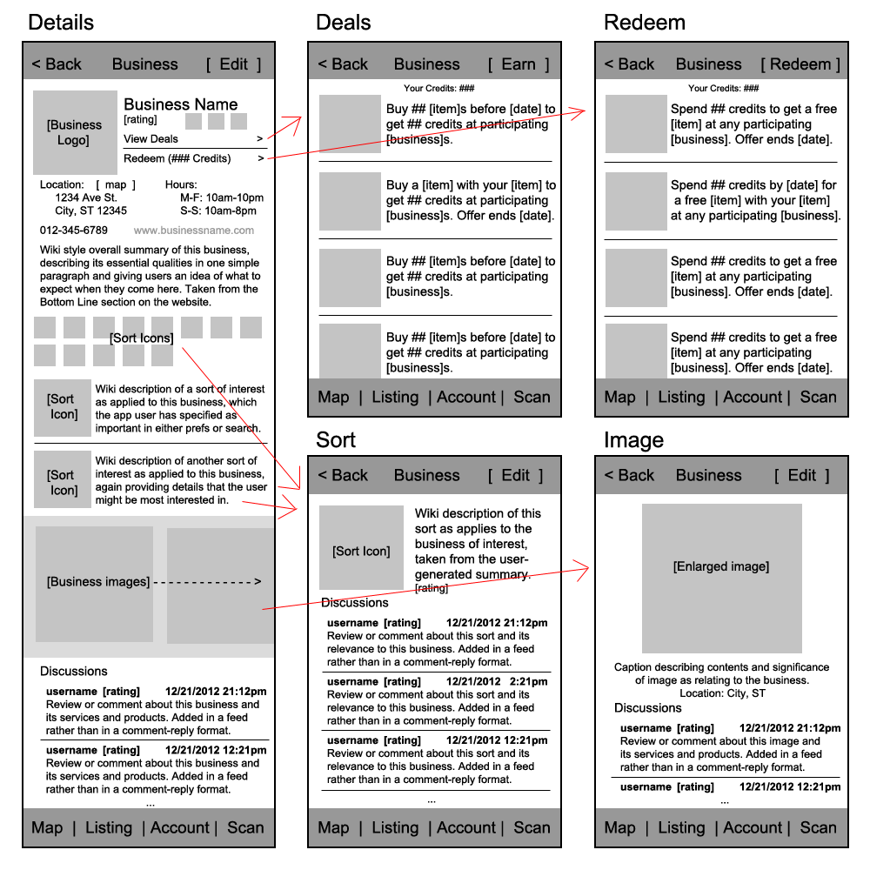
Remove 8/6
See Figure 6a-d
Removed on 8/2
See next two slides
Tap to open photo gallery
Icon will indicate the sort’s rating as well
Remove horizontal line
paragraph
Removed 7/24
Add:
Rating Functionality
Discussions should include rating system and be threaded
Add:
Rating
Don’t allow people to leave general comments
More content found elsewhere

Slide 10
Earn Credits
(tap earn credits on the business details page)
Carrier Info
Back
[Business Name]
[# credits]
Check mark if completed
Do NN to get Y credits
Do NN to get Y credits
Do NN to get Y credits
Do NN to get Y credits
Eventually, allow users to tap the actions to set reminders.
Do NN to get Y credits
Map
Listing
MySortz
Earn
Figure 7

Slide 11
Redeem Credits
(tap redeem credits on the business details page)
Carrier Info
Back
[Business Name]
[# credits]
Check mark if already purchased
Buy YYY with NN credits
Buy YYY with NN credits
Buy YYY with NN credits
Buy YYY with NN credits
Buy YYY with NN credits
Map
Listing
MySortz
Earn
Figure 8

Slide 12
MySortz Feed
(tap MySortz and tap Feed)
Carrier Info
Feed
Friends
Alerts
My Profile
[A list of your friends’ activities or activity at your favorite businesses]
[Design TBD]
Map
Listing
MySortz
Earn
Figure 9

Slide 13
MySortz Friends
(tap MySortz and tap Friends)
Carrier Info
Feed
Friends
Alerts
My Profile
[ A list of your friends. Will allow you to give credits to your friends / refer them ]
[Design TBD]
Map
Listing
MySortz
Earn
Figure 10

Slide 14
MySortz Alerts
(tap MySortz and tap Friends)
Carrier Info
Feed
Friends
Alerts
My Profile
[ Alerts for proximity to business or (in the future) push notifications from the server]
[Design TBD]
Map
Listing
MySortz
Earn
Figure 11

Slide 15
MySortz Profile
(tap MySortz and tap My Profile)
Carrier Info
Feed
Friends
Alerts
My Profile
[ Your profile page. Contains your avatar, as well as some info about your interests. It’s the splash page people see whenever they click on your name]
[Design TBD]
Map
Listing
MySortz
Earn
Figure 12

Slide 16
[Title]
(access point(s))
Carrier Info
Figure N

