Slide 1
C++ for C programmers
Al Khwarizmi (LSD S3)
Oct, 2022
Instructors: N. Hamid - R. Mahjoubi

Slide 2
What is C++
C++ is a general-purpose
Object-oriented programming language.
created by Bjarne Stroustrup at Bell Labs circa 1980.
C++ is very similar to C (invented by Dennis Ritchie in the early 1970s).
C++ is so compatible with C that it will probably compile over 99% of C programs without changing a line of source code. Though C++ is a lot of well-structured and safer language than C as it OOPs based.

Slide 3
Why C++ ?
Stop coding C!
C++ is a more structured and safer variant of C:
There are very few reasons not to switch to C++.
C++ (almost) contains C as a subset.
So you can use any old mechanism you know from C
However: where new and better mechanisms exist, stop using the old style C-style idioms.

Slide 4
C++ Scopes / Namespaces

Slide 5
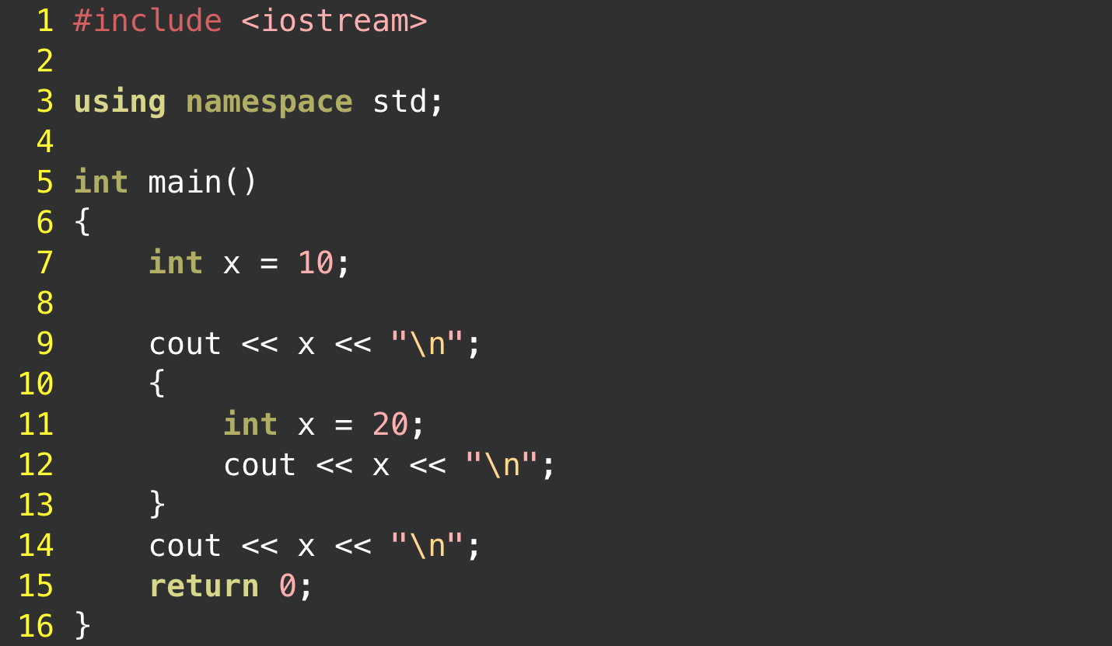
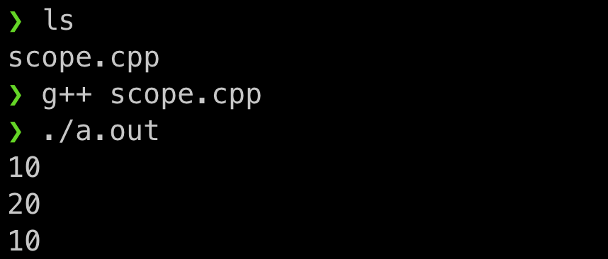
Scopes
A portion of the source code where a given name is valid (Variable, Function, Class, Namespace…)
From the terminal :
Instructor: N. Hamid - R. Mahjoubi
Al Khwarizmi (LSD S3)

Slide 6
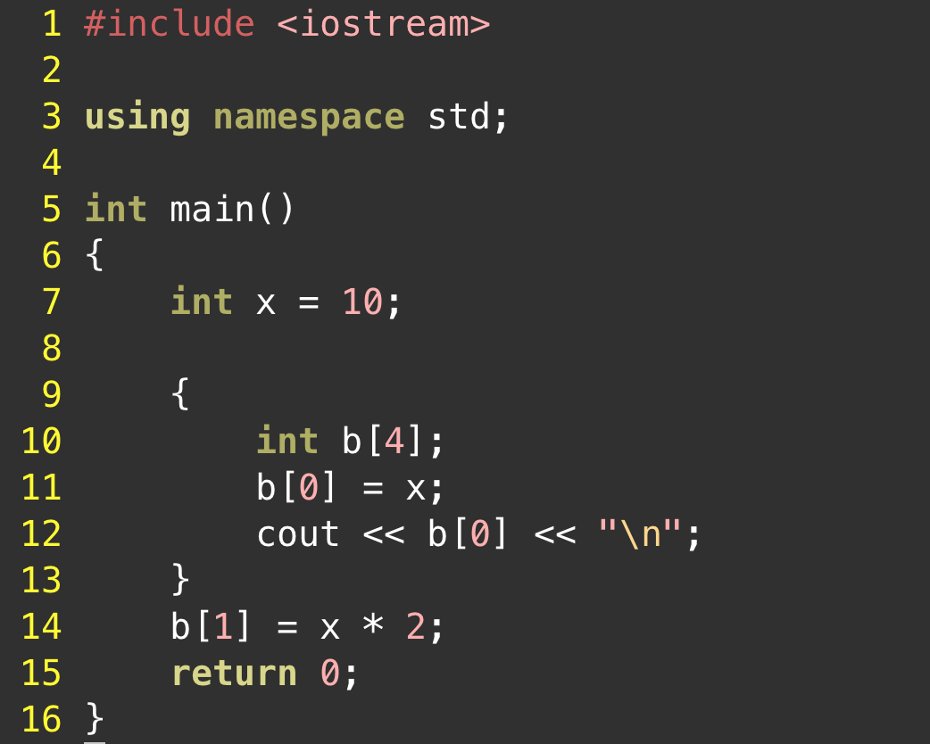
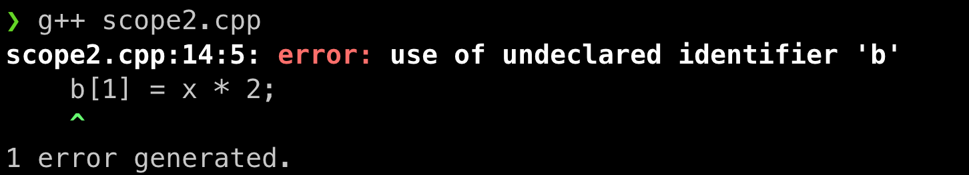
Scopes
Variables are (statically) allocated when defined and freed at the end of a scope
From the terminal :
Instructor: N. Hamid - R. Mahjoubi
Al Khwarizmi (LSD S3)

Slide 7
Namespaces
A namespace is a declarative region that provides a scope to the identifiers (the names of types, functions, variables, etc) inside it.
Namespaces are used to organize code into logical groups and to prevent name collisions that can occur especially when your code base includes multiple libraries.
Instructor: N. Hamid - R. Mahjoubi
Al Khwarizmi (LSD S3)

Slide 8
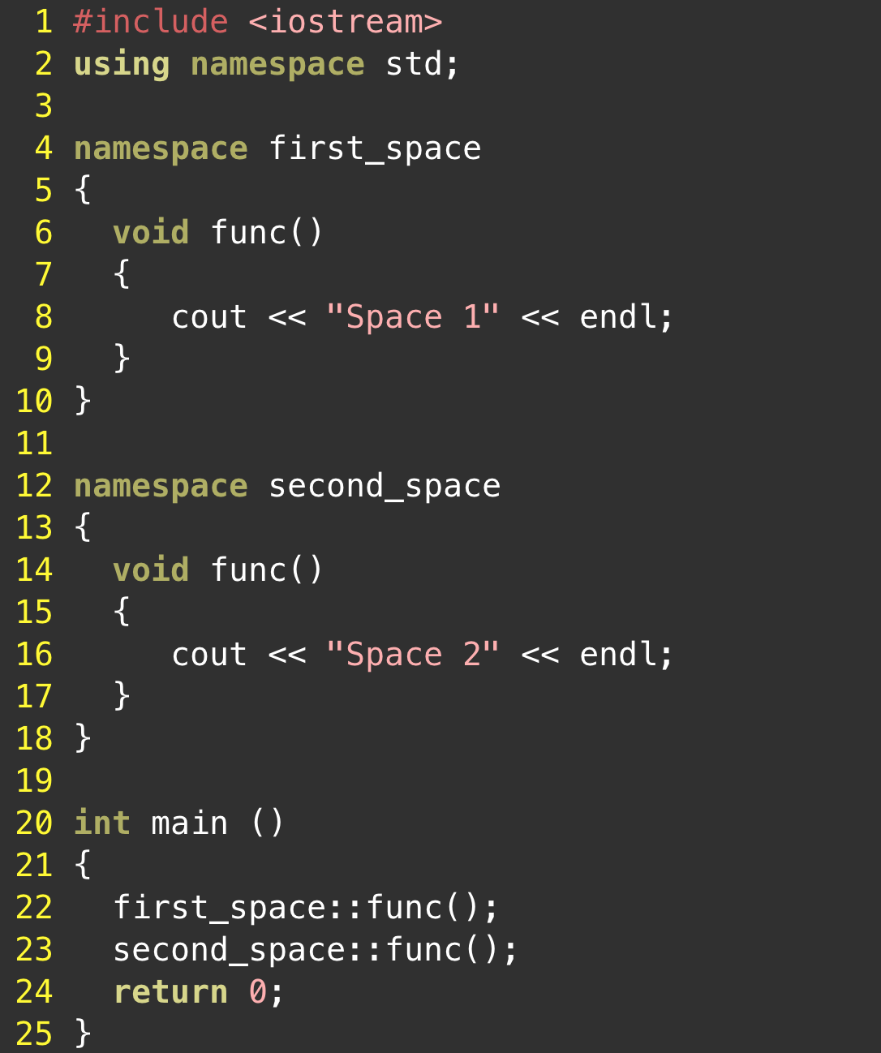
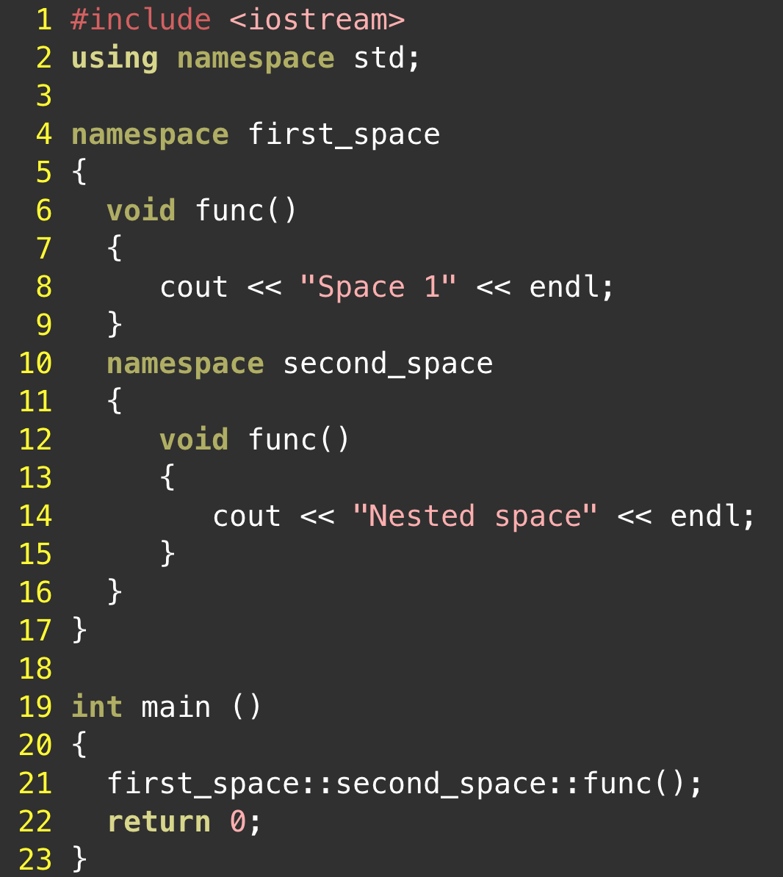
Namespaces
Instructor: N. Hamid - R. Mahjoubi
Al Khwarizmi (LSD S3)

Slide 9
C++ Input & Output

Slide 10
Input and output (I/O) streams
Input and output functionality is not defined as part of the core C++ language, but rather is provided through the C++ standard library (and thus resides in the std namespace).
When you include the iostream header, you gain access to a whole hierarchy of classes responsible for providing I/O functionality.
Streams:
stream is just a sequence of bytes that can be accessed sequentially
Over time, a stream may produce or consume potentially unlimited amounts of data.
Typically we deal with two different types of streams. Input streams and output streams.
Instructor: N. Hamid - R. Mahjoubi
Al Khwarizmi (LSD S3)

Slide 11
Input and output (I/O) streams
Input streams:
Are used to hold input from a data producer, such as a keyboard, a file, or a network
For example, the user may press a key on the keyboard while the program is currently not expecting any input. Rather than ignore the users keypress, the data is put into an input stream, where it will wait until the program is ready for it.
Output streams:
Are used to hold output for a particular data consumer, such as a monitor, a file, or a printer
When writing data to an output device, the device may not be ready to accept that data yet -- for example, the printer may still be warming up when the program writes data to its output stream. The data will sit in the output stream until the printer begins consuming it.
Instructor: N. Hamid - R. Mahjoubi
Al Khwarizmi (LSD S3)

Slide 12
Input and output (I/O) streams
Input Output in C++:
The istream class is the primary class used when dealing with input streams. With input streams, the extraction operator (>>) is used to remove values from the stream. This makes sense: when the user presses a key on the keyboard, the key code is placed in an input stream. Your program then extracts the value from the stream so it can be used.
The ostream class is the primary class used when dealing with output streams. With output streams, the insertion operator (<<) is used to put values in the stream. This also makes sense: you insert your values into the stream, and the data consumer (e.g. monitor) uses them
The iostream class can handle both input and output, allowing bidirectional I/O.
Instructor: N. Hamid - R. Mahjoubi
Al Khwarizmi (LSD S3)

Slide 13
Input and output (I/O) streams
Input Output in C++:
Standard streams in C++
A standard stream is a pre-connected stream provided to a computer program by its environment. C++ comes with four predefined standard stream objects that have already been set up for your use.
cin -- an istream class tied to the standard input (typically the keyboard)
cout -- an ostream class tied to the standard output (typically the monitor)
cerr -- an ostream class tied to the standard error (typically the monitor), providing unbuffered output
Instructor: N. Hamid - R. Mahjoubi
Al Khwarizmi (LSD S3)

Slide 14
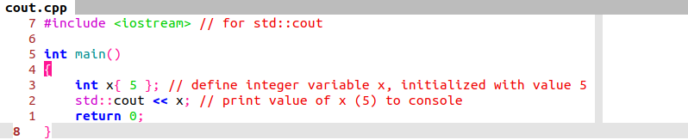
Input and output (I/O) streams
Std::cout example:
Instructor: N. Hamid - R. Mahjoubi
Al Khwarizmi (LSD S3)

Slide 15
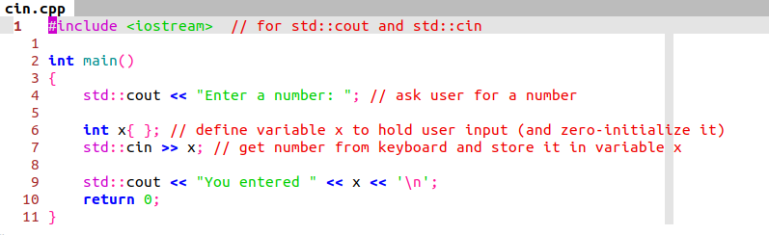
Input and output (I/O) streams
Std::cin example:
Instructor: N. Hamid - R. Mahjoubi
Al Khwarizmi (LSD S3)

Slide 16
Strings

Slide 17
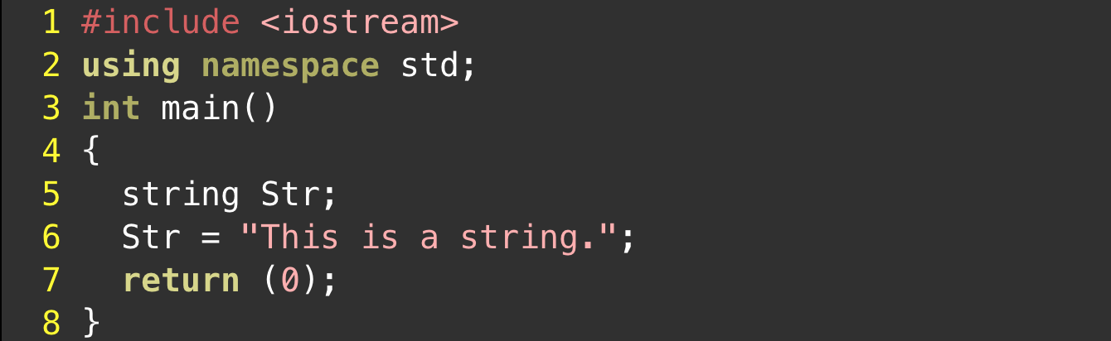
C++ strings
What is string in c++ ?
One of the most useful data types supplied in the C++ libraries is the string. A string is a variable that stores a sequence of letters or other characters.
Syntax:
Instructor: N. Hamid - R. Mahjoubi
Al Khwarizmi (LSD S3)

Slide 18
C++ strings
Why using c++ strings ?
The main advantage of using strings in c++, is that strings use dynamic memory allocation. This means you do not have to create your variable with a fixed size during initialization that you will not be able to change throughout the whole program. However, instead, a string can easily be resized, concatenated, shrunk, and manipulated during runtime.
Instructor: N. Hamid - R. Mahjoubi
Al Khwarizmi (LSD S3)

Slide 19
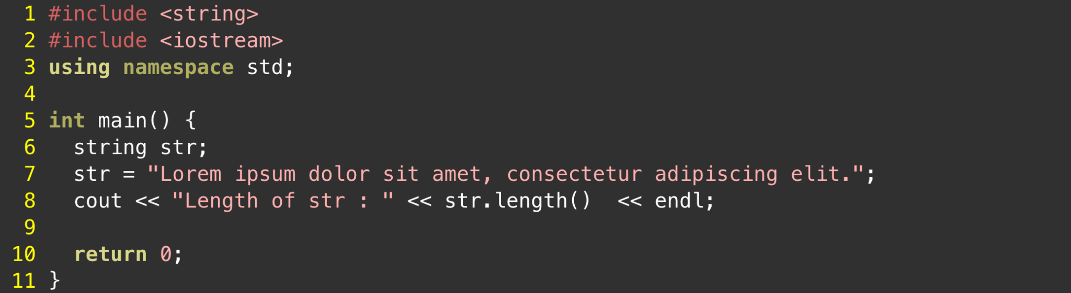
Operations on strings
Basic Operations :
Counting the number of characters in a string. The length method returns the number of characters in a string, including spaces and punctuation.
Instructor: N. Hamid - R. Mahjoubi
Al Khwarizmi (LSD S3)

Slide 20
Operations on strings
Basic Operations :
Accessing individual characters. Using square brackets, you can access individual characters within a string as if it’s a char array. Positions within a string str are numbered from 0 through str.length() - 1. You can read and write to characters within a string using [ ].
Comparing two strings. You can compare two strings for equality using the == and != operators. You can use <, <=, >, and >= to compare strings as well.
Instructor: N. Hamid - R. Mahjoubi
Al Khwarizmi (LSD S3)

Slide 21
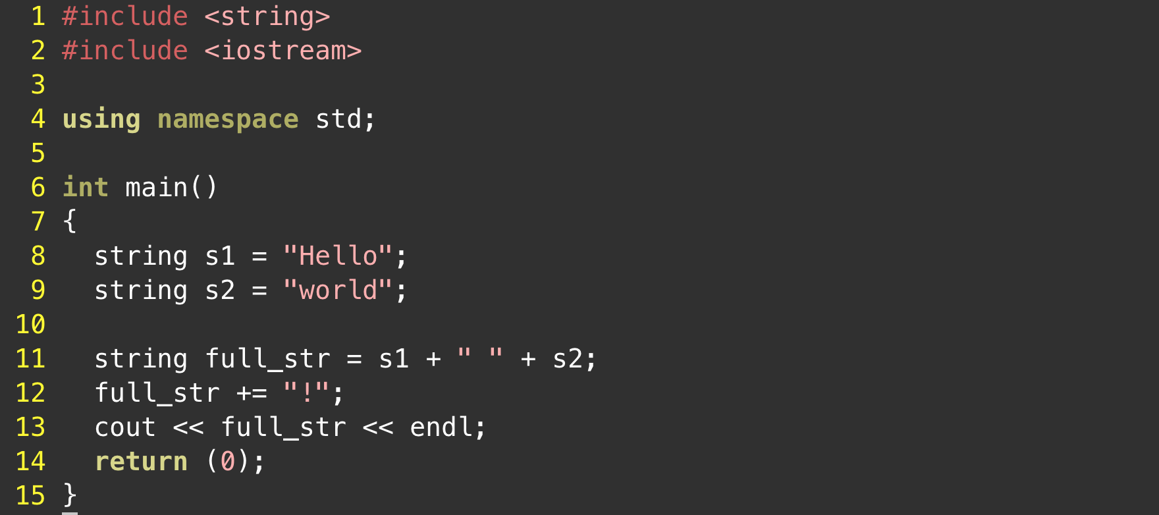
Operations on strings
Basic Operations :
Appending to a string: C++ strings are wondrous things. Suppose you have two strings, s1 and s2 and you want to create a new string of their concatenation. Conveniently, you can just write s1 + s2, and you’ll get the result you’d expect. Similarly, if you want to append to the end of string, you can use the += operator. You can append either another string or a single character to the end of a string.
Instructor: N. Hamid - R. Mahjoubi
Al Khwarizmi (LSD S3)

Slide 22
Operations on strings
Basic Operations :
Searching within a string. The string member function find is used to search within a string for a particular string or character.
Extracting substrings. Sometimes you would like to create new strings by extracting portions of a larger one. The substr member function creates substrings from pieces of the receiver string.
Modifying a string by inserting and replacing. Finally, let’s cover two other useful member functions that modify the receiver string. The first, str1.insert(start, str2), inserts str2 at position start within str1, shifting the remaining characters of str1 over. The second, str1.replace(start, length, str2), removes from str1 a total of length characters starting at the position start, replacing them with a copy of str2.
Instructor: N. Hamid - R. Mahjoubi
Al Khwarizmi (LSD S3)

Slide 23
Arrays

Slide 24
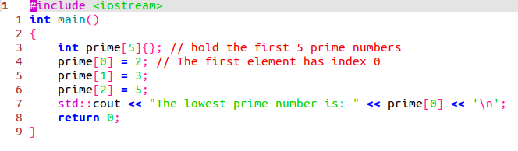
C style arrays
Fixed size arrays:
An array is an aggregate data type that lets us access many variables of the same type through a single identifier.
A fixed array (also called a fixed length array or fixed size array) is an array where the length is known at compile time
Syntax:
Instructor: N. Hamid - R. Mahjoubi
Al Khwarizmi (LSD S3)

Slide 25
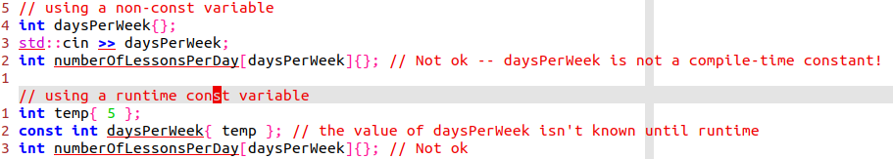
C style arrays
Fixed size arrays:
When declaring a fixed array, the length of the array (between the square brackets) must be a compile-time constant. This is because the length of a fixed array must be known at compile time.
Consider the following examples:
Instructor: N. Hamid - R. Mahjoubi
Al Khwarizmi (LSD S3)

Slide 26
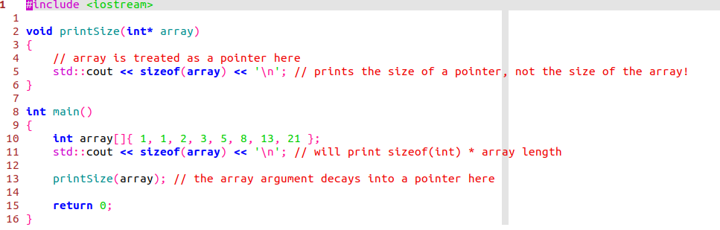
C style arrays
Passing fixed arrays to functions:
When passing an array as an argument to a function, a fixed array decays into a pointer, and the pointer is passed to the function:
Instructor: N. Hamid - R. Mahjoubi
Al Khwarizmi (LSD S3)

Slide 27
C style arrays
Passing fixed arrays to functions:
Finally, it is worth noting that arrays that are part of structs or classes do not decay when the whole struct or class is passed to a function. This yields a useful way to prevent decay if desired.
Instructor: N. Hamid - R. Mahjoubi
Al Khwarizmi (LSD S3)

Slide 28
C style arrays
Fixed size arrays:
A note on fixed size arrays:
Because fixed arrays have memory allocated at compile time, that introduces two limitations:
Fixed arrays cannot have a length based on either user input or some other value calculated at runtime.
Fixed arrays have a fixed length that can not be changed
In many cases, these limitations are problematic. Fortunately, C++ supports a second kind of array known as a dynamic array. The length of a dynamic array can be set at runtime, and their length can be changed.
Instructor: N. Hamid - R. Mahjoubi
Al Khwarizmi (LSD S3)

Slide 29
C style arrays
Dynamic arrays:
C++ supports three basic types of memory allocation:
Static memory allocation happens for static and global variables. Memory for these types of variables is allocated once when your program is run and persists throughout the life of your program.
Automatic memory allocation happens for function parameters and local variables. Memory for these types of variables is allocated when the relevant block is entered, and freed when the block is exited, as many times as necessary.
Dynamic memory allocation, the program is responsible for managing the memory.
Instructor: N. Hamid - R. Mahjoubi
Al Khwarizmi (LSD S3)

Slide 30
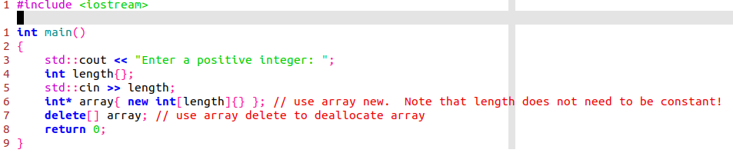
C style arrays
Dynamic arrays:
To allocate an array dynamically, we use the array form of new and delete (often called new[] and delete[]):
Instructor: N. Hamid - R. Mahjoubi
Al Khwarizmi (LSD S3)

Slide 31
C style arrays
Initializing dynamically allocated arrays
Prior to C++11, there was no easy way to initialize a dynamic array to a non-zero value (initializer lists only worked for fixed arrays). This means you had to loop through the array and assign element values explicitly.
However, starting with C++11, it’s now possible to initialize dynamic arrays using initializer lists!
Instructor: N. Hamid - R. Mahjoubi
Al Khwarizmi (LSD S3)

Slide 32
C style arrays
Resizing arrays
Dynamically allocating an array allows you to set the array length at the time of allocation. However, C++ does not provide a built-in way to resize an array that has already been allocated. It is possible to work around this limitation by dynamically allocating a new array, copying the elements over, and deleting the old array. However, this is error prone, especially when the element type is a class (which have special rules governing how they are created).
Consequently, we recommend avoiding doing this yourself.
Fortunately, if you need this capability, C++ provides a resizable array as part of the standard library called std::vector. We’ll introduce std::vector shortly.
Instructor: N. Hamid - R. Mahjoubi
Al Khwarizmi (LSD S3)

Slide 33
Introduction to std::array

Slide 34

STD::ARRAY
Fixed size arrays:
std::array provides fixed array functionality that won’t decay when passed into a function
std::array is defined in the <array> header, inside the std namespace.
Declaration and initialization:
Instructor: N. Hamid - R. Mahjoubi
Al Khwarizmi (LSD S3)

Slide 35
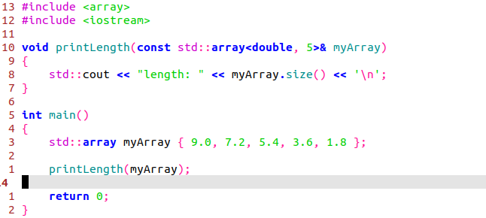
STD::ARRAY
Passing std::arrays to functions:
Because std::array doesn’t decay to a pointer when passed to a function, the size() function will work even if you call it from within a function:
Instructor: N. Hamid - R. Mahjoubi
Al Khwarizmi (LSD S3)

Slide 36
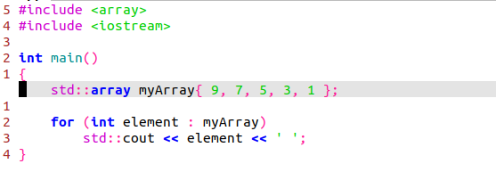
STD::ARRAY
Range-based for-loops:
Because the length is always known, range-based for-loops work with std::array:
Instructor: N. Hamid - R. Mahjoubi
Al Khwarizmi (LSD S3)

Slide 37
C++ vectors

Slide 38

C++ Vectors
Vectors are used to store elements of similar data types. However, unlike arrays, the size of a vector can grow dynamically.
That mean vector provides dynamic array functionality that handles its own memory management. This means you can create arrays that have their length set at run-time, without having to explicitly allocate and deallocate memory using new and delete.
Vectors are part of the C++ Standard Template Library. To use vectors, we need to include the vector header
Instructor: N. Hamid - R. Mahjoubi
Al Khwarizmi (LSD S3)

Slide 39

C++ Vectors
Vector declaration:
We can declare a vector in C++:
The type parameter <int> specifies the type of the vector.
num is the name of the vector.
we have not specified the size of the vector during the declaration. This is because the size of a vector can grow dynamically so it is not necessary to define it.
Instructor: N. Hamid - R. Mahjoubi
Al Khwarizmi (LSD S3)

Slide 40
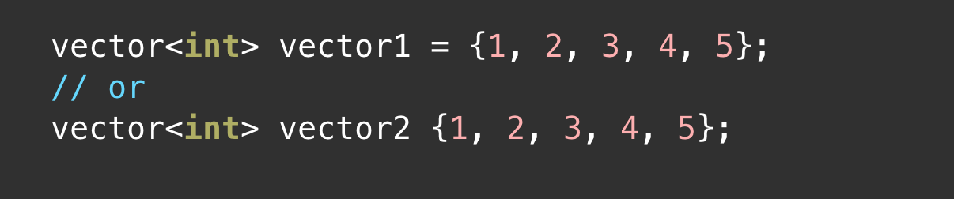
C++ Vectors
Vector initialization:
First Method (-std=c++11 maybe needed when compiling):
Second Method:
Instructor: N. Hamid - R. Mahjoubi
Al Khwarizmi (LSD S3)

Slide 41
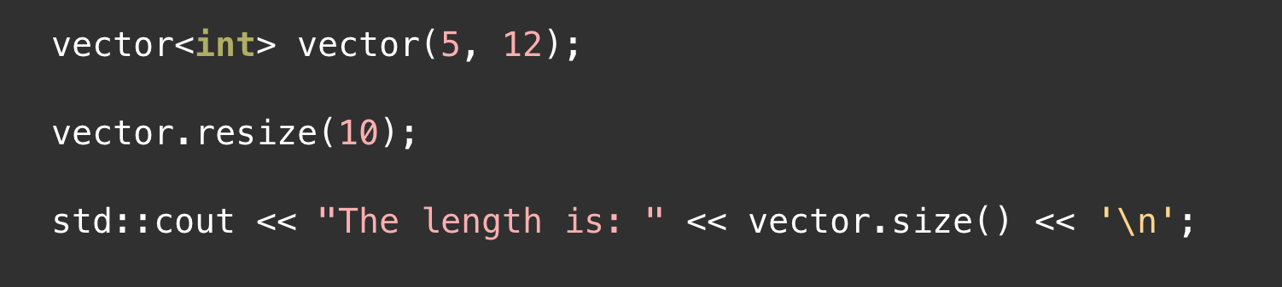
C++ Vectors
Resizing a Vector:
When we resize the vector, the existing element values will be preserved, the new elements will be initialized to the default value for the type (for example 0 for integers).
Resizing a vector is as simple as calling the resize() function:
Vectors may also be resized to a smaller size.
Instructor: N. Hamid - R. Mahjoubi
Al Khwarizmi (LSD S3)

Slide 42
C++ Vectors
Basic Vector Operations:
Vectors, like strings, are a class in C++. Like we did with strings, we will ignore the object-oriented nature of vectors and simply note that they provides various methods to perform different operations on vectors.
We’ll take a look at some commonly used vector operations:
Add elements
Access elements
Change elements
Remove elements
Instructor: N. Hamid - R. Mahjoubi
Al Khwarizmi (LSD S3)

Slide 43
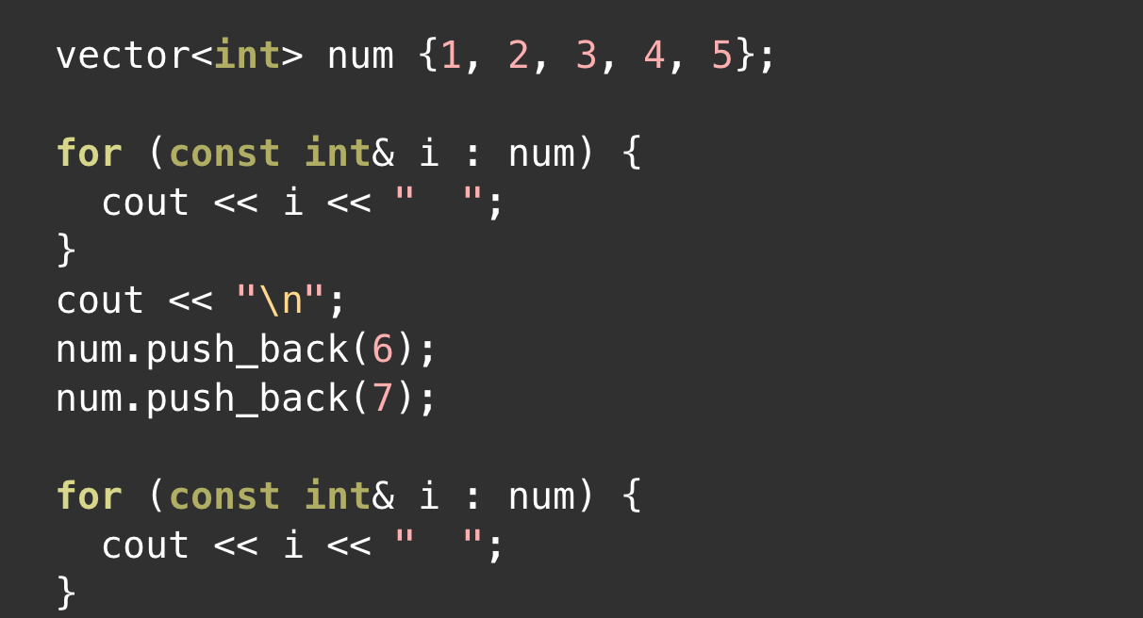
C++ Vectors
Add Elements to a Vector:
push_back() Method is used to add a single element into a vector, it insert the new element into the end of the vector.
The new vector will be : 1 2 3 4 5 6 7
Instructor: N. Hamid - R. Mahjoubi
Al Khwarizmi (LSD S3)

Slide 44
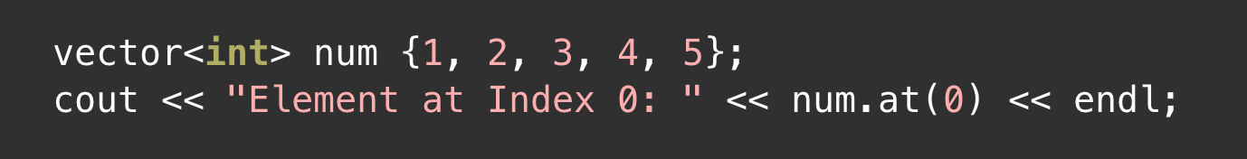
C++ Vectors
Access Elements of a Vector:
at() Method is used to access the element for the specified index
Result:
Element at Index 0: 1
Note: Like an array, we can also use the square brackets [] to access vector elements.
Instructor: N. Hamid - R. Mahjoubi
Al Khwarizmi (LSD S3)

Slide 45
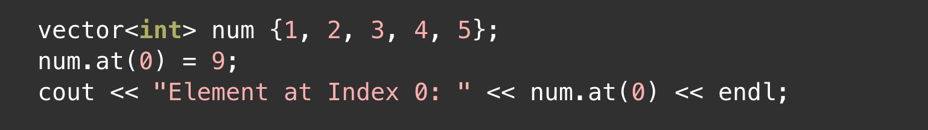
C++ Vectors
Change Vector Element:
at() Method can be used also to change the element value.
Result:
Element at Index 0: 9
Again !! you can use brackets [] to change an element value.
Instructor: N. Hamid - R. Mahjoubi
Al Khwarizmi (LSD S3)

Slide 46
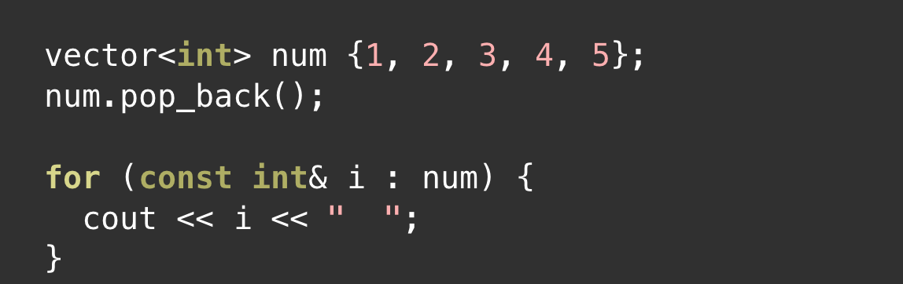
C++ Vectors
Delete Vector Element:
pop_back() Method is used to delete a single element from a vector.
The new vector will be : 1 2 3 4
Instructor: N. Hamid - R. Mahjoubi
Al Khwarizmi (LSD S3)

Slide 47
C++ Vectors
Other vector methods:
size() returns the number of elements present in the vector
clear() removes all the elements of the vector
front() returns the first element of the vector
back() returns the last element of the vector
empty() returns 1 (true) if the vector is empty
capacity() check the overall size of a vector
Instructor: N. Hamid - R. Mahjoubi
Al Khwarizmi (LSD S3)

Slide 48
C++ Templates

Slide 49
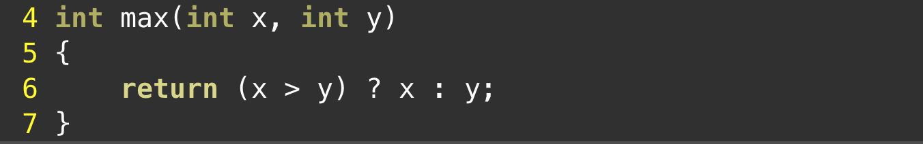
C++ Templates
Function Template:
Let’s say you wanted to write a function to calculate the maximum of two numbers. You might do so like this:
While the caller can pass different values into the function, the type of the parameters is fixed, so the caller can only pass in int values. That means this function really only works well for integers (and types that can be promoted to int).
So what happens later when you want to find the max of two double values? Because C++ requires us to specify the type of all function parameters, the solution is to create a new version of max() with parameters of type double:
Instructor: N. Hamid - R. Mahjoubi
Al Khwarizmi (LSD S3)

Slide 50
C++ Templates
Function Template:
In C++, the template system was designed to simplify the process of creating functions that are able to work with different data types.
Unlike a normal definition (where all types must be specified), in a template we can use one or more placeholder types. A placeholder type represents some type that is not known at the time the template is written, but that will be provided later.
Once a template is defined, the compiler can use the template to generate as many functions as needed, each using different actual types!
Instructor: N. Hamid - R. Mahjoubi
Al Khwarizmi (LSD S3)

Slide 51
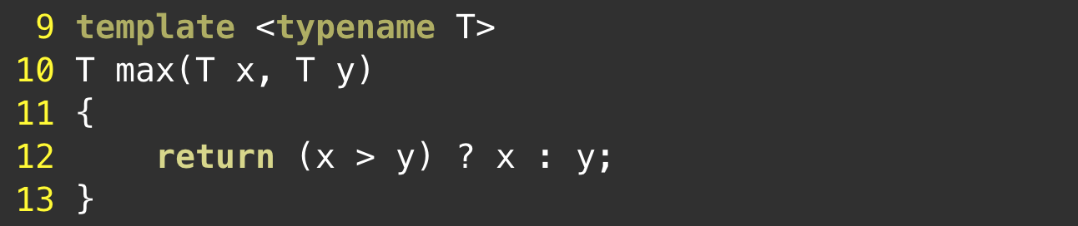
C++ Templates
Defining a Function Template:
A function template starts with the keyword template followed by template parameter(s) inside <> which is followed by the function definition.
Instructor: N. Hamid - R. Mahjoubi
Al Khwarizmi (LSD S3)

Slide 52
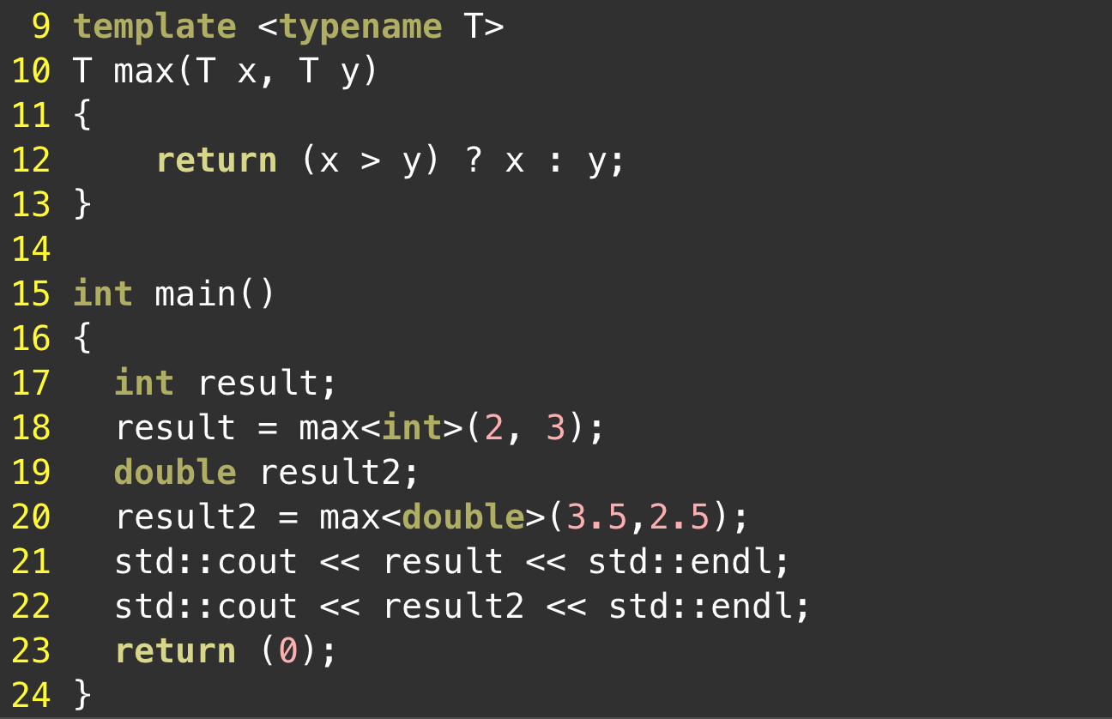
C++ Templates
Calling a Function Template:
Once we've declared and defined a function template, we can call it in other functions or templates (such as the main() function) with the following syntax
Instructor: N. Hamid - R. Mahjoubi
Al Khwarizmi (LSD S3)

Slide 53
C++ object oriented programming

Slide 54
OOP
What is object-oriented programming?
Object oriented programming is a programming model for software design that revolves around objects instead of functions.
Let’s take a look around! everywhere we look there are objects, books, tables, food and even you.
Objects have two major components to them:
1) A list of relevant properties
2) Some behaviors
OOP provides us with the ability to create objects that tie together both properties and behaviors into a self-contained, reusable package.
OOP allows programs to be written in a more modular fashion, which makes them easier to write and understand, and also provides a higher degree of code-reusability.
Instructor: N. Hamid - R. Mahjoubi
Al Khwarizmi (LSD S3)

Slide 55
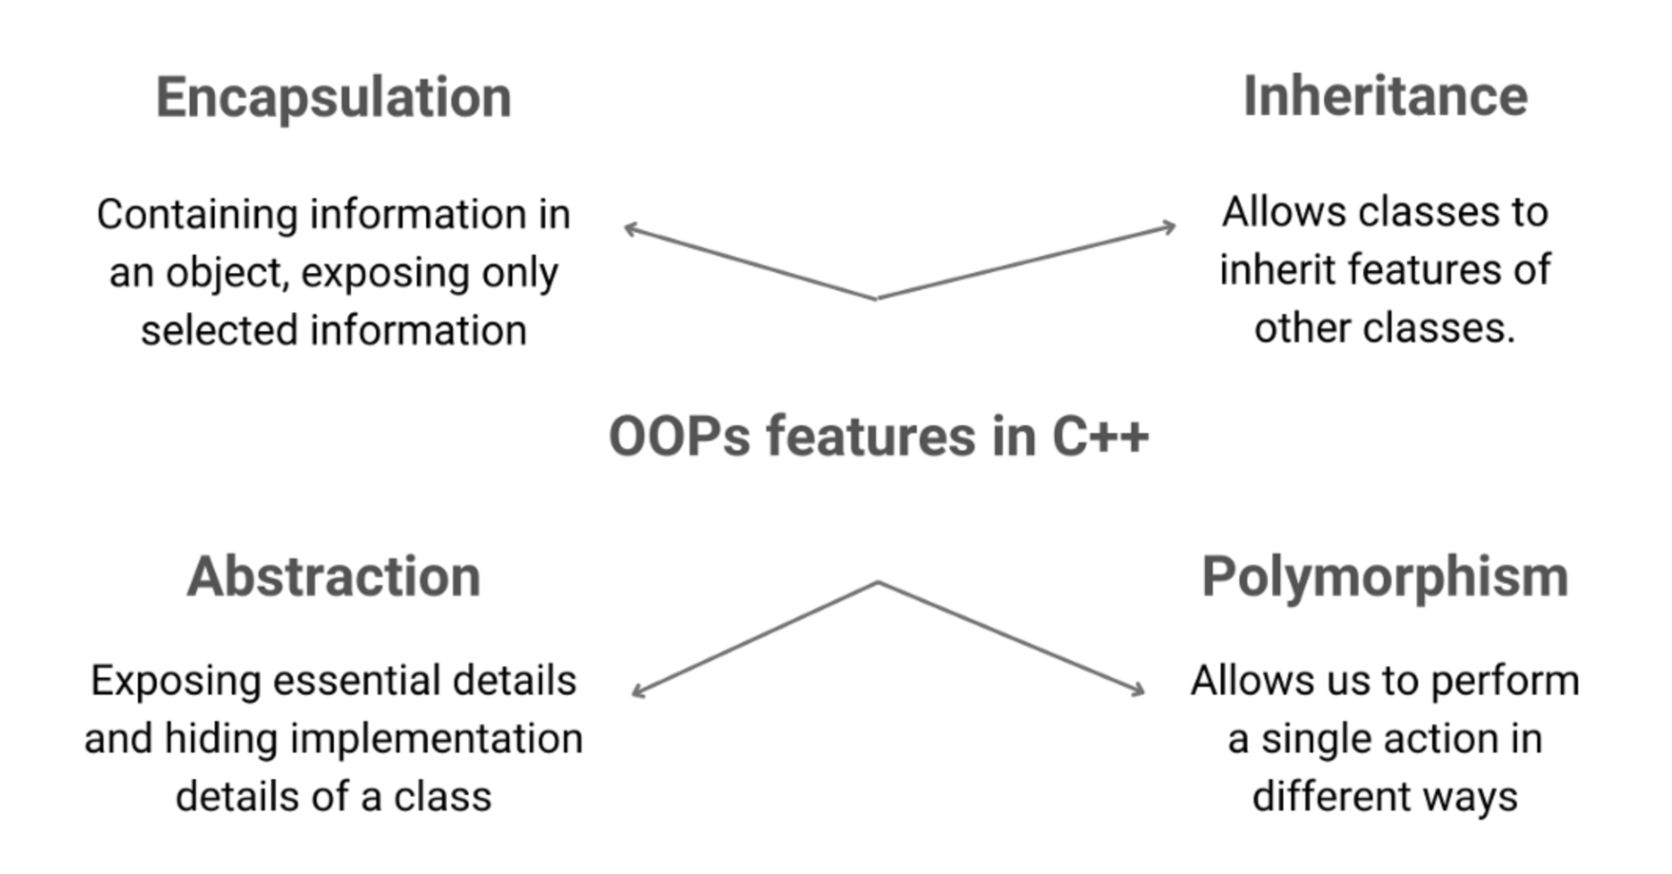
OOP
Key features of OOP
Object-oriented programming brings several useful concepts, such as: inheritance, encapsulation, abstraction and polymorphism.
Instructor: N. Hamid - R. Mahjoubi
Al Khwarizmi (LSD S3)

Slide 56
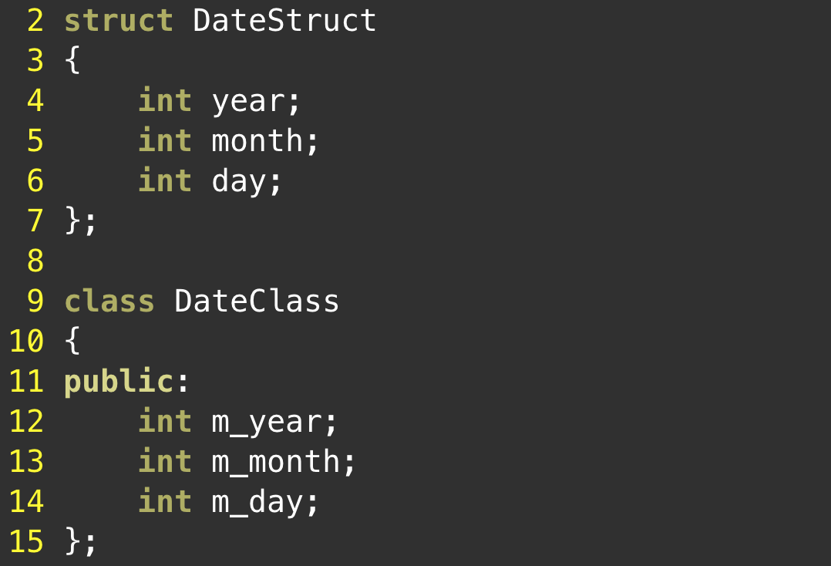
OOP
Classes
In OOP, we often want our types to not only hold data, but provide functions that work with the data as well. In C++, this is typically done via the class keyword. The class keyword defines a new defined type called a class.
classes and structs are essentially the same. the following struct and class are effectively identical:
Instructor: N. Hamid - R. Mahjoubi
Al Khwarizmi (LSD S3)

Slide 57
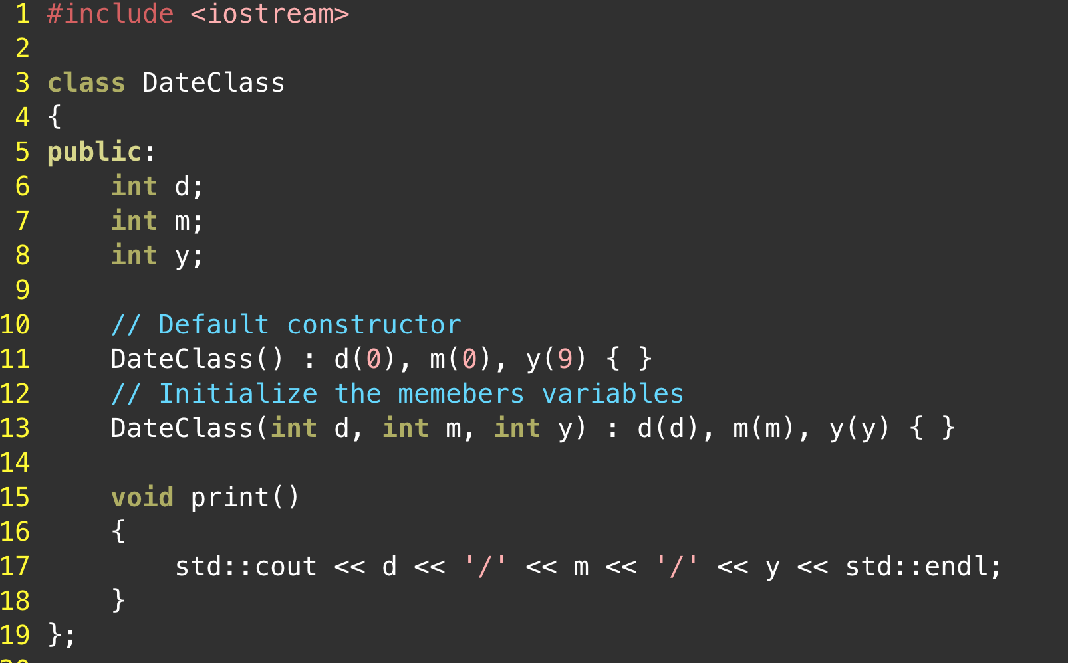
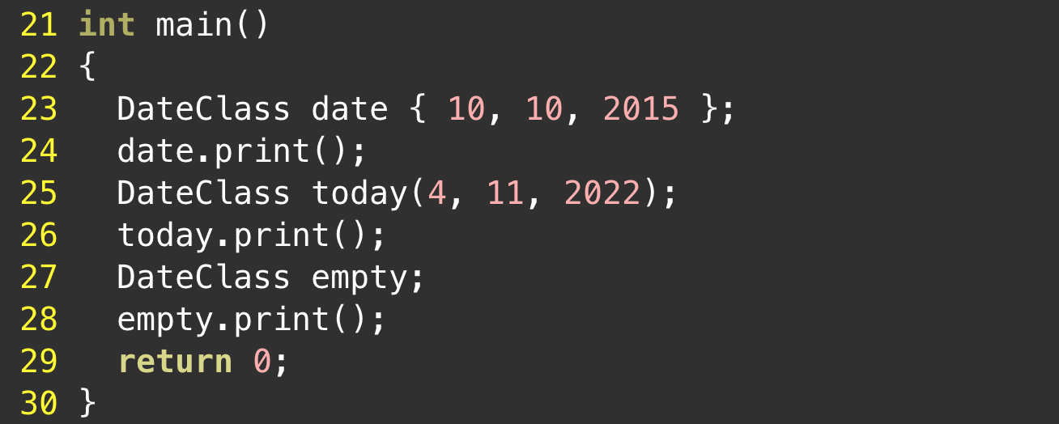
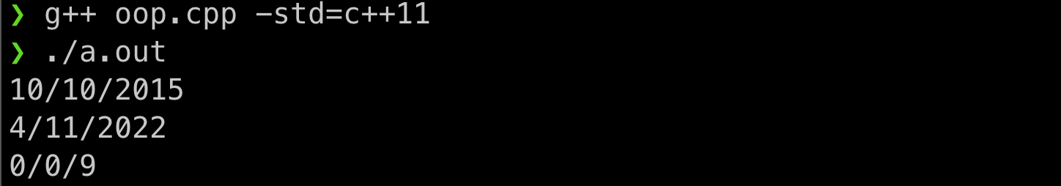
OOP
Member Functions
In addition to holding data, classes (and structs) can also contain functions! Functions defined inside of a class are called member functions (or sometimes methods). Member functions can be defined inside or outside of the class definition. We’ll define them inside the class for now (for simplicity), and show how to define them outside the class later.
Instructor: N. Hamid - R. Mahjoubi
Al Khwarizmi (LSD S3)

Slide 58
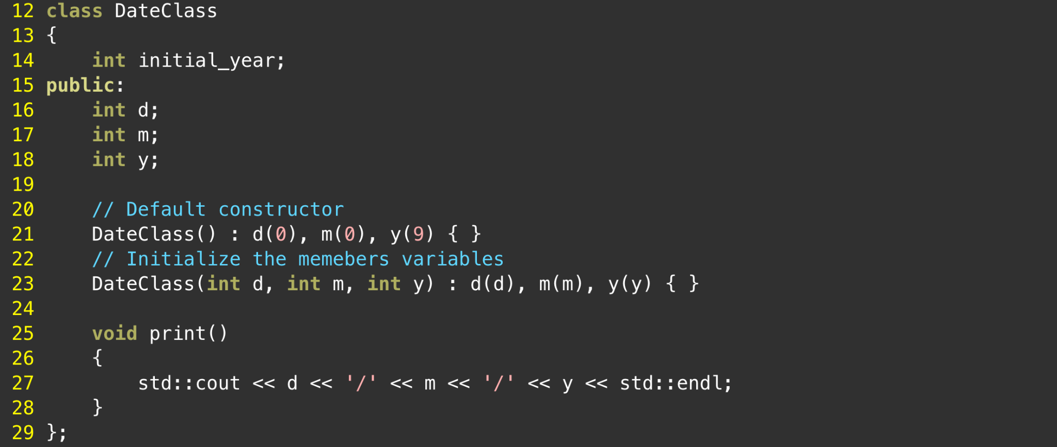

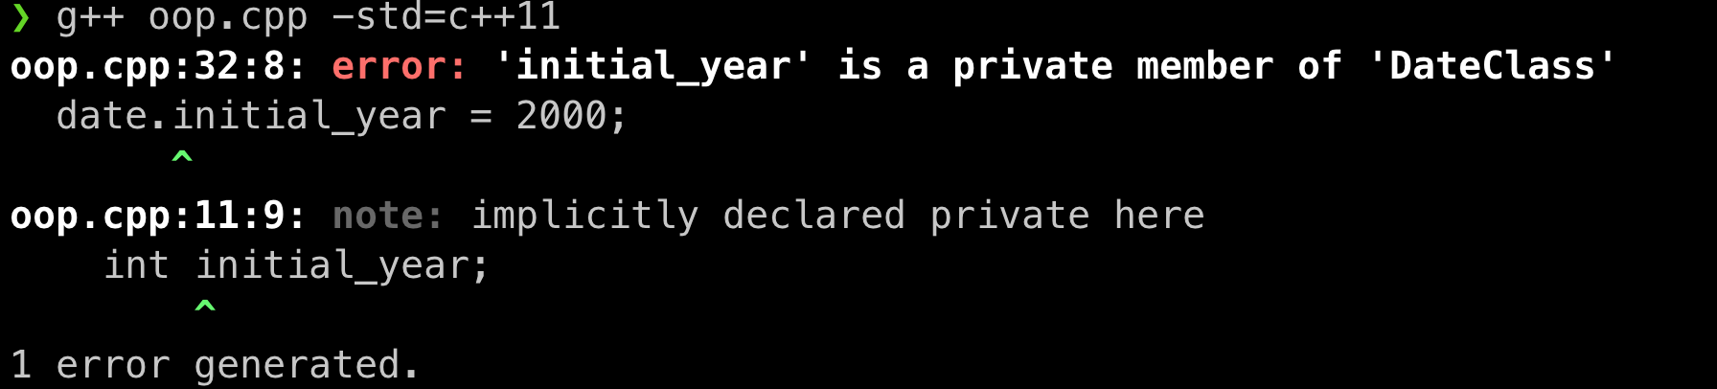
OOP
Public vs private access specifiers
By default, all members of a class are private. Private members are members of a class that can only be accessed by other members of the class.
Let’s consider the following example:
Because main() is not a member of DateClass, it does not have access to initial_year private member.
Instructor: N. Hamid - R. Mahjoubi
Al Khwarizmi (LSD S3)

Slide 59
OOP
Access specifiers
Although class members are private by default, we can make them public by using the public keyword:
Let’s consider the same example:
Because variables members d, m, y are public they can be accessed directly from the main().
Instructor: N. Hamid - R. Mahjoubi
Al Khwarizmi (LSD S3)

Slide 60
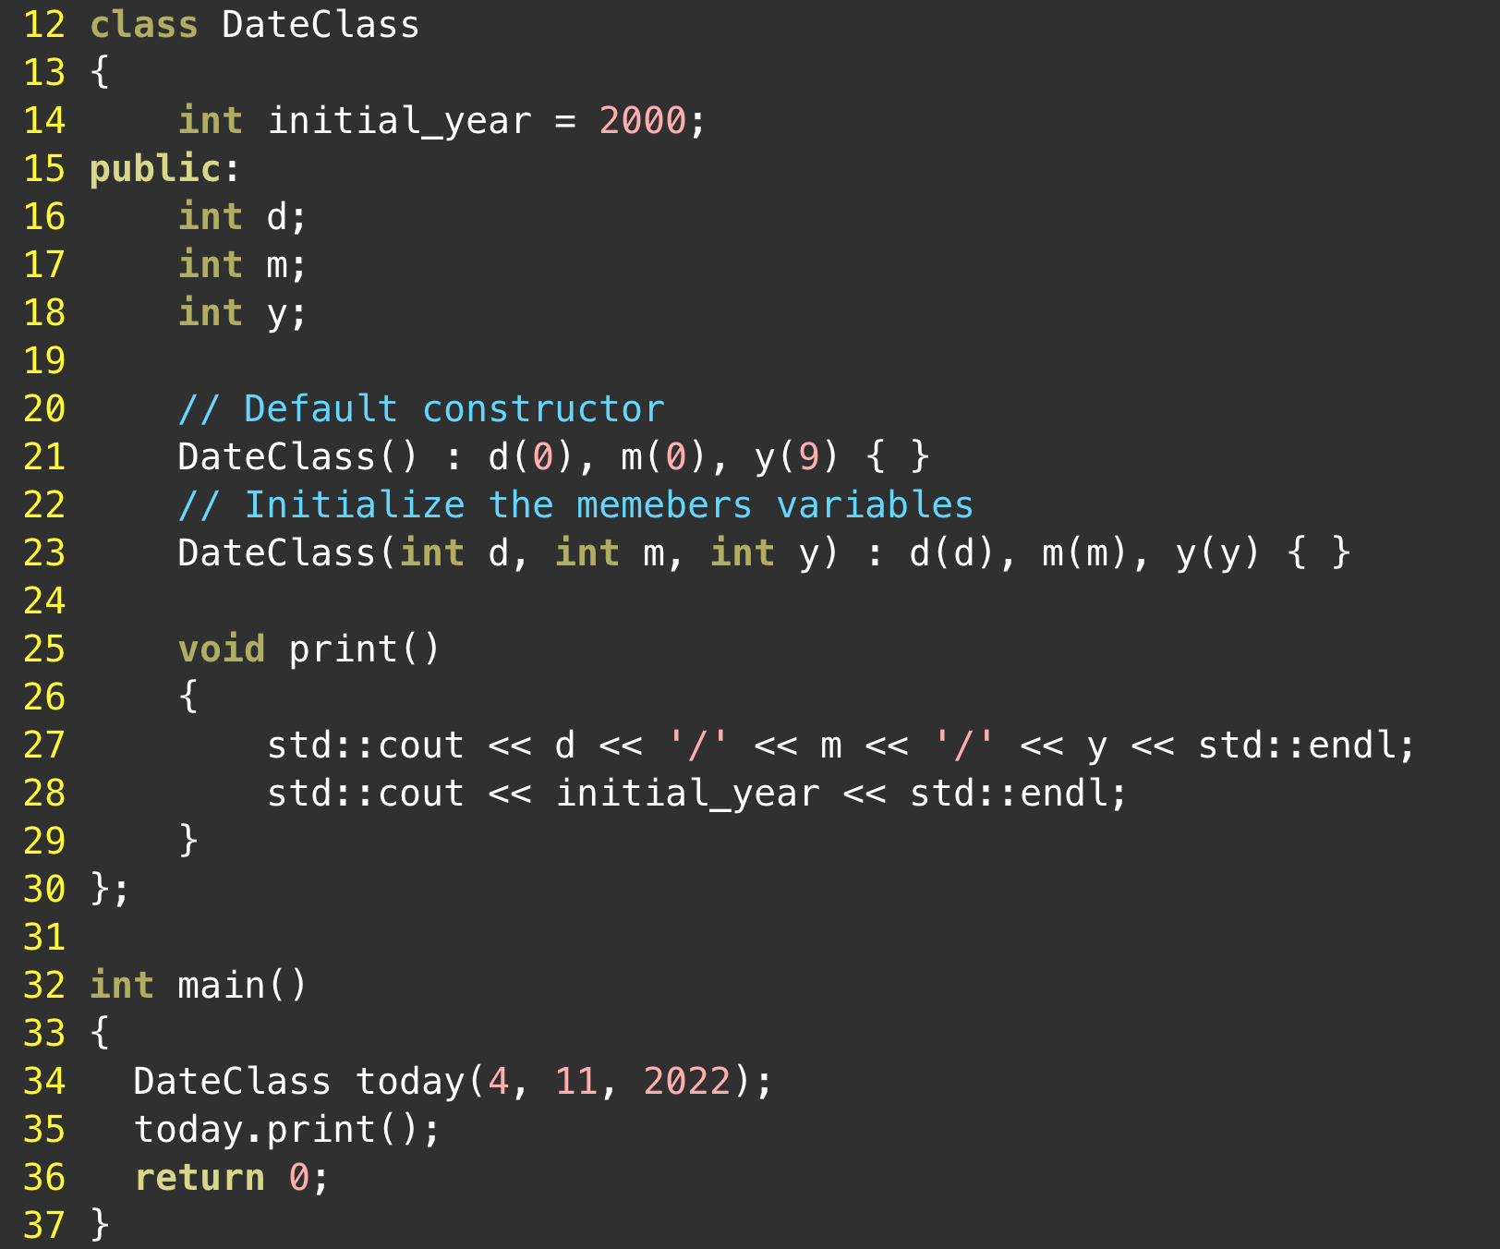
OOP
Mixing access specifiers
A class can (and almost always does) use multiple access specifiers to set the access levels of each of its members. There is no limit to the number of access specifiers you can use in a class.
For example this code work fine even if the print function use the private member initial_year and this is because the print function is public and it’s a member of the same class as the member initial_year.
Instructor: N. Hamid - R. Mahjoubi
Al Khwarizmi (LSD S3)

Slide 61
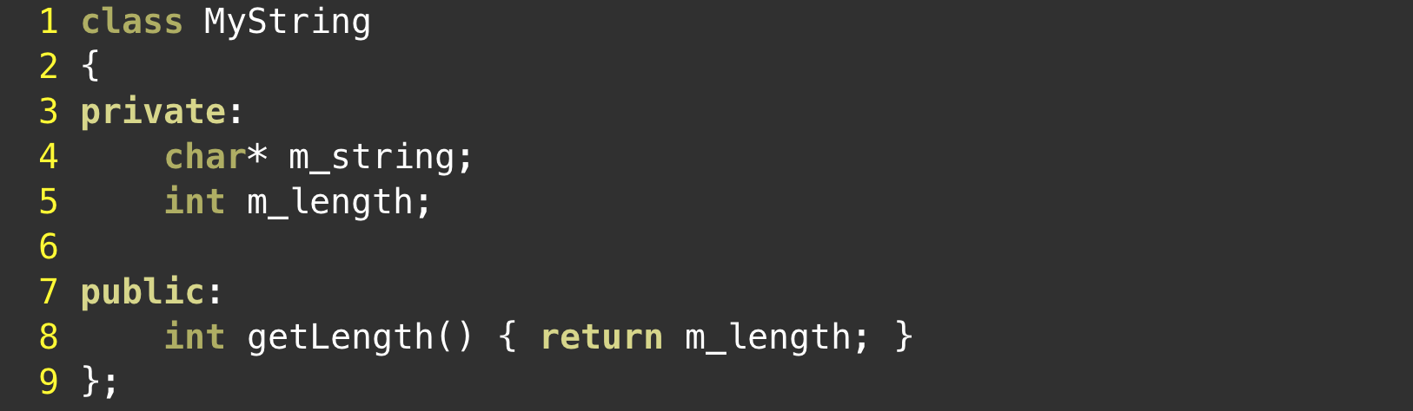
OOP
Encapsulation:
Encapsulation (also called information hiding) is the process of keeping the details about how an object is implemented hidden away from users of the object.
We can implement encapsulation using the access specifiers.
Instructor: N. Hamid - R. Mahjoubi
Al Khwarizmi (LSD S3)

Slide 62
OOP
Constructor member initializer lists:
In previous lessons, some types of data (e.g. const and reference variables) must be initialized on the line in which they are declared.
Now consider the following class:
class Something
{
private:
const int m_value;
public:
Something(int x);
};
How would you write its Constructor to initialize the constant member m_value ?
Instructor: N. Hamid - R. Mahjoubi
Al Khwarizmi (LSD S3)

Slide 63
OOP
Constructor member initializer lists:
Using what you have seen so far you might try
Something::Something(int x)
{
m_value = x;
}
This will trigger the following error
error: assignment of read-only member ‘Something::m_value’
You see that assigning values to const or reference member variables in the body of the constructor is clearly not possible in some cases.
Instructor: N. Hamid - R. Mahjoubi
Al Khwarizmi (LSD S3)

Slide 64
OOP
Constructor member initializer lists:
To solve this problem, C++ provides a method for initializing class member variables via a member initializer list (often called a “member initialization list”).
The syntax is as follows:
Something::Something(int x) : m_value{x}
{
}
The member initializer list is inserted after the constructor parameters. It begins with a colon (:), and then lists each variable to initialize along with the value for that variable separated by a comma.
Instructor: N. Hamid - R. Mahjoubi
Al Khwarizmi (LSD S3)

Slide 65
OOP
Constructor member initializer lists:
Now consider a class with an array member:
class Something
{
private:
const int array[5];
};
Prior to C++11, you can only zero initialize an array member via a member initialization list:
Something::Something(): array {}
{}
Instructor: N. Hamid - R. Mahjoubi
Al Khwarizmi (LSD S3)

Slide 66
OOP
Constructor member initializer lists:
Consider a class with an array member:
class Something
{
private:
const int array[5];
};
since C++11, you can fully initialize a member array using uniform initialization:
Something::Something(): array { 1, 2, 3, 4, 5 }
{}
Exercice: Write a program that outputs the C++ standard implemented by your compiler.
Instructor: N. Hamid - R. Mahjoubi
Al Khwarizmi (LSD S3)

Slide 67
OOP
Constructor member initializer lists:
Note: Variables in the initializer list are not initialized in the order that they are specified in the initializer list. Instead, they are initialized in the order in which they are declared in the class.
To avoid any surprises the following recommendations should be observed:
Don’t initialize member variables in such a way that they are dependent upon other member variables being initialized first.
Initialize variables in the initializer list in the same order in which they are declared in your class. This isn’t strictly required so long as the prior recommendation has been followed.
Instructor: N. Hamid - R. Mahjoubi
Al Khwarizmi (LSD S3)

Slide 68
OOP
The `this` pointer:
Consider the following class, its constructor has a parameter with the same name as a member variable.
class Test
{
private:
int data;
public:
Test(int data);
};
How would initialize the member variable with the value of the local variable?
Instructor: N. Hamid - R. Mahjoubi
Al Khwarizmi (LSD S3)

Slide 69
OOP
The `this` pointer :
You can can see a changing the member variable with the identifier `data` will not do the trick, and you will only be changing the value of the local variable `data`.
To disambiguate between the member and local variables we can use the “this” pointer which is a pointer to the object being operated on to access the member variables
The syntax is as follows:
Test::Test(int data)
{this->data = data;}
Each member function has a “this” pointer parameter that is set to the address of the object being operated on
Instructor: N. Hamid - R. Mahjoubi
Al Khwarizmi (LSD S3)

Slide 70
OOP
The `this` pointer :
Another utility of “this” pointer is making a class member function return the object it was working with as a return value.
This is useful when you want to allow a series of member functions to be “chained” together, so several member functions can be called on the same object. Consider The following
class Calc
{
private:
int m_value{0};
public:
void add(int value) { m_value += value; }
void sub(int value) { m_value -= value; }
void mult(int value) { m_value *= value; }
int getValue() { return m_value; }
};
#include <iostream>
int main()
{
Calc calc{};
calc.add(5); // returns void
calc.sub(3); // returns void
calc.mult(4); // returns void
std::cout << calc.getValue() << '\n';
return 0;
}
Instructor: N. Hamid - R. Mahjoubi
Al Khwarizmi (LSD S3)

Slide 71
OOP
The `this` pointer :
We can achieve the same thing by chaining the calls to the member functions, by making each function return *this.
class Calc
{
private:
int m_value{};
public:
Calc& add(int value) { m_value += value; return *this; }
Calc& sub(int value) { m_value -= value; return *this; }
Calc& mult(int value) { m_value *= value; return *this; }
int getValue() { return m_value; }
};
#include <iostream>
int main()
{
Calc calc{};
calc.add(5).sub(3).mult(4);
std::cout << calc.getValue() << '\n';
return 0;
}
Instructor: N. Hamid - R. Mahjoubi
Al Khwarizmi (LSD S3)

Slide 72
OOP
The `this` pointer :
NOTE: “this” is a const pointer -- you can change the value of the underlying object it points to, but you can not make it point to something else!.
Instructor: N. Hamid - R. Mahjoubi
Al Khwarizmi (LSD S3)

Slide 73
OOP
Friend functions
A friend function is a function that can access the private members of a class as though it was a member of that class. A friend function may be either a normal function, or a member function of another class.
class Point
{
private:
double x{};
double y{}
public:
Value(double x, double y);
friend bool is_the_same(const Point& p1, const Point& p2);
};
bool is_the_samel(const Point&p1, const Point& p2)
{
return (p1.x == p2.x && p1.y == p2.y );
}
Because is_the_same() is a friend of the Point class, it can access the private members of all Value objects
Instructor: N. Hamid - R. Mahjoubi
Al Khwarizmi (LSD S3)

Slide 74
OOP
Friend functions
A function can be a friend of more than one class at the same time., consider the following example (follow up of the previous section)
using namespace std;
class Line
{
private:
Point p1, p2;
double M,B;
public:
Line(Point P1, Point P2); //we calculate M and B in the constructor
};
friend bool point_in_line(const Point& p, const Line& L);
friend bool point_in_line(const Point& p, const Line& L);
{
return (p.y == L.M * p.x + L.B);
}
Instructor: N. Hamid - R. Mahjoubi
Al Khwarizmi (LSD S3)

Slide 75
OOP
Friend classes
It is also possible to make an entire class a friend of another class. This gives all of the members of the friend class access to the private members of the other class. Here is an example:
class Storage
{
private:
int val1 {};
double val2 {};
public:
Storage(int val1, double val2);
friend class Display;
};
class Display
{
public:
Display();
void displayItem(const Storage& storage)
{
std::cout << storage.val1 << ' ' << storage.val2 << '\n';
}
};
Because the Display class is a friend of Storage, any of Display’s members that use a Storage class object can access the private members of Storage directly
Instructor: N. Hamid - R. Mahjoubi
Al Khwarizmi (LSD S3)

Slide 76
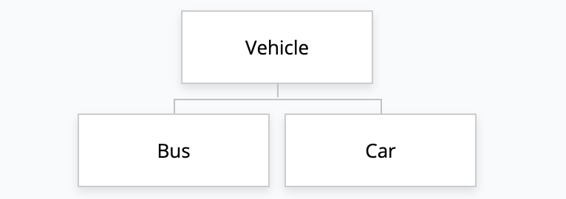
OOP
Inheritance:
inheritance allows the creation of new objects by directly acquiring the attributes and behaviors of other objects and then extending or specializing them.
Instructor: N. Hamid - R. Mahjoubi
Al Khwarizmi (LSD S3)

Slide 77
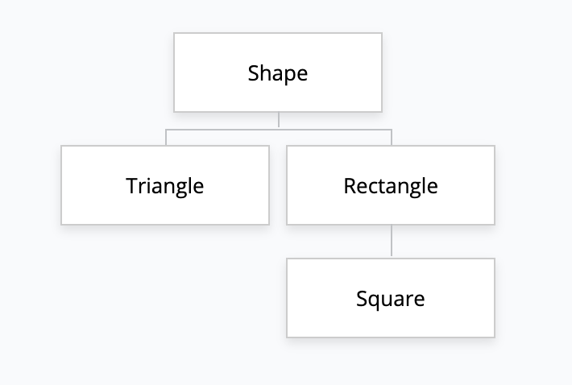
OOP
Inheritance:
Inheritance in C++ takes place between classes. In an inheritance relationship, the class being inherited from is called the parent class, base class, or superclass, and the class doing the inheriting is called the child class, derived class, or subclass.
A class can be both parent and child, For example in this diagram, Rectangle is both a child (to Shape) and a parent (to Square).
Instructor: N. Hamid - R. Mahjoubi
Al Khwarizmi (LSD S3)

Slide 78
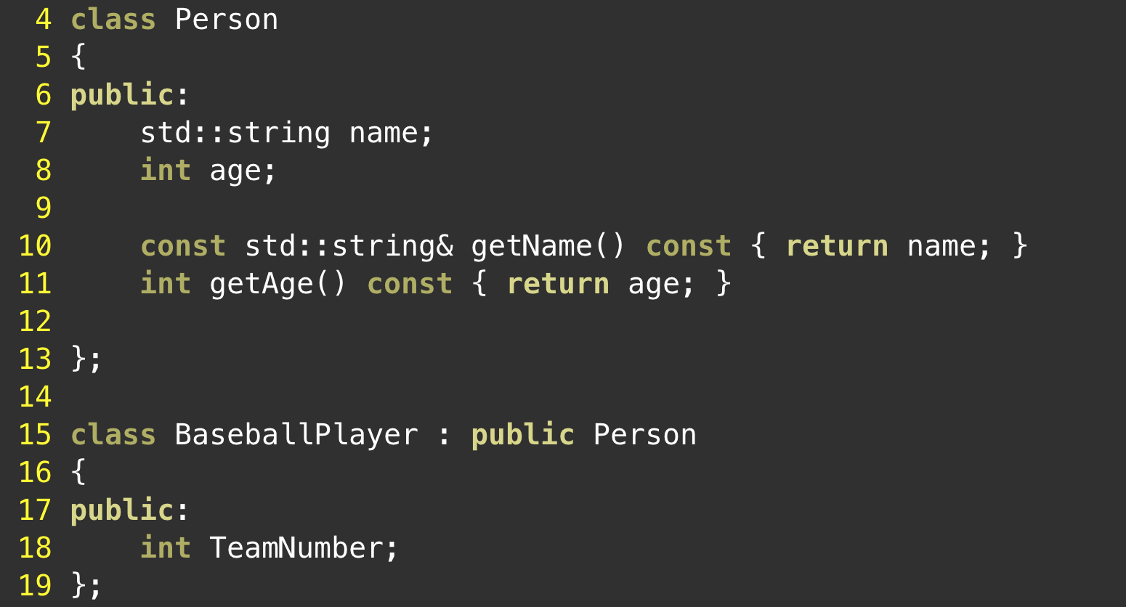
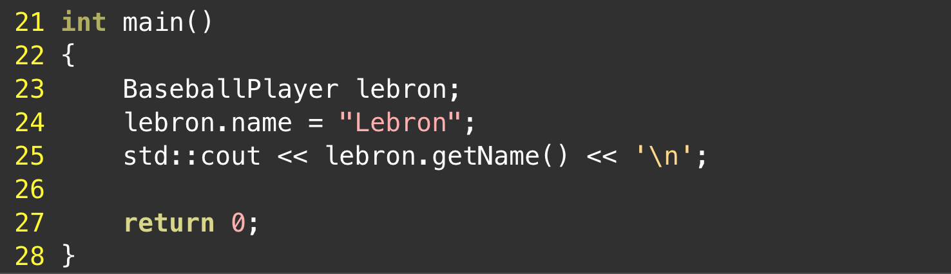
OOP
Inheritance:
A child class inherits both behaviors (member functions) and properties (member variables) from the parent.
These variables and functions become members of the derived class.
Because child classes are full-fledged classes, they can have their own members that are specific to that class.
Instructor: N. Hamid - R. Mahjoubi
Al Khwarizmi (LSD S3)

Slide 79
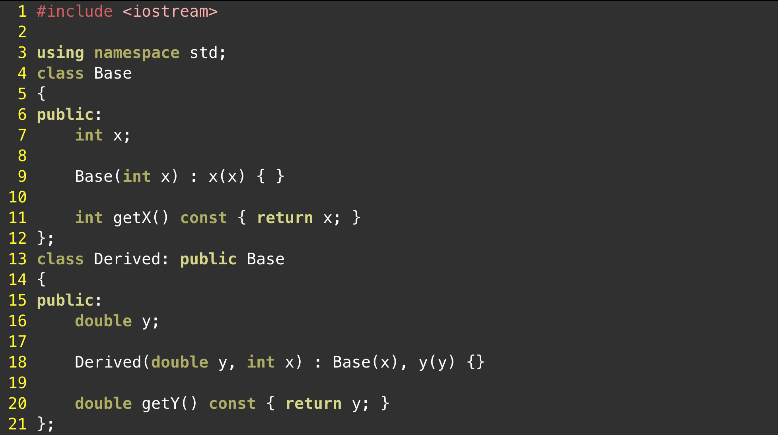
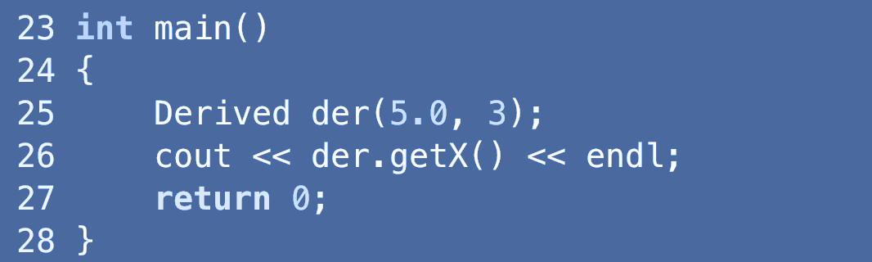
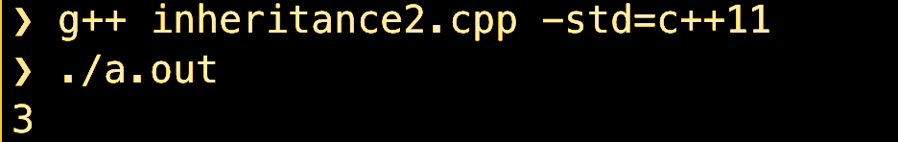
OOP
Inheritance - Constructors and initialization of derived classes:
Instructor: N. Hamid - R. Mahjoubi
Al Khwarizmi (LSD S3)

Slide 80
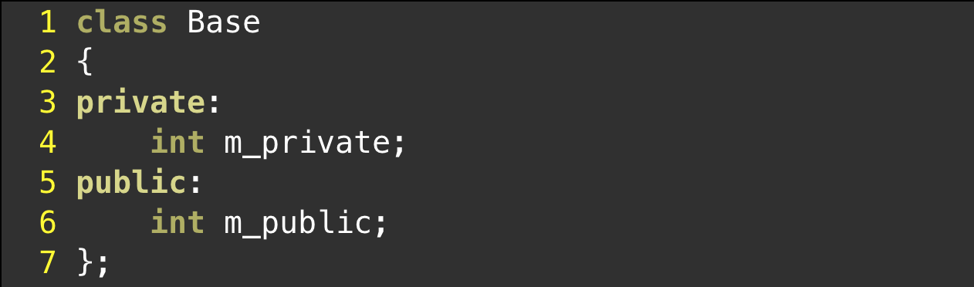
OOP
Inheritance and access specifiers:
At this point, you’ve seen the private and public access specifiers, which determine who can access the members of a class. As a quick refresher, public members can be accessed by anybody. Private members can only be accessed by member functions of the same class or friends. This means derived classes can not access private members of the base class directly.
Instructor: N. Hamid - R. Mahjoubi
Al Khwarizmi (LSD S3)

Slide 81
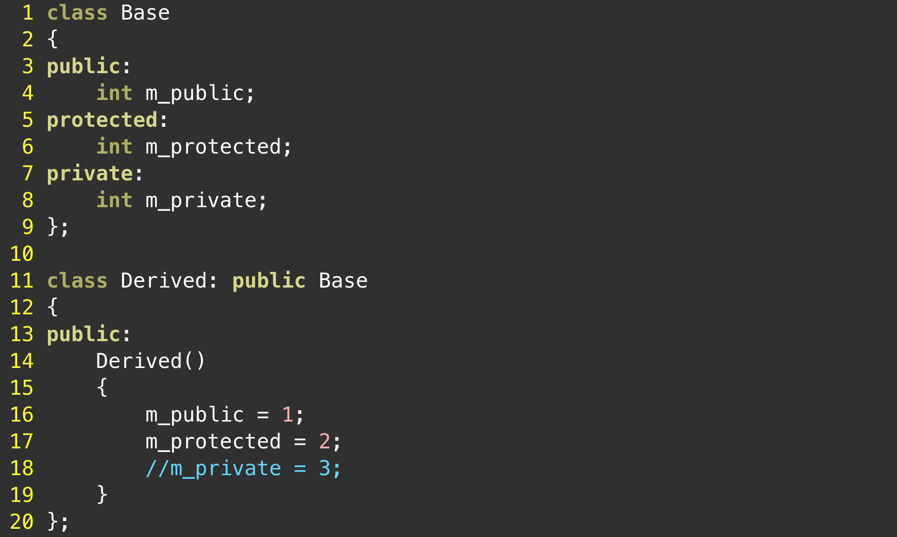
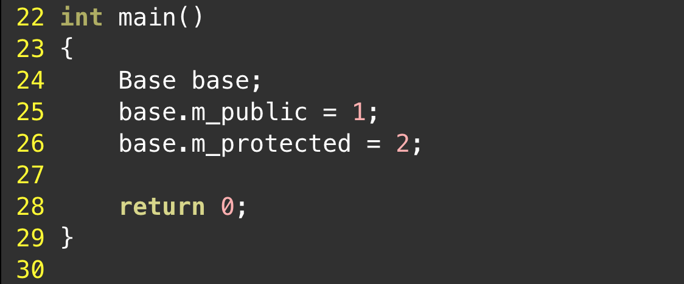
OOP
Inheritance and access specifiers:
C++ has a third access specifier that we have yet to talk about because it’s only useful in an inheritance context. The protected access specifier allows the class the member belongs to, friends, and derived classes to access the member. However, protected members are not accessible from outside the class.
Instructor: N. Hamid - R. Mahjoubi
Al Khwarizmi (LSD S3)

Slide 82
OOP
Adding new functionality to a derived class:
C++ has a third access specifier that we have yet to talk about because it’s only useful in an inheritance context. The protected access specifier allows the class the member belongs to, friends, and derived classes to access the member. However, protected members are not accessible from outside the class.
Instructor: N. Hamid - R. Mahjoubi
Al Khwarizmi (LSD S3)

