Slide 1





Backtranslation Feedback Improves User Confidence in MT, Not Quality
Vilém Zouhar, Michal Novák, Matúš Žilinec, Ondřej Bojar, Mateo Obregón, Robin L Hill, Frédéric Blain, Marina Fomicheva, Lucia Specia, Lisa Yankovskaya
Charles University University of Edinburgh University of Sheffield
University of Wolverhampton University of Tartu
NAACL 2021
Notes:
Hello everyone, this is a presentation of our collaborative paper Backtranslation Feedback Improves User Confidence in MT, Not Quality.

Slide 2

Inbound vs. Outbound Translation
(NAACL)
Wir fügen Dokumente bei.
Responsible for correct interpretation
(NAACL)
Also gut, wir sind vereinbaren.
Responsible for correct message
Notes:
Machine translation usage can be roughly divided into inbound and outbound translation.
In inbound translation, we are the recipients of a message in a foreign language and it is our responsibility to understand it correctly. Prototypically, it is reading a website in a foreign language. In the first row we’re perhaps reading a German email and of course it’s up to us to decode the correct meaning. Here we’re assuming that German is a foreign language. For our personal use it may be enough to use publicly available MT to get the gist of the message.
In outbound translation, the direction of a foreign message is from us to someone else and it is our responsibility to ensure that the message is grammatically and content-wise correct. An example here is communication by email or filling in foreign language forms. However, a reasonable person would not believe 100% of what comes out of publicly available MT system, they would not put it in an email and would not send it.
For both cases, inbound and especially outbound translation, some feedback is needed. This feedback should tell the users if the translation is correct and if there may be errors. The goal is also to increase the user's confidence in machine translation.
---
This cannot be done by just always reporting that everything is fine. To build trust, the feedback system needs to look like it’s really doing some work. In case the machine translation didn't work out it should report where the errors are and potentially what are the suggestions.

Slide 3

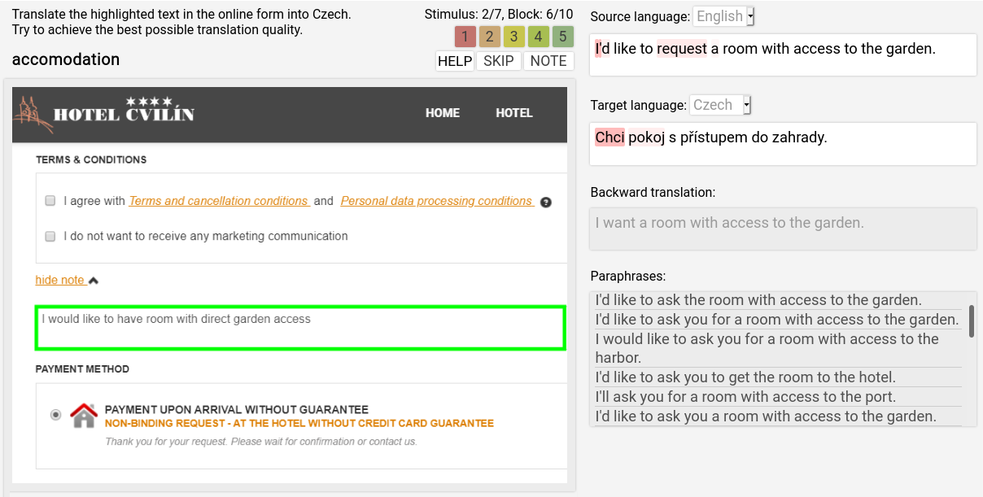
: environment for OT experiments

Slide 4
: environment for OT experiments
A user wants to translate to a language that they do not understand
Receive cues that should inform about translation quality
May rephrase the query while keeping its intention
Notes:
We focus on the following issue: A user wants to translate into a language they do not understand, which is a specific case of outbound translation. For that, they receive cues about the translation quality and they may continue working with the system interactively.
---
For outbound translation, we created a system containing prototypes of said feedbacks that allows us to experiment on real-life scenarios. For those we chose the e-commerce domain in which usually the internet users fill in forms on websites. This is on the left side of this image. The users were tasked with translating the message in the green box into either Czech or Estonian. Here assume that they don’t know any of the languages.
For that, they have the Ptakopět system at their disposal which we can see on the right side. It starts with the input in English then the output in Czech followed by backtranslation to English and paraphrases to the input. The highlighting is based on word-level quality estimation and is projected to the input via word alignment.
The users have unlimited time to work with a single stimulus and can edit the input as well as the output in Czech or Estonian to manually fix for example named entities.
When they submit, they report how confident they are in the quality of the translation they created. We also asked native Czech and Estonian speakers to validate the translations on multiple levels, such as fluency, adequacy or relatedness to the original input.

Slide 5
: environment for OT experiments
A user wants to translate to a language that they do not understand
Receive cues that should inform about translation quality
May rephrase the query while keeping its intention
Objectives:
  High quality of the translation
  High confidence of the user about the translation quality
Notes:
There are two goals that we have in mind: Increasing the translation quality as well as the users’ confidence in the output. These are obviously not orthogonal but also not the same.

Slide 6
: environment for OT experiments
A user wants to translate to a language that they do not understand
Receive cues that should inform about translation quality
May rephrase the query while keeping its intention
Objectives:
  High quality of the translation
  High confidence of the user about the translation quality
Controlled variables:
  Cue modules
  MT systems (target language, type)
Notes:
We therefore designed a system and an experiment which we will discuss on the next slides. In this experiment we control the feedback modules that are available to the users in order to determine the effect of each. We also control the specific MT system used to see how MT performance affects the process.

Slide 7
: environment for OT experiments
A user wants to translate to a language that they do not understand
Receive cues that should inform about translation quality
May rephrase the query while keeping its intention
Objectives:
  High quality of the translation
  High confidence of the user about the translation quality
Controlled variables:
  Cue modules
  MT systems (target language, type)
scene
Notes:
We denote the setting of the stimulus and the specific subset of cue modules as a “scene”.
-------------
We denote a sequence of interactions related to a specific user, query and setting of controlled variables by the term “scene”.
Thorough the experiment each participant was shown up to 70 stimuli. Namely we manipulated which feedback modules were available to the user for a specific stimulus, what was the quality of the MT system and what was the target language.

Slide 8
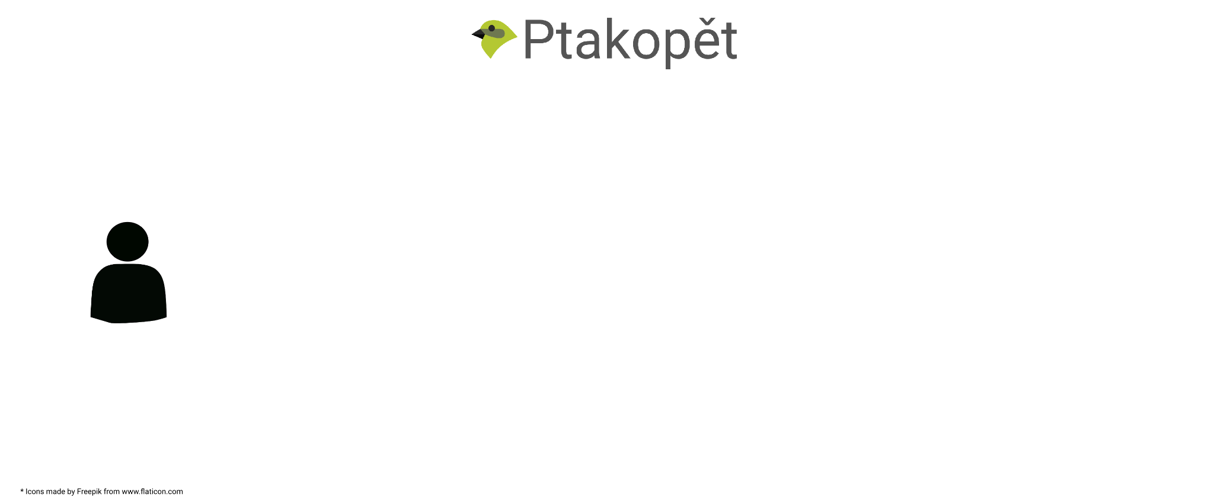
Experiment scene
Notes:
Now we will discuss what interactions happen during one of such scenes.

Slide 9
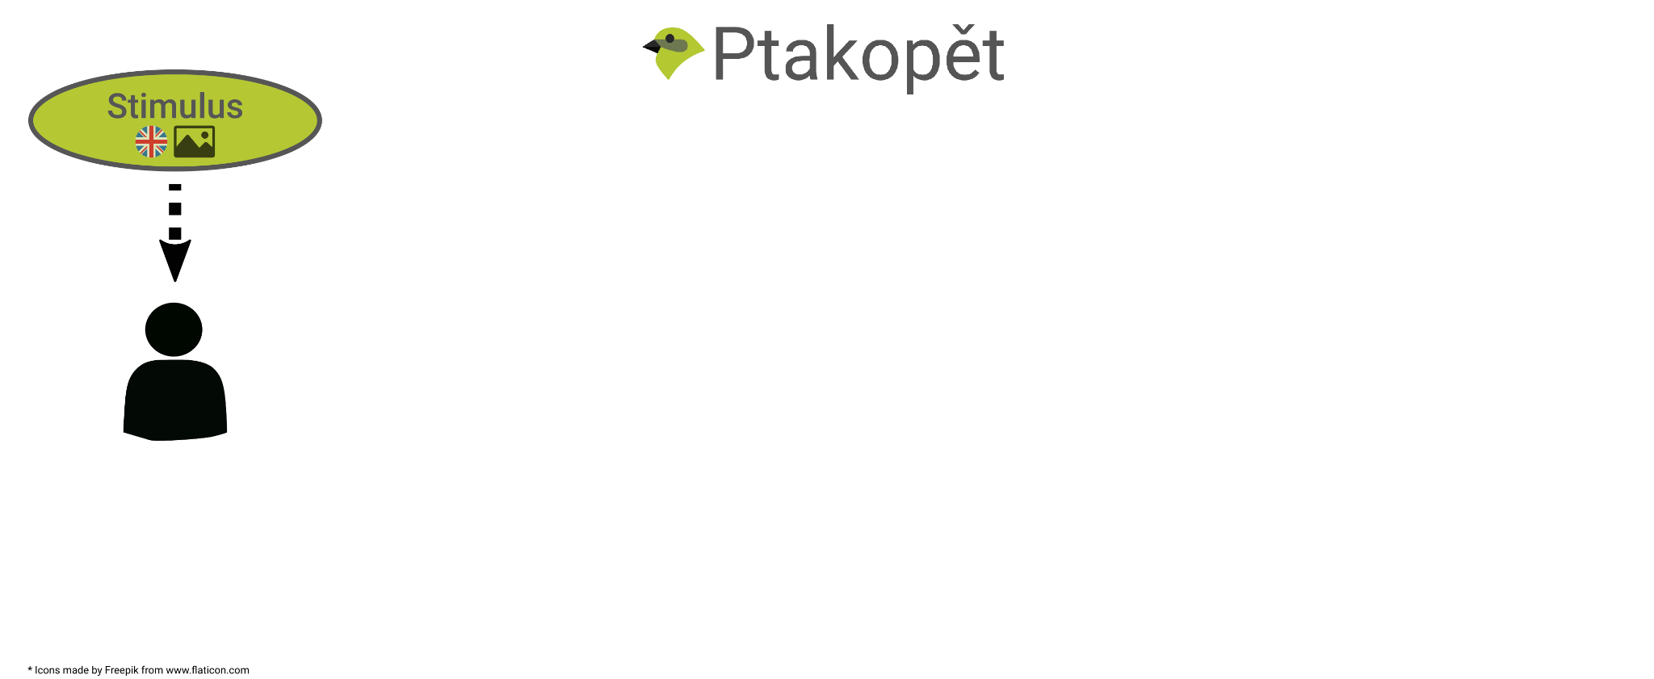
Experiment scene
Notes:
We start with a user who sees a stimulus in English. Specifically the stimulus is a crop of a website containing a pre-filled form which the participants are asked to translate.

Slide 10
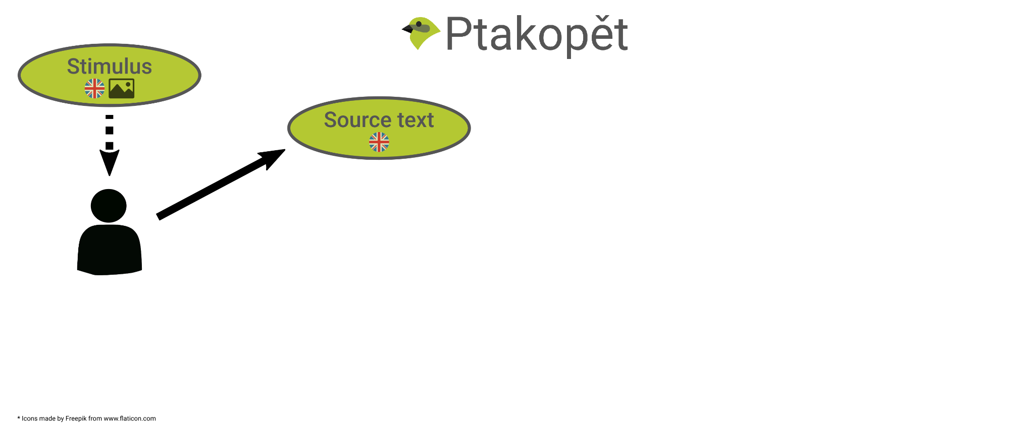
Experiment scene
Notes:
The user then produces the source text, which has the same intention as the query in the stimulus. They may choose to simply copy it or if they have some experience with MT, they simplify it.
---
That is, it may be exactly the same or rephrased.

Slide 11
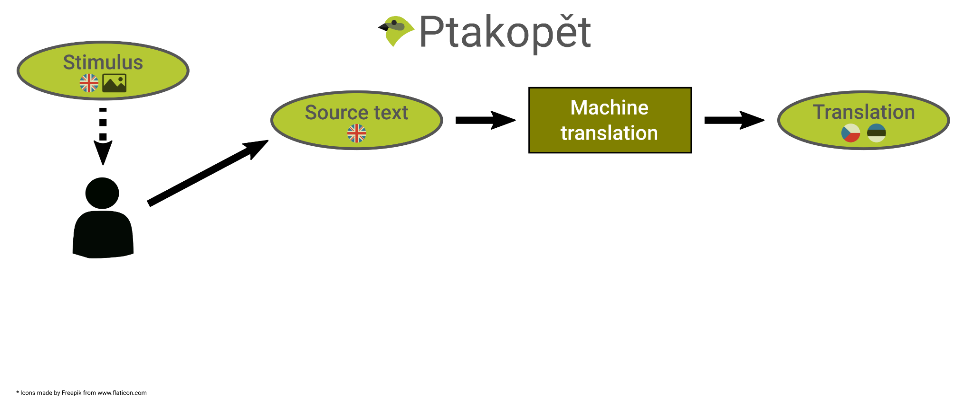
Experiment scene
Notes:
The source text is translated from English to Czech or Estonian and the translation is shown.

Slide 12
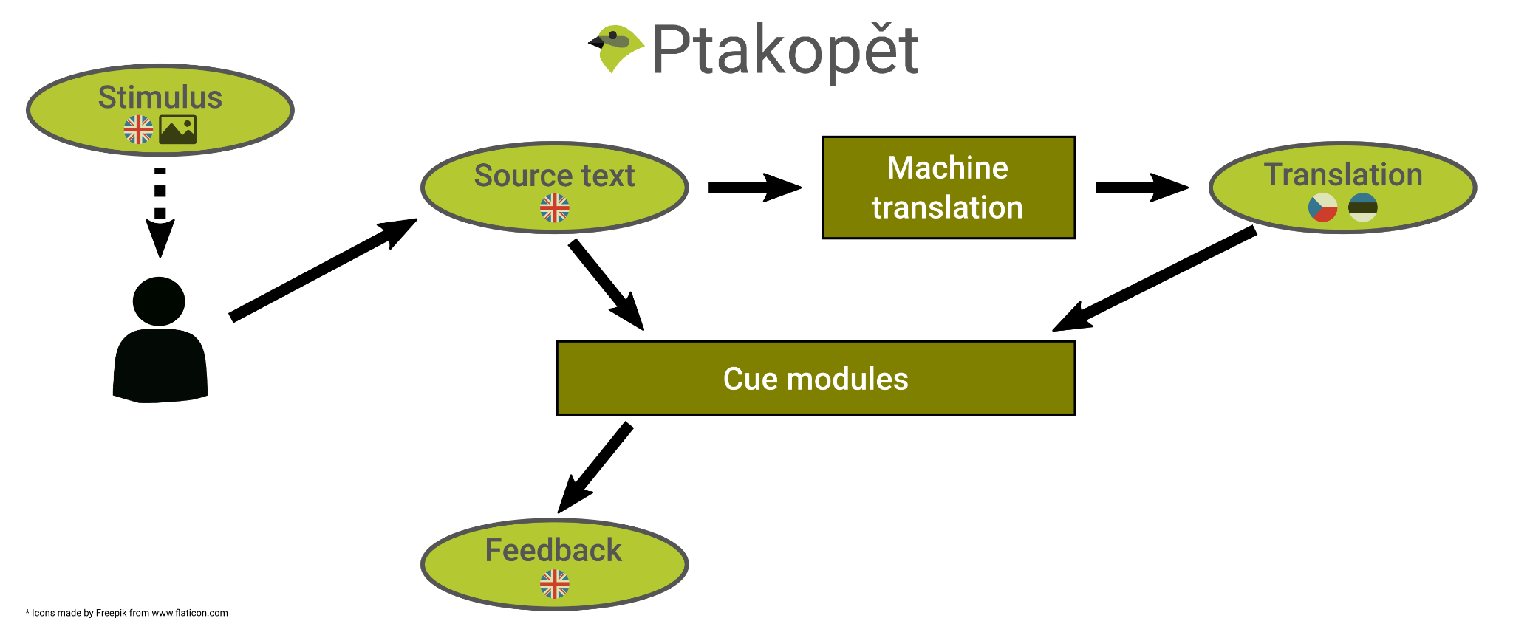
Experiment scene
Notes:
At the same time, the user is given a feedback: Cues about quality of the translation. Unlike the translation, the cues are in English, so the user understands them.

Slide 13
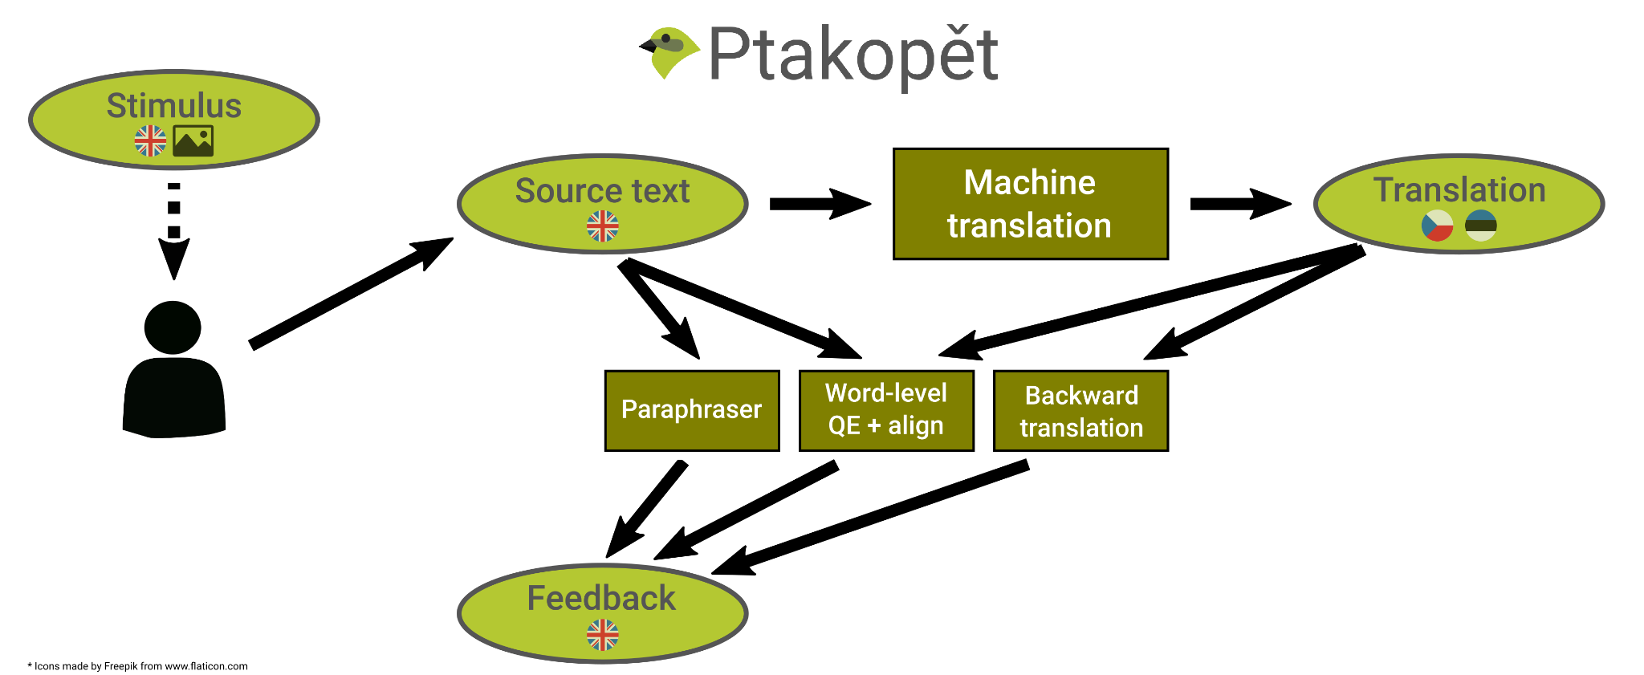
Experiment scene
Notes:
In particular, the modules producing cues are a backward translation system, paraphrase and word-level quality estimation projected through word alignment to the source text.

Slide 14

Experiment scene
Notes:
The user perceives the feedback and possibly some hints from the translation itself, such as correct spelling of named entities. Then they decide if the source text requires another round of rephrasing.

Slide 15
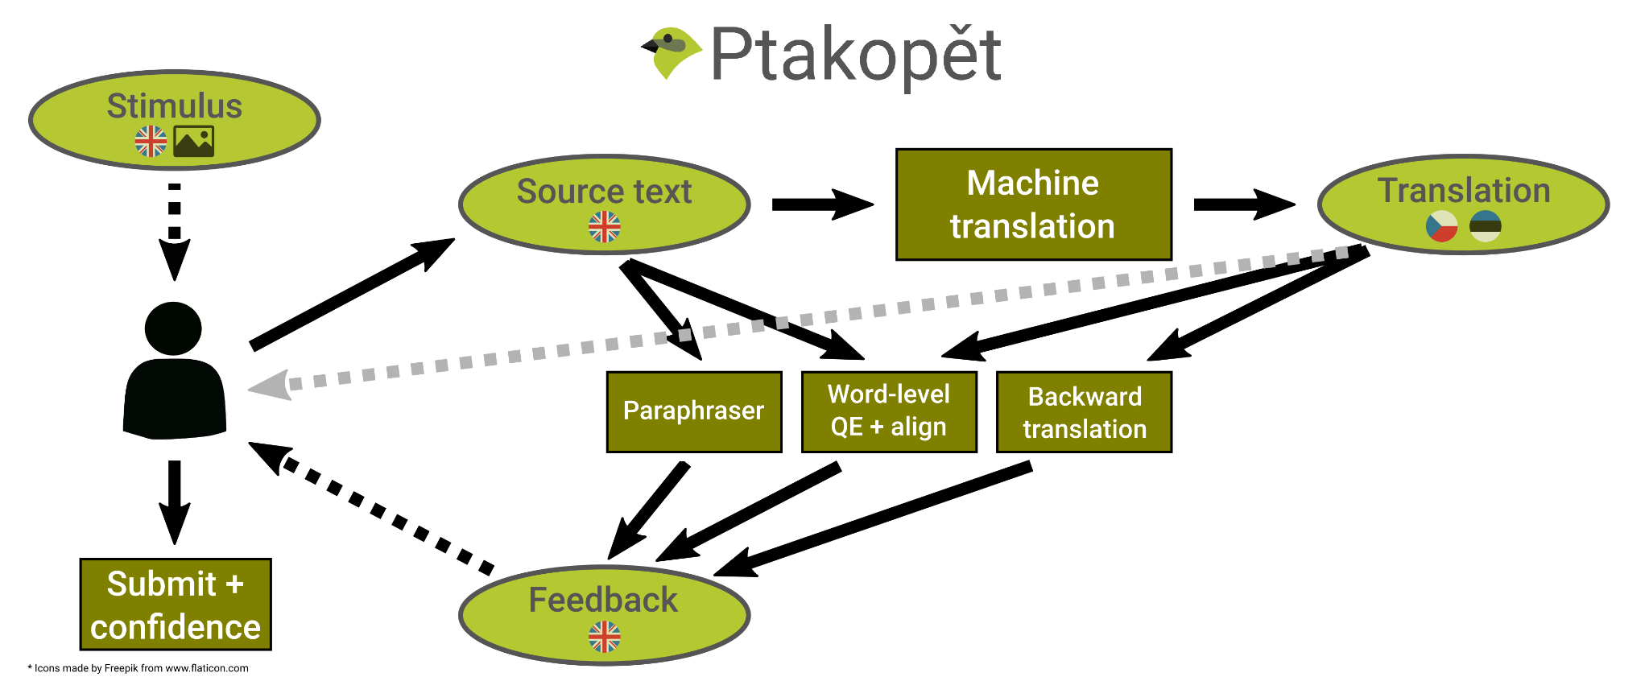
Experiment scene
Notes:
If not, the user may submit the final source text and its translation. They are also asked to report their confidence about the quality of the translation.

Slide 16
Experiment scene
Notes:
When we look at the screenshot of Ptakopět, we can focus on individual components of the experiment in more detail.
The stimulus on the left is one of many collected by another group of annotators. They were instructed to, first, look for web forms on English pages that contain a text field for open queries and then create a query that should be appropriate in the context of the webpage. Some websites were originally in Czech. In the context of our terminology, the translation of the website into English was inbound translation and now the users are producing their own text in outbound translation.
The query, highlighted in green rectangle, is what participants of the experiment are asked to translate.
---
MN: tak by to malo byt spravne, ze stranka je vysledok inbound translation, ale pre jednoduchost anotatori hladali priamo anglicke stranky (niektore su anglicke mutacie ceskych webov, ine su nativne anglicke)

Slide 17
Stimuli
Screenshots of web forms with a pre-filled query + website topic
E-commerce domain
70 screenshots
  Collected by 6 annotators
  Annotators looked for web forms that contain fields to be filled with a text that requires translation
Example
STIM: [accomodation] I would like to have room with direct garden access.
Notes:
The progression is as follows. The stimulus “I would like to have room with direct garden access.” is shown to the user.

Slide 18
Machine Translation
Transformer-based models
Czech Teacher (Czech 3)
  Winning CS-EN system at WMT’19 News Translation Shared Task
Czech Student (Czech 2)
  CPU-optimized student created by knowledge distillation using Teacher
  Much faster
  Worse by 0.5-3.0 BLEU
Czech weak teacher (Czech 1)
Estonian Student
Randomly select
Example
STIM: I would like to have room with direct garden access.
SRC: I’d like to request a room with access to the garden.
MT: Chci pokoj s přístupem do zahrady.
Notes:
They then rephrase the stimulus query and have it translated. The rephrased version is “I’d like to request a room with access to the garden.” It bears roughly the same meaning.
The input gets translated into Czech.
All the MT models are Transformer-based. The best one, Czech Teacher is the current state of the art. From this, a student model was distilled and optimized on CPU performance. In comparison to its teacher the qualitative performance is worse but with much higher speed. For brevity, the other two MT systems are described in full in the paper.
For each scene, the used MT system is selected randomly.

Slide 19
Cue modules
Backward translation (BT)
  Same MT in reversed direction
Word-level quality estimation (QE)
  Glass-box features exploiting information from MT system
  Projected to source by word alignment
  Only 14-37% F-score of detecting errors
Paraphrasing (PP)
  Pivot translation via 41 languages
  Grouped by similarity
Random combination (even empty)
Example
STIM: I would like to have room with direct garden access.
SRC: I’d like to request a room with access to the garden.
MT: Chci pokoj s přístupem do zahrady.
BT: I want a room with access to the garden.
PARAPH: I’d like to ask for a room with access to the garden.
Notes:
Finally, the cues show the possible paraphrases, the translation back to English and word-level quality estimation projected to the source.
The backtranslation is just the same MT but in the opposite direction. The word-level quality estimation leverages glass-box features from the MT system itself. Unlike sentence-level models, performance of word-level models is in general sub-optimal, which is confirmed also in our case. And lastly, the paraphrasing is done by simply translating from English to 41 different languages and then back to English.
Every user saw each stimulus exactly once but with different combinations of cues provided by these modules. For instance, whereas one user saw a stimulus with all cues, another two users could see the same stimulus with a random subset of cues or with no cue at all. This allowed us to quantify the effect of each module.

Slide 20
Self-reported confidence
How much the user believes the translation is correct
  from 1 (least) to 5 (most)
Example
STIM: I would like to have room with direct garden access.
SRC_1: …
MT_1: …
BT_1: ...
PARAPH_1: …
…
SRC_n: I’d like to request a room with access to the garden.
MT_n: Chci pokoj s přístupem do zahrady.
BT_n: I want a room with access to the garden.
PARAPH_n: I’d like to ask the room with access to the garden.
CONF: 4
Notes:
In the same manner, the user may then further interact with the outbound translation system and once they’re satisfied, they submit the final source text and its translation together with their confidence about the output. That is 4 in the presented example and it means they were mostly satisfied with the result and had confidence that it is adequate and generally correct.

Slide 21
Experiment scene
Notes:
For clarity we show the interface again. On the left side is the stimulus and on the right side the MT input and cue modules.

Slide 22
Experiment details
52 English speaking participants (49 native)
70 scenes with a random combination of an MT system and cue modules
2,486 valid scenes collected in total (48 per user on average)
Notes:
We used around 50 participants and 70 web form snippets from the e-commerce domain as stimuli.

Slide 23
Experiment details
52 English speaking participants (49 native)
70 scenes with a random combination of an MT system and cue modules
2,486 valid scenes collected in total (48 per user on average)
 | # Scenes | Time [s] | Actions | Pace [s]
CS Teacher | 601 | 52 | 1.66 | 41
CS Student | 643 | 42 | 3.66 | 17
+BT | 1253 | 49 | 2.55 | 29
+QE | 1240 | 49 | 2.86 | 26
+PP | 1211 | 51 | 2.75 | 28
Notes:
This table shows rudimentary statistics of the collected data.

Slide 24
Experiment details
52 English speaking participants (49 native)
70 scenes with a random combination of an MT system and cue modules
2,486 valid scenes collected in total (48 per user on average)
 | # Scenes | Time [s] | Actions | Pace [s]
CS Teacher | 601 | 52 | 1.66 | 41
CS Student | 643 | 42 | 3.66 | 17
+BT | 1253 | 49 | 2.55 | 29
+QE | 1240 | 49 | 2.86 | 26
+PP | 1211 | 51 | 2.75 | 28
Notes:
The distribution of collected samples over different configurations is more or less balanced.

Slide 25
Experiment details
52 English speaking participants (49 native)
70 scenes with a random combination of an MT system and cue modules
2,486 valid scenes collected in total (48 per user on average)
 | # Scenes | Time [s] | Actions | Pace [s]
CS Teacher | 601 | 52 | 1.66 | 41
CS Student | 643 | 42 | 3.66 | 17
+BT | 1253 | 49 | 2.55 | 29
+QE | 1240 | 49 | 2.86 | 26
+PP | 1211 | 51 | 2.75 | 28
Notes:
Czech Student is a CPU-optimized student system, which makes it much faster to respond. This is reflected in shorter average time spent per scene, yet performing more than twice as many actions.

Slide 26
MT evaluation
Human evaluation by 12 Czech and 3 Estonian native speakers
Based on:
  Source (SRC), its translation (TGT) and the corresponding stimulus (STI)
Rating from 1 (least) to 5 (most) = the scale of self-reported confidence:
  Overall quality
  SRC-STI adequacy
  TGT-SRC adequacy
  TGT-STI adequacy
  Fluency
Notes:
We asked the annotators to rate source texts and their translations using 5 different criteria. For simplicity, we show here only the overall quality of translation. Please see the paper for the rest of the measures.

Slide 27
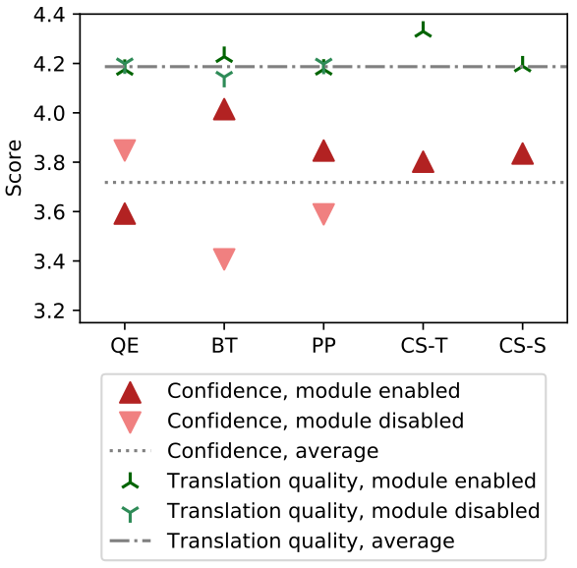
Results
Notes:
This graph shows how the presence of different cue modules and MTs influence the self-reported confidence and the overall translation quality.

Slide 28
Results
Despite the higher quality of CS Teacher, users are slightly more confident with CS Student
  Possibly high Student speed
Notes:
First interesting thing we notice is that the student model, despite having worse objective quality, is on par or even slightly outperforms its teacher when it comes to user confidence. We hypothesise that this is caused by the high speed of the student.

Slide 29
Results
Despite the higher quality of CS Teacher, users are slightly more confident with CS Student
  Possibly high Student speed
BT feedback significantly increases confidence with little impact on quality
  Great for reassuring users
Notes:
Next, backtranslation shows to have high impact on the user confidence but almost no real effect on the objective quality.

Slide 30
Results
Despite the higher quality of CS Teacher, users are slightly more confident with CS Student
  Possibly high Student speed
BT feedback significantly increases confidence with little impact on quality
  Great for reassuring users
PP insignificantly increases confidence
  Practical use is questionable
Notes:
Paraphrasing slightly increases the confidence but not at all the quality.

Slide 31
Results
Despite the higher quality of CS Teacher, users are slightly more confident with CS Student
  Possibly high Student speed
BT feedback significantly increases confidence with little impact on quality
  Great for reassuring users
PP insignificantly increases confidence
  Practical use is questionable
QE decreases confidence
  Word-level models not mature enough for user-facing applications
Notes:
And finally, the word-level quality estimation only decreases user confidence from which we conclude that the current form is not ready for user-facing applications.

Slide 32
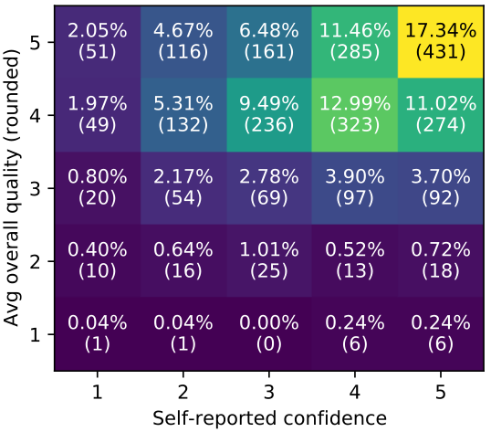
Results
Both confidence and quality scores cluster around the highest values
  63% of scenes received 4 or 5 in both scores
Notes:
One of the caveats of our work is that the vast majority of the produced translations had very high self-reported confidence and very high objective quality.

Slide 33
Results
Both confidence and quality scores cluster around the highest values
  63% of scenes received 4 or 5 in both scores
Positive in terms of industry progress, yet harder to analyze
Notes:
This is a good thing in terms of MT progress but it makes the results harder to interpret.

Slide 34
Results
Both confidence and quality scores cluster around the highest values
  63% of scenes received 4 or 5 in both scores
Positive in terms of industry progress, yet harder to analyze
Could be mitigated by:
  Much lower-resourced language pairs
  More complex queries to translate
Notes:
This could be resolved by focusing on more low-resource language directions other than Czech-English and Estonian-English or by asking the users to translate more complex queries.

Slide 35
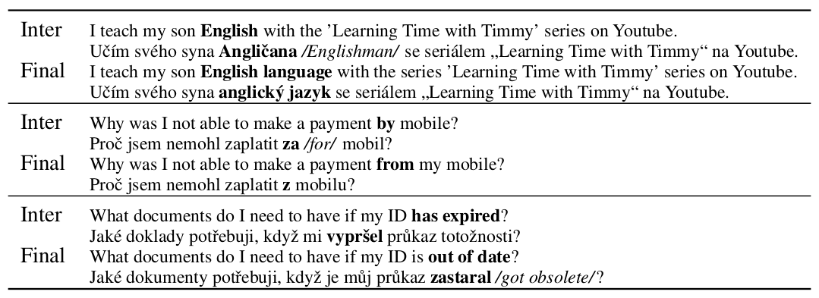
Examples
Notes:
Lastly, let’s look at three examples of the intermediate and the final inputs with their translations to Czech. The intermediate input is a viable rephrasing of the original query that user at some point considered but abandoned in the end.
In the top two, the rephrasing helped to improve the translation quality: First by adding a word “language” to prevent translating “English” as a Czech word for “Englishmen”. And secondly by substituting a preposition.
Conversely, the replacement of the verb “has expired” by a phrase “out of date” led to a drop in translation quality. This is due to a grammatical error and use of the Czech expression meaning “got obsolete”, which indeed sounds old-fashioned in this context.

Slide 36
Conclusion
Inbound vs. Outbound MT problem definition
Backtranslation helps in confidence
MT system speed is important even in comparison to objective quality
Notes:
To conclude, in this work we defined the issue of inbound and outbound translation. And in an experiment we saw that MT system speed is more important in user confidence that it’s objective quality.
And finally, we focused on backtranslation, which is a common practice for many people and me as well when using publicly available MT systems. We saw that providing this feedback, helps only in their confidence and not the overall translation quality.
Thank you everyone for your attention and I look forward to the followup discussion.
---
Future work: mitigate clustering around best scores

