Slide 1





Backtranslation Feedback Improves User Confidence in MT, Not Quality
Vilém Zouhar, Michal Novák, Matúš Žilinec, Ondřej Bojar, Mateo Obregón, Robin L Hill, Frédéric Blain, Marina Fomicheva, Lucia Specia, Lisa Yankovskaya
Charles University University of Edinburgh University of Sheffield
University of Wolverhampton University of Tartu
NAACL 2021
Notes:
Hello everyone, this is a pitch of our collaborative paper Backtranslation Feedback Improves User Confidence in MT, Not Quality.

Slide 2

Inbound vs. Outbound Translation
(NAACL)
Wir fügen Dokumente bei.
Responsible for correct interpretation
(NAACL)
Also gut, wir sind vereinbaren.
Responsible for correct message
Notes:
Machine translation usage can be roughly divided into inbound and outbound translation.
In inbound translation, we are the recipients of a message in a foreign language and it is our responsibility to understand it correctly. Prototypically, it is reading a website in a foreign language. In the first row we’re perhaps reading a German email and of course it’s up to us to decode the correct meaning. For our personal use it may be enough to use publicly available MT to get the gist of the message.
In outbound translation, the direction of a foreign message is from us to someone else and it is our responsibility to ensure that the message is grammatically and content-wise correct. An example here is communication by email or filling in foreign language forms. However, a reasonable person would not believe 100% of what comes out of publicly available MT system, they would not put it in an email and would not send it.
For both cases, inbound and especially outbound translation, some feedback is needed. This feedback should tell the users if the translation is correct and if there may be errors.
1:30
---
The goal is also to increase the user's confidence in machine translation.
---
This cannot be done by just always reporting that everything is fine. To build trust, the feedback system needs to look like it’s really doing some work. In case the machine translation didn't work out it should report where the errors are and potentially what are the suggestions.

Slide 3

: environment for OT experiments
A user wants to translate to a language that they do not understand
Receive cues that should inform about translation quality
May rephrase the query while keeping its intention
Notes:
We focus on the following issue: A user wants to translate into a language they do not understand, which is a specific case of outbound translation. For that, they receive cues about the translation quality and they may continue working with the system interactively.
---
For outbound translation, we created a system containing prototypes of said feedbacks that allows us to experiment on real-life scenarios. For those we chose the e-commerce domain in which usually the internet users fill in forms on websites. This is on the left side of this image. The users were tasked with translating the message in the green box into either Czech or Estonian. Here assume that they don’t know any of the languages.
For that, they have the Ptakopět system at their disposal which we can see on the right side. It starts with the input in English then the output in Czech followed by backtranslation to English and paraphrases to the input. The highlighting is based on word-level quality estimation and is projected to the input via word alignment.
The users have unlimited time to work with a single stimulus and can edit the input as well as the output in Czech or Estonian to manually fix for example named entities.
When they submit, they report how confident they are in the quality of the translation they created. We also asked native Czech and Estonian speakers to validate the translations on multiple levels, such as fluency, adequacy or relatedness to the original input.

Slide 4
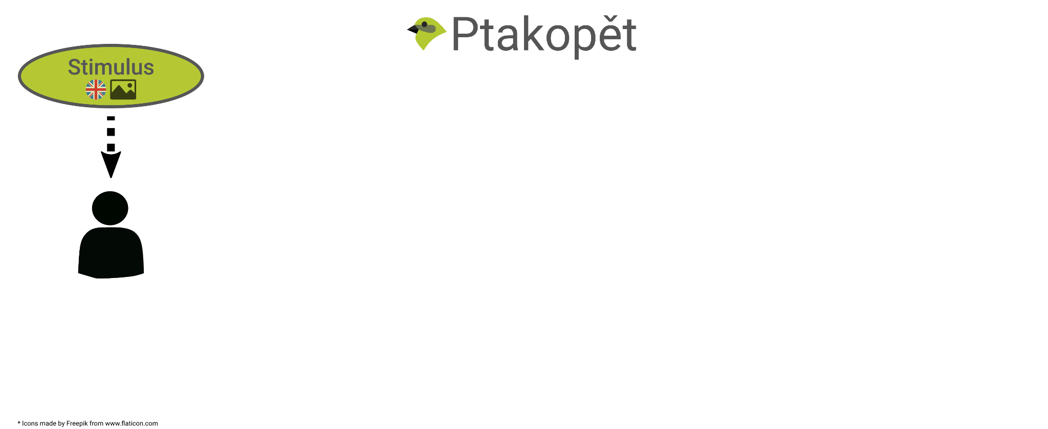
Experiment scene
Notes:
We start with a user who sees a stimulus in English. Specifically the stimulus is a crop of a website containing a pre-filled form which the participants are asked to translate.

Slide 5
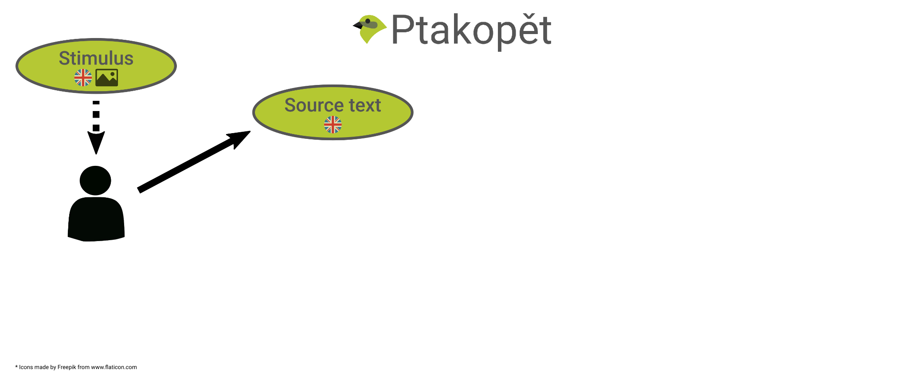
Experiment scene
Notes:
The user then produces the source text, which has the same intention as the query in the stimulus. They may choose to simply copy it or if they have some experience with MT, they simplify it.
---
That is, it may be exactly the same or rephrased.

Slide 6
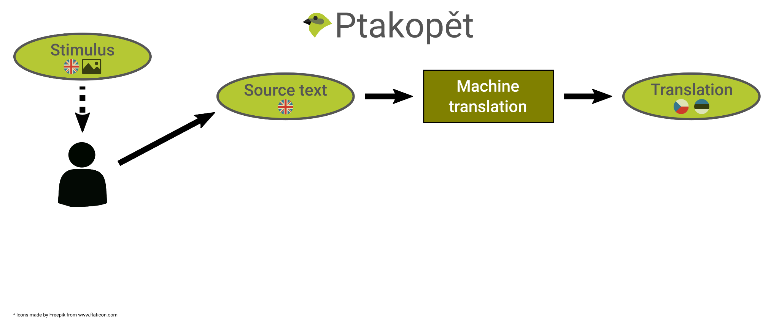
Experiment scene
Notes:
The source text is translated from English to Czech or Estonian and the translation is shown.

Slide 7
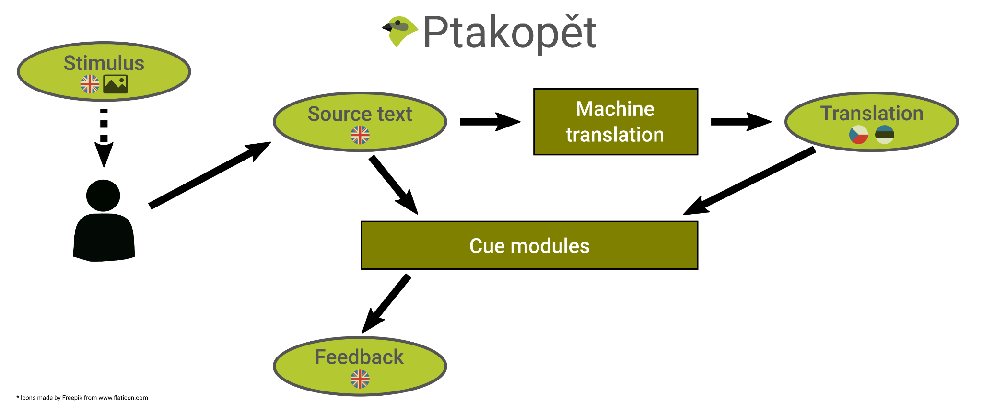
Experiment scene
Notes:
At the same time, the user is given a feedback: Cues about quality of the translation. Unlike the translation, the cues are in English, so the user understands them.

Slide 8
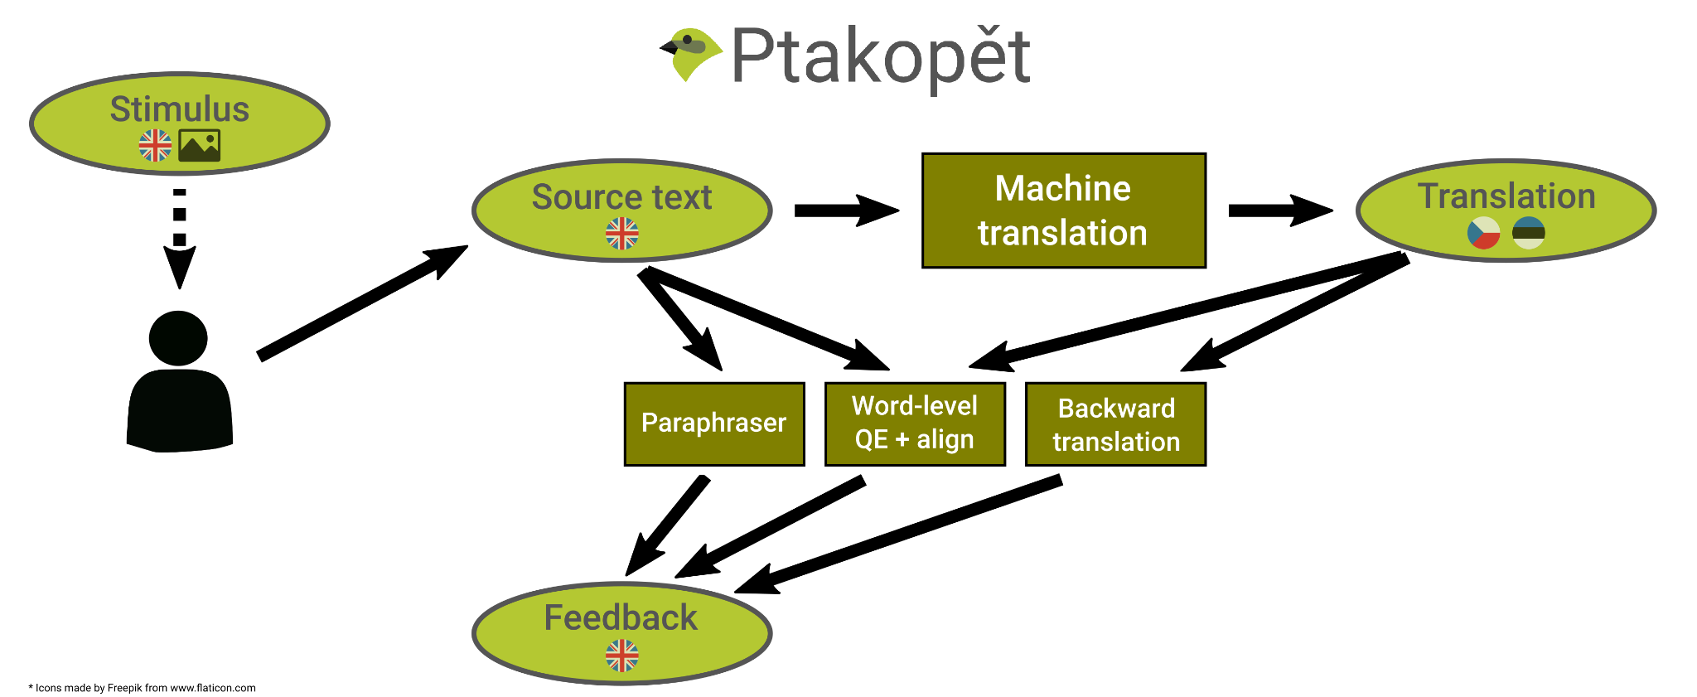
Experiment scene
Notes:
In particular, the modules producing cues are a backward translation system, paraphrase and word-level quality estimation projected through word alignment to the source text.

Slide 9

Experiment scene
Notes:
The user perceives the feedback and possibly some hints from the translation itself, such as correct spelling of named entities. Then they decide if the source text requires another round of rephrasing.

Slide 10
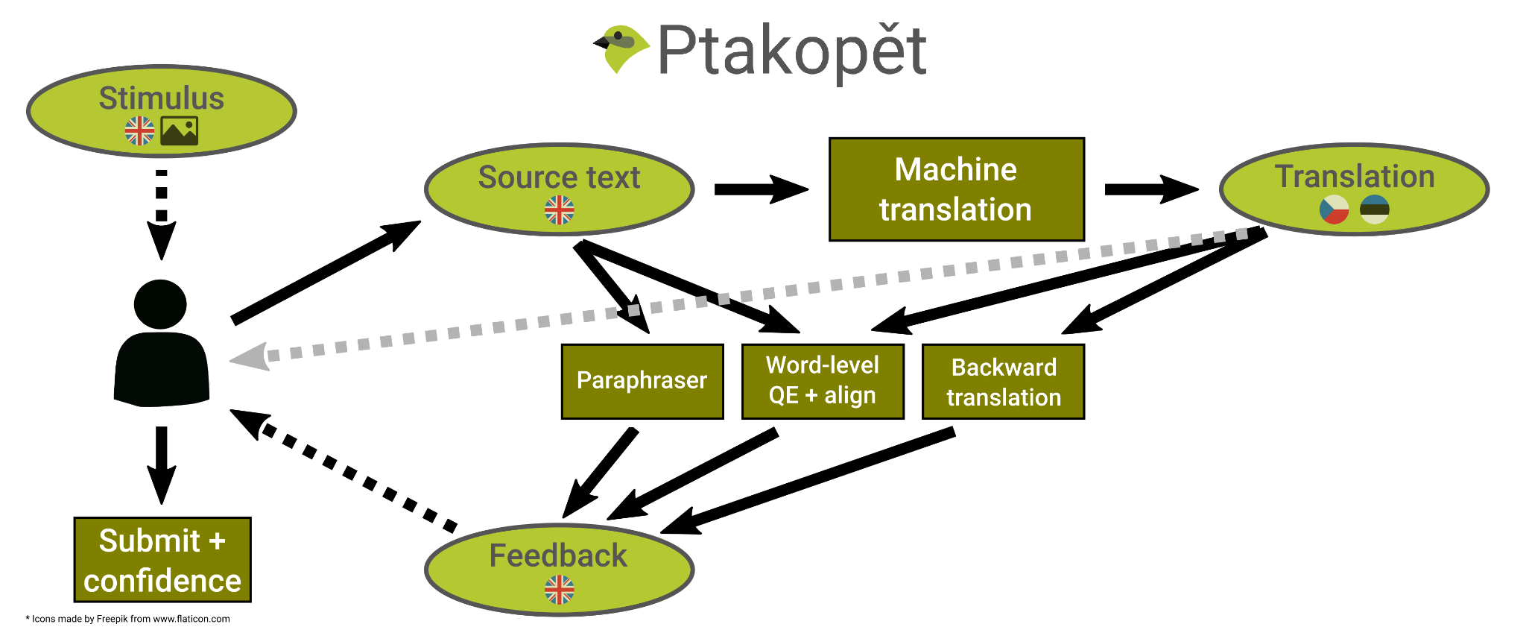
Experiment scene
Notes:
If not, the user may submit the final source text and its translation. They are also asked to report their confidence about the quality of the translation.
2:37

Slide 11
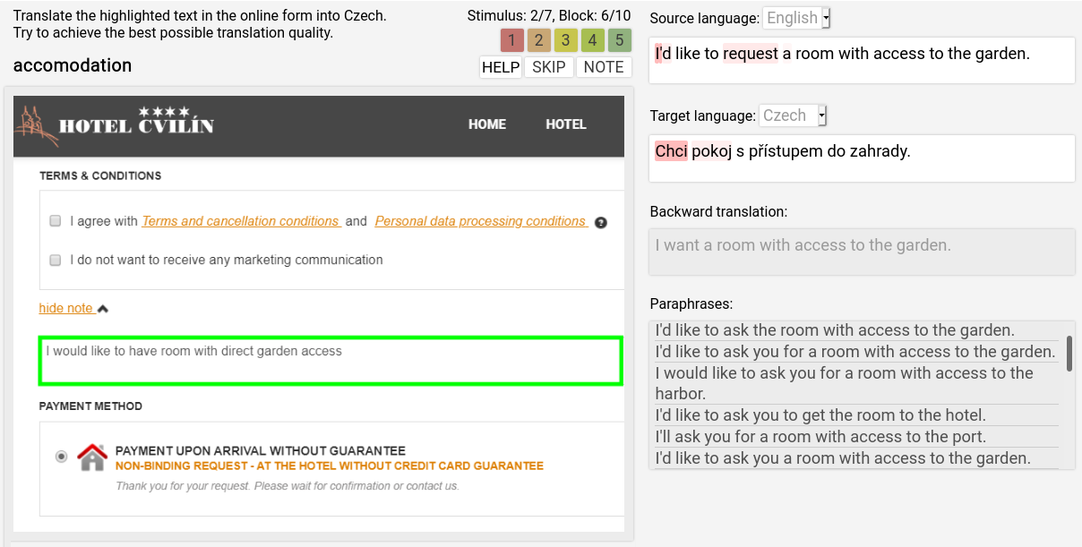
Experiment scene
Notes:
When we look at the screenshot of our system, we can focus on individual components of the experiment in more detail.
The stimulus is on the left, The query, highlighted in the green rectangle, is what participants of the experiment are asked to translate. The textareas on the right correspond to the separate cue modules.

Slide 12
MT evaluation
52 English speaking participants (49 native)
2,486 valid scenes collected in total (48 per user on average)
Human evaluation by 12 Czech and 3 Estonian native speakers
Based on:
  Source (SRC), its translation (TGT) and the corresponding stimulus (STI)
Rating from 1 (least) to 5 (most) = the scale of self-reported confidence:
  Overall quality
  SRC-STI adequacy
  TGT-SRC adequacy
  TGT-STI adequacy
  Fluency
Notes:
After collecting the data we asked native annotators to rate source texts and their translations using 5 different criteria. For simplicity, we show here only the overall quality of translation.

Slide 13
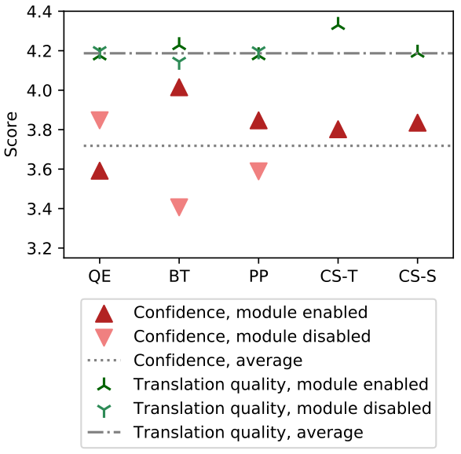
Results
Notes:
This graph shows how the presence of different cue modules and MTs influence the self-reported confidence and the overall translation quality of the results..

Slide 14
Results
Despite the higher quality of CS Teacher, users are slightly more confident with CS Student
  Possibly high Student speed
Notes:
First interesting thing we notice is that the fast student MT model, despite having worse objective quality, is on par or even slightly outperforms its teacher when it comes to user confidence. We hypothesise that this is caused by the high speed of the student.

Slide 15
Results
Despite the higher quality of CS Teacher, users are slightly more confident with CS Student
  Possibly high Student speed
BT feedback significantly increases confidence with little impact on quality
  Great for reassuring users
Notes:
Next, backtranslation shows to have high impact on the user confidence but almost no real effect on the objective quality.

Slide 16
Conclusion
Inbound vs. Outbound MT problem definition
Backtranslation helps in confidence
MT system speed is important even in comparison to objective quality
Notes:
To conclude, in this work we defined the issue of inbound and outbound translation. And in an experiment we saw that MT system speed is more important in user confidence that it’s objective quality.
And finally, we focused on backtranslation, which is a common practice for many people and me as well when using publicly available MT systems. We saw that providing this feedback, helps only in user confidence and not the overall translation quality.
Thank you everyone for your attention and I look forward to the followup discussion.
---
Future work: mitigate clustering around best scores

