Slide 1
Sampling and Filtering of Neural Machine Translation Distillation Data
Vilém Zouhar
NAACL-SRW 2021
Notes:
Hey everybody, this is a presentation of ‘Sampling and Filtering of Neural Machine Translation Distillation Data’

Slide 2
Overview
Motivation, Related Work (2 min)
Idea (1 min)
Contribution (7 min)
  Experimental Setup
  Data Sampling
  Baseline
  Schemas and Results
Conclusion (2 min)
Notes:
First I will talk about the motivation and the related work.
Then I introduce the main idea, followed by the experimental work.
At the end we draw conclusions and practical tips based on the results.
Generally this presentation should be easy to follow and shouldn’t require any advanced mathematical nor MT knowledge.

Slide 3
Motivation
Model {stealing,distillation}
  Transferring knowledge from large model (teacher) to smaller one (student)
  Filtering improves performance (German et. al.)
    Model inferences have no additional features that imply the quality
Teacher
(big model, big data)
Distillation
Student
(small model, small data)
Notes:
In model distillation we are using an existing pre-trained teacher model and want to create a scaled down version of it, which we call the student. The reasons may be the memory footprint, inference speed or security concerns.
The easiest way to do such a distillation is to translate a parallel corpus by the teacher and use the translations instead of the actual parallel data for training the student.
This was shown to have better performance than using the original data.
We already know, that filtering of this new data improves the performance but this paper explores this phenomenon more closely and propose improvements.

Slide 4
Related Work
Most prevalent
  Take all the best decoder hypotheses
  Combine them with original (not teacher train) data
  Output: two translations per one sentence → Twice as much data
Teacher
Student
original data
best hypothesis
Notes:
When it comes to model distillation, the most common way is to take all the best decoder hypotheses and combine them with the original data. The output, which contains two translations per source sentence, is then used for training the students.

Slide 5
Related Work
More sophisticated
  Filter sentences which are suspicious
    Not recognized by language recognizer (German et. al.)
    More than / less than k*length of the reference /source
  Filter based on reference quality, e.g. TER (Freitag et. al.)
    Not main topic of their work
→ TER is very arbitary, how do other metrics behave?
→ What about other sampling methods?
→ What about the combination of them?
Notes:
A more sophisticated way is to filter out sentences which are suspicious. This includes sentences that aren’t recognized by a language recognizer or that are much longer or shorter than the reference.
This filtering is then based on reference quality measured for example by TER.
This still leaves many questions open, which have not been documented or systematically studied yet.

Slide 6
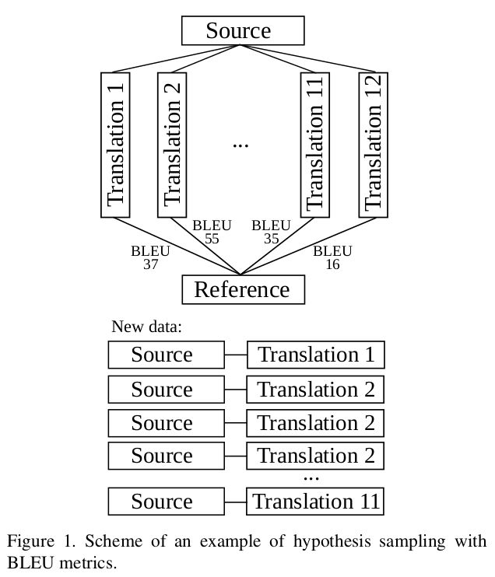
Idea
Distillation
  Query teacher on source sentences
  Get 12 translations for every sentence
  Treat them w.r.t. their quality
    Filter worse ones
    Oversample better ones
  Quality measured by
    Decoder score
    Reference based metrics (BLEU, ChrF, TER, SP)
Notes:
The proposed approach is the following:
First we query the teacher model on the source sentences and get 12 translations each by the beam decoder.
Then we treat them with respect to their quality. That means filtering out the worse ones while oversampling the better ones.
The quality is measured by the decoder score and other reference based metrics like BLEU or TER.
The goal is to achieve better results with the student than the common baseline.

Slide 7
Dataset
Europarl v10 parallel corpus
  English – Czech (0.6M sentences)
  English – German (1.8M sentences)
  Longer than what is usual:
    ~23 words per sentence
  Intentionally very domain restricted
Notes:
As the data set the paper uses the Europarl parallel corpus and focuses on English to Czech, Czech to English and English to German translation directions.
The corpus is quite small by common standards but this is compensated by it being domain restricted.

Slide 8
Experimental Setup
Models
  Teacher
    Transformer based, speed optimized (German et. al.)
  Student
    Follow architecture of teacher
    Half the size of the embedding vector (256 instead of 512)
    Half of the attention heads (4 instead of 8)
    Intentionally very small
Notes:
The teacher itself is already quite small.
The student model follows the architecture of the teacher with some parts scaled down for faster training and inference speed.

Slide 9
Experimental Setup
Process
  Create new data set (data sampling)
    Use different sampling methods
  Train student on the new data
    CS→EN, EN→CS, EN→DE
  Evaluate and see the effect of the chosen method
Notes:
The process for every sampling method is the following:
First a new dataset is created by making use of the specific sampling method.
Then, 3 student models are trained, based on the new data.
Finally the new student performance by the standard BLEU metric is evaluated.

Slide 10
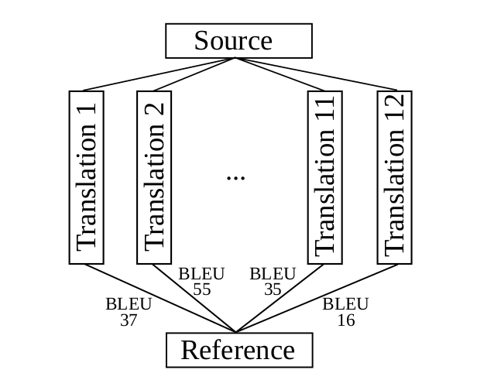
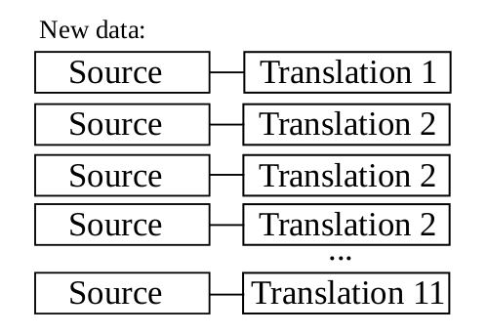
Data Sampling
Notation
    take top translation k₁ times, second one k₂ times, etc. …
second best k₂ = 1
top best k₁ = 3
.
.
.
Notes:
Throughout the work the following notation is used:
The function you can see here takes the top translation k1 times, the second best k2 times and so on. This is used for oversampling better hypotheses.
The ordering is given by the metric in the lower index, such as BLEU, TER or the decoder score.

Slide 11
Data Sampling
Notation
    Take n top translation hypotheses according to metrics (equals )
    Take all sentence translations with metrics
    At least m
    Deduplicate sentence pairs of X
Notes:
T-n takes the top n translation hypotheses according to the metric.
G takes all the sentence translations with metric at least m.
Dedup simply deduplicates the sentence pairs.

Slide 12
Data Sampling
Notation
  Concatenation of sampling methods
    Join the top 2 sentences measured by BLEU
    Add them to hypotheses with decoder score at least -10
Notes:
The combination of the methods is also used. Simply by just joining the results.

Slide 13
Our Work – BLEU Metric
BLEU (bilingual evaluation understudy)
  Formula for evaluating quality of text that has been translated
  Based on unigram, bigram, trigram and quadgram precision
  Values between 0 to 1 (usually denoted as 0 to 100)
  Close to 100: translation very similar to reference
  Close to 0: translation not similar to reference
→ Bigger is better
Notes:
The quality of our students is measured based on the BLEU metric. It operates on n-gram level. The higher it is, the more the sentence is similar to the reference. If it’s zero, then it’s not similar at all.
It’s percentage, but usually denoted as a number between a zero and one hundred.
The main takeaway is that higher is better, which we try to follow also with other metrics.

Slide 14
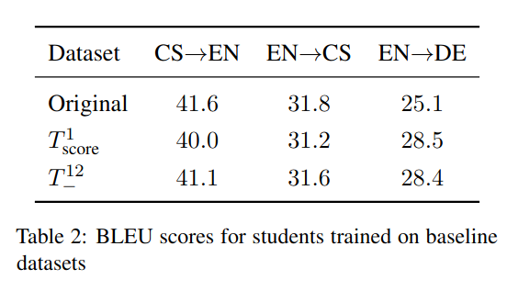
Baseline
Notes:
For baselines the following was chosen: training on the original data, training on the top one hypotheses according to the decoder score and training on all data.
Already here we can see an artefact of the specific setup and that is the quite high BLEU score in the last row. The last row just takes all the teacher output without regards to the quality. It creates twelve translations for one source sentence. This hints that the student model is data and vocabulary hungry and that providing just more context in the target language improves the performance.

Slide 15
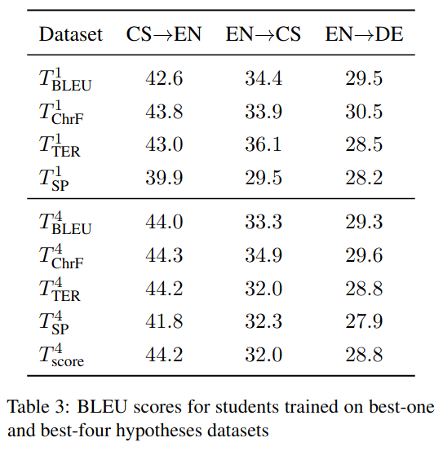
Results – Best One and Four Hypotheses
Notes:
Taking the top one hypothesis is a common practice when parallel data is available. And already here the improvement gain is apparent, especially when we use BLEU as the selection metric.
Even though using BLEU for sentence-level decisions is thought of as very bad practice, here it works surprisingly well.
Taking top four hypotheses works even better. Specifically for the decoder score, it is better than top one or all twelve hypotheses, as we saw in the baseline.

Slide 16
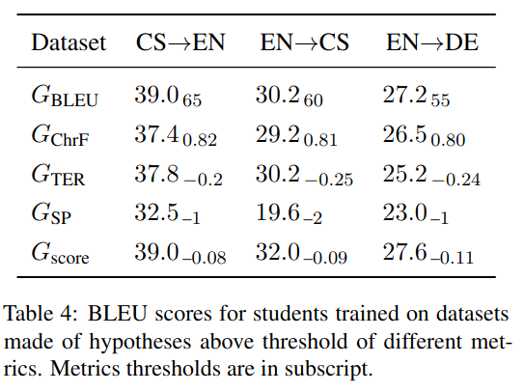
Results – Threshold Filtering
Notes:
Filtering out low scoring sentences did not work as expected. The main issue that was observed is that most hypotheses for a single source sentence are very similar and therefore receive very close metric scores. Therefore thresholds were chosen, so that the new dataset is similar in size to the original one.
In the BLEU case, about 27% of the source sentences were preserved. Interestingly enough, the score dropped only by an average of 1.1 against the top one by decoder score baseline.
In practice, the thresholds are much more benevolent and are used in intersection with some other method.

Slide 17
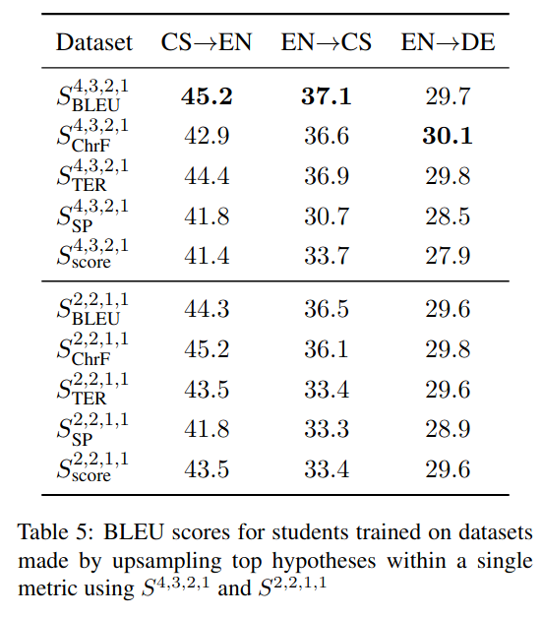
Results – Oversampling
Notes:
Oversampling the best hypotheses multiple times leads to even slightly better results. Namely the second part of the table is better than taking just top 4 hypotheses. This was checked by a one-tailed t-test with the p-value under 0.005.

Slide 18
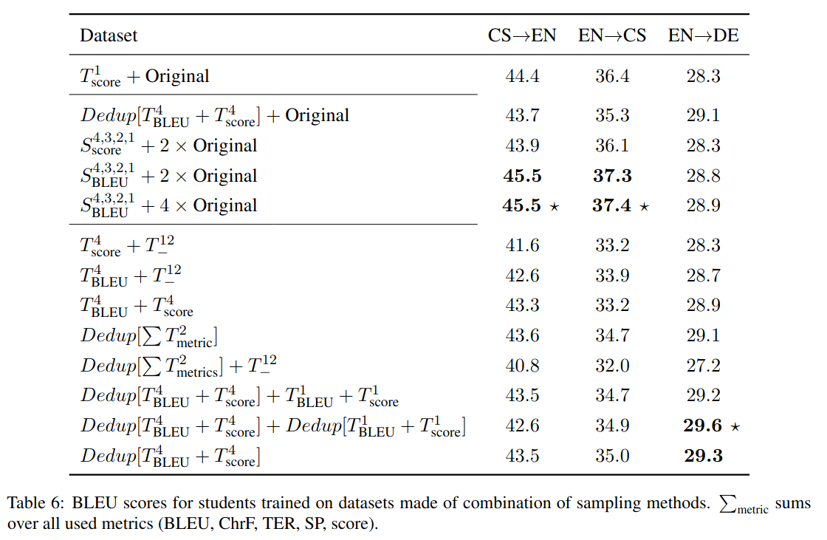
Results – Combination
Notes:
Finally the combination of the used methods was also tried. The highest results were achieved by taking the oversampled data and adding the original data to it four times. The number four was chosen so that the original data are one third of the new dataset.
This can’t be compared to the original baseline, but to a new one, where the top hypothesis is combined with the original data as well. This is in the first row.
The paper describes also more experimented setups but unfortunately there is too little time to talk about them.

Slide 19
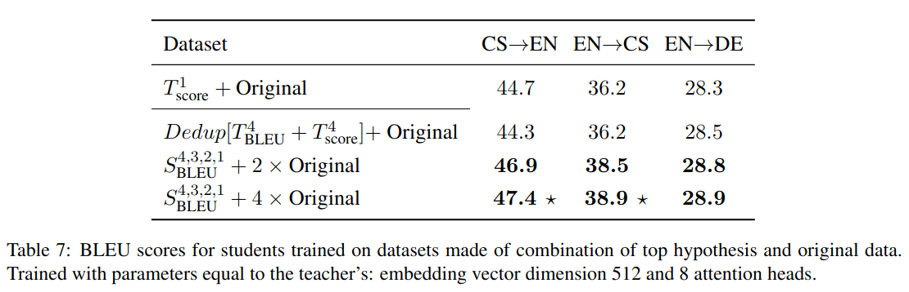
Results – Bigger Models
Notes:
I also experimented with slightly larger models, which confirmed this method by even a larger margin.
Unfortunately, for the German model the gains were much smaller than for the Czech ones. This can be the effect of having more training data available, but this an area of future research.

Slide 20
Contributions
Meaning of results
  Smaller students
    Improve results by 0.9 BLEU score
    Not much, but orthogonal to other tricks
  Students with the same architecture like teacher
    Improve results by 2.0 BLEU score
Notes:
Overall a slight improvement in MT performance was achieved. This may seem only a little, but it is orthogonal to other tricks, so it can be used independently.

Slide 21
Conclusion
Although widely used:
  Taking only highest-scoring sentence & original → not the best results
  Combination of oversampled good hypotheses & original
  Choice of reference metric does not significantly influence results
Caveats:
  Evaluation on custom dataset, not standardized ones
    Computation power limitations
  Oversampling vectors chosen at random
    They are an independent variable as well
  Models very small
Notes:
The main message is that the recipe for distillation is slightly different than what researchers usually use. And namely, it is supersampling of the better hypotheses.
As a colorally the results show that the metric used for ranking is not as important as the method itself.
There are however a few caveats to this work and that is the usage of a domain restricted and a very small dataset. This is usually a bad practice, especially in combination with the small size of the model.
The training of 120 student models however required already more than 4500 GPU hours on the cluster.

Slide 22
Future Work
Bigger models:
  Behavior on larger data & models
  Computationally expensive, but focus only on the best methods
Experiment with other ML domains:
  Does distillation oversampling work in other ML domains as well?
More oversampling schemes
  Sampling parameters chosen arbitrarily
Notes:
Naturally this leads to future work. For example replicating these results with standard-size models and datasets or using other sampling methods that are more based on the metric value instead of just the ordering.
The question whether this works also for other, perhaps even non-NLP tasks, is still open.

