Slide 1
Sampling and Filtering of Neural Machine Translation Distillation Data
Vilém Zouhar, Philipp Zimmermann
2020/2021 ML in CySec
Notes:
Hey everybody and welcome to the presentation of our Project ‘Sampling and Filtering of Neural Machine Translation Distillation Data’

Slide 2
Overview
Motivation, Related Work (2 min)
Idea (1 min)
Our Work (5 min)
  Experimental Setup
  Data Sampling
  BLEU Metrics
  Baseline
  Results
Conclusion (2 min)
Notes:
First we will talk about our motivation and the related work we found.
We then introduce our Idea, followed by our work.
At the end we state out a conclusion based on our results.

Slide 3
Motivation
Model stealing, Model distillation
  Transferring knowledge from large model (teacher) to smaller one (student)
  Filtering improves performance (German et. al.)
    Model inferences have no additional features that imply the quality
Teacher
(big model, big data)
Distillation
Student
(small model, small data)
Notes:
In the lecture we talked about Model stealing and distillation and that is basically transferring knowledge from a large model, called the teacher, to a smaller one, called the student.
We already know, that filtering of the data improves the performance, but we wanted to explore this phenomenon more closely in the context of machine translation.

Slide 4
Related Work
Most prevalent
  Take all the best decoder hypotheses
  Combine them with original (not teacher train) data
  Output: two translations per one sentence → Twice as much data
Teacher
Student
original data
best hypothesis
Notes:
When it comes to model stealing, the most common way is to take all the best decoder hypotheses and combine them with the original data. The Output, which contains two translations per source sentence, then is used for training the students.

Slide 5
Related Work
More sophisticated
  Filter sentences which are suspicious
    Not recognized by language recognizer (German et. al.)
    More than / less than k*length of the reference /source
  Filter based on reference quality, e.g. TER (Freitag et. al.)
    Not main topic of their work
→ TER is very arbitary, how do other metrics behave?
→ What about other sampling methods?
→ What about the combination of them?
Notes:
A more sophisticated way is to filter out sentences which are suspicious. This includes sentences that aren’t recognized or that are much longer or shorter than the reference.
This filtering is then based on reference quality measured for example by TER.
This still leaves many questions open, which have not been documented or systematically studied yet.

Slide 6
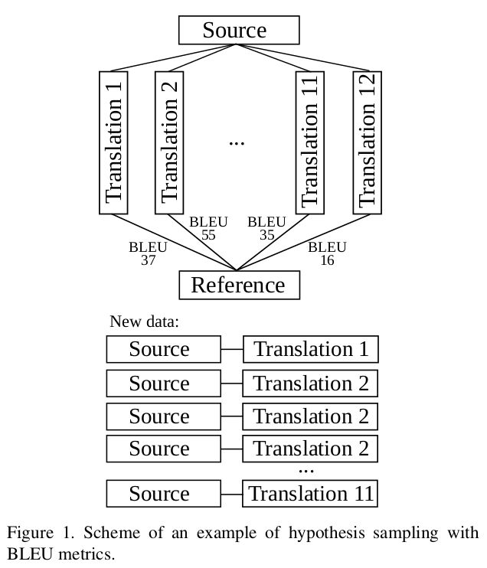
Idea
Distillation
  Query teacher on source sentences
  Get 12 translations for every sentence
  Treat them w.r.t. their quality
    Filter worse ones
    Oversample better ones
  Quality measured by
    Decoder score
    Reference based metrics (BLEU, ChrF, TER, SP)
Notes:
Our approach is the following:
First we query the teacher model on the source sentences and get 12 translations each.
Then we treat them with respect to their quality. That means filtering out the worse ones while oversampling the better ones.
The quality is measured by the decoder score and other reference based metrics like BLEU or TER.
The goal is to achieve better results with the student than the common baseline.

Slide 7
Our Work – Data Set
Europarl v10 parallel corpus
  English – Czech (0.6M sentences)
  English – German (1.8M sentences)
  Longer than what is usual:
    ~23 words per sentence
  Intentionally very domain restricted
Notes:
As our data set we used the Europarl parallel corpus and we focused on English to Czech, Czech to English and English to German directions.
The corpus is quite small by common standards, but this is compensated by it being domain restricted.

Slide 8
Our Work – Experimental Setup
Models
  Teacher
    Transformer based, speed optimized (German et. al.)
  Student
    Follow architecture of teacher
    Half the size of the embedding vector (256 instead of 512)
    Half of the attention heads (4 instead of 8)
    Intentionally very small
Notes:
The teacher itself is already quite small.
With our student model we follow the architecture of the teacher with some parts scaled down for faster training speed.

Slide 9
Our Work – Experimental Setup
Process
  Create new data set (data sampling)
    Use different sampling methods
  Train student on the new data
    CS→EN, EN→CS, EN→DE
  Evaluate and see the effect of the chosen method
Notes:
The process for every sampling method is the following:
First we create a new dataset by making use of the specific sampling method.
We then train 3 student models based on the new data.
Finally we evaluate the new student performance.

Slide 10
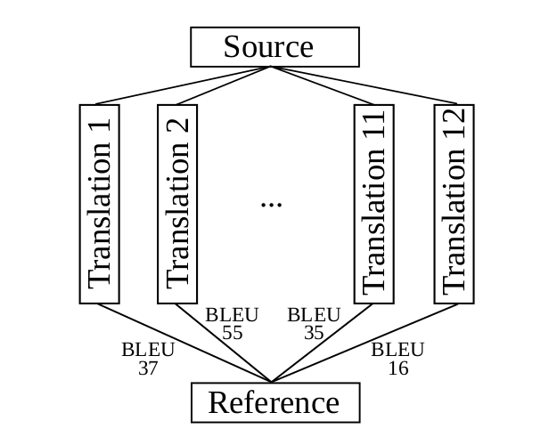
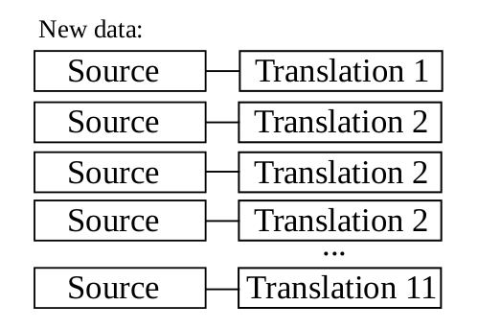
Our Work – Data Sampling
Notation
    take top translation k₁ times, second one k₂ times, etc. …
second best, k₂ = 1
top best, k₁ = 3
.
.
.
Notes:
Throughout the work we use the following notation:
The function you can see here takes the top translation k1 times, the second best k2 times and so on. This is used for oversampling better hypotheses.
The ordering is given by the metric in the lower index, such as BLEU or TER.

Slide 11
Our Work – Data Sampling
Notation
    Take n top translation hypotheses according to metrics (equals )
    Take all sentence translations with metrics
    At least m
    Deduplicate sentence pairs of X
Notes:
T-n takes the top n translation hypotheses according to the metric.
G takes all the sentence translations with metrics at least m.
Dedup simply deduplicates the sentence pairs of X
We also make use of the combination of the method by just joining the results.

Slide 12
Our Work – Data Sampling
Notation
  Concatenation of sampling methods
  +
    Join the top 2 sentences measured by BLEU
    Add them to hypotheses with decoder score at least -10

Slide 13
Our Work – BLEU Metric
BLEU (bilingual evaluation understudy)
  Formula for evaluating quality of text that has been translated
  Based on unigram, bigram, trigram and quadgram precision
  Values between 0 to 1 (usually denoted as 0 to 100)
  Close to 100: translation very similar to reference
  Close to 0: translation not similar to reference
→ Bigger is better
Notes:
The quality of our students is measured based on the BLEU metric. It operates on n-gram level. The higher it is, the more the sentence is similar to the reference. If it’s zero, then it’s not similar at all.
It’s percentage, but usually denoted as a number between a zero and one hundred.
The main takeaway is that higher is better, which we try to follow also with other metrics.

Slide 14
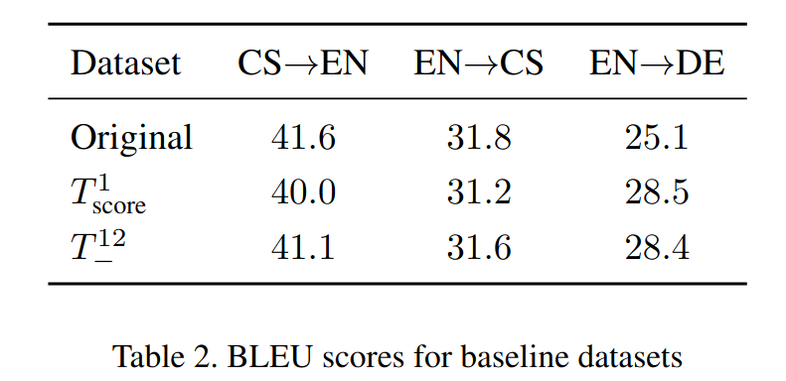
Our Work – Baseline
Notes:
For baselines we chose training on the original data, training on the top one hypotheses according to the decoder score and training on all data.
Already here we can see an artefact of our specific setup and that is the quite high BLEU score in the last row, which hints that the student model is data and vocabulary hungry and that providing just more context in the target language improves the performance.

Slide 15
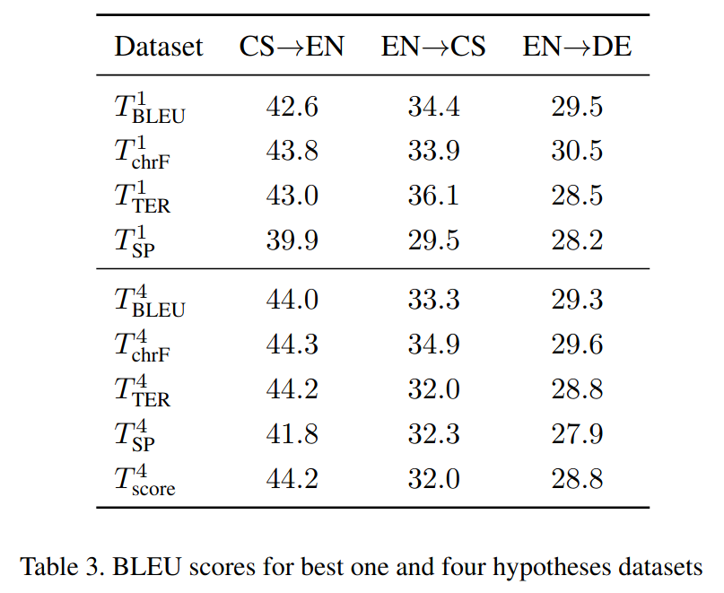
Our Work – Results – Best One and Four Hypotheses
Notes:
Taking the top one hypotheses is a common practice when parallel data is available. And already here the improvement gain is apparent, especially when we use BLEU as the selection metric.
Even though using BLEU for sentence-level decisions is thought of as very bad practice, here it works surprisingly well.
Taking top four hypotheses works even better. Specifically for the decoder score, it is better than top one or all twelve hypotheses, as we saw in the baseline.

Slide 16
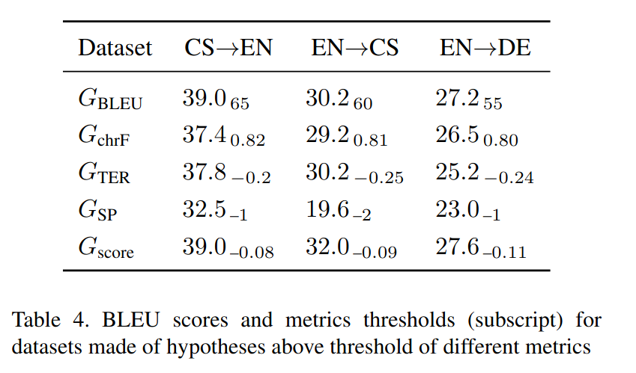
Our Work – Results – Threshold Filtering
Notes:
Filtering out low scoring sentences did not work as we expected. The main issue we observed is that most hypotheses for a single source sentence are very similar and therefore receive very close scores. We therefore chose such thresholds, so that the new dataset is similar in size to the original one.
In the BLEU case, about 27% of the source sentences were preserved. Interestingly enough, the score dropped only by an average of 1.1 against the top one by decoder score baseline.
In practice, the thresholds are much more benevolent and are used in intersection with some other method.

Slide 17
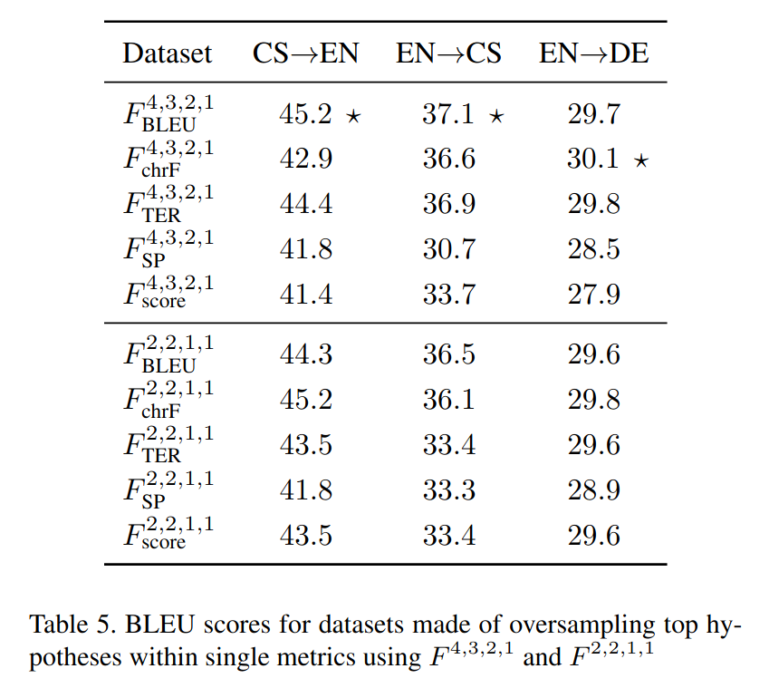
Our Work – Results – Oversampling
Notes:
Oversampling the best hypotheses multiple times leads to even slightly better results. Namely the second part of the table is better than taking just top 4 hypotheses. This was checked by a one-tailed t-test with the p-value under 0.005.

Slide 18
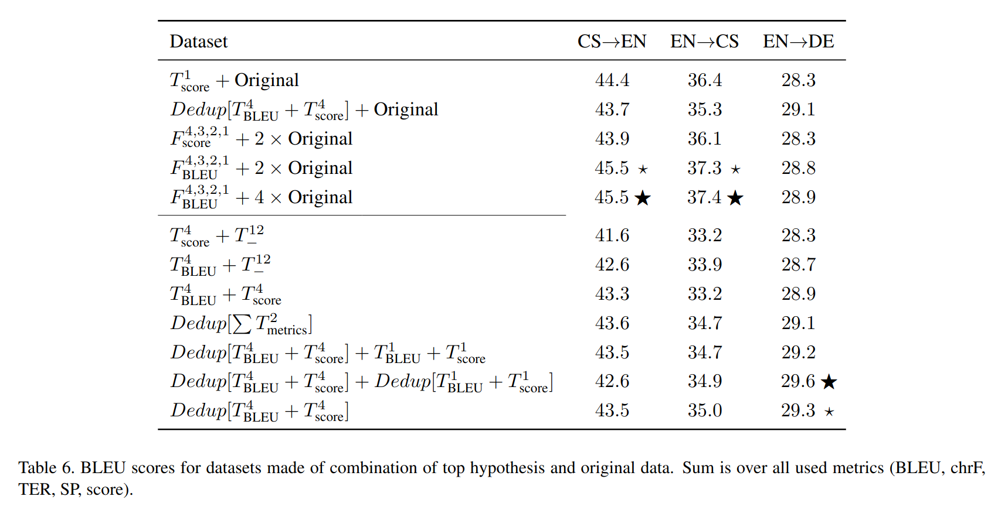
Our Work – Results – Combination
Notes:
Finally we experimented with the combination of the used methods. The highest results were achieved by taking the oversampled data and adding the original data to it four times. The number four was chosen so that the original data are one third of the new dataset.
This can’t be compared to the original baseline, but to a new one, where the top hypothesis is combined with the original data as well. This is in the first row.
We experimented with more setups, but unfortunately there is too little time to talk about them.

Slide 19
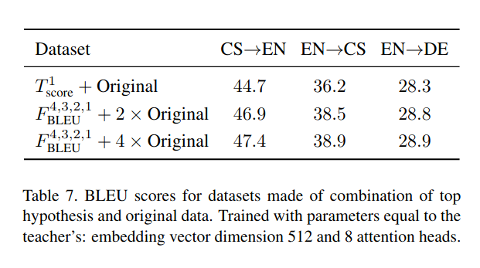
Our Work – Results – Bigger Models
Notes:
We also experimented with slightly larger models, which confirmed this method by even a larger margin.
Unfortunately, for the German model the gains were much smaller than for the Czech ones. This can be the effect of having more training data available, but this an area of future research.

Slide 20
Our Work
Meaning of results
  Smaller students
    Improve results by 0.9 BLEU score
    Not much, but orthogonal to other tricks
  Students with the same architecture like teacher
    Improve results by 2.0 BLEU score
Notes:
Overall we achieved a slight improvement in the MT performance. This may seem only a little, but this is the kind of difference that every trick in WMT conference does to the performance.
Furthermore, this is orthogonal to other tricks, so it can be used independently.

Slide 21
Conclusion
Although widely used:
  Taking only highest-scoring sentence & original → not the best results
  Combination of oversampled good hypotheses & original
  Choice of reference metric does not significantly influence results
Caveats:
  Evaluation on custom dataset, not standardized ones
    Computation power limitations
  Oversampling vectors chosen at random
    They are an independent variable as well
  Models very small
Notes:
The main message is that the recipe for distillation is slightly different than what people usually use.
There are however a few caveats to our work and that is the usage of a domain restricted and a very small dataset. This is usually a bad practice, especially in combination with the small size of the model.
The training however required already more than 4000 GPU hours on the cluster and we wanted to hit the holiday period so that we wouldn’t be blocking my colleagues. Training more than 120 student models in a multi-stage setups used most of the Christmas cluster CPU and GPU capacity.

Slide 22
Future Work
Bigger models:
  Behavior on larger data & models
  Computationally expensive, but focus only on our best methods
Experiment with other ML domains:
  Does distillation oversampling work in other ML domains as well?
Note:
  Version of this paper in a review process
Notes:
Naturally this leads to future work which we would like to see and that’s replicating these results with standard-size models and datasets.
The question whether this works also for other, perhaps non-NLP tasks, is still open.
As a side note, a version of this paper is currently in the review process.

