Slide 1
Sampling and Filtering of Neural Machine Translation Distillation Data
Vilém Zouhar, Philipp Zimmermann
2020/2021 ML in CySec

Slide 2
Motivation
Model stealing
  Model inferences have no additional features that imply the quality
  Filtering improves performance (Germann et. al.)
  Parallel corpus required – breaks the point?
Model distillation
  More probable scenario
  Same as for model stealing
    But we have at least legal gray-box acces

Slide 3
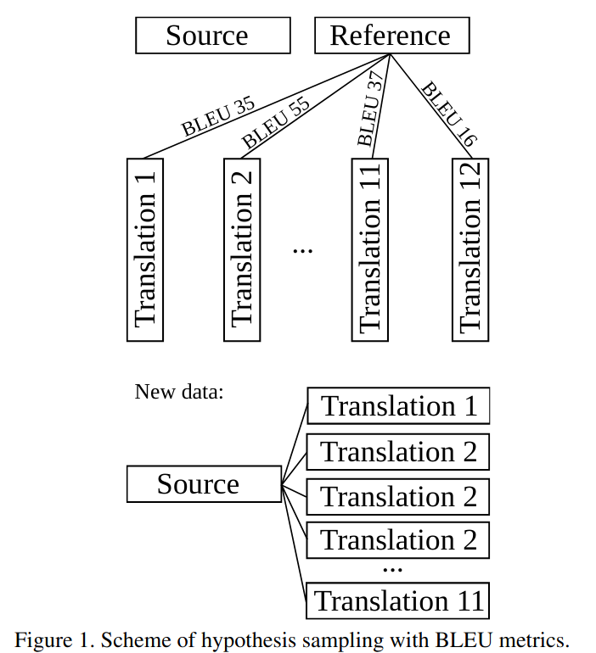
Approach
Treat sentences w.r.t. their quality
  Filter the worse ones
  Oversample the better ones
Quality measured by:
  Decoder score
  Reference-based metrics
    BLEU, chrF, TER, SP

Slide 4
Related Work
Most prevalent:
  Take all the best decoder hypothesis
  Combine with original data
More sophisticated
  Filter sentences which are suspicious
    Not recognized by language recognizer (Germann et. al.)
    More than/less than k*length of the reference/source
  Filter based on reference quality, e.g. TER (Freitag et. al.)
    Not the main topic of their work
    TER is very arbitrary, how do other metrics behave?
    What about the combiation of sampling methods?

Slide 5
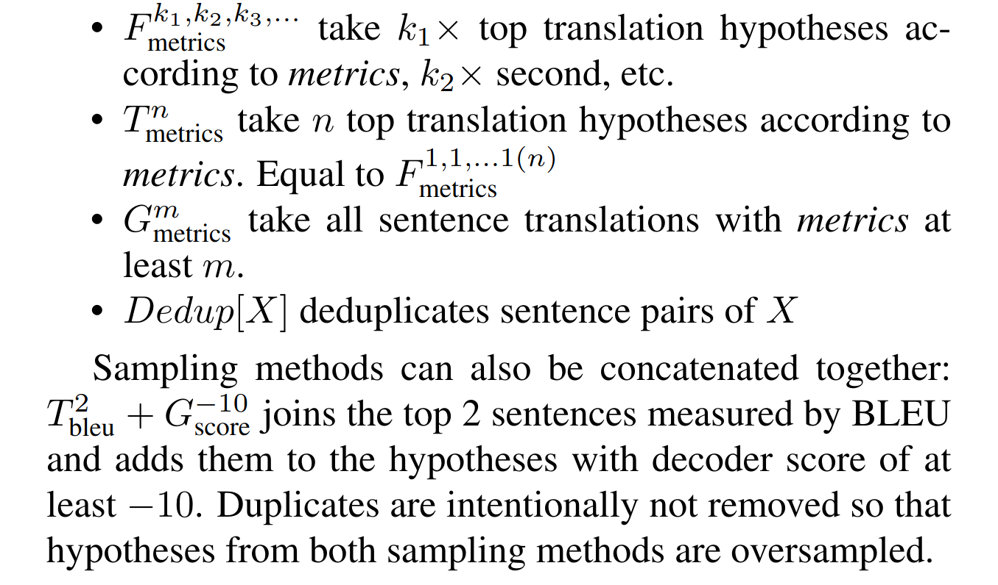
Our Work
Introduce notation for data sampling
Explore the behaviour on three MT teachers

Slide 6
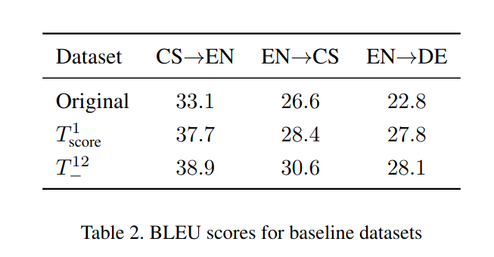
Our Work – Baseline

Slide 7
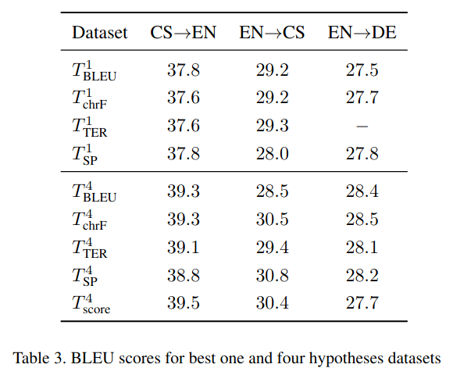
Our Work – Best 1 or 4 hypotheses

Slide 8
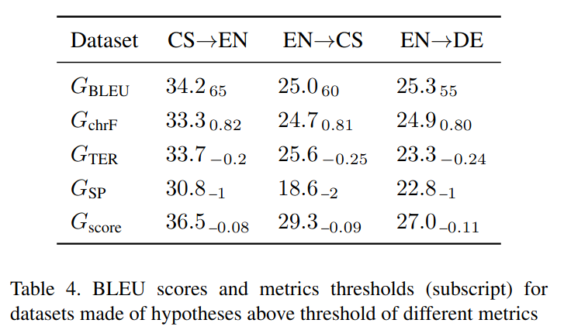
Our Work – Threshold Filtering

Slide 9
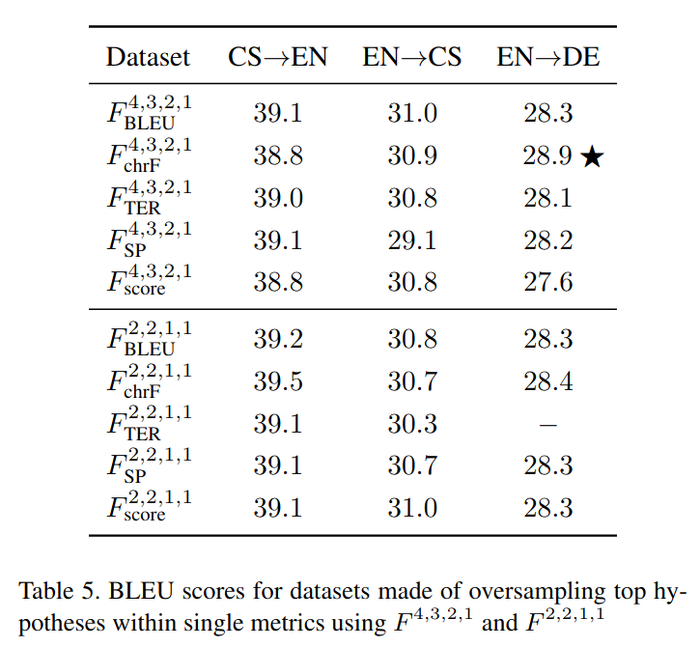
Our Work – Oversampling

Slide 10
Our Work – Oversampling

Slide 11
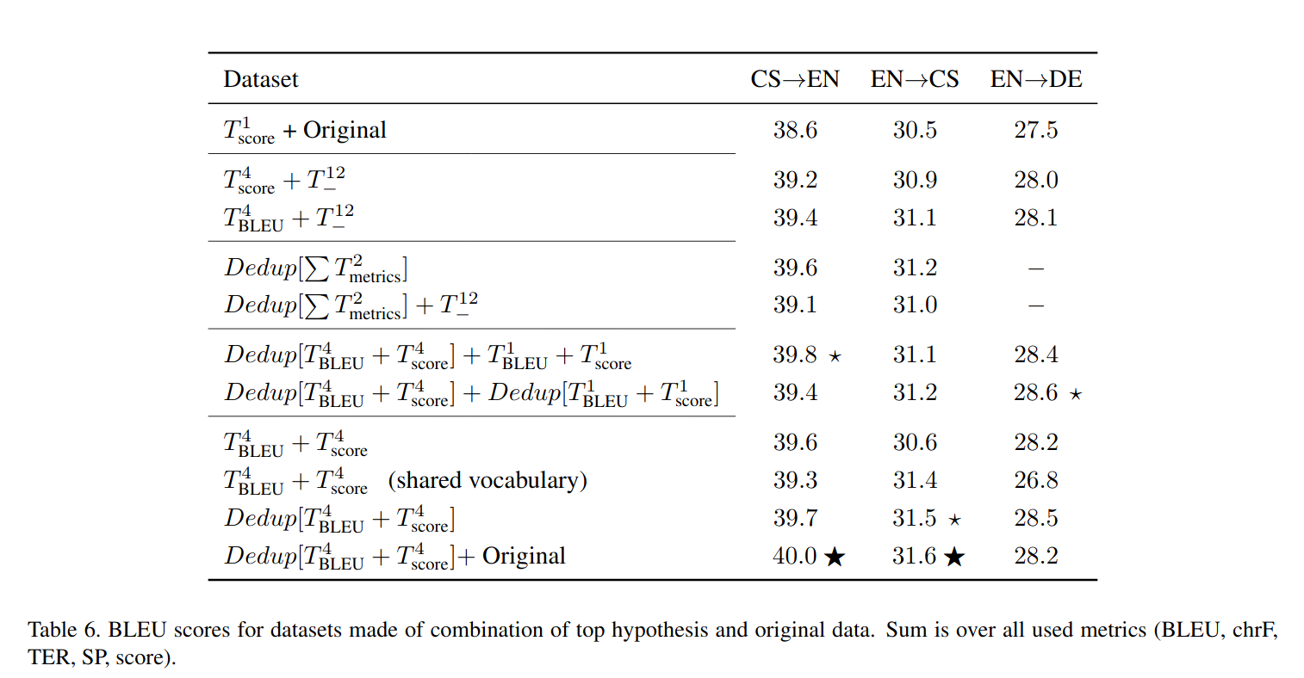
Our Work – Combination

Slide 12
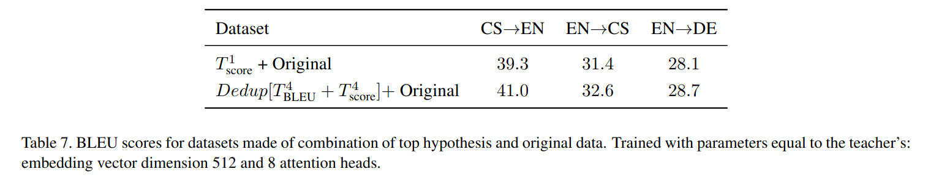
Our Work – Bigger Models

Slide 13
Our Work – Why Almost Done
Computation availability
  Uncertainty about the training size
  39*3 MTs to train, data preparation CPU intensive
  ÚFAL Charles Uni cluster free over holidays
PBML submission
  99% certainty of not being accepted
  Get MT expert feedback

Slide 14
Our Work – What needs to be done
Paper needs polishing
Results are validation test only
  Validation test was used only for best epoch & few experiment discards
    Results will probably be all systematically lower and have higher variance
  Nevertheless still time consuming
    39*3 inferences of 15k sentences takes time
    Evaluation
All values need to be recomputed

Slide 15
Our Question(s)
We are at 4.5 pages
  Is it a hard limit?

