Slide 1
Effective Approaches to Attention-based Neural Machine Translation
Minh-Thang Luong, Hieu Pham, Christopher D. Manning
arxiv.org/abs/1508.04025

Slide 2
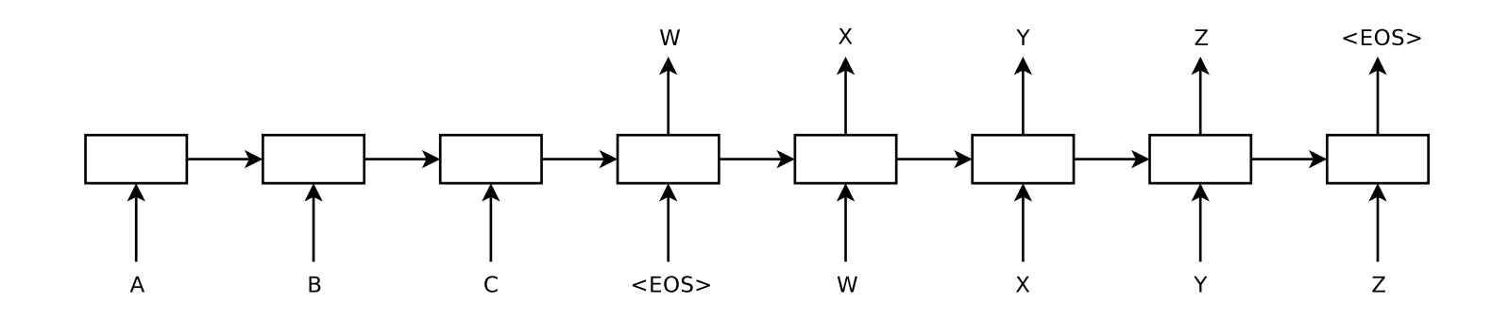
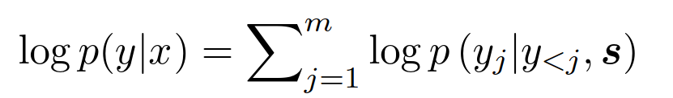
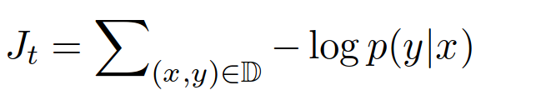
Vanilla Encoder-Decoder
Sentence probability:
Training loss:
Notes:
In MT the data is in the form of sentence pairs. Neural MT models themselves are generally sequence to sequence, where the units can be either tokens or some subword unit, which is however not relevant for this paper. Recap of the basic architecture they're trying to improve. It's an encoder-decoder with RNNs, using LSTMs. Encoding the sentence is easy, we just put the first word together with some zero state vector into the encoder LSTM, we get a hidden state, which we then use with the next word in the same LSTM. After we process the whole sentence, we have the whole input in one vector.
Decoding is somewhat more difficult, because it’s not exactly like we put words in and get words out. When we put the last hidden state in the decoder, our output will be a probability distribution of all words in our target vocabulary. So we pick one, and together with the modified hidden state we put it again in the decoder unit. This process is repeated until we get the end of sentence token. The issue is that we don’t know which word to choose in advance. We could always take the word with the maximum probability, which however doesn’t guarantee that the overall sentence probability will be the highest. This approach is called greedy decoding, but usually in decoding we use some kind of a beam search and keep a stack of probable sentences/hypotheses. This is why NMTs are called just language models, because they just model the probability of the next word given all the produced output, as seen in the first equation.
In training, this isn’t an issue, because we know which words to choose in advance and the loss is basically the negative of the probability of the whole dataset.

Slide 3
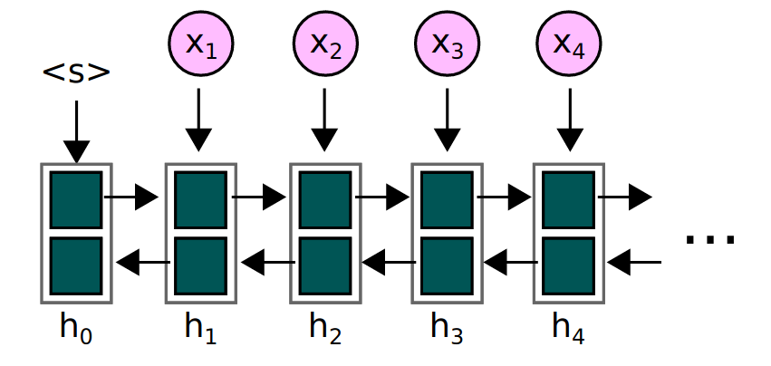
BiRNN Encoder-Decoder
Notes:
One problem with the previous approach is that at some point, the whole sentence and all of its meaning is stacked in a single vector. That’s problematic, because due to vanishing gradients, the weights in the first steps of the network are not updated effectively. Another issue is, that when people are rating translations, they focus most at the sentence beginnings and sometimes don’t even read the end. But when we encode the input sentence, the last tokens are going to be the most represented in the single vector between the encoder and the decoder.
Because of that, we can either put the sequence there backwards, or just use bidirectional RNN and then just either concatenate or add the final vectors.

Slide 4
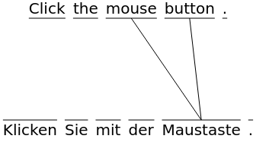
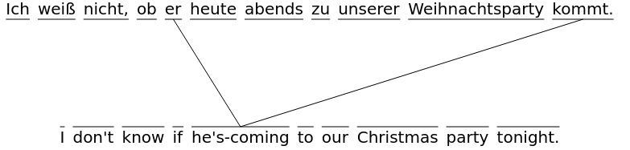
Alignment
Problem:
Vanishing gradients, long term dependencies.
Idea:
Tell the network where to look in the input.
Notes:
Even with using the stacked RNNs in both directions, we still suffer from the basic problem, that at some point, the whole sentence is in a fixed-sized vector. What we’d want is for the network to look at different parts of the input sentence when it’s producing the output.
So perhaps in this example from English to German, when the decoder is producing the word Maustaste, it should take a look in the input sentence to words corresponding to mouse button and not care about the rest. Another example is this German sentence. When the decoder is producing the word kommt, it needs to know that it was third person singular so that it can fulfill the noun-verb agreement requirement. This information is in the hidden state, but since it was quite some time ago when the decoder produced the word he, it may be represented less.

Slide 5
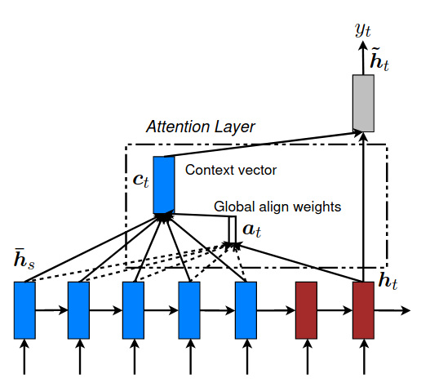
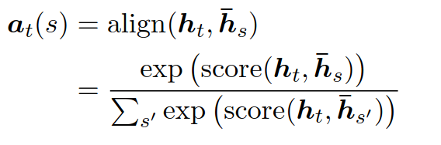

Global Attention
Attention relevance between the current decoder state and input state s
Context & state concatenation
Word output
Notes:
This is the goal of attention mechanisms in general. Citing from paper: The idea of a global attentional model is to consider all the hidden states of the encoder when deriving the context vector. This sounds perhaps counterintuitive, because it’s considering all the hidden states and not just a selection. The consideration actually means, that it computes the relevance, or alignments score for every input hidden state. The result is just some number which can be arbitrarily large or negative, so it’s softmaxed across all hidden states. This way we get a number between zero and one for every hidden input state and these numbers sum up to one.
Obviously the next step is to multiply every input hidden state with this relevance score and combine this weighted average with the hidden state of the decoder. This is described on the figure in the paper. The h_t is the hidden state of the decoder to which the context vector is added, forming h_t with tilda cap from which they produce the output word. This is equation five and words are produced as in equation six.
Training-wise, this is much more effective, because if the currently produced word has a high loss and also for example the attention was mostly on the first input word of the sentence, then the gradient is easily going to propagate to the relevant iteration of LSTM.

Slide 6
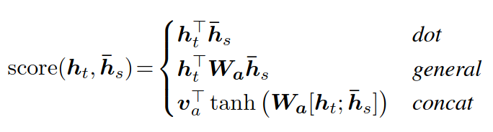

Computing Score (Globally)
Attention score, not attention!
Attention, not attention score!
Notes:
So far we didn’t look at how the attention scores are computed. In general we have access to the current decoder hidden state and all the input hidden state. We then want to generate some number, called attention energy or score. The authors list several options ranging from just multiplying the two hidden states, or with a matrix in between or concatenating them, multiplying by a matrix, squeezing through a non-linear function and multiplying the result by a vector.
The authors also experimented with disregarding the encoder hidden states in the computation and just multiplying the decoder hidden state by a matrix, which results in an attention vector for the whole input sentence.
The matrix W_a and the vector v_a are network parameters, which can be learned.

Slide 7
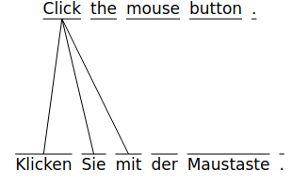
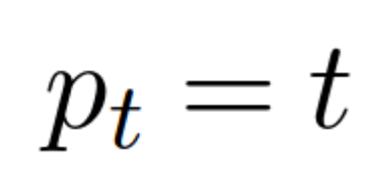
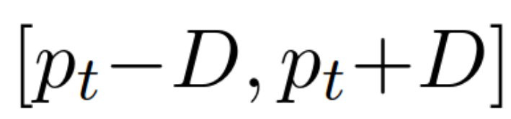
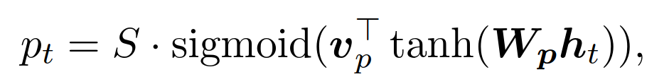
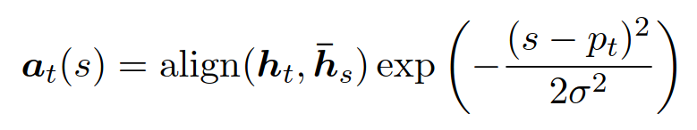
Local Attention (local-m, local-p)
Diagonal alignment:
Considered window of input tokens:
Let the network predict the alignment itself:
Force it to focus on tokens around the predicted location:
Notes:
The problem of global attention is that in general scenarios, computing the attention scores for all of the encoder and decoder states can be quite demanding and also the computation graph has lots of paths by which the gradient can traverse.
What we’d want is to limit the number of words to which we attend. The easiest way would be to create a sliding window and look at for example the fifth input word when producing the fifth word. This is called the monotonic alignment and fails, simply because the translation alignment itself is not diagonal and the input and output sentences usually have a different number of tokens. Also it doesn’t solve the issue of long term dependencies. This is called local-m.
An alternative is to let the network predict the position. To make it valid, they just predict a number from 0 to 1, which is interpreted as a relative position in the source sentence should the network attend to. This is called local-p.
We let the system itself come up with the target input position p_t and look at a window of a fixed length from which we compute the context vector as in global attention. The authors also use a trick to force the network to concentrate on the window midpoint, by multiplying it by a gaussian distribution around this point. The width of this distribution as well as the window size is a training hyperparameter.

Slide 8
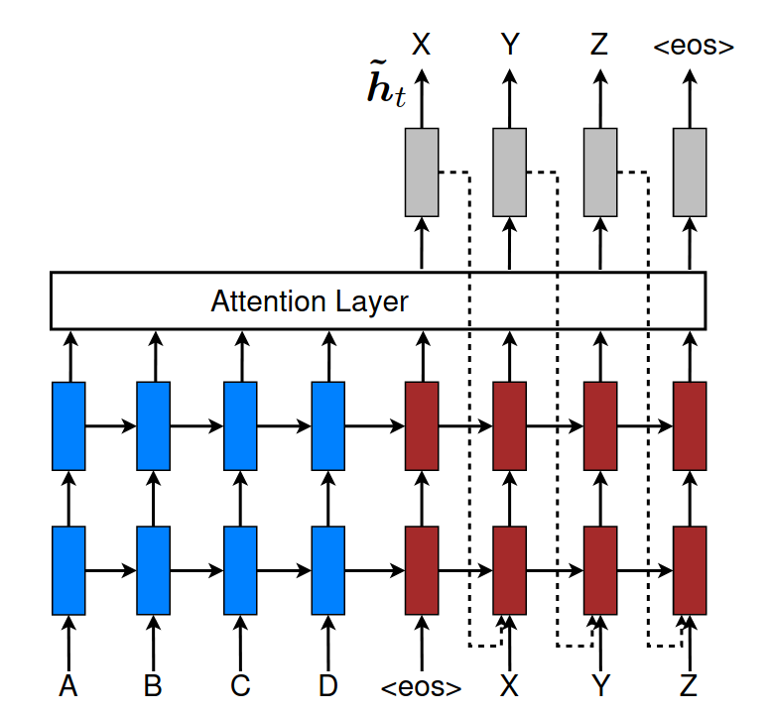
Input-feeding Approach
Also add the previous hidden state (not the generated word) to the current decoding computation.
Notes:
The last trick the authors use is to simply put the previous state, to which the context was added to the next decoder timestep. The motivation is that in the decoding part of a classical phrase based machine translation system, one would keep a track of which words or phrases were already translated then only focus on those which yet weren’t. Basically the network should be aware to which words it already attended.
The figure contains just a stacked RRN, which is unnecessary and for simplification, the middle layer could be removed.

Slide 9
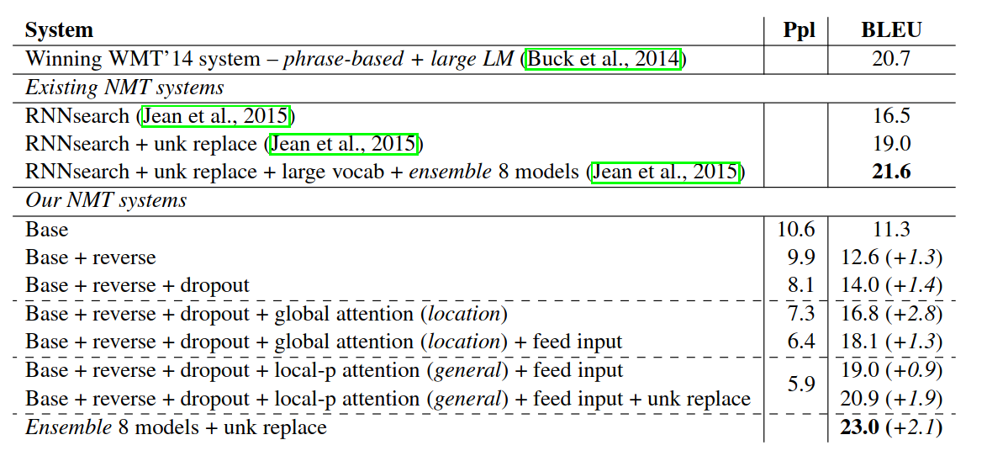
Experiments
Notes:
The authors demonstrated the usefulness of their techniques by comparing it to other state of the art models, which were submitted to the workshop on machine translation 2014 in the news translation task. And the winner is local attention with predicted window position, with the feed input trick and unknown replace automatic post-editing.
A very basic yt useful trick is to reverse the sentence. This becomes obsolete once we use bidirectional RNNs, but in their setup it helped.

Slide 10
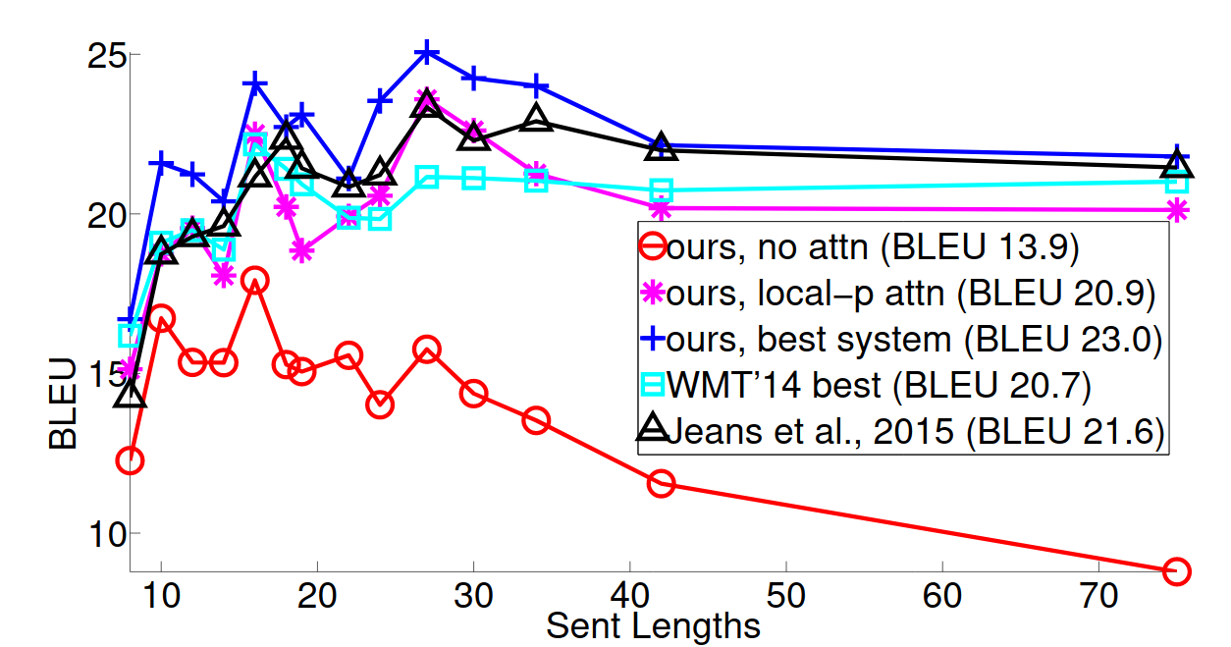
Sentence Length
Attention saves long sentences, especially compared to vanilla RNN.
Notes:
As expected, the BLEU score degrades more slowly with the attention present.

Slide 11
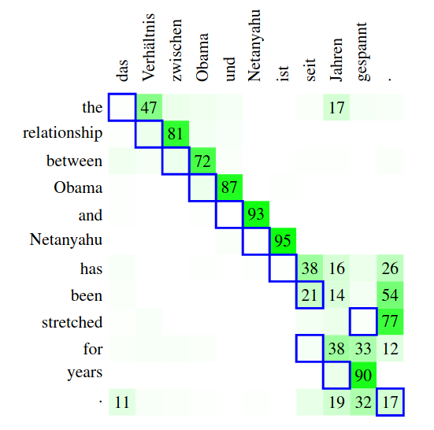
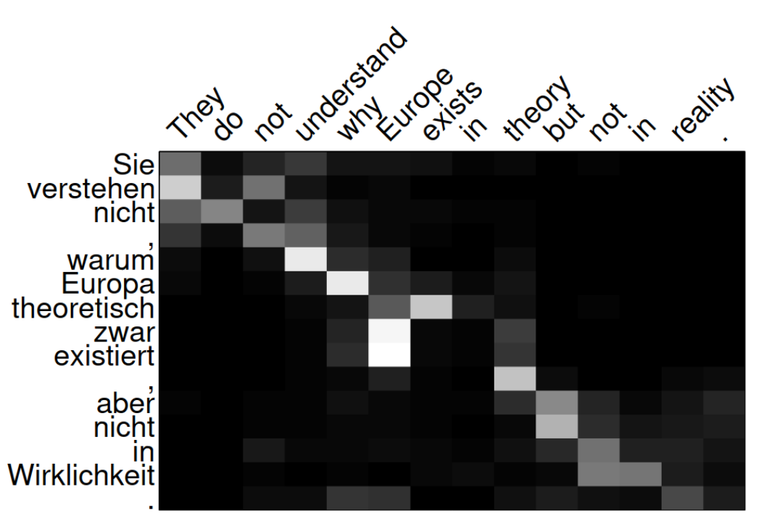
Attention Note #1
Why is alignment off by one?
Notes:
The figure shows the attention from the paper’s best model. What’s perhaps a bit surprising is that the words are not what we thought word alignment should look like. Even with complex linguistic dependencies one would suspect, that when predicting Europa it will take a look at Europe, but that’s not what happened.
We could hope that perhaps the authors did a off-by-one error, but in fact, this is a well known phenomenon that occurs also with other neural MT setups. It was mentioned by Philipp Koehn as a part of the Six Challenges for Neural Machine Translation.
The blue rectangles are output of fast_align, which uses the IBM alignment model 4, while the green squares are alignment weights from a neural MT.
This offset can be somewhat explained by the usage of one-directional encoders. When a given a given word is to be translated, the attention is used to get some more context into the yet non-translated parts of the sentence. So the question now is does the network attend the previous word and not the next one? It has to do with the fact that the sentence is encoded backwards. With bidirectional encoding the alignments are more what we expect.

Slide 12
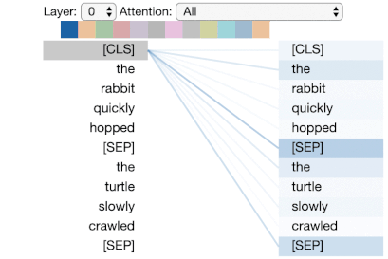
Attention Note #2
Attention heads encode linguistic structures.
Heads from Transformer self-attention resemble linguistic dependency.
Notes:
People also use multiple set of alignment matricies to compute the attention. These are the so-called attention heads and each produce different attention energies. For example in the Transformer model, which uses self-attention, the heads can be shown to represent some sort of a dependency relationship between the constituents.

Slide 13
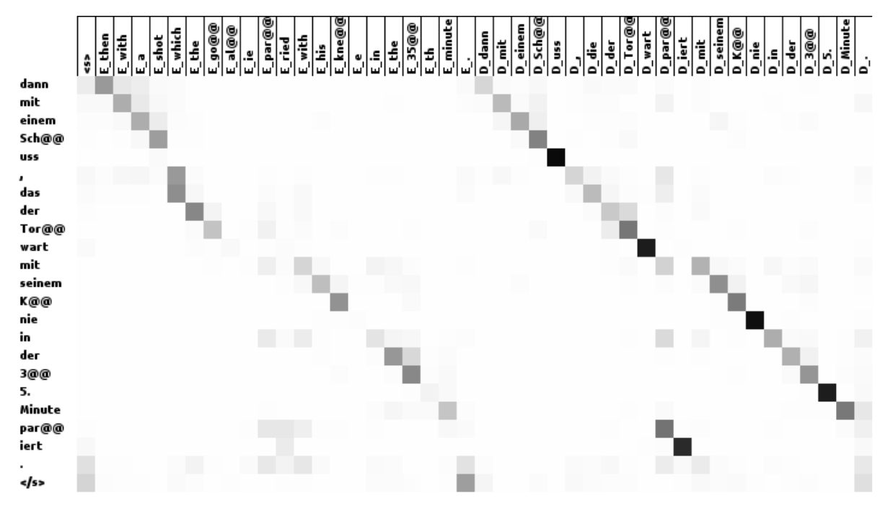
Attention Note #3
Append less performant MT output as an input to attention based MT
Notes:
The attention allows us to be less strict in the input, so some people tried to for example to append the output of a phrase based mt to the input and when they looked at the attentions they found out that the network was attending to both the actual input and phrase based mt output.

Slide 14
Summary
vanilla RNN suffers from vanishing gradients
attention brings input closer to the output
global attention - whole sentence
local attention - window of tokens

Slide 15
Resources
Effective Approaches to Attention-based Neural Machine Translation, Minh-Thang Luong, Hieu Pham, Christopher D. Manning
https://arxiv.org/abs/1508.04025
Class on Statistical Machine Translation
Ondřej Bojar
http://ufal.mff.cuni.cz/courses/npfl087
Enabling Outbound Machine Translation
My bachelor thesis
https://dspace.cuni.cz/bitstream/handle/20.500.11956/119400/130284419.pdf
Six Challenges for Neural Machine Translation
Philipp Koehn, Rebecca Knowles
https://arxiv.org/abs/1706.03872
A Multiscale Visualization of Attention in the Transformer Model
Jesse Vig
https://github.com/jessevig/bertviz
Slow Align
https://vilda.net/s/slowalign/

