Slide 1
Fact Learning With Adaptive Color Palette: Effect of Stimuli-Independent Hints
(a short pitch)
Vilém Zouhar, Anjali Nair, Tianyi Li, Leander van Boven

Slide 2
Introduction - Fact Learning
Hints can (superficially) help learn faster Van den Broek et al. (2019)
Color makes stronger connections (red = danger, green = nature) Chang et al. (2018)
Combine above:
  Show a color whenever a word is displayed
  Incorporate SlimStampen model to obtain difficulty of word to the user
  Learn Swahili vocabulary
Notes:
For the task of fact learning we chose the prototypical example of learning new vocabulary. The fact that hints help learn seems intuitive though as the last paper we read shows, contextual hints may be detrimental in the real world where they are not available.
On the other side there is also research on how colors can make stronger connections. And in our study we plan to join these two to see non-contextual hints in the form of color help in learning.
In practice what we plan to do is to show a color palette which is based on estimated word difficulty. This is a non-contextual hint because it’s not bound to the prompt-answer pair and consciously it does not help in recalling the answer.

Slide 3
Factors & Experiment Design
Palette (between-subject):
P0: no colour palette
P1: colour palette chosen by the user
P2: words have assigned random colors
Notes:
If we decide to test whether providing a difficulty palette helps in learning, we obviously need a control group without the palette. That’s P0 and P1 is the palette scaled by the difficulty.
The group P2 will have colors randomly assigned towords and these will be fixed for the duration of the experiment. We need this group to see whether the difference between P0 and P1 is really because of the difficulty palette or because the users subconsciously learned also the mapping from colors to answers. For example, if I always see a word with a certain specific yellow color, it may help me recall the answer.

Slide 4
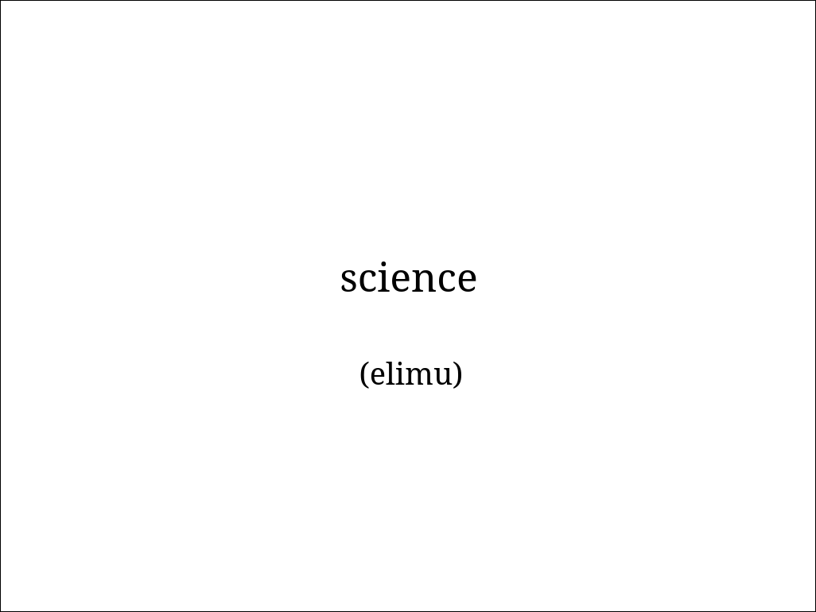
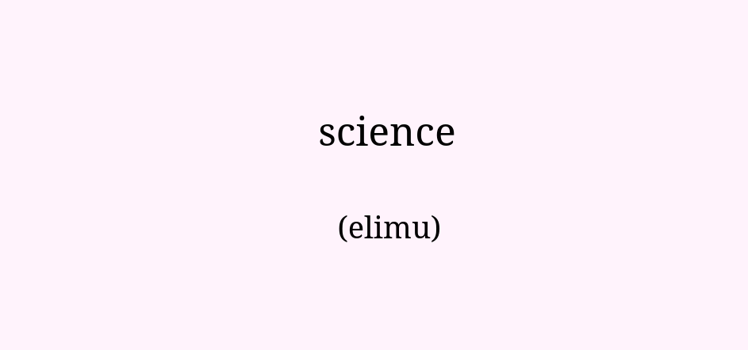
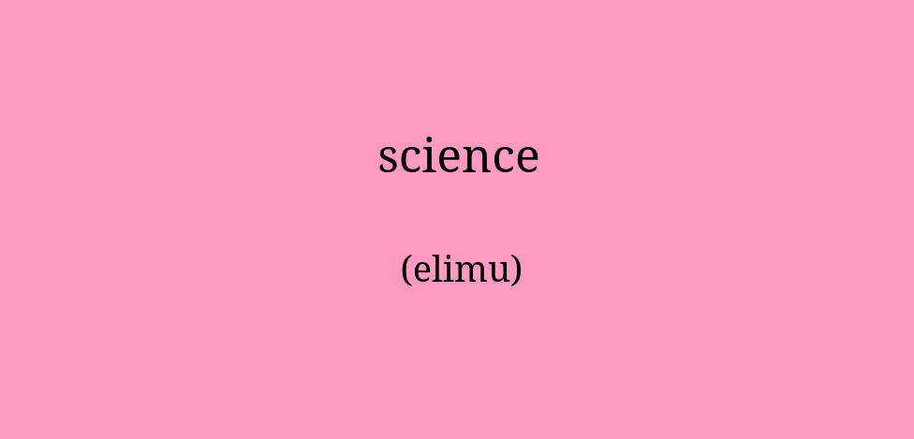
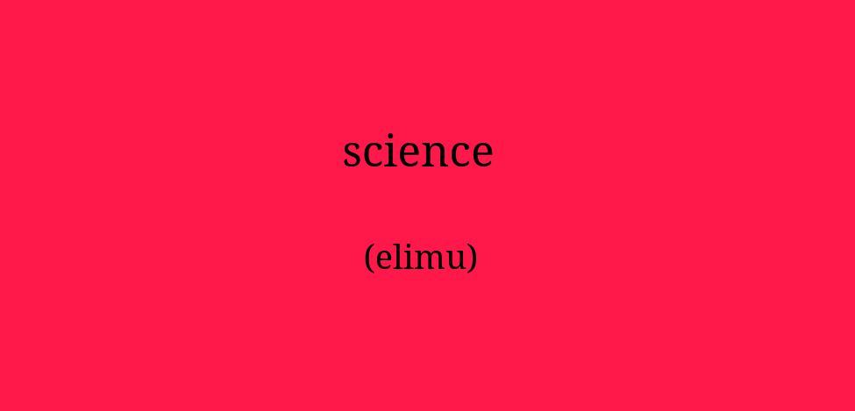
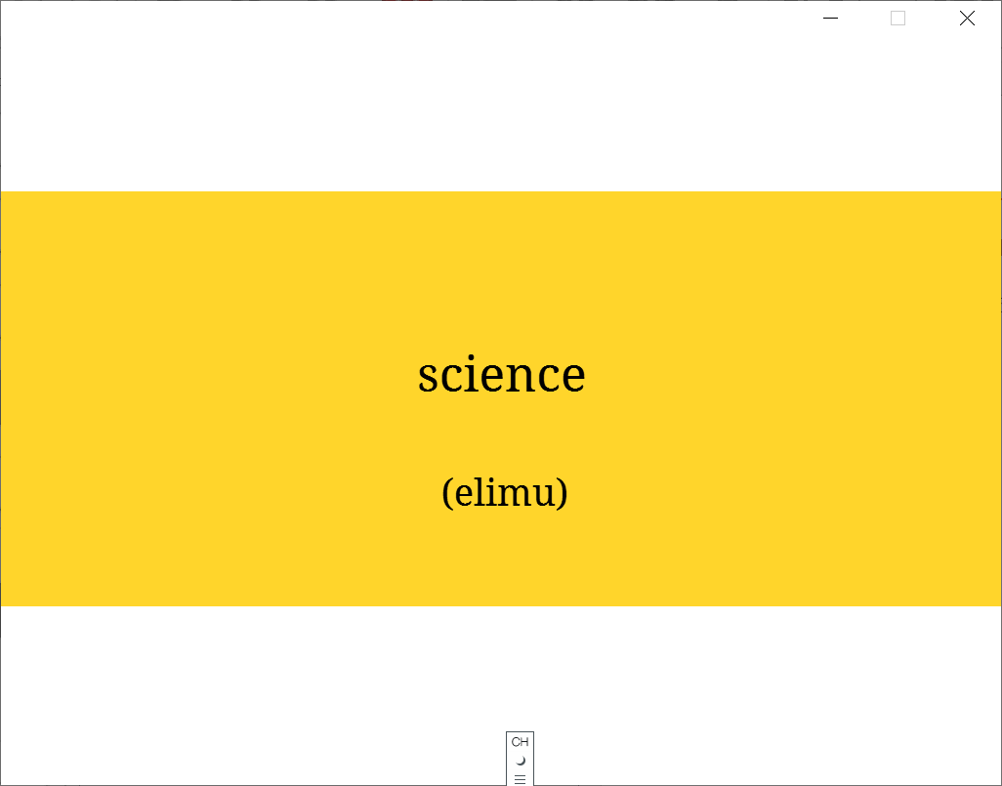
Mock-up Design: Palette
(easy) (medium) (hard)
P0
P1
P2
Notes:
This is the overview of the groups. P0 has no colors, P1 has colors scaled by the difficulty and P2 has random mapping between words and colors.

Slide 5
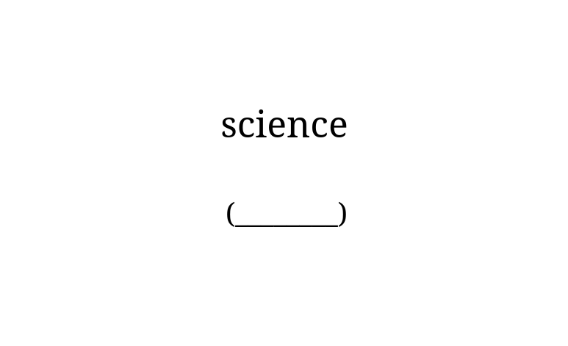
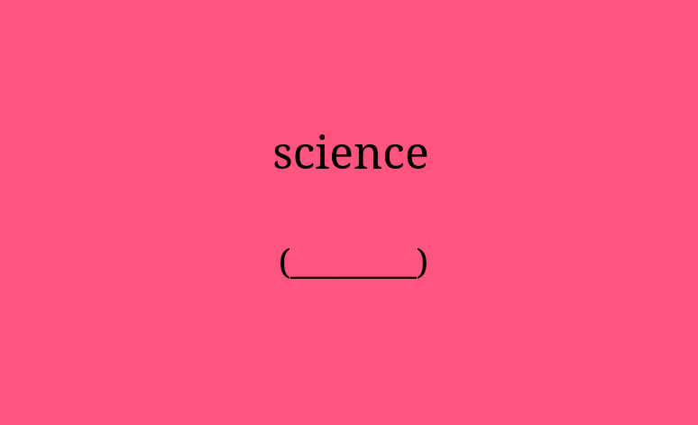
Factors & Experiment Design (cont.)
Palette (between-subject):
P0: no colour palette
P1: colour palette chosen by the user
P2: words have assigned random colors
Evaluation (within-subject):
E0: evaluation without any color cues
E1: evaluation with the same scheme as the original
  P1 and P2 only
5 conditions
E0
E1
Notes:
This is however not the end of our factor design, because we also want to see whether the user started relying on the non-contextual cues too much, as it happened in the other paper. And therefore the final testing will be done on two levels: with colors and without colors.

Slide 6
Research Questions & Expectations
Does having access to color palette help in learning?
  perf_{E0}(P1) > perf_{E0}(P0) ?
Is palette access necessary in the testing?
  perf_{E1}(P1) > perf_{E0}(P1) ?
Is palette access better than random mapping?
  perf_{E}(P1) > perf_{E}(P2) ?
Can random mapping be better than no colors?
  perf_{E1}(P2) > perf_{E0}(P0) ?
  perf_{E0}(P2) < perf_{E0}(P0) ?
E1
E0
Performance
P0
P1
P2
Notes:
Our research questions are mostly comparing all the different conditions. What we are mostly interested in, obviously, is whether color palette works even outside of the environment with the cues and how much worse it gets when the colors are not presented anymore in the testing.
Finally we also wish to see whether random colors are better than P0 and how much their presentation in testing matters.
Our expectations are formalized in the equations and in this graph. Similar to the paper, we expect the way its tested to have a large impact on the performance.

Slide 7
Hypotheses & Expected Results
Higher performance among participants in the adaptive colour pallete condition (P1) with their own selection
E1 will have better performance than E0 because of the similar reasons to those proposed by Van den broek (2019)

Slide 8
Pre-survey
What color palette to use in P1?
Do we all agree that there is one that corresponds to easy-difficult?
easy - difficult
easy - difficult
easy - difficult
easy - difficult
Average Color Palette Preference
Colour Palettes
Notes:
One final note and that is about the selection of the palette used in P1. What we don’t know is that whether everyone agrees that for example yellow-blue is the palette that corresponds to easy-hard difficulty and we don’t want to introduce more confounding factors by forcing this onto incompatible participants.
For this reason we’re going to do a small survey to see whether people mostly agree what the most natural palette for them is and based on the distribution we’ll either select one (ideally), or make the user select from a pool of palettes at the beginning.

Slide 9
References
Chang, B., Xu, R., & Watt, T. (2018). The impact of colors on learning.
Van den Broek, G. S., Segers, E., Van Rijn, H., Takashima, A., & Verhoeven, L. (2019). Effects of elaborate feedback during practice tests: Costs and benefits of retrieval prompts. Journal of Experimental Psychology: Applied, 25(4), 588.

