Slide 1

Battle of Neighborhoods – Paris
IBM Data Science Capstone
January 4, 2021

Slide 2
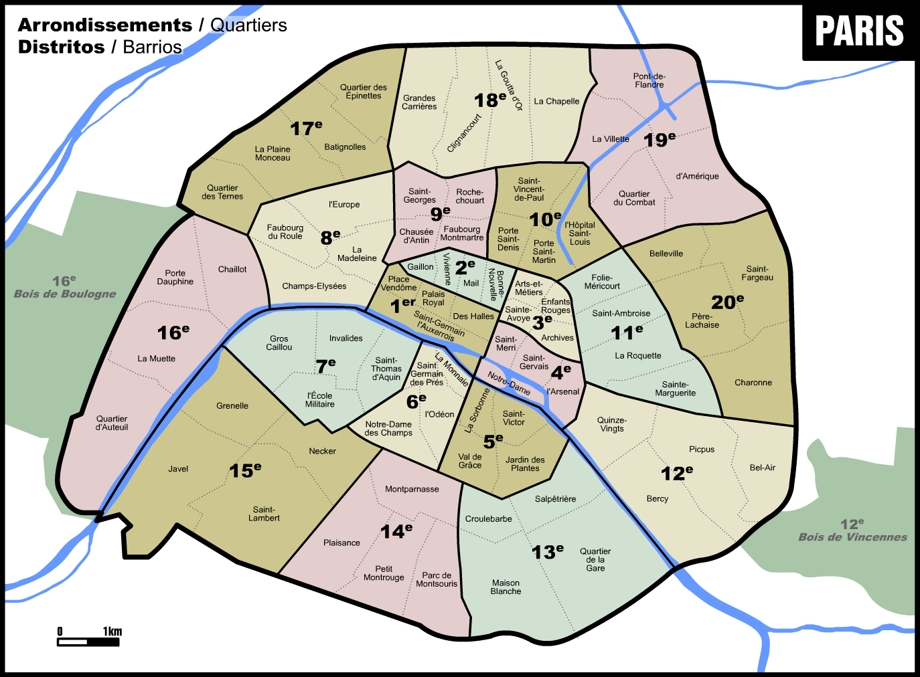
Introduction
Paris is one of the most visited cities in the world.
Unbeknownst to most, each of its 20 Arrondissements (Districts) is divided into 4 Quartiers Administratifs or Neighborhoods, giving a nice round number of 80 neighborhoods in total.
wikipedia

Slide 3

The Problem
True* story: Bob has a plan for the day. He wants to eat Chinese for lunch, watch a movie, go to a café, browse for music at a store, have Italian for dinner and finish the night at a bar, all in the same neighborhood so as to minimize distance traveled. Where should he go? Which neighborhood can grant him all of his wishes?
Based on the user's input of venue categories, return candidate neighborhoods that contain venues belonging to the categories of interest entered by the user.
*not

Slide 4

Potential stakeholders
The following users may be stakeholders interested in this type of solution:
- tourists that may want to book a hotel next to certain venue categories
- a person who would like to buy an appartment in the city of Paris in poximity of specific venue categories (a gym and a cafe for example)
- a local Parisien who wants to minimize the distance traveled and visit all venue categories of interest, all in the same neighborhood

Slide 5
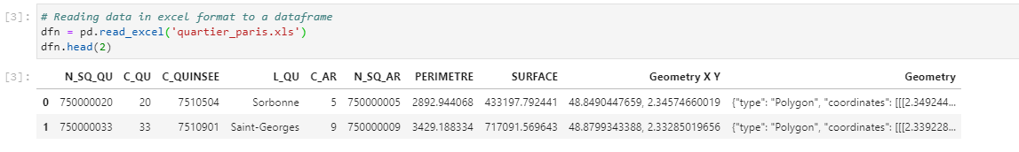

The Dataset consists of the neighborhoods with the corresponding geographic coordinates
The starting dataset is obtained from https://opendata.paris.fr/explore/dataset/quartier_paris/information/ and is composed of the neighborhoods in Paris and certain of their characteristics such as their geographical coordinates, the surface area, district, etc.
Foursquare.com is also leveraged to obtain location data pertaining to the venues in Paris.

Slide 6
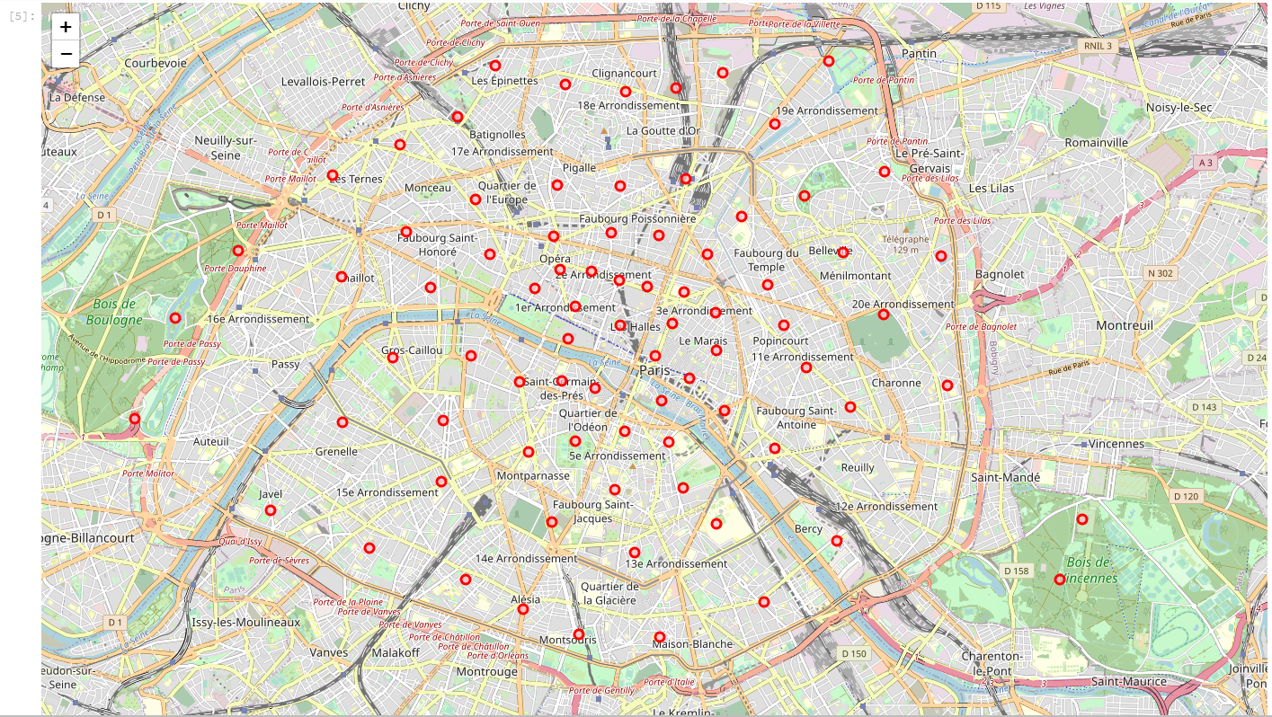
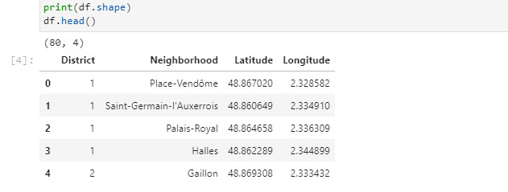
Cleaning and visualizing the data reveals that some markers are offset
Cleaning the dataset and visualizing it gives the following dataframe and Folium map

Slide 7
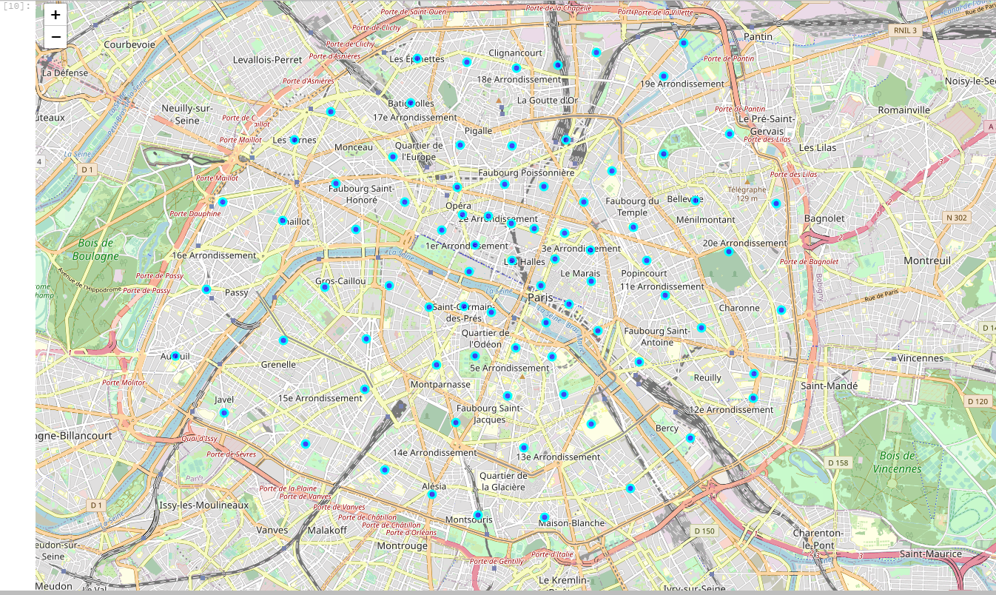
Some more cleaning and visualizing to correct some points that were offset
All the points are inside the Boulevard Peripherique and correspond better to the center of the neighborhood ‘where people live’ vs the geographic center of the neighborhood, offset by the large parks in the Parisien west and east.

Slide 8
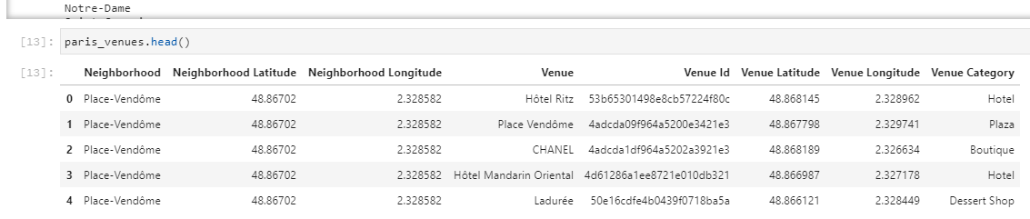
The dataframe obtained from Foursquare
5291 venues returned by Foursquare, of which 299 unique venue categories. This dataframe shall be the basis for the next and final part of the project.

Slide 9
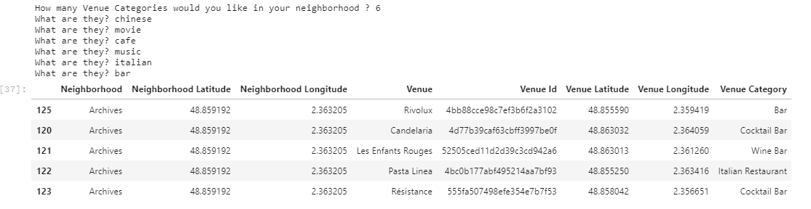
Prompting the user for input
After inputing the number of venue categories of interest and listing them, the previous dataframe is leveraged to return neighborhoods which contained the venue categories of interest to the user.
Remember Bob’s example

Slide 10
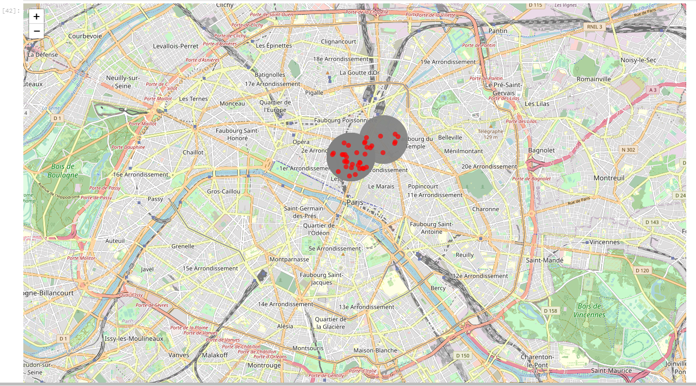
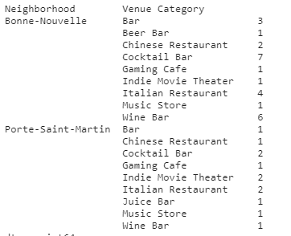
Visualizing the neighborhoods and venues
Bob is happy, both neighborhoods which contain the venue categories that he’s looking for are next to each other, what’s more they’re in the center of Paris

Slide 11
Conclusion and further studies
Going further, one may want to:
- use a grid instead of neighborhoods, since districts vary in surface/size, but also neighborhoods
- maybe use both Foursquare, Google maps and other API’s to obtain as many venues as possible.
- What may also be interesting is to obtain a rating for every venue and make it available on the map when a user clicks on a marker.

