Slide 1
Gene Expression Signatures in Breast Cancer
邹炼 Lian Zou
指导老师： 周丰丰
MSI, SIAT
Email: zoulian_medphy@sina.com

Slide 2
问题模型及数据集

Slide 3
问题模型及数据集
Gene Expression Signatures in Breast Cancer
Find Gene expression signatures to distinguish phenotype, histologic subtypes, and tumor invasiveness
(Identify Expression profiling by array ) A binary classification problem
Gene expression analysis were performed with the Affymetrix Genechip System (Affymetrix, Santa Clara, Calif) at Progenika Biopharma (Derio, Spain) and at San Cecilio University Hospital. 58 samples were studied, 31 tumors and 27 controls.
Several differentially expressed gene sequences were identified at different stages of breast cancer.
Platform: GPL570[HG-U133_Plus_2] Affymetrix Human Genome U133 Plus 2.0 Array
http://www.ncbi.nlm.nih.gov/geo/query/acc.cgi?acc=GSE10810

Slide 4
问题模型及数据集
Gene Expression Signatures in Breast Cancer
The recent introduction of DNA microarray technology has enabled the classification of malignant tumors on a genome-wide scale by simultaneously monitoring the expression of thousands of genes in study samples. Microarray gene expression profiling also is having a growing impact on other aspects of breast cancer, including prognosis, treatment, and prediction of response to therapy. To establish gene signatures for 3 well-defined breast cancer phenotypes:1) patients with tumors classified as T1, T2, or T3; lymphnode-negative (N0); and estrogen receptor (ER)-positive; 2)patients with tumors classified as T1, T2, or T3; N0, andER-negative; and 3) patientswith tumors classified as T1,T2, or T3; lymph node-positive (Nþ)(N1,N2,orN3); and ER-positive or ER-negative. The general objectives were 1) to analyze the relation between these phenotypes and their respective gene expressionprofiles, 2) to determine the genetic sequences expressed differentially in different stages of the disease, 3) to investigate the metabolic gene pathways involved, and 4) to identify sequences with biologic significance for tumor progression among the group of genes with altered expression profiles.
Pedraza, et al. (2010). "Gene Expression Signatures in Breast Cancer Distinguish Phenotype Characteristics, Histologic Subtypes, and Tumor Invasiveness." Cancer 116(2): 486-496.

Slide 5
问题模型及数据集
Gene Expression Signatures in Breast Cancer
#Sample | Description | #Sample | Description
GSM272923 | Control Con_rep1 | GSM272950 | Tumor Tum_Ph1_rep1
GSM272924 | Control Con_rep2 | GSM272951 | Tumor Tum_Ph1_rep2
GSM272925 | Control Con_rep3 | GSM272952 | Tumor Tum_Ph1_rep3
GSM272926 | Control Con_rep4 | GSM272953 | Tumor Tum_Ph1_rep4
GSM272927 | Control Con_rep5 | GSM272954 | Tumor Tum_Ph1_rep5
GSM272928 | Control Con_rep6 | GSM272955 | Tumor Tum_Ph1_rep6
GSM272929 | Control Con_rep7 | GSM272956 | Tumor Tum_Ph1_rep7
GSM272930 | Control Con_rep8 | GSM272957 | Tumor Tum_Ph1_rep8
GSM272931 | Control Con_rep9 | GSM272958 | Tumor Tum_Ph1_rep9
… | 27 controls… | … | 31 tumors…
http://www.ncbi.nlm.nih.gov/geo/query/acc.cgi?acc=GSE32175

Slide 6
数据探索

Slide 7
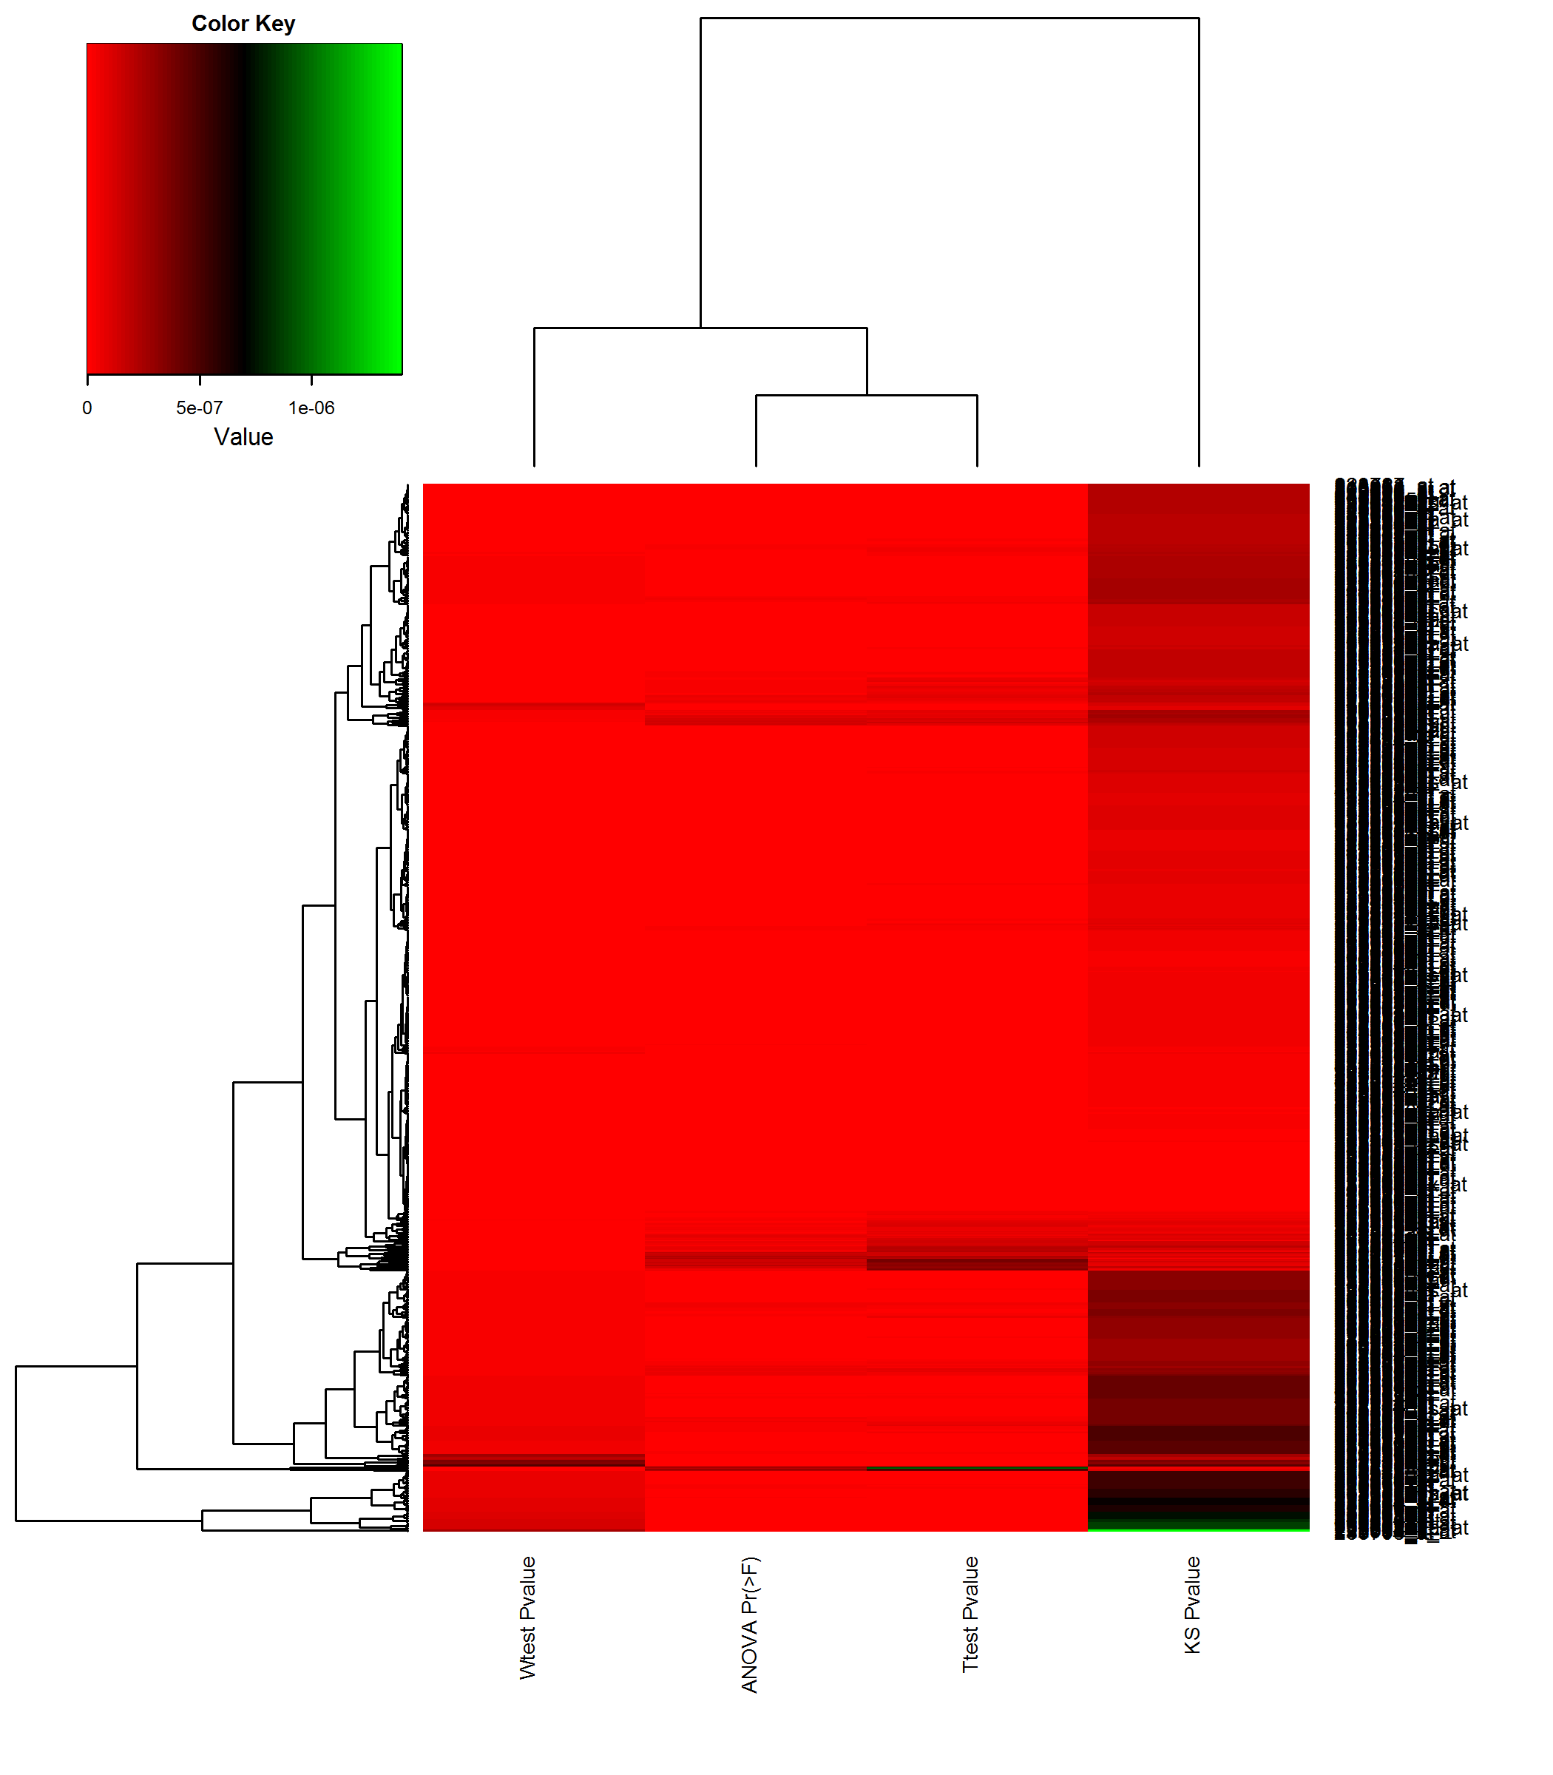
数据探索
Gene Expression Signatures in Breast Cancer
tTest and ANOVA have the similar effection, select the t Test for following data exploration.

Slide 8
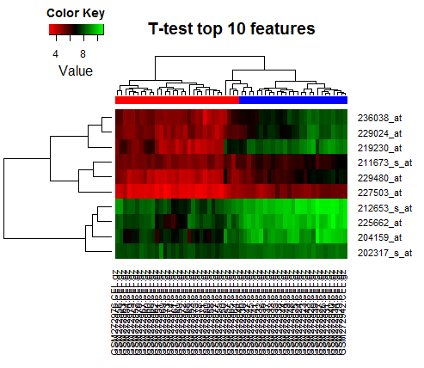
数据探索
Gene Expression Signatures in Breast Cancer
Top-10 features ranked by T-test. The heatmap shows that the two classes can be separated by the 10 features.

Slide 9
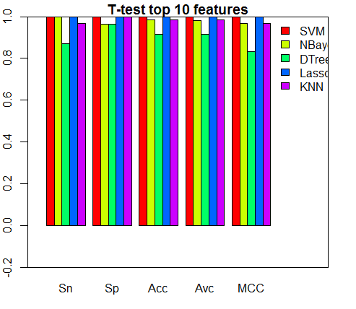
数据探索
Gene Expression Signatures in Breast Cancer
Top-10 features ranked by T-test are used to train the classifiers with very high accuracies.

Slide 10
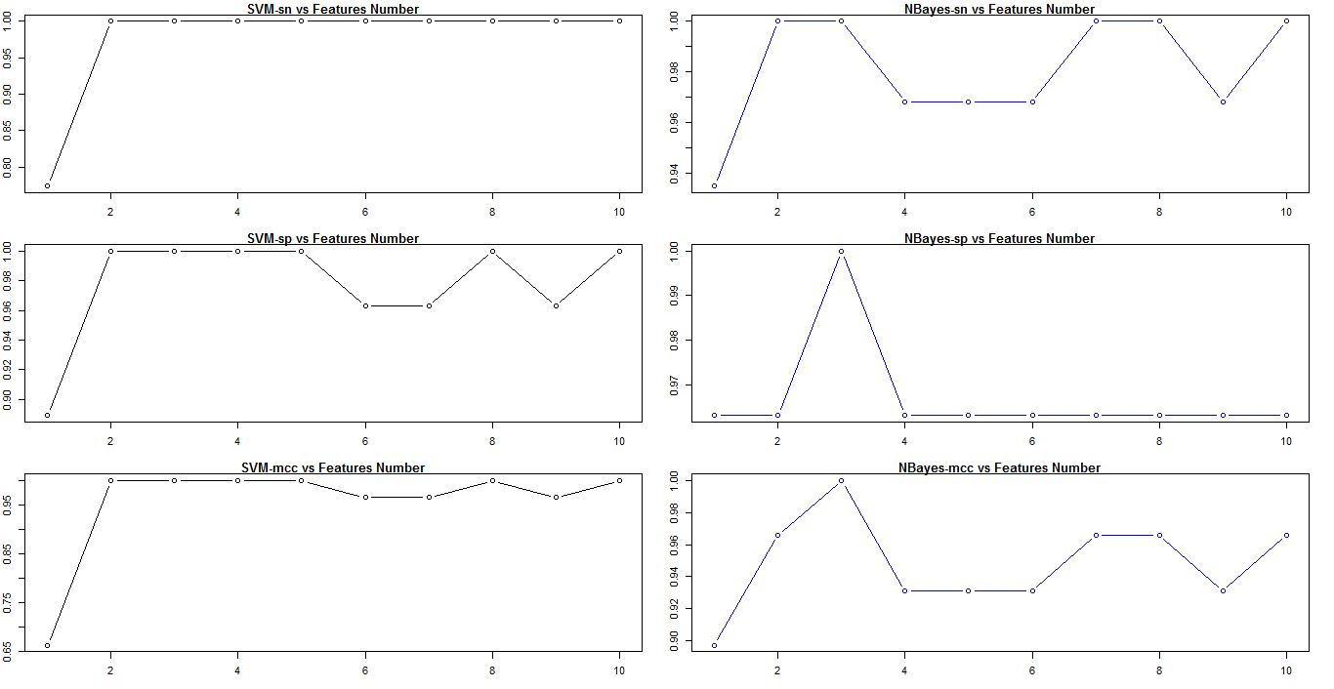
数据探索
Gene Expression Signatures in Breast Cancer
10 features is a proper size for SVM and NBayes

Slide 11
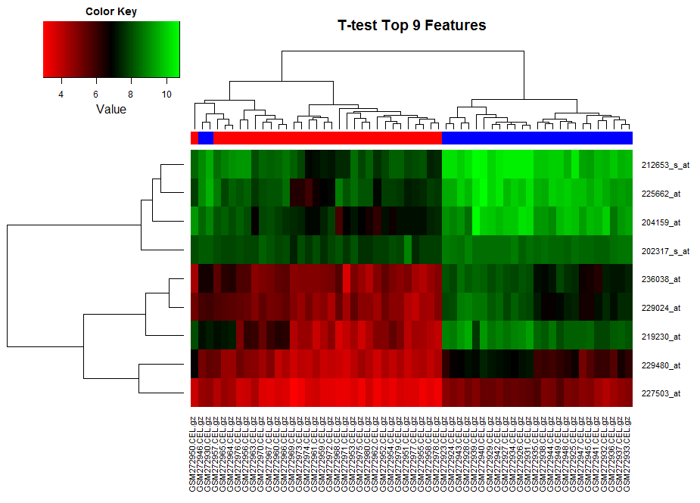
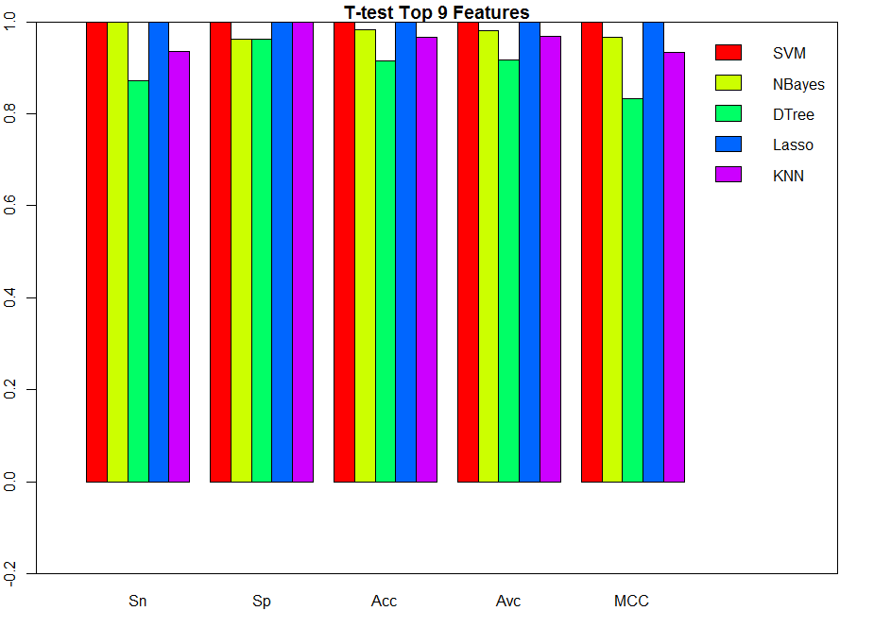
数据探索
Gene Expression Signatures in Breast Cancer
Top 9 feature will not distinguish the tumors and controls

Slide 12
疾病标志物检测

Slide 13
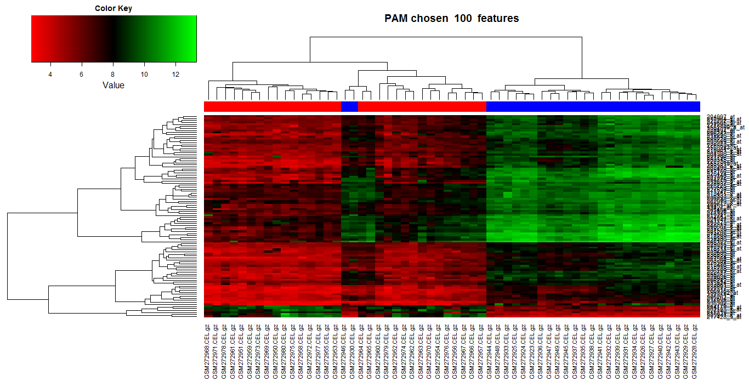
数据探索
Gene Expression Signatures in Breast Cancer
3 fold cross validation. Features are selected by PAM. Cutoff = 100

Slide 14
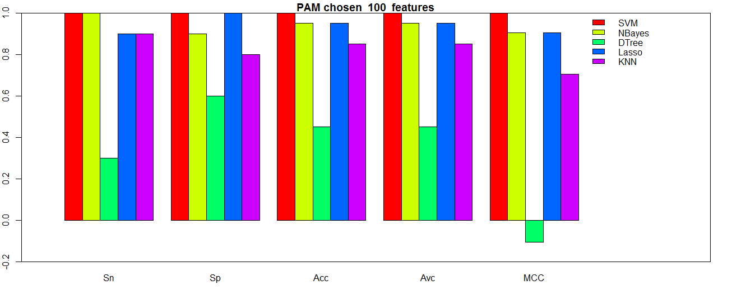
数据探索
Gene Expression Signatures in Breast Cancer
3 fold cross validation. Features are selected by PAM. Cutoff = 100

Slide 15
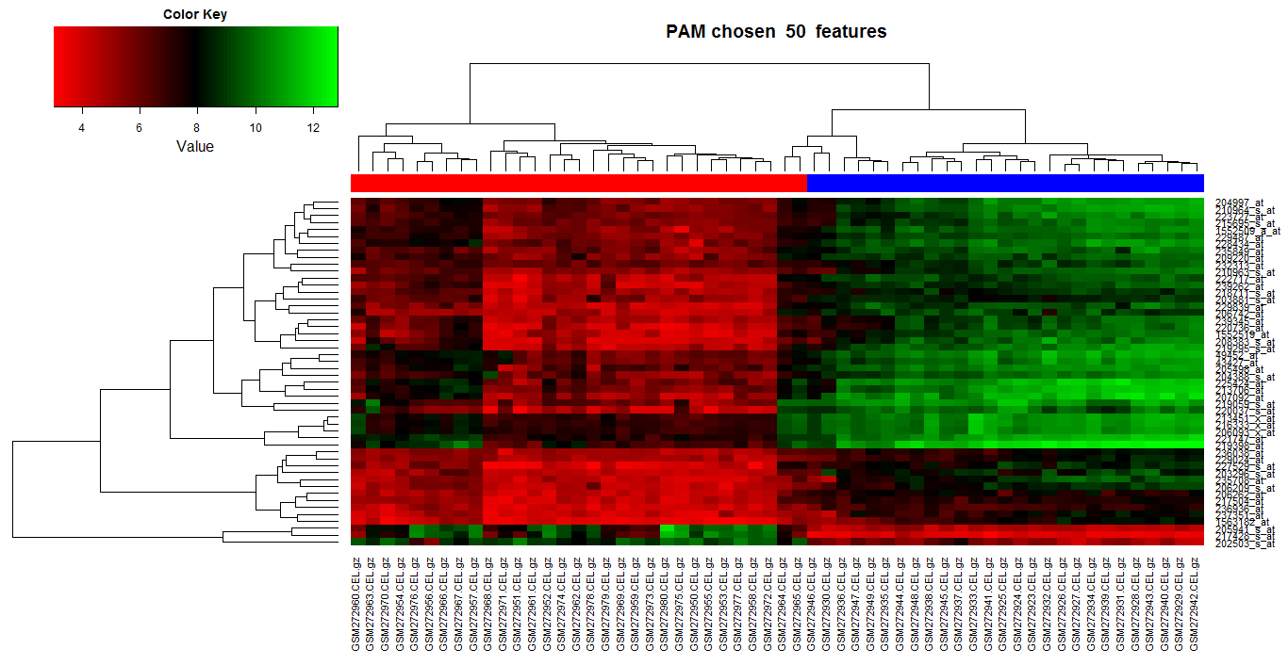
数据探索
Gene Expression Signatures in Breast Cancer
3 fold cross validation. Features are selected by PAM. Cutoff = 50

Slide 16
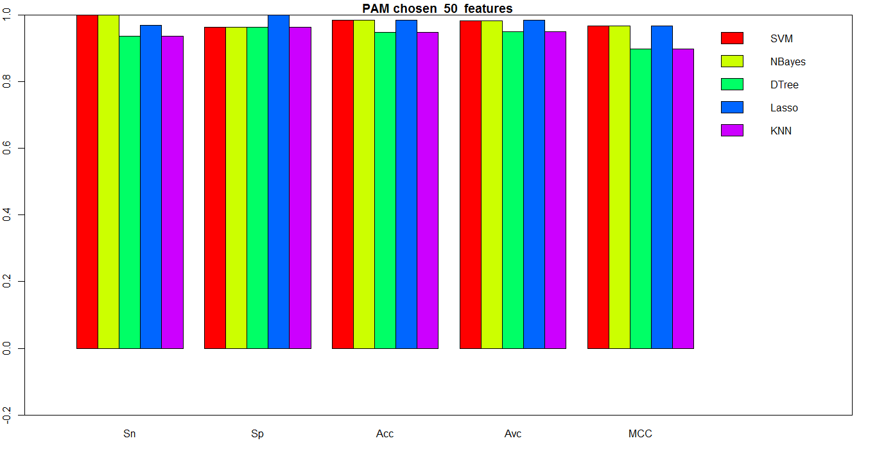
数据探索
Gene Expression Signatures in Breast Cancer
3 fold cross validation. Features are selected by PAM. Cutoff = 50

Slide 17
数据探索
Gene Expression Signatures in Breast Cancer
3 fold cross validation. Features are selected by RRF.
Only one feature ,Gen id : 229839_at
Can’t display a heatmap

Slide 18
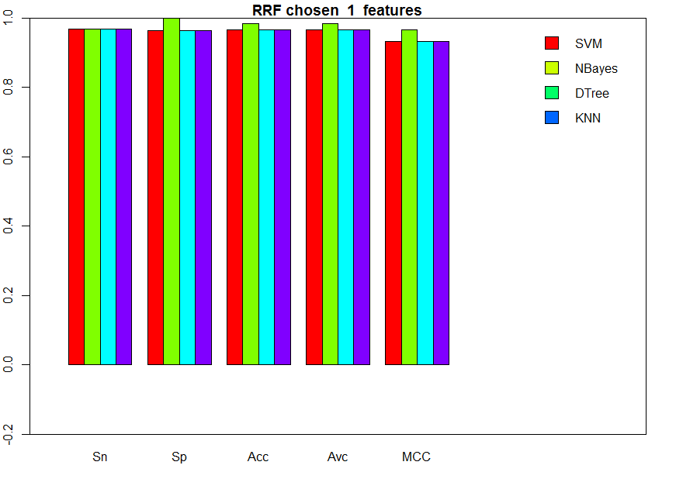
数据探索
Gene Expression Signatures in Breast Cancer
3 fold cross validation. Features are selected by RRF.

Slide 19
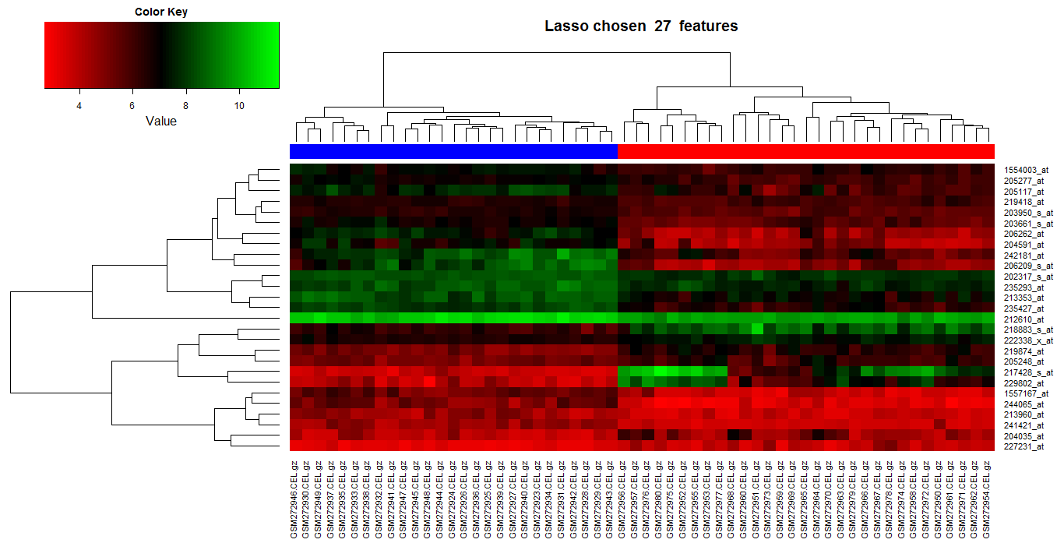
数据探索
Gene Expression Signatures in Breast Cancer
3 fold cross validation. 27 Features are selected by Lasso.

Slide 20
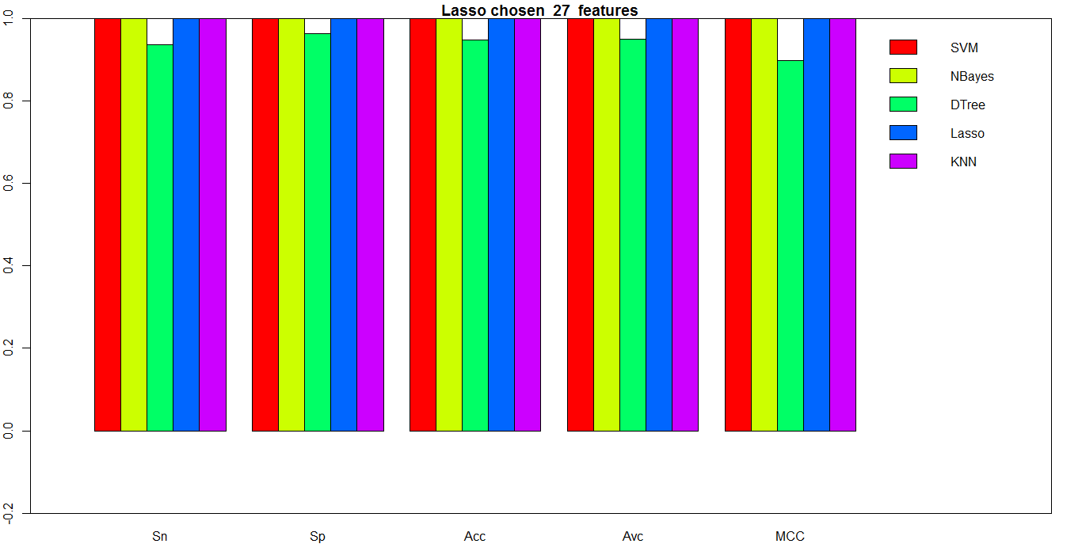
数据探索
Gene Expression Signatures in Breast Cancer
3 fold cross validation. Features are selected by Lasso.

Slide 21
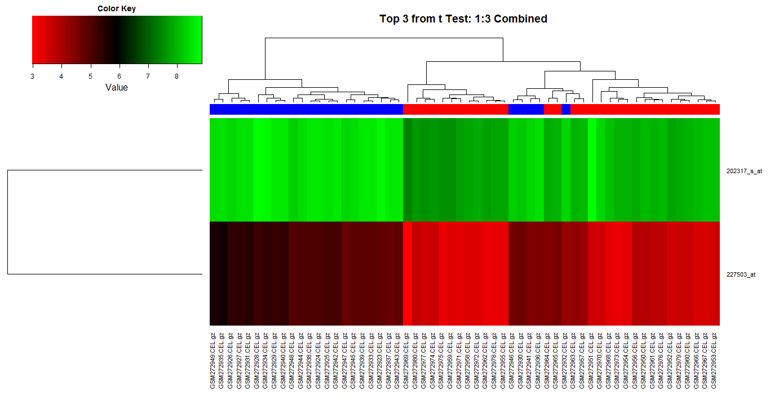
数据探索
Gene Expression Signatures in Breast Cancer
3 fold cross validation. Exhaustive search for the best feature pairs from the top 3 features from T-test. (Rank-3 + Rank-1)

Slide 22
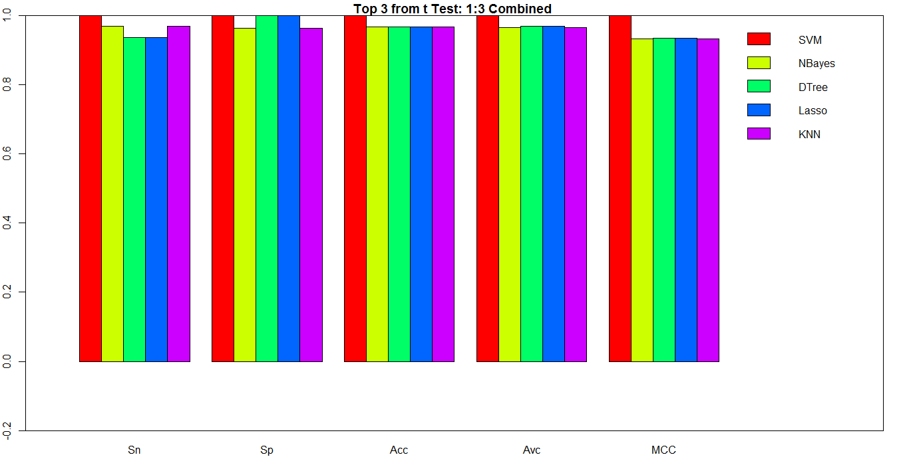
数据探索
Gene Expression Signatures in Breast Cancer
3 fold cross validation. Exhaustive search for the best feature pairs from the top 3 features from T-test. (Rank-3 + Rank-1)

Slide 23
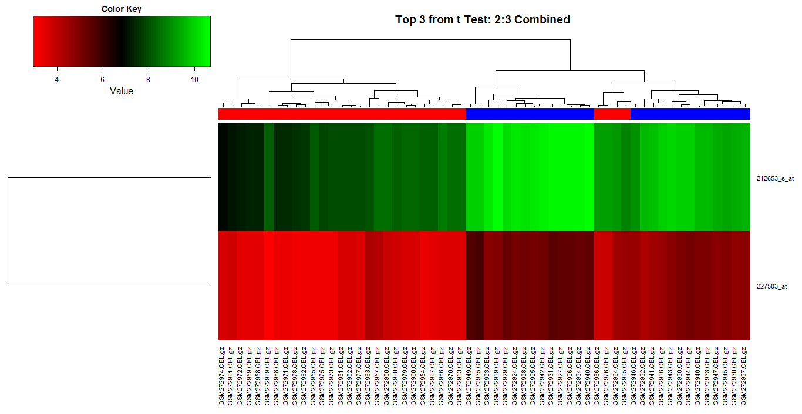
数据探索
Gene Expression Signatures in Breast Cancer
3 fold cross validation. Exhaustive search for the best feature pairs from the top 3 features from T-test. (Rank-3 + Rank-2)

Slide 24
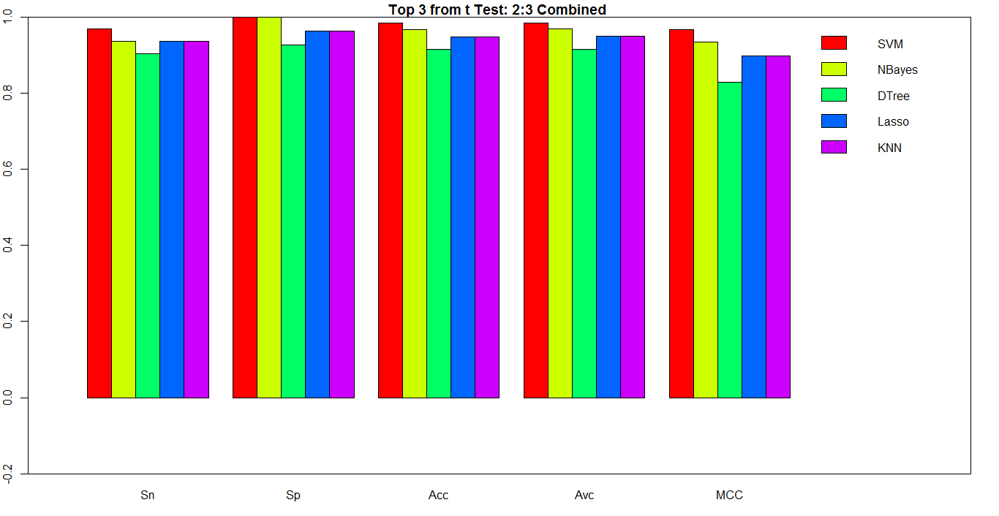
数据探索
Gene Expression Signatures in Breast Cancer
3 fold cross validation. Exhaustive search for the best feature pairs from the top 3 features from T-test. (Rank-3 + Rank-2)

Slide 25
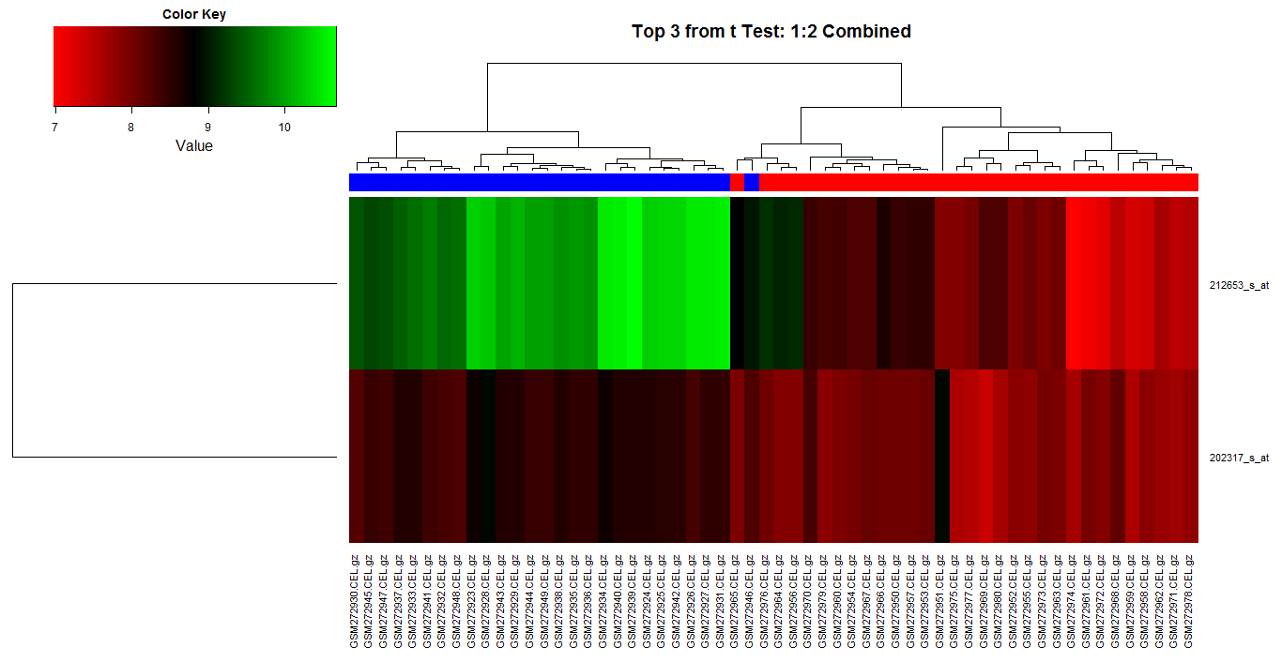
数据探索
Gene Expression Signatures in Breast Cancer
3 fold cross validation. Exhaustive search for the best feature pairs from the top 3 features from T-test. (Rank-2 + Rank-1)

Slide 26
数据探索
Gene Expression Signatures in Breast Cancer
3 fold cross validation. Exhaustive search for the best feature pairs from the top 3 features from T-test. (Rank-2 + Rank-1 is the best one)
Rank1 and Rank 2
212653_s_at
202317_s_at

Slide 27
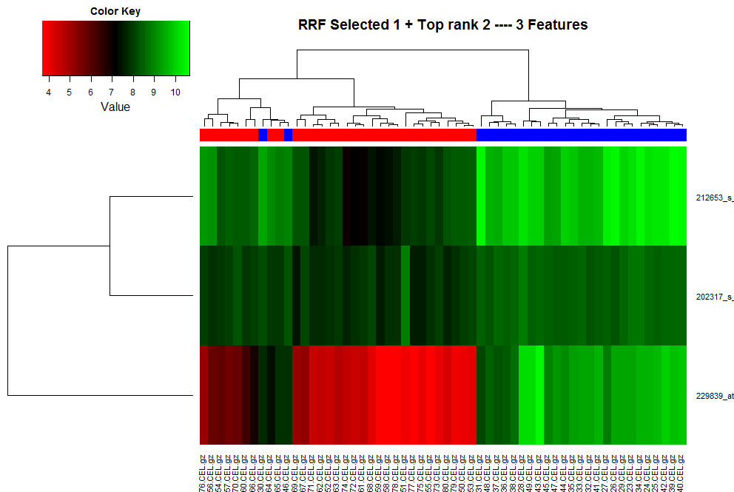
数据探索
Gene Expression Signatures in Breast Cancer
RRF Selected feature and (Rank-2 + Rank-1Combination)

Slide 28
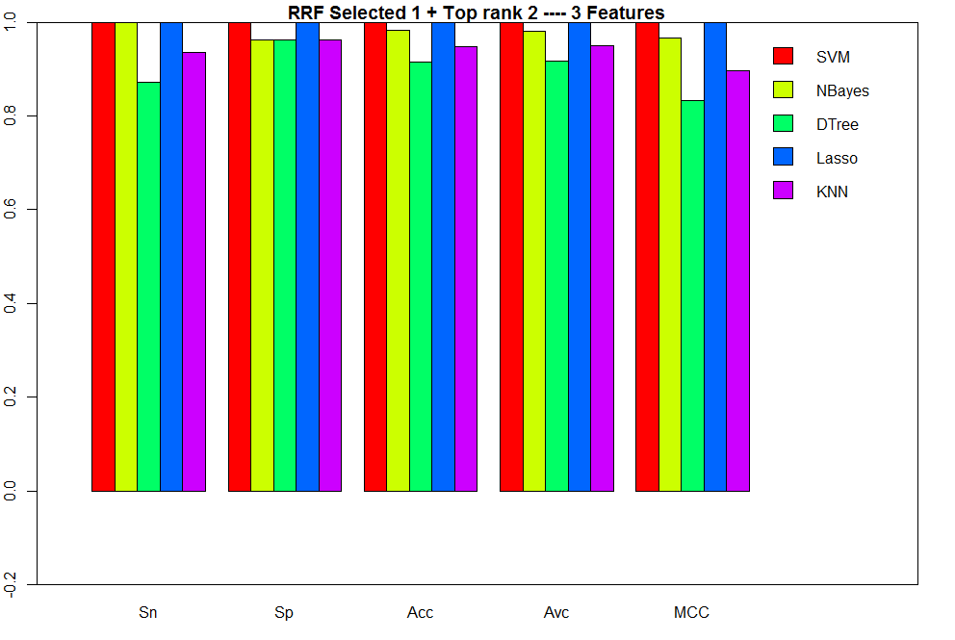
数据探索
Gene Expression Signatures in Breast Cancer
RRF Selected feature and (Rank-2 + Rank-1Combination)

Slide 29
生物功能分析

Slide 30
数据探索
Gene Expression Signatures in Breast Cancer
212653_s_at | EH domain binding protein 1 | Related Genes | Homo sapiens
INTERPRO | Calponin-like actin-binding,
OMIM_DISEASE | Common sequence variants on 2p15 and Xp11.22 confer susceptibility to prostate cancer, Prostate cancer, hereditary, 12,
SMART | CH,
SP_PIR_KEYWORDS | 3d-structure, alternative splicing, coiled coil, complete proteome, cytoplasm, membrane, phosphoprotein, polymorphism,
UP_SEQ_FEATURE | chain:EH domain-binding protein 1, compositionally biased region:Poly-Glu, domain:CH, helix, modified residue, sequence conflict, sequence variant, splice variant, strand, turn,

Slide 31
数据探索
Gene Expression Signatures in Breast Cancer
229839_at | scavenger receptor class A, member 5 (putative) | Related Genes | Homo sapiens
GOTERM_BP_FAT | transition metal ion transport, protein complex assembly, ion transport, cation transport, iron ion transport, cellular ion homeostasis, cellular iron ion homeostasis, endocytosis, response to temperature stimulus, response to heat, response to abiotic stimulus, membrane invagination, di-, tri-valent inorganic cation transport, membrane organization, vesicle-mediated transport, cellular homeostasis, metal ion transport, cellular cation homeostasis, cellular di-, tri-valent inorganic cation homeostasis, cellular response to stress, ion transmembrane transport, cellular response to heat, iron ion transmembrane transport, homeostatic process, macromolecular complex subunit organization, chemical homeostasis, ion homeostasis,protein oligomerization, protein homooligomerization, di-, tri-valent inorganic cation homeostasis, iron ion homeostasis,cation homeostasis, cellular chemical homeostasis, transmembrane transport, macromolecular complex assembly, protein trimerization, protein homotrimerization, protein complex biogenesis,
GOTERM_CC_FAT | plasma membrane, integral to plasma membrane, cell surface, integral to membrane, intrinsic to membrane, intrinsic to plasma membrane, plasma membrane part,
GOTERM_MF_FAT | scavenger receptor activity, iron ion binding, ion binding, cation binding, metal ion binding, transition metal ion binding,ferritin receptor activity,
INTERPRO | Speract/scavenger receptor, Collagen triple helix repeat, Speract/scavenger receptor related,
SMART | SR,
SP_PIR_KEYWORDS | alternative splicing, cell membrane, coiled coil, complete proteome, disulfide bond, glycoprotein, ion transport, iron, iron transport, membrane, polymorphism, receptor, Signal-anchor, transmembrane, transport,
UP_SEQ_FEATURE | chain:Scavenger receptor class A member 5, disulfide bond, domain:Collagen-like, domain:SRCR, glycosylation site:N-linked (GlcNAc...), sequence conflict, sequence variant, splice variant, topological domain:Cytoplasmic, topological domain:Extracellular, transmembrane region,

Slide 32
数据探索
Gene Expression Signatures in Breast Cancer
202317_s_at | ubiquitination factor E4B (UFD2 homolog, yeast) | Related Genes | Homo sapiens
GOTERM_BP_FAT | protein polyubiquitination, proteolysis, ubiquitin-dependent protein catabolic process, apoptosis, cell death, macromolecule catabolic process, response to radiation, response to UV, response to light stimulus, response to abiotic stimulus,programmed cell death, death, protein ubiquitination, modification-dependent protein catabolic process, protein catabolic process, protein modification by small protein conjugation, protein ubiquitination during ubiquitin-dependent protein catabolic process, modification-dependent macromolecule catabolic process, cellular protein catabolic process, cellular macromolecule catabolic process, proteolysis involved in cellular protein catabolic process, protein modification by small protein conjugation or removal,
GOTERM_CC_FAT | ubiquitin ligase complex,
GOTERM_MF_FAT | ubiquitin-protein ligase activity, ligase activity, forming carbon-nitrogen bonds, acid-amino acid ligase activity, small conjugating protein ligase activity, enzyme binding, ubiquitin-ubiquitin ligase activity,
INTERPRO | U box domain, Ubiquitin conjugation factor E4, core,
KEGG_PATHWAY | Ubiquitin mediated proteolysis,
PIR_SUPERFAMILY | PIRSF017105:ubiquitin conjugation factor E4 with U-box domain, Ufd2 type,
SMART | Ubox,
SP_PIR_KEYWORDS | 3d-structure, alternative splicing, complete proteome, cytoplasm, phosphoprotein, polymorphism, ubl conjugation pathway,
UP_SEQ_FEATURE | chain:Ubiquitin conjugation factor E4 B, domain:U-box, modified residue, mutagenesis site, sequence variant, site:Cleavage; by caspase-3 and caspase-7, site:Cleavage; by caspase-6 and granzyme B, splice variant,

Slide 33
分类性能比较

Slide 34
数据探索
Gene Expression Signatures in Breast Cancer
Pedraza, V., J. A. Gomez-Capilla, et al. (2010). "Gene Expression Signatures in Breast Cancer Distinguish Phenotype Characteristics, Histologic Subtypes, and Tumor Invasiveness." Cancer 116(2): 486-496.
http://www.ncbi.nlm.nih.gov/pubmed/20029976

Slide 35
数据探索
Gene Expression Signatures in Breast Cancer
Abstract
BACKGROUND: The development of reliable gene expression profiling technology is having an increasing impact on the understanding of breast cancer biology.
METHODS: In this study, microarray analysis was performed to establish gene signatures for different breast cancer phenotypes, to determine differentially expressed gene sequences at different stages of the disease, and to identify sequences with biologic significance for tumor progression. Samples were taken from patients before their treatment. After microarray analysis, the expression level of 153 selected genes was studied by real-time quantitative polymerase chain reaction analysis.
RESULTS: Several gene sequences were expressed differentially in tumor samples versus control samples and also were associated with different breast cancer phenotypes, estrogen receptor status, tumor histology, and grade of tumor differentiation. In lymph node-negative tumors were identified a set of genes related to tumor differentiation grade.
CONCLUSIONS: Several differentially expressed gene sequences were identified at different stages of breast cancer.

Slide 36
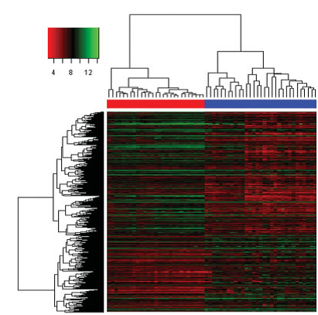

数据探索
Gene Expression Signatures in Breast Cancer

Slide 37
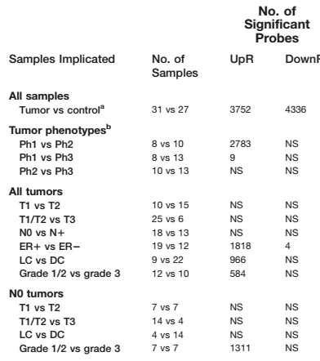

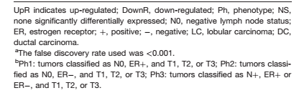
数据探索
Gene Expression Signatures in Breast Cancer

Slide 38
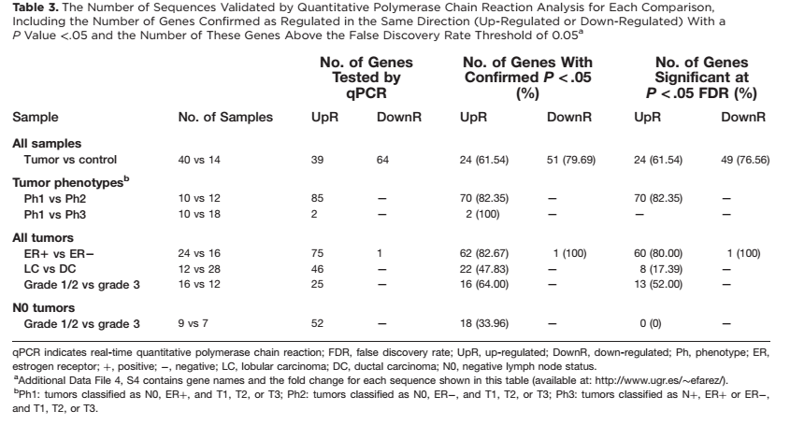
数据探索
Gene Expression Signatures in Breast Cancer

Slide 39
Thanks! Any questions?

