Slide 1

New Delhi: A New City to Extend The Café Business

Slide 2
Introduction
New Delhi is the capital city of India. It is a part of the city of Delhi’s 11 districts. The city itself has a population of 257,803. However, the much larger metro area has a population that exceeds 26 million.
With it’s diverse culture , comes diverse food items. We all know that Indians love spicy foods but how do they accept the western food? How much they like the most common drink in western countries, like coffee? Thus, as part of this project , we will list and visualise all major parts of New Delhi City.

Slide 3
Objectives
Questions that can be asked using the above mentioned datasets
What is the best location in New Delhi City for a Cafe ?
Which areas have large number of Cafe Market ?
Which areas have less number of restaurants ?
Which is the best place to stay if I prefer to drink a good cup of Coffee ?
What places are have the best restaurants in New Delhi?

Slide 4
Data
For this project we need the following data :
New Delhi Restaurants data that contains list Locality, Restaurant name, Rating along with their latitude and longitude.
Data source : Zomato kaggel dataset
Description : This data set contains the required information. And we will use this data set to explore various locality of new delhi city.
Nearby places in each locality of new delhi city.
Data source : Fousquare API
Description : By using this api we will get all the venues in each neighborhood.

Slide 5
Approach
Collect the new delhi city data from Zomato kaggel dataset
Using FourSquare API we will find all venues for each neighborhood.
Filter out all venues that are nearby by locality.
Using aggregative rating for each resturant to find the best places.
Visualize the Ranking of neighborhoods using folium library(python)

Slide 6
Results

Slide 7
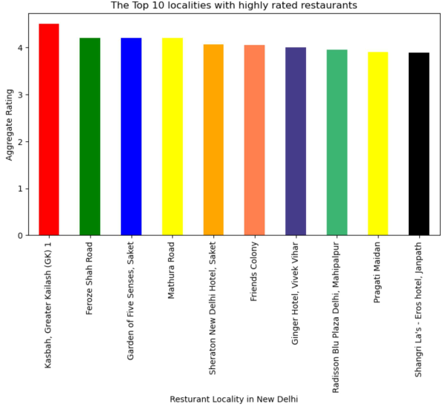
The best restaurants are available in Kasbah and Greater Kailash area.

Slide 8
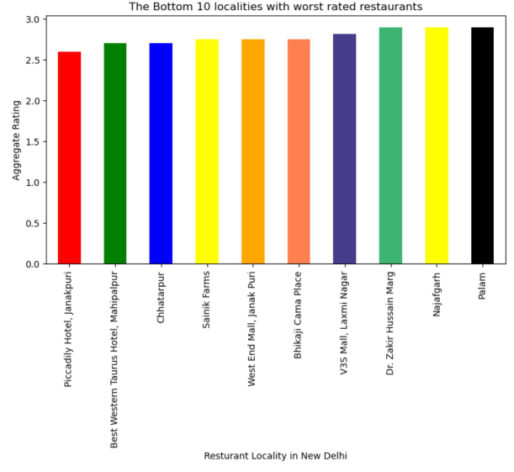
The worst restaurants are in Piccadily Hotel and Janakpuri area.

Slide 9
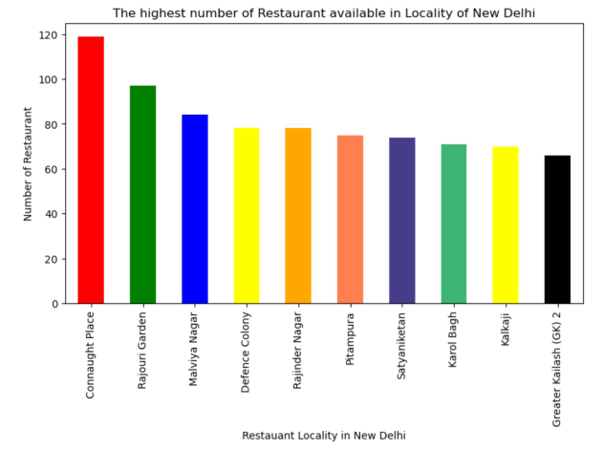
Connaught Place is the best area to attract people to stay and eat in restaurants.

Slide 10
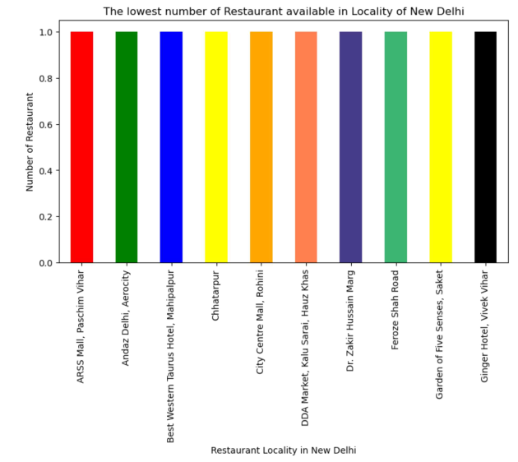
ARSS Mall, Paschim is the area has least restaurants.

Slide 11
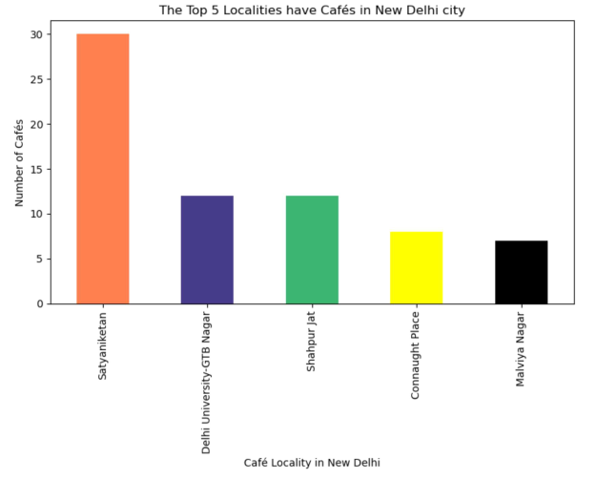

Slide 12
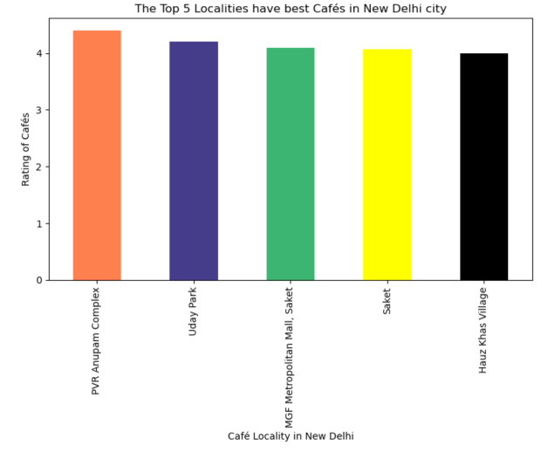

Slide 13

Popularity of Café in New Delhi:
Although Indian people prefer spicy food, their interest in western food is noticeable. Among the 283 localities, Café is listed in the Top 5 most common venues in 68 localities. The percentage is 28.56%.

Slide 14
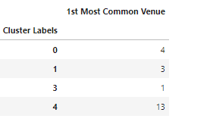
Cluster Examines:
According to my analysis, people live in 21 localities out of 283 choose Café as the most preferable venue. 13 of the 21 localities are in the Cluster 5. The Cluster 1 to 4 respectively has 4, 3, 0 and 1 localities where people prefer Café as the most common venue.
After examining the clusters, we will analyse further for the Cluster 5 area.

Slide 15

Cluster 5:
In the Cluster 5 area, Café is very popular : 55.56% localities have Cafés as the Top 5 most common venues.

Slide 16
Conclusion
According to the observation generated by the data, we can conclude points as follows:
1. According to the Clusters examines, we can say that the popularity of Café is noticeable and it has a very good market in the particular area: Cluster 5.
2. The Cafe can open at areas that have the best restaurants, such as Kasbah and Greater Kailash.
3. Or at the best area to attract people to stay and eat, such as Connaught.
4. Or at PVR Anupam Complex where has the best Cafe of New Delhi.
5. Or at Satyaniketan where has the most Cafes in New Delhi.
6. However, there are some areas that we shall avoid too, such as Piccadily Hotel and Janakpuri, because of the bad score of local restaurants.

