Slide 1
Graphs

Slide 2
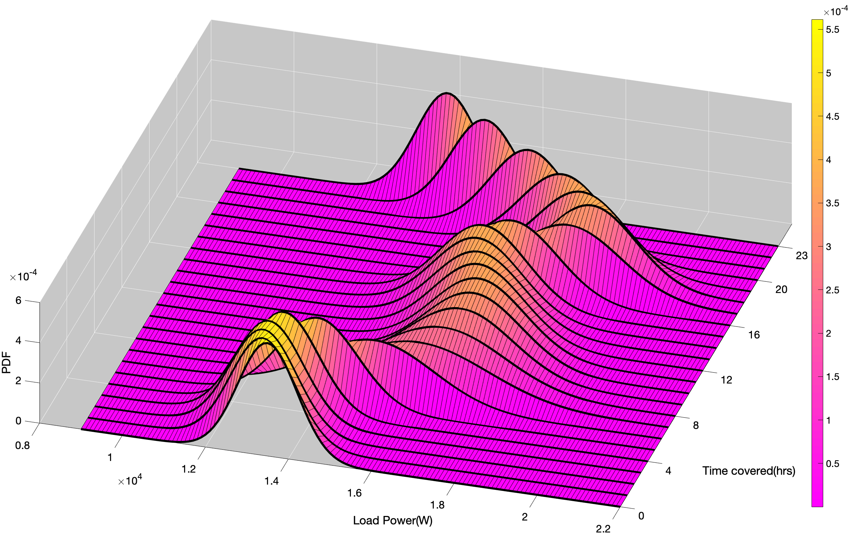
Load pdf Profile

Slide 3
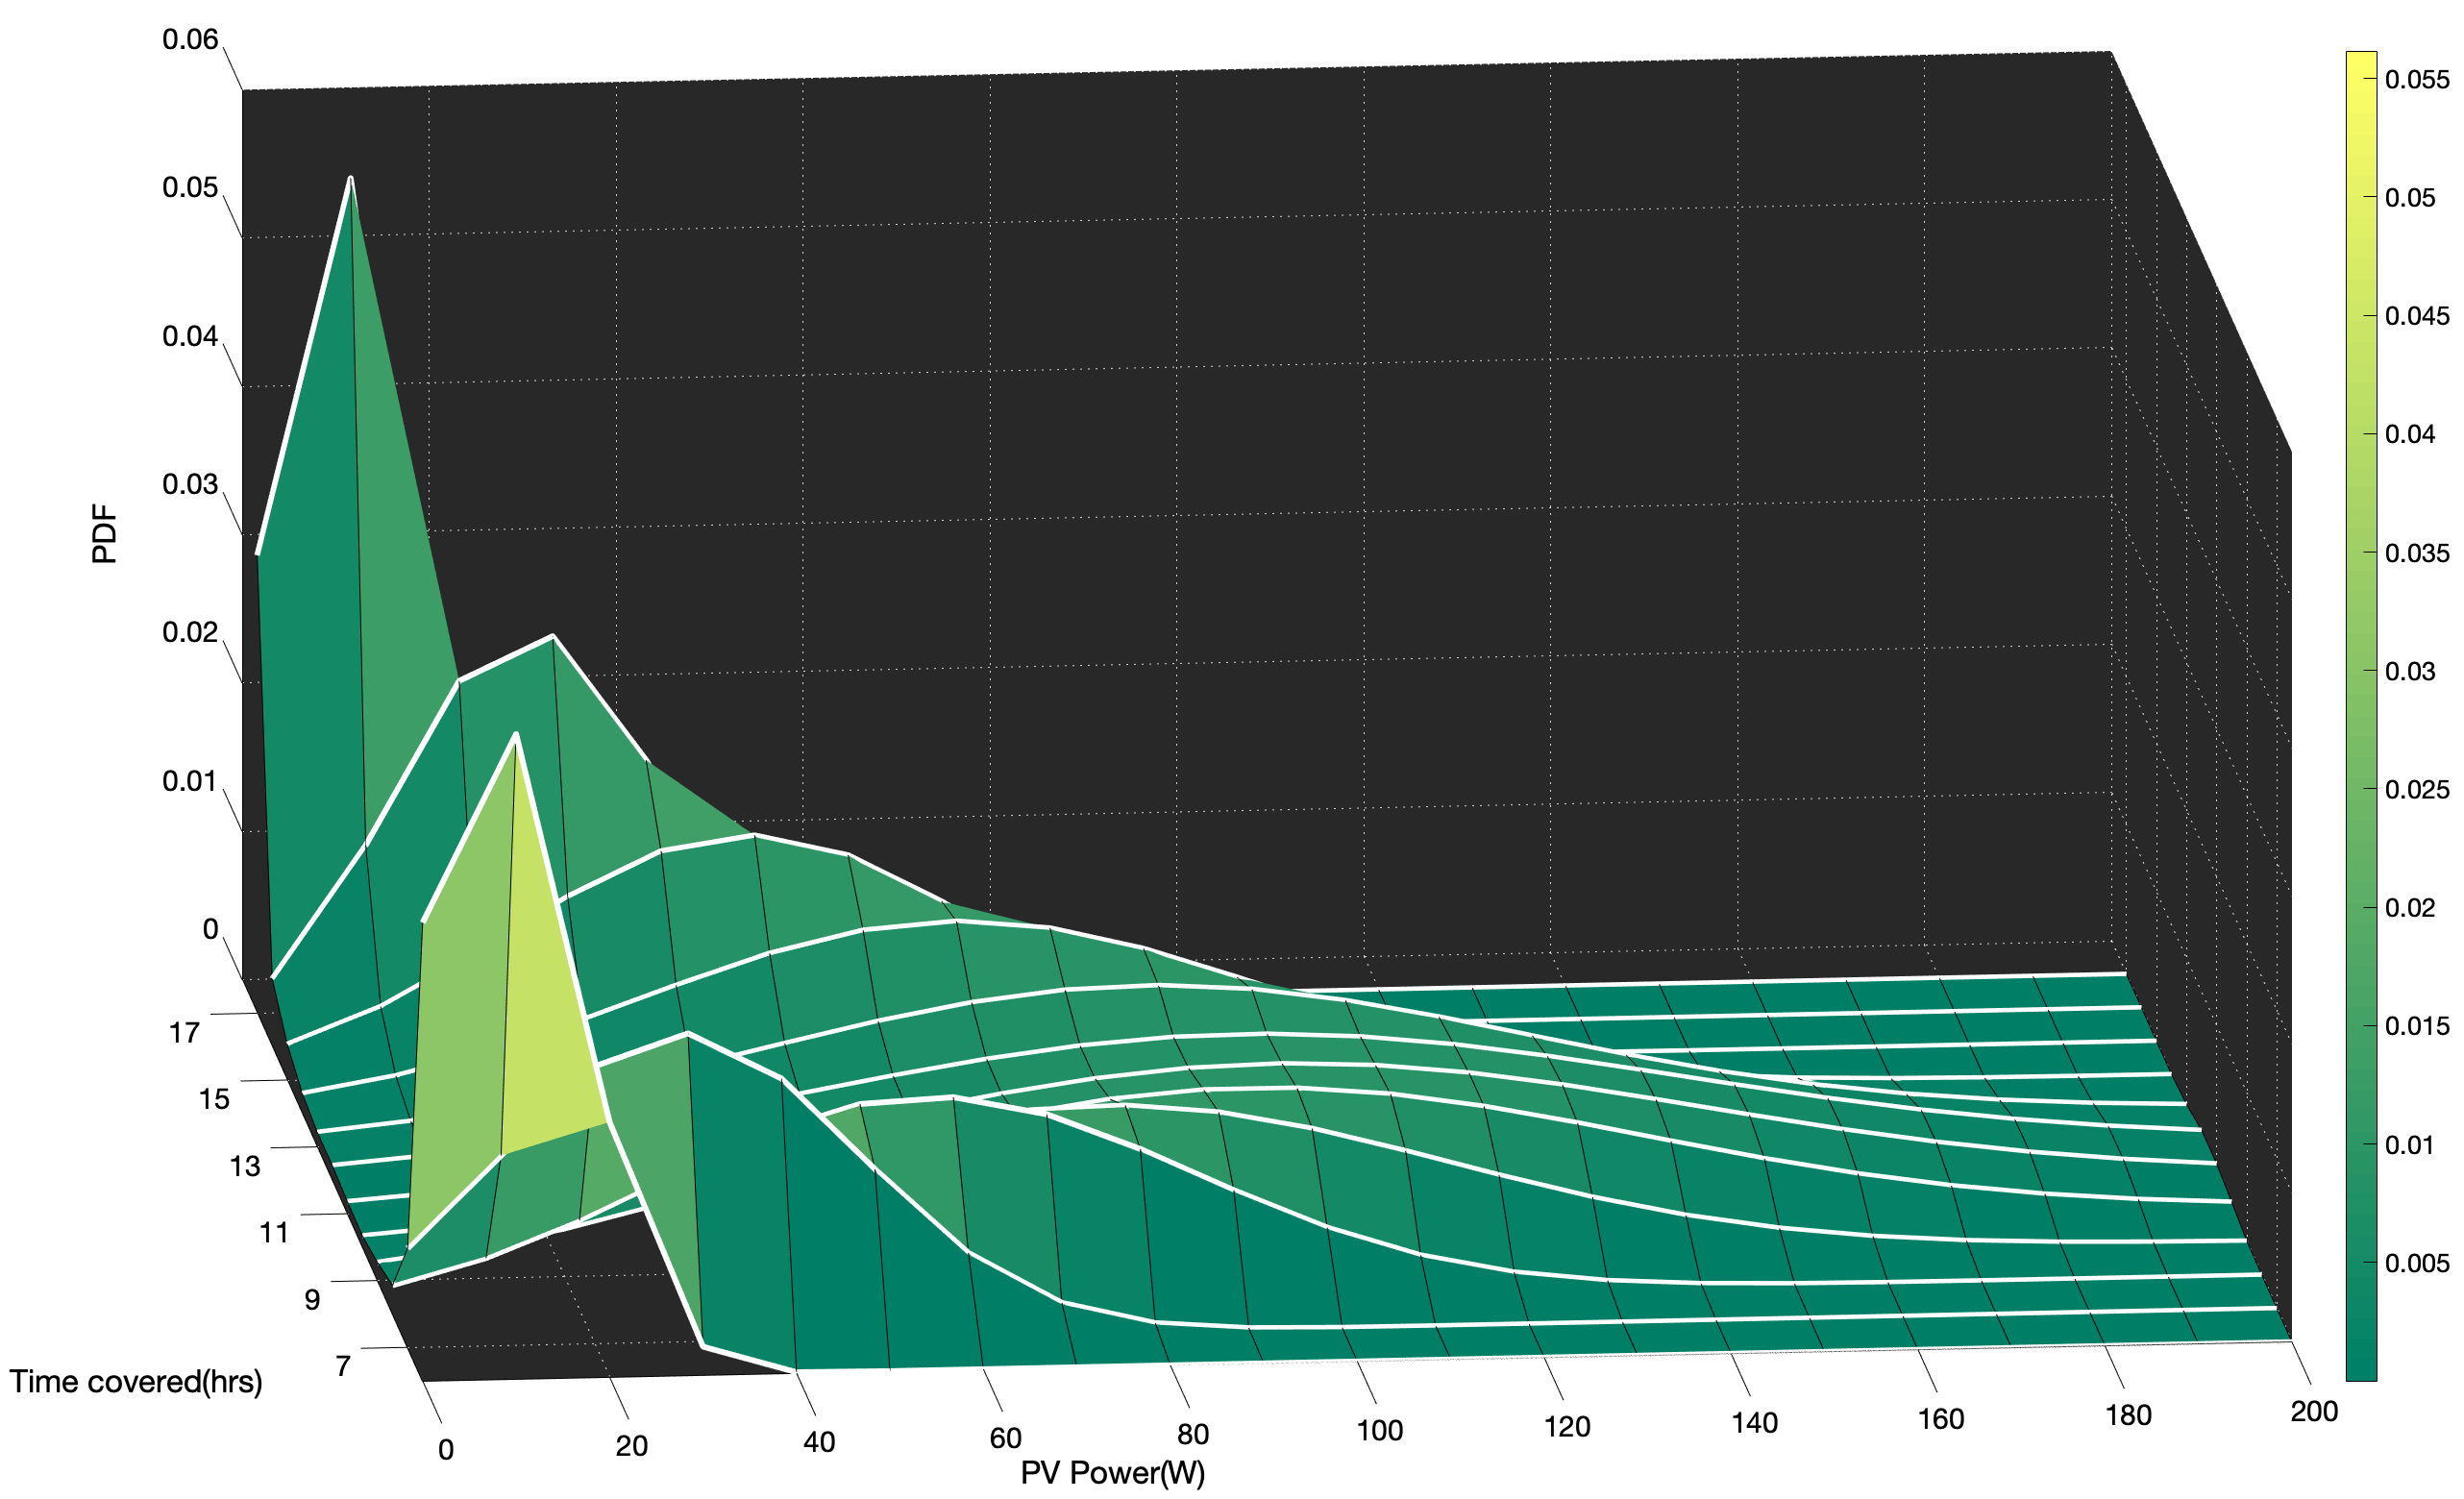
PV pdf profile

