Slide 1
Optimization Approaches

Slide 2
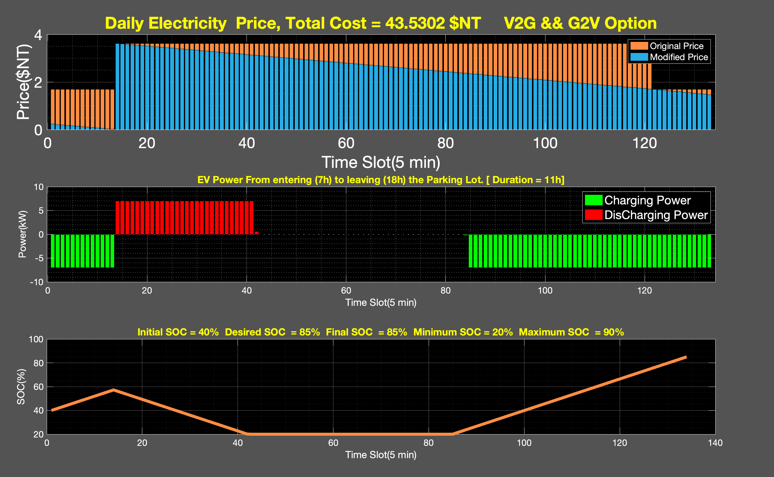


Double Linear Programing
Charging cost = 43.53NT
Discharged power = 196.6 kW
Equivalent energy =196.6$×\frac{5}{60}=16.38$kWh
BDC = 4.1USD/24kWh = 128.32NT/24kWh
BDC for discharging = $\frac{128.32×28.61}{24}=87.5NT$
linprog(f,A,b,Aeq,beq,lb,ub)
f: Price
A&b : SOC max, min
Charge only: Aeq&beq = SOC desired
ESS-charge :lb = -7; ub = 0
7h
ESS
14h
Charging Only
18h
ESS-discharge :lb = 0; ub = 7
BDC to be compared with Single Linear Programing Approach

Slide 3
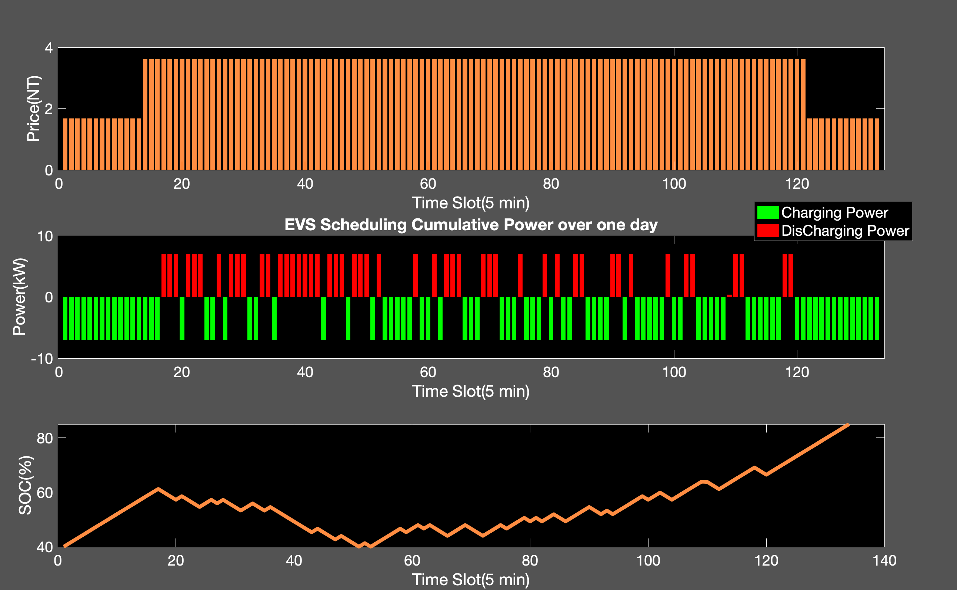


Single Linear Programing
Charging cost = 43.53NT
Discharged power = 343.4kW
Equivalent energy = $343.4×\frac{5}{60}=28.61$kWh
BDC = 4.1USD/24kWh = 128.32 NT/24kWh
BDC for discharging = $\frac{128.32×28.61}{24}=153NT$
linprog(f,A,b,Aeq,beq,lb,ub)
f: Price
A&b : SOC max, min
Aeq&beq = SOC desired
Higher BDC from aggregator point of view
lb = -7; ub = 7
Quick battery replacement from user point of view

