Slide 1
LAN and WAN
Local Area Network (LAN)
  Small network, short distance
    A room, a floor, a building
    Limited by no. of computers and distance covered
    Usually one kind of technology throughout the LAN
  Examples:
    Network inside the Student Computer Room
    Network inside your home

Slide 2
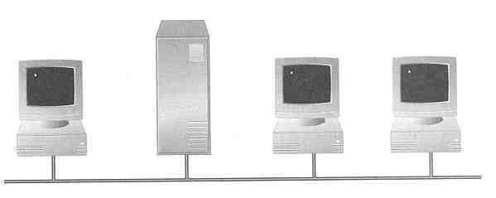
Wide Area Network (WAN)
  A network that uses long-range telecommunication links to connect 2 or more LANs/computers housed in different places far apart.
    Towns, states, countries
  Examples:
    Network of our Campus
    Internet
Your home
WAN
USA
Student Computer Centre

Slide 3
Example WAN technologies:
  ISDN – Integrated Service Digital Network
    Basic rate: 192 Kbps Primary rate: 1.544Mbps
  T-Carriers ― basically digital phone lines
    T1: 1.544Mbps T3: 28×T1
  Frame relay
    Each link offers 1.544Mbps or even higher
  ATM – Asynchronous Transfer Mode
    Support B-ISDN: 155Mbps or 622Mbps or higher
  SONET – Synchronous Optical Network
    Basic rate OC1: 51.84Mbps
    Support OC12 and up to OC192 (9953.28Mbps) or even higher in the future

Slide 4
Example of WAN: Broadband Cable Network
Cable TV services have been extensively developed in most modern cities
Cable TV companies try to make use of their coaxial cable installed (that are supposed to carry TV signals) to deliver broadband data services
Many cable network wiring has been replaced with hybrid fiber-coax (HFC) ― i.e. use of fiber-optic cable to connect to the subscribers’ buildings, and then the original coaxial cable to connect to each household

Slide 5

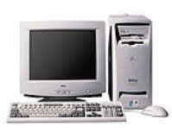
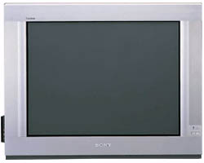
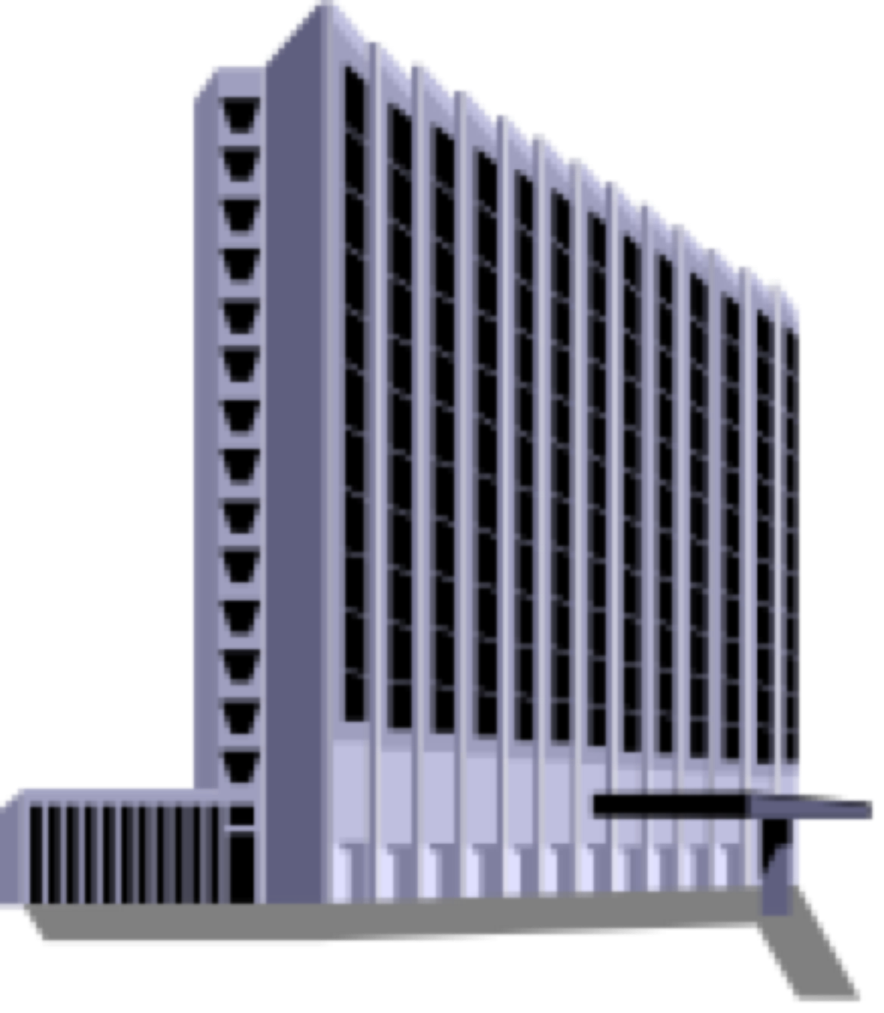
The connection is shared by a number of subscribers, hence may raise performance and security problems
PC
TV
Fiber-optic cable
Cable Drop
Coaxial
Cable
Cable company

Slide 6

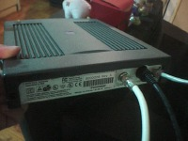
Cable is an asymmetrical technology
  Downstream: max 36 Mbps
  Upstream: max 10 Mbps
May be reduced to 3 – 10 Mbps downstream and 2 Mbps upstream, depending on no. of subscribers
Need a special cable modem
Ethernet
link to PC
Teryon Cable Modem
Coaxial link
from cable TV
socket

Slide 7
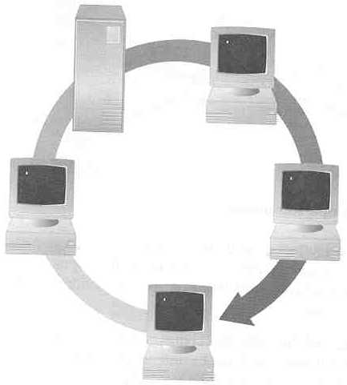
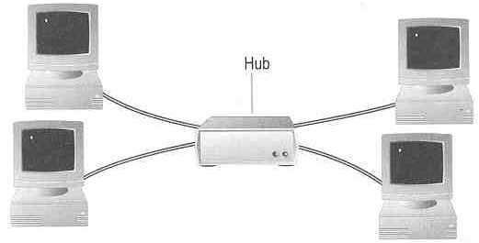
Topology ― 3 basic types
How so many computers are connected together?
  Bus Topology Ring Topology
  Star Topology
Hub

Slide 8
  Bus Topology
    Simple and low-cost
    A single cable called a trunk (backbone, segment)
    Only one computer can send messages at a time
    Passive topology - computer only listen for, not regenerate data
  Star Topology
    Each computer has a cable connected to a single point
    More cabling, hence higher cost
    All signals transmission through the hub; if down, entire network down
    Depending on the intelligence of hub, two or more computers may send message at the same time

Slide 9
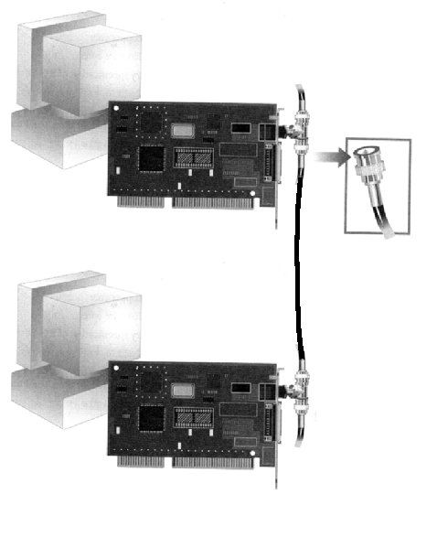
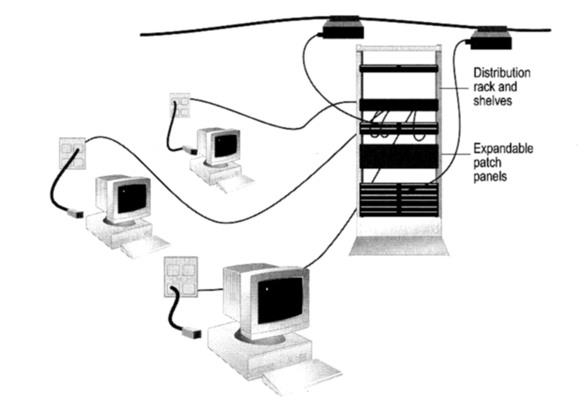
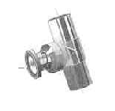
How to construct a network with Bus / Star Topology?
  Bus Topology
Coaxial cable
  Star Topology
BNC T-Connector
Network Card

Slide 10
Ring Topology
  Every computer serves as
  a repeater to boost signals
  Typical way to send data:
    Token passing
      only the computer who
      gets the token can send
      data
  Disadvantages
    Difficult to add computers
    More expensive
    If one computer fails, whole network fails
Ack
T
T
T
T
T
data
data
data
data
T
data
T
T
T
Ack
T
T
data
Ack
T
T
Ack

