Slide 1
Group 6 Project
Kevin Chen Xiaojie (E0385016)
Zou Xuan (E0384799)
Kunal Jadhav (E0385000)
Nurdin Effendi (E0384876)

Slide 2
Agenda
Overview
Logical Architecture
Physical Architecture
Implementation Experience
Demo

Slide 3
Overview - About Sponsor
Fruits Vending Pte Ltd is a premium smart vending machines manufacturer and operator in Singapore.
They specialize in providing freshly squeezed orange juice vending services through ubiquitous vending machine.

Slide 4
Overview - Business problem to achieve
Establish a membership system in fulfilling the following requirements:
Recognize Customers and Get Their Feedback
Reward Royal Customers
Reduce Cash Payment and Promote “QR Code” Cashless Payment
Scalability and Ability to Replicate the Business to Other Companies with same requirements easily

Slide 5
Agenda
Overview
Logical Architecture
Physical Architecture
Implementation Experience
Demo

Slide 6
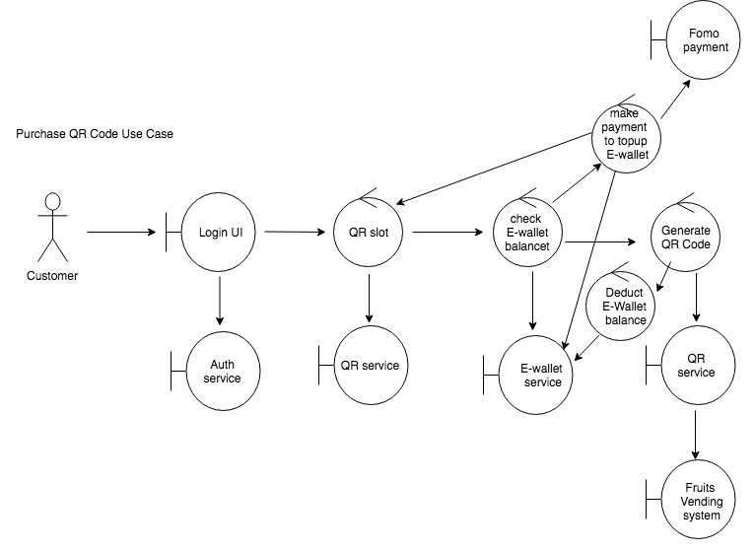
Logical Architecture – Outline Functional components Purchase QR Code Use Case

Slide 7
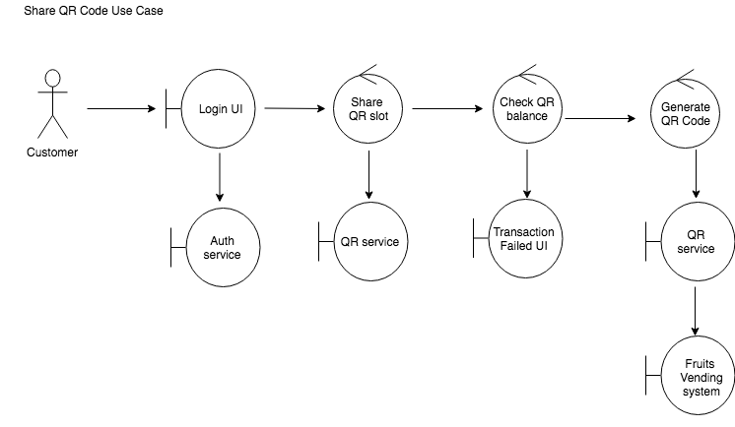
Logical Architecture – Outline Functional components Share QR Code Use Case

Slide 8
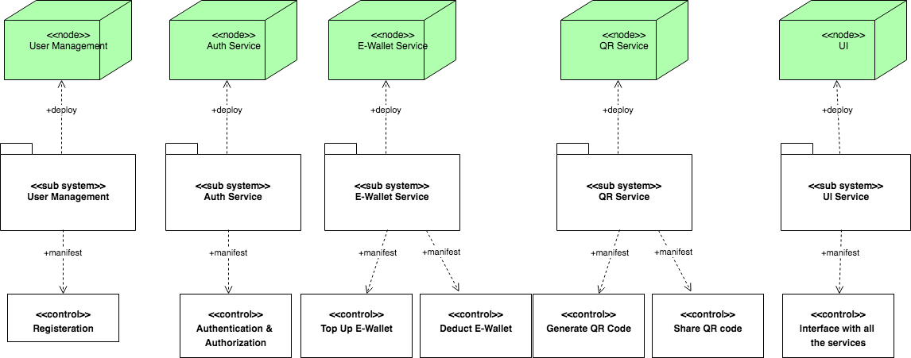
Logical Architecture-Detail deployment components

Slide 9
Agenda
Overview
Logical Architecture
Physical Architecture
Implementation Experience
Demo

Slide 10
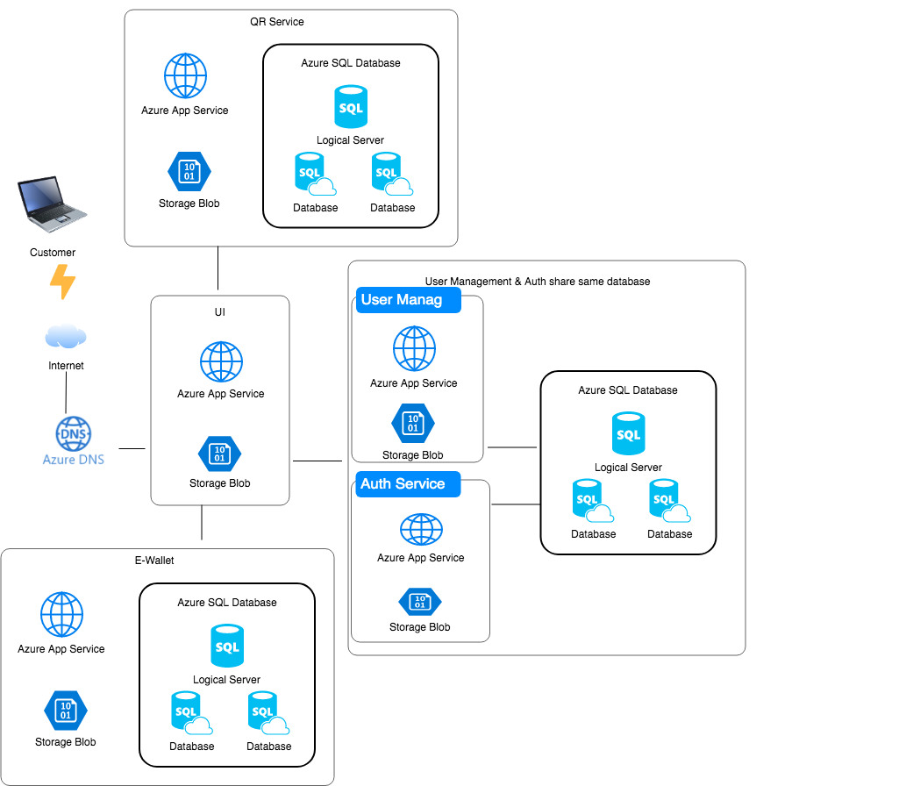
Physical Architecture

Slide 11
Agenda
Overview
Logical Architecture
Physical Architecture
Implementation Experience
Demo

Slide 12
Implementation Experience
1.Swagger
2.

