Slide 1
Compilers:
Principles, Techniques, and Tools
Xiaofang Qi 戚晓芳
xfqi@seu.edu.cn
Room 420, Building of College of Computer Science & Engineering

Slide 2
References
[1] Compilers: Principles, Techniques, and
Tools. A.V Aho,Ravi Sethi, J.D Ullman.人
民邮电出版社,2002
(中译本：编译原理，李建中、姜守旭，
机械工业出版社，2003)
[2] 编译原理及编译程序构造.秦振松.东南大
学出版社,1997
[3] 程序设计语言编译原理.陈火旺.国防工业
出版社,2000

Slide 3
Why to Study Compilers

Slide 4
Essential Software Tool
Help to understand the internal process of program execution.
  To design more efficient programs
  Error detection and Debugging
Better Grip of Programming Languages
Design and Application of Domain-specific Languages

Slide 5
Excellent Software Example
Many algorithms and models used in compilers are fundamental, and will be useful elsewhere:
  automata, regular expressions (lexing)
  context-free grammars, trees (parsing)
  hash tables (symbol table)

Slide 6
Useful in Software Engineering
Software development
coding, testing, maintenance
software productivity tools
data flow analysis: error detection, model checking, memory leak, array bounds,
alias/pointer analysis
instrumentation: testing, debugging

Slide 7
Conclusion
The ideas behind principles and techniques of a compiler writing can be used many times in the career of a computer scientist.

Slide 8
How to learn the course?
Reading the book
More exercises , more practice
Discuss with classmates

Slide 9
Grading
Exercises – 10%
Experiments – 20%
2 experiments
Final examination –70%

Slide 10

联系方式
课程QQ群： 442088094，
编译原理2021
My QQ：1741482258
Email：xfqi@seu.edu.cn
Phone:13770789960

Slide 11
1 Introduction to Compiling

Slide 12
compiling
Lexical & Syntax Analysis
Source Code
Syntax Tree
Syntax-directed Translation
Intermediated Code
Target Code Generation
Optimization
Assembling Code
Optimized Code
Assembler
Binary Code
Executable Code
OS
Linking
DLL

Slide 13
Compiler
a program
Input: “that reads a program written in one language – the source language”
Process: “and translates it”
Output: “into an equivalent program in another language – the target language.”

Slide 14
Compiler
Translate in a whole with optimization and Execute
Source
program
target
program
compiler
error message
input
Target program
output

Slide 15
Interpreter
source program
Interpreter
output
input
Translate and Execute by Statement without optimization

Slide 16
Compiler vs Intepreter
faster portable
Optimization easier to debug

Slide 17
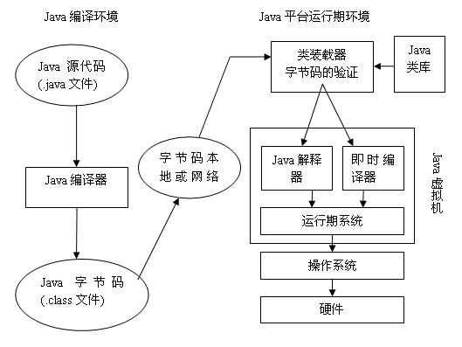
A Hybrid Compiler

Slide 18
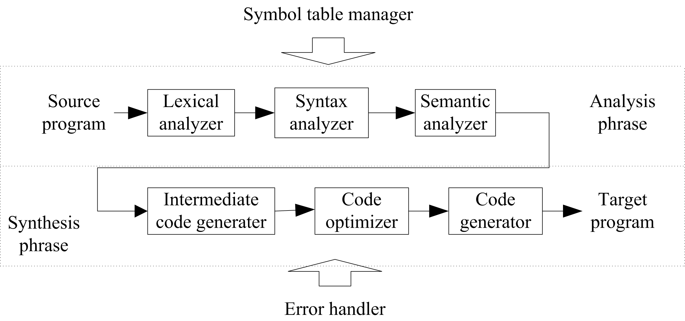
The Phases of a Compiler
Token stream
Syntax tree
Three address code
Machine code

Slide 19
Lexical Analysis(Linear analysis)
position := initial + rate * 60
6 groups of lexical elements:
  Keywords:
  Identifier: position, initial, rate
  Operator: :=, +, *
  Constant: 60
  Separators: space character, Character tabulation,
the end of a line
  Delimiters: ( ) , : ; => << >> <>
Group these information into tables

Slide 20
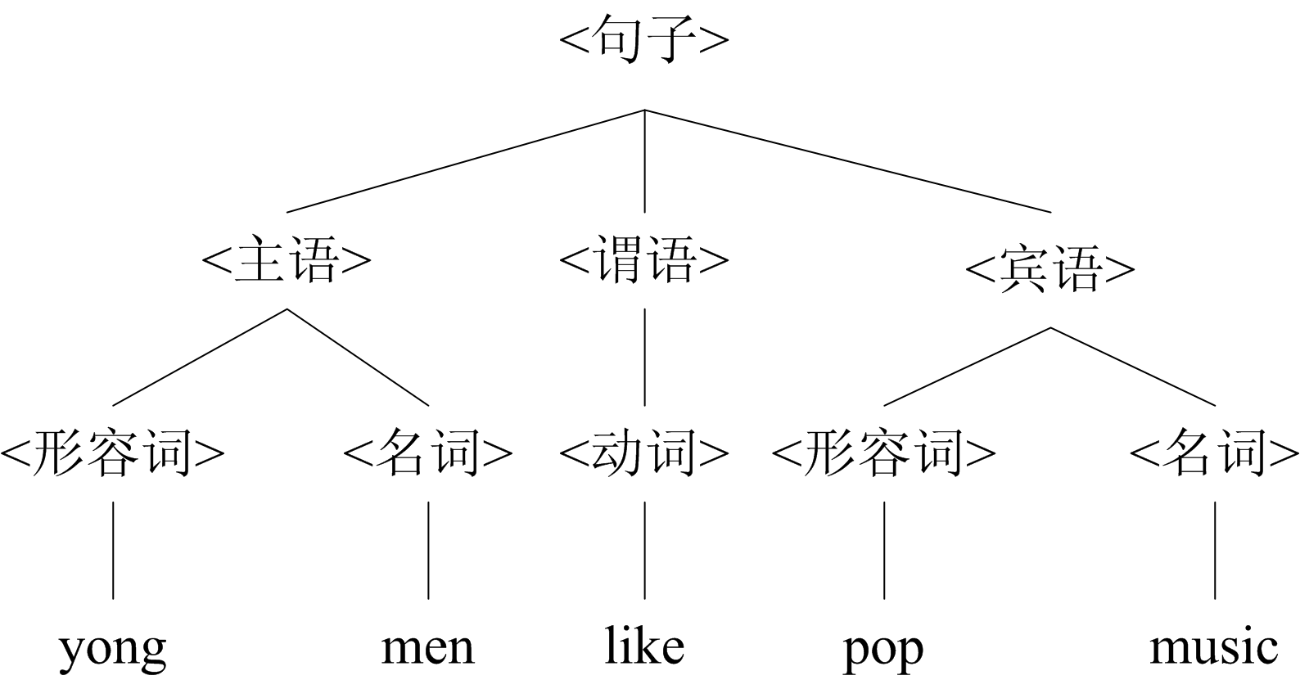
Syntax Analysis(Parsing, Hierarchical Analysis)

Slide 21
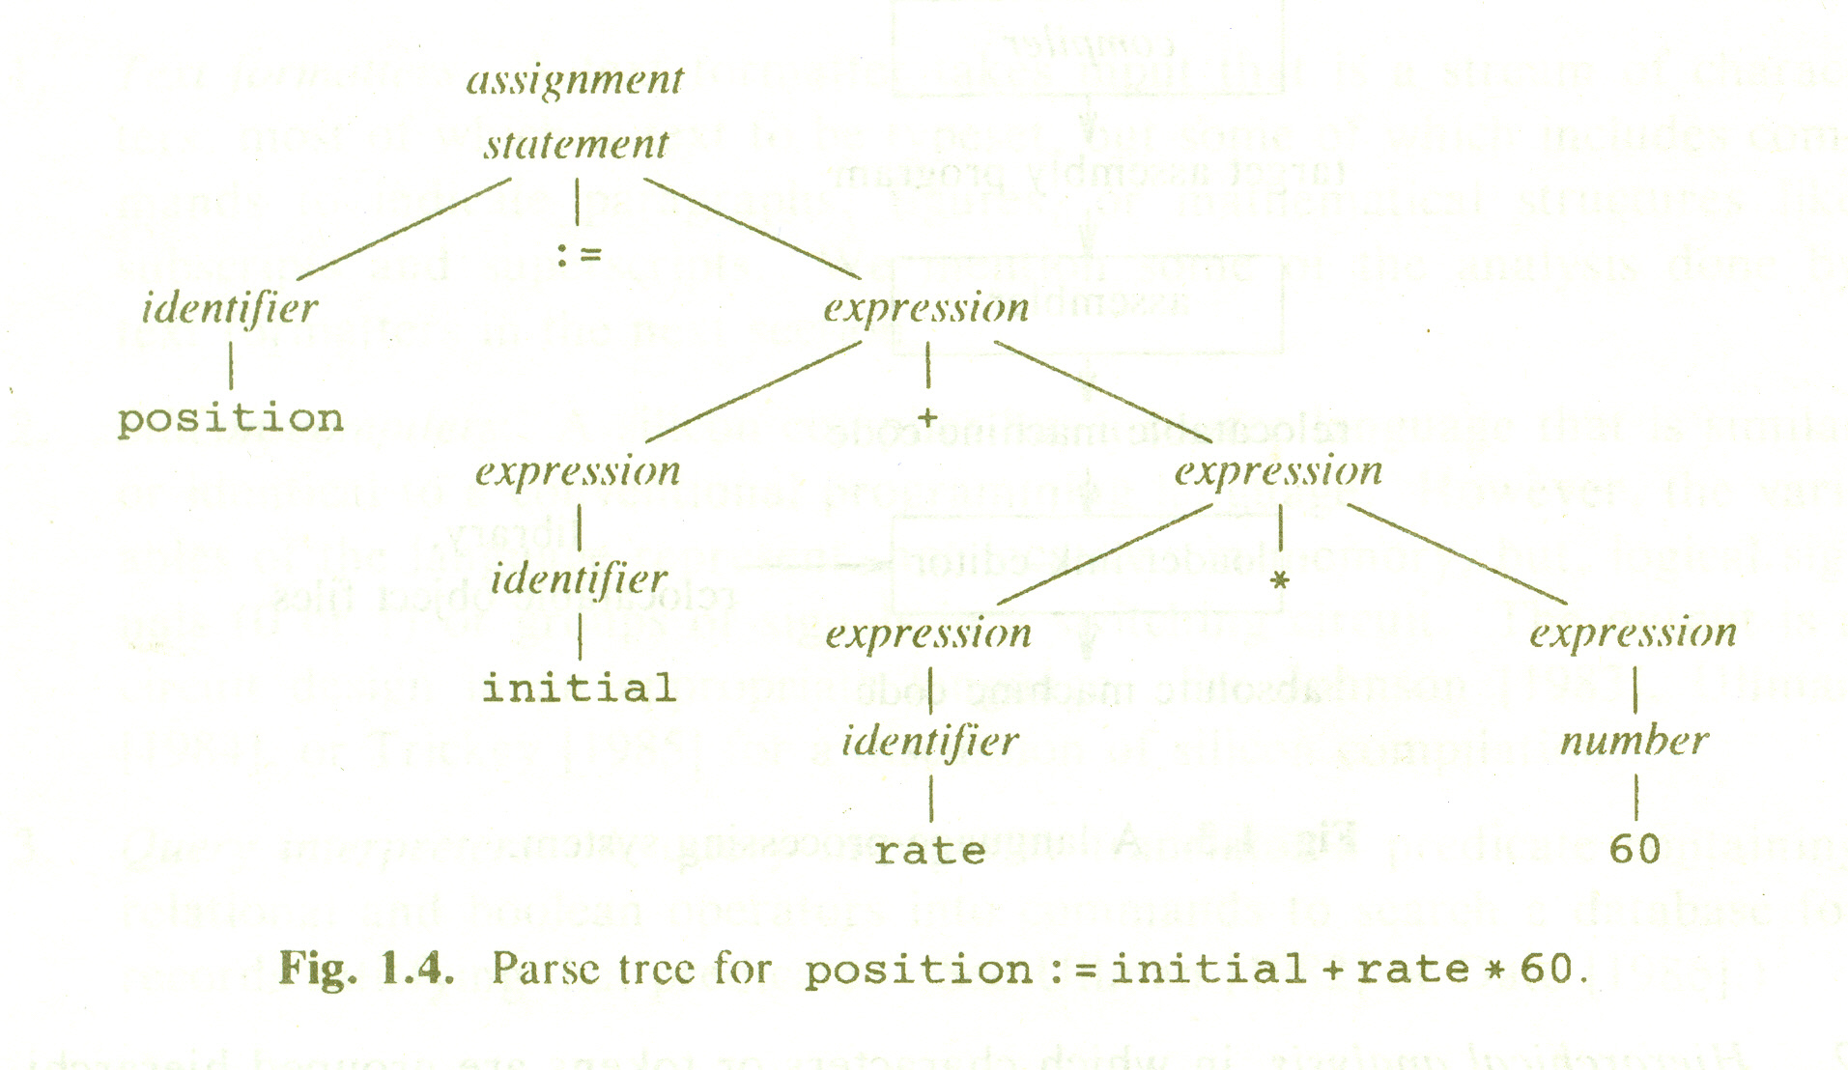
Syntax Analysis

Slide 22
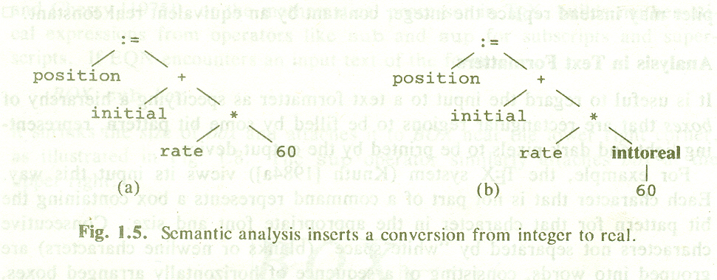
Semantic Analysis

Slide 23
Intermediate Code Generator
Properties of intermediate code:
  Easy to produce
  Easy to translate into the target program
Three address code
Syntax directed generation

Slide 24
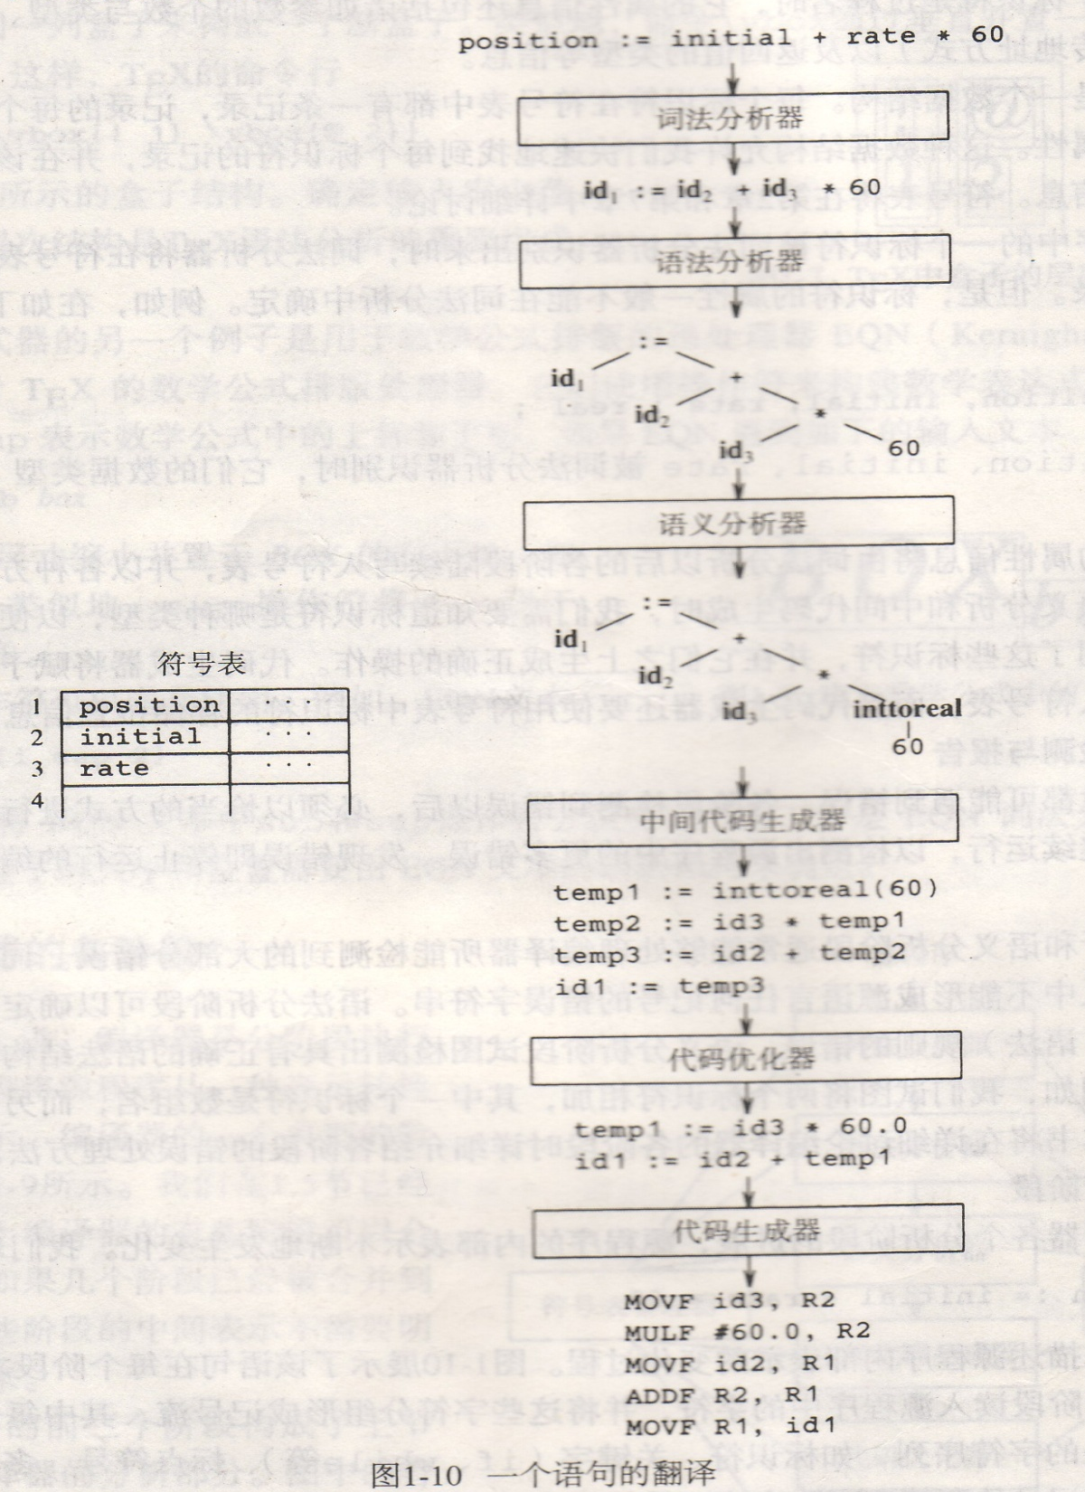
A Complete
Process
A crucial aspect of Code Generation : assignment of variables to registers

Slide 25
Compiler-Construction Tools
Scanner generator: Lex
Parser generator: Yacc
Syntax-directed translation engines
Automatic code generators
Data-flow engines

Slide 26
Framework of The Course
1. Introduction to compiling
2. Programming Language and Grammar Definition
3. Lexical Analysis: Regular Grammar and Finite Automation
Lex
4. Syntax Analysis: Context-free Grammar and Push-down
Automation, LL(1) Grammar,LR Grammar,
LR parsing, Using ambiguous grammars
Tools: YACC

Slide 27
Framework of The Course
5.Intermediate Code Generation and Syntax-directed Translation
6.Type Checking and Run-Time Environment
7.Code Optimization: Block Optimization, Loop Optimization,
Global Optimization
8.Target Code generation

