Slide 1
Chapter 4 Syntax Analysis

Slide 2
Introduction

Slide 3
Description of the Syntax
Context-free grammars

Slide 4
Advantages Offered by Grammar (1)
to both language designers and compiler writers
precise, structural syntax specification
for language description and parser construction (error report)
facilitate evolvement of programming languages

Slide 5
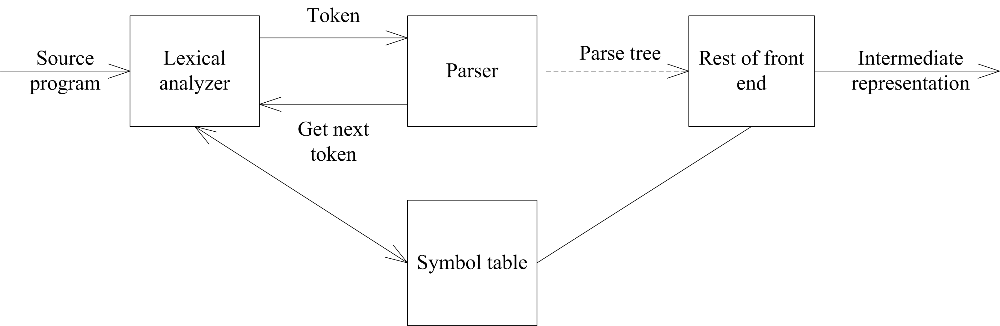
Position of Parser in Compiler Model

Slide 6
The Role of the Parser(1)
Obtains a string of tokens from the lexical analyzer.
Verifies that the string can be generated by the grammar.
Reports any syntax errors in an intelligible fashion.

Slide 7
The Role of the Parser(2)
Recovers from commonly occurring errors so that it can continue processing the remainder of its input.
Generates the parse tree.

Slide 8
General Types of Parsers for Grammar

Slide 9
Top-Down Method
Build parse trees from the top (root) to the bottom (leaves) .
Derive and match
LL(1) grammars (often implemented by hand).

Slide 10
Bottom-Up Method
reduce
LR grammars (often constructed by automated tools).

Slide 11
Syntax Error Handling

Slide 12
Errors (1)
Lexical
  such as misspelling an identifier, keyword, or operator
Syntactic
  such as an arithmetic expression with unbalanced parentheses

Slide 13
Errors (2)
Semantic
  such as an operator applied to an incompatible operand
Logical
  such as an infinitely recursive call

Slide 14
Simple-to-State Goals of an Error Handler
It should report the presence of errors clearly and accurately.
It should recover from each error quickly enough to be able to detect subsequent errors.
It should not significantly slow down the processing of correct programs.

Slide 15
Error-Recovery Strategies
Panic mode
  Discard input symbols one at a time until one of a designated set of synchronizing tokens is found
Phrase level
  Replace a prefix of the remaining input by some string that allows the parser to continue

Slide 16
Error-Recovery Strategies
Error productions
  Augment the grammar for the language at hand with productions that generate the erroneous constructs
Global correction

Slide 17
Top-Down Parsing

Slide 18
Basic Ideas
Left-most derivation (Top-down), match, backtracking, retry

Slide 19
Example 4.14 of [1] (adapted)
Consider the grammar
S →cAd
A →c | ab | a
Construct a parse tree for the input string “cad”.

Slide 20
void A() {
1) Choose an A-production, A → X1 X2 . . . Xk;
2) for ( i = 1 to k ) {
3 ) if ( Xi is a nonterminal )
4) call procedure Xi () ;
5) else if ( Xi equals the current input symbol a )
6) advance the input to the next symbol;
7) else /* an error has occurred */;
8) }

Slide 21
Recursive-Descent Parsing (1)
A procedure to construct the parse tree for the input string starting from the start symbol, normally named S, in preorder.
When there is a mismatch, go back to the last non-terminal symbol and choose another alternative production.

Slide 22
Recursive-Descent Parsing (2)
Halt when a parse tree is constructed successfully for the input string.
Announce failure when it is not possible to construct a parse tree for the input string.

Slide 23
Backtracking vs. Non-backtracking
Recursive-Descent Parsing - inefficient
Non-backtracking parser – predictive

Slide 24
Factors Concerns Prediction
Common preceding symbols derived by alternative productions of the same non-terminal symbol
Left-recursive grammar
Ambiguity grammar

Slide 25
Eliminating Ambiguity
Rewriting the grammar
  stmt → if expr then stmt | if expr then stmt else stmt | other
  =>
  stmt → matched-stmt | unmatched-stmt
  matched-stmt →if expr then matched-stmt else matched-stmt | other
  unmatched-stmt →if expr then stmt | if expr then matched-stmt else unmatched-stmt

Slide 26
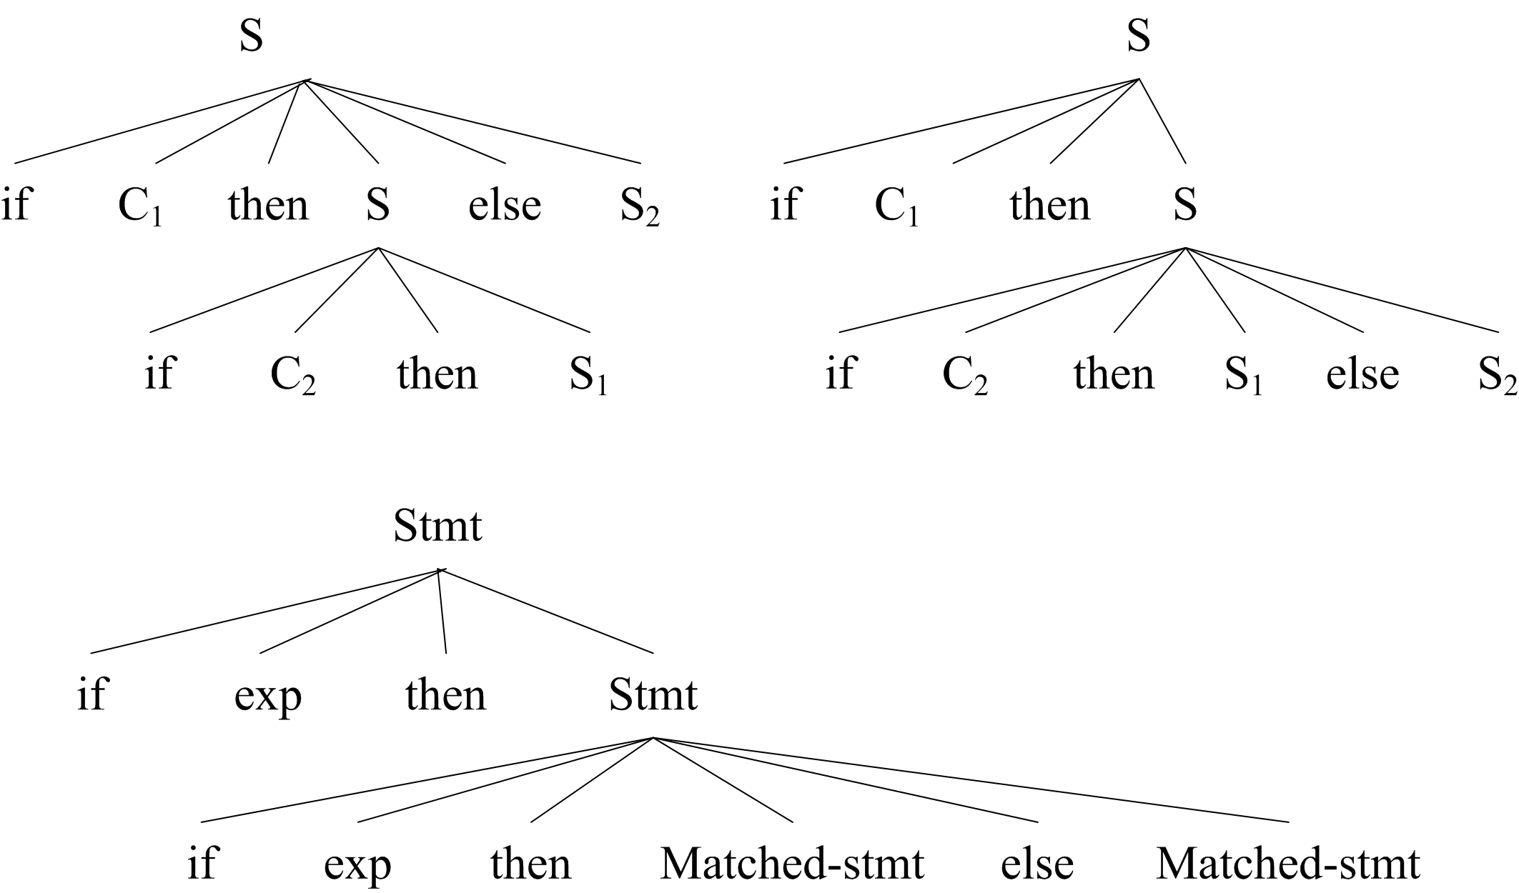

Slide 27
Elimination of Left Recursion

Slide 28
Basic form of left recursion
Immediate left recursion
P →Pα|β
Indirect left recursion
P →Aa , A→Pb

Slide 29
Elimination of Immediate Left Recursion (The simplest form)
P → Pα|β
=> P →βP’ P’ →αP’|ε

Slide 30
Elimination of Immediate Left Recursion (The general form)
p →pα₁ | pα₂ | … | pα_{m} |
β₁ | β₂ | … | β_{n}
=>
p → β₁P’ | β₂P’ | … | β_{n}P’
P’ → α₁ P’ | α₂ P’ | … | α_{m} P’ | ε

Slide 31
Elimination of Indirect Left Recursion
How to solve the following simple case?
Indirect left recursion
P → Aa , A→ Pb | c
Cycles formed by the preceding non-terminals of indirect left recursion productions.

Slide 32
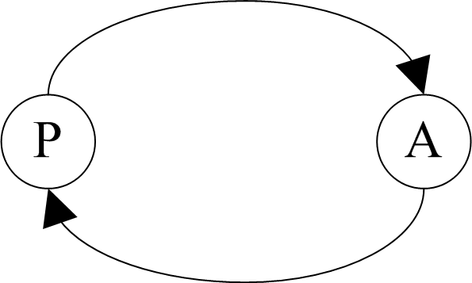
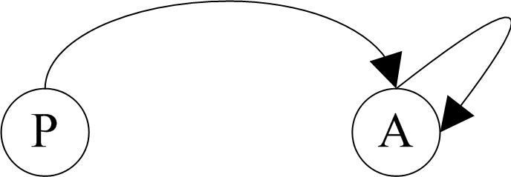
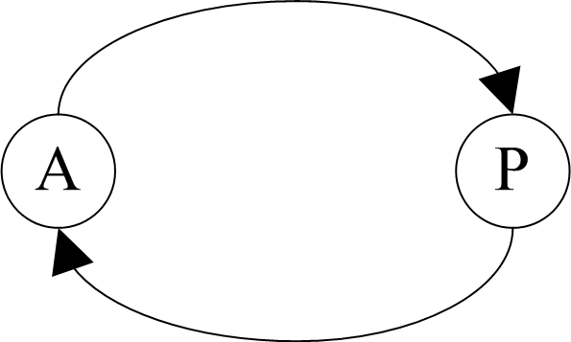

Cases of Indirect Left Recursion ₍₁₎

Slide 33
Algorithm 4.1
(1) Arrange the non-terminals in G in some order as
P₁,P₂,…,P_{n},.
(2) for (i=1,i<=n,i++) {
for (k=1,k<=i-1,k++) {
replace each production of the form P_{i} →P_{k}γ
by P_{i} →δ₁ γ |δ ₂ γ |……| δ_{n} γ; where P_{k}
→δ₁| δ₂|……| δ_{n,} are all the current P_{k}-
productions }
eliminate the immediate left recursion
(3) Rearrange the grammar.

Slide 34
Example – the Question ^{[2]}
Eliminating left recursions of the
following productions:
(1) S → Qc | c
(2) Q → Rb | b
(3) R → Sa | a

Slide 35
Example – the Answer ^{[2]}
(1) Arrange the non-terminals in the order:R,Q,S
(2) for R: no actions.
for Q:Q → Rb|b Q → Sab|ab|b
for S: S → Qc|c S → Sabc|abc|bc|c;
then get S → (abc|bc|c)S`
S` → abcS`|ε
(3) Because R,Q is not reachable, so delete them
so, the grammar is :
S → (abc|bc|c)S`
S`→ abcS`|ε

Slide 36
Notes
If the non-terminals is arranged in a different order, the output grammar will be different. However, it produces the same language.
The starting symbol should not be changed.

Slide 37
Left Factoring
A grammar transformation for predictive parsing
prediction

Slide 38
Left Factoring
Change productions like
A → δβ₁| δβ₂|…. | δβ_{n}
  into
  A → δA`
A`→ β₁ |β₂ | …. | β_{n}

Slide 39
Predictive Parsers
In many cases, by eliminating left recursion from a grammar, and left factoring the result grammar. For
  A → α₁ | α₂ | … | α_{m}
  the current input symbol a
there would be no more than one alternative that derives a string beginning with a.

Slide 40
Model of a Non-recursive Predictive Parser
Input
a+b……#
Stack
Output
S
#
Predictive Parsing Program
Parsing Table M

Slide 41
Behavior of the Predictive Parsing Program ₍₁₎
X: the symbol on top of the stack;
a: the current input symbol
If X=a=#, the parser halts and announces success;
If X=a≠#, the parser pops X off the stack and advances the input pointer to the next input symbol;

Slide 42
Behavior of the Predictive Parsing Program ₍₂₎
If X is a non-terminal, consults entry M[X, a] of the parsing table M.
This entry will be either an X-production or an error entry.
If, M[X, a]={X → UVW}, replaces X by WVU (with U on top)

Slide 43
Original grammar
  E → E + T | T
  T → T * F | F
  F → (E) | id

Slide 44
parse the string id+id*id#
1. E → TE’ | 2. E’ → +TE’
3. E’ → ε | 4. T → FT’
5. T’ → *FT’ | 6. T’ → ε
7. F → id | 8. F →(E)

Slide 45
Example 4.17 of [1]
Parsing table M for Grammar (4.11) of [1]
 | id | + | * | ( | ) | #
E | E→TE’ |  |  | E→TE’
E’ |  | E’→+TE’ |  |  | E’→ε | E’→ε
T | T→FT’ |  |  | T→FT’
T’ |  | T’→ε | T’→*FT’ |  | T’→ε | T’→ε
F | F→ id |  |  | F →(E)

Slide 46
Example 4.17 of [1]
Moves Made by Predictive Parser on input id + id * id

Slide 47
Construction of Predictive Parsing Tables
FIRST & FOLLOW

Slide 48

FIRST
α ∈V*, FIRST(α) = {a | α a…, a∈V_{T}*}
If α ε, then ε is also in FIRST(α)

Slide 49
Computation of FIRST(α)
α = α ₁ α ₂… α_{n}， α_{i} ∈ (V_{N} ∪ V_{T}), 1 ≤ i ≤ n
{i = 0; FIRST(α) = {}; //initialization
repeat {
i = i + 1;
FIRST(α) = FIRST(α) ∪ (FIRST(α_{i}) - {ε});
} until (i = n and ε ∈ ¬(FIRST(α_{i})))
if ( i = n and ε ∈ FIRST(α_{n})) then
FIRST(α) = FIRST(α) ∪ {ε} }

Slide 50
Compute First Set
FIRST(α)
α=α₁α₂…α_{n}
FIRST(α) = FIRST(α₁), if ε∉FIRST(α₁)
FIRST(α₁) ∪ FIRST(α₂) … ∪ FIRST(α_{k})
if ε∈FIRST(α_{i}) (1≤i<k) , ε∉FIRST(α_{k})
ε∈FIRST(α) if ε∈FIRST(α_{i}) (1≤i≤ n)

Slide 51
FOLLOW
For non-terminal A, to be the set of terminals a that can appear immediately to the right of A in some sentential form.
FOLLOW(A)＝{a|S …Aa…, a ∈V_{T} }
If S …A, then #∈ FOLLOW(A)。

Slide 52
Compute Follow Set
FOLLOW(A)
N->αAβ Add FIRST(β)-{ε}
If ε∈FIRST(β), or N->αA, Add FOLLOW(N)
#∈FOLLOW(S)

Slide 53
Computation of Follow(A)
(1) Place # in FOLLOW(S), where S is the start symbol and # is the input right end-marker.
(2)If there is A →αBβ in G, then add (FIRST(β)-{ε}) to FOLLOW(B).
(3)If there is A →αB, or A→αBβ where FIRST(β) contains ε，then add FOLLOW(A) to FOLLOW(B).

Slide 54
Example 4.17 of [1] (1)
Consider the following Grammar, construct FIRST & FOLLOW for each non-terminals
1.E → TE` 2.E` → +TE`
3.E` → ε 4.T → FT`
5.T` → *FT` 6.T` → ε
7.F → i 8.F →(E)

Slide 55
Example 4.17 of [1] (2)
Answer:
FIRST(E)=FIRST(T)=FIRST(F)={(, i}
FIRST(E`) = {+, ε}
FIRST(T`) = {*, ε}

Slide 56
Computation of Follow(A)
fix point of FOLLOW(A)
FOLLOW(E) = FOLLOW(E`)={),#}
FOLLOW(T) = FOLLOW(T`)={+,),#}
FOLLOW(F)={*,+,),#}

Slide 57
Construct Predictive Parsing Table
S
S
B
A
b
parsed
ε
parsed
a
a
ε∈FIRST(β)
A-> α
a∈FIRST(α)
b
B-> β
b∈FOLLOW(B)
A
A-> α
B
B-> ɛ

Slide 58
Construction of a Predictive Parsing Table
Suppose A →α is a production with a in FIRST(α). Then
  expand A by α when the current input symbol is a.
  If α → ε, expand A by α if the current input symbol is in FOLLOW(A),
  or if the # on the input has been reached and # is in FOLLOW(A).

Slide 59
Algorithm to Construct a Predictive Parsing Table (1)
Input. Grammar G.
Output. Parsing table M.
(1) For each production A →α , do
steps 2 and 3.
(2) For each terminal a in FIRST(α),
add A →α to M[A, a].

Slide 60
Algorithm to Construct a Predictive Parsing Table (2)
(3) If ε is in FIRST(α), add A → ε to M[A, b] for each terminal b in FOLLOW(A). If ε is in FIRST(α) and # is in FOLLOW(A), add A → ε to M[A,#].
(4) Make each undefined entry of M be error.

Slide 61
Example 4.18 of [1] (1)
Consider the following Grammar, construct predictive parsing table for it.
1.E → TE` 2.E` → +TE`
3.E` →ε 4.T → FT`
5.T` → *FT` 6.T` → ε
7.F → i 8.F →(E)

Slide 62
Example 4.18 of [1] (2)
Answer:
First(E)=First(T)=First(F)={(, i}
First(E`)={+, ε}
First(T`)={*, ε}
Follow(E)= Follow(E`)={),#}
Follow(T)= Follow(T`)={+,),#}
Follow(F)={*,+,),#}

Slide 63
Example 4.18 of [1] (3)
 | i | + | * | ( | ) | #
E | E→TE` |  |  | E→TE`
E` |  | E`→ +TE` |  |  | E`→ε | E`→ε
T | T→FT` |  |  | T→FT`
T` |  | T`→ε | T`→ *FT` |  | T`→ε | T`→ε
F | F→ i |  |  | F →(E)

Slide 64
LL(1) Grammars

Slide 65
LL(1) Grammar?
Construct parsing table
look for multidefined entries
Look at FIRST & FOLLOW sets
G is LL(1) ⇔
whenever there exists A->α|β in G,
(1) FIRST(α)∩ FIRST(β)=∅
(2) At most one of α and β derive the ε,
if β⇒ ε, then FIRST(α)∩FOLLOW(A)=∅
// Left recursion, common prefixes, ambiguity

Slide 66
Example 4.19 0f [1]
The Following Grammar abstracts the dangling-else problem.
S → iEtS | iEtSeS | a
E → b

Slide 67
After Left Factoring
S → iEtSS` |a
S` → eS | ε
E →b
Construct predictive parsing table for the grammar.

Slide 68
Predictive Parsing Table M
 | a | b | e | i | t | #
S | S →a |  |  | S → iEtSS`
S` |  |  | S`→ eS S`→ ε |  |  | S`→ε
E |  | E →b

Slide 69
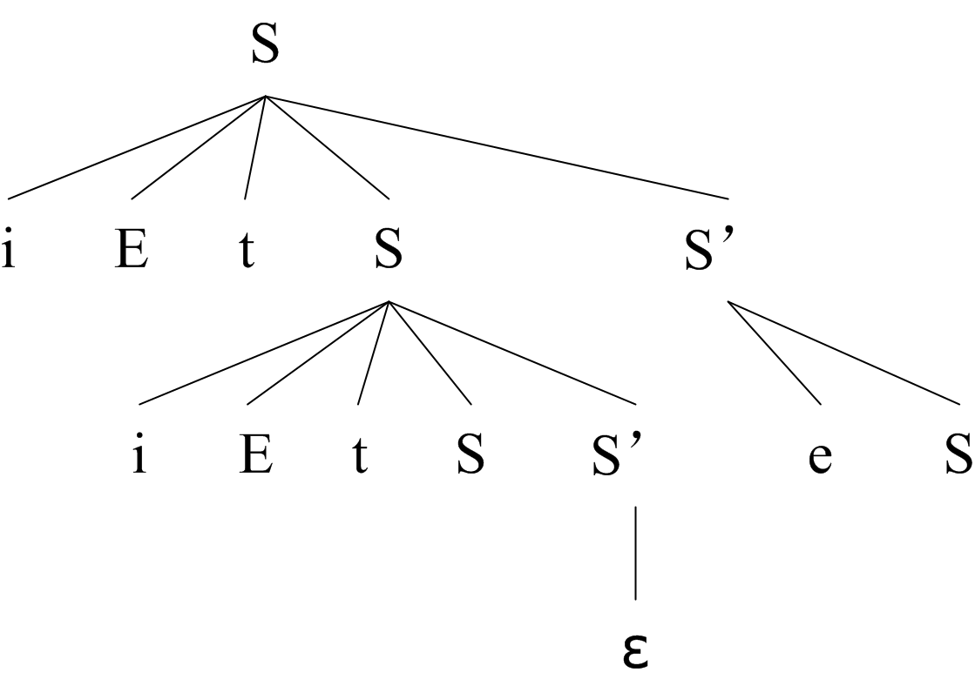
Illustration of the Confliction

Slide 70
LL(1) Grammars
whose parsing table has no multiply-defined entries

Slide 71
What does “LL(1)” Stands for
The first “L” stands for scanning the input from left to right.
The second “L” stands for producing a leftmost derivation.
“1” means using one input symbol of look-ahead at each step to make parsing action decisions.

Slide 72
Distinctive Properties of LL(1) Grammar (1)
No ambiguous or Left-recursive grammar can be LL(1).

Slide 73
Distinctive Properties of LL(1) Grammar (2)
A grammar G is LL(1) if and only if whenever A →α | β are two distinct productions of G:
  First (α)∩First(β)=Ø
    no terminal a do both α and β derive strings beginning with a.
    At most one of α and β can derive the empty string.
  If β →ε, First (α)∩Follow(β)=Ø.

Slide 74
Transforming a Grammar to LL(1) Grammar
Eliminating all left recursion
Left factoring

Slide 75
Error Recovery in Predictive Parsing
Panic-mode error recovery
Phrase-level recovery

Slide 76
Exercise
4.3.1
Supplement for Ch4

