Slide 1
Syntax-Directed Translation

Slide 2
Introduction
SDD
SDT
Bottom-up & Top-down translation
Implementing Methods of SDT

Slide 3
Basic idea
- Guided by context-free grammar
(Translating when parsing )
  Attaching attributes to the grammar symbols representing the program construction.
  Values for attributes are computed by “semantic rules ”associated with the grammar productions.

Slide 4
Syntax-directed definitions(SDD)
    Extend with attribute & semantic rules
    SDD是每个文法符号加一个语义属性集合相关联，将每个产生式与一组语义规则相关联，规则用于计算该产生式中各文法符号的属性值。
High-level specifications for translations
Hide implementation details
No need to specify explicitly the order in which translation take place
    E→E₁+E₂ E.val=E₁.val+E₂.val

Slide 5
Attribute grammar属性文法
A syntax-directed definition in which the functions in semantic rules cannot have side effects.
      副作用：e.g 打印一个结果或将信息加入符号表
      print(E.val); addtype(id.entry,T.type);
Notes:
(1)Functions in semantic rules will often be written as expressions.
(2) Occasionally, semantic rules are written as procedure calls or program fragments (in the time, we name the attribute of non-terminal as a dummy attribute)
(3)Values for attributes of terminals are usually supplied by the lexical analyzer

Slide 6
Syntax Directed Translation schemes (SDT)
    Indicate the order in which semantic rules are to be evaluated.
    Allow some implementation details to be shown
    S →{B.ps=10}B{S.ht=B.ht}
继承属性？
合成属性

Slide 7
Implement Syntax-Directed Translation(1)
Input
string
Dependency
graph
Evaluation order
for semantic rules
Evaluation of the semantic rules may generate code, save information in a symbol table , issue error messages, or perform any other activities.
Parse
tree

Slide 8
Implement Syntax-Directed Translation(2)
Special cases of syntax-directed definitions can be implemented in a single pass by evaluating semantic rules during parsing, without explicitly constructing a parse tree or a graph showing dependencies between attributes.

Slide 9
Syntax-Directed Definitions
    A generalization of a context-free grammar in which each grammar symbol has an associated set of attributes.

Slide 10
Attribute
    Represent anything we choose: a string, a number, a type, a memory location, etc.
    Notes: The value of an attribute at a parse-tree node is defined by a semantic rule associated with the production used at that node.

Slide 11
Types of Attribute
    Synthesized attribute
      The value of a synthesized attribute at a node is computed from the values of attributes at the children of that node in the parse tree
      由孩子节点决定
    Inherited attribute
      The value of an inherited attribute is computed from the values of attributes at the siblings and parent of that node.
      由兄弟/父节点决定

Slide 12
S-attributed & L-attributed SDD
S-attributed definitions: Only synthesized attributes
S-属性定义SDD Bottom up 只有合成属性
L-attributed Definition: Top down, left-to-right
L-属性定义SDD
synthesized attributes 合成属性
inherited attribute 可以有继承属性但要满足：
each inherited attribute of X_{j},1<=j<=n, on the right side of A →X₁X₂…X_{n}, depends only on
  1)The attributes of the symbols X₁,X₂,…X_{j-1} to the left of X_{j} in the production and
  2)The inherited attributes of A.

Slide 13
Dependency graph
    A graph that represents dependencies between attributes set up by the semantic rules
    Notes: (1)From the dependency graph,we can derive an evaluation order for the semantic rules
    (2)Evaluation of the semantic rules defines the values of the attributes at the nodes in the parse tree
    (3)Semantic rule may have side effects, e,g, printing a value

Slide 14
Annotated parse tree
    A parse tree showing the values of attributes at each node
    Notes: The process of computing the attribute values at the nodes is called annotating or decorating the parse tree.

Slide 15
E.g.
Production | Semantic rules
A →E n (n for new-line) | Print(E.val) (A has a dummy attribute)
E →E ⁽¹⁾+T | E.val= E⁽¹⁾.val+ T.val
E→T | E.val= T.val
T →T ⁽¹⁾ *F | T.val= T⁽¹⁾.val*F.val
T→F | T.val= F.val
F →(E) | F.val= E.val
F → digit | F.val=digit.lexval

Slide 16
E.g. Annotated parse tree for 3*5+4 n
A
n
E.val=19
E.val=15 + T.val=4
T.val=15
F.val=4
T.val=3 * F.val=5
digit.lexval=4
F.val=3
digit.lexval =5
digit.lexval =3

Slide 17
E.g. Syntax-directed definition with inherited attribute L.in
Production | Semantic rules
D →T L | L.in=T.type 继承兄弟节点
T →int | T.type= integer
T →real | T.type=real
L →L ⁽¹⁾,id | L ⁽¹⁾.in=L.in 继承父节点 addtype(id.entry, L.in)
L → id | addtype(id.entry, L.in)

Slide 18
E.g. Parse tree with inherited attribute in at each node labeled L. (real id1,id2,id3)
D
T.type=real L.in=real
real L.in=real , id3
addtype(id3.entry, real)
L.in=real , id2
addtype(id2.entry, real)
id1
addtype(id1.entry, real)

Slide 19
Dependency graphs
1)Definition
  A directed graph that describes the inter-dependencies among the inherited and synthesized attributes at the nodes in a parse tree
  2)Constructing a dependency graph for a given parse tree

Slide 20
for each node n in the parse tree do
for each attribute a of the grammar symbol at n do
construct a node in the dependency graph;
for each node n in the parse tree do
for each semantic rule b=f(c1,c2,……,ck)
associated with the production used at n do
for (i=1, i<=k ,i++)
construct an edge from the node for ci to the node for b;

Slide 21
E
•val
E⁽¹⁾ + E⁽²⁾
Val val
Production | Semantic rules
E →E ⁽¹⁾ + E⁽²⁾ | E.val= E⁽¹⁾.val+E⁽²⁾.val

Slide 22
Evaluation order
  -Topological sort of a DG
  Any ordering m₁,m₂,…,m_{k} of the nodes of the graph such that edges go from nodes earlier in the ordering to later nodes.

Slide 23
D
T type 4 in 5 L
real in 6 L , id3 3 entry
In 7 L , id2 2 entry
id1 1 entry
4,5,3,6,2,7,1

Slide 24
From this topological sort, we obtain the following program.(ai for the attribute associated with the node numbered i in the dependency graph.)
  a4=real;
  a5=a4;
  Addtype (id3.entry, a5);
  a6=a5;
  Addtype (id2.entry, a6);
  a7=a6;
  Addtype (id1.entry, a7);

Slide 25
Syntax-directed Translation schemes (SDT)
A context-free grammar in which attributes are associated with the grammar symbols and semantic actions enclosed between braces {} are inserted within the right sides of productions.
SDD can be implemented using SDT

Slide 26
Any SDT can be implemented by first building a parse tree
performing preorder traversal of the parse tree, the actions in a left-to-right depth-first order.
先序排序：先根后左再右

Slide 27
Typically, SDT's are implemented during parsing, without building a parse tree.
Bottom-up Parsing: LR-parsable grammar, S-attributed SDD.
Top-down Parsing: LL-parsable grammar, and L-attributed SDD

Slide 28
An example
Maps infix expressions into postfix expressions
后序：
  E →TR
  R → +T {print (‘+’)} R⁽¹⁾|ε
  T →num {print (num.val)}

Slide 29
The parse tree with translate schemes for the input 9+5+2.
E
T R
9 {print(‘9’)} + T {print(‘+’)} R
5 {print(‘5’)} + T {print(‘+’)} R
2 {print(‘2’)} ε
1)Here, actions are considered as terminal symbols
2)By depth-first order traverse ,we can get the sequence
9 5 + 2 +

Slide 30
Rules on a translation scheme design
  attribute value is available when an action refers to it

Slide 31
SDD→SDT( Only Synthesized Attributes)
placing this action at the end of the right side of the associated production
E.g. Production Semantic Rule
T →T₁*F T.val= T₁.val*F.val
T →T₁*F{ T.val= T₁.val*F.val}

Slide 32
SDD→SDT(Inherited & Synthesized)
Inherited attributes:
  must be computed in an action before that symbol. 继承属性放在符号之前
  Action must not refer to a synthesized attribute of a symbol to the right of the action.
Synthesized attributes:
Action can usually be placed at the end of the right side of the production.
合成属性放在产生式右边的最后

Slide 33
Production Semantic Rules
S→B B.ps=10
S.ht=B.ht
B →B₁B₂ B₁.ps=B.ps
B₂.ps=B.ps
B.ht=max(B₁.ht,B₂.ht)
B →text B.ht=text.h*B.ps
Syntax-directed definition
S →{B.ps=10}B{S.ht=B.ht}
B →{B₁.ps=B.ps}B₁{B₂.ps=B.ps}B₂{B.ht=max(B₁.ht,B₂.ht)}
B →text { B.ht=text.h*B.ps}
Related Translation scheme

Slide 34
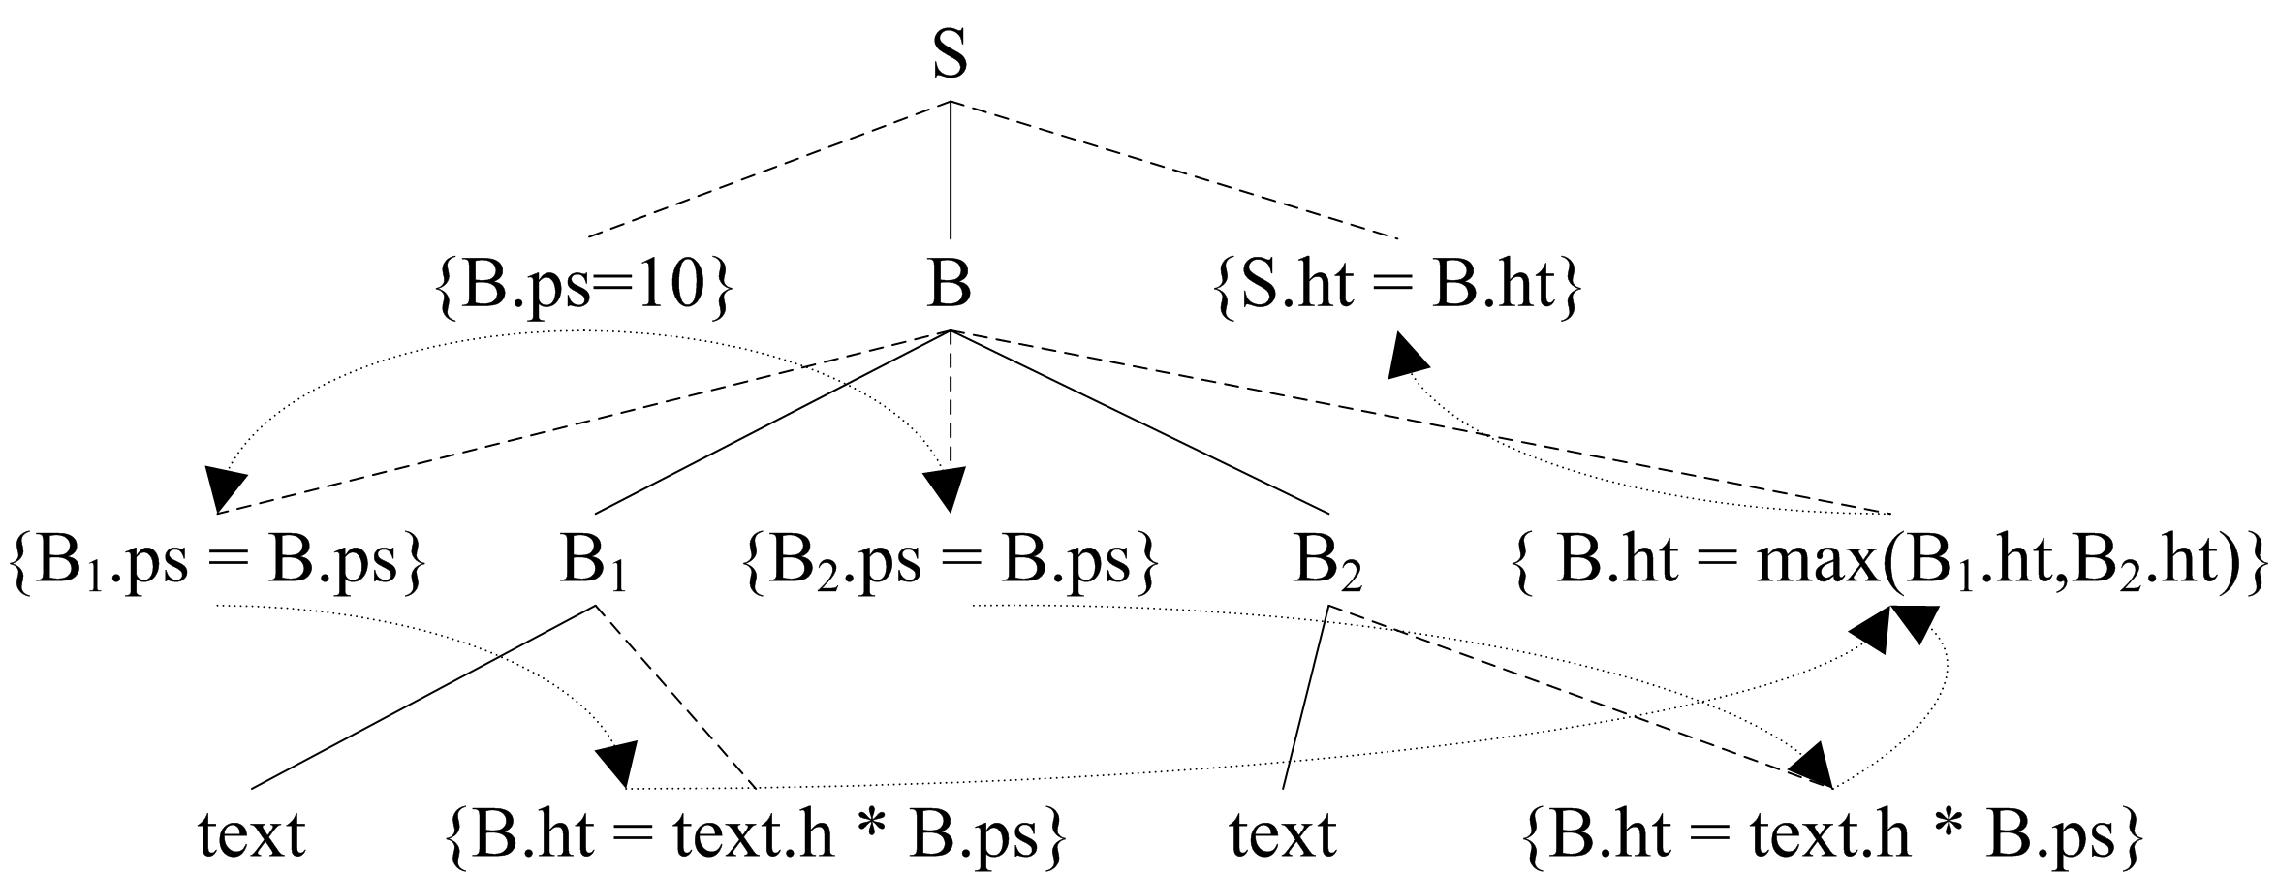

Slide 35
Bottom-up Translation (S-attributed)
Basic idea
  No need to build a parse tree
  during LR parsing by executing the actions when reductions
  The parser keeps the values of the synthesized attributes associated with the grammar symbols on its stack

Slide 36
  When a reduction is made, the values of the new synthesized attributes are computed from the attributes appearing on the stack for the grammar symbols on the right side of the reducing production.

Slide 37
Notes
  1)A translator for an S-attributed definition can often be implemented with an LR-parser
  2)The stack is used to hold information about sub-trees that have been parsed.
  3)We can use extra fields in the parser stack to hold the values of synthesized attributes

Slide 38
An Example
T
+
E
top
Production | Code fragment
L →E# | Print(val[top])
E →E ⁽¹⁾ + T | Val[top-2]= val[top-2]+val[top], top=top-2 结合栈来分析
E →T
T→T ⁽¹⁾*F | Val[top-2]= val[top-2]*val[top], top=top-2
T →F
F→(E) | Val[top-2]= val[top-1] top=top-2
F → digit
top-2

Slide 39
  E.g.
State | Val
… | …
X | X.val
Y | Y.val
… | …

Slide 40
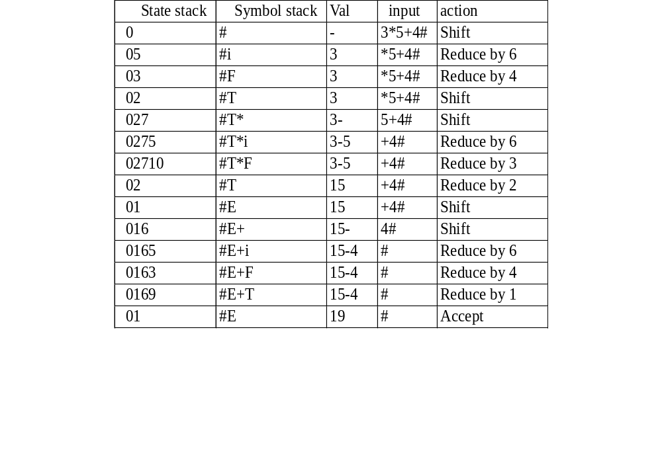
Moves made by translator on 3*5+4#

Slide 41
Top-down Translation (L-attributed)
Basic idea
Use L-attributed definition and translation schemes during predictive parsing
Extend the algorithm for eliminating left recursion to a translation schemes with synthesized attributes.

Slide 42
Eliminating Left Recursion from a SDT
if each action simply prints a string,
treat the actions as if they were terminal symbols when transforming the grammar.

Slide 43
E → E ₁ + T { print ('+');}
E → T
E →T R
R → + T { print ('+');}R
R →ε

Slide 44
Compute Attributes Rather Than Merely Printing
Suppose we have the following translation scheme
  A →A₁Y {A.a=g(A₁.a,Y.y)}
  A →X {A.a=f(X.x )}
  Notes: We assume here each grammar symbol has a synthesized attribute, and f and g are arbitrary functions.

Slide 45
A.a=g(g(f(X.x),Y₁.y),Y₂.y)
A.a=g(f(X.x),Y₁.y) Y₂
A.a=f(X.x) Y₁
X
One way of computing an attribute value

Slide 46
After eliminating left recursion:
  A →XR
  R →YR|ε

Slide 47
A
X R.i=f(X.x)
Y₁ R.i=g(f(X.x),Y₁.y)
Y₂ R.i=g(g(f(X.x),Y₁.y),Y₂.y)
ε
Another way of computing an attribute value

Slide 48
Taking the semantic actions into account, the transformed scheme becomes:
  A →X {R.i=f(X.x)}
  R {A.a=R.s}
  R →Y {R₁.i=g(R.i, Y.y)}
  R₁ {R.s=R₁.s}
  R →ε {R.s=R.i}

Slide 49
E.g. Translation scheme with left-recursive grammar
  E →E₁+T {E.val=E₁.val+T.val}
  E →T {E.val=T.val}
  T →num {T.val=num.val}

Slide 50
Transformed translation scheme with right-recursive grammar
  E →T {R.i=T.val}
  R {E.val=R.s}
  R →+
  T {R₁.i=R.i+T.val}
  R₁ {R.s=R₁.s}
  R →ε {R.s=R.i}
  T →num {T.val=num.val}
  Notes: “s” means synthesized attribute,”i” means inherited attribute

Slide 51
Transformed translation scheme with right-recursive grammar
  E →T {R.i=T.val}
  R {E.val=R.s}
  R →+
  T {R₁.i=R.i+T.val}
  R₁ {R.s=R₁.s}
  R →ε {R.s=R.i}
  T →num {T.val=num.val}
  Notes: “s” means synthesized attribute,”i” means inherited attribute

Slide 52
Evaluation of the expression 9+5+2.
E
T.val=9 R.i=9
Num.val=9 + T.val=5 R.i=14
Num.val=5 + T.val=2 R.i=16
Num.val=2 ε

Slide 53
For B → X {a} Y
If the parse is top-down, we perform a just before we attempt to expand this occurrence of Y (if Y a nonterminal) or check for Y on the input (if Y is a terminal).

Slide 54
Stack Semantic actions Input String
E 9+5#
R T₁
R 9 T₁.val=9
R R.i=9 +5#
R₁ T₂ + +5#
R₁ T₂ 5#
R₁ 5 T₂.val=5
R₁ R₁.i=R.i+T₂.val=14
R₁.s=R₁.i=14
R.s= R₁.s=14
E.val=R.s=14

Slide 55
Implementing Methods of SDT
Build the parse tree, add actions, and execute the actions in preorder
Implement an SDT in conjunction with an LL-parser
Implement an SDT in conjunction with an LR-parser
Use a recursive-descent parser

Slide 56
  Input
  A syntax-directed translation scheme with an underlying grammar suitable for predictive parsing
Output
Code for a syntax-directed translator

Slide 57
Method
  For each non-terminal A, construct a function that has a formal parameter for each inherited attribute of A and that returns the values of the synthesized attributes of A.
  Notes: We assume here that each non-terminal A has just one synthesized attribute.

Slide 58
  The code associated with each production does the following:
    For token X with synthesized attribute x, save the value of x in the variable declared for X.x. Then generate a call to match token X and advance the input

Slide 59
    For non-terminal B, generate an assignment c=B(b₁,b₂,…,b_{k}) with a function call on the right side, where b₁,b₂,…,b_{k} are the variables for the inherited attributes of B and c is the variable for the synthesized attribute of B

Slide 60
    For an action , copy the code into the parser, replacing each reference to an attribute by the variable for that attribute

Slide 61
R→addop
T{R1.i=mknode(addop.lexeme,R.i,T.nptr)}
R1 {R.s=R1.s}
R→ε {R.s=R.i}
Node *R(i:*Node)
{
Node *nptr,i1,s1,s;
char addoplexeme;
if (lookahead==addop)
{
addoplexeme=lexval;
match(addop);
nptr=T();
i1=mknode(addoplexeme,i,nptr);
s1=R(i1);
s=s1
}
else s=i;
return(s)
}

Slide 62
Exercises for Ch5
Supplemental exercises for Ch5
5.1.1

