Slide 1
Chapter 7
Runtime Environments

Slide 2
Program vs Program Execution
An execution of a program is called as a process.
A program consists of several procedures (functions).
An execution of a program would cause the activation of the related procedures.

Slide 3
Allocation and De-allocation of Data Objects
A name (e.g, a variable name) in a procedure would be related to different data objects.
An activation may manipulate data objects allocated for its use.

Slide 4
Bindings of Names
When an environment associates storage location s with a name x, we say that x is bound to s;
the association itself is referred to as a binding of x.
A binding is the dynamic counterpart of a declaration.

Slide 5
Data Object
Even each name is declared once in a program, the same name may denote different objects at run time.
The “ data object” corresponds to a storage location that can hold values.

Slide 6
Environment and State
In programming language semantics, the term “environment” refers to a function that maps a name to a storage location, and term “state” refers to a function that maps a storage location to the value held there.

Slide 7
Environment and State
environment state
name storage value

Slide 8
Environment and State
An assignment changes the state, but not the environment.

Slide 9
Allocation and De-allocation of Data Objects
Managed by the run-time support package.
The representation of a data object at run time is determined by its type.
If x is not of a basic type, the storage s for x may be a collection of memory words.

Slide 10
Factors that Determines the Run Time Environment of a Program
Recursive call of procedures.
Local name storage space allocation strategy.
global name storage space allocation strategy.
Static or dynamic array.

Slide 11
Factors that Determines the Run Time Environment of a Program
whether a function is allowed to be a parameter of or return value of a function.

Slide 12
Subdivision of Runtime Memory
Typical subdivision of runtime memory into code and data areas
code
The generated target code;
Data objects;
A counterpart of the control stack to keep track of procedure activations;
Static data
heap
stack

Slide 13
Storage Allocation Strategies

Slide 14
Storage Allocation Strategies
Static allocation.
  Lays out storage for all data objects at compile time.
Stack allocation.
  Manages the run-time storage as a stack.
Heap allocation.
  Allocates and de-allocates storage as needed at run time from a heap.

Slide 15
Restrictions Going along with Using Static Allocation Alone
The size of a data object and constraints on its position in memory must be known at compile time.
Data structures cannot be created dynamically.
Recursive procedures are restricted.
Fortran permits static storage allocation.

Slide 16
Heap Allocation
Heap allocation parcels out pieces of contiguous storage when needed.
Pieces may be de-allocated in any order.

Slide 17
Stack Allocation

Slide 18
Activation Trees
A tree to depict the control flow enters and leaves activation of a procedure
f₄
f₄(){
f₃;
f₂;}
f₃(){
f₂;
f₁}
f₂(){
f₁();
f₀();}
f₃
f₂
f₂
f₁
f₁
f₀
f₁
f₀

Slide 19
Control Stacks
A stack to keep track of live procedure activations.
Lifetime of the procedures corresponding to the nodes.

Slide 20
Activation Records/Frames
A contiguous block of storage that stores information needed by a single execution of a procedure.

Slide 21
Activation Records
  A general activation record
Returned value
Actual parameters
Optional control link
Optional access link
Saved machine status
Local data
temporaries

Slide 22
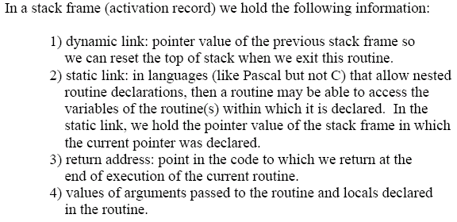

Slide 23
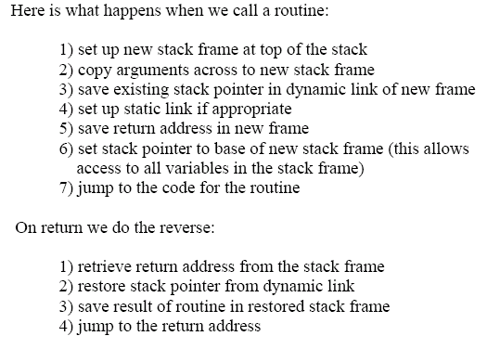

Slide 24
Stack Allocation
Based on the idea of a control stack;
storage is organized as a stack, and activation records are pushed and popped as activations begin and end, respectively.

Slide 25
Stack Allocation
Storage for the locals in each call of a procedure is contained in the activation record for that call.
Locals are bound to fresh storage in each activation.

Slide 26
Calling Sequences:
An Example
the calling sequence is like the following
main () {…… q( ); } p( ) {……} | q( ) { …… p( ); …… }

Slide 27
Calling Sequences:
An Example
TOP
Activation record for p
Top-SP
Activation record for q
Activation record for main

Slide 28
Calling Sequences
The caller evaluates actual parameters.
The caller stores a return address and the old value of top-sp into the callee’s activation record.
The callee saves register values and other status information.
The callee initializes its local data and begins execution.

Slide 29
A Possible Return Sequence
The callee places a return value next to the activation record of the caller.
Using the information in the status field, the callee restores top-sp and other registers and branches to a return address in the caller’s code.

Slide 30
A Possible Return Sequence
the caller can copy the returned value into its own activation record and use it to evaluate an expression.

Slide 31
Stack Allocation for Non-nested Procedure

Slide 32
Storage Organization of C Language
……
Activation Record of the function called by Main function
Activation Record of Main function
Global Variable Data Area

Slide 33
TOP
P AR
SP
Q AR
Main AR
global Var

Slide 34
Activation Record of a Function in C
Unit for Returned Value of function
Internal Temporary Work Units
Local Variable Data Storage Units
Formal parameter Storage Units
Number of Formal Parameters
Returned Address
Caller’s SP
TOP
SP

Slide 35
An Example
#include <stdio.h>
int i,j;
int main()
{
int k,l;
cin>>l; //assume l=3
k=p(l);
cout<<k;
}

Slide 36
int p(int m)
{
int t;
if (m==0 || m==1)
return(1);
else {
t=m*p(m-1);
return(t); } }

Slide 37
+19 | …
+18 | K+12(SPp(2))
+17 | Returned value from P(2)
+16 | t
+15 | Formal Parameter m | 2
+14 | Number of Parameter | 1
+13 | Returned address
+12 | K+6(SPp(3))
+11 | Returned value from P(3)
+10 | t
+9 | Formal Parameter m | 3
+8 | Number of Parameter | 1
+7 | Returned address
+6 | K+2(SPmain)
+5 | Returned value from main
+4 | l | 3
+3 | k
+2 | K(SP0)
+1 | j
K | i

Slide 38
Stack Allocation for Nested Procedures

Slide 39
Procedure Definitions in A Pascal Program
P₀
P₀
P₂
P₁
P₂
P₁
Call P₂
Call P₂
Call P₁
Call P₁

Slide 40
Nesting Depth
P_{i}
i
i－1
P_{i-1}
……
P₀
0

Slide 41
Access Links
P₀
P₂
Access link
P₁
Top-SP
P₂
P₁
Access link
Call P₂
Call P₁
P₀
Access link

Slide 42
Access Links
TOP
P₀
P₂
Access link
P₂
Top-SP
P₁
P₁
Access link
Call P₂
Call P₁
P₀
Access link

Slide 43
Displays
Faster access to global than with access links can be obtained using an array of pointers to activation records, called a display.

Slide 44
Displays
Suppose control is in an activation of procedure p_{j} at nesting depth j, then the display of activation of pj is:
SP for p_{j}
j
j－1
SP for p_{j-1}
……
SP for p₀
0

Slide 45
Displays
When a new activation record for a procedure at nesting depth i is setup, we
  Copy d[0]…d[i-1] from activation record of the caller;
  Set d[i] to point to the new activation record.

Slide 46
Parameter Passing

Slide 47
Parameter-passing Methods
Call-by-value
Call-by-reference
Copy-restore
Call-by-name

Slide 48
Call-by-value (in C and Pascal)
A formal parameter is treated just like a local name, so the storage for the formals is in the activation record of the called procedure.
The caller evaluates the actual parameters and places their r-values in the storage for the formals.

Slide 49
Call-by-Reference
also known as call-by-address or call-by-location.
If an actual parameter is a name or an expression having an l-value, then that l-value itself is passed.

Slide 50
Call-by-Reference
If the actual parameter is an expression that has no l-value, then the expression is evaluated in a new location, and the address of that location is passed.

Slide 51
Copy-Restore
a hybrid between call-by-value and call-by-reference is copy-restore linkage.
Also known as copy-in copy-out, or value-result.
Before control flows to the called procedure, the actual parameters are evaluated. (copy-in).

Slide 52
Copy-Restore
When control returns, the current r-value of the formal parameters are copied back into the l-values of the actuals, using the l-values computed before the call(copy-out)
Only actuals having l-values are copied.

Slide 53
Call-by-Name
Traditionally defined by the copy-rule of Algol.
It is just as macro-expansion or in-line expansion.

Slide 54
Supplement for Ch7
7.2.1

