Slide 1
Chapter 9 Code Optimization

Slide 2
Overview
Position of code optimizer
Source program
Front
end
Intermediate code
Code optimizer
Intermediate code
Code generator
target program

Slide 3
Purpose of Code Optimizer
to get better efficiency
  Run faster
  Take less space

Slide 4
Places for Potential Improvements
Source code
  User can profile program, change algorithm or transform loops.
Intermediate code
  Compiler can improve loops, procedure calls or address calculations

Slide 5
Places for Potential Improvements
Target code
  Compiler can use registers, select instructions or do peephole transformations

Slide 6
Organization of the code Optimizer
Control-flow analysis
Data-flow analysis
transformations
Control-Flow Analysis
  Identify blocks and loops in the flow graph of a program
Data-flow analysis
  Collect information about the program as a whole and to distribute this information to each block in the flow graph.

Slide 7
Basic blocks
Maximal sequences of consecutive three-address instructions with the properties that
  The flow of control can only enter the basic block through the first instruction in the block.
  Control will leave the block without halting or branching, except possibly at the last instruction in the block.

Slide 8
An Example
T1=a*a
T2=a*b
T3=2*T2
T4=T1+T3
T5=b*b
T6=T4+T5

Slide 9
The Use of a Name
Suppose three-address statement i assigns a value to x . If statement j has x as an operand, and control can flow from statement i to j along a path that has no intervening assignments to x, then we say statement j uses the value of x computed at statement i .

Slide 10
Live variable
We further say that x is live at statement i .
A name in a basic block is said to be live at a given point if its value is used after that point in the program, perhaps in another basic block.

Slide 11
Partition into Basic Blocks
Input: A sequence of three-address statements
Output: A list of basic blocks with each three-address statement in exactly one block.
Method: We first determine the set of leaders, the first statements of basic blocks.

Slide 12
Determination of Leaders of Basic Blocks
(1) The first statement is a leader.
(2) Any statement that is the target of a conditional or unconditional goto is a leader.
(3) Any statement that immediately follows a goto or conditional goto statement is a leader.

Slide 13
Partition into Basic Blocks
For each leader, its basic block consists of the leader and all statements up to but not including the next leader or the end of the program.

Slide 14
An Example
begin
read X;
read Y;
while (X mod Y<>0) do
begin
T:=X mod Y;
X:=Y;
Y:=T
end;
write Y
end
(1)Read X
(2)Read Y
(3) T1:=X mod Y
(4) If T1<>0 goto (6)
(5)goto (10)
(6)T:=X mod Y
(7)X:=Y
(8)Y:=T
(9)goto (3)
(10)write Y
(11)halt

Slide 15
(1)Read X
(2)Read Y
(3) T1:=X mod Y
(4) If T1<>0 goto (6)
(5)goto (10)
(6)T:=X mod Y
(7)X:=Y
(8)Y:=T
(9)goto (3)
(10)write Y
(11)halt

Slide 16
Flow graph
The basic blocks become the nodes of a flow graph, whose edges indicate which blocks can follow which other blocks.

Slide 17
Flow Graph
There is an edge from block B to block C if and only if it is possible for the first instruction in block C to immediately follow the last instruction in block B .

Slide 18
Flow Graph
There are two ways that such an edge could be justified:
  There is a conditional or unconditional jump from the end of B to the beginning of C .
  C immediately follows B in the original order of the three-address instructions,and B does not end in an unconditional jump.

Slide 19
Flow Graph
We say that B is a predecessor of C , and C is a successor of B .
A directed graph that are composed of the set of basic blocks making up a program.

Slide 20
Loops
Since virtually every program spends most of its time in executing its loops, it is especially important for a compiler to generate good code for loops.

Slide 21
Loops
We say that a set of nodes L in a flow graph is a loop if
1. There is a node in L called the loop entry with the property that no other node in L has a predecessor outside L.
That is , every path from the entry of the entire flow graph to any node in L goes through the loop entry.

Slide 22
Loops
2. Every node in L has a nonempty path, completely within L, to the entry of L.

Slide 23
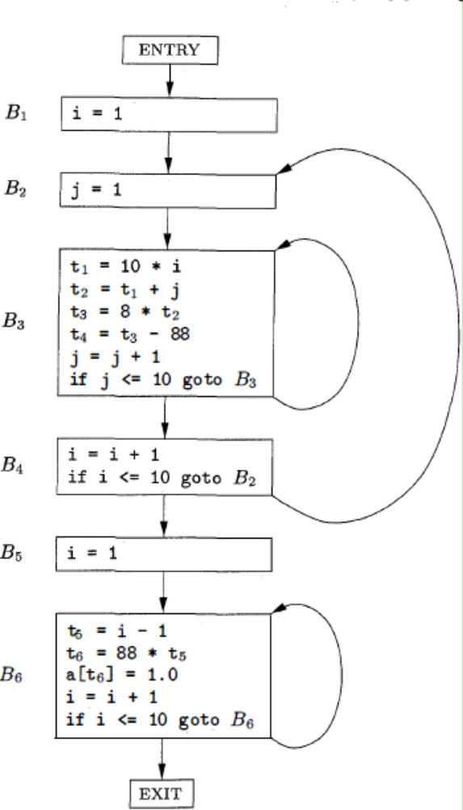

Slide 24
Dominator
We say node d of a flow graph dominates node n, written d dom n, if every path from the initial node of the flow graph to n goes through d.

Slide 25
Back Edge
The edges whose tails dominate their heads.
Given a->b, if b dom a, then a->b is a back edge.

Slide 26
Find All the Loops in a Flow Graph
Input: A flow graph G and a back edge n -> d.
Output: The set loop consisting of all nodes in the natural loop of n -> d.

Slide 27
Find All the Loops in a Flow Graph
Main( ){
stack=empty;
Loop={d};
Insert(n);
While stack is not empty {
pop m, the first element of stack, off stack;
for each predecessor p of m do
insert(p);
}
}

Slide 28
Find All the Loops in a Flow Graph
void insert (m){
if m is not in loop {
loop = loop ∪ {m};
push m onto stack;
}
}

Slide 29
1
Dominators
1 {1}
2 {1,2}
3 {1,2,3}
4 {1,2,3,4}
5 {1,2,3,4,5}
6 {1,2,3,4,5,6}
Back Edges Loops
4→2 {4,3,2}
3→3 {3}
6→6 {6}
2
3
4
5
6

Slide 30
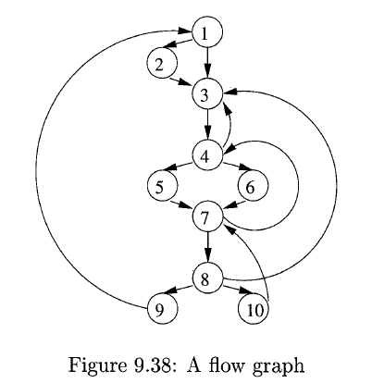

Slide 31
Dominators
1 {1}
2 {1,2}
3 {1,3}
4 {1,3,4}
5 {1,3,4,5}
6 {1,3,4,6}
7 {1,3,4,7}
8 {1,3,4,7,8}
9 {1,3,4,7,8,9}
10 {1,3,4,7,8,10}
Back Edges Loops
10→7 {10,8,7}
7→4 {7,5,6,10,8,4}
8→3 4 →3
{8,7,10,5,6,4,3}
9→1
{9,8,7,10,5,6,4,3,2,1}

Slide 32
Optimization of Basic Blocks
Constant folding
  Evaluate constant expressions at compile time and replace the constant expressions by their values
Common subexpression elimination
Copy propagation
Dead code elimination

Slide 33
Common Subexpression Elimination
An expression E is called a common sub-expression if an expression E was previously computed, and the values of variables in E have not changed since the previous computation.
Notes: We can avoid re-computing the expression if we can use the previously computed value.

Slide 34
An Example
A source code
Pi:=3.14
A:＝2*Pi*(R+r);
B:=A;
B:=2*Pi*(R+r)*(R-r)
(1)Pi:=3.14
(2)T1:=2*Pi
(3)T2:=R+r
(4)A:=T1*T2
(5)B:=A
(6)T3:=2*Pi
(7)T4:=R+r
(8)T5:=T3*T4
(9)T6:=R-r
(10)B:=T5*T6

Slide 35
(1)Pi:=3.14
(2)T1:=6.28
(3)T2:=R+r
(4)A:=T1*T2
(5)B:=A
(6)T3:=6.28
(7)T4:=R+r
(8)T5:=T3*T4
(9)T6:=R-r
(10)B:=T5*T6
(1)Pi:=3.14
(2)T1:=6.28
(3)T2:=R+r
(4)A:=T1*T2
(5)B:=A
(6)T3:=T1
(7)T4:=T2
(8)T5:=T3*T4
(9)T6:=R-r
(10)B:=T5*T6

Slide 36
Copy Propagation
Assignments of the form f:=g is called copy statements.
Copy propagation is the process of replacing the occurrences of targets of direct assignments with their values.
A direct assignment is an instruction of the form x = y, which simply assigns the value of y to x.

Slide 37
Copy Propagation
From the following code:
  y = x
  z = 3 + y
Copy propagation would yield:
  z = 3 + x

Slide 38
(1)Pi:=3.14
(2)T1:=6.28
(3)T2:=R+r
(4)A:=T1*T2
(5)B:=A
(6)T3:=T1
(7)T4:=T2
(8)T5:=T3*T4
(9)T6:=R-r
(10)B:=T5*T6
(1)Pi:=3.14
(2)T1:=6.28
(3)T2:=R+r
(4)A:=T1*T2
(5)B:=A
(6)T3:=T1
(7)T4:=T2
(8)T5:=T1*T2
(9)T6:=R-r
(10)B:=T5*T6

Slide 39
Dead Code Elimination
A variable is live at a point in a program if its value can be used subsequently; otherwise it is dead at that point.
Notes: A related idea is dead or useless code, statements that compute values that never get used.

Slide 40
(1)Pi:=3.14
(2)T1:=6.28
(3)T2:=R+r
(4)A:=T1*T2
(5)B:=A
(6)T3:=T1
(7)T4:=T2
(8)T5:=T1*T2
(9)T6:=R-r
(10)B:=T5*T6
(1)Pi:=3.14
(2)T1:=6.28
(3)T2:=R+r
(4)A:=T1*T2
(8)T5:=T1*T2
(9)T6:=R-r
(10)B:=T5*T6
Only A and B are used later

Slide 41
DAG
There is a node in the dag for each of the initial values of the variables appearing in the basic block.
There is a node n associated with each statement s within the block.

Slide 42
DAG
n₂
A
A := B
(:=, B, _, A)
op
n₁
B

Slide 43
DAG
A := B op C
(op, B, C, A)
n₃
A
op
n₁
n₂
B
C

Slide 44
DAG
If B rop C goto (s)
(jrop, B, C, (s))
n₃
(s)
rop
n₁
n₂
B
C

Slide 45
DAG
A:=B+C
B:=2*A
D:=A
n₅
B
*
n₃
A,D
+
n₁
n₂
n₄
B
C
2

Slide 46
DAG
The children of n are those nodes corresponding to statements that are the last definitions prior to s of the operands used by s.
Node n is labeled by the operator applied at s, and also attached to n is the list of variables for which it is the last definition within the block.

Slide 47
An Example
(1)T0:=3.14
(2)T1:=2*T0
(3)T2:=R+r
(4)A:=T1*T2
(5)B:=A
(6)T3:=2*T0
(7)T4:=R+r
(8)T5:=T3*T4
(9)T6:=R-r
(10)B:=T5*T6

Slide 48
n8
B
n8
B
*
*
n6
A
n6
A,T5
*
*
n5
n7
S2
n5
T2,T4
n7
T6
S1
+
-
+
-
n3
n4
T1,T3
n3
n4
n2
n1
T0
n2
R
r
R
r
6.28
3.14
6.28

Slide 49
Finding Local Common
Subexpressions
as a new node M is about to be added, whether there is an existing node N with the same children, in the same order, and with the same operator.
If so, N computes the same value as M and may be used in its place.

Slide 50
Dead Code Elimination
We delete from a DAG any root (node with no ancestors) that has no live variables attached.
Repeated application of this transformation will remove all nodes from the DAG that correspond to dead code.

Slide 51
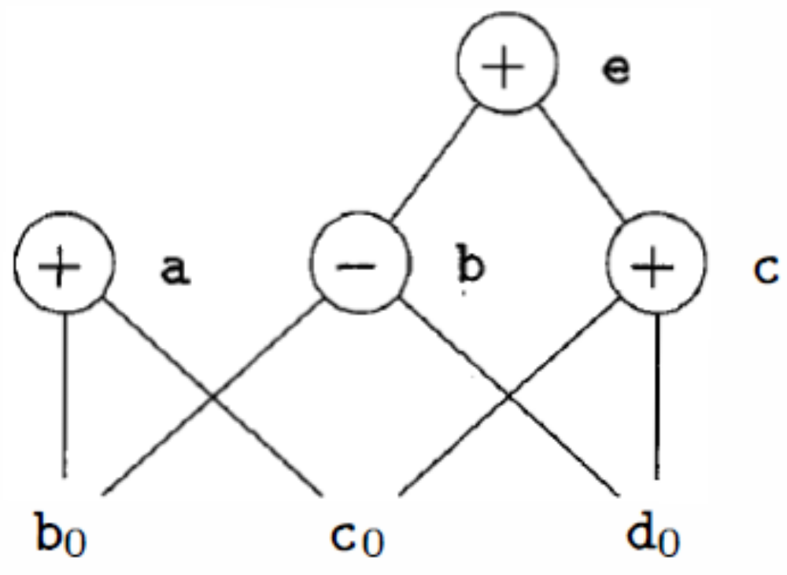
An counterexample
a = b + c;
b = b – d;
c = c + d;
e = b + c;

Slide 52
Representation of Array References
x = a[i]
a [j] = y
z = a[i]

Slide 53
Representation of Array References
A := B[C]
(=[], B[C], _, A)
n₃
A
=[]
n₁
n₂
B
C

Slide 54
Representation of Array References
D[C] := B
([]=, B, _, D[C])
n₄
[]=
n₁
n₂
n₃
D
C
B

Slide 55
Representation of Array References
What is different is that the creation of this node kills all currently constructed nodes whose value depends on D .
n₄
[]=
n₁
n₂
n₃
D
C
B

Slide 56
Representation of Array References
A node that has been killed cannot receive any more labels;
that is, it cannot become a common subexpression.

Slide 57
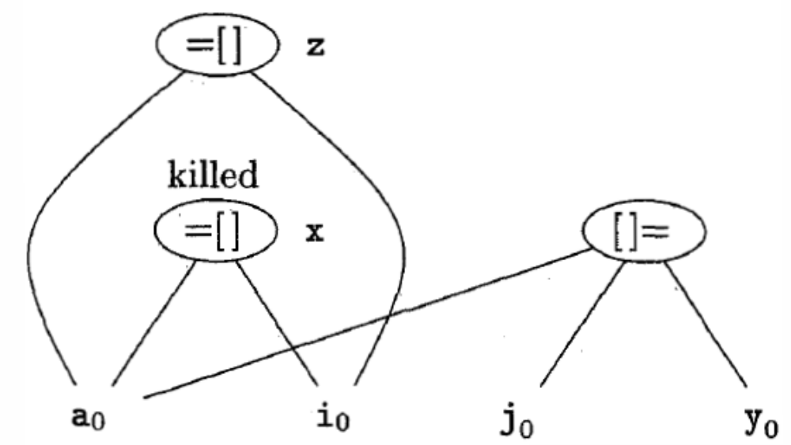
An Example
x = a[i]
a [j] = y
z = a[i]

Slide 58
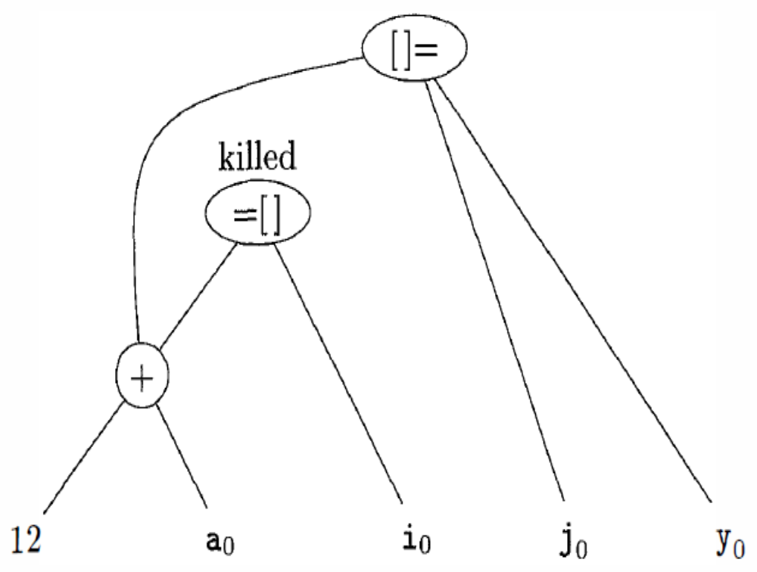
An Example
b = 12 + a
x = b [i]
b [j ] = y

Slide 59
Generating Code from Dags
Rearranging the order(Heuristic Order)
t1=a+b
t2=c+d
t3=e-t2
t4=t1-t3
t2=c+d
t3=e-t2
t1=a+b
t4=t1-t3
-
t4
+
t1
-
t3
a0 b0 e0
+
t2
c0 d0

Slide 60
Code Optimization in a Loop
Code motion
Reduction in Strength
Induction Variables: its value increases by one each time it is assigned

Slide 61
Pre-Headers
Move statements before the header.
Create a new block, preheader.
It has only the header as successor,
and all edges which formerly entered the header of L from outside L instead enter the preheader.

Slide 62
An Example
j:=1;
for i=1 to 100 do
A[i,j]:=B[i,j] +2
And the array is :
A,B:array[1:100,1:10]
m=1

Slide 63
(1)j:=1 (2)i:=1
(3) If i>100 goto (15)
(4)T1:=i*10 (5)T2:=T1+j
(6)T3:=a-11 (7)T4:=i*10
(8)T5:=T4+j (9)T6:=b-11
(10)T7:=T6[T5]
(11)T8:=T7+2
(12)T3[T2]:=T8
(13)i:=i+1
(14)goto (3)

Slide 64
(1)j:=1 (2)i:=1
(3) If i>100 goto (15)
(4)T1:=i*10 (5)T2:=T1+j
(6)T3:=a-11 (7)T4:=i*10
(8)T5:=T4+j (9)T6:=b-11
(10)T7:=T6[T5]
(11)T8:=T7+2
(12)T3[T2]:=T8
(13)i:=i+1
(14)goto (3)

Slide 65
(1)j:=1 (2)i:=1
(6)T3:=a-11 (9)T6:=b-11
(3) If i>100 goto (15)
(4)T1:=i*10 (5)T2:=T1+j
(7)T4:=i*10
(8)T5:=T4+j
(10)T7:=T6[T5]
(11)T8:=T7+2
(12)T3[T2]:=T8
(13)i:=i+1
(14)goto (3)

Slide 66
(1)j:=1 (2)i:=1
(6)T3:=a-11 (9)T6:=b-11 (4)T1=10 (7)T4=10
(3) If i>100 goto (15)
(5)T2:=T1+j
(8)T5:=T4+j
(10)T7:=T6[T5]
(11)T8:=T7+2
(12)T3[T2]:=T8
(13)i:=i+1
(4)T1:=T1+10
(7)T4:=T4+10
(14)goto (3)

Slide 67
(1)j:=1 (2)i:=1
(6)T3:=a-11 (9)T6:=b-11 (4)T1=10 (7)T4=10
(3) If T1>1000 goto (15)
(5)T2:=T1+j
(8)T5:=T4+j
(10)T7:=T6[T5]
(11)T8:=T7+2
(12)T3[T2]:=T8
(4)T1:=T1+10
(7)T4:=T4+10
(14)goto (3)

Slide 68
Data-flow analysis
1.Data-flow analysis
Analyze global data-flow information to do code optimization and a good job of code generation
Notes: Data-flow information can be collected by setting up and solving systems of equations that relate data information at various points in a program flow.

Slide 69
Data-flow analysis
2.Definitions
1)Point
The label of a statement in a program
2)Path
Path from p1 to pn is a sequence of points p1,p2,…, pn such that for each i between 1 and n-1,either

Slide 70
Data-flow analysis
  (1) pi is the point immediately preceding a statement and pi+1 is the point immediately following that statement in the same block, or
  (2) pi is the end of some block and pi+1 is the beginning of a successor block.

Slide 71
Data-flow analysis
3) Reaching
  A definition of a variable x is a statement that assigns, or may assign, a value to x.
  We say a definition d reaches a point p is there is a path from the point immediately following d to p, such that d is not “killed” along that path.

Slide 72
Data-flow analysis
  Notes:
  (1)Intuitively, if a definition d of some variable a reaches point p, then d might be the place at which the value of a used at p might last have been defined.
  (2)We kill a definition of a variable a if between two points along the path there is a definition of a.

Slide 73
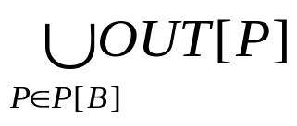
Data-flow analysis
3.Reaching-Definition Data-flow equations
OUT[B]=(IN[B]–KILL[B])∪GEN[B]
IN[B]=
P[B] is the predecessor of B
IN[B]:Set of definitions of each reachable variable at the beginning of Block B
KILL[B]:Set of re-defined definitions of variables
GEN[B]:Set of definitions of new generated variables in Block B
OUT[B]:Set of definition of each reachable variables
at the end of Block B

Slide 74
Data-flow analysis
4. Reaching Algorithm
Input . A flow graph for which kill[B] and gen[B] have been computed for each block B.
Output. In[B] and out[B] for each block B.
Method

Slide 75
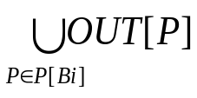
for each block B do
{ IN[Bi]=OUT[Bi]=Φ;}
change=TRUE;
while change do {
change=FALSE;
for each block B do {
IN[B]= ;
oldout=out[B];
OUT[Bi]=(IN[Bi]-KILL[Bi])∪GEN[Bi]
if out[B]<>oldout
change=TRUE;
}
}
//Forward

Slide 76
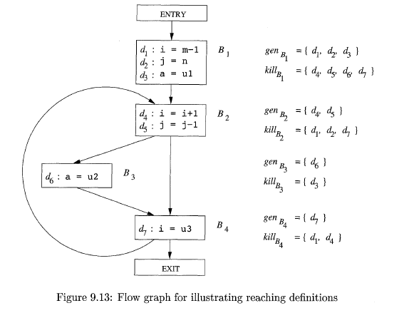

Slide 77
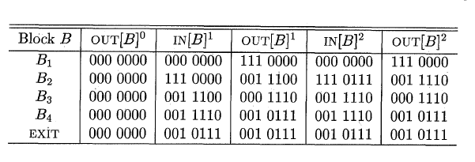
d₁d₂d₃d₄d₅d₆d₇

Slide 78
Data-flow analysis
5.Live-Variable Analysis
In live-variable analysis we wish to know for variable x and point p whether the value of x at p could be used along some path in the flow graph starting at p.
If so, we say x is live at p; otherwise x is dead at p.

Slide 79
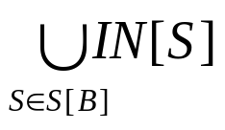
Data-flow analysis
5.Live-Variable Analysis
IN[B]=(OUT[B]–DEF[B])∪USE[B]
OUT[B]=
S[B] is a successor of B
DEF(B)is the set of variables defined in B
prior to any use of that variable in B
USE(B) is the set of variables whose values may be used in B prior to any definition of the variable

Slide 80
B
B
t=m+1
m=n+10
m=n+10
t=m+1
USE(B)={m,n}
DEF(B)={m,t}
USE(B)={n}
DEF(B)={m,t}
//m是定义后使用

Slide 81
B
B
m=n+1
x=m+10
x=m+10
m=n+1
USE(B)={n}
DEF(B)={m,x}
USE(B)={m,n}
DEF(B)={x}
//m使用后定义，应在IN集中

Slide 82
Data-flow analysis
6.Live variable Algorithm
Input. A flow graph with L.DEF and L.USE computed for each block.
Output. L.Out[B], the set of variables live on exit from each block B of the flow graph.
Method.

Slide 83
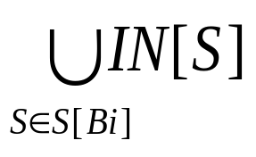
for each block B do L.IN[Bi]=Φ;
while (changes to any IN occur) do {
for each block B do {
L.OUT[B]= ;
IN[B]=(OUT[B]-DEF[B])∪USE[Bi]
}
}
//Backward

Slide 84
Data-flow analysis
7.Definition-Use Chains
We say a variable is used at statement s if its r-value may be required.
The du-chaining problem is to compute for a point p the set of uses s of a variable, say x, such that there is a path from p to s that does not redefine x.

Slide 85
Exercise
Supplemental exercise 2 for Ch9
9.1.4 p596

