Slide 1



ZOWIE, ZHANGXIANG, SIDDARTH, PARIK

Slide 2
TABLE OF CONTENT
Exploratory Data Analysis
Zowie
Siddarth
Zhang Xiang
Parik
Introduction
Background
Problem statement
Hypothesis
Projected Outcome
Sub-hypothesis
Gantt chart

Slide 3
INTRODUCTION
In recent years, there was an overall decrease in ticket sales, caused by various external factors (Socio-economic, Politics, Environmental) which resulted in a 6.2million USD loss in 2019.
Hence, our aim is to improve the overall performance of American Airlines, a prominent airline company in the United States.
Our objective is to gain valuable insights into multiple aspects of the airline industry. Such as pricing trends, flight delays, consumer perspectives, and seat availability., from 2017 to 2019.
Furthermore. We aim to conduct a comparative analysis between American Airlines and its primary competitors, United Airlines & Delta Airlines. To pinpoint areas for improvement and potential competitive advantages.
Insights that are derived from our analysis will help in discovering what factors affect ticket sales the most, and how we can maintain or improve upon them.

Slide 4


BACKGROUND
American Airlines stands as one of the leading airlines, not just in the United States but worldwide. As a major player in the global aviation industry, we provide a wide range of domestic and international flights to numerous destinations. Our commitment lies in genuinely valuing our passengers and understanding the pivotal role that exceptional services play in crafting an unforgettable travel experience. We understand that elements like attentive service, comfortable surroundings, punctuality, and excellent amenities greatly impact how our passengers feel about their flights and overall satisfaction. With a strong commitment to these aspects, we strive to improve the quality of our services and ensure that every passenger enjoys a positive and delightful journey.

Slide 5
BACKGROUND
As Data Analysts at American Airlines, our main job is to explore a large amount of data that we have. Our goal is to extract meaningful insights that can guide informed decision-making processes. We fully recognize the immense value of data-driven strategies in optimizing the airline's overall performance and operational efficiency. By leveraging advanced data analytics techniques, our focus is on tackling key areas that directly impact the business, including ticket demand, flight delays, and the overall flight experience for passengers. Through this project, we aim to generate positive outcomes and drive the airline towards greater success.

Slide 6

PROBLEM STATEMENT
A decrease in revenue from 2017 to 2018 and 2019 has prompted American airlines to conduct an in-depth analysis into their data from 2017 to 2019, as well as competitors United and Delta airlines.
This is done in order to find out the reasons for decreased sales and customer satisfaction.

Slide 7
“Low prices, low delay rates with quality service will lead to higher customer satisfaction which in turn, generates higher revenue.”

Slide 8
HYPOTHESIS &
PROJECTED OUTCOME
This hypothesis will guide our analysis into
Factors that control dynamic ticket prices, and how it influences customers’ buying decision
Factors that affect delay rates and how we can predict delay of flights
Through customer reviews, uncover points of American Airlines that customers are satisfied / unsatisfied with.
Through customer ratings of factors of flights, discover how these factors affect ticket sales
Insights derived from our analysis can lead us into proposing solutions on how we can avoid or mitigate the effects of such factors (e.g. reduce price, develop new unique selling points, further promote unique services)

Slide 9

SUB-HYPOTHESIS
ZOWIE
Dynamic ticket prices are mainly determined by date of flight
SIDDARTH
Weather conditions are the primary contributing factors to airline delays
ZHANGXIANG
Quality of Service will influence satisfaction and future choice of airline.
PARIK
The quality of services affects the remaining seat availability

Slide 10
SUB-HYPOTHESIS
ZOWIE
Dynamic ticket prices are mainly determined by date of flight
SIDDARTH
Weather conditions are the primary contributing factors to airline delays
ZHANGXIANG
Quality of Service will influence satisfaction and future choice of airline.
PARIK
The quality of services affects the remaining seat availability

Slide 11
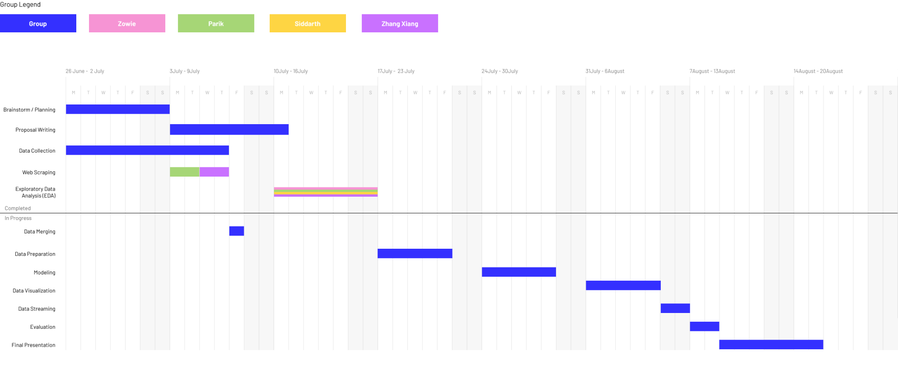
GANTT CHART

Slide 12
HYPOTHESIS: Dynamic ticket prices are mainly determined by date of flight.
The objective of this study is to investigate the extent to which dynamic ticket prices for American airline flights are determined by the date of the flight.
This will be done by analyzing historical ticket price data and considering various factors that influence pricing dynamics.
The findings will contribute to a better understanding of the factors influencing dynamic pricing for American airlines, and provide insights for American airlines and customers regarding pricing strategies, booking decisions, and market competitiveness.

Slide 13
DATASET: Origin and Destination Survey 2017-2019
The dataset contains a wide range of data about different aspects of a flight.
This comprehensive dataset allows for in-depth analysis and exploration of different factors affecting flights of different airlines.
The columns i will be using are
Year
Quarter
Airline Name
OriginAirportID
OriginState
DestAirportID
DestState
FarePerMile
MktFare
MktMilesFlown
Datasets - Download page (bts.gov)

Slide 14
INTENTION & INSIGHTS
Intention:
Correlation analysis: Analyze the factors of American airline flights, and discover how these factors affect price.
Competitor analysis: Compare factors of American airlines against United airlines and Delta airlines. Some factors include price per mile flown, distance of flight and date of flight
Insights:
Discover the strength and direction of the relationship between various factors and price, and hence which factors affect pricing the most.
This analysis may reveal that factors like flight distance have a strong positive correlation with prices, indicating that longer flights tend to be more expensive.
A competitor analysis will help identify the ways that American airlines are different in comparison to United and Delta airlines.
Lower price per mile flown might indicate more cost-effective options for passengers.
Understanding the differences in pricing can assist in developing pricing strategies and identifying opportunities for competitive advantage.

Slide 15
DASHBOARD
Posible charts
Multiline plot; Average flight price for each airline by months
Scatter plot; show relationship between price and distance traveled
Stacked bar chart; count of flights by months, each section represents an airline
Combination chart (grouped bar chart and line chart)
Grouped bar chart; each group would represent an airline and the bars within each group would represent the number of round-trip flights and number of one-way flights for that airline.
Line chart; average price of each airline
Filters
Filter by Airline, Years, Quarters, Months

Slide 16
Hypothesis, Intentions and Insights
Hypothesis:
Weather conditions are the primary factors contributing to airline delay. Adverse weather conditions may significantly impact flight operations as it make cause taking of and landing to be unsafe.
Intention
Flight Delay Analysis: Analyze the factors influencing flight delays. Determine the most significant factors contributing to flight delays and their impact
Competitor Analysis: Analyze the delay patterns of different airlines and compare their performance in terms of flight delays. Identify airlines with higher or lower rates of delays and assess the impact of factors such as weather conditions, distance group, and day of the week on delays for each airline
Insights
Assess Delay factors: Determine factors that contribute to flight delays and determine if weather is the dominant role in causing flight delays.
Resource Allocation: Understanding flight delay factors can help airlines optimize resource allocation, improving efficiency and cost effectiveness.
Mitigating Customer Impact: Predicting flight delays enables proactive passenger notification, facilitating alternative arrangements and necessary compensation or assistance. This proactive approach enhances customer satisfaction and mitigates the negative effects of delays on passenger experiences.

Slide 17
Dataset
The dataset contains daily information covering from flight information, carrier company, to taxing-in, taxing-out time, and generalized delay reason for exactly 10 years. Each year has a different csv. For this study I will be using the years 2017 to 2019.
Columns used:
FL_DATE
OP_CARRIER
OP_CARRIER_FL_NUM
ORIGIN
DEST
DEP_TIME
DEP_DELAY
TAXI_OUT
TAXI_IN
WHEELS_OFF
WHEELS_ON
ARR_TIME
ARR_DELAY
AIR_TIME
DISTANCE
CARRIER_DELAY
WEATHER_DELAY
NAS_DELAY
SECURITY_DELAY
LATE_AIRCRAFT_DELAY

Slide 18
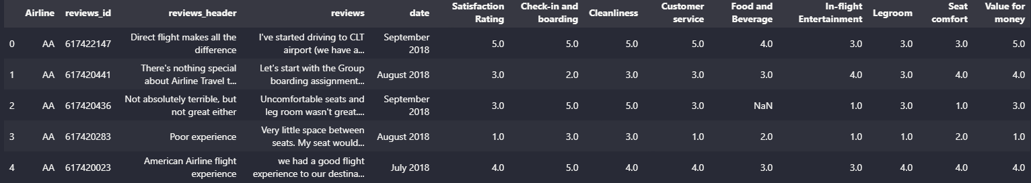
HYPOTHESIS: Quality of Service will influence satisfaction and future choice of airline.
Data Scraped from the 3 airlines stated above over year around 2017 to 2019. The web scraped 90282 rows data from TripAdvisor, without cleaning. This dataset provides sufficient amount of data for further analysis, with all required columns of data for further analysis.
Zhang Xiang & Parik dataset
Website Scraped (Included) – https://www.tripadvisor.com
- American Airline
- United Airline
- Delta Airline

Slide 19
HYPOTHESIS: Quality of Service will influence satisfaction and future choice of airline.
Intention
Identify customer satisfaction: Understand the overall opinion of customers towards American Airlines with comparison of it competition airlines (United Airline & Delta Airline)
Enhance operational efficiency: By analyzing customer reviews, airlines can identify issues or areas where service quality can be improved, to address pain points, and enhance efficiency, leading to better customer satisfaction and loyalty.
Competitive Analysis: Comparing sentiments across different airlines can provide insights into how the airline performs in comparison to its competitors. This analysis can help identify areas where the airline can differentiate itself and gain a competitive advantage.
Brand Reputation Monitoring: Tracking sentiments expressed by customers in reviews can help monitor the airline's brand reputation.

Slide 20
HYPOTHESIS: Quality of Service will influence satisfaction and future choice of airline.
Insights
Key strengths and weaknesses: Identifying particular components of the flight experience that passengers value or find lacking might assist identify American Airlines, Delta, and United Airlines' strengths and shortcomings.
Comparative performance: Analyzing customer ratings from several airlines can give insight into how American Airlines compares to its competitors. Understanding where American Airlines succeeds or falls behind its competitors could affect strategic decision-making and identify areas for growth.
Trends and patterns: Analyzing customer evaluations might indicate trends and patterns in terms of common feedback, or preferences. For example, if several consumers frequently appreciate or dislike a certain feature of the flying experience, it suggests a trend that requires attention or additional inquiry.

Slide 21
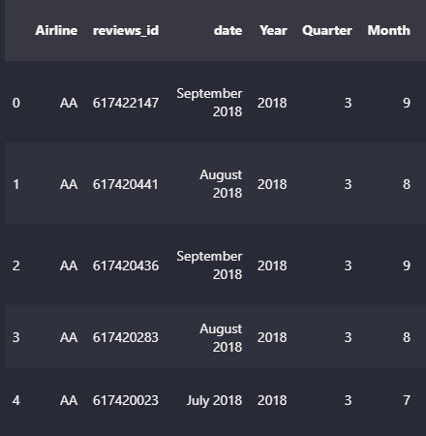
How this dataset link with other datasets?
Data in common with team members: Airline, Year and Quarter
Merge using
Airline,Year,Quarter
Notes:
zx

Slide 22
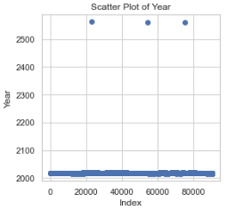
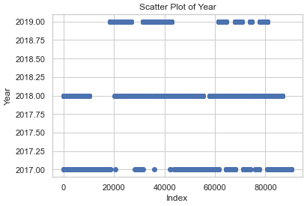
Outlier - Year
With data scraped, I found outlier value for the “Year”.
Notes:
zx

Slide 23
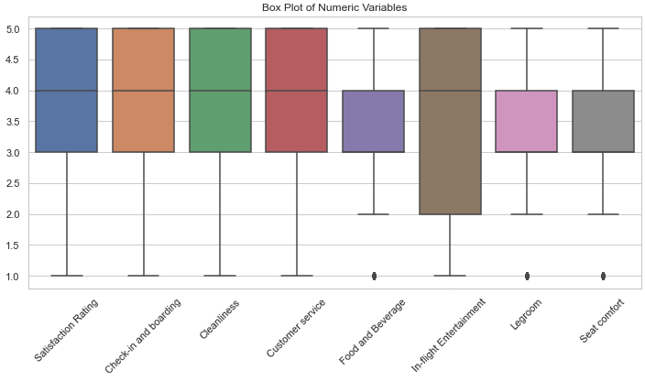
Outlier Check - Numeric Variable
No outlier found
Notes:
zx

Slide 24
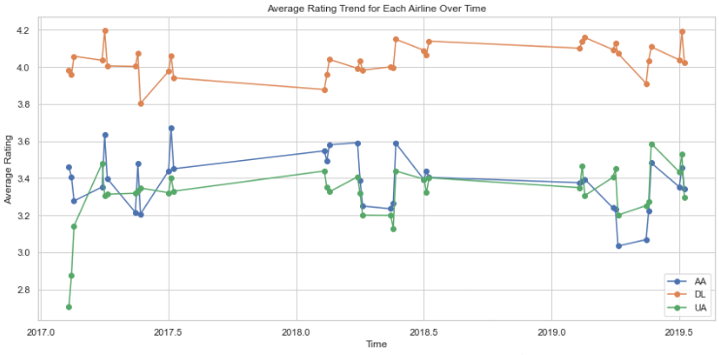
Data-Insights: Multi-Line Chart
American Airline is more comparable with United AIrline, whereas Delta Airline Rating is the highest over years.
With comparison with these two airline company, it enable American Airline to better find insights on similarity and differences between the competitor.
Notes:
zx

Slide 25
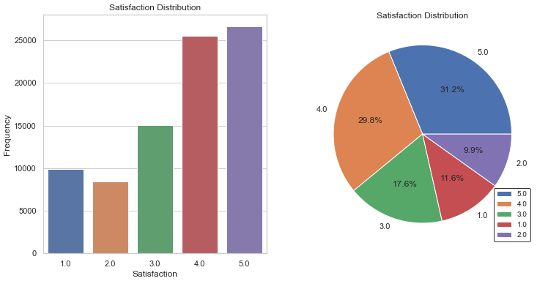
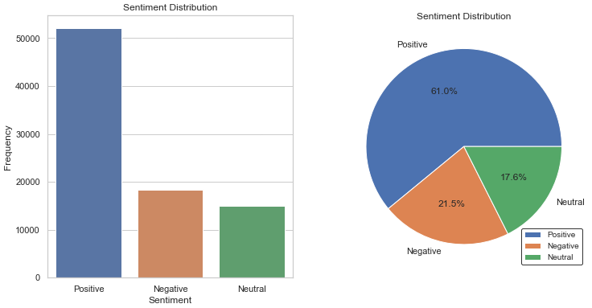
Target Variable: Evaluation on Balance
Rating
Sentiment (Considering)
Notes:
zx

Slide 26
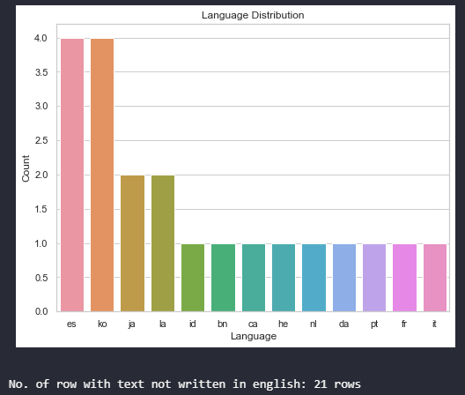
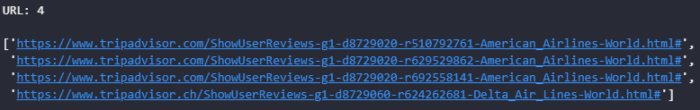
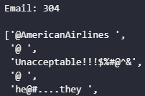

Review Evaluation
Other Language found (English)
URL Found - Does not contribute information to text analysis
Email + Emoji- Does not contribute information to text analysis
Notes:
zx

Slide 27
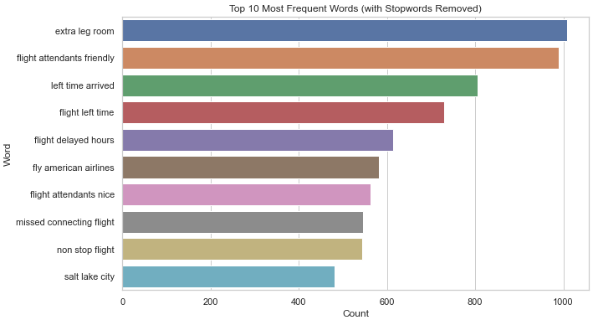
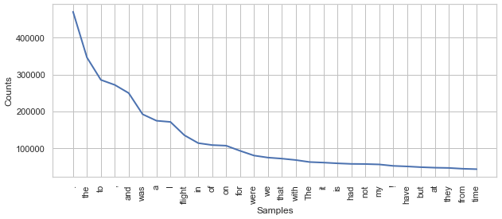
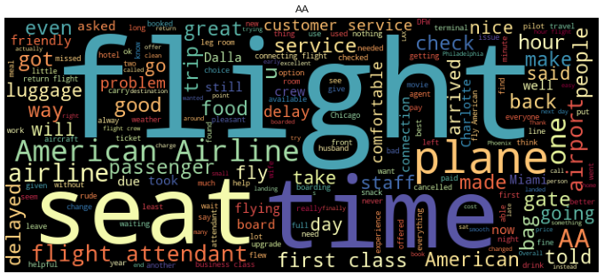
Review Evaluation
Stop Words appear frequently: It will be removed during text-preprocessing
Trigram when stop-words is removed
Frequent word generated for American Airline
Notes:
zx

Slide 28
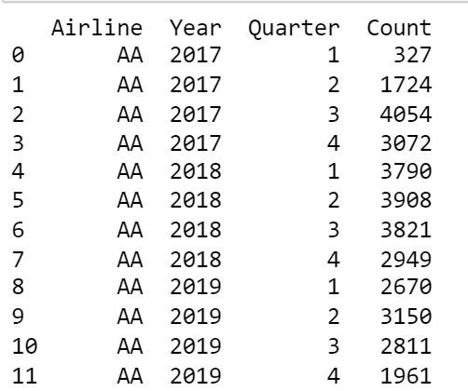
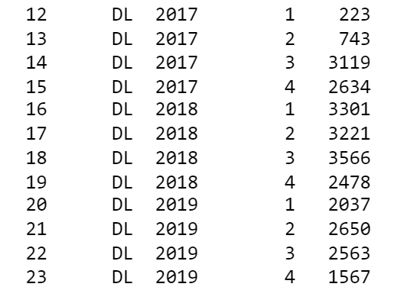
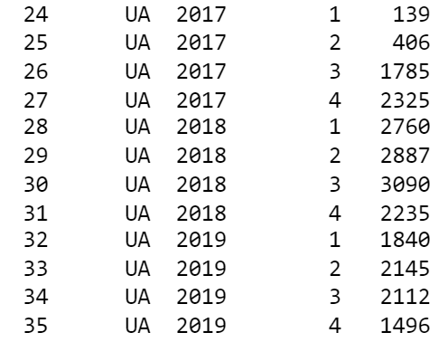
Group By Airline,Year, Quarter
American Airline
Delta Airline
United Airline
Notes:
zx

Slide 29
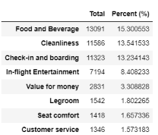
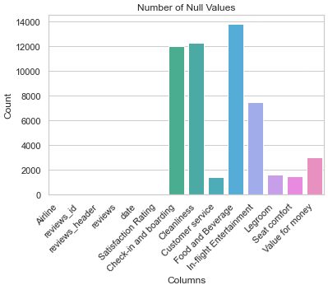

% of missing values in each factor
Notes:
zx

Slide 30
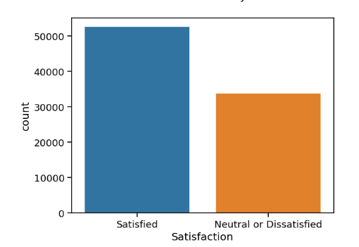
Distribution of satisfaction rate
Satisfied : 52, 152 ( 61 % )
Neutral or Dissatisfied: 33, 407( 39% )
Notes:
zx

Slide 31
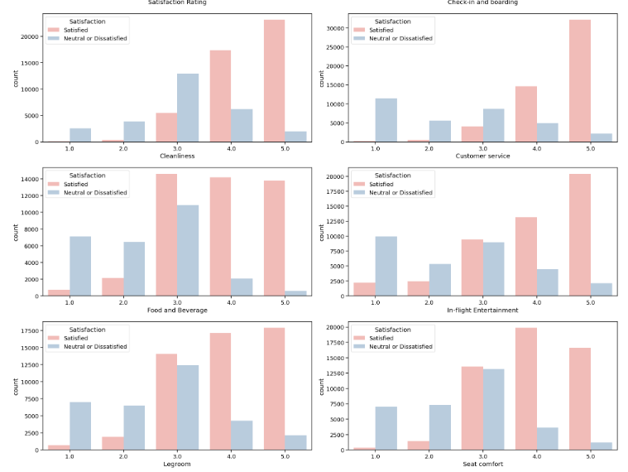
Distribution of satisfaction rate
If cleanliness is 3 and below, there is a higher chance it will be dissatisfied. goes same for customer service.
Notes:
zx

Slide 32
data dictionary
what is data about - distribution - possible values - understand data
check outlier / unusual values
justify reasoning
through eda, what are common columns
how we merge
why merge
parik need cols from 2 datasets
matched date rows
filter necessary rows (airline)
column understanding
eda
merge
stream
cleaning

Slide 33
SLIDES
join rows (airline, year, quarter, destination state, origin state) - show dataset columns
indiv
datasets used and y include
eda + exploration

