Slide 1




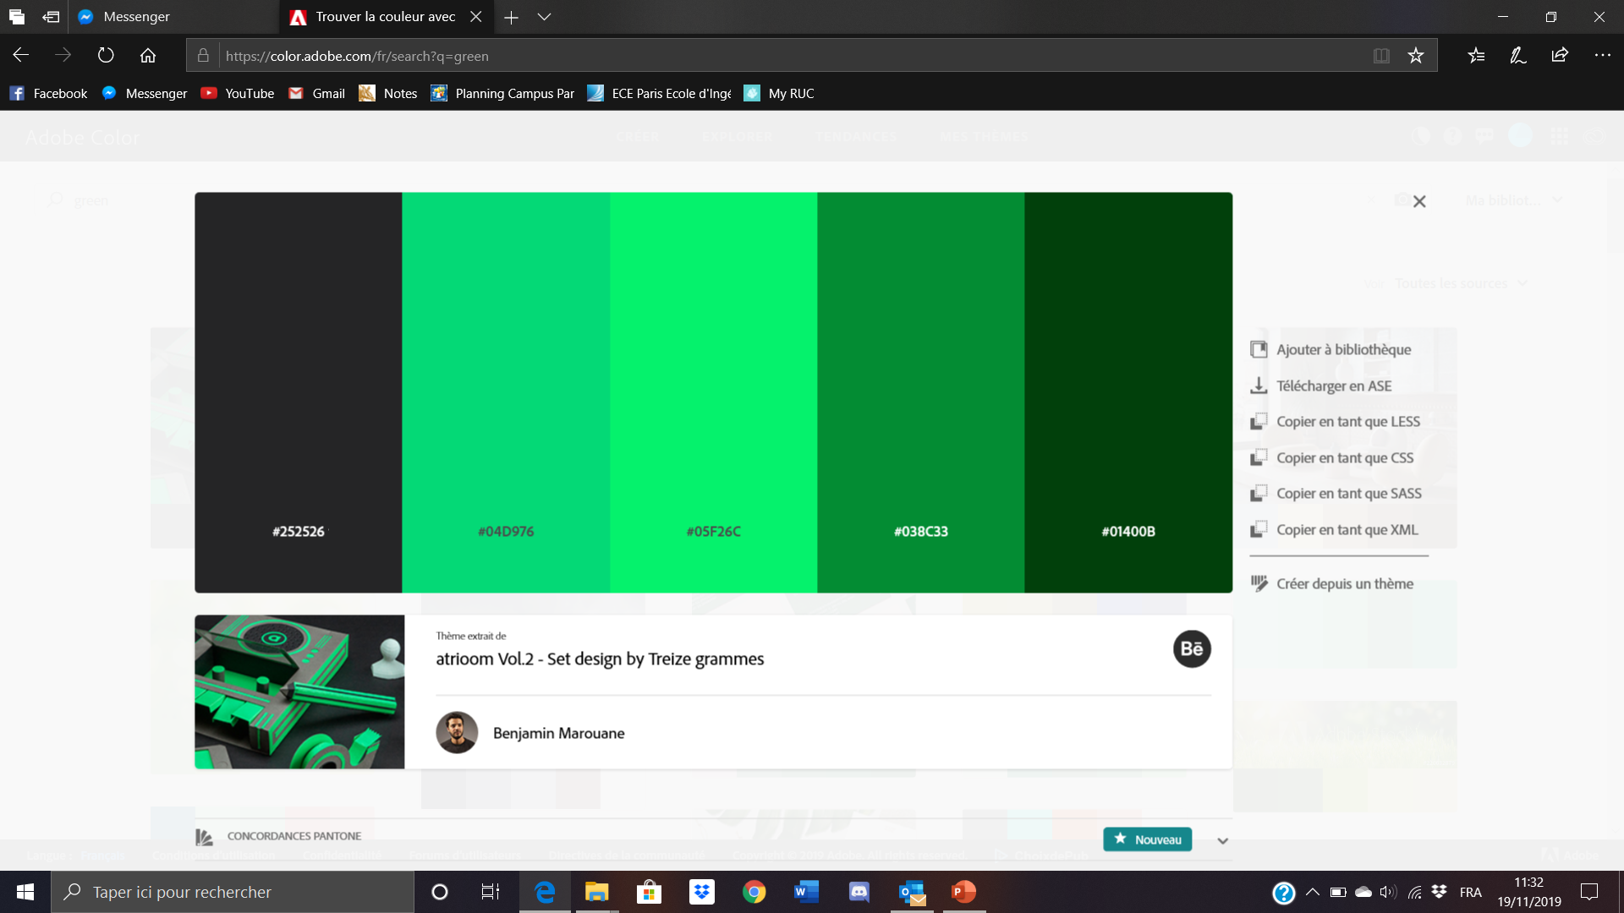
DashBoard
To Do List

