Slide 1
Help us improve Zowe install experience Tuesday, Apr. 23, 2019 Playforward

Slide 2
Agenda
Zowe 1.0
Zowe Architecture
Zowe launch and Run
Journey from zowe.org to mainframe started tasks
Install and configure ZOWESVR
Install and configure ZWESIS01
Pain points
Cupids To-Be
Installer and launch topology
Installer and questions
Launch with configuration and questions
Delivery Route and support questions

Slide 3
Questions
Manage via started tasks or USS processes
PARMLIB vs. /etc/.profile or hybrid hierarchy
User IDs
Keystore keyring
Install using JCL or shell scripts
How much to automate ? PROCLIB, PARMLIB, APF Load Lib
Locations /usr/lpp/zowe/v1 and /var/zowe/v1
ZWESVR and get rid of option ?
Support – base zowe.org FMID redistributed on IBM, Broadcom, other
Receive order 1) manual, 2) shell with wget for CSI entry 3) Formal receive order server
Tony – how do sites know PTFs and APARs are available. How to know/notify
PTF – APAF – emergency fix/user mod.
Lifecycle – STC for each component or one PROCLIB with USS

Slide 4
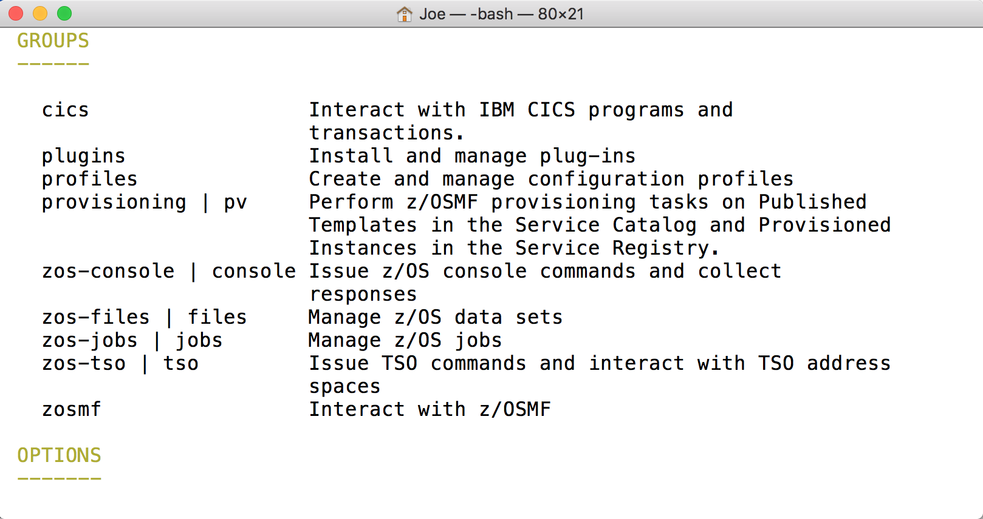
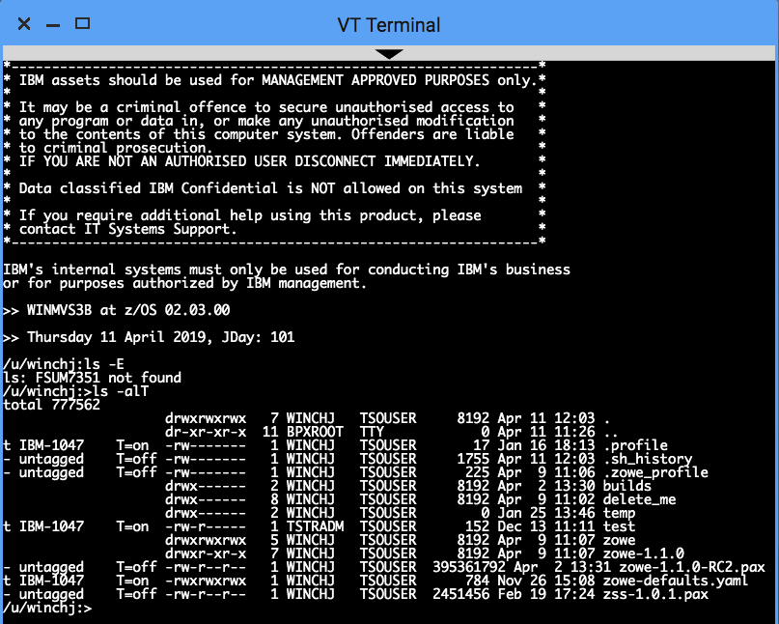
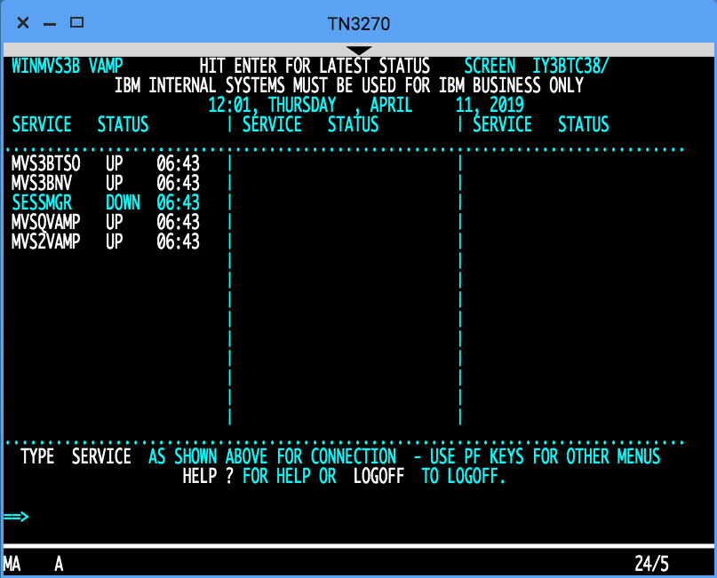
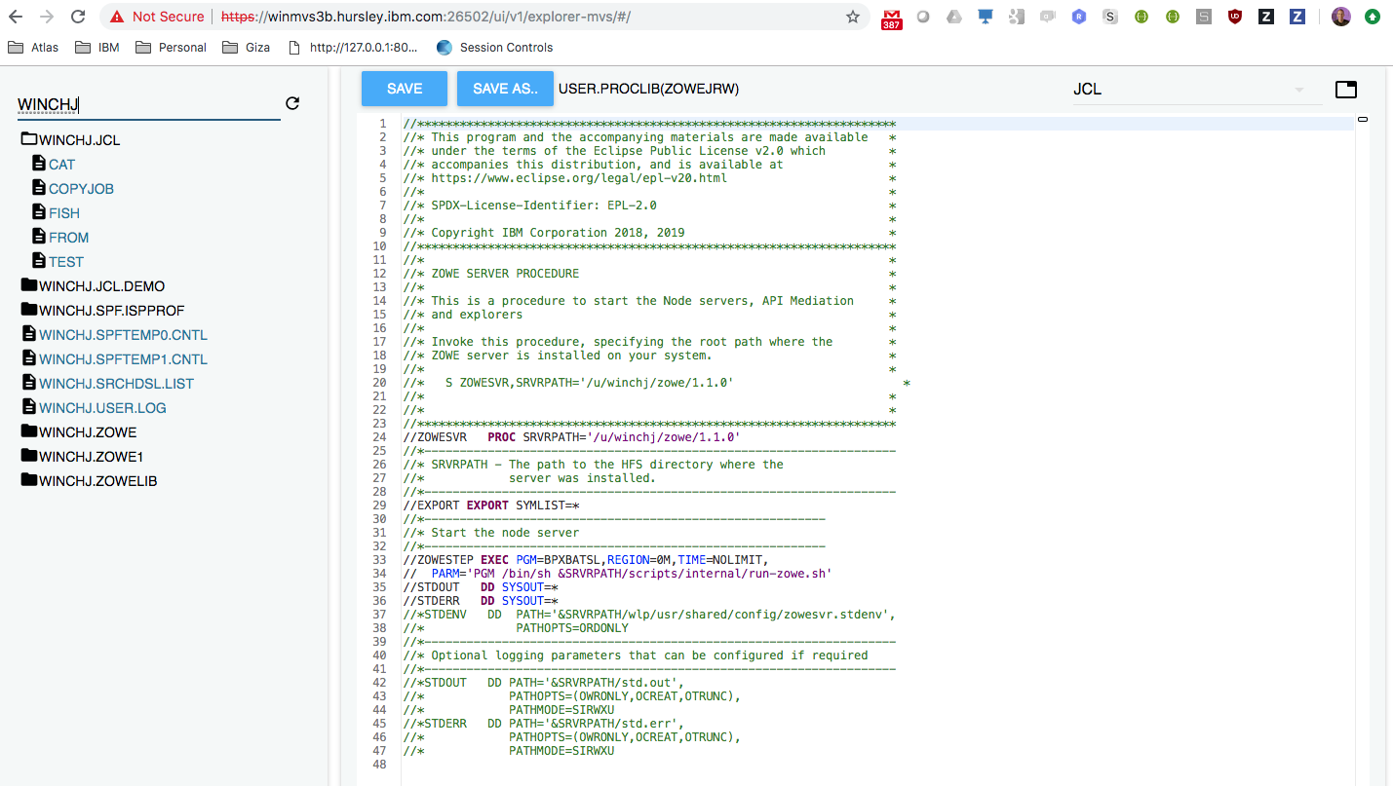
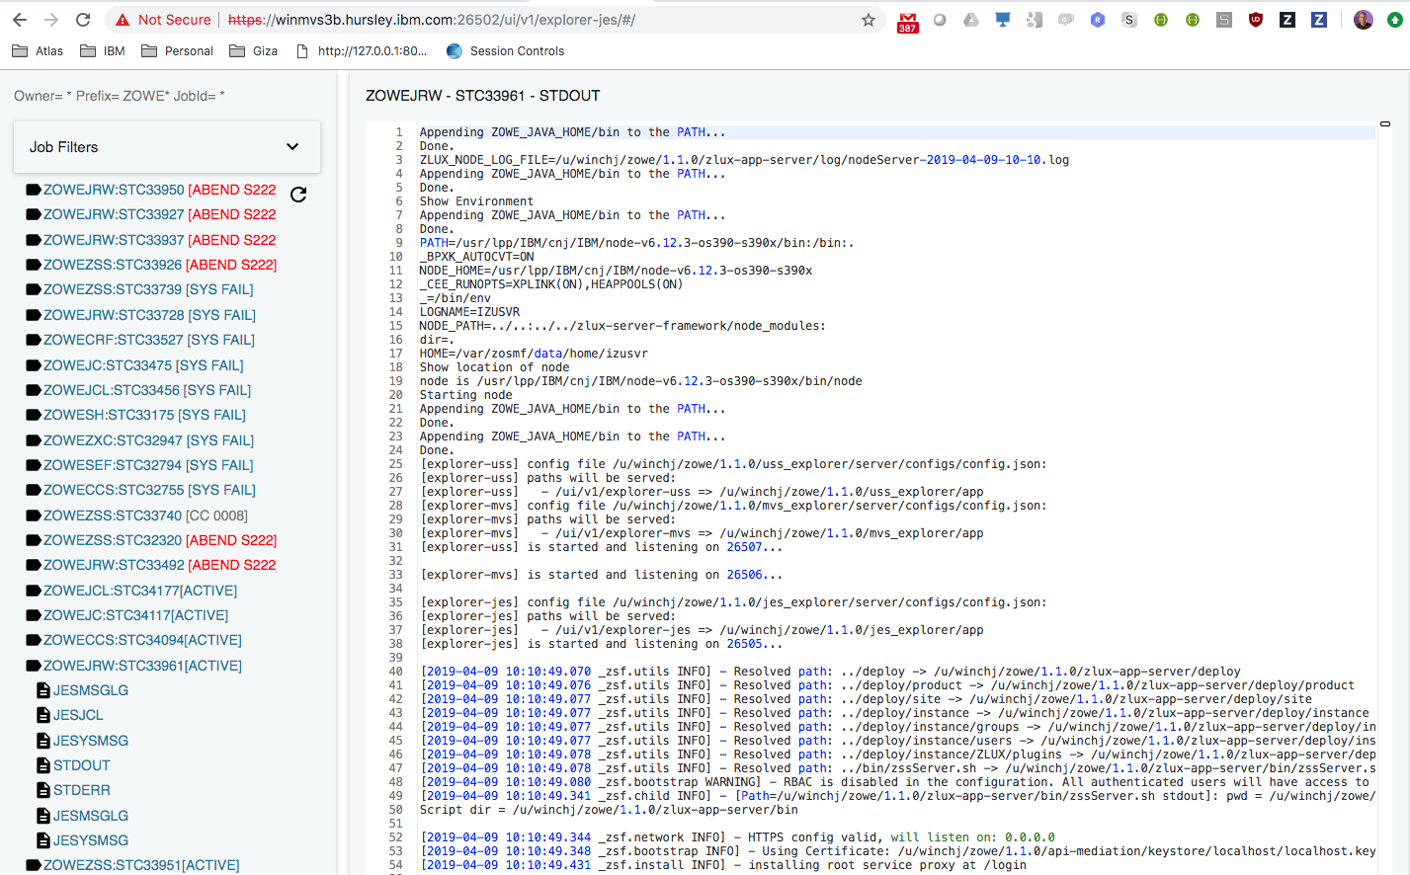
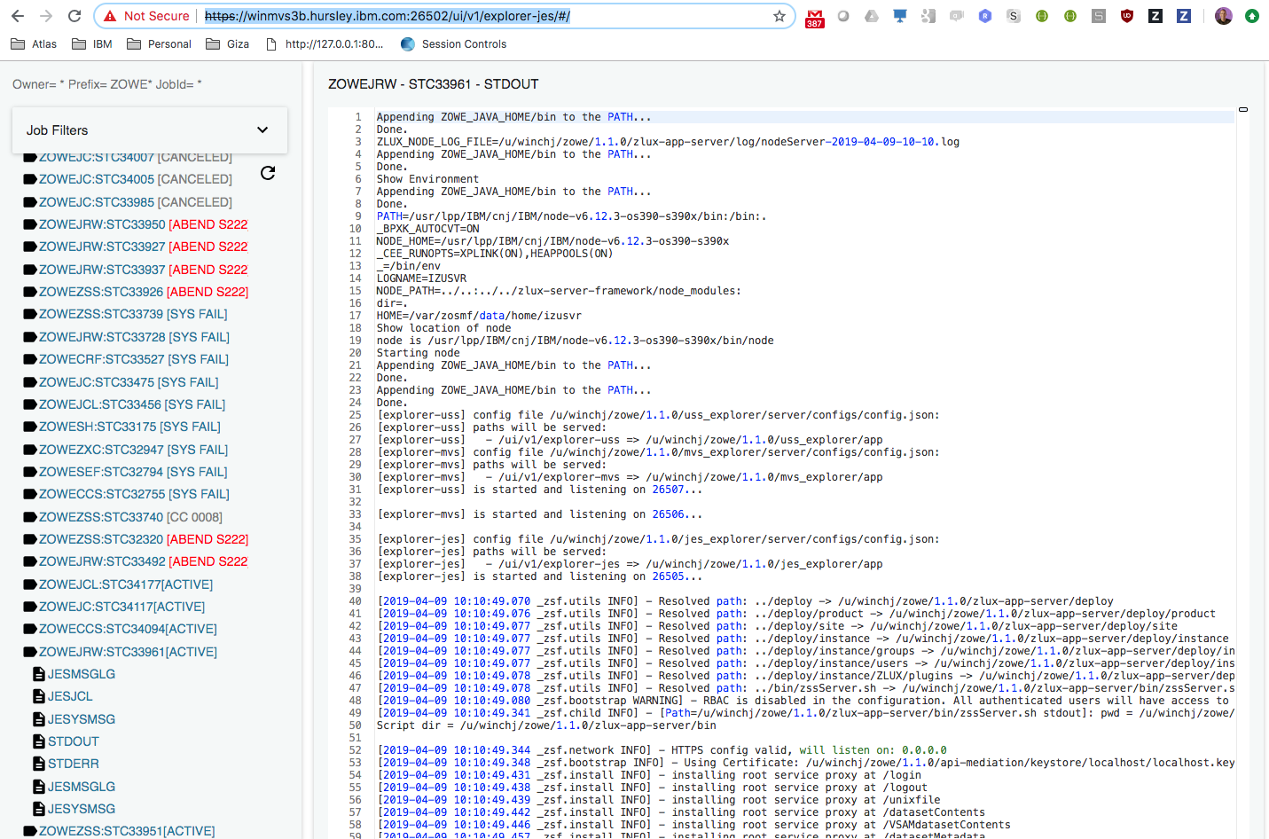
Zowe architecture
Zowe Desktop
VT Terminal
TN 2170
MVS Explorer
JES Explorer
USS Explorer
Command line interface
Desktop
8544
7554
z/OS
In progress
API Gateway
8544
7552
7553
8547
8545
7443
8548
8546
8550
ZLUX
API Catalog
API Discovery
File API
JES API
MVS UI
JES UI
USS
UI
TN3270
VT
8542
zssServer
X-MEM
z/OSMF
Java 8
Node 6.14
ZWESIS01
C / metal C

Slide 5
Zowe architecture
Zowe Desktop
VT Terminal
TN 2170
MVS Explorer
JES Explorer
USS Explorer
Command line interface
Desktop
8544
7554
z/OS
In progress
API Gateway
/S ZOWESVR
8544
7552
7553
8547
8545
7443
8548
8546
8550
ZLUX
API Catalog
API Discovery
File API
JES API
MVS UI
JES UI
USS
UI
TN3270
VT
8542
zssServer
/S ZWESIS01
X-MEM
z/OSMF
Java 8
Node 6.14
ZWESIS01
C / metal C

Slide 6
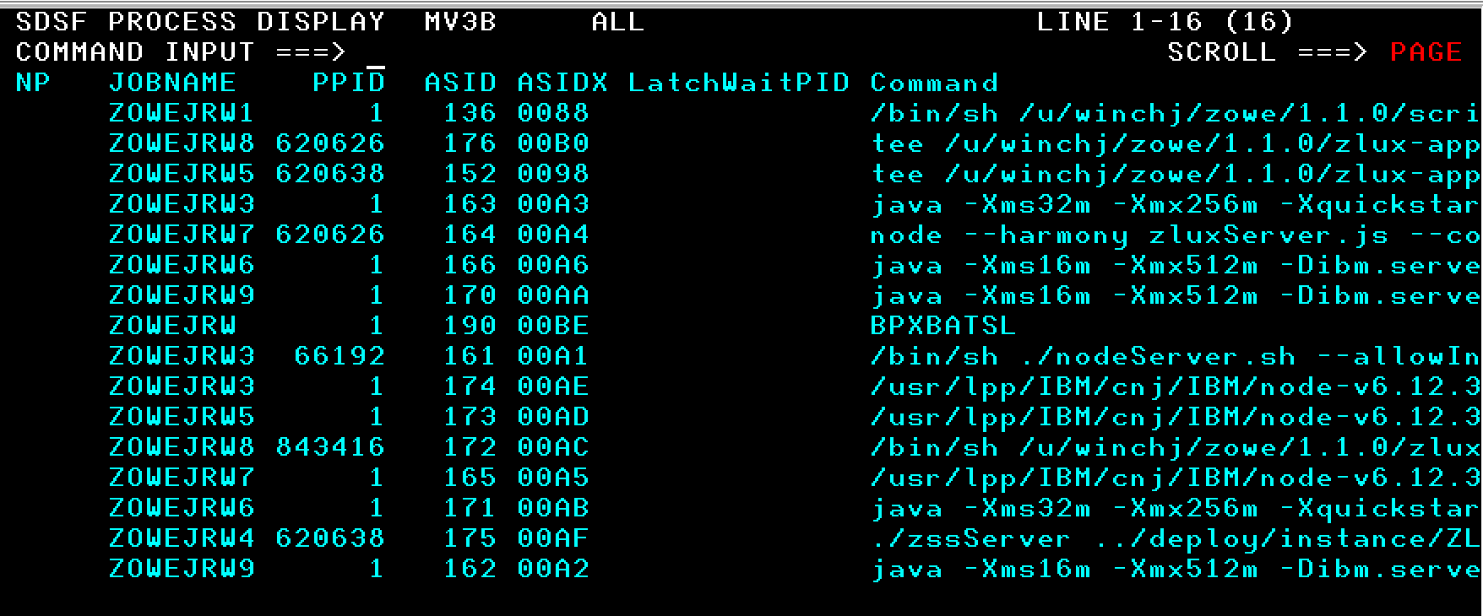
Zowe launch and run
Zowe Desktop
VT Terminal
TN 2170
MVS Explorer
JES Explorer
USS Explorer
Command line interface
Desktop
z/OS
*.PROCLIB(ZOWESVR)
Owner: IZUSVR Group: IZUADMIN
/S ZOWESVR
/S ZWESIS01
X-MEM
z/OSMF
Java 8
Node 6.14
ZWESIS01
C / metal C

Slide 7
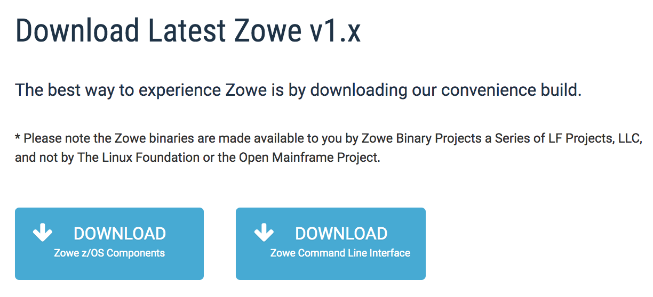
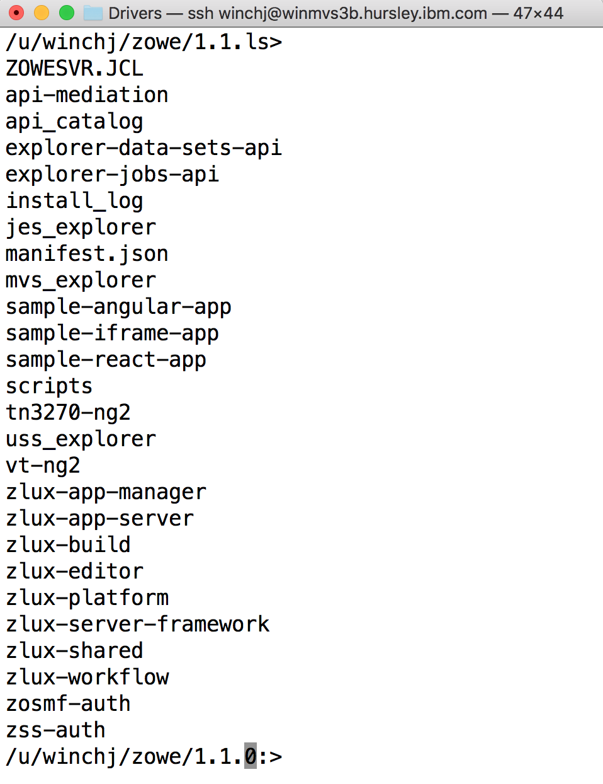
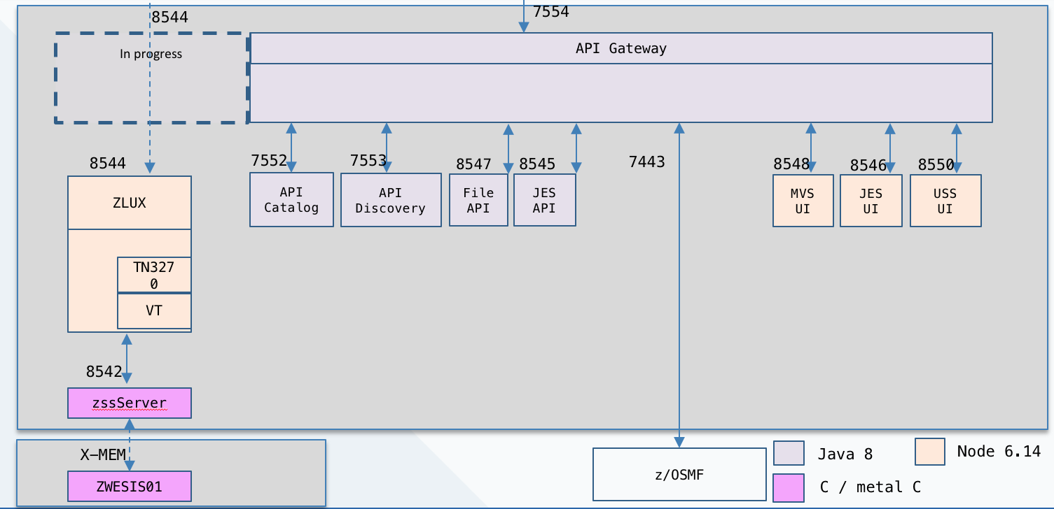
Getting from Zowe.org to mainframe’s STC
USS runtime folder structure with code
sftp to z/OS USS
pax –ppx –rf zowe-v.r.m.pax
Proclib ZOWESVR
Proclib ZWESIS01

Slide 8
Installing and configuring ZOWESVR
Choose ports for Zowe API gateway, Zowe ZLUX server, and 9 other microservices
Define where z/OSMF is located
Define where Java is located
Define where Node is located
Specify northbound TLS certificate, self sign generated or re-use existing certificate
Specify whether southbound servers (such as z/OSMF) will be trusted if their certificates are self signed/cross signed
Define ssh and telnet port numbers for TN3270 and VT terminal apps
Specify PROCLIB name for ZOWESVR which is added to first available PROCLIB in JES concatenation path

Slide 9
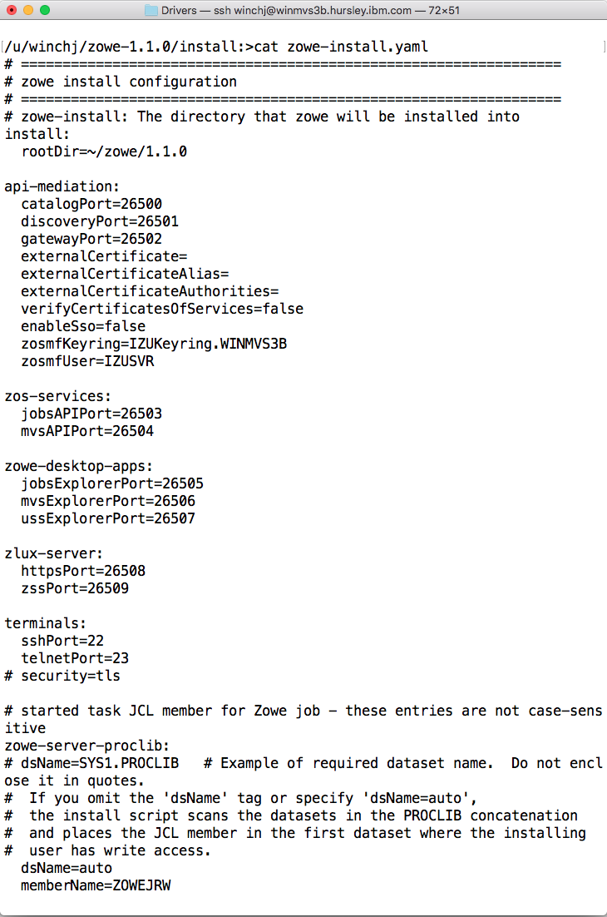
Installing and configuring ZOWESVR
edit zowe-install.yaml
/.zowe-install.sh
Certificate import of z/OSMF may
fail based on user permissions
chmod on folders to protect private
keys and user data may fail
Auto creation of ZOWESVR proclib
in first available on JES concatenation
path may fail

Slide 10
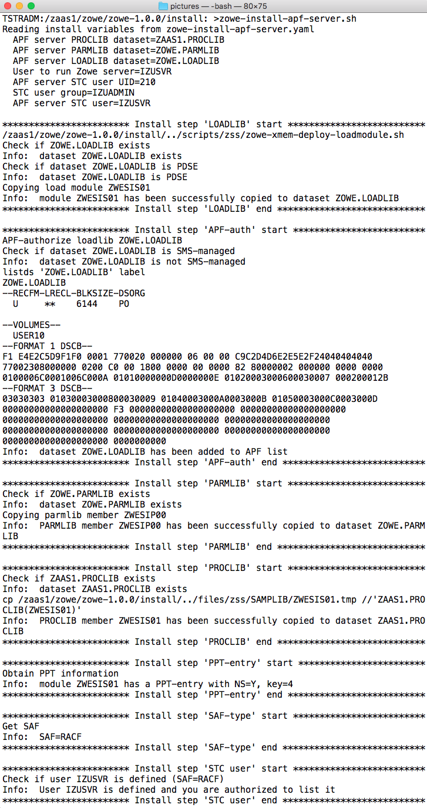
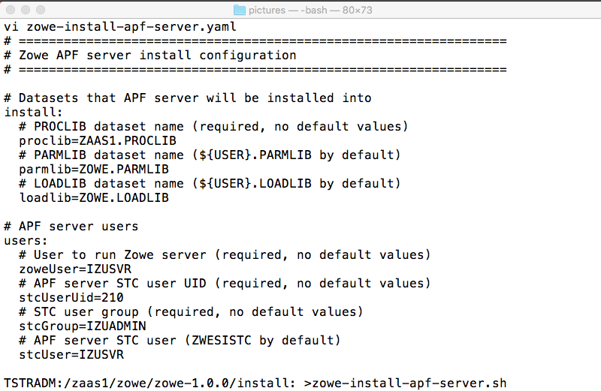
Installing and configuring ZWESIS01
/.zowe-install.apf-server.sh
Create PDSE load library and copy
ZWESIS01 Load module from LOADLIB
edit zowe-install-apf-server.yaml
APF auth load library
IZUSVR needs READ access to
CSFRNGL in the CSFSERV class for
ICSF Cryptographic
Copy PARMLIB from install SAMPLIB
Copy ZWESIS01 PROCLIB
PERMIT BPX.SERVER and BPX.DAEMON
ACCESS(UPDATE)
PPT Key(4)
IZUSVR READ of ZWES.IS FACILITY

Slide 11
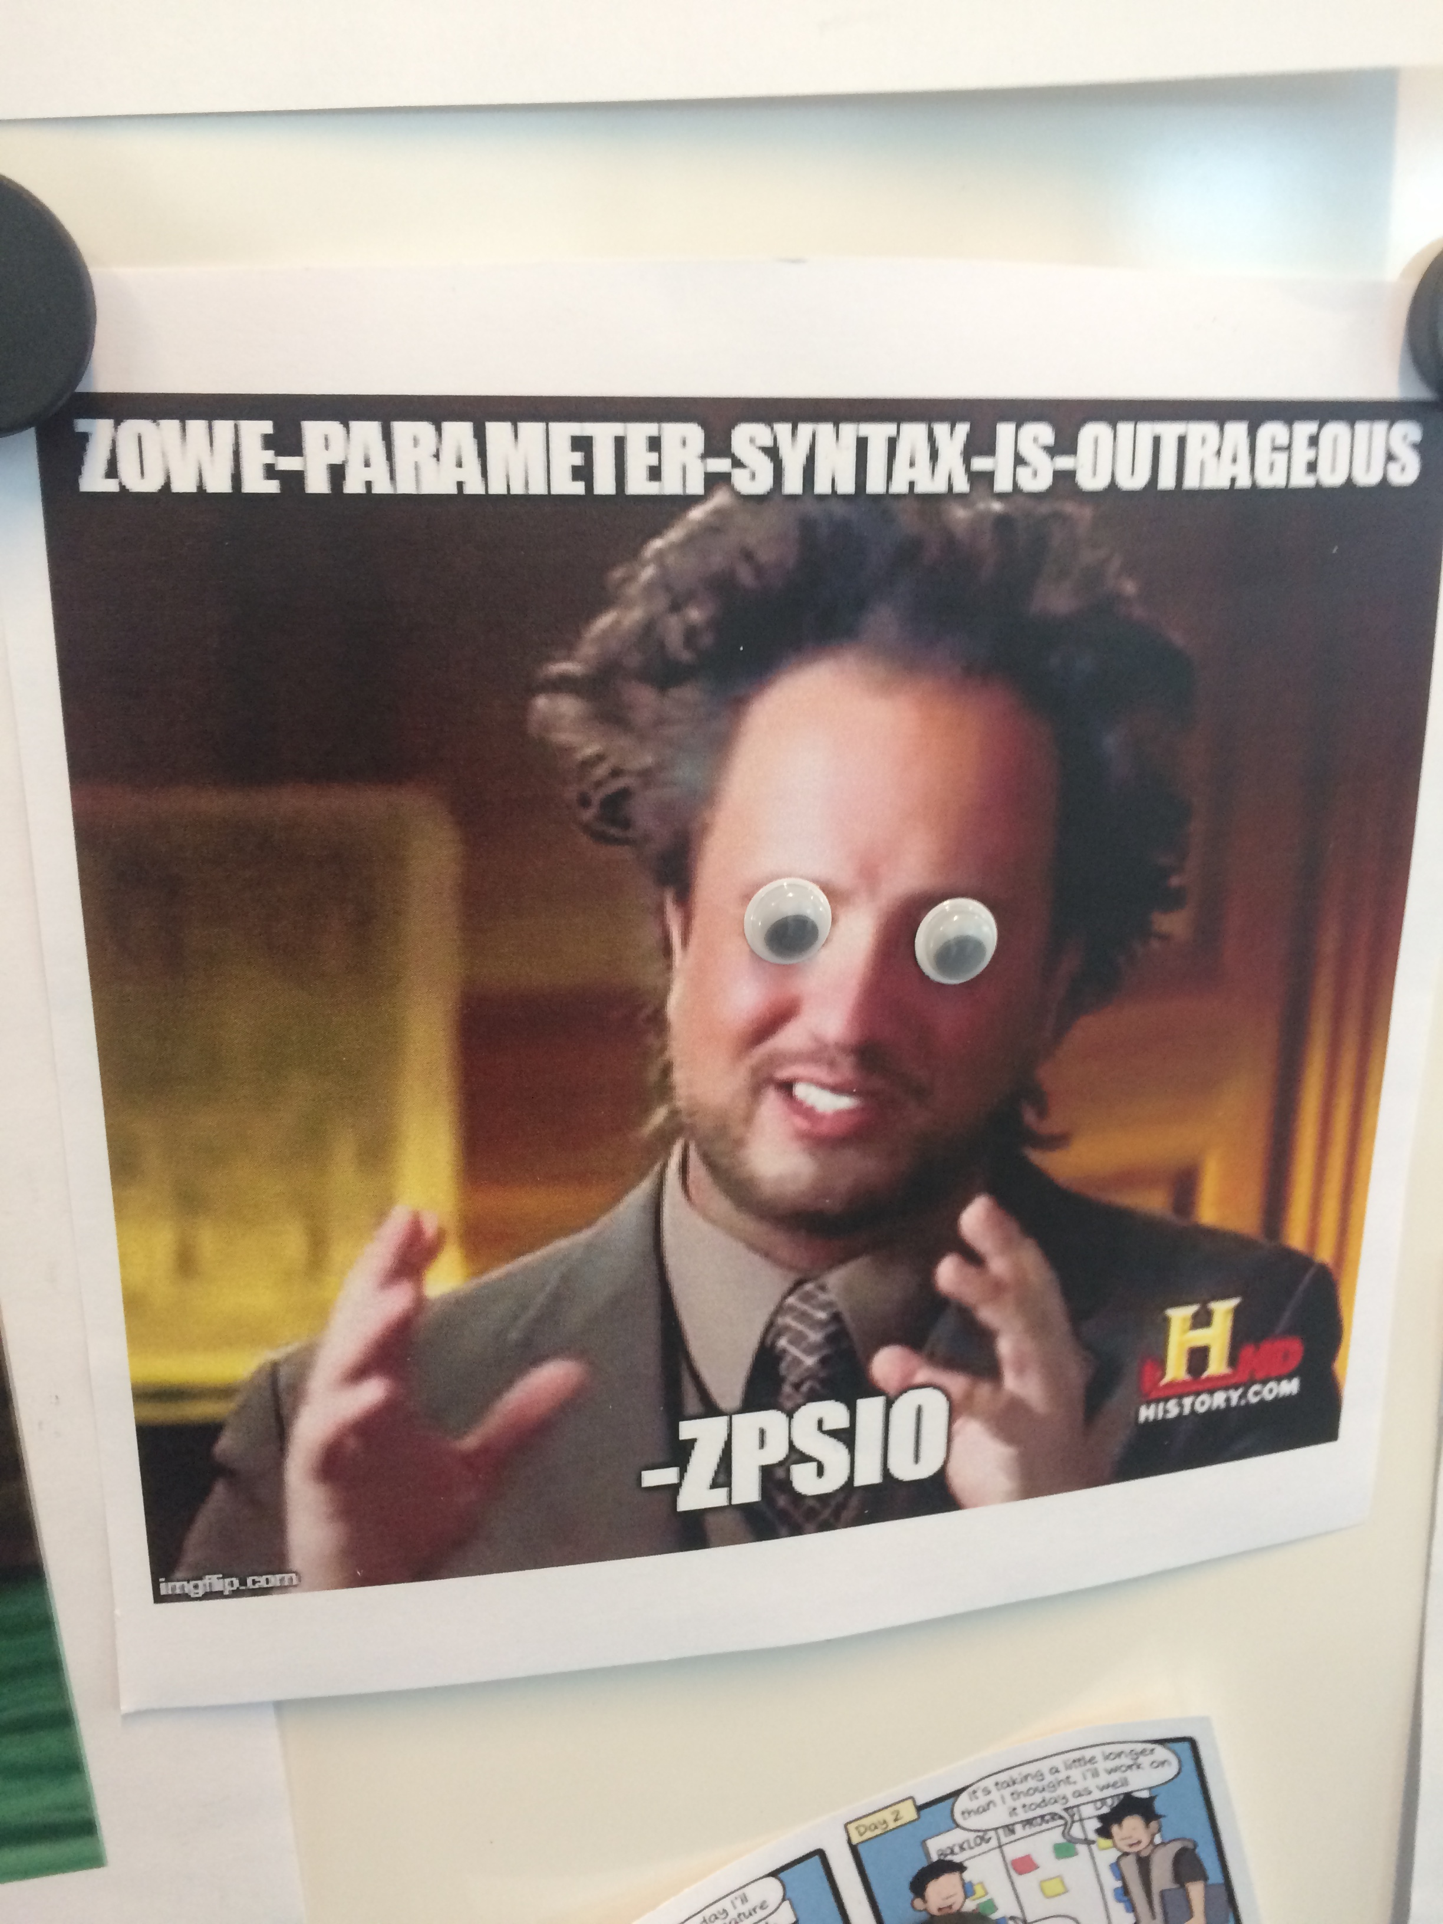
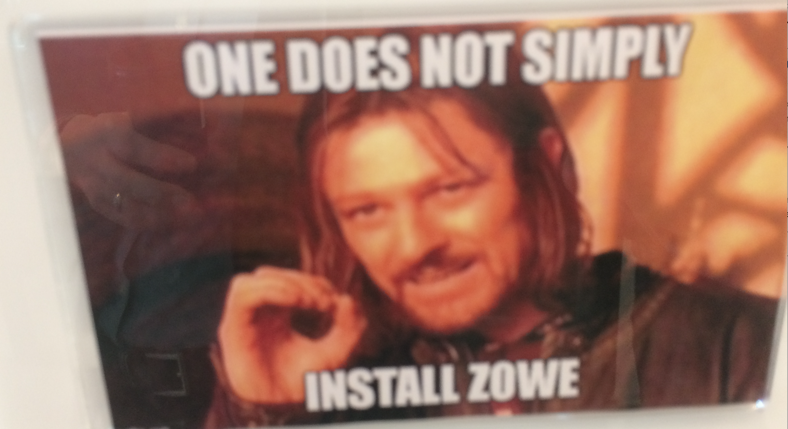

Slide 12
Pain points
No enterprise SMP/E installer
Rollback, install history, customer production acceptance
Configuration data is specified at install time
A single Zowe install cannot be started with different config parms
Configuration data lost on upgrade
Start up of Zowe brings up everything even if not all is needed
Too many pre-reqs for Zowe
Install scripts fail if user doesn’t have sufficient permissions
Diagnosing problems difficult. Many runtime problems require re-install

Slide 13
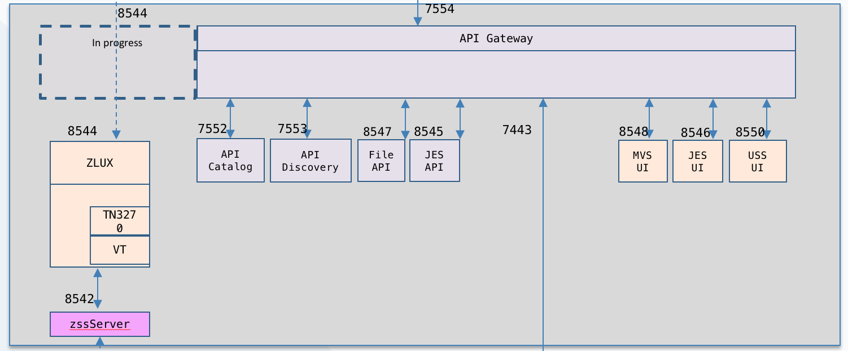
To Be - Installation and launch Topology
Deployment
APPLY
Runtime Libraries and File Systems (Read-only)
ZWESOS01 Launch with
PARMLIB
Single cross memory server
SMP/E Target Libraries and File Systems
Extract and SMP/E Install
RECEIVE
z/FS
SMP/E CSI
PROCLIB
PARMLIB
z/FS
PAX File
PROCLIB
PARMLIB
/S ZWESVR, PRM=XX Launch with
CONFIG_DIR(/var/lpp/zowe/v1)
Validate, migrate and create defaults
/S ZWESVR, PRM=YY Launch with
CONFIG_DIR(/u/wincj/zowe/1.2.1)
Validate, migrate and create defaults
Configured Instance A
Configured Instance B
active_configuration.cfg
Shared Config Area
(keystore)

Slide 14
To Be - Installer
SMP/E installer
Single AZWE001 FMID delivered on zowe.org with PTFs, APARs, emergency fixes
Installed to /usr/lpp/zowe/v1
Configuration required at startup only persisted in /var/zowe
Keep zowe.org simple .pax
Install script lays down runtime folder only. Defaults to /tmp/zowe/v.r.m
Configuration required at startup only
MVS One time configuration
ZWESVR. RDEFINE for user ID
ZWESIS01. RDEFINE for user ID. APF Auth PDSE, PPT KEY(4), ZWES.IS FACILITY READ, BPX.SERVER FACILITY(UPDATE) BPX.DAEMON(UPDATE), CSFSERV READ.

Slide 15
To Be Installer Questions
User IDs and groups the server should run under.
Currently we use IZUSVR and IZUADMIN. Should we make ZWESVR and ZWEGRP or do people want to specify their own ?
Install using JCL or shell scripts for RDEFINE, PERMIT, … commands
How much to automate ?
1) Create SAMPLIB and LOADLIB folders with files/members and leave all to sysprog. Where should we put it ? USS or a specified PDS location ?
2) Provide shell scripts to deploy PROCLIB member, APF load library, …
SMP/E Locations /usr/lpp/zowe/v1 and /var/zowe/v1for configuration
Standard .pax locations /tmp/zowe/v.r.m and ~/zowe
Proclib named ZWESVR and get rid of option ?

Slide 16
To Be – Launch with Configuration
Startup configuration
PROCLIB paired with PARMLIB
PARMLIB specified USER_DIR launch folder, (default value /var/zowe/v1). Similar to an Eclipse workspace, contains manifest information, persistent data.
Launch –
Work out required configure parameters
PARMLIB > ~/.profile > /etc/.profile > defaults.
Backup existing “active_configuration.cfg” to “backup_configuration.yymmdd.hhmmss”
Create new “active_configuration.cfg” and initialize USER_DIR
Launch components based on configuration specification

Slide 17
Launch with Configuration Questions
Manage via started tasks or USS processes
PARMLIB vs. /etc/.profile or hybrid hierarchy
2 char of full path, eg. /S ZWESVR, PRM=XX or PRM=SYS1.PARMLIB(ZWESVRXX) or PRM=ZWESVRXX
Certificates
How to manage keystore data ?
What northbound certificate ?
Should we use keyrings ? AT-TLS ? (Java supports keyrings – node ?)
Component Lifecycle
STC for all together, e.g. /S ZWESVR, PRM=xx. Single STC with multiple address spaces, cannot bounce independently. Can still identify with suffixes of ML, AF, EX
STC for each component. Multiple STCs, individual bounce and restart
API Mediation /S ZWESVRML,PRM=ML, Desktop /S ZWESVRAF, PRM=AF, Explorers /S ZWESVREX,PRM=EX
Should we allow components that can run off platform (Java, node stacks) to be delivered in docker containers for off host, or Linux including Linux on z, and a core Zowe launcher that brings up just the z/OS pieces (ZWESIS01 and zssServer) ?

Slide 18
Delivery route
ISV Enterprise support
AZWE001 FMID
APAR
AZWE001 FMID
PTF
AZWE001 FMID
APAR
/usr/lpp/zowe/v1
/var/zowe/v1
/usr/lpp/zowe/v1
/var/zowe/v1
/usr/lpp/zowe/v1
/var/zowe/v1
SMP/E PTF
AZWE001 FMID
SMP/E PTF
simple.sh installer
~/tmp/zowe/1.1.3
~/zowe/config
Emergency fix
simple.sh installer
~/tmp/zowe/1.1.4
~/zowe/config
1.1.3
1.1.4
Monthly PTF build
APAR
APARs rolled into PTF
github.com/zowe
Zowe.v.rm.PAX
Zowe.v.rm.PAX
Zowe.v.rm.PAX

Slide 19
Support Questions
Support – base zowe.org FMID redistributed on IBM, Broadcom, other ISVs offering enterprise support
Fmid AZWE001 used by zowe.org also used by ISVs who redistribute unchanged
Receive order
1) manual,
2) shell with wget for CSI entry
3) Formal receive order server
How do sites know PTFs and APARs are available. How to know/notify
PTF – APAR – emergency fix/user mod.

Slide 20
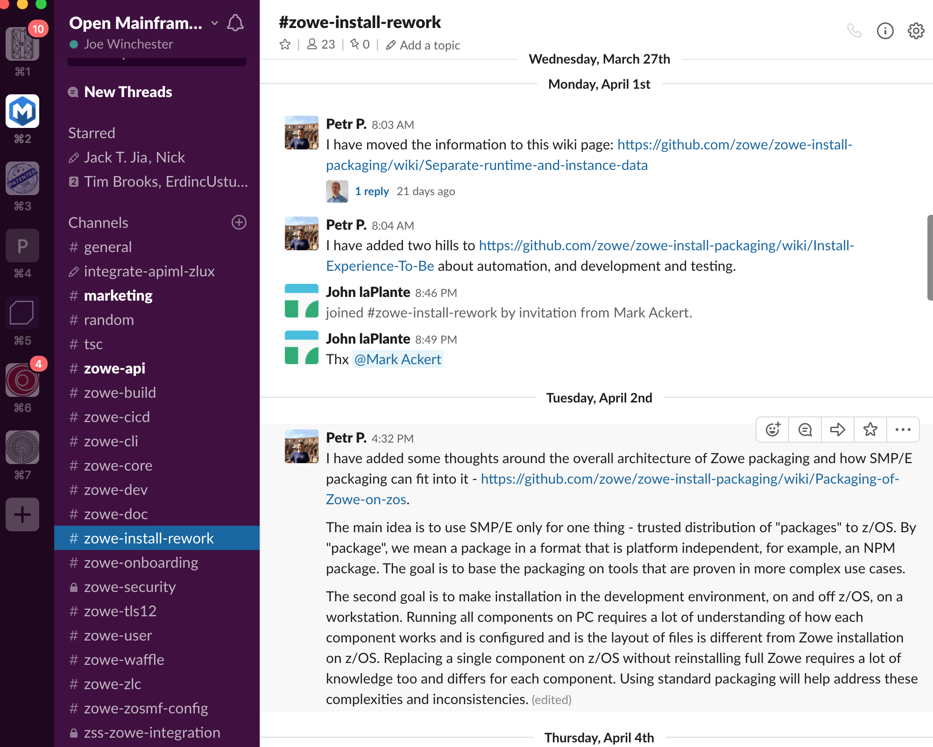
Stay in touch
https://openmainframeproject.slack.com/messages/CH9R3FD1V

