Slide 1
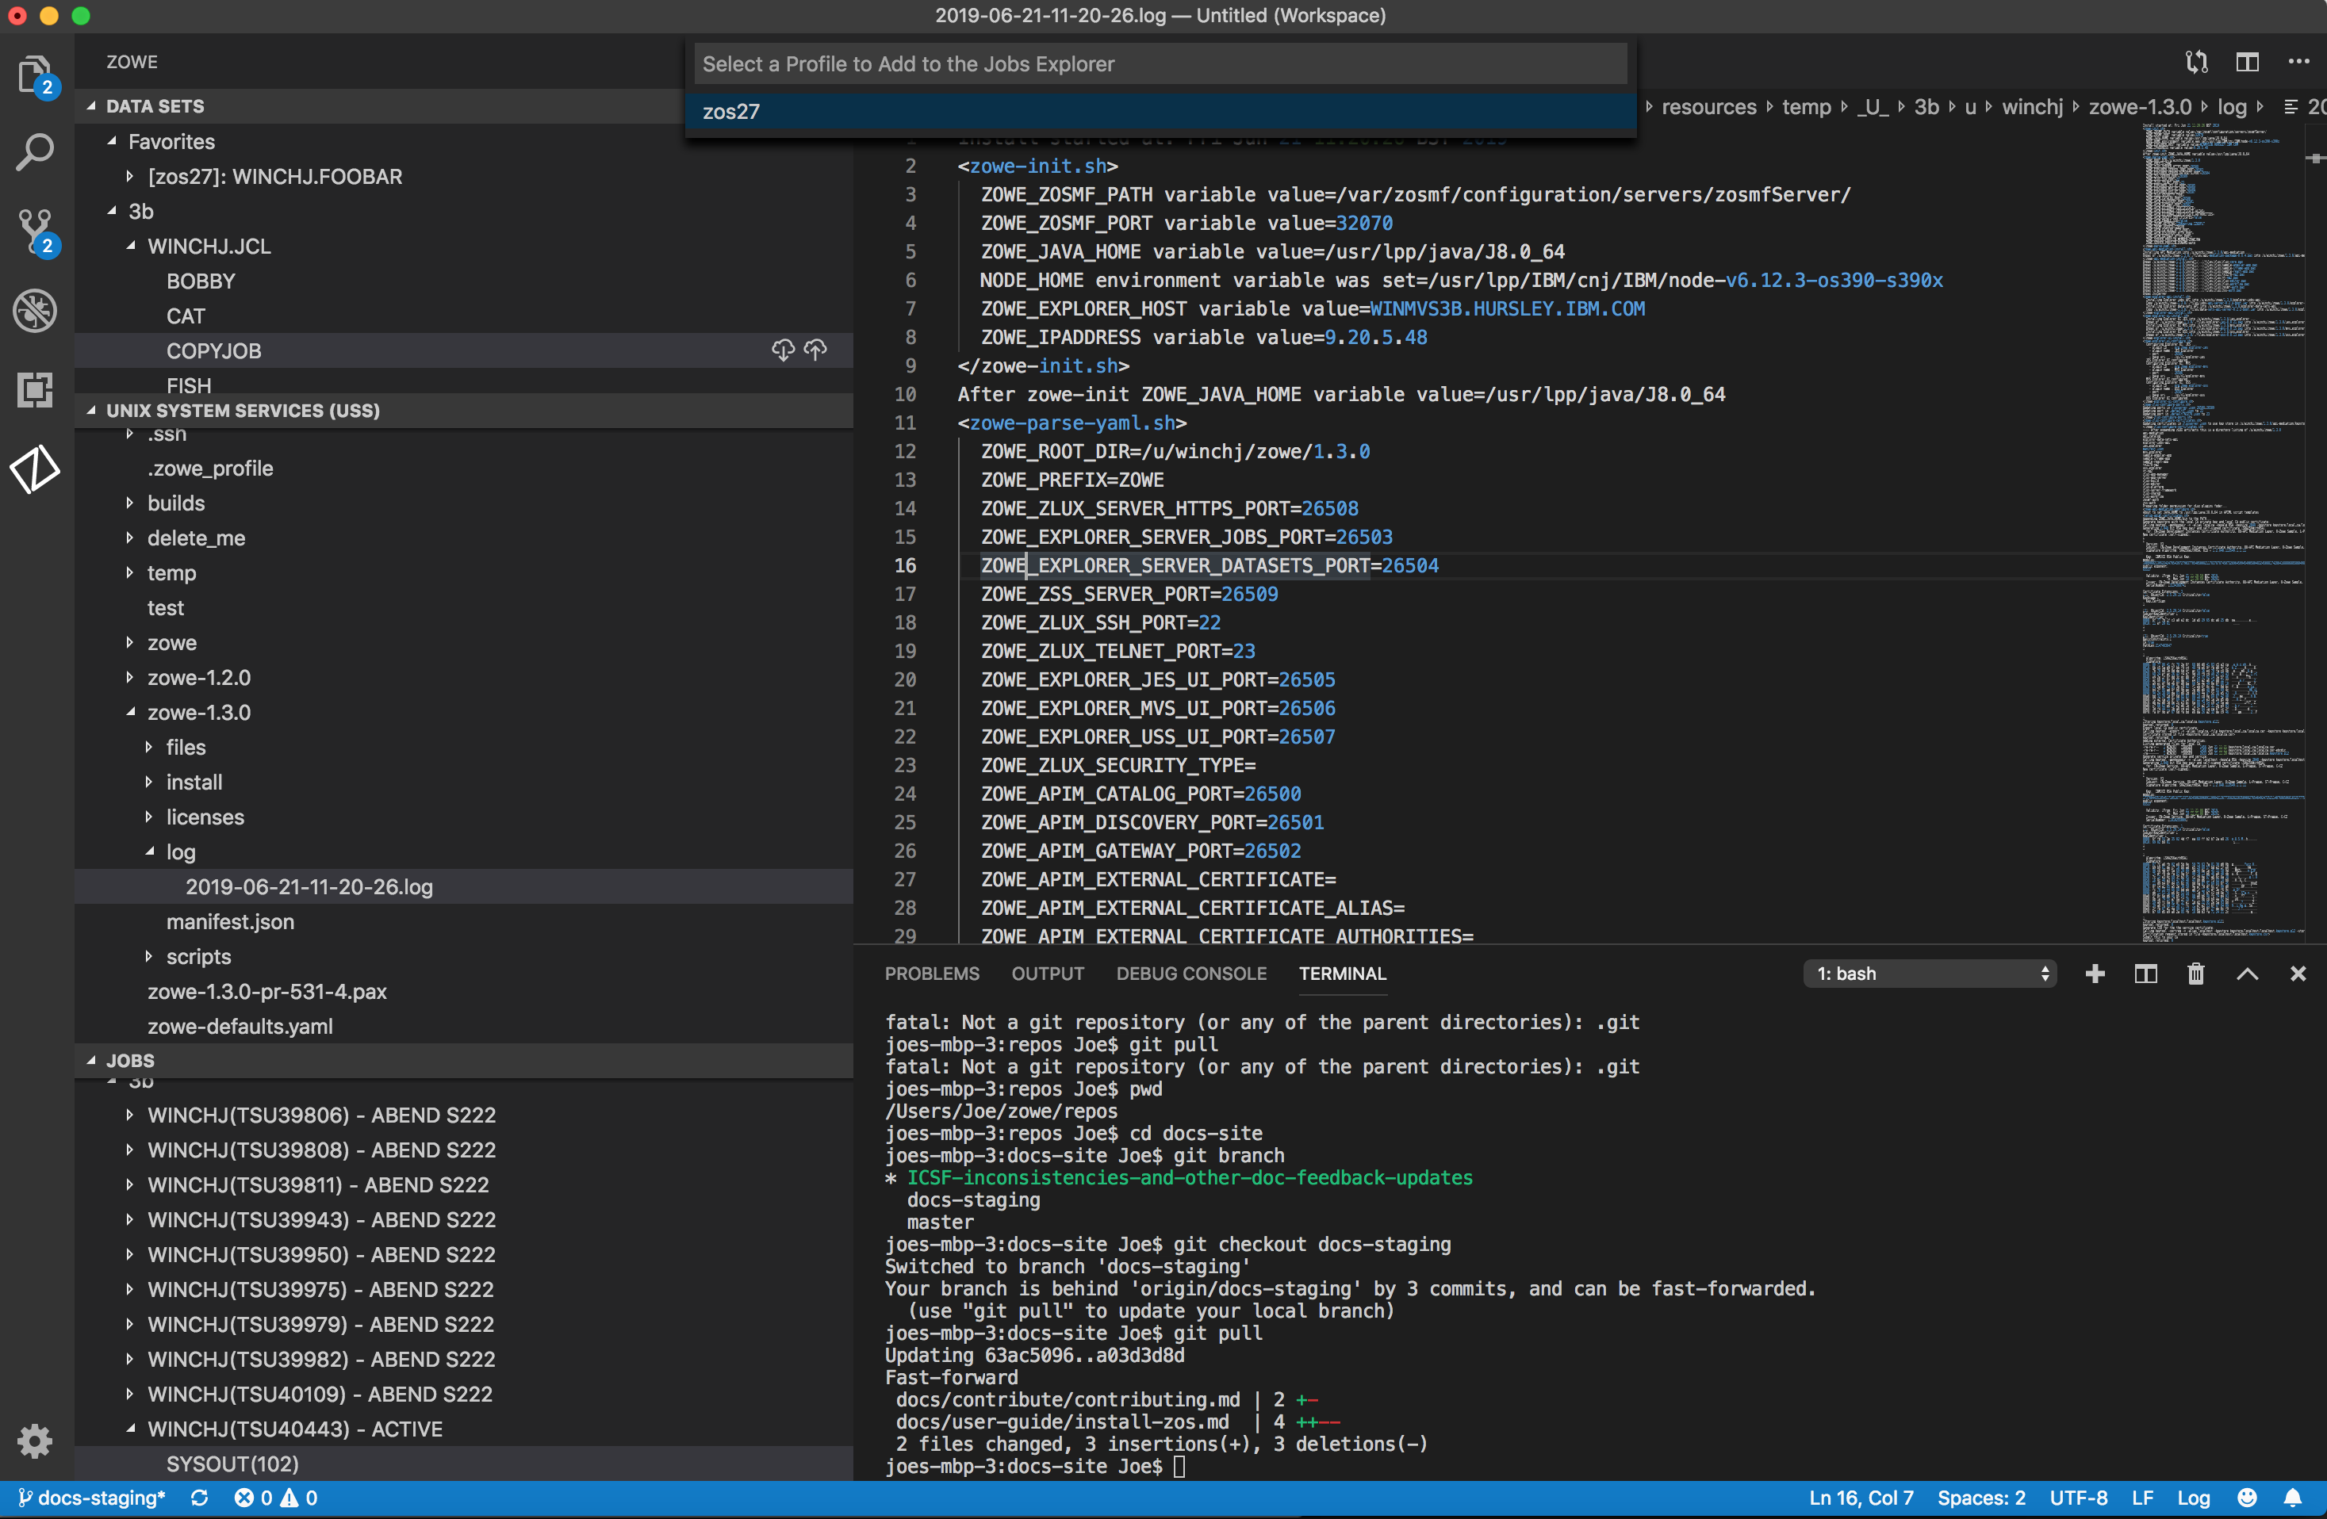
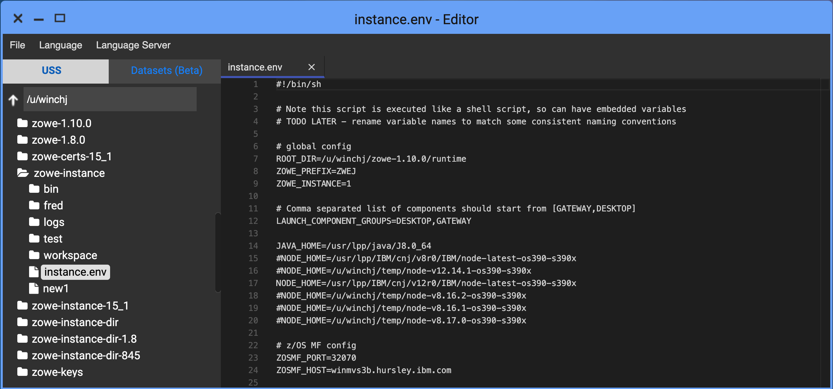
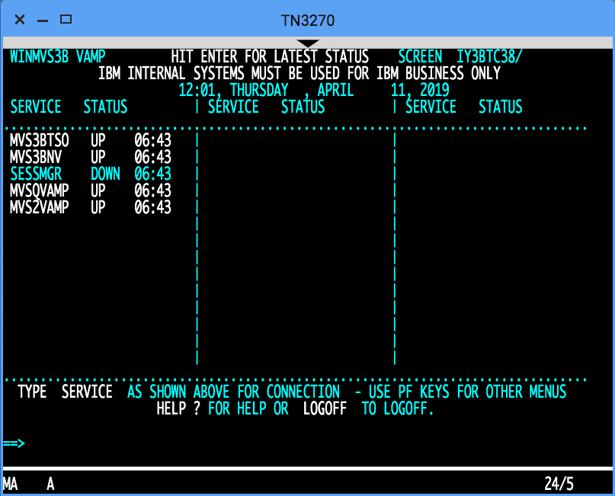
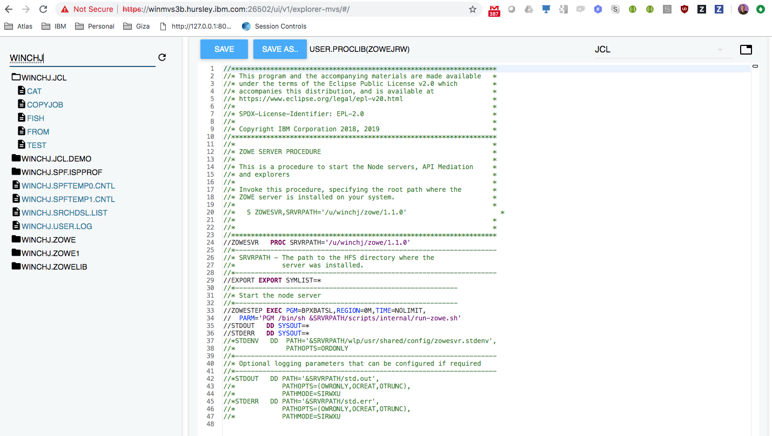
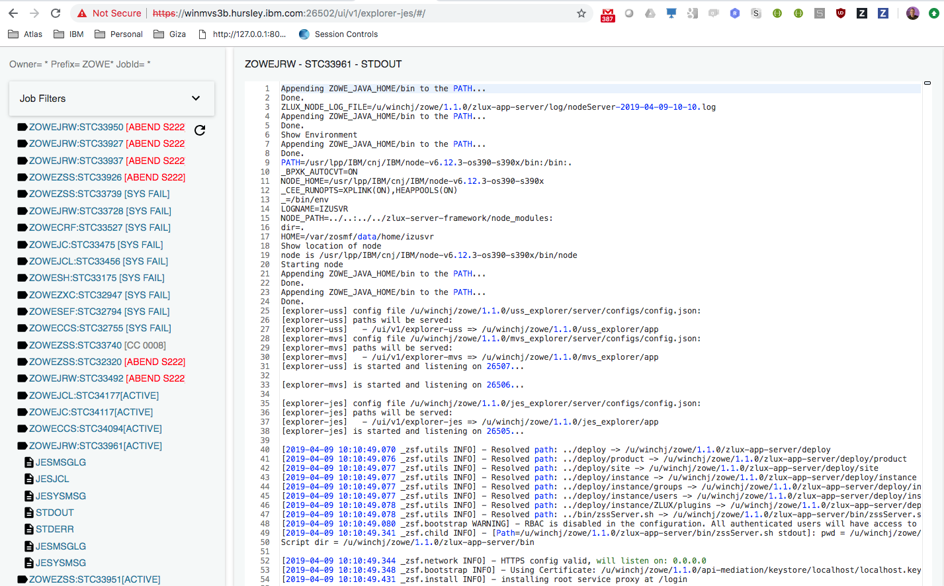
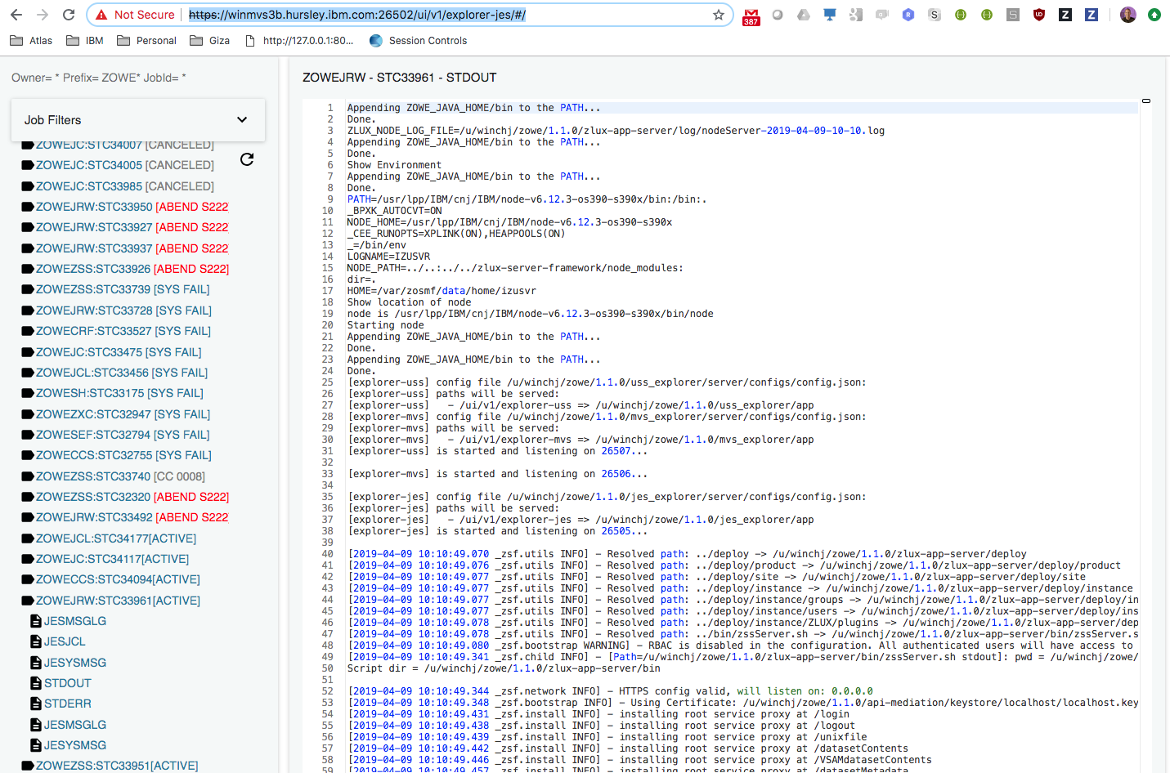
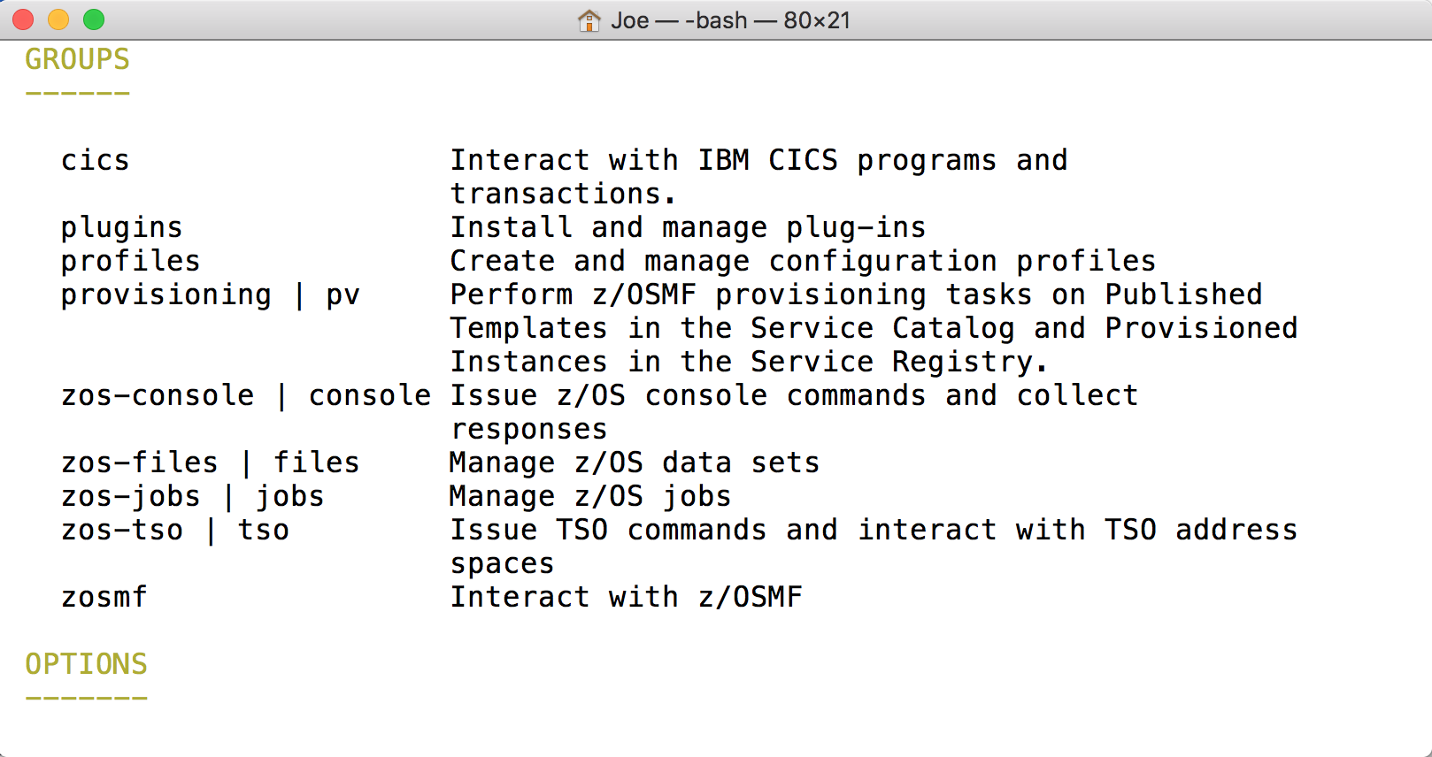
Zowe
Explorer
VS Code
Core desktop apps
Extension Plugins
Extension
Plugins
Core CLI
Core Extensions
File Editor
3270 Terminal
MVS Explorer
JES Explorer
USS Explorer
iFrame
HTML
CLI
extension
IMS
CICS
DB2
MQ
Zowe Desktop running in web browser
Zowe CLI running in desktop shell
7554
API Mediation Layer
(optional needed for SSO/MFA)
8544
7552
7553
Java
Telnet
ZLUX
API Discovery
23
API Catalog
3270
Apps…
8548
8546
8550
VT Terminal
File Editor
Included as apps
MVS UI
JES UI
USS
UI
SSH
23
node
8542
2
8547
8545
zssServer
metal C
/S ZWESVSTC
File API
JES API
nnnn
7443
1
REST API Extension Server
z/OSMF
IMS Ops
API
CICS CMCI
DB2
MQ Console
REST APIs
Workflows
TSO / MVS Commands
Files, USS, JES
SSO token generation
X-MEM
ZWESIS01
C
/S ZWESISTC
IMS Connect
Notes:
If you update this diagram, please update “zowe-desktop-unable-to-logon.pptx” and PNG file as well.

