Slide 1
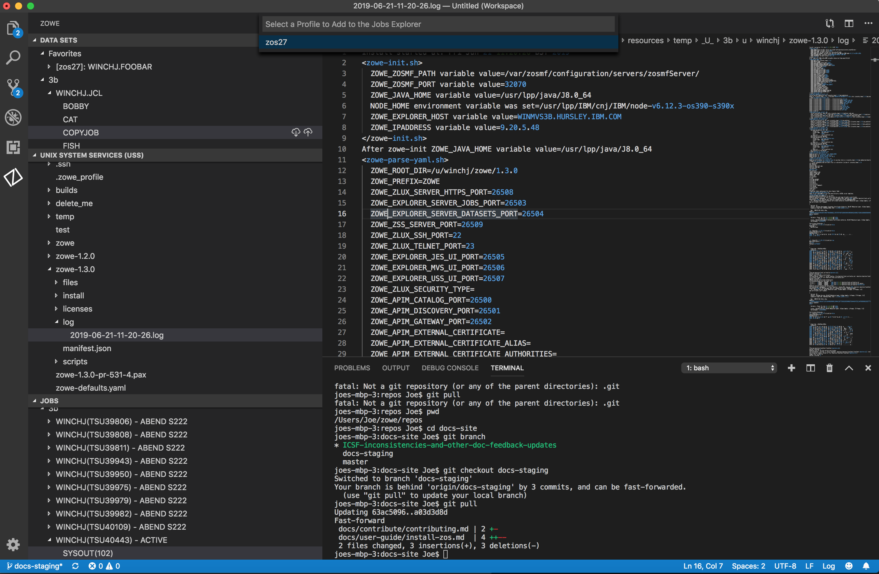

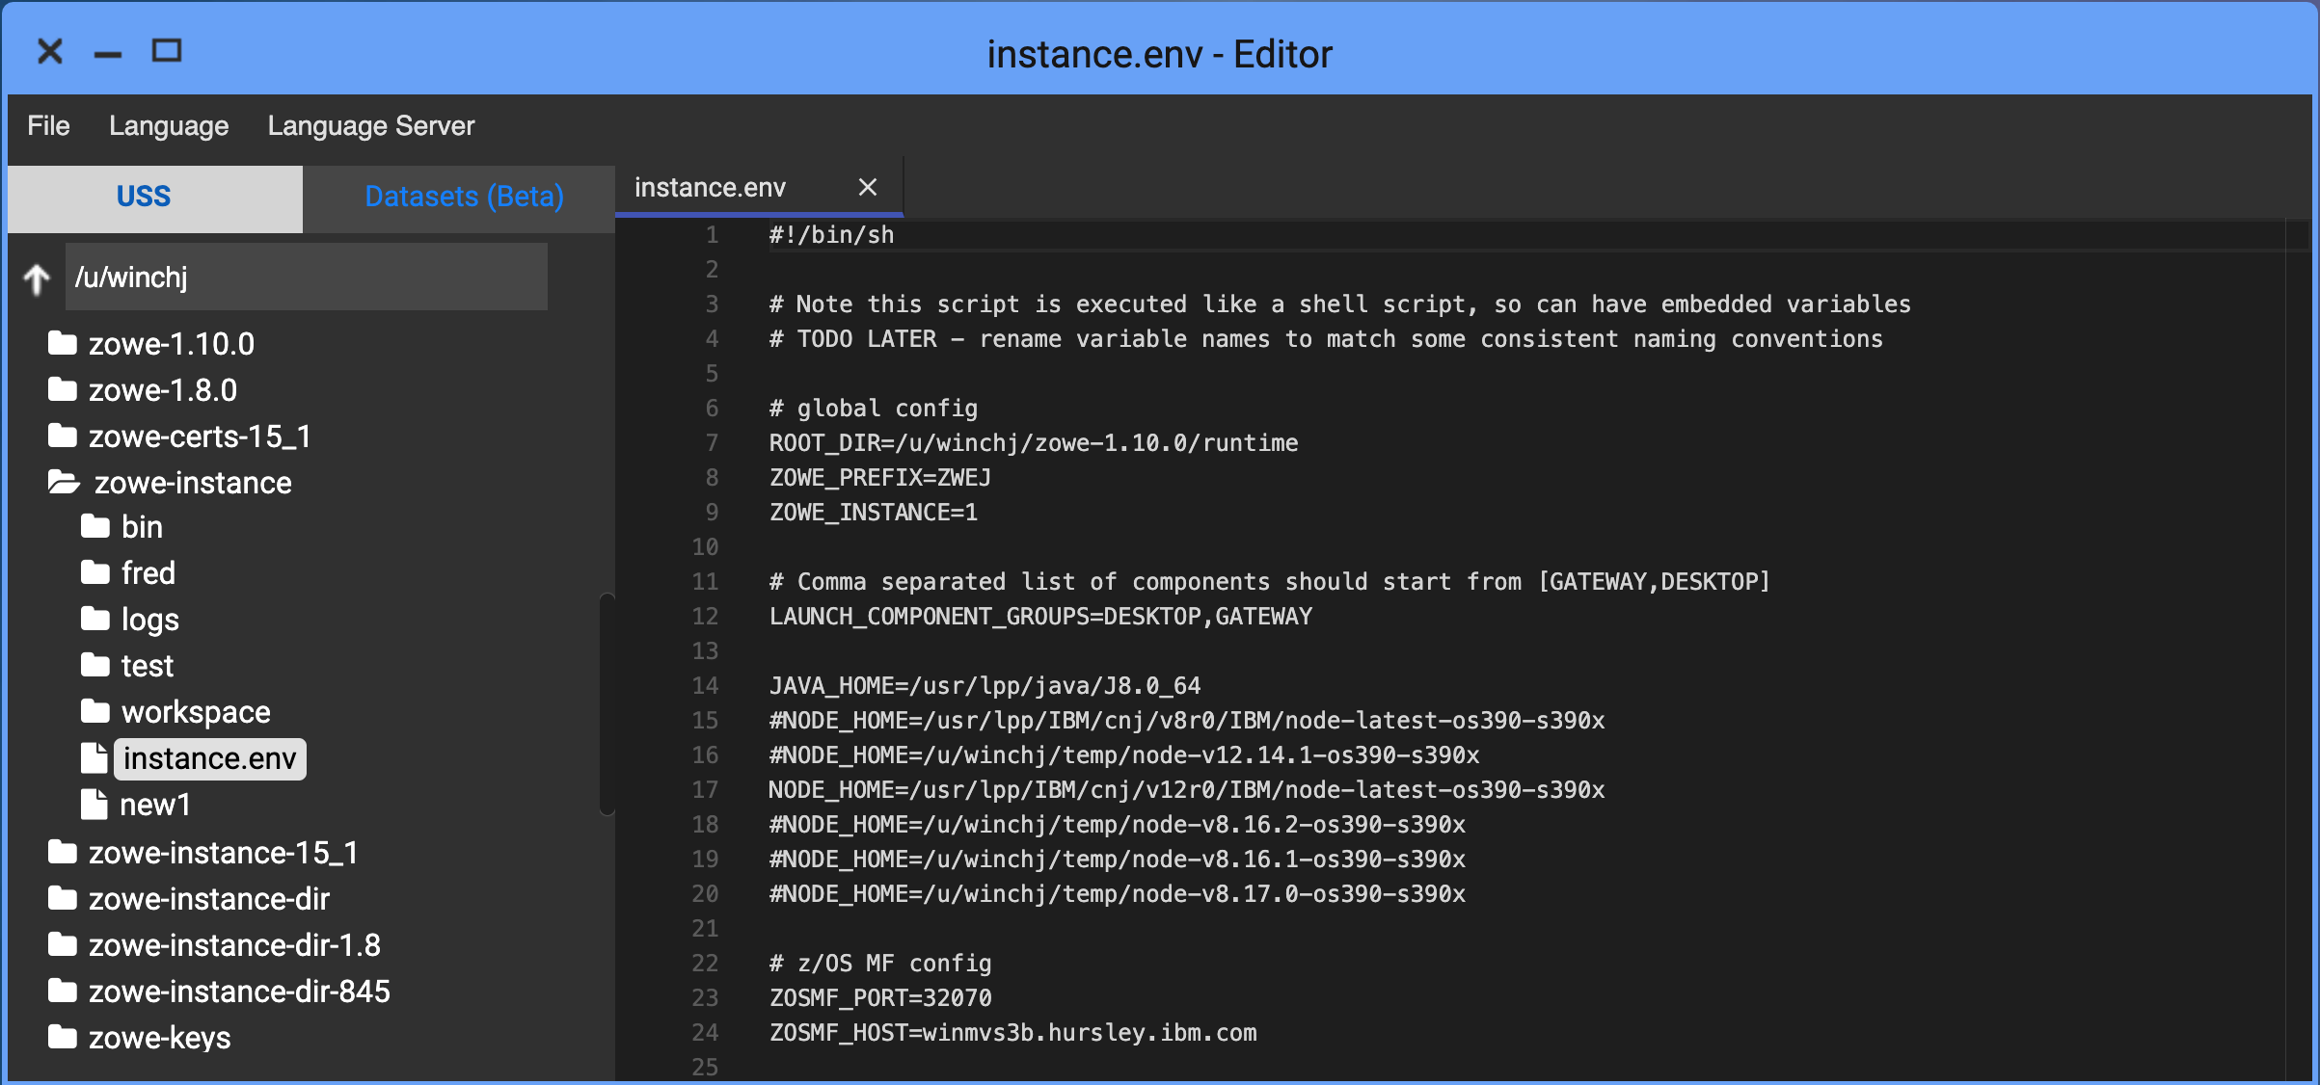
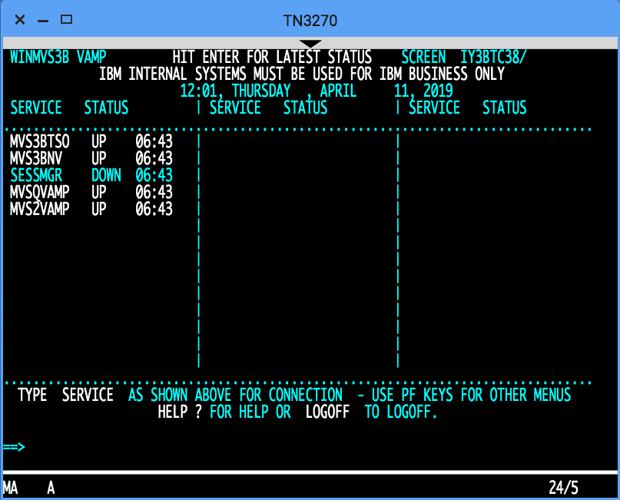
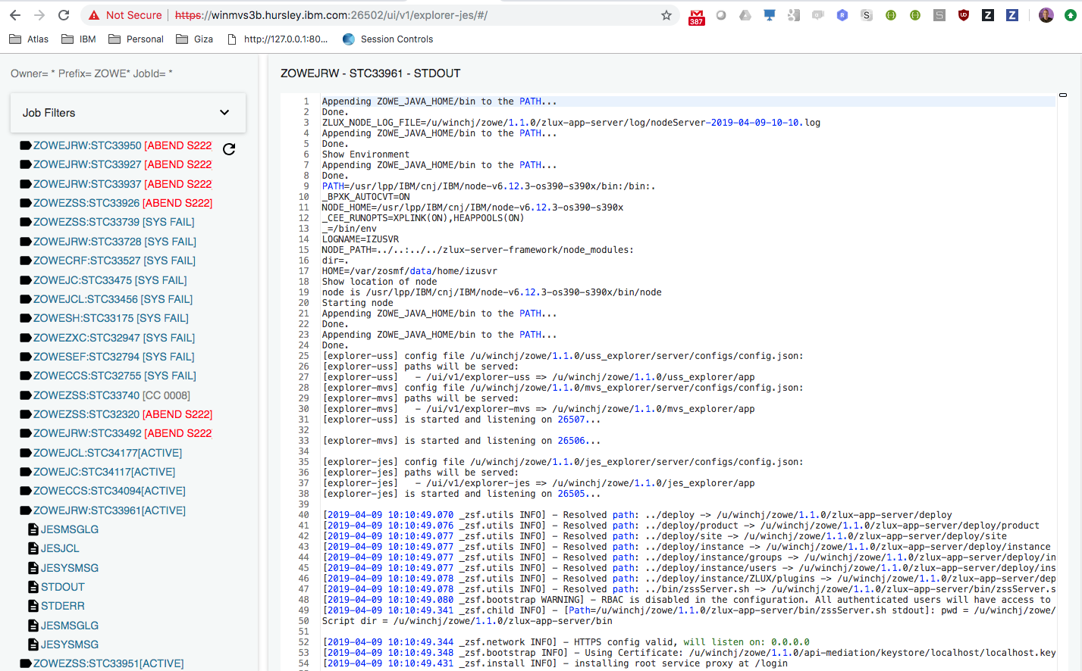
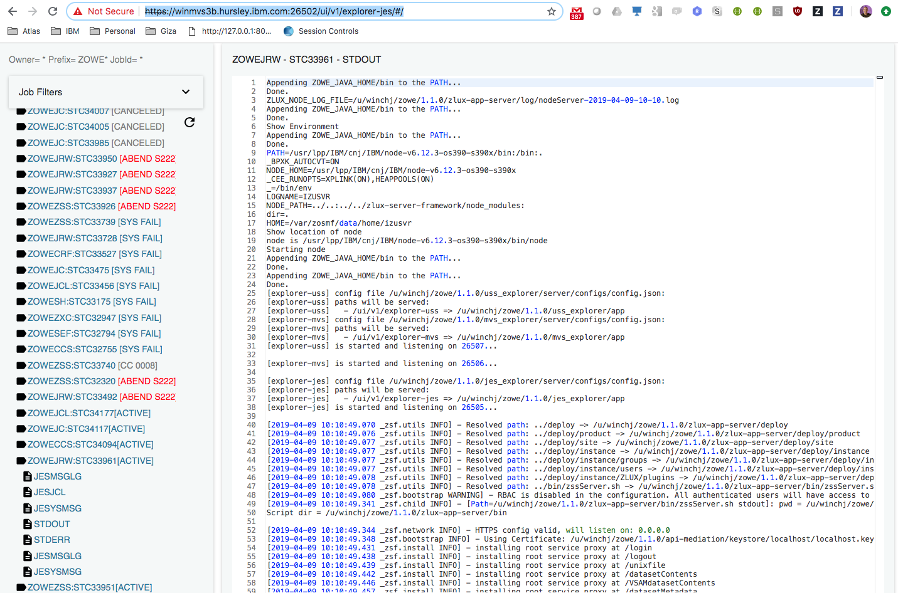
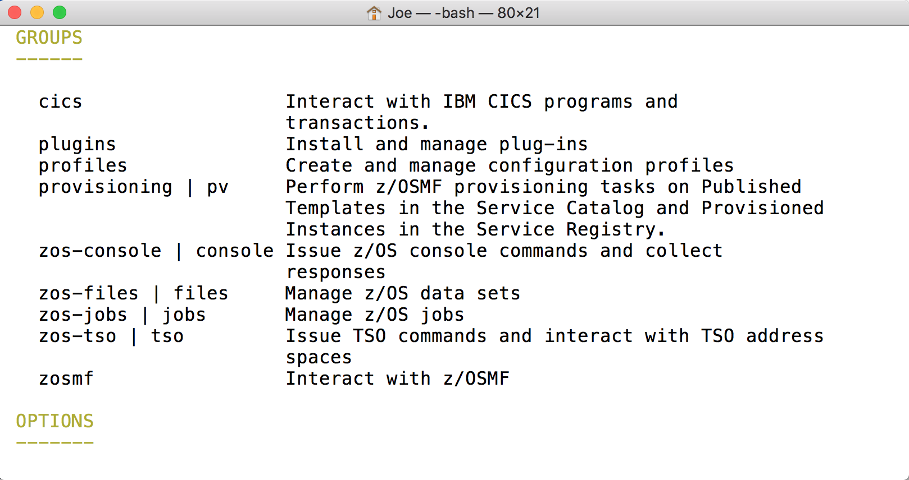
Zowe
Explorer
VS Code
Core desktop apps
Extension Plugins
Extension
Plugins
Core CLI
Core Extensions
File Editor
3270 Terminal
JES Explorer
IP Explorer
iFrame
HTML
CLI
extension
IMS
CICS
DB2
MQ
Node SDK
Zowe Desktop running in web browser
Zowe CLI running in desktop shell
ZWESLSTC
Running under USS
7554
API Gateway
(optional needed for SSO/MFA)
7555
7553
7552
7551
Caching
Service
API Discovery
API Catalog
Metrics Service
7556
Apps…
8547
8545
App server
File Editor
File API
JES API
VT Terminal
3270
(Optional, off by default)
zssServer
7557
22
23
nnnn
7443
Cross Memory
SSH
Telnet
REST API Extension Server
z/OSMF
IMS Ops
API
CICS CMCI
DB2
MQ Console
Java
REST APIs
Workflows
TSO / MVS / Console
Files, USS, JES
ZWESISTC
ZIS.
Node.js
IMS Connect
ZWESIS01
metal C / C
Notes:
If you update this diagram, please update “zowe-desktop-unable-to-logon.pptx” and PNG file as well.

Slide 2

Zowe
Explorer
VS Code
Core desktop apps
Extension Plugins
Extension
Plugins
Core CLI
Core Extensions
File Editor
3270 Terminal
JES Explorer
IP Explorer
iFrame
HTML
CLI
extension
IMS
CICS
DB2
MQ
Node SDK
Zowe Desktop running in web browser
Zowe CLI running in desktop shell
Running in a Docker Container
7554
API Gateway
(optional needed for SSO/MFA)
7555
7553
7552
7551
Caching
Service
API Discovery
API Catalog
Metrics Service
7556
Apps…
8547
8545
App server
File Editor
File API
JES API
VT Terminal
3270
(Optional, off by default)
ZWESLSTC
zssServer
7557
7443
22
23
nnnn
Running under USS
SSH
Telnet
REST API Extension Server
z/OSMF
IMS Ops
API
CICS CMCI
DB2
MQ Console
Cross Memory
REST APIs
Workflows
TSO / MVS / Console
Files, USS, JES
ZWESISTC
ZIS.
Java
Node.js
IMS Connect
ZWESIS01
metal C / C
Notes:
If you update this diagram, please update “zowe-desktop-unable-to-logon.pptx” and PNG file as well.

Slide 3

Zowe
Explorer
VS Code
Core desktop apps
Extension Plugins
Extension
Plugins
Core CLI
Core Extensions
File Editor
3270 Terminal
JES Explorer
IP Explorer
iFrame
HTML
CLI
extension
IMS
CICS
DB2
MQ
Node SDK
Zowe Desktop running in web browser
Zowe CLI running in desktop shell
Ingress
Running in a Kubernetes Cluster
7554
Deployment/Service
Persistent Volume Claim
Workspace
API Gateway
(optional needed for SSO/MFA)
Pod
7555
7553
7552
7551
Caching
Service
API Discovery
API Catalog
API Catalog
Caching
Service
API Discovery
API Catalog
Metrics Service
Namespace: zowe
StatefulSet/Service
Deployment/Service
7556
zowe-sa
8547
8545
ServiceAccount
Apps…
zowe-config
zowe-certificates-cm
App server
File Editor
File API
JES API
ConfigMap
ConfigMap
zowe-launch-scripts
initContainers
VT Terminal
(Optional, off by default)
zowe-certificates-secret
3270
Secret
ZWESLSTC
zssServer
7557
7443
22
23
nnnn
Running under USS
SSH
Telnet
REST API Extension Server
z/OSMF
IMS Ops
API
CICS CMCI
DB2
MQ Console
Cross Memory
REST APIs
Workflows
TSO / MVS / Console
Files, USS, JES
ZWESISTC
ZIS.
Java
Node.js
IMS Connect
ZWESIS01
metal C / C
Notes:
If you update this diagram, please update “zowe-desktop-unable-to-logon.pptx” and PNG file as well.

Slide 4
z/OS LPAR A
7554
port sharing
z/OS LPAR B
ZWESLSTC
Sysplex Distributor
(Can be on different sysplex)
Running under USS
7554
Running under USS
7554
API Gateway
API Gateway
7555
Caching
Service
7555
VSAM
Caching
Service
7553
API Discovery
7552
API Discovery
7553
API Catalog
API Catalog
7552
Apps…
Apps…
ZLUX
File Editor
ZLUX
File Editor
VT Terminal
VT Terminal
3270
3270
zssServer
zssServer
ZIS.
ZWESIS01
ZIS.
ZWESIS01
Notes:
If you update this diagram, please update “zowe-desktop-unable-to-logon.pptx” and PNG file as well.

