Slide 1
Stage 1: Plan and prepare
Plan and prepare for the installation
Stage 2: Install the Zowe runtime
Start the installation
Ensure system requirements are met
What is your preferred installation method?
SMP/E build
Convenience build
Download the Zowe SMP/E build
Download the convenience build
Install the Zowe SMP/E build
Verify, transfer, and expand the PAX file on z/OS
Installation Output:
A zFS folder containing unconfigured Zowe runtime <RUNTIME_DIR>
A PDS SAMPLIB member SZWESAMPE containing example JCL
A PDS load library SZWEAUTH containing load modules
Install the Zowe runtime
(Script: zowe-install.sh)
Stage 3: Configure the Zowe runtime
(One-time setup per z/OS environment) Configure the z/OS security manager
Configure the Zowe instance directory
(Script: zowe-configure-instance.sh)
Instance directory 2
Instance directory N
Configure Zowe certificates keystore and trust store directory
(Script: zowe-setup-certificates.sh)
(Required for Zowe Desktop) Configure the Zowe cross memory server ZWESISTC
Configure the Zowe started task ZWESVSTC
Stage 4: Verify the installation
Verify that Zowe is installed and configured correctly

Slide 2
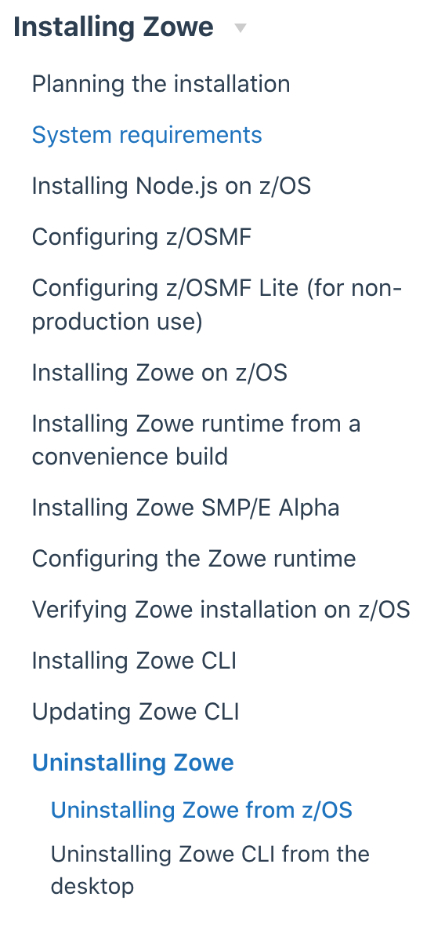
Planning and preparing the installation
Planning the installation of Zowe z/OS components
System requirements
Installing Node.js on z/OS
Configuring z/OSMF
Configuring z/OSMF Lite (for non-production use)
Installing Zowe z/OS components
Talk about the installation methods, provide the diagram together with task description and links (what’s written in install-zos.md now)
Installation introduction and task flow
Installing Zowe runtime from a convenience build
Installing Zowe runtime from the SMP/E build
Configuring a z/OS system for Zowe
OLD TOC
Configuring the Zowe instance directory
Configuring the Zowe certificate store
Configuring the Zowe Cross Memory Server
Configuring the Zowe started tasks
Verifying Zowe installation on z/OS
Uninstalling Zowe z/OS components
Installing Zowe CLI
Installing Zowe CLI
Updating Zowe CLI
Uninstalling Zowe CLI
Configuring Zowe components

