Slide 1
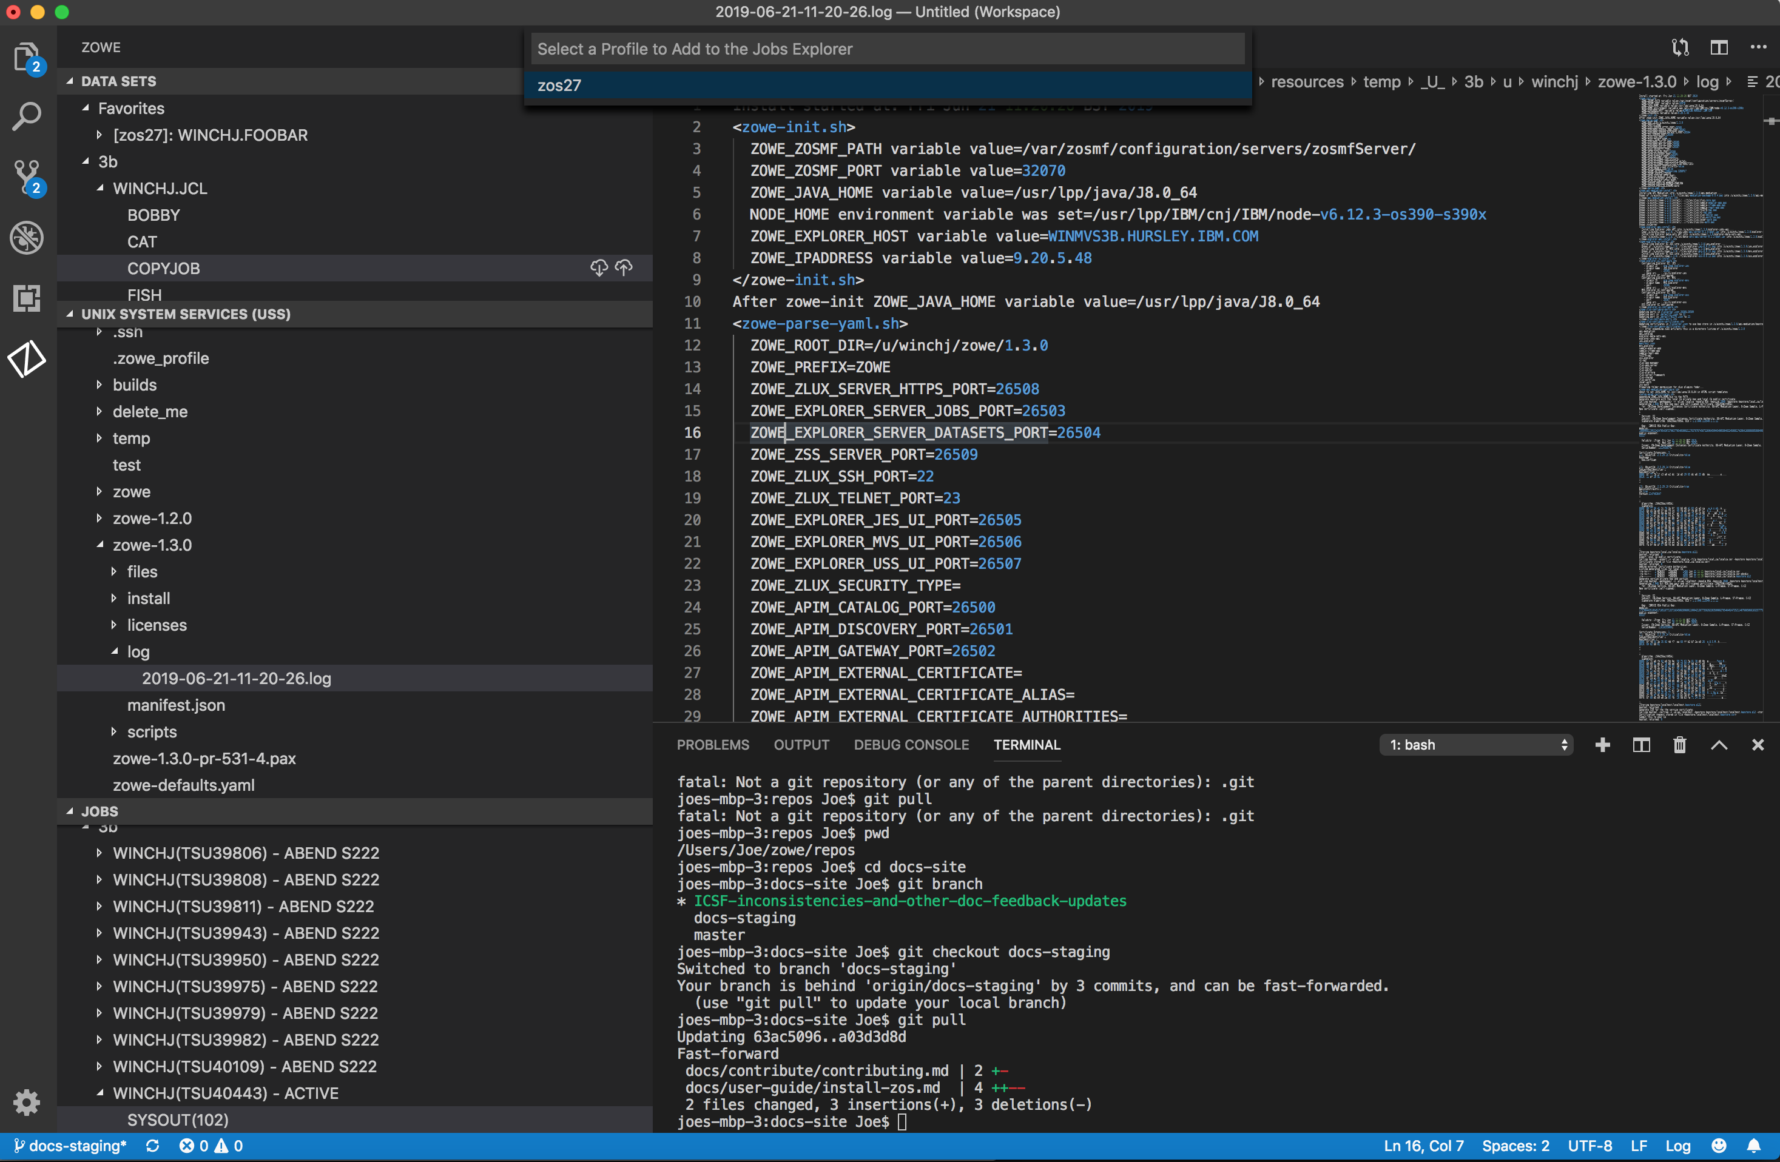
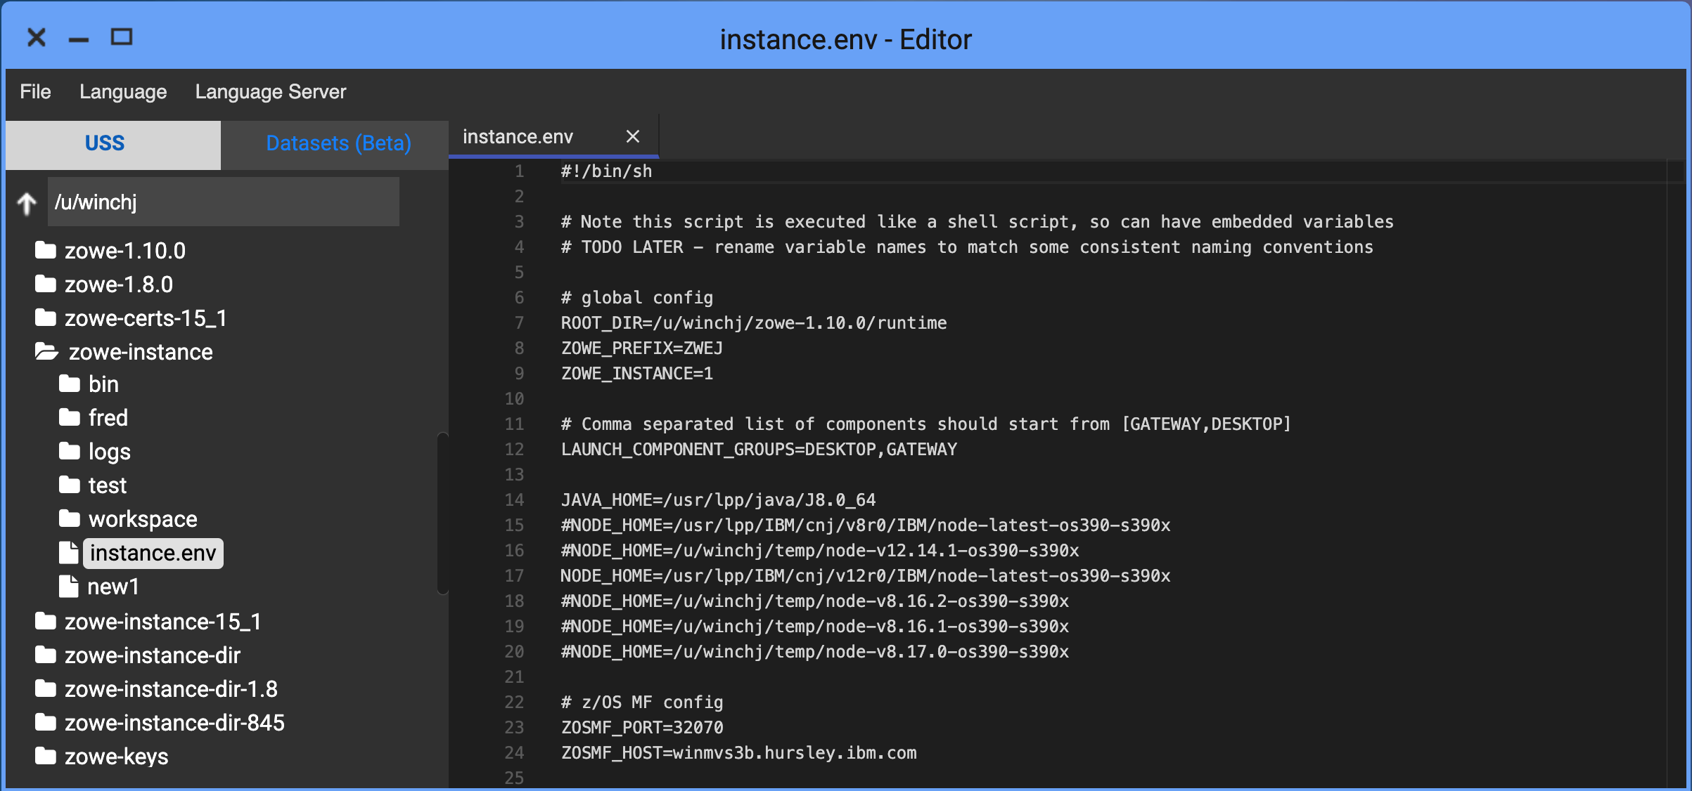
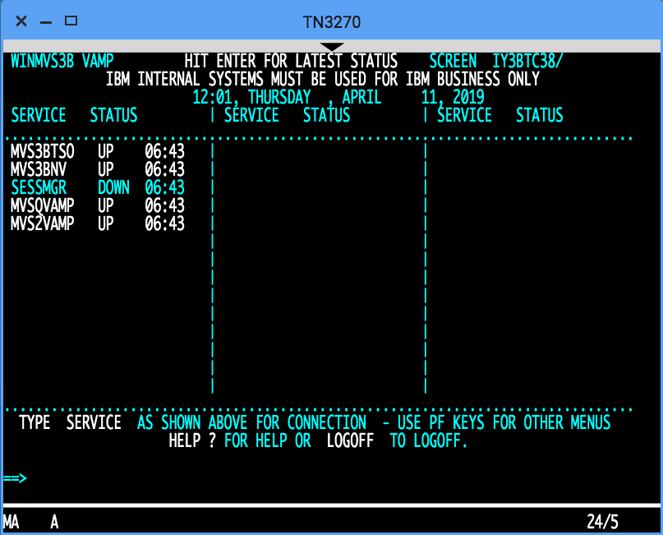
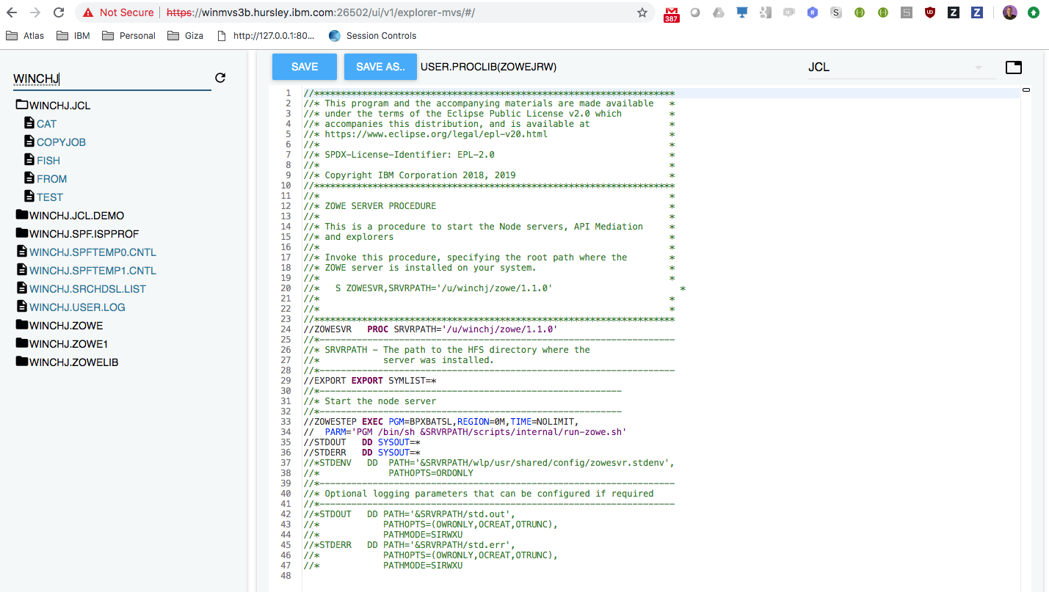
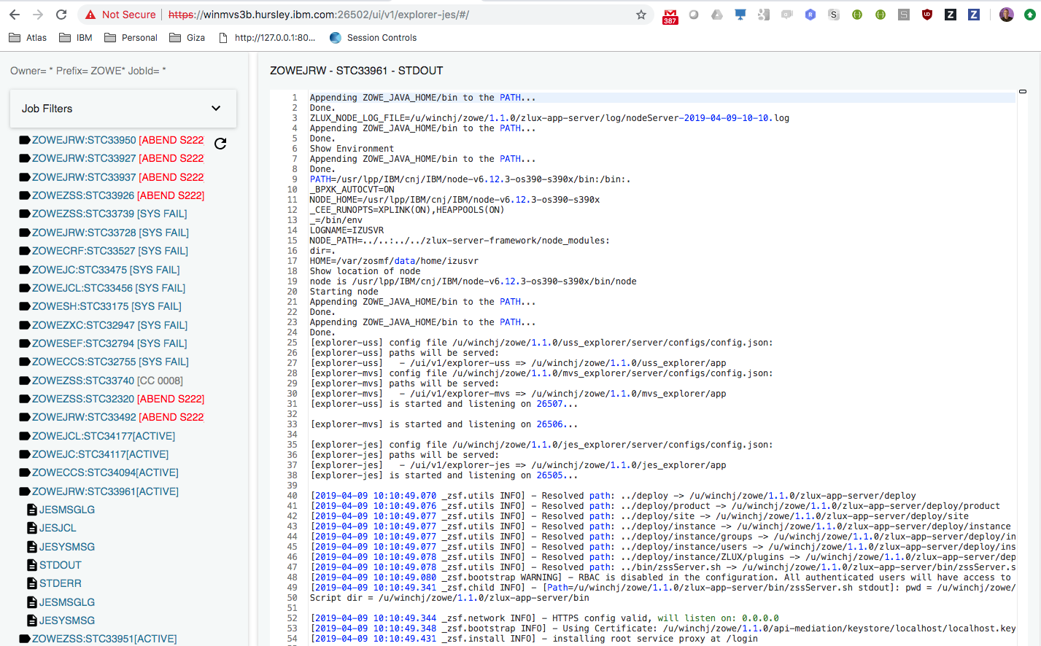
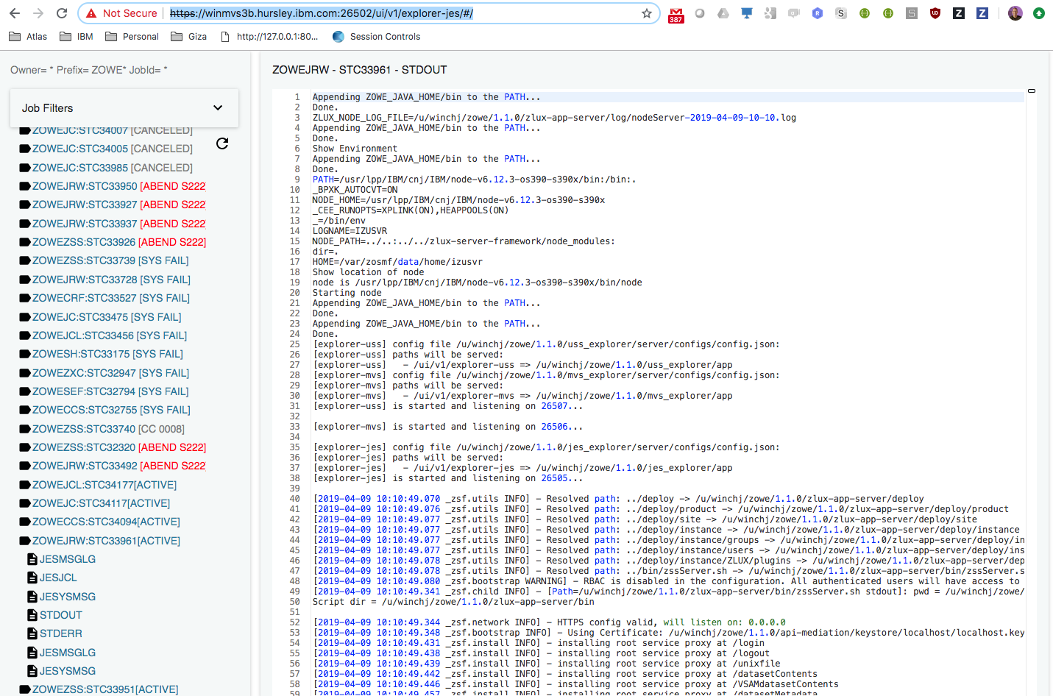
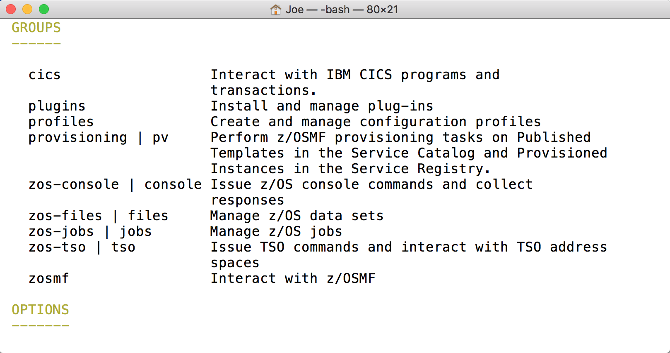
Zowe
Explorer
VS Code
Core desktop apps
Extension Plugins
Extension
Plugins
Core CLI
Core Extensions
File Editor
3270 Terminal
MVS Explorer
JES Explorer
USS Explorer
iFrame
HTML
CLI
extension
IMS
CICS
DB2
MQ
Zowe Desktop running in web browser
Zowe CLI running in desktop shell
7554
Northbound
API Gateway
(optional needed for SSO/MFA)
Southbound
8544
7552
7553
Telnet
ZLUX
API Discovery
23
API Catalog
3270
Apps…
8548
8546
8550
VT Terminal
File Editor
Included as apps
MVS UI
JES UI
USS
UI
SSH
22
node
8542
8547
8545
zssServer
/S ZWESVSTC
File API
JES API
nnnn
7443
REST API Extension Server
z/OSMF
IMS Ops
API
CICS CMCI
DB2
MQ Console
REST APIs
Workflows
TSO / MVS Commands
Files, USS, JES
SSO token generation
X-MEM
Java
ZWESIS01
/S ZWESISTC
Node.js
IMS Connect
metal C / C
Notes:
If you update this diagram, please update “zowe-desktop-unable-to-logon.pptx” and PNG file as well.

Slide 2
