Slide 1
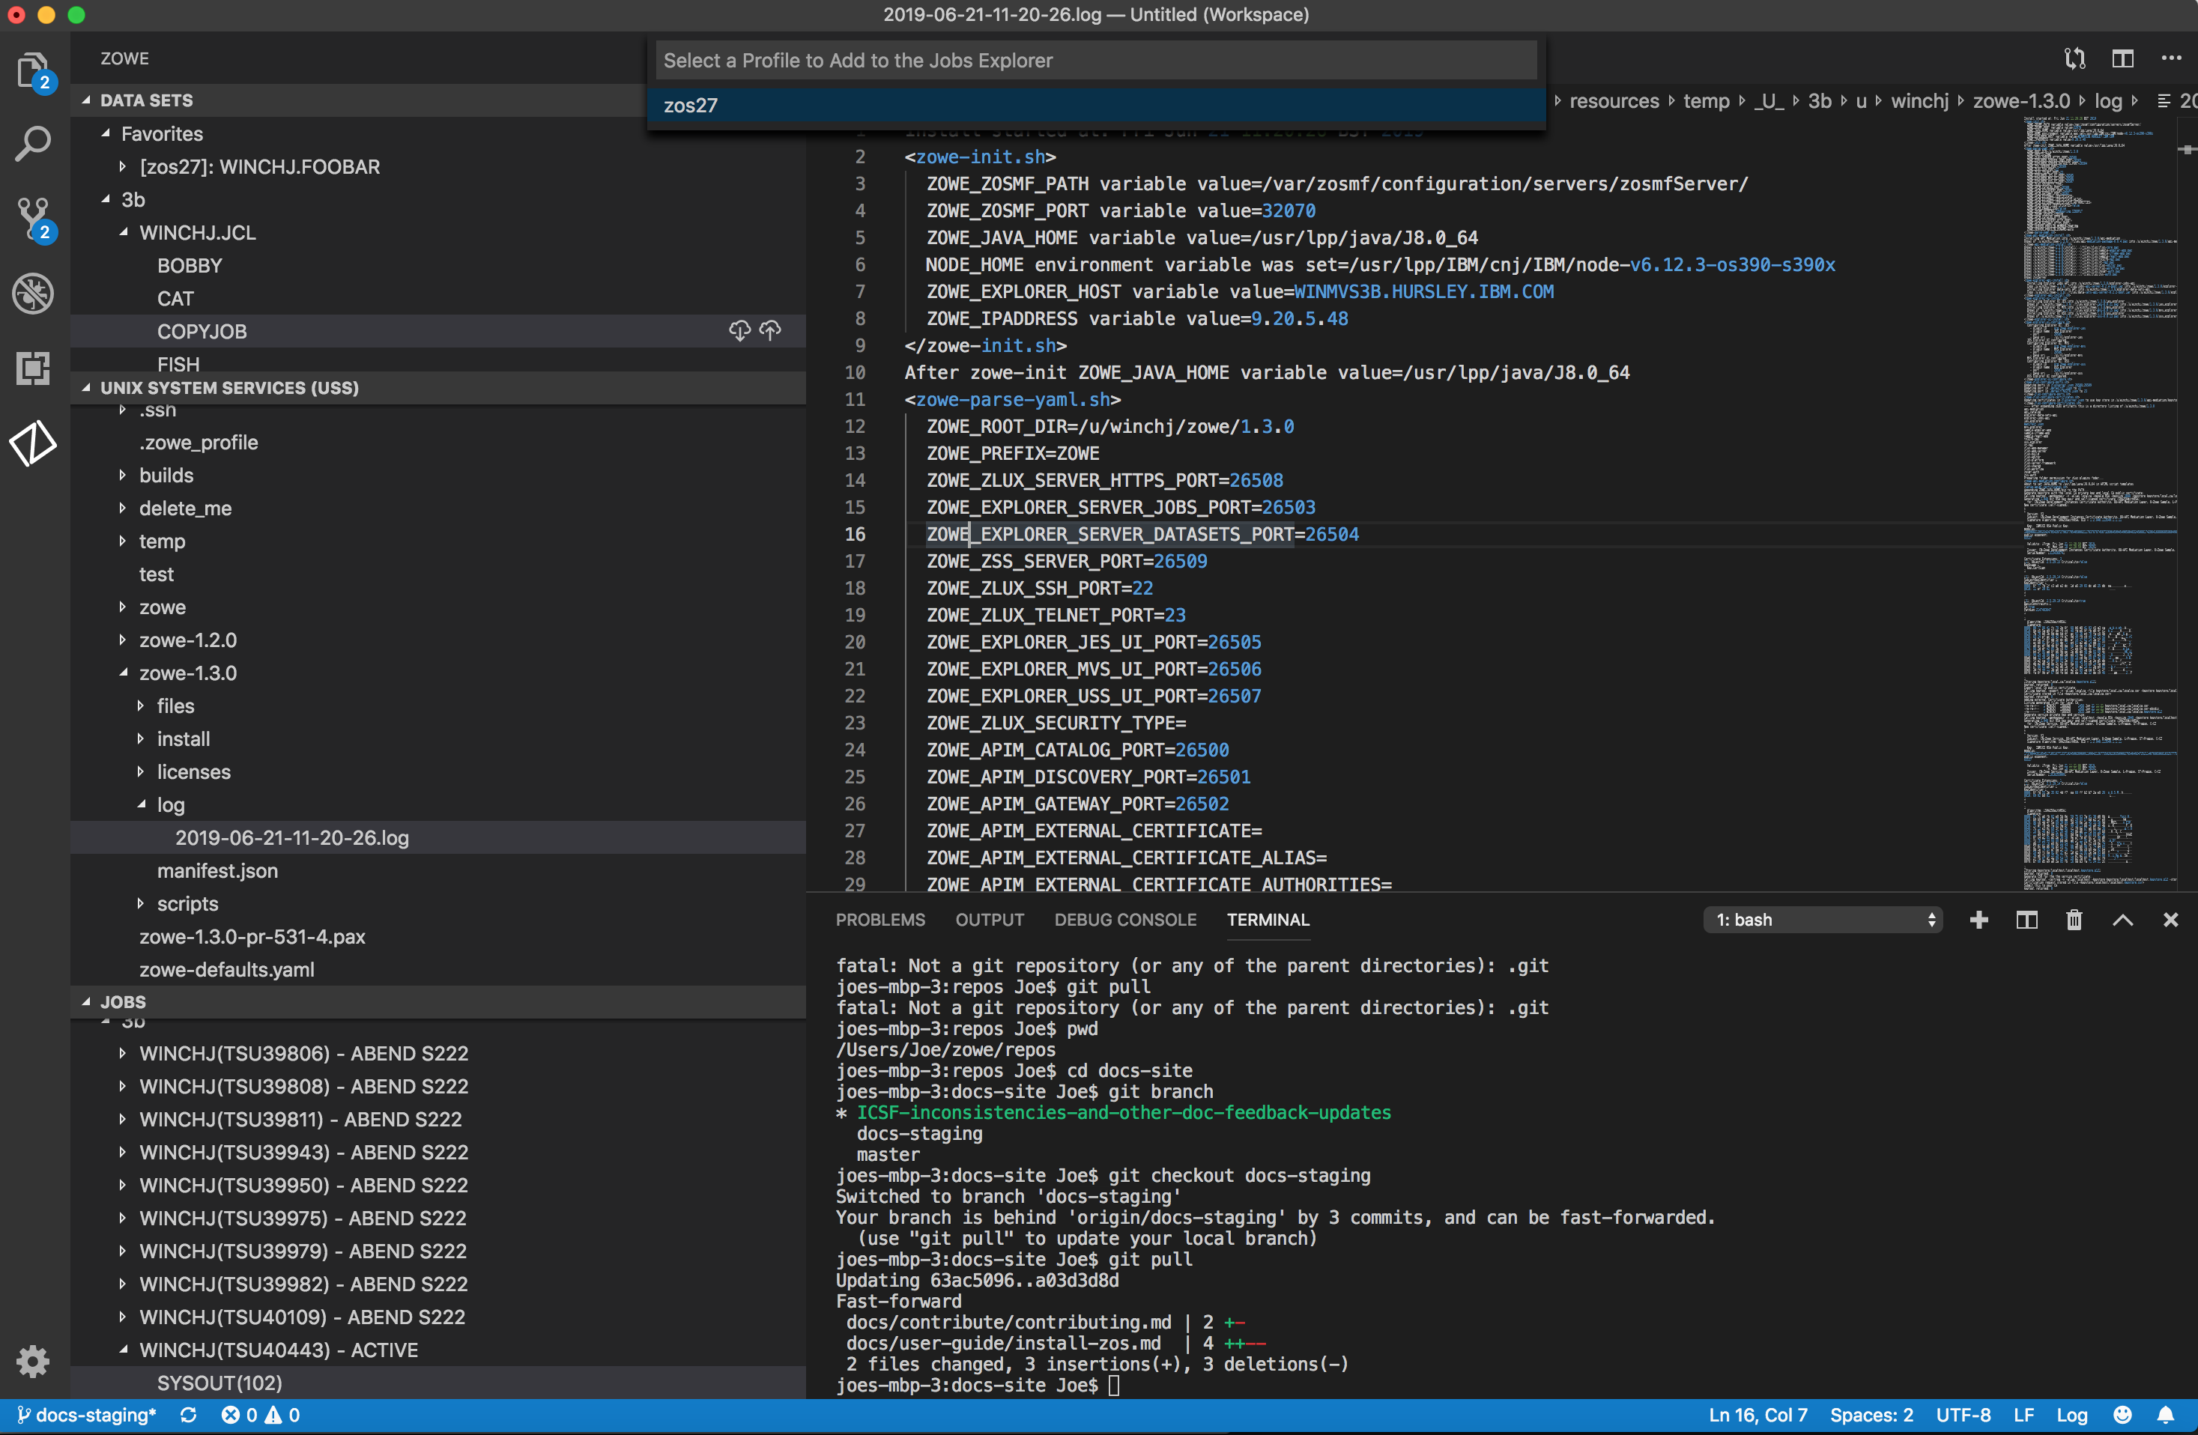
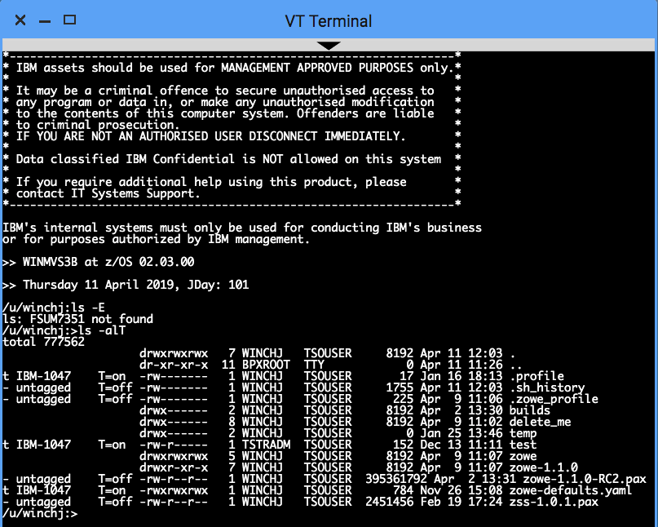
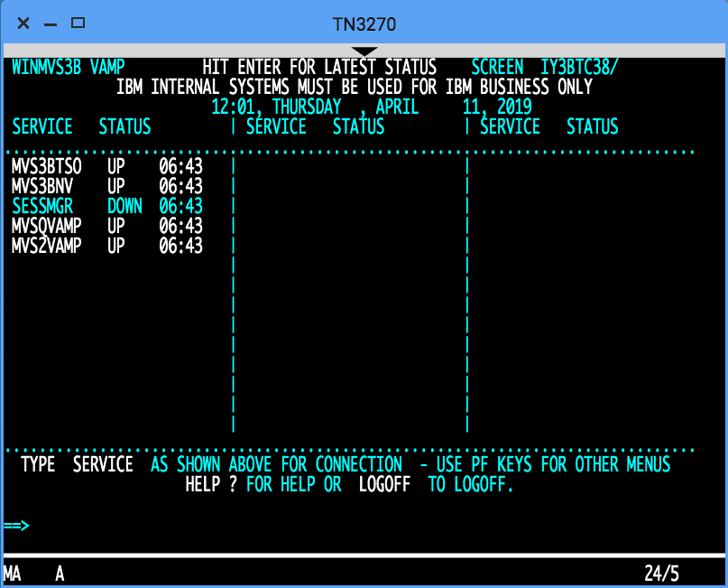
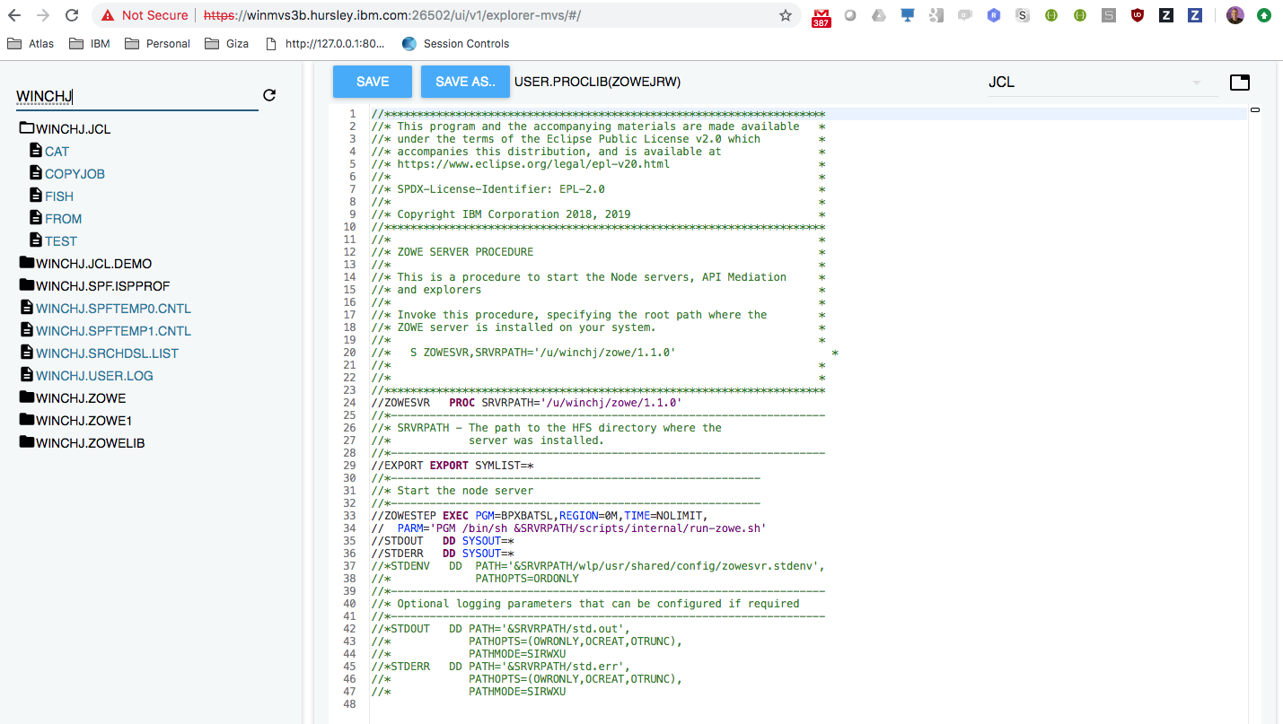
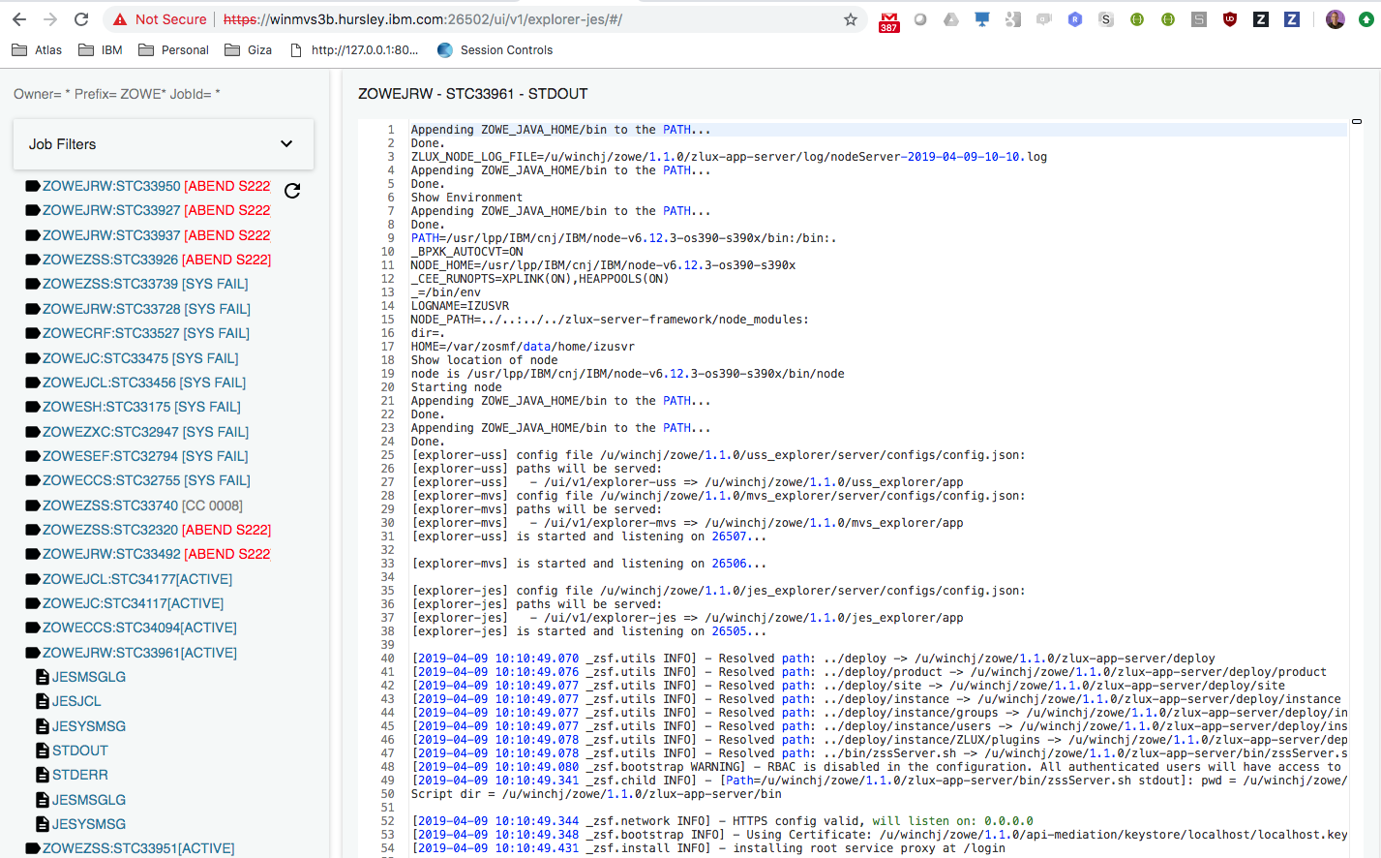
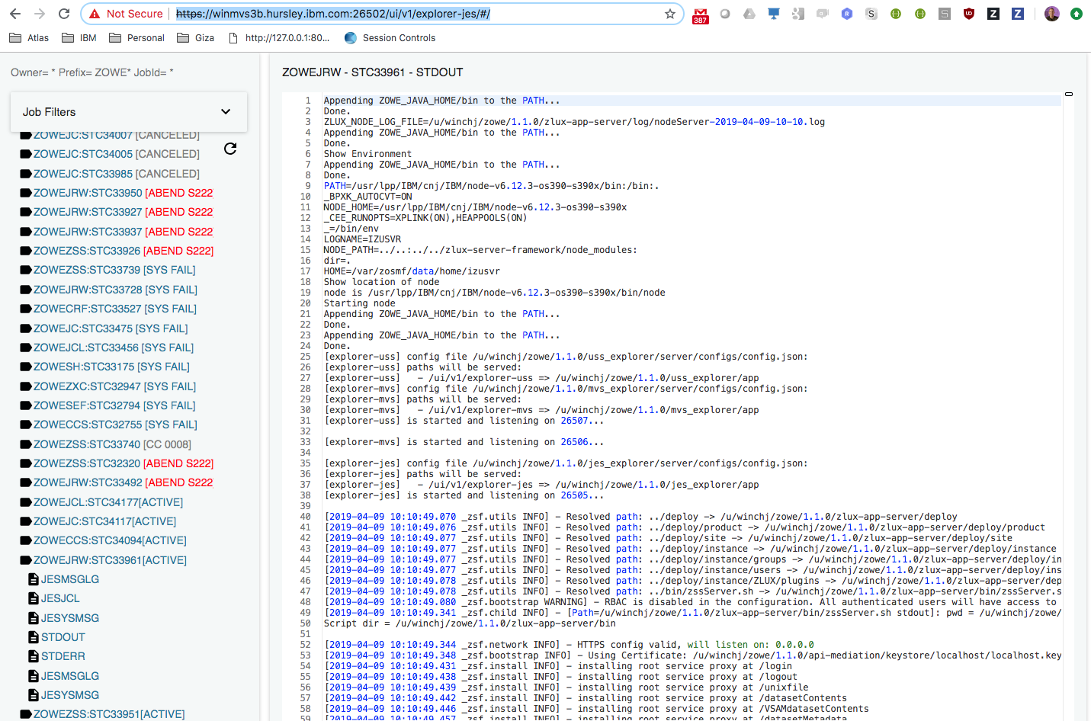
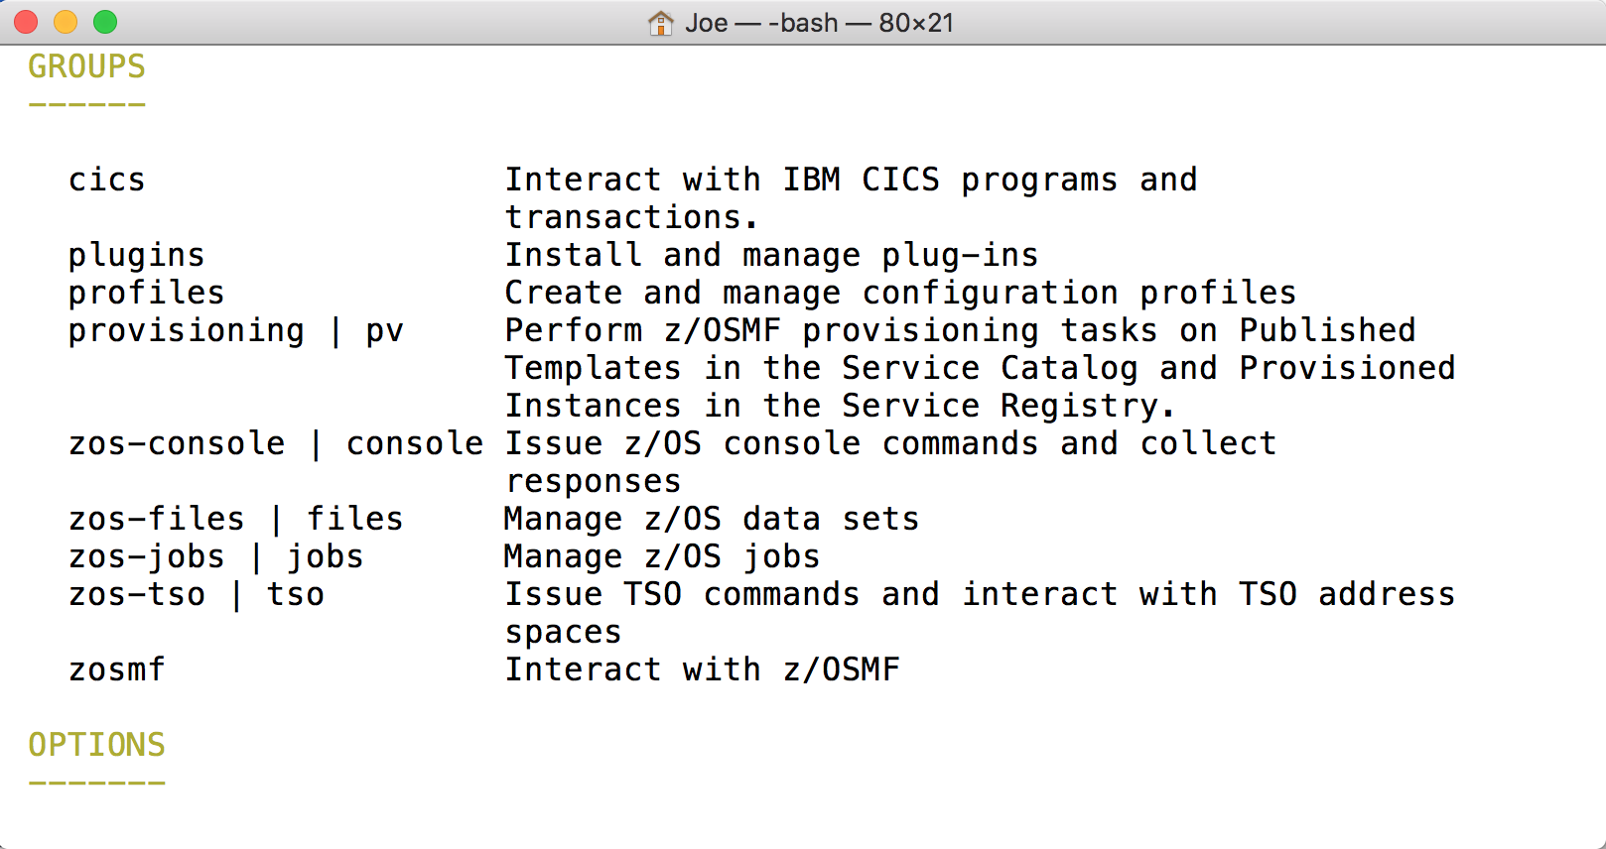
Visual
Studio
VT Terminal
TN 2170
MVS Explorer
JES Explorer
USS Explorer
iFrame
CLI
Plugins
Existing HTML
CLI
extension
CICS
IMS
DB2
Zowe Desktop running in web browser
Zowe CLI running in desktop shell
7554
In progress
API Gateway
Java
8544
7552
7553
8548
8546
8550
ZLUX
API Catalog
API Discovery
MVS UI
JES UI
USS
UI
8547
8545
TN3270
File API
JES API
VT
node
nnnn
7443
Existing REST API Server
z/OSMF
CICS
CMCI
IMS Connect
DB2
8542
zssServer
C / metal C
REST APIs
Workflows
TSO Commands
MVS Commands
Files, USS, JES
IMS Plex
X-MEM
ZWESIS01

Slide 2
Zowe instance
USS folder(s)
Zowe runtime USS folder,
/usr/lpp/zowe/v1
ROOT_DIR=
ZOWE_JAVA_HOME=
ZOWE_NODE_HOME=
ZOSMF_PORT=
ZOSMF_HOST=
ZOWE_IP_ADDRESS=
ZOWE_EXPLORER_HOST=
KEYSTORE_DIRECTORY=
ZOWE_ZLUX+SERVER_PORT=
…<PORT>
LAUNCH_COMPONENT_GROUPS=GATEWAY,DESKTOP
ZWEAD_EXTERNAL_STATIC_DEF_DIRECTORIES=
<ROOT_DIR>
/bin
/zowe-configure-instance.sh
/zowe-setup-certificate.sh
/zowe-setup-certificate.env
/components
/scripts
…
<zowe-instance-dir-1>
/bin
zowe-start.sh
zowe-stop.sh
instance.env
/logs
/workspace
/app-server
/plugins
>zowe-configure-instance.sh –c <INSTANCE_DIR>
<zowe-instance-dir-2>
/bin
zowe-start.sh
zowe-stop.sh
instance.env
…
>zowe-setup-certificates.sh –p <certificate_config>
<KEYSTORE_DIRECTORY>
Northbound certificate
(generated and self signed)
(generated and existing CA signed)
(imported)
(imported from existing SAF) – to do
Southbound trust store
VERIFY_SSL=true/false

